Slide 1
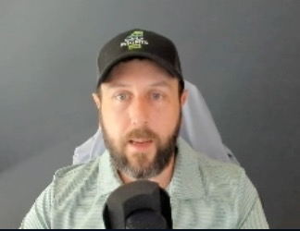
POWER TRADER
2024
Smart Americans are tuning out politics, and instead making up to +1,129% in 2 days... And all it took is ONE special $0.65 cent trade!
See how to trade like this leading up to the November 5th elections:

Slide 2
Imagine Making MASSIVE Gains Leading Up To The November Election...
350% in 5 days
494% in 5 days
538% in 3 days
1,129% in 2 days
367% overnight
68% within hours
154% overnight
1,215% in 6 days

Slide 3
TYPE “FREEDOM” IN THE CHAT...
If You Want The ULTIMATE Way To Profit On The Upcoming Elections

Slide 4
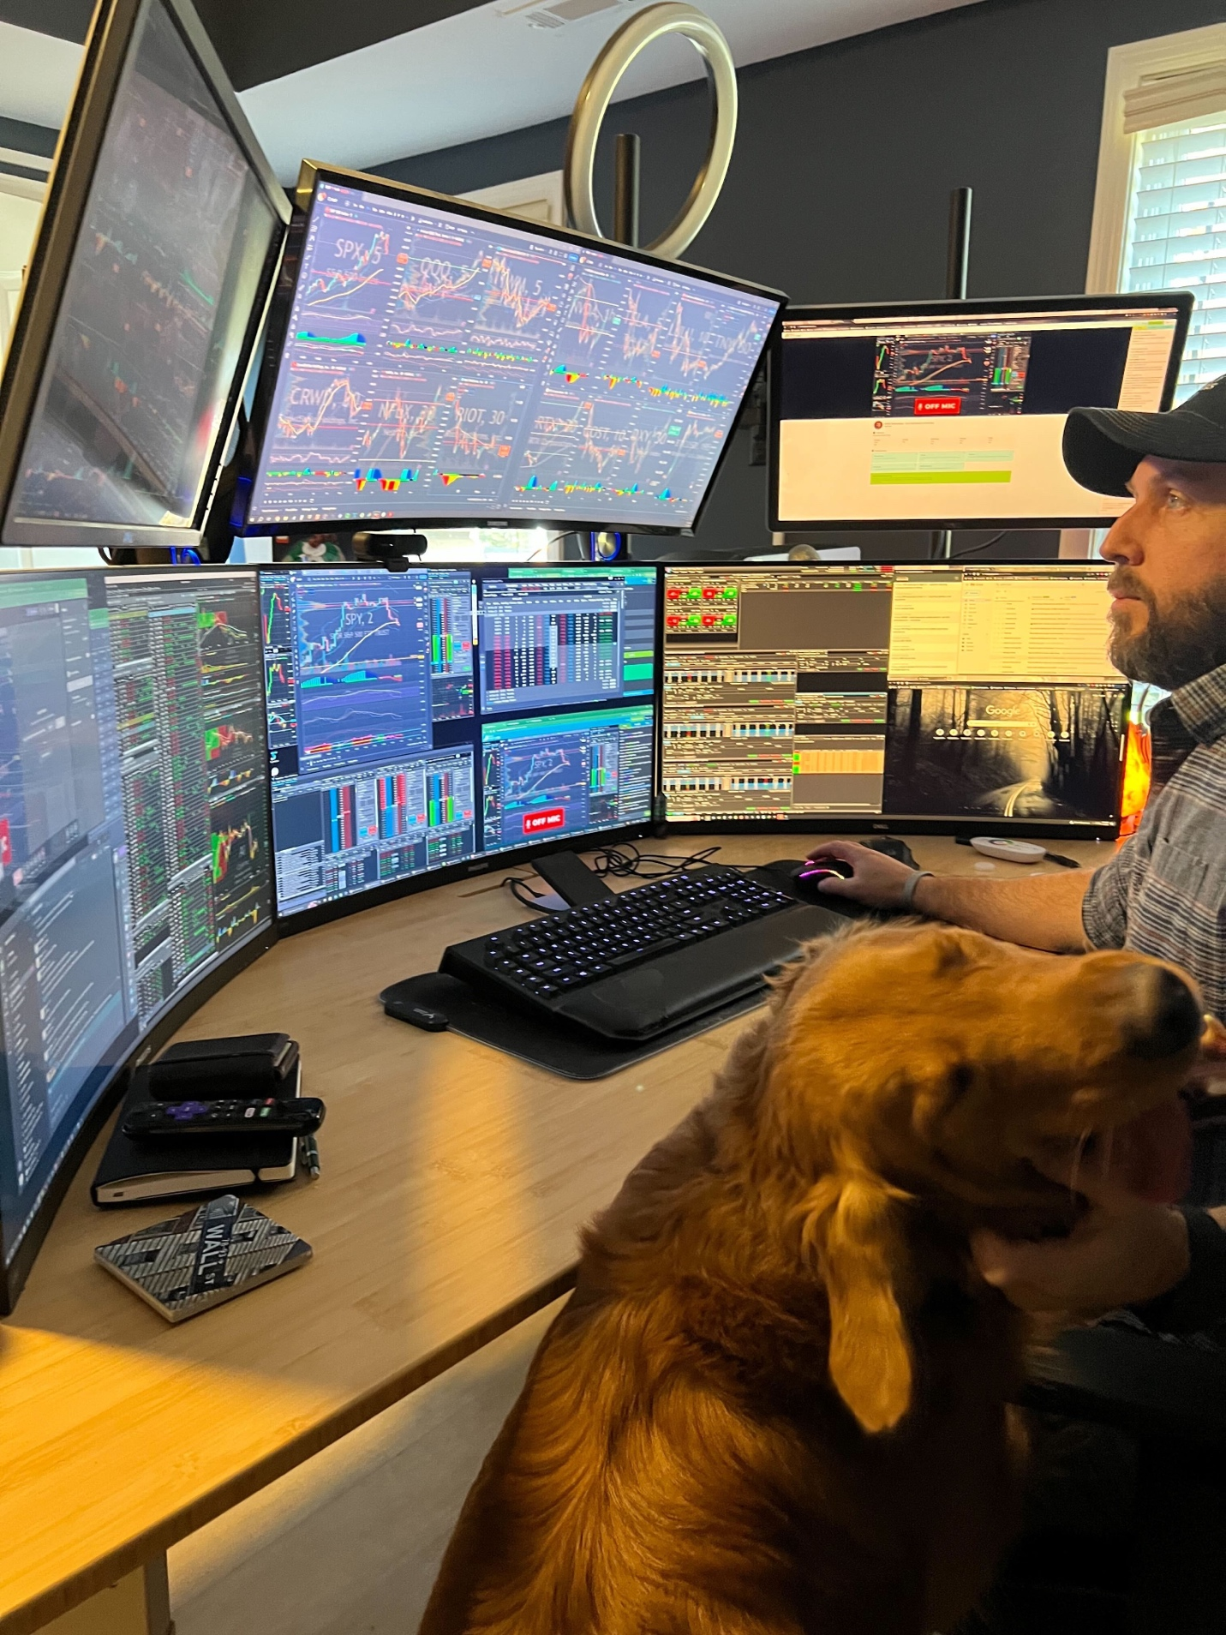
First... Who Am I?
Former Construction Worker To Pro Trader
Turned $37k into $2.7 Million (7,127% Total Return) in 4 years!
Taught my winning strategies to tens of THOUSANDS of everyday Americans
63 X 100% winners across my services since April 2023

Slide 5
We Win BIG By
IGNORNING The Mainstream’s Noise!

Slide 6
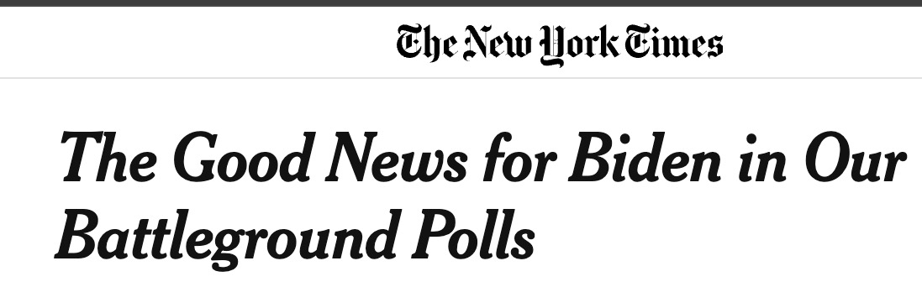
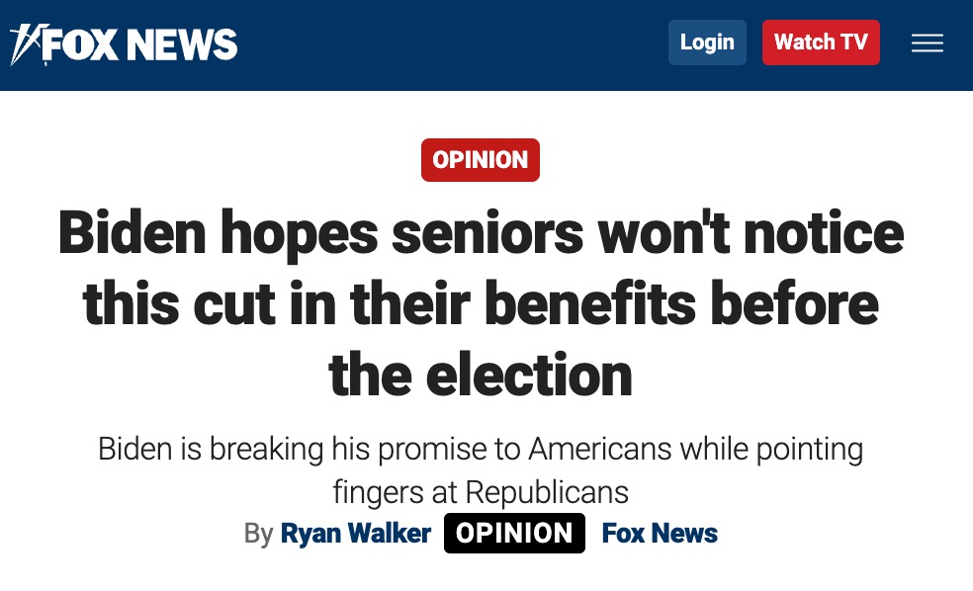
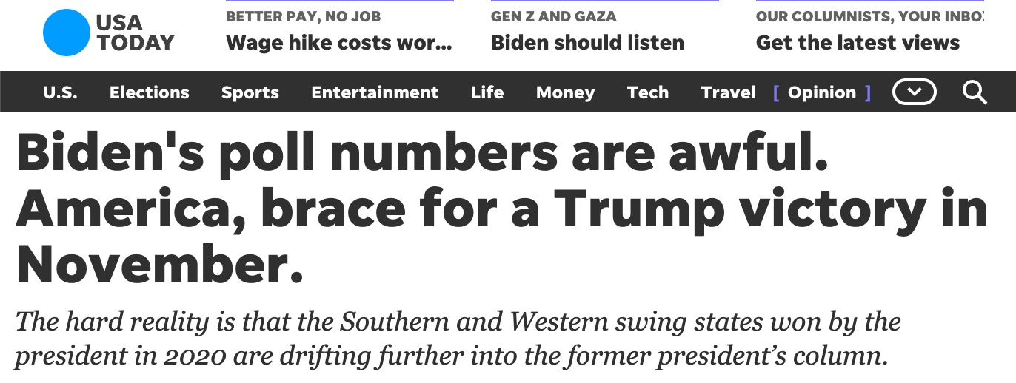
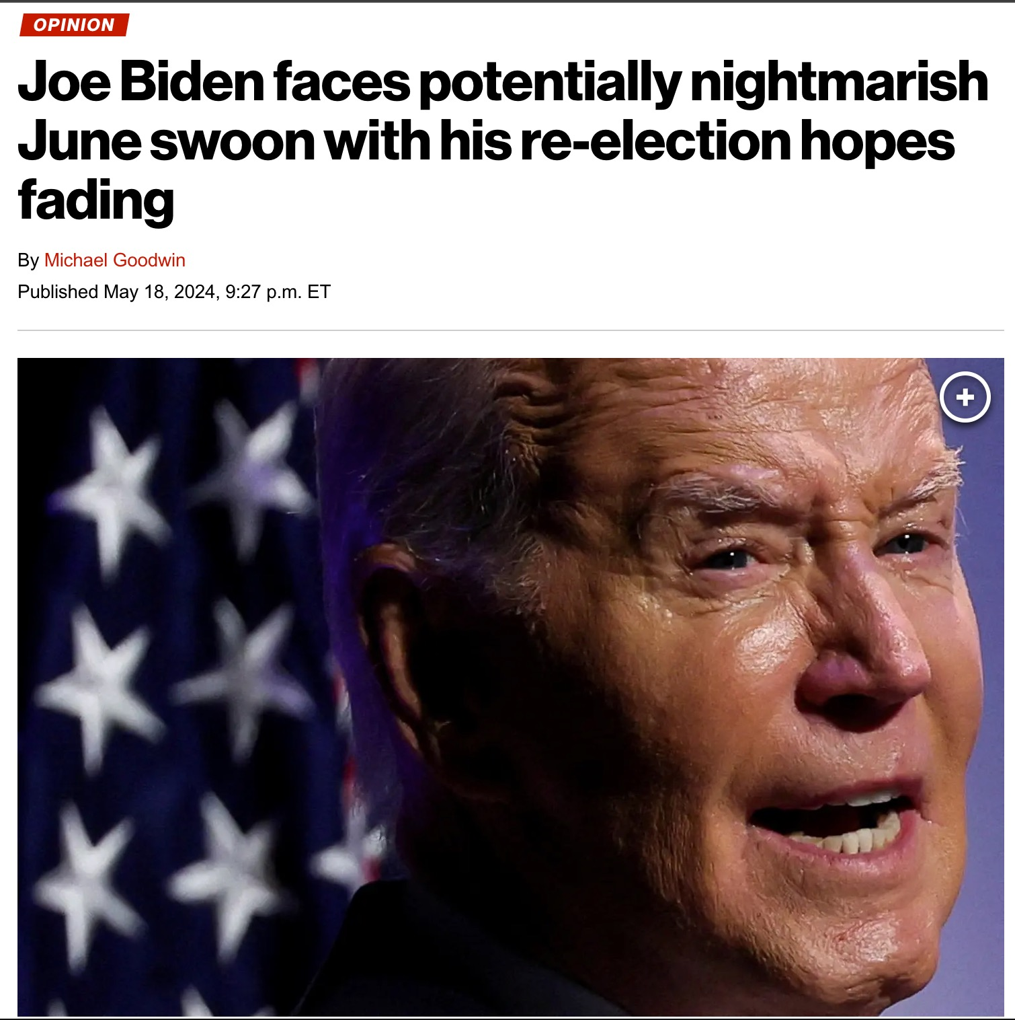
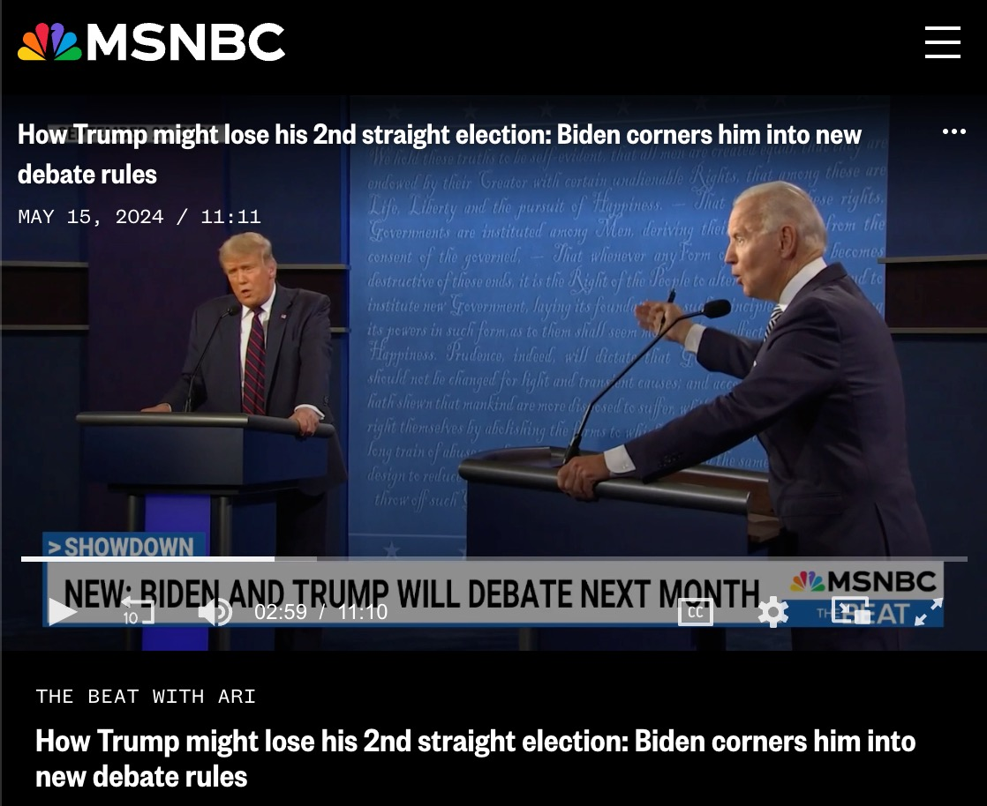
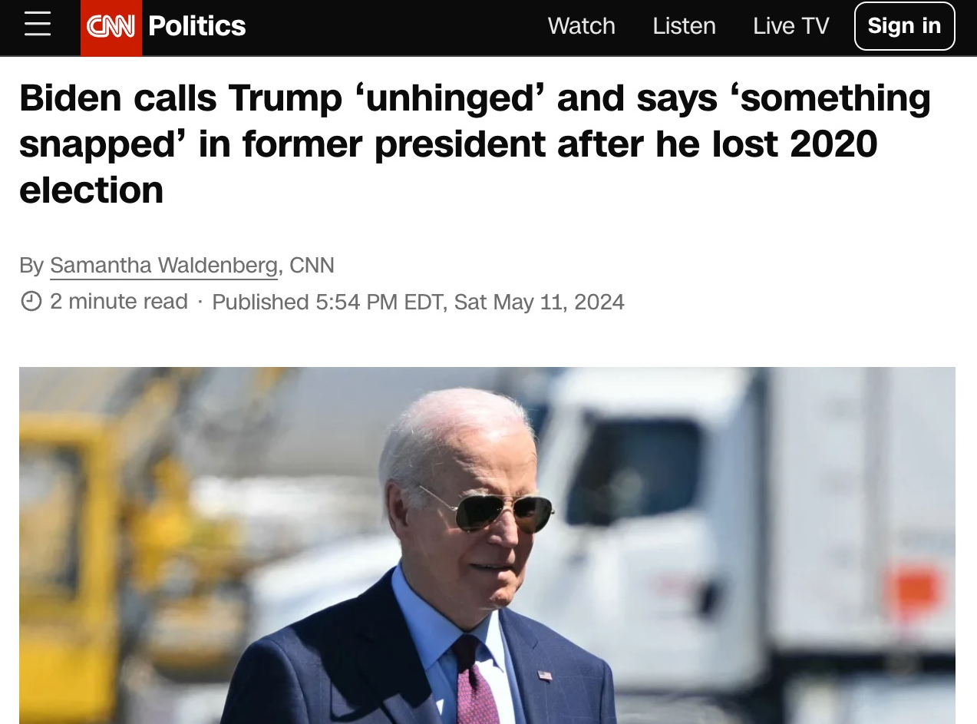
The Mainstream Pumps Nonstop Political Drama During The Election Season...

Slide 7
THIS ELECTION...
I’M VOTING FOR MASSIVE TRADING PROFITS!

Slide 8
MYTH:
THE ELECTION DOESN’T INFLUENCE
THE STOCK MARKET
❌

Slide 9
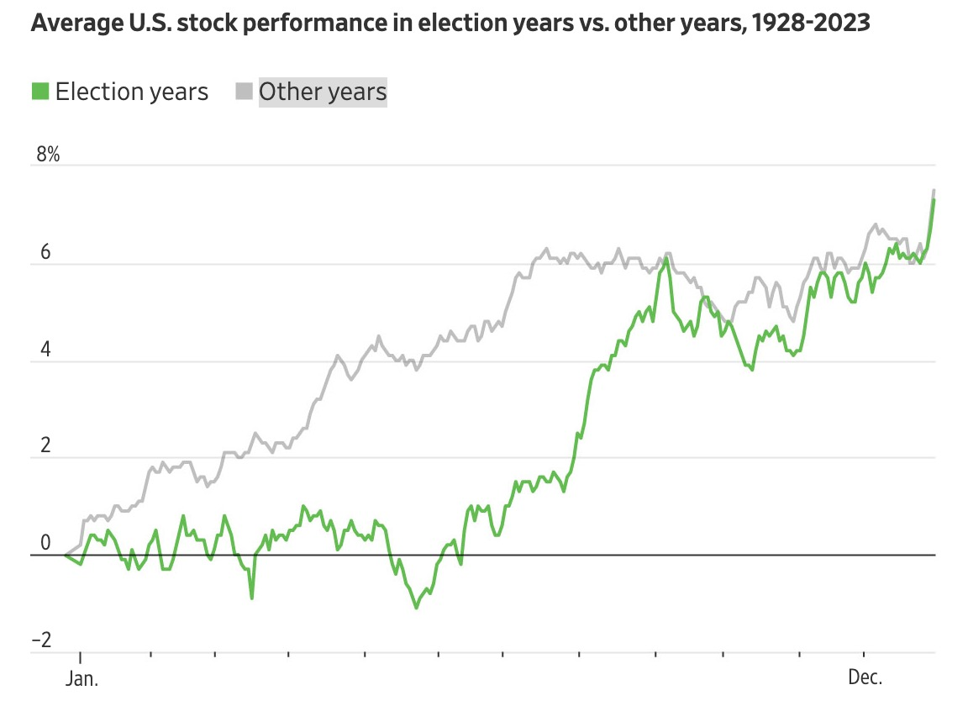
The Market SOARS During The 2nd Half Of Election Years (As Does Volatility)
(Blackrock)

Slide 10
As Sentiment Changes... The Market Reacts!

Slide 11
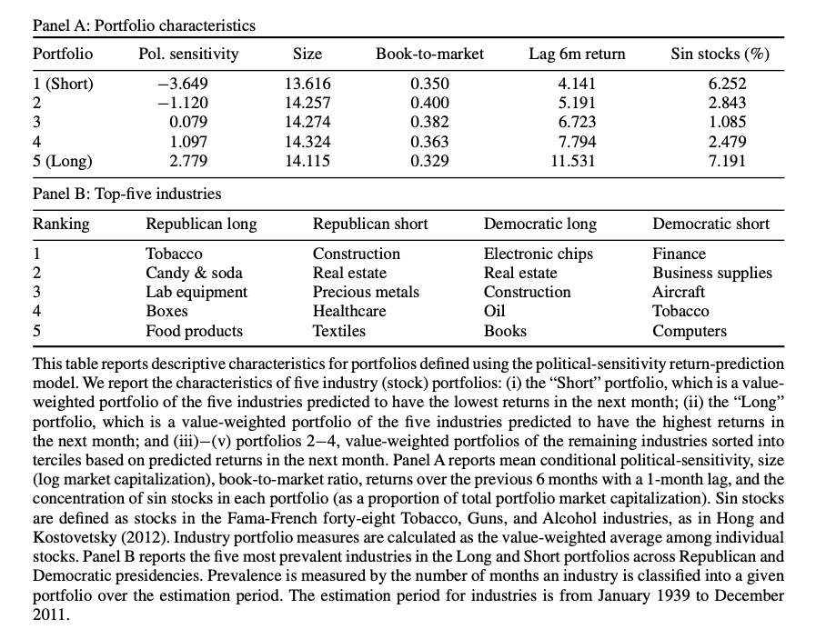
"Investors systematically alter their holdings of certain types of stocks because of changes in the political climate”
– Cornell University Study

Slide 12
“Election years tend to be more volatile. The uncertainty tends to make it more pronounced”
– JP Morgan (Bank)

Slide 13
#1 Mistake:
Taking Your Money Out Of The Market Because Of Volatility & Political Fears...

Slide 14
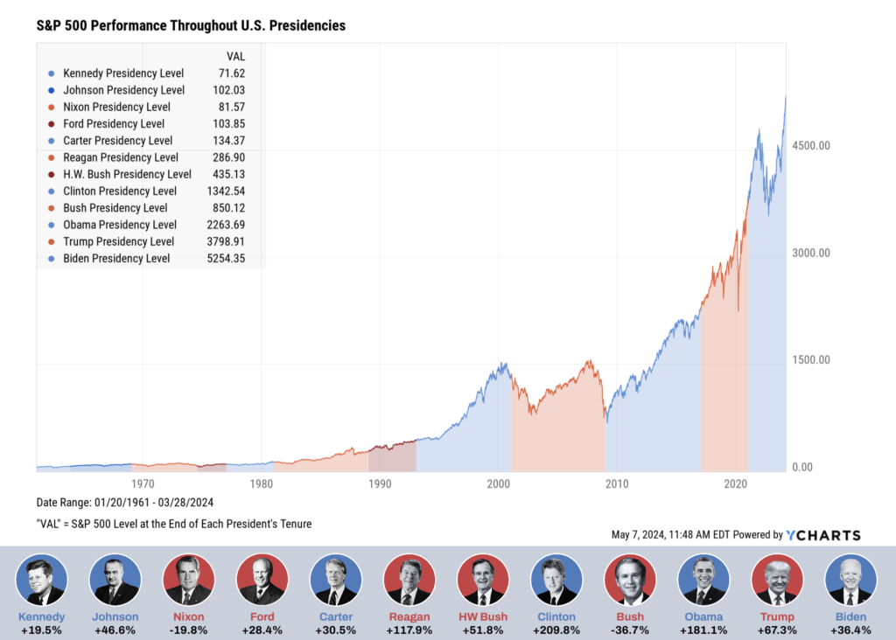
The market generally prevails regardless of President!

Slide 15
BUT AS
TRADERS...
WE LOVE VOLATILITY! 🤑

Slide 16
Investors overreact to news ALL THE TIME during election season...
And when they do you NEED to be ready to profit!

Slide 17
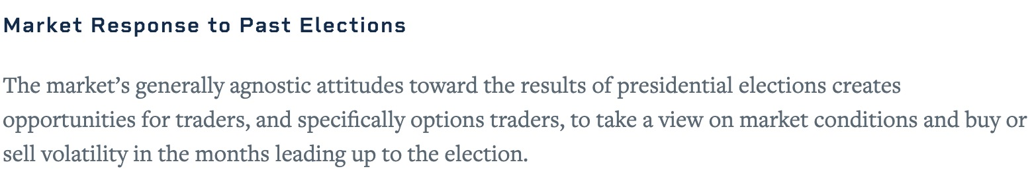
CME Group (Chicago Mercantile Exchange):

Slide 18
My Favorite Election Season Play:
WRITE THIS DOWN!
Step 1: Scan For Stocks Investors Are Betting AGAINST
I’m looking for stocks with a high short float %
Number shares sold short ÷ total shares
I’m looking for stocks with 20% short interest (or higher)

Slide 19
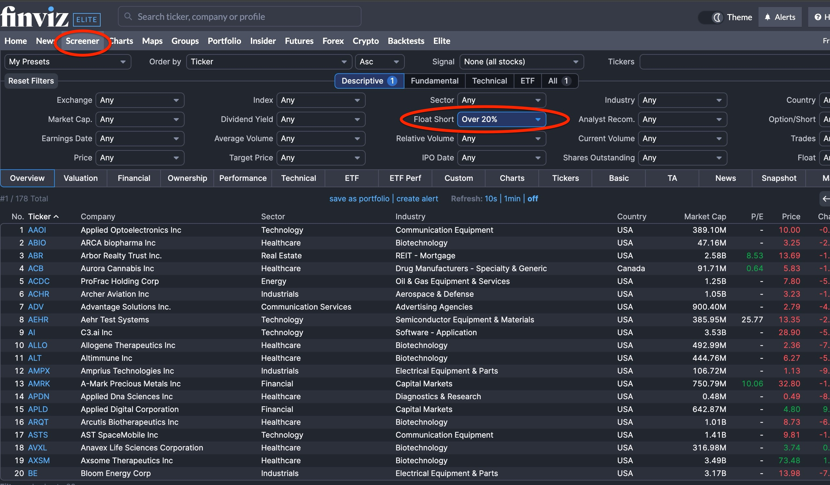
My Favorite Election Season Play:
WRITE THIS DOWN!
My Favorite Site For Finding these: FinViz.com

Slide 20
My Favorite Election Season Play:
WRITE THIS DOWN!
Step 2: Find the Overreactions
Once I’ve found a high-short float stock I analyze the stock’s chart...
If it has a bullish setup on its chart, we’re likely looking at an overreaction.

Slide 21
My Favorite Election Season Play:
WRITE THIS DOWN!
Step 3: Trade!

Slide 22
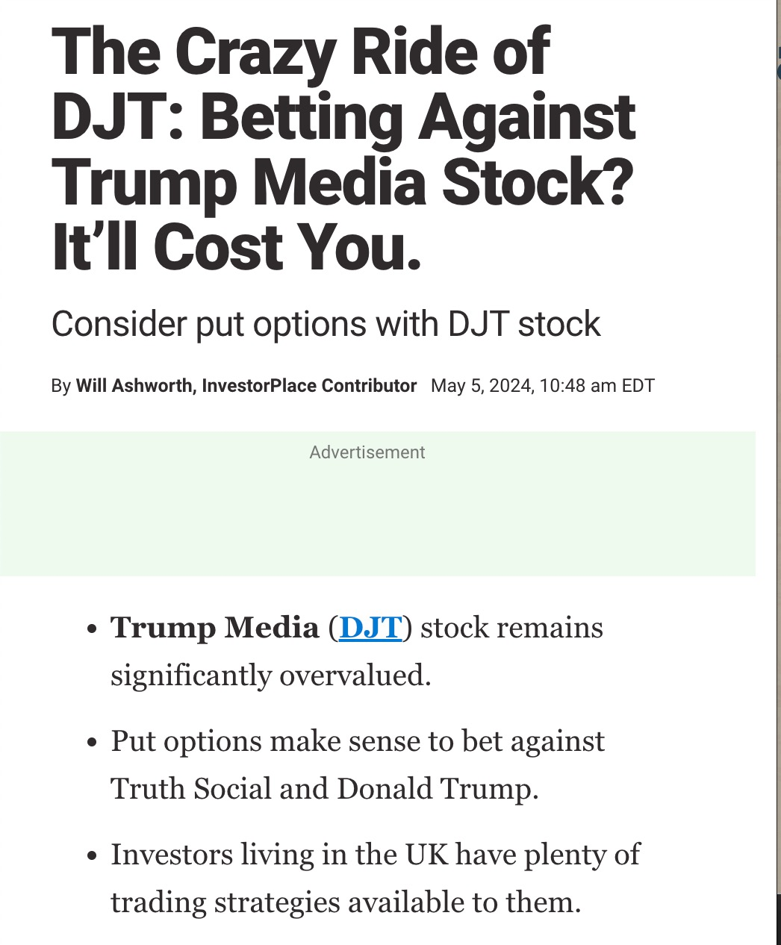
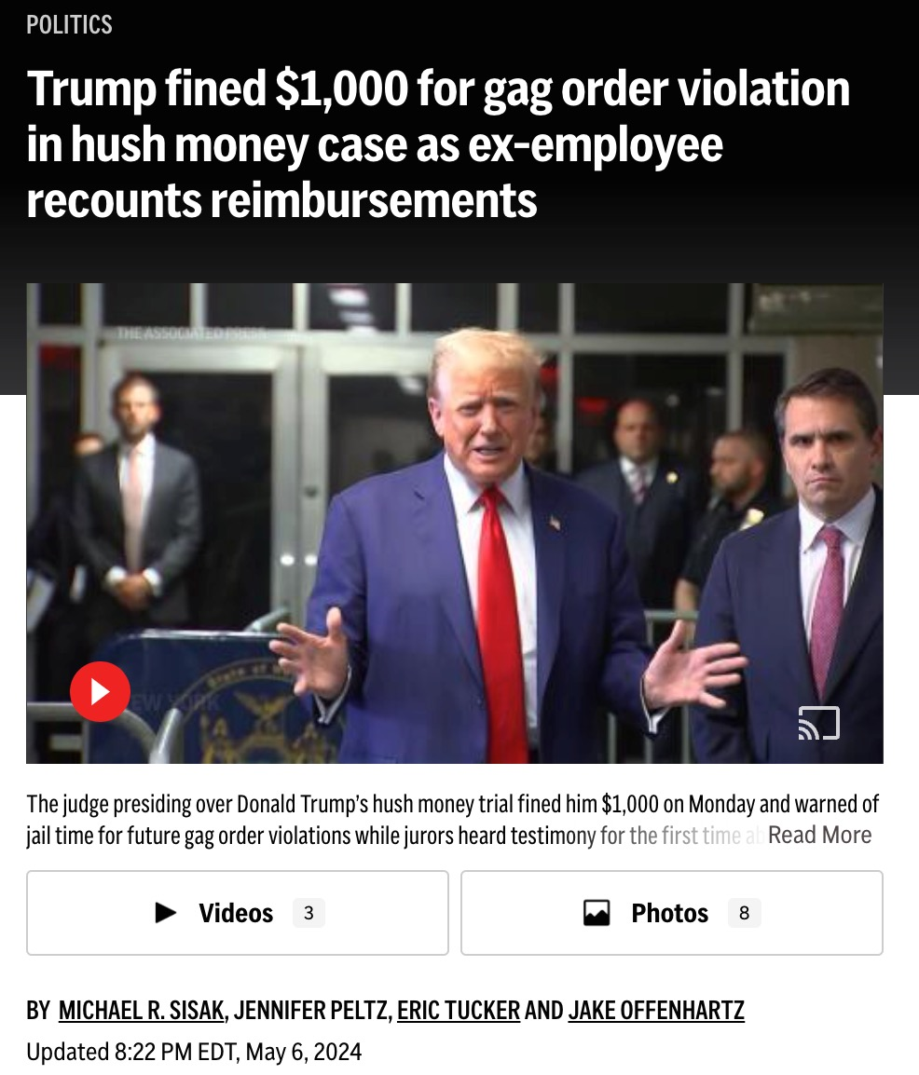
Recent Historical Example:
Trump’s Legal Drama And Overvalue Fears Create Massive Short-Interest Against DJT

Slide 23
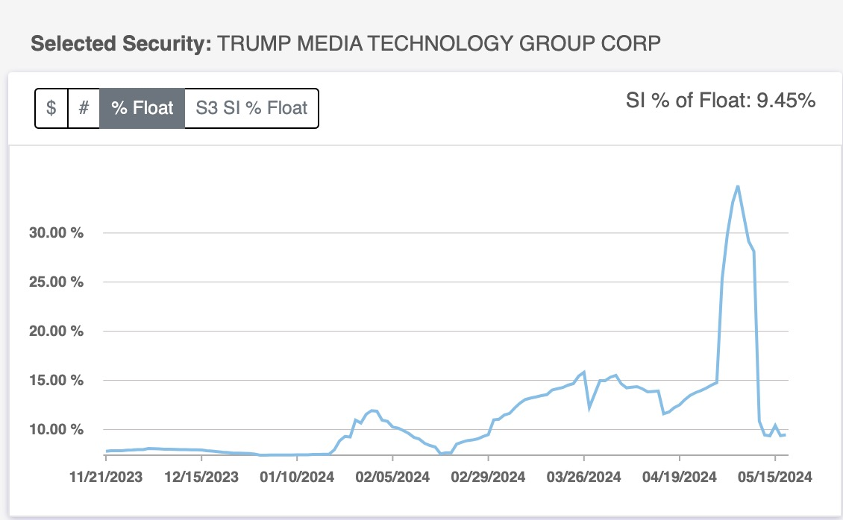
✅ Step 1: High Short Float on DJT (> 20%)
33% Short Float

Slide 24
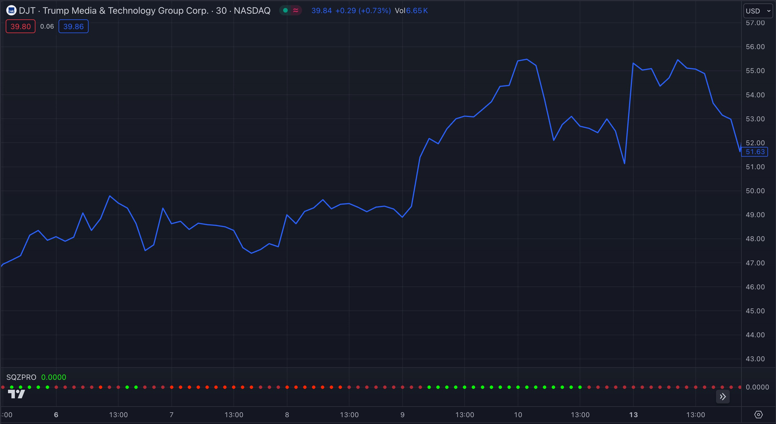
✅ Step 2: Find The Overreaction

Slide 25
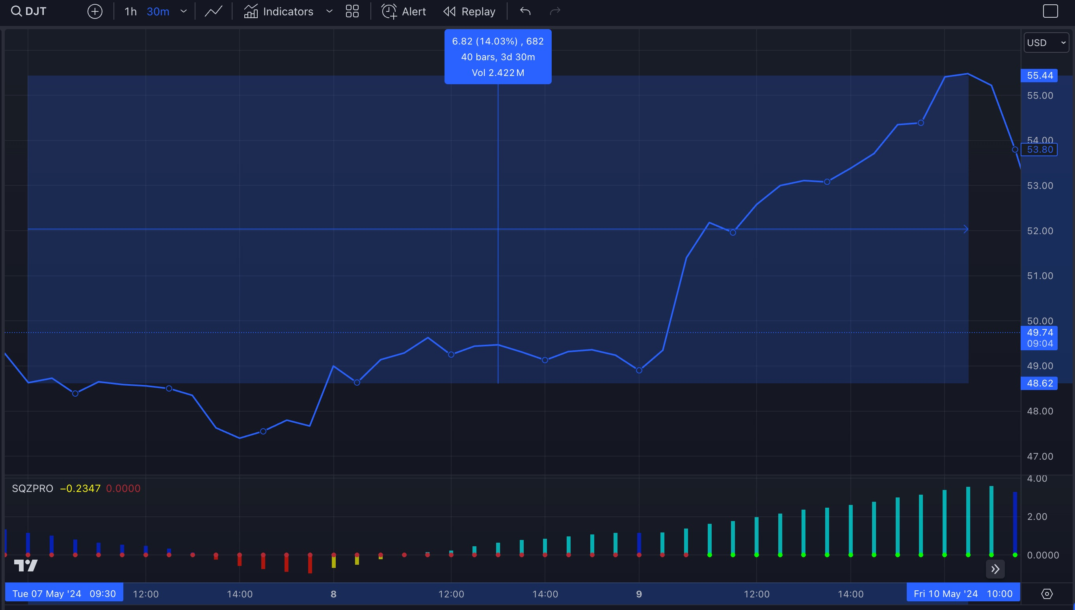
What Really Happened:
Stock Gain: 14% (in 3 days)
Active
Squeeze
(Price Compression)

Slide 26
When I Find A High Short-Float Stock With A Bullish Chart... I Maximize My Profits With A “Lotto Trade”
What is a lotto trade?
Usually cheaper than $1 option contracts
($2 for large-cap stocks)
Expiration less than 2 weeks out
1,000%+ Gain Potential

Slide 27
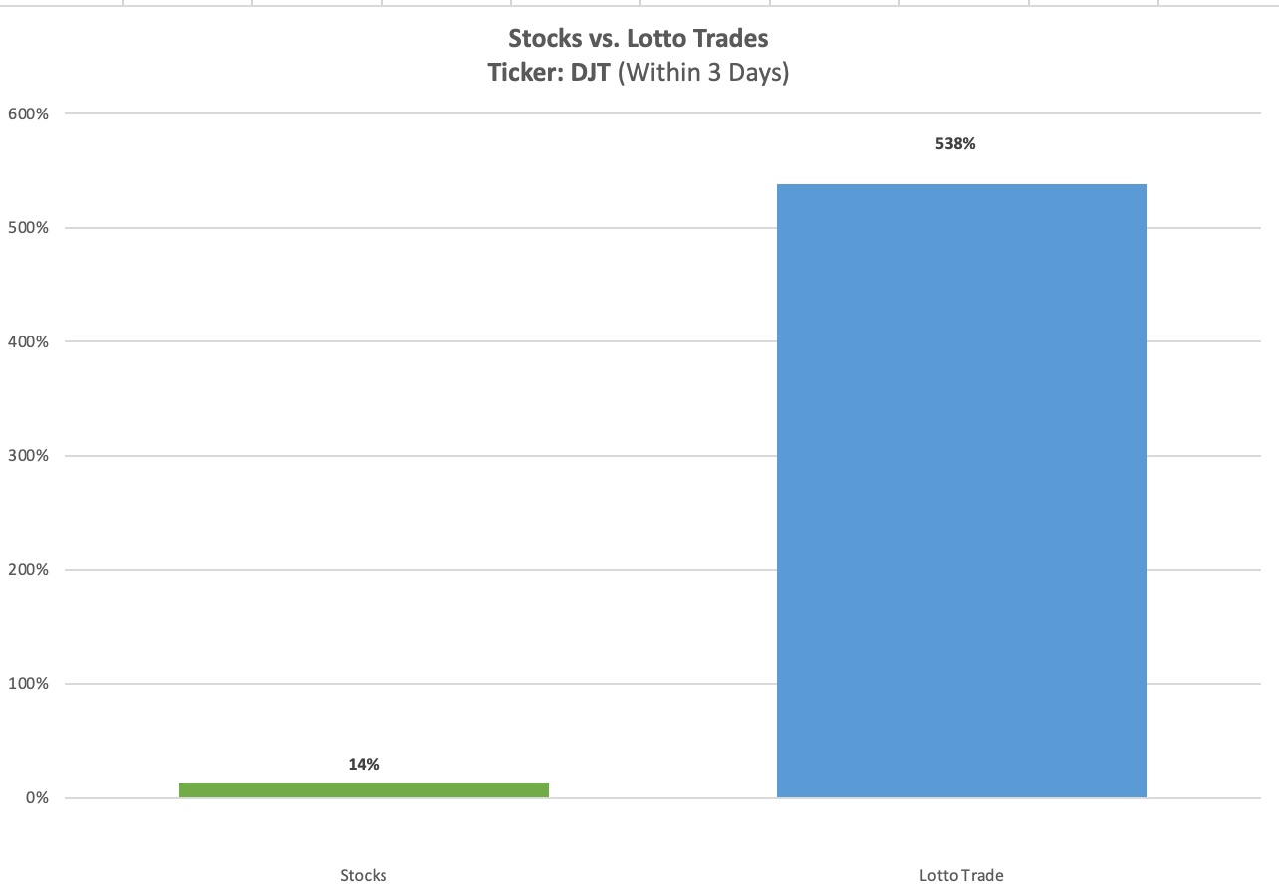
14% DJT Stock Move ➡️ 538%
With A $0.94 Lotto Trade

Slide 28
🚫 DISCLAIMER: Don’t Risk Your Entire Retirement Portfolio...
These are dirt-cheap moonshot plays with MASSIVE reward potential! Use your “why not?!” money... Not your life savings!
Nothing is guaranteed... You should never invest more than you can afford to lose...
We’re going to show you some of the top examples we’ve found but individual results will vary!
e

Slide 29
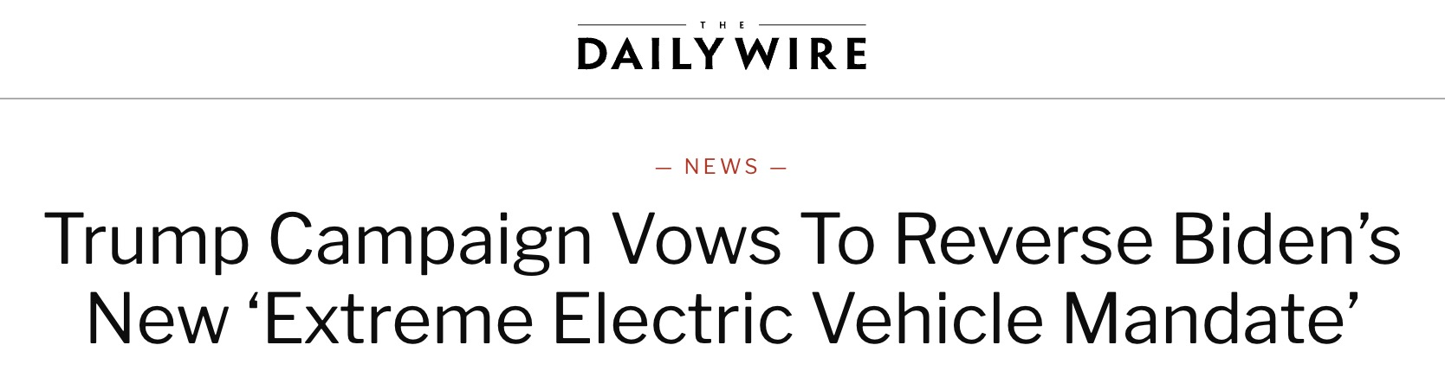
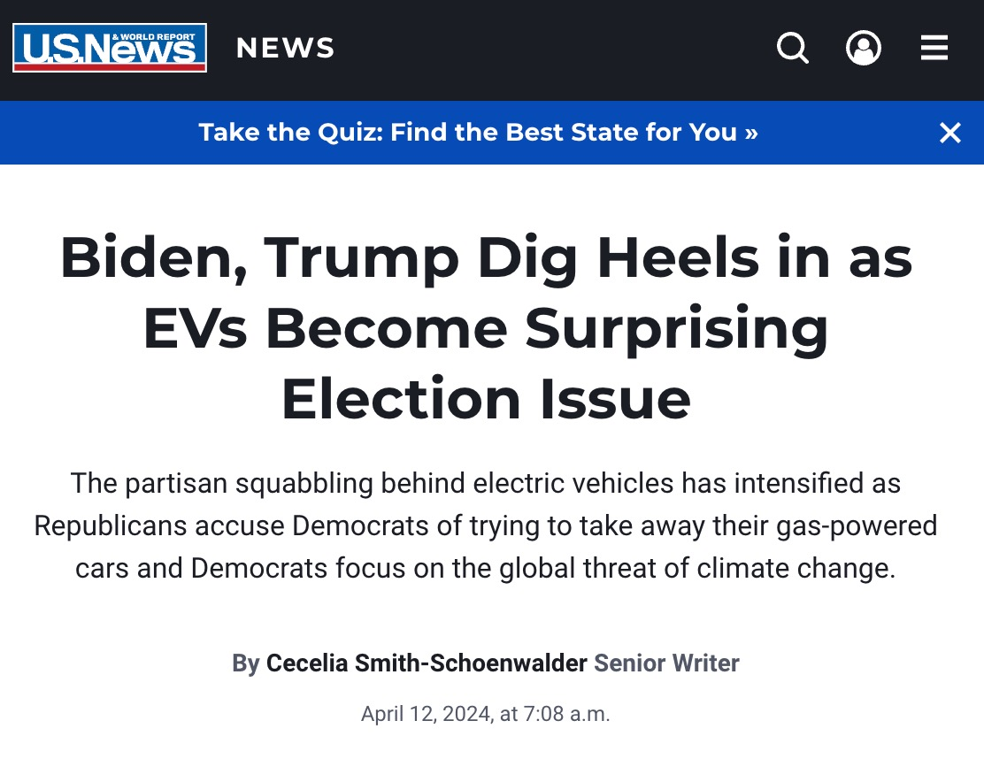
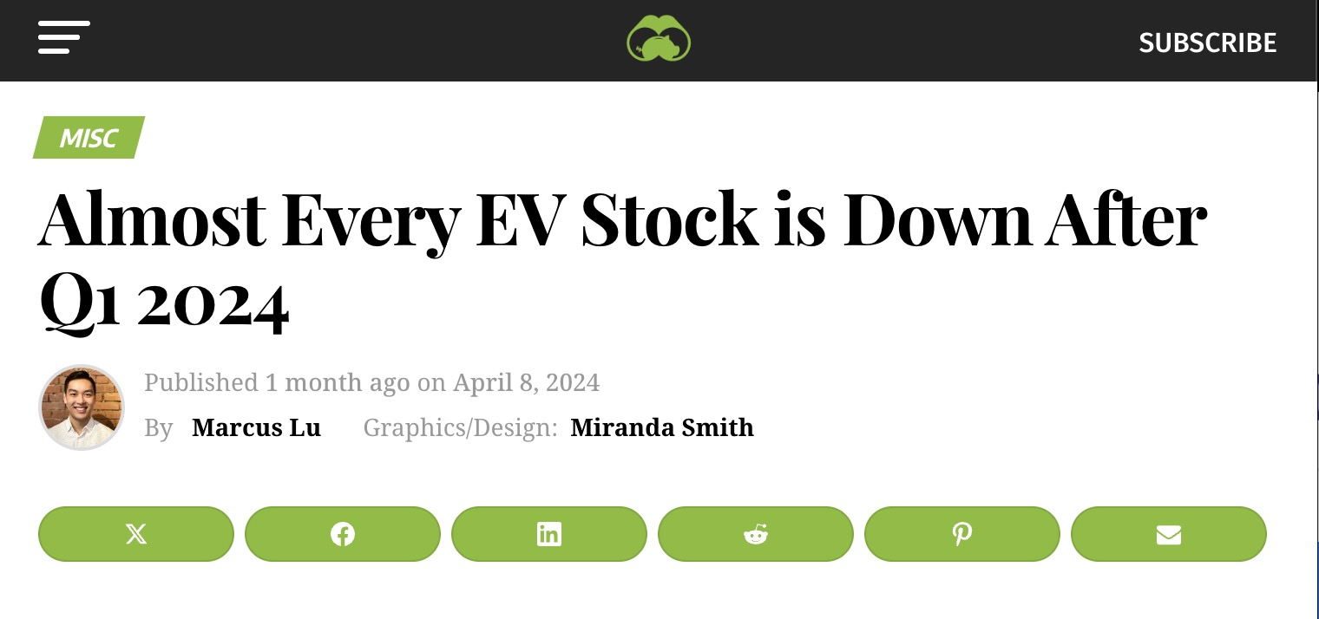
Recent Historical Example:
Market Reacts To EV Stocks As Trump Presidency & Poor Earnings Performance Weigh Down EV

Slide 30
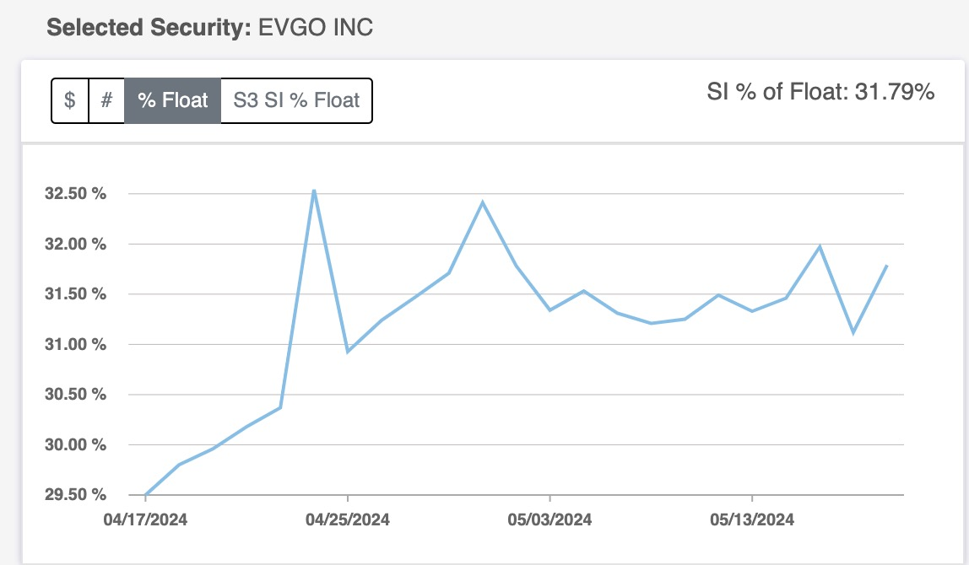
✅ Step 1: High Short Float On EVGO (>20%)

Slide 31
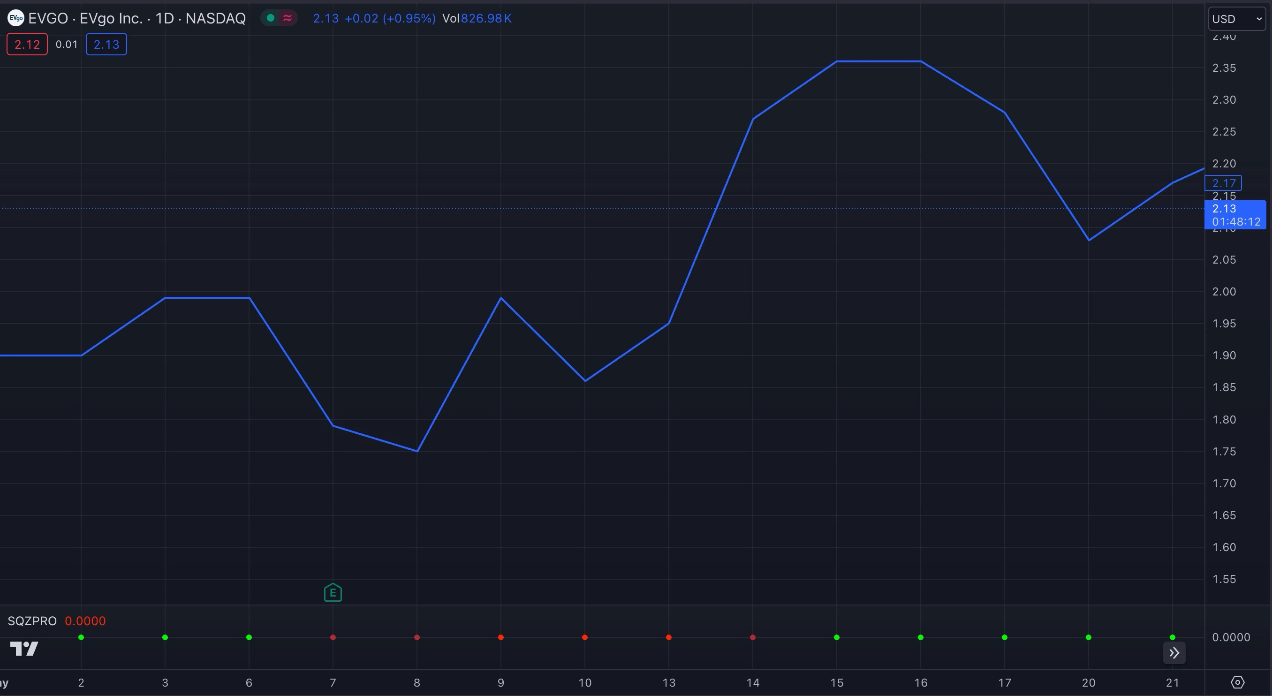
✅ Step 2: Find The Overreaction

Slide 32
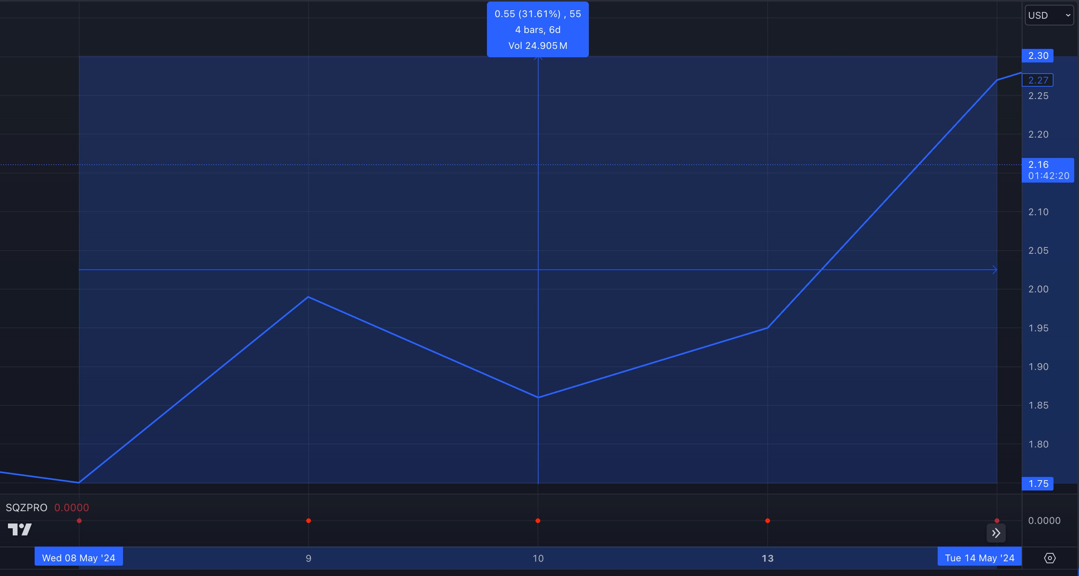
What Really Happened:
Stock: 32% (in 6 days)
Active
Squeeze
(Price Compression)

Slide 33
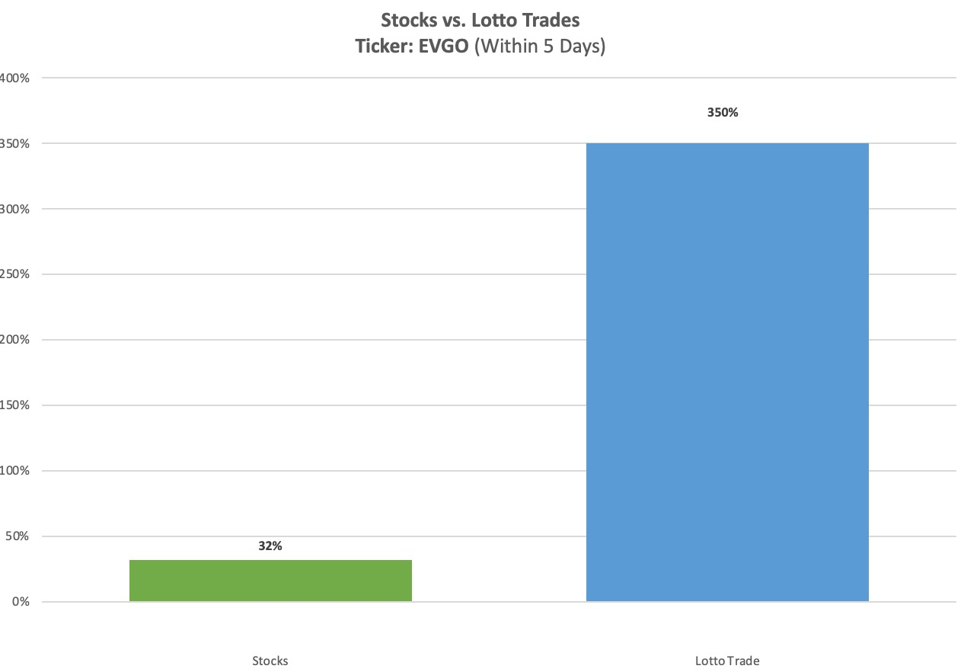
32% EVGO Stock Move ➡️ 350%
With A $0.10 Lotto Trade

Slide 34
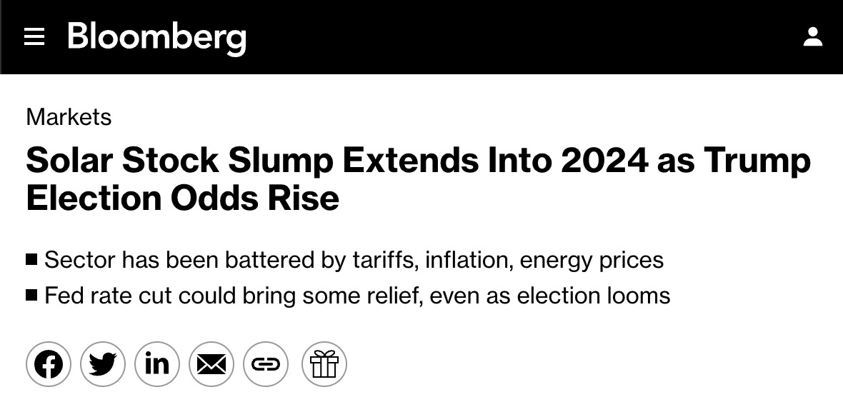
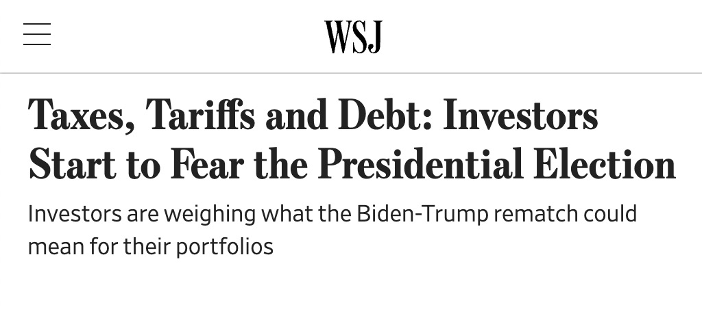
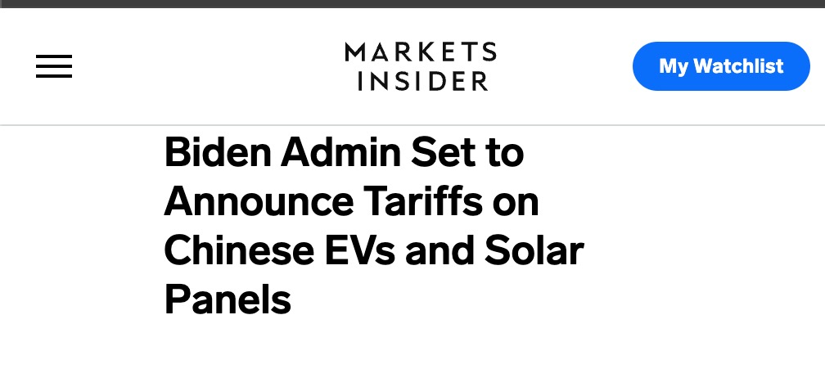
Recent Historical Example:
Potential Trump Presidency and Tariffs On Chinese Solar Spook Solar Stock Investors...

Slide 35
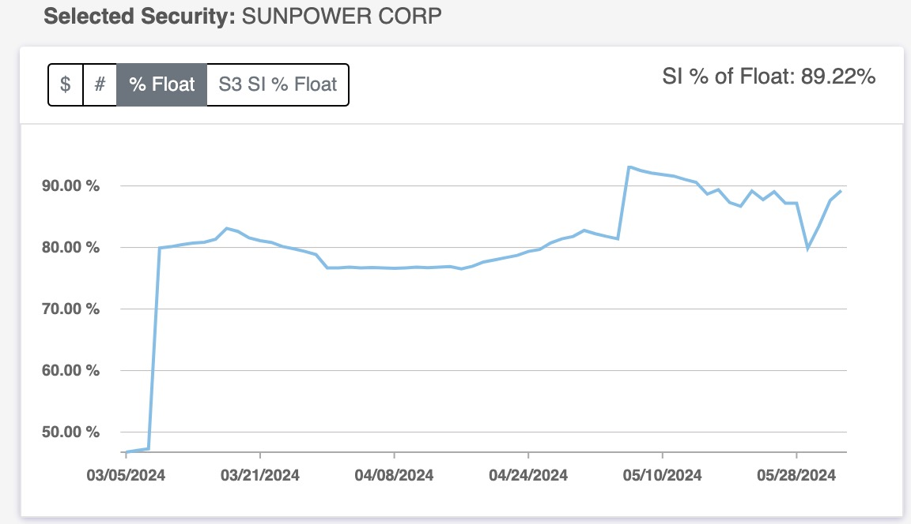
✅ Step 1: High Short Float On SPWR (>20%)

Slide 36
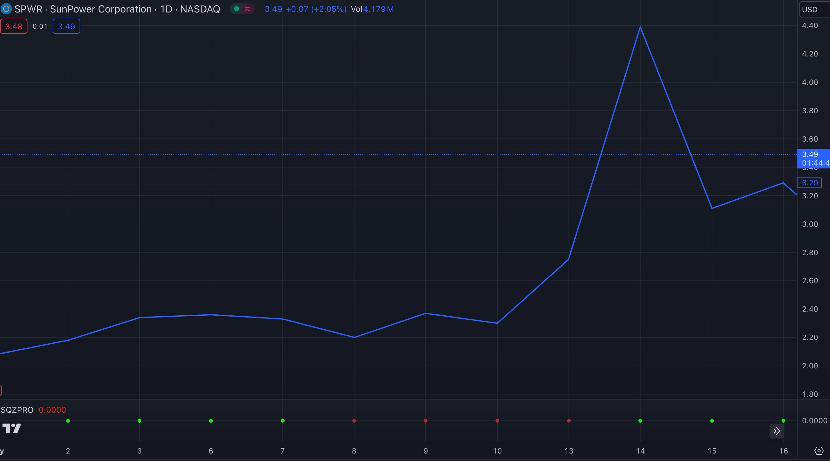
✅ Step 2: Find The Overreaction

Slide 37
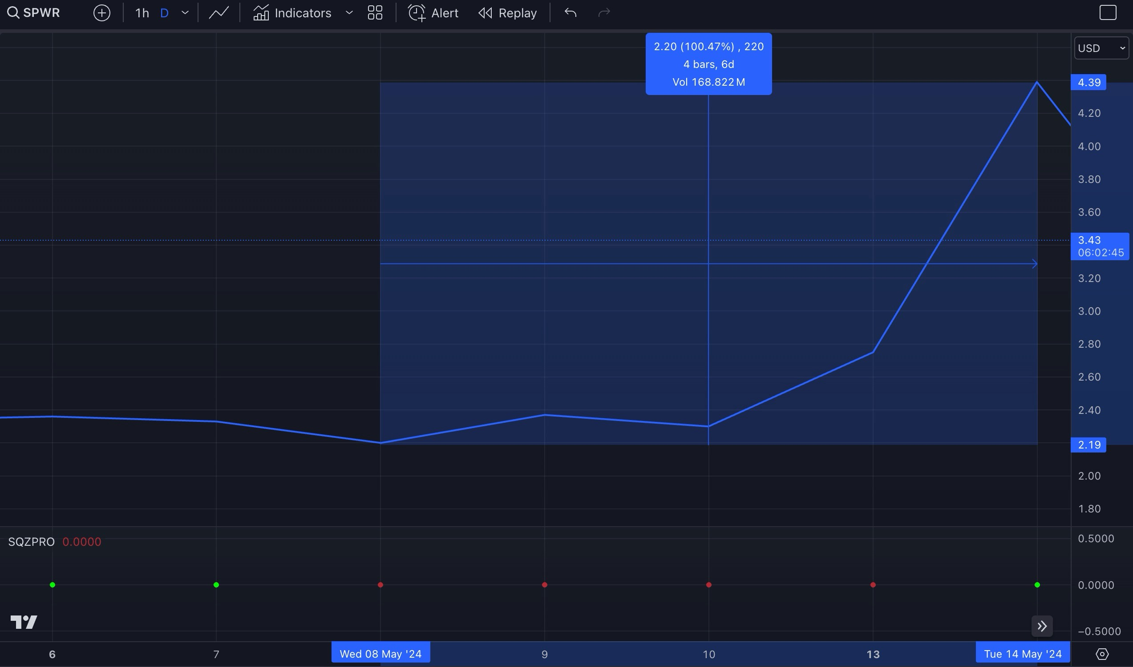
What Really Happened:
Stock: 100% (in 6 days)
Active
Squeeze
(Price Compression)

Slide 38
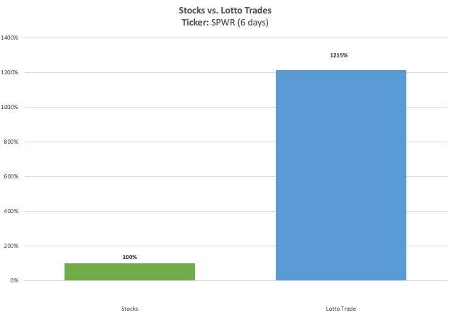
100% SPWR Stock Move ➡️ 1,215%
With A $0.27 Lotto Trade

Slide 39
The Best Part?
This Strategy Can Even Work When Politics AREN’T Involved...

Slide 40
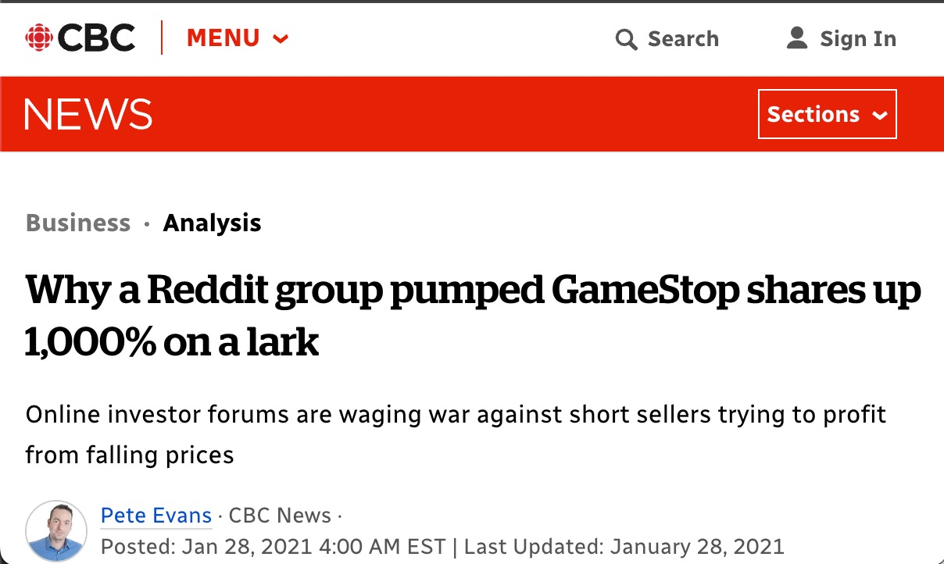
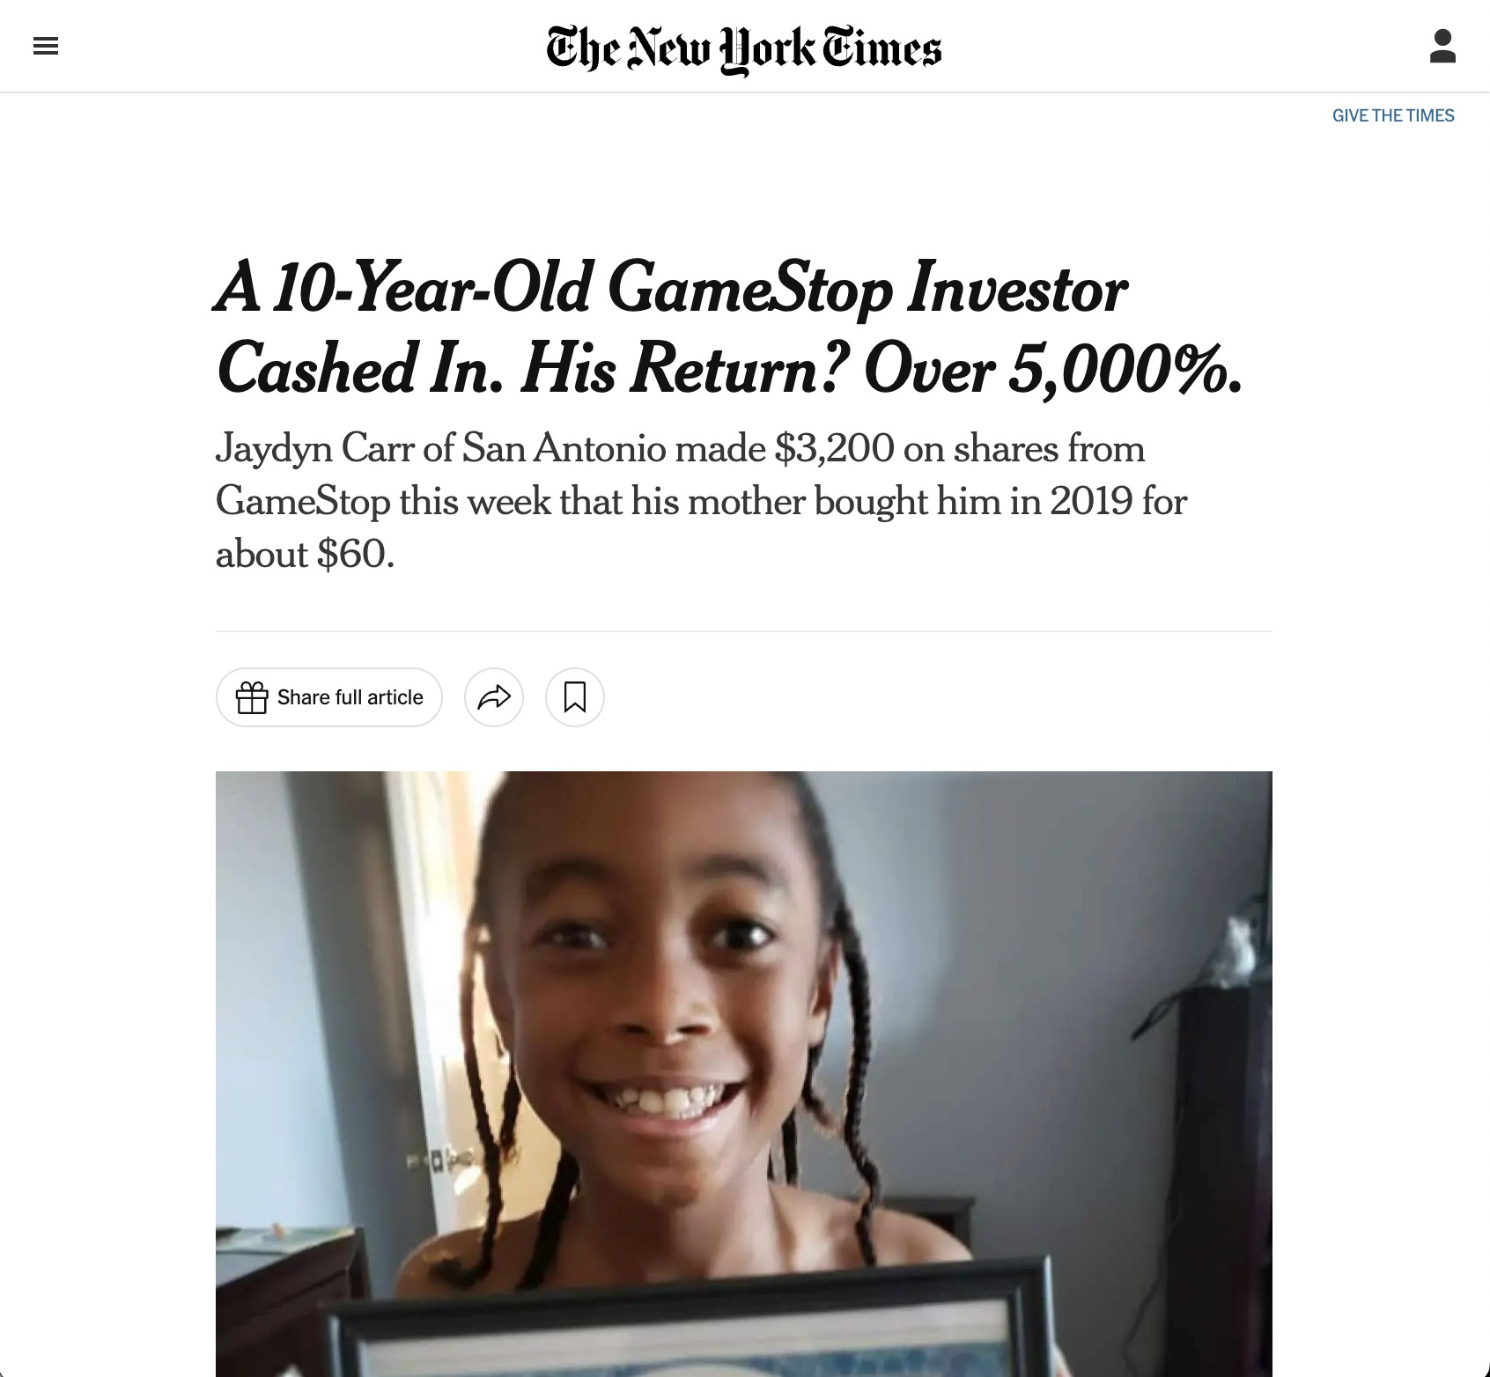
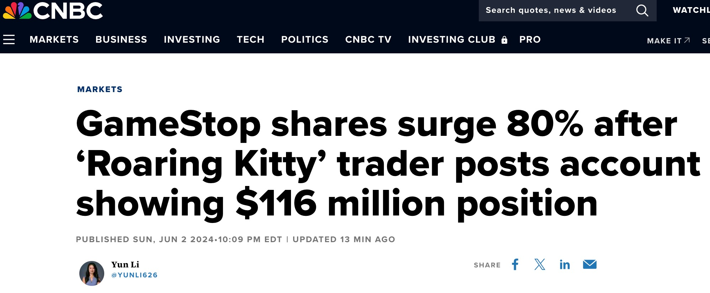
Perfect Example: The Meme Stock Phenomenon
Notes:
This is the perfect example of everyday investors turning the table on short-sellers!

Slide 41
You Don’t Need A Big Move In The Stock Price For This Strategy To Work!

Slide 42
REAL MONEY LOTTO TRADE WIN:
Russell 2000 (IWM)
From Daily Profits Live service

Slide 43
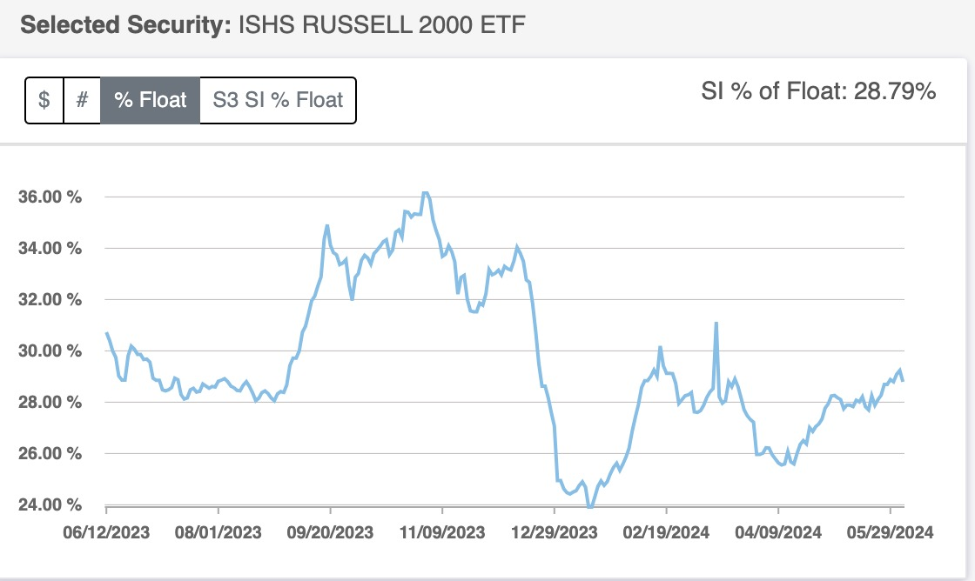
✅ Step 1: Found High Short Float On IWM

Slide 44
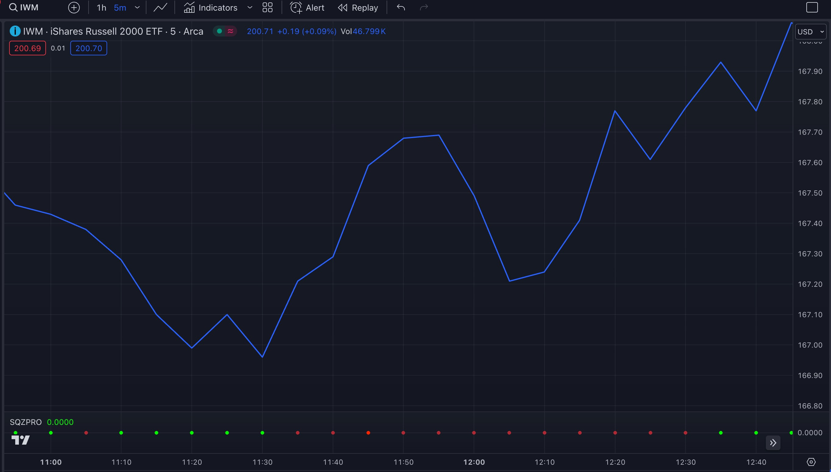
✅ Step 2: Determine If There Is An Overreaction

Slide 45
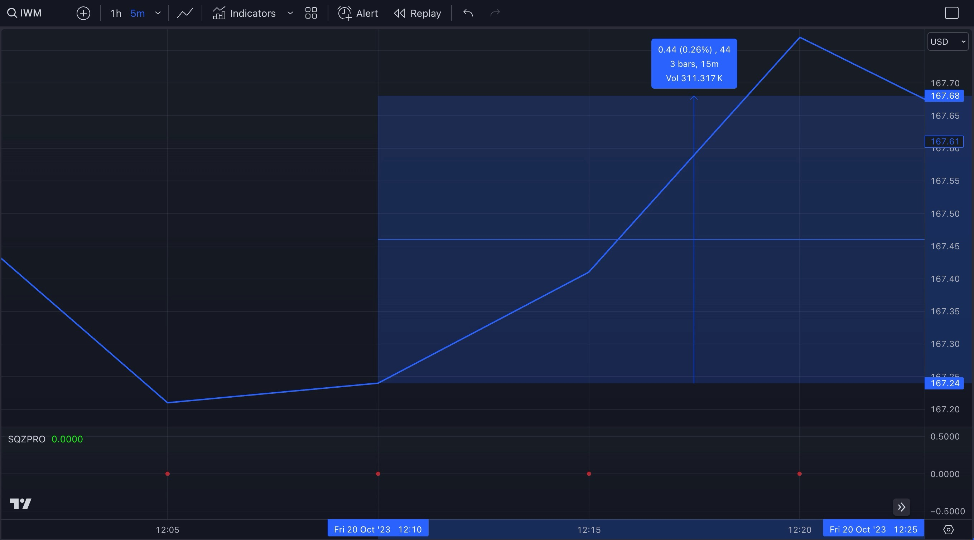
What Really Happened:
Stock: 0.26% (in 14 minutes)
Active
Squeeze
(Price Compression)

Slide 46
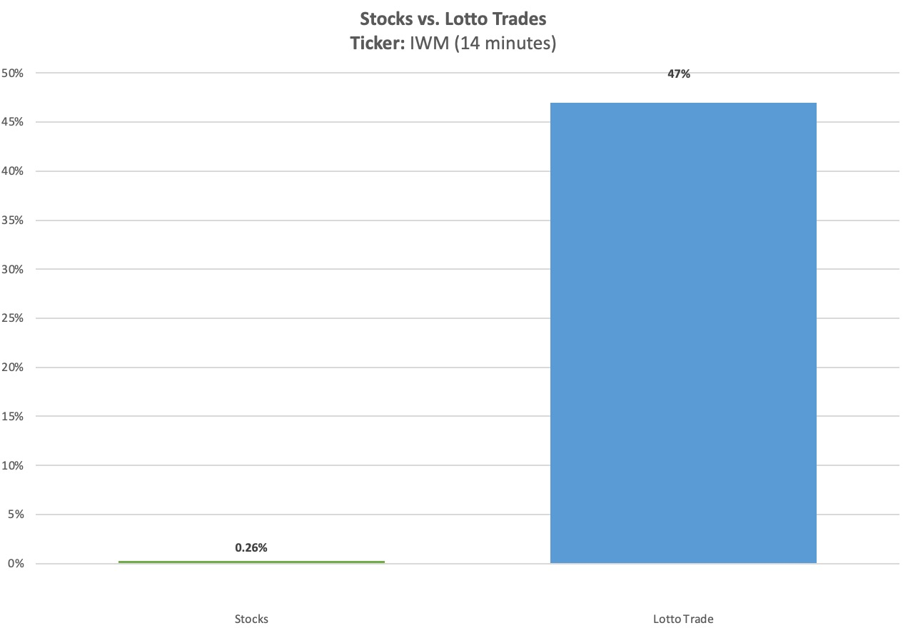
But With A Lotto Trade We Cashed In For 47%... in just 14 minutes!
(Nearly 5 years of average annual market returns!)

Slide 47
REAL MONEY LOTTO TRADE WIN:
CARVANA (CVNA)
From Daily Profits Live service

Slide 48
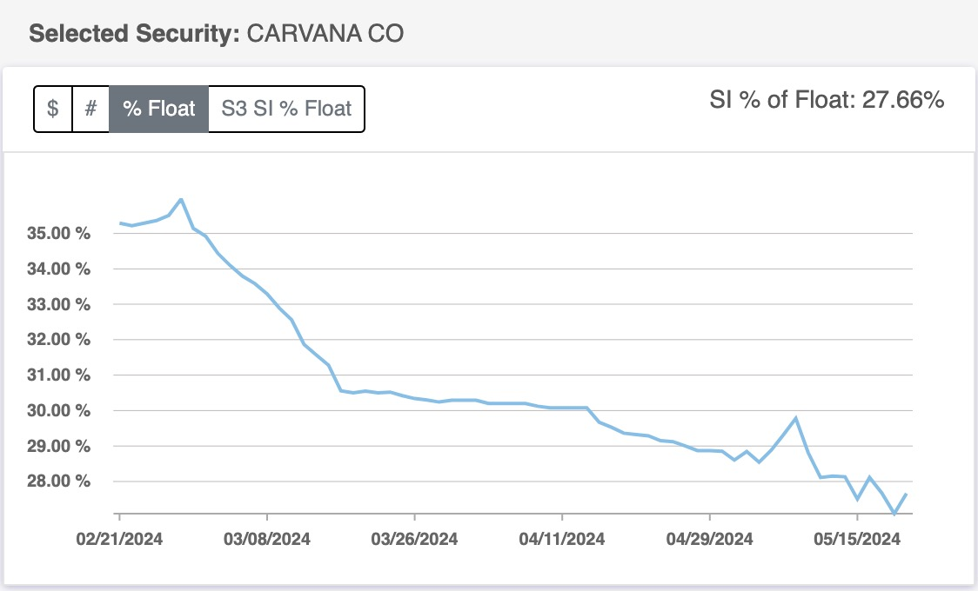
✅ Step 1: Found High Short Float On CVNA

Slide 49
✅ Step 1: Found High Short Float On CVNA

Slide 50
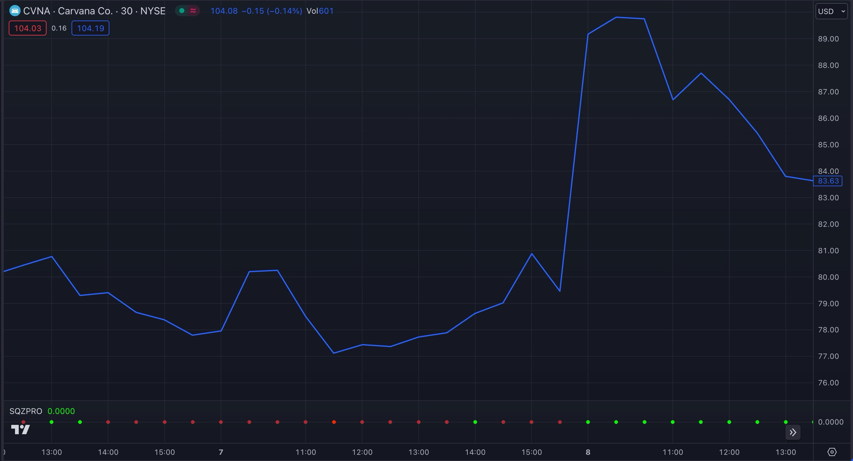
✅ Step 2: Determine If There Is An Overreaction

Slide 51
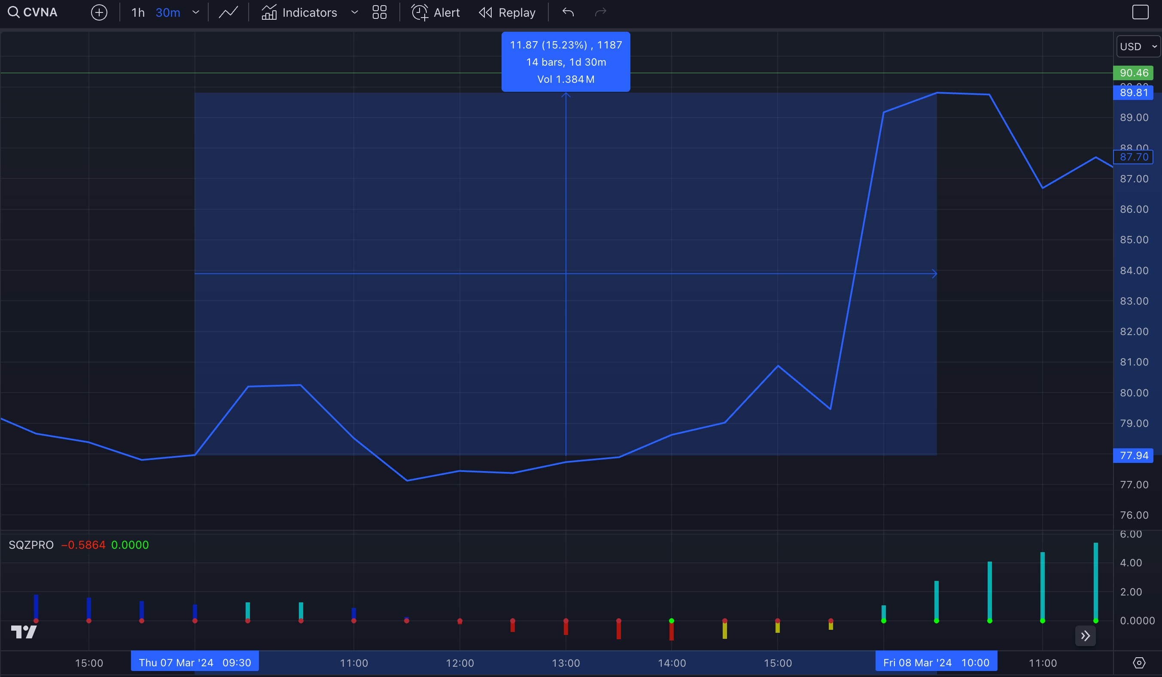
What Really Happened:
Stock: 15% (Overnight)
Active
Squeeze
(Price Compression)

Slide 52
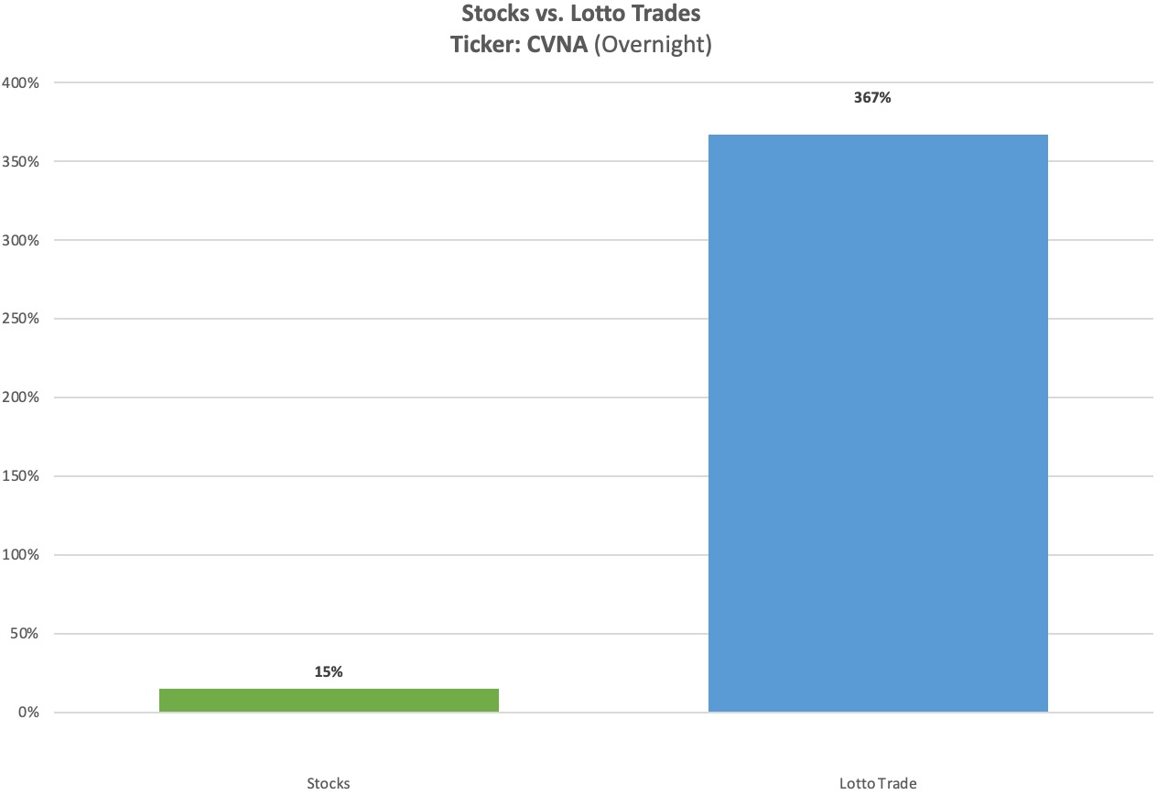
But With A Lotto Trade We Cashed In For 367% overnight!

Slide 53
My Top Members
Profited Too...

Slide 54
REMEMBER: While Lotto Trades Can Mean MASSIVE Profits...
These Are Cheap, High-Risk High Reward Moonshot Trades!
❌ DON’T bet more than you are willing to lose
❌ DON’T expect a high win-rate
✅ Have fun with these plays & enjoy
landing crazy winners whenever they happen!

Slide 55
REAL MONEY LOTTO TRADE WIN:
B Riley Financial Inc (RILY)
From Daily Profits Live service

Slide 56
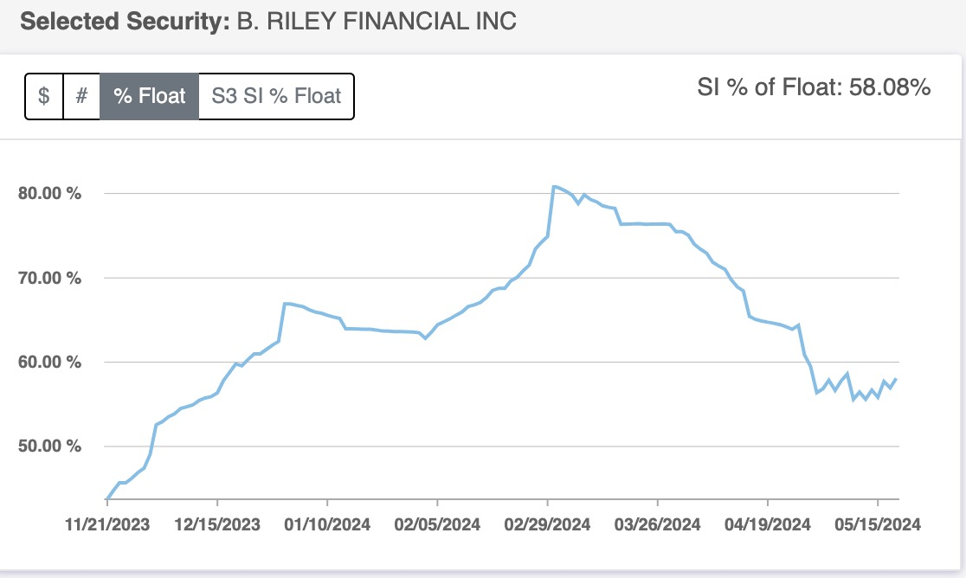
RILY LOTTO TRADE:
HIGH SHORT-FLOAT FOR MONTHS!

Slide 57
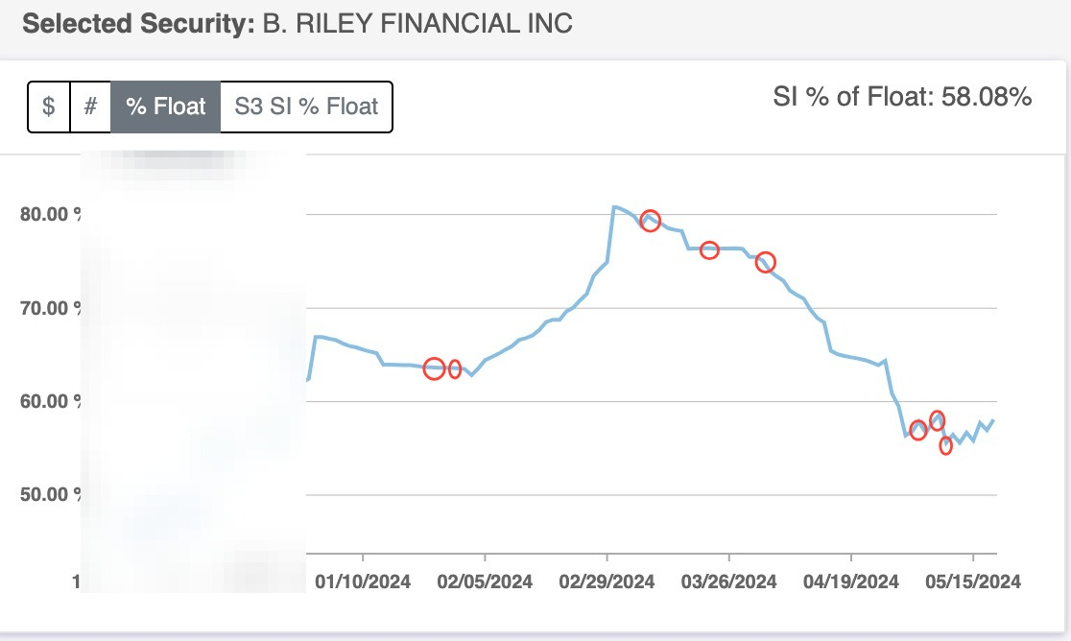
We Traded RILY Successfully Multiple Times!

Slide 58
Our RILY Lotto Trades This Year...
286% in 2 days
68% within hours
76% within hours
82% within hours
113% overnight
127% overnight
141% overnight
154% overnight
494% within hours
1,129% in 2 Days

Slide 59
$1000 Turns Into...
286% in 2 days ➡️ $3,860
68% within hours ➡️ $1,680
76% within hours➡️ $1,760
82% within hours ➡️ $1,820
113% overnight ➡️ $2,130
127% overnight ➡️ $2,270
141% overnight. ➡️ $2,270
154% overnight ➡️ $2,540
494% within hours ➡️ $5,940
1,129% in 2 Days ➡️ $12,290

Slide 60







My Top Students
Profited Too...

Slide 61
These Lotto Trade Recommendations Have Been Reserved For My Most Dedicated Students...

Slide 62

Starting Monday...
We’re Going To Be Hunting For Lotto Trades This Election Season Inside My Private Chat Room:

Slide 63
Inside Look At The #1 Weekly Trading
Livestream + Chat Room...
All-time Win-Rate: 78%
Average Return: 15% in 5 Days
Q1 Win Rate: 100%
Q1 Total Return: 192% (17x greater than S&P 500!)

Slide 64
What Members Are Saying:
“Nate has changed my trading life, from bouncing back and forth... to now up over 600% in 6 months.”
-Steward L.

Slide 65
What Members Are Saying:
“Account is growing not losing. Retired and love trading. Having a 89% win rate from what I have learned. A+ [Nate is a] great teacher”
-Tony.

Slide 66
What Members Are Saying:
“Made 1100% on Rily [in 2 days] and turned a $1300 account into $45,000 [in 4 months] since I joined with three losses”
-Laura.

Slide 67
What Members Are Saying:
“Nate’s strategy doesn’t take doesn’t thousands of dollars to get started.”
-Mike W.

Slide 68
This is Your Invitation To Trade Alongside Me Every Monday @ 12PM!

Slide 69
The Full Package:
#1 - Access To My Weekly Livestream + Chatroom
Join me every Monday @ 12pm EST as I go over my favorite trade ideas and teach the same strategies that I used to turn $37k into $2.7 Million (7,127% return in 4 years)
Collaborate and learn from other members of the #1 trading community on the web
Exclusive access to all session recordings (in case you ever miss a LIVE session)

Slide 70
The Full Package:
#2 - Weekly Profit Surge Trade Recommendations For A Year
TWO trade recommendations per week! (Including my #1 trade recommendation AND my favorite trade setup found with the help of my proprietary AI scanner)
78% All-Time Win Rate!
Buy and sell alerts + commentary delivered via email and mobile
push notifications AND live streamed during my sessions

Slide 71
The Full Package:
#3- My Entire Private Training Library
All of my top lessons and special reports including:
The $2.7 Million Profit System (2nd Edition)
How to Profitably Trade Options (the Easy Way)
One Ticker Payouts: The Profit Rule Book
The AI Profit Surge
AND MORE!

Slide 72
The Full Package:
EXCLUSIVE EVENT BONUSES... FREE TODAY
BONUS #1: Lotto Trade Alerts - I’ll share my favorite lotto plays on short float setups leading up to the elections (2-3 per month) ($1,500 value)
BONUS #2: Short Float Watchlist - My Regularly Updated List Of Short-Float Stocks Poised For MASSIVE Breakouts ($900 value)
BONUS #3: Election Trader 2024 - The Ultimate Guide To Targeting 1,000%+ During Election Season (REPORT) ($500 value)

Slide 73

The Full Package:
100% MONEY BACK GUARANTEE
If for any reason Profit Surge Trader isn’t for you after you test drive it... simply call my VIP Concierge Team within your first 365 days and they’ll refund your subscription entirely.
Try it out RISK FREE... No questions asked!

Slide 74
What Members Are Saying:
“I just turned 80... I resigned myself to working until my death, with no hope of paying off my debt and leaving my wife who is 20 years younger with anything. Then I came across Nate's service and story. Frankly, it gave me hope. I have experienced more success with Nate and his community more than anywhere else.”
-David

Slide 75
The Full Package:
BONUS #4: *FREE* VIP Invitation To My All-Day LIVE Events:
One Day Trading Blitz – Full day of LIVE trading alongside me
(Every 2 months)
Daily Profits Live Open Houses - Full week of LIVE trading (9am-4pm) inside my daily chat room Daily Profits Live ... FOR FREE! 2x per year.
Last Open House: 19-for-22 including gains up to 1,129% in just 2 days!

Slide 76
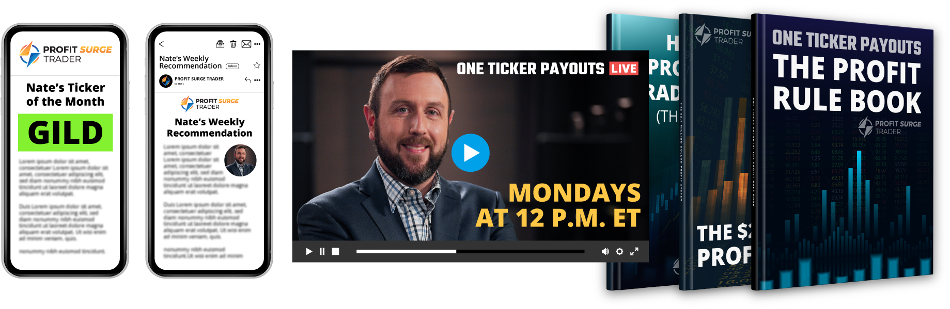
The Full Package:
$10,000 Value!

Slide 77
The Full Package:
Normal Retail Price
$997 per year
Weekly Livestreams + Trade Recommendations
Exclusive Special Event Bonuses
365 Day x 100% Money Back Guarantee

Slide 78

The Full Package:
Normal Retail Price:
$997 per year
Today’s Price:
Just $149 Per Year!
Weekly Livestreams + Trade Recommendations
Exclusive Special Event Bonuses
1 Year 100% Money Back Guarantee
Use The VIP Discount Link Below

