Slide 2


Welcome to
The Gift Gap
Live Demo
RYAN FITZWATER
CEO & Executive Publisher
Revealed: The Easiest, Most Reliable Trading Method We’ve Ever Developed
Stay Tuned for our live Q&A at the end of the event.

Slide 3

Meet Your Host: Ryan Fitzwater
Started at Monument Traders Alliance in 2019
Grew it to over 250,000 active readers
and members
Former Director of Research at The Oxford Club
Manages Over $1 Million Investment Portfolio
Active investor since 2009
Family man with three kids

Slide 4

Meet the Expert: Bryan Bottarelli
CBOE trader in the Apple Computer pit
Multimillionaire at 34
Over 2,000 winning trades with a 76% win rate
Bryan’s top students have seen incredible results…
Like David, who took $20,000 and turned it into $185,000
in one year…. Mo, who turned a $25,000 portfolio into
over $225,000 in just four months
BRYAN BOTTARELLI
Head Trade Tactician

Slide 5

The #1 Strategy for This Market
Tells You Exactly When to
Buy a Stock After a Big Drop
Also Tells You Exactly When
a Stock is Overbought After
a Big Move Up
It’s a method called
“The Gift Gap.”

Slide 6
Trading Gift Gaps Can Show You Gains As High As these top examples from our back test…
89% in 5 days
114% in 19 days
235% in 11 days
452% in 8 days

Slide 7
What is a Gift Gap?
This is a way to target temporarily undervalued stocks
using one simple, elegant, and powerful indicator.
It’s like getting a “flash sale” on a stock... Where you
can exploit market overreactions.
It involves one signal called the Gift Gap.
We’ll show you live trade set-ups
during demo session.

Slide 8
What You’ll Learn Today
We’ll walk through the entire Gift Gap strategy...
You’ll see how our back test achieved up to a 97% win rate,
and we’ll show you many of our top examples today.
And we’ll reveal exactly how to trade
Gift Gaps for maximum potential profits…

Slide 9

Disclaimer
Risk is a part of all investing. You should never invest more than you can afford to lose.

Slide 10
Let’s Dive Into Gift Gaps!
What Do You Notice About These Charts?

Slide 11
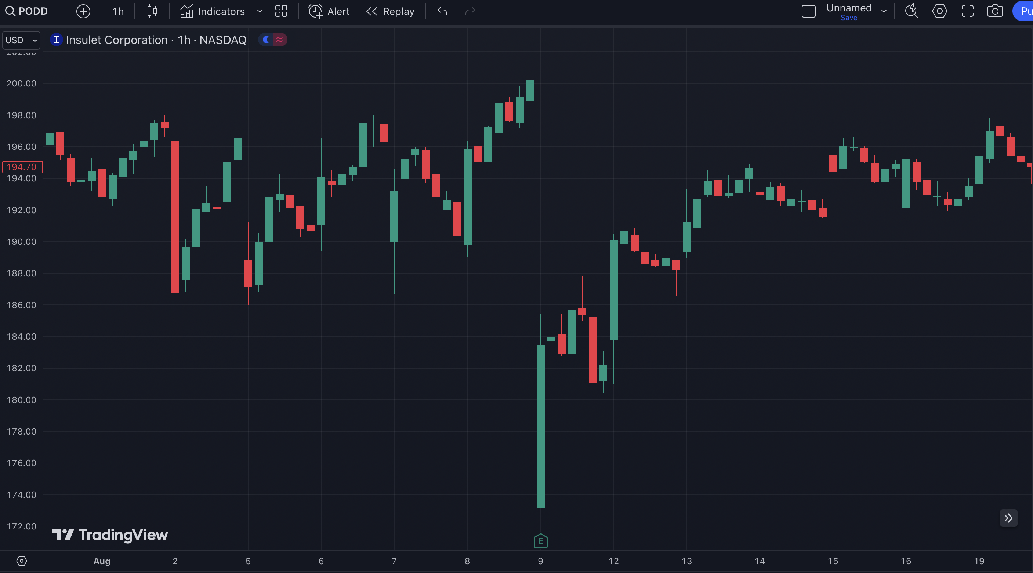

Slide 12
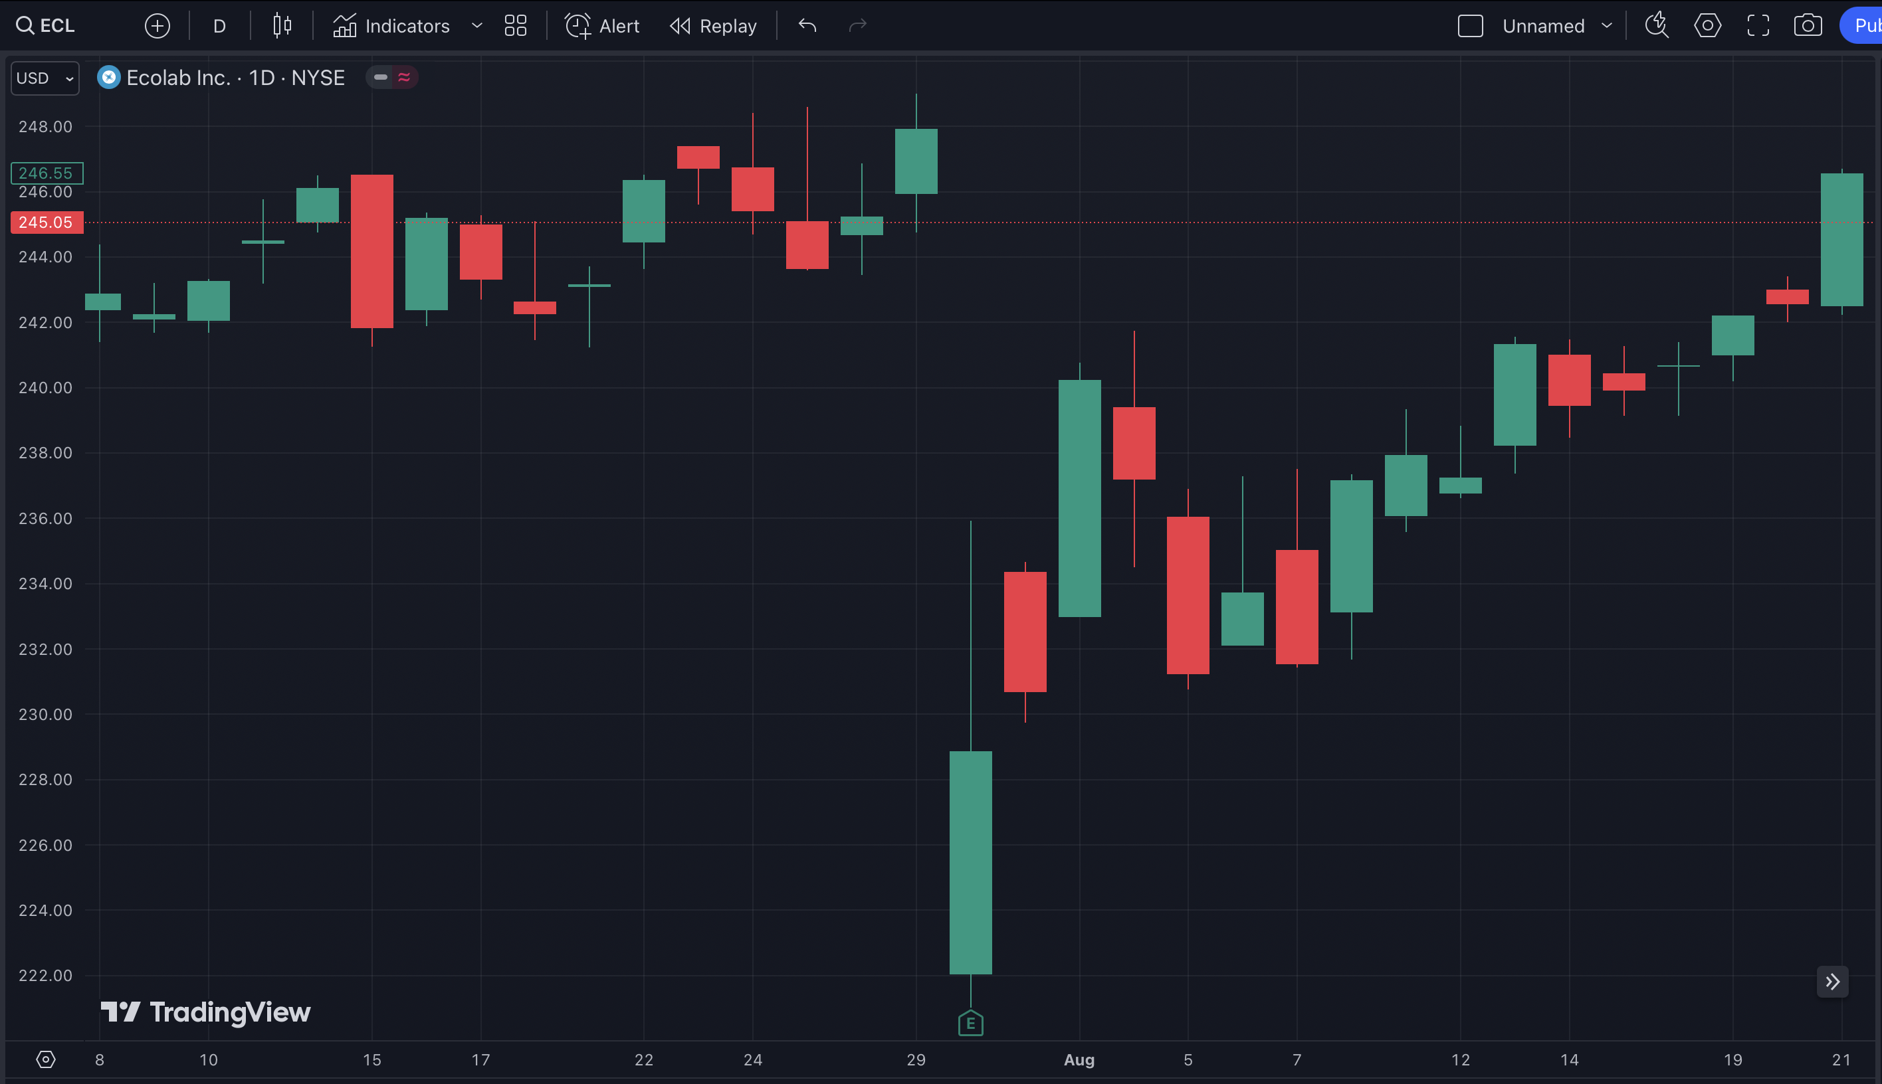

Slide 13
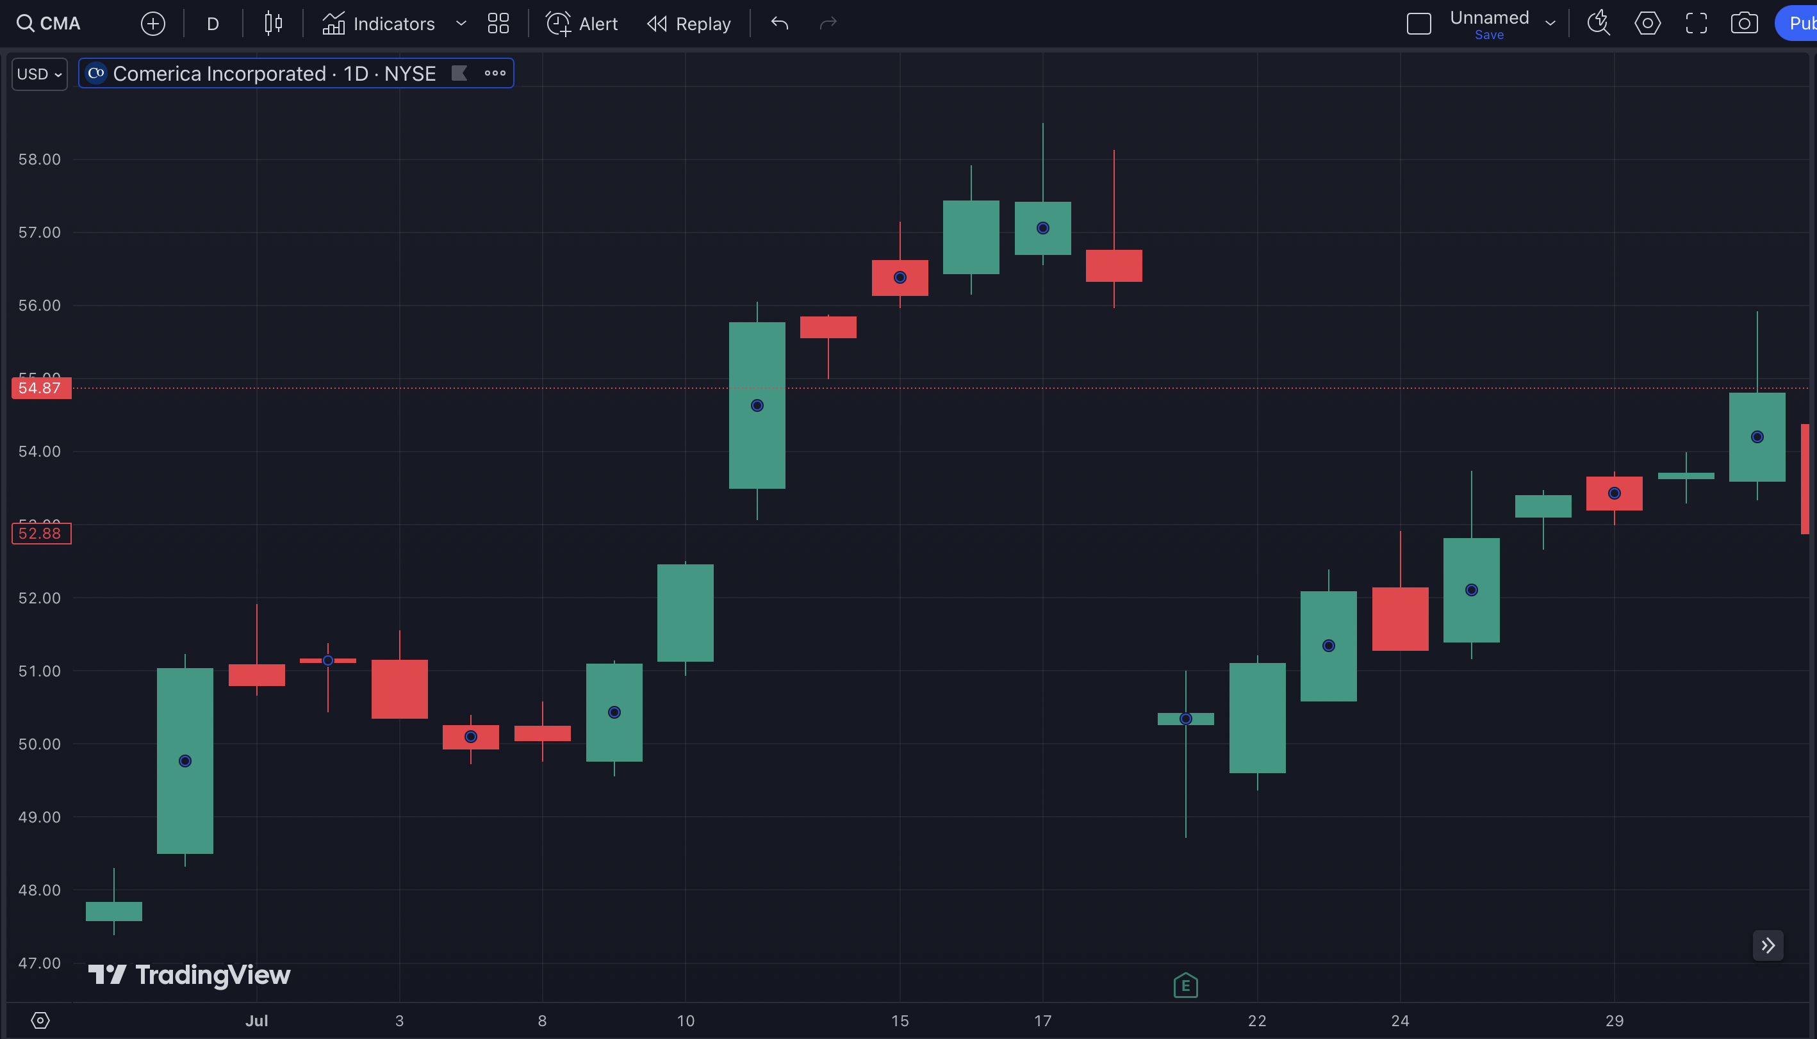

Slide 14

So What Are You Seeing Here?
Gaps happen when a stock moves
10% or more, up or down, often
within hours.
This creates a temporary gap
in the stock chart.
This is important: the gap is then filled.

Slide 15
Gap

Slide 16
Gap Fill

Slide 17
Gap

Slide 18
Gap Fill

Slide 19
Gap

Slide 20
Gap Fill

Slide 21
This is Why We Call
These Gifts…
These Are Opportunities for Huge Gains!

Slide 22
It’s Like Getting a
“Flash Sale” on a Stock
The Gains Could Be Huge…
If You Know How to Properly
Trade Them!

Slide 23
114%
in 19 Days

Slide 24
250%
in 35 Days

Slide 25
454%
in 31 Days

Slide 26
Do you see why we consider them gifts?
If you know how to trade them, it’s serious money.

Slide 27
Here’s the Secret…
Most Gaps Get Filled!
Coming up… secret gap fill
trigger revealed!

Slide 28
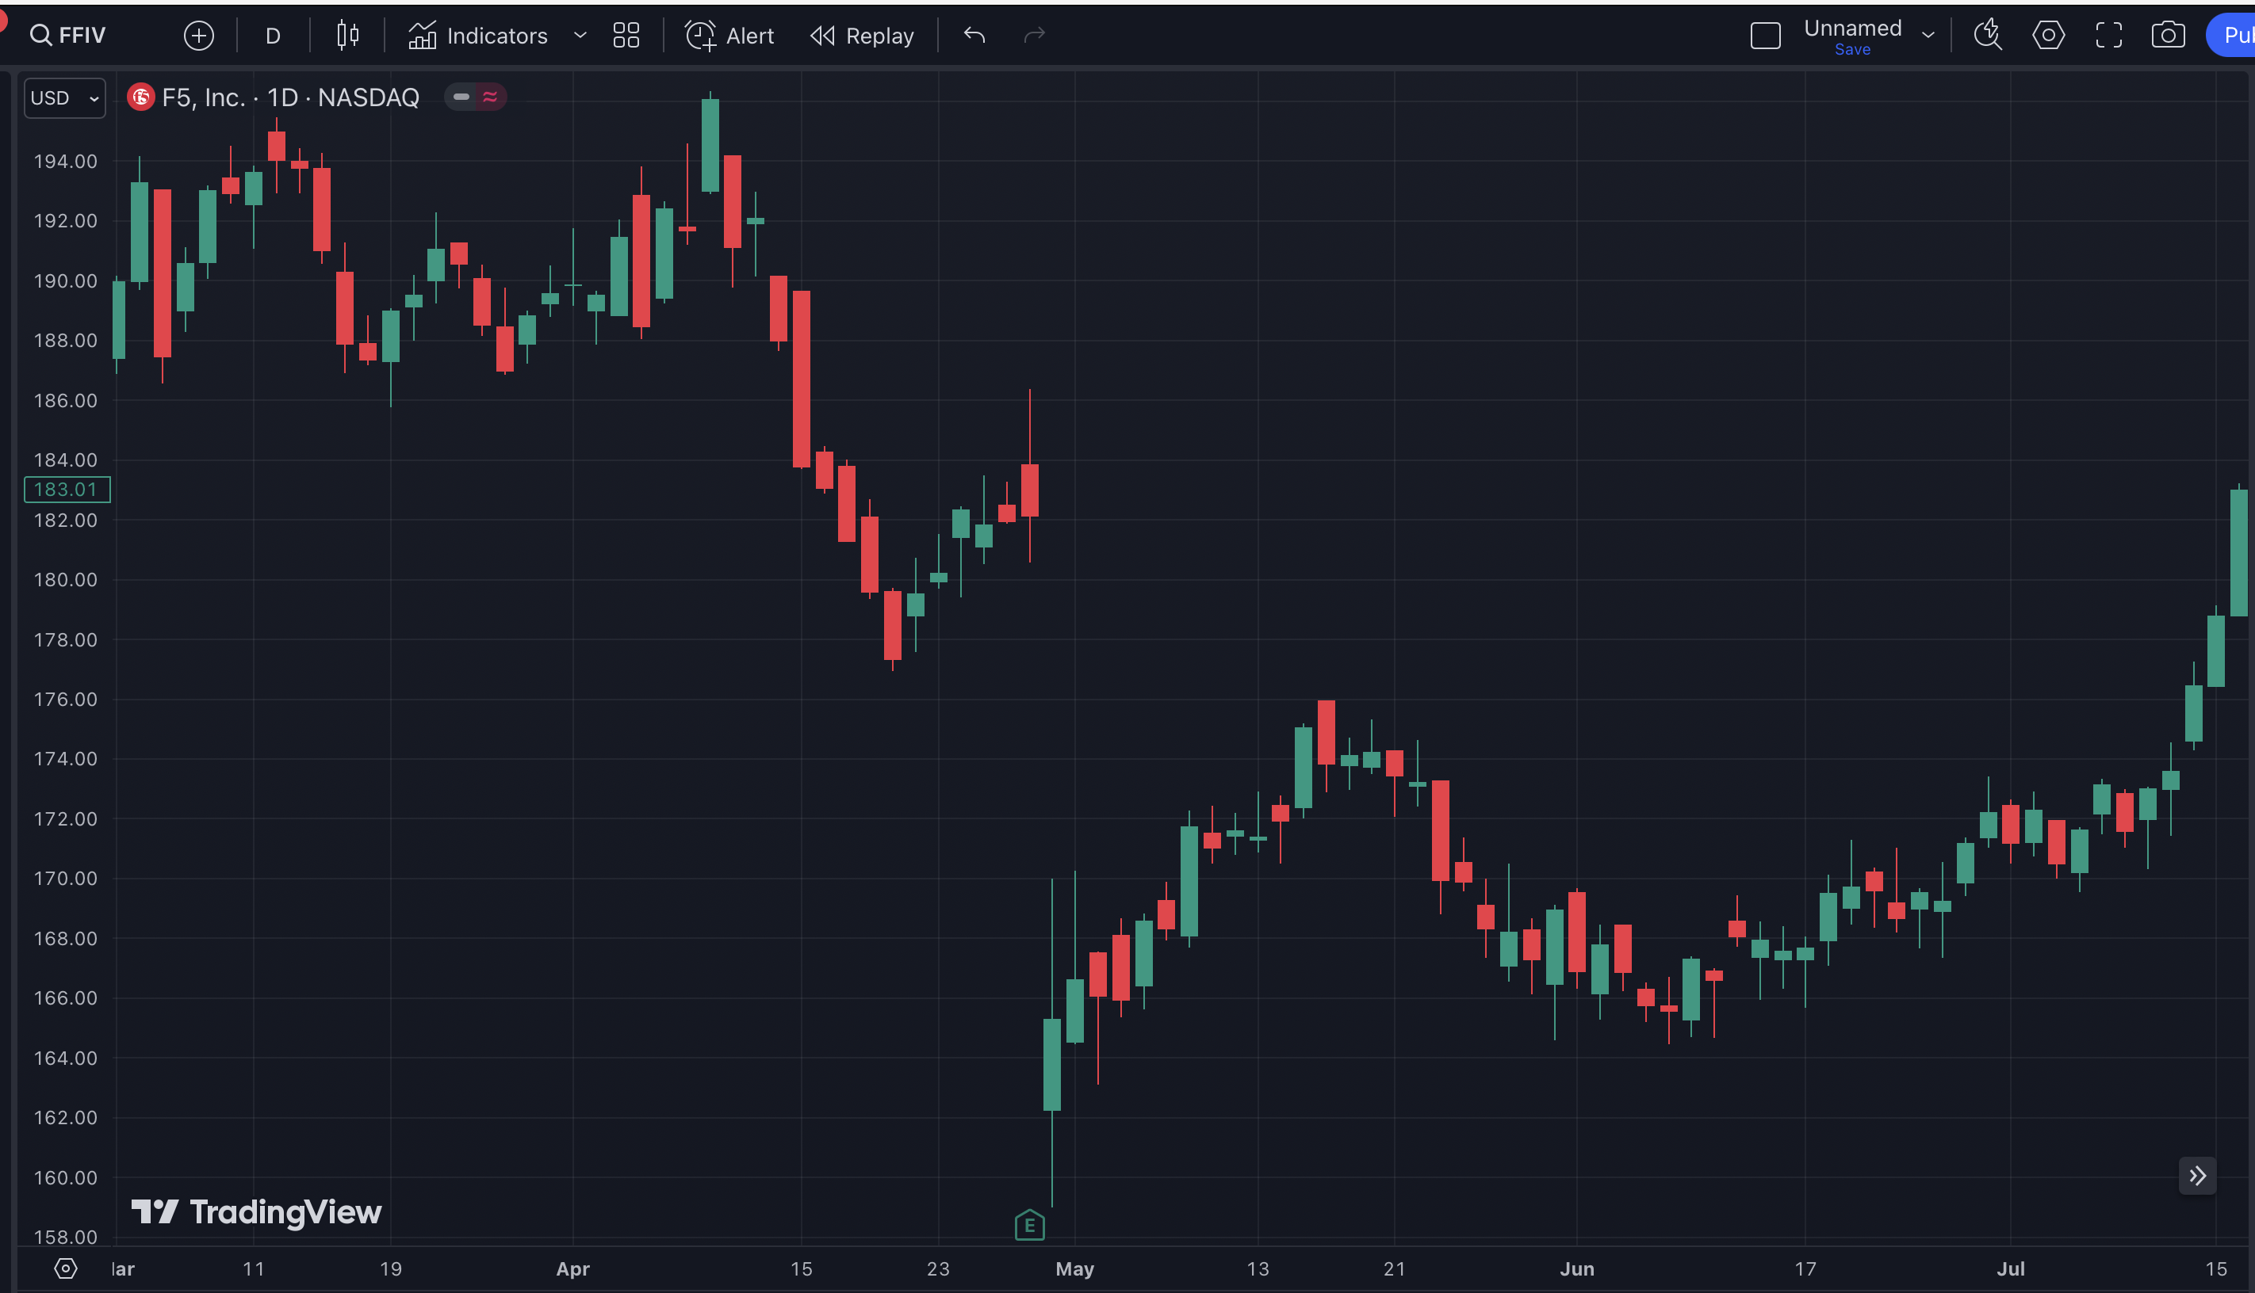
Gap

Slide 29
127%
in 77 Days

Slide 30
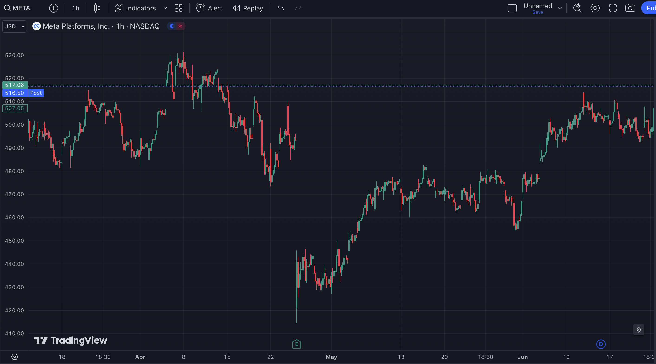
Gap

Slide 31
151%
in 42 Days

Slide 32
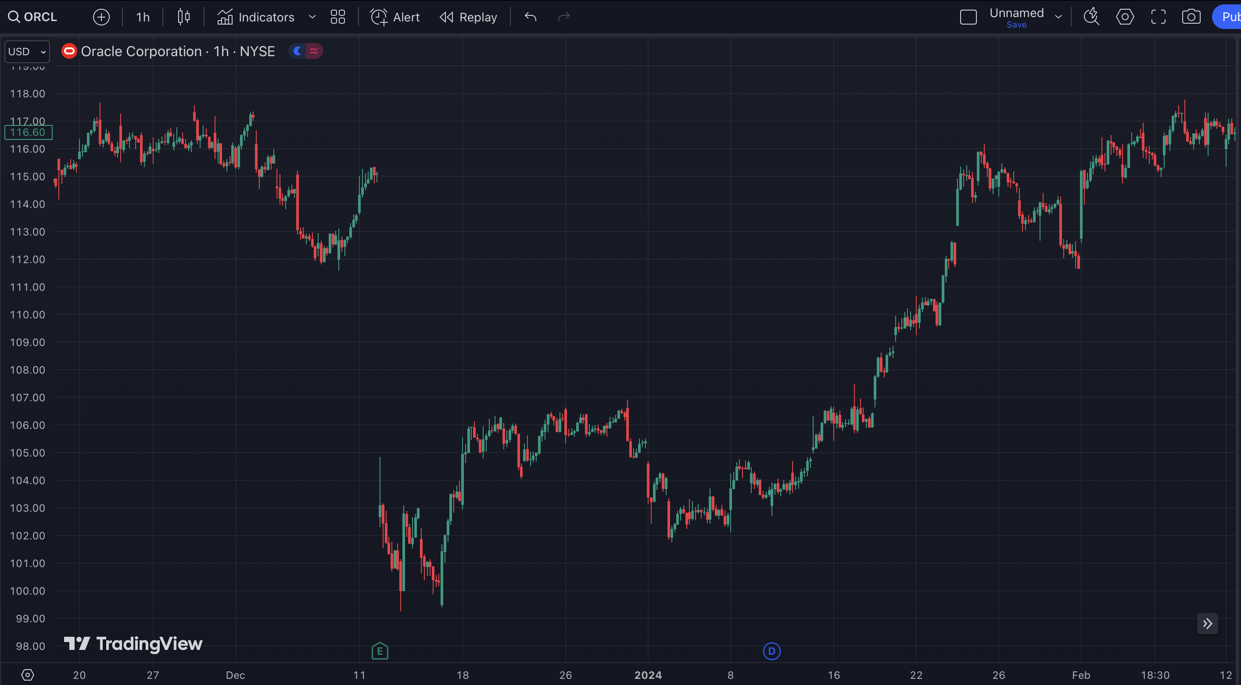
Gap

Slide 33
397%
in 52 Days

Slide 34
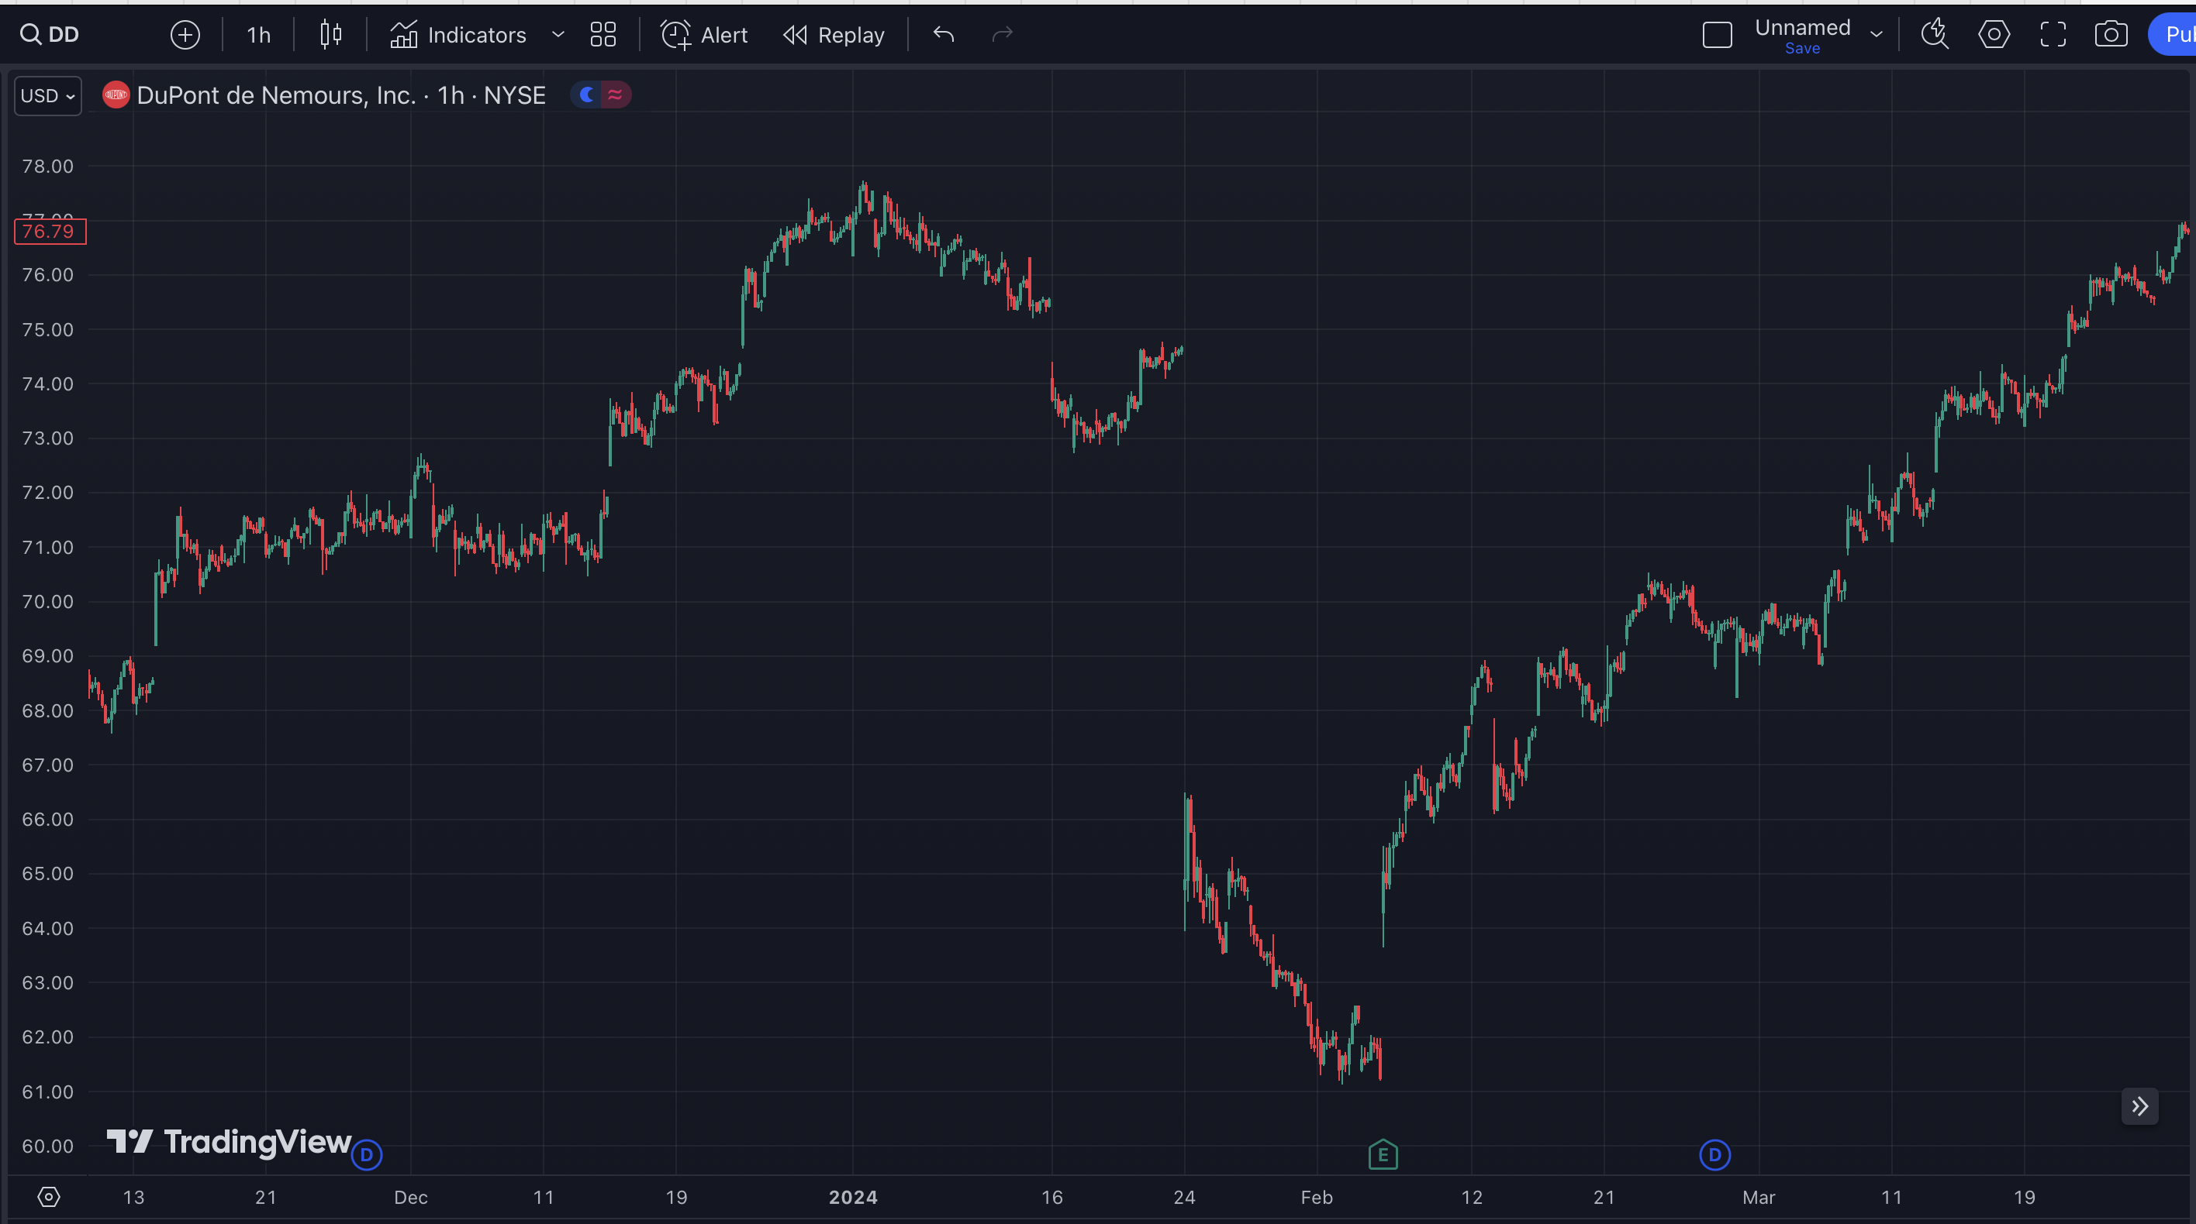
Gap

Slide 35
437%
in 58 Days

Slide 36
But…
There’s a problem.

Slide 37
The Problem
You can’t blindly buy stocks that gap down.
It’s hard to avoid catching a falling knife.

Slide 38
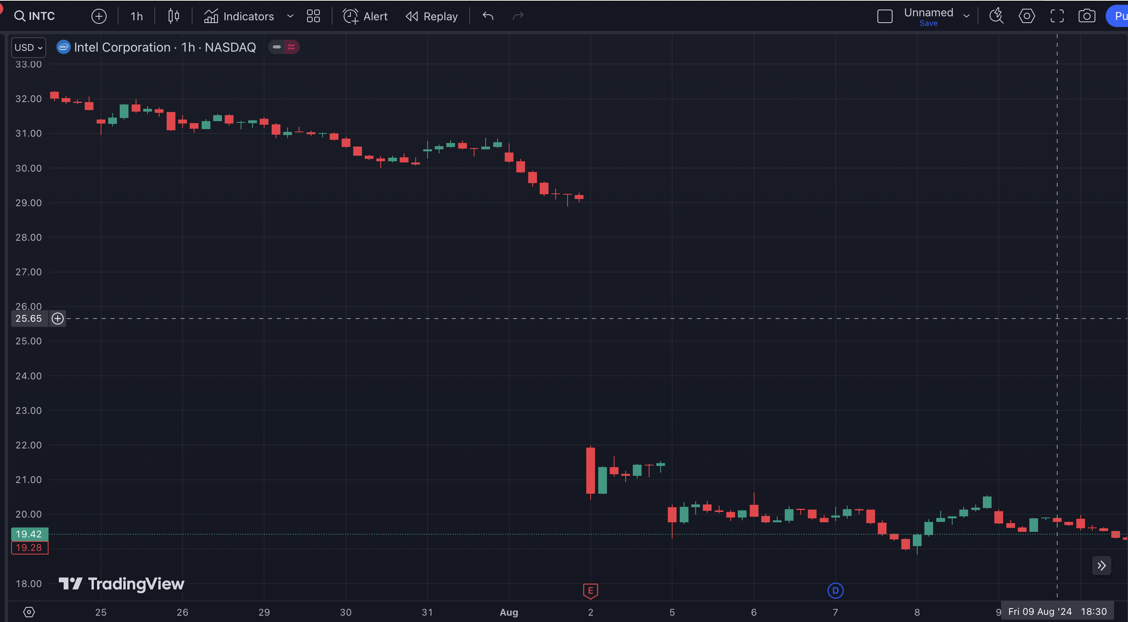
Gap

Slide 39
No Gap Fill

Slide 40
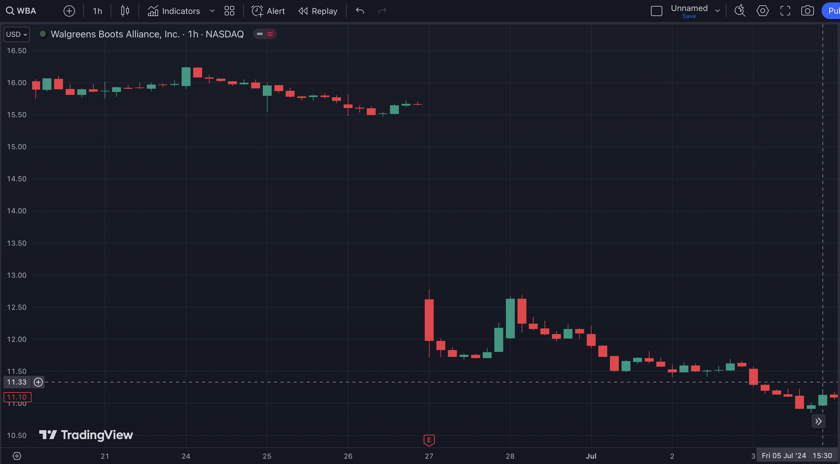
Gap

Slide 41
No Gap Fill

Slide 42
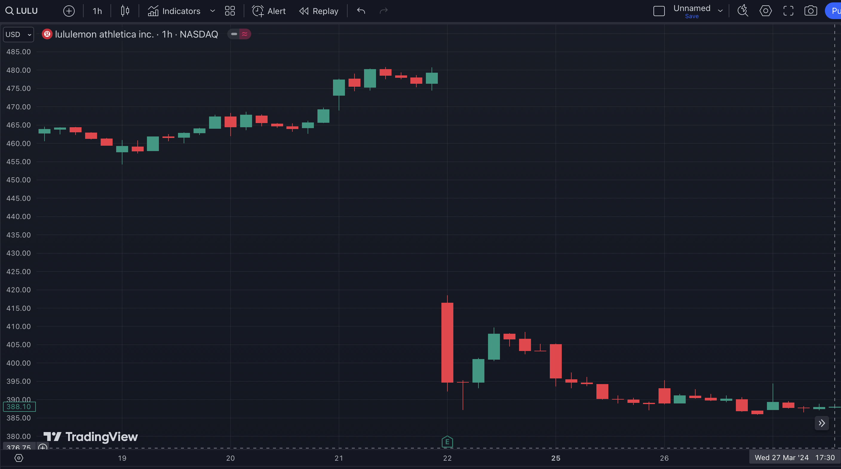
Gap

Slide 43
No Gap Fill

Slide 44
The Solution…
We have created a system to solve this.
Let me show you…

Slide 45
How Do You Know When The Gap Will Get Filled?
Most traders don’t use this because they do not understand how to trade proper signals.
You need to make sure the stock is poised and ready to fill a gap.
How do you know that? We’ve found the
secret trigger that nobody knows…

Slide 46
The Gift Gap 10% Trigger
The ideal time to get into a Gift Gap Trade is when it backfills…
10% of the gap move.

Slide 47
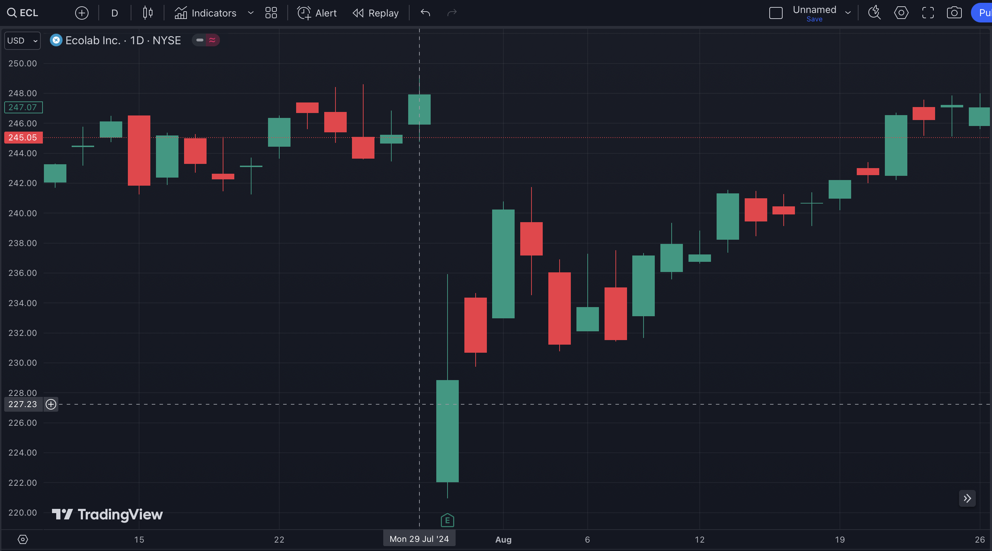
Here is the Gap on July 29

Slide 48
You Must…
Wait For The 10% Gap
Fill Trigger!

Slide 49
THIS is the trigger. This is when 10% of the Gap is filled.

Slide 50
454%
in 31 Days

Slide 51
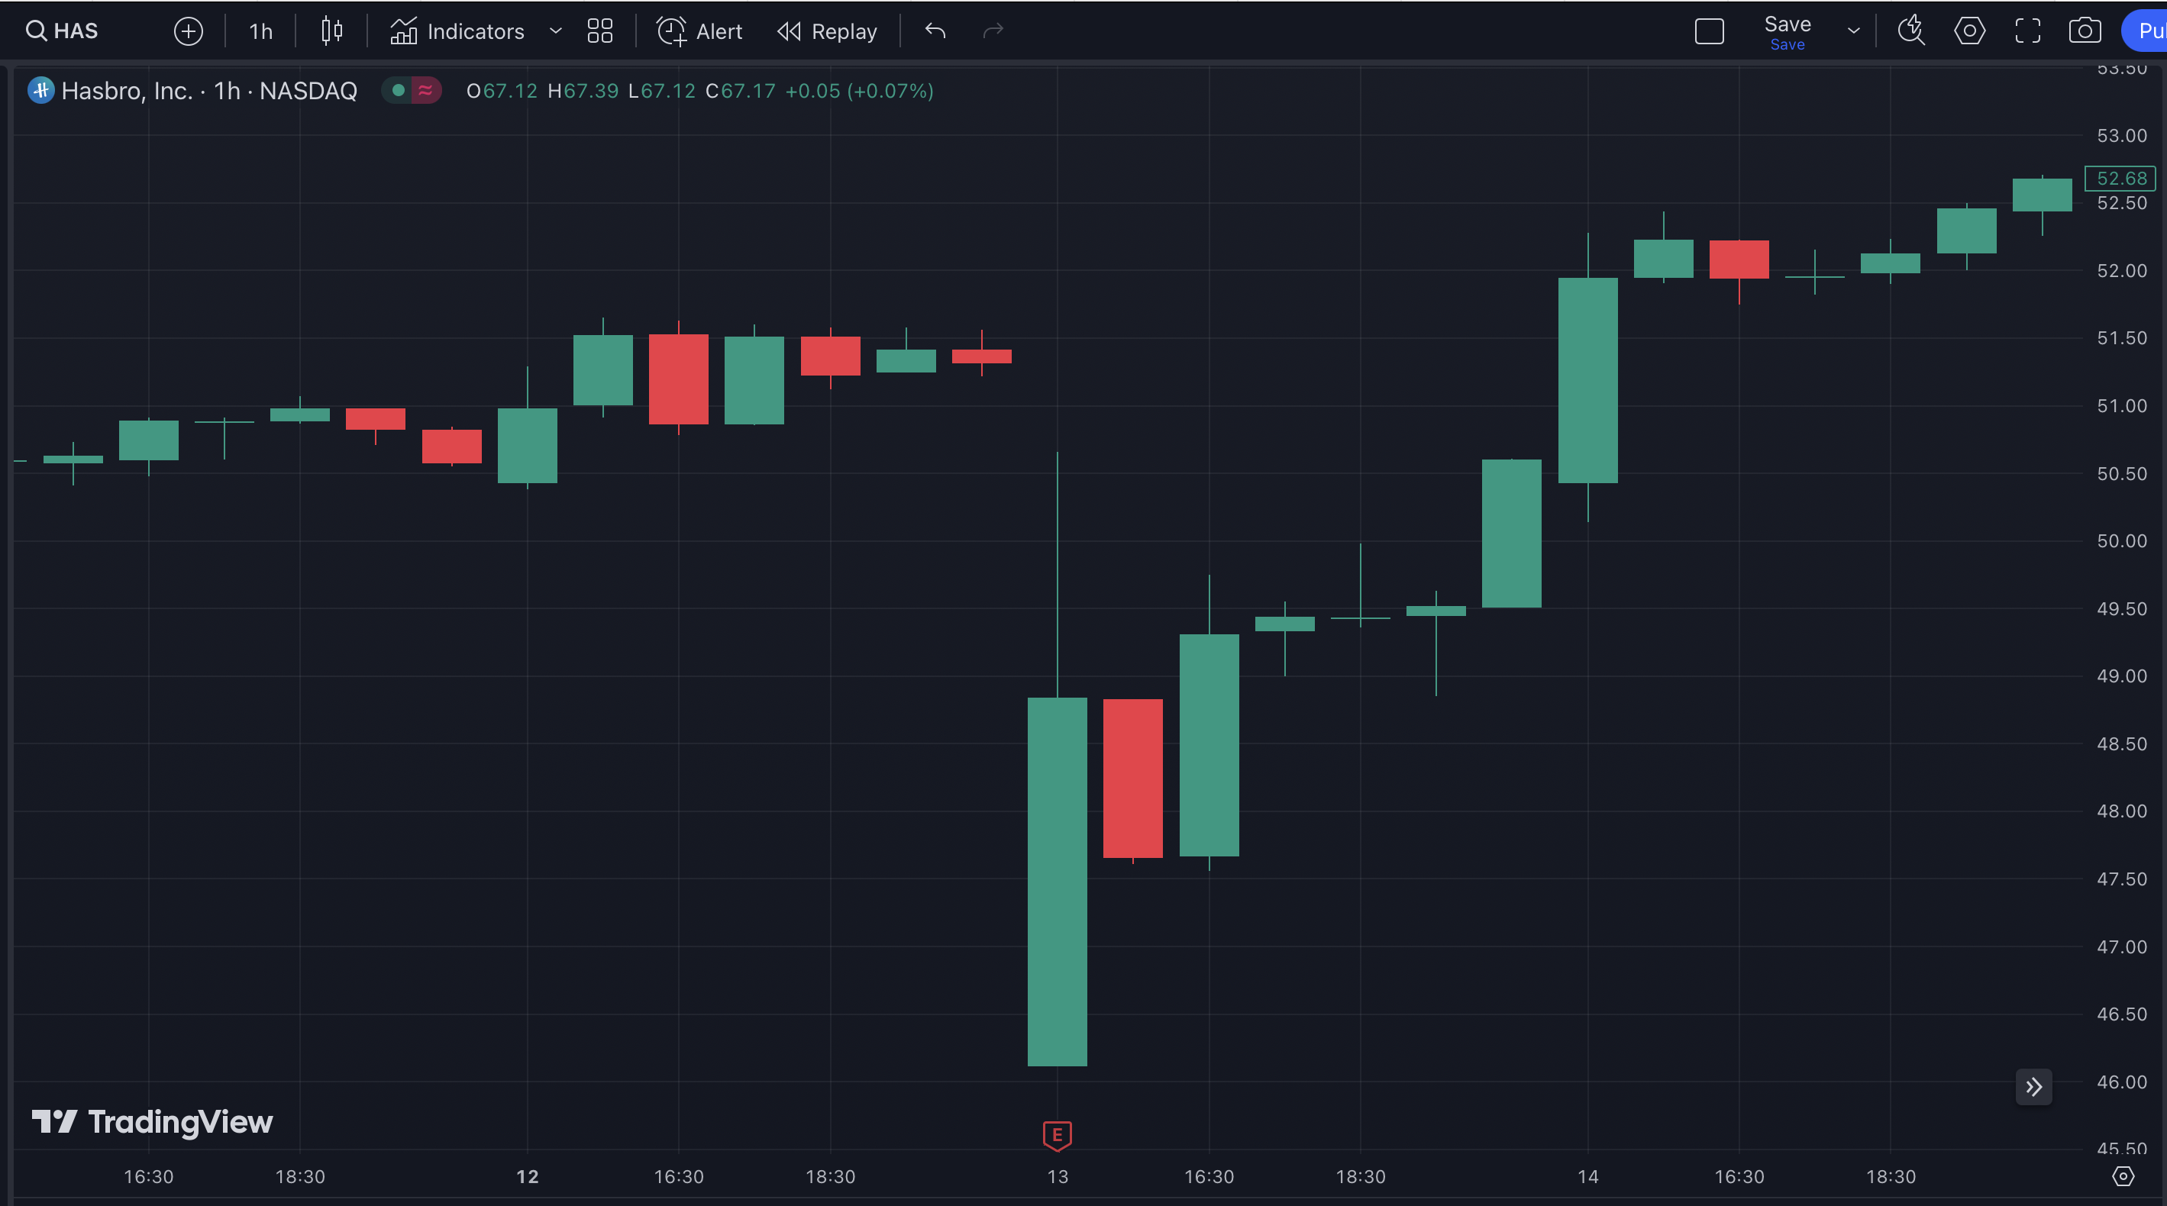
Here is the Gap

Slide 52
THIS is the trigger. 10% of the Gap has been filled.

Slide 53
103%
in One Day

Slide 54
Why Does This Work?
What you’re seeing is called a “oversold reversal”
The stock has oversold and buyers are jumping
in and pushing it back higher
THIS is when we want to get in

Slide 55
Key Take Away…
If You Buy After 10% of the Gap is Filled, The Win Rate Goes Through the Roof…

Slide 56
Backtested Gap Fill Win Rates
After 10% Trigger
25% Gap Fill: Win Rate 97.11% in 23 Days
50% Gap Fill: Win Rate 92.79% in 44 Days
75% Gap Fill: Win Rate 88.65% in 61 Days
100% Gap Fill: Win Rate 84.82% in 76 Days
Based on 5 year backtest and 365-day max holding period

Slide 57
Let’s Break It Down…

Slide 58
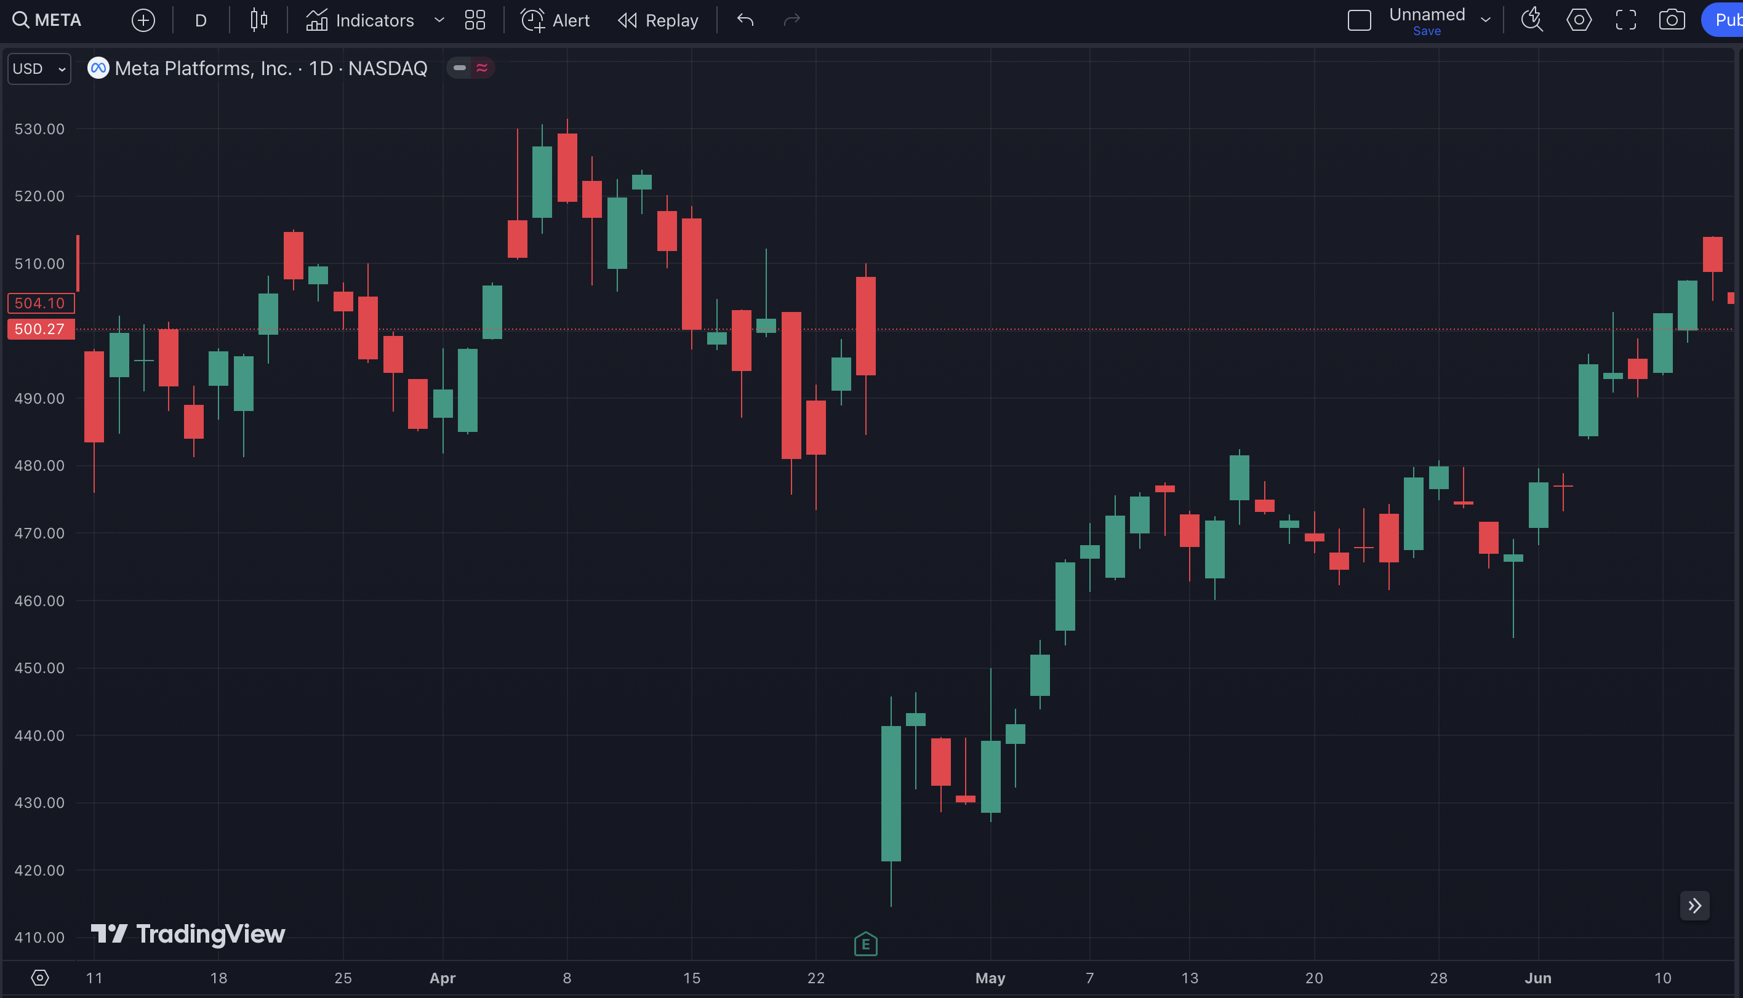
Gift Gap Here

Slide 59
Gift Gap Trigger

Slide 60
22.66%
GAIN
25% Fill

Slide 61
58.76%
GAIN
50% Fill

Slide 62
135.17%
GAIN
75% Fill

Slide 63
225.59%
GAIN
100% Fill

Slide 64

We Found the Sweet Spot!

Slide 65
You Want to Target the First Leg of the Fill
25% Gap Fill: Win Rate 97.11% in 23 Days
50% Gap Fill: Win Rate 92.79% in 44 Days
75% Gap Fill: Win Rate 88.65% in 61 Days
100% Gap Fill: Win Rate 84.82% in 76 Days
Based on 5 year backtest and 365-day max holding period

Slide 66
You Want to Target the First Leg of the Fill
Over a 10-year period, we analyzed 3,735 gap down events.
When targeting a 25% gap fill, our win rate was a staggering 97.11%.
That means out of those 3,735 trades, 3,627 were winners.
The average winning trade lasted just 4 days.
Even more remarkably, 80% of these winning
trades hit our target within the first two days.

Slide 67
The First Quarter Move of a Gap Fill is PERFECT for Short Term Trades

Slide 68
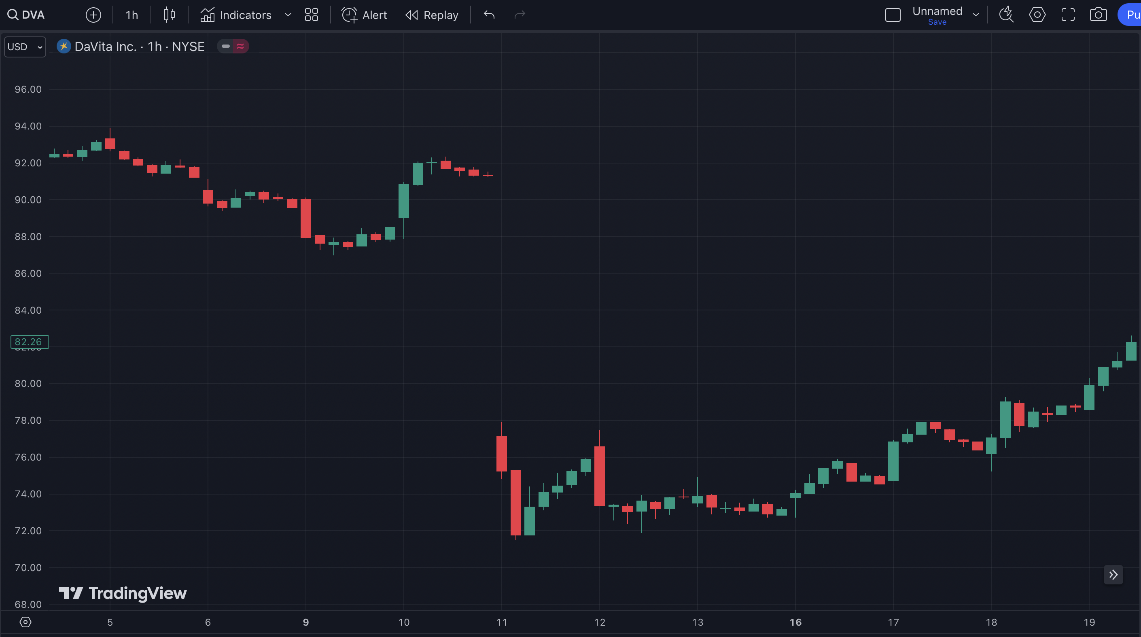
92%
in 8 Days

Slide 69
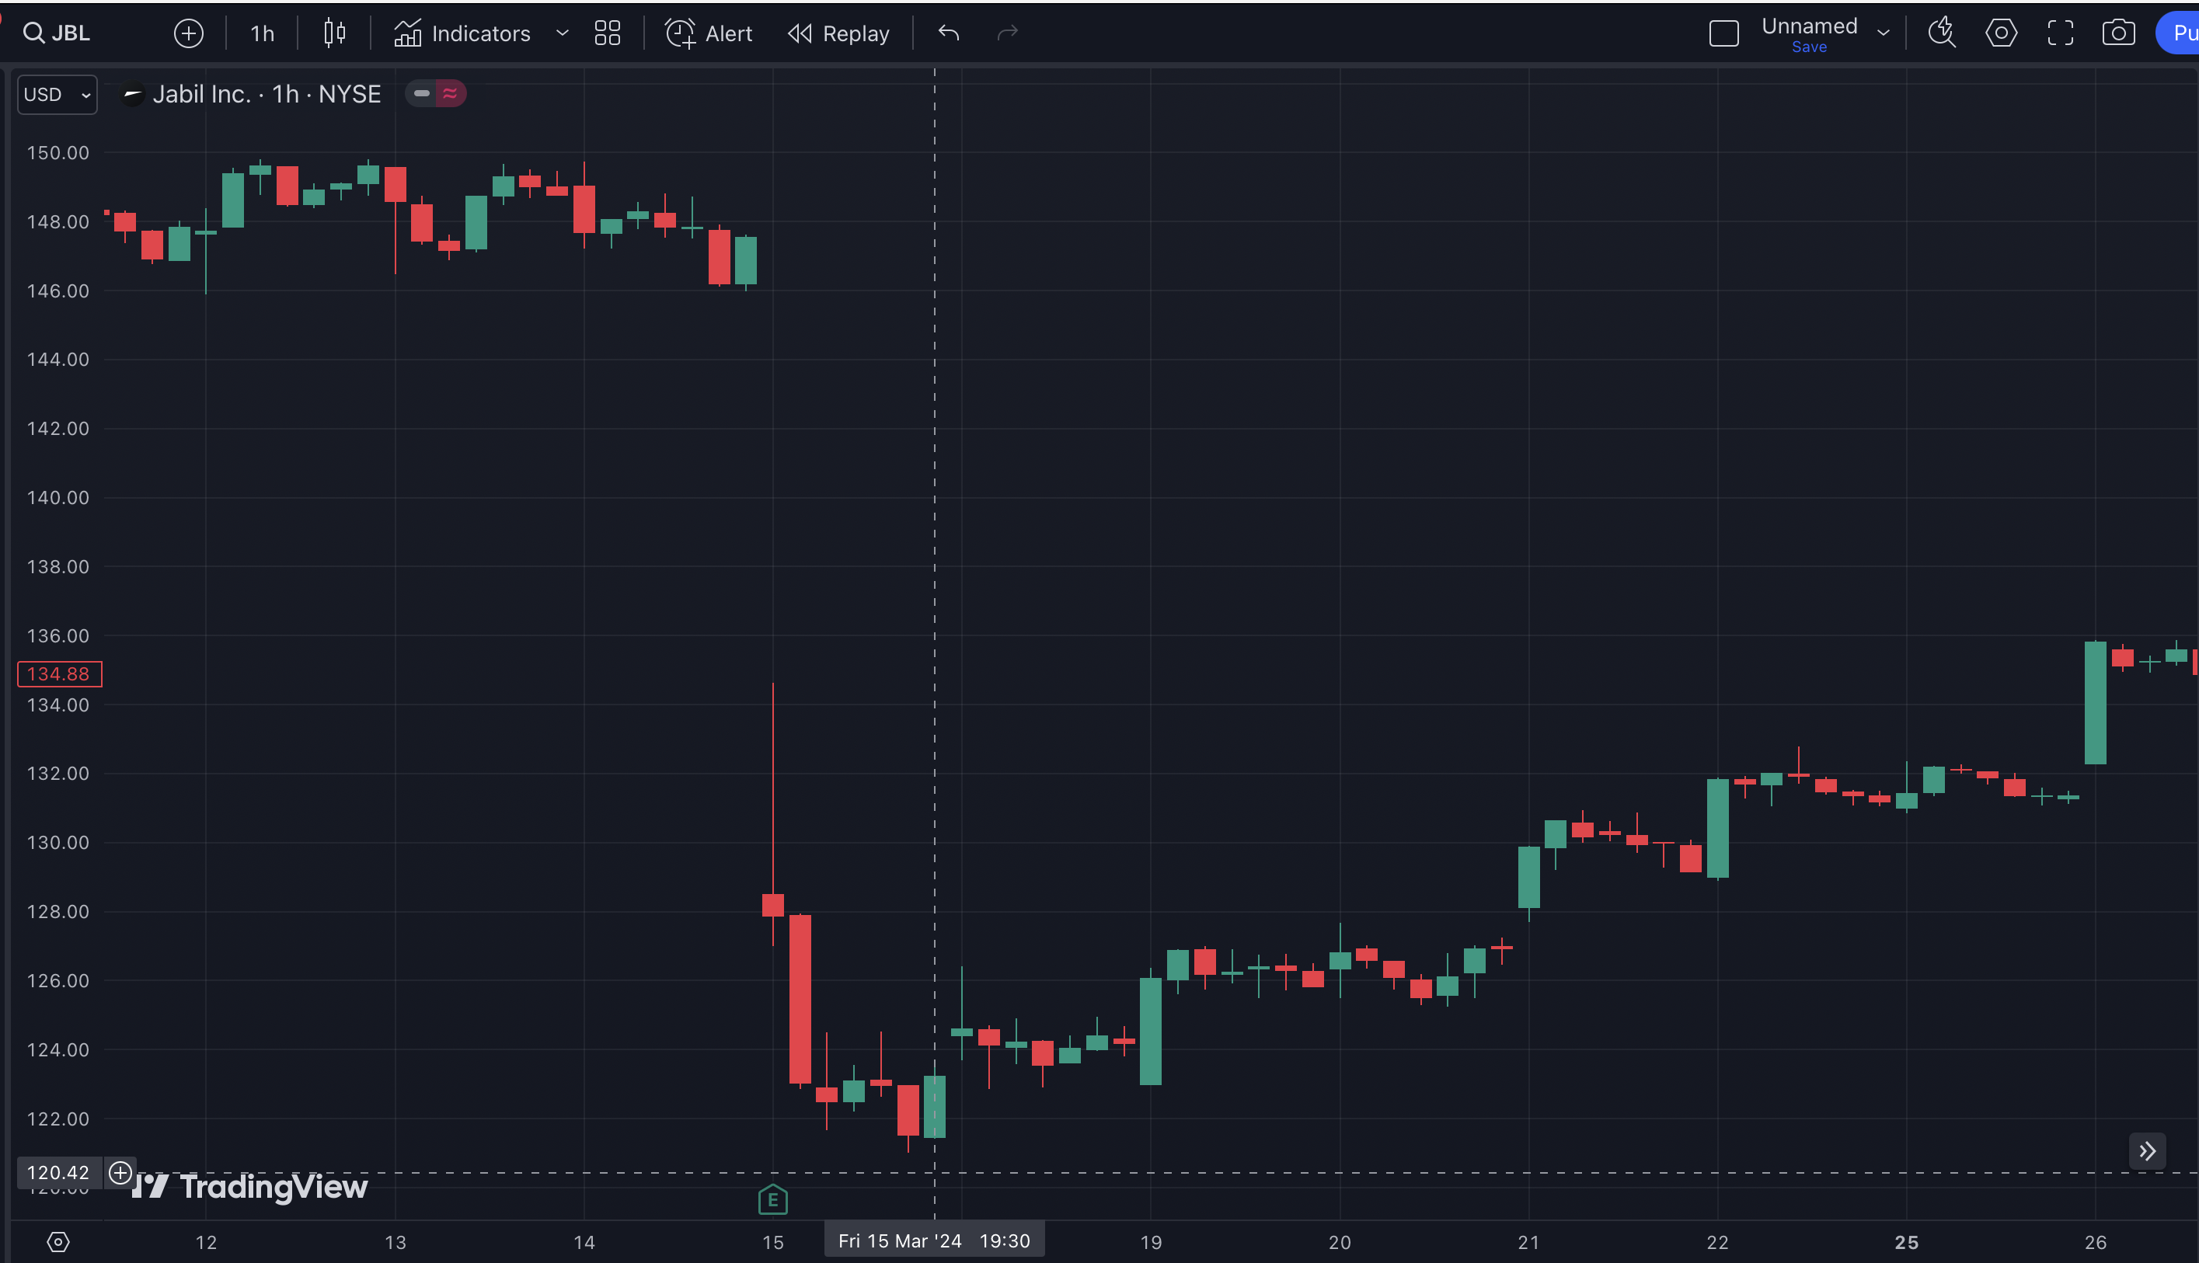
235%
in 11 Days

Slide 70
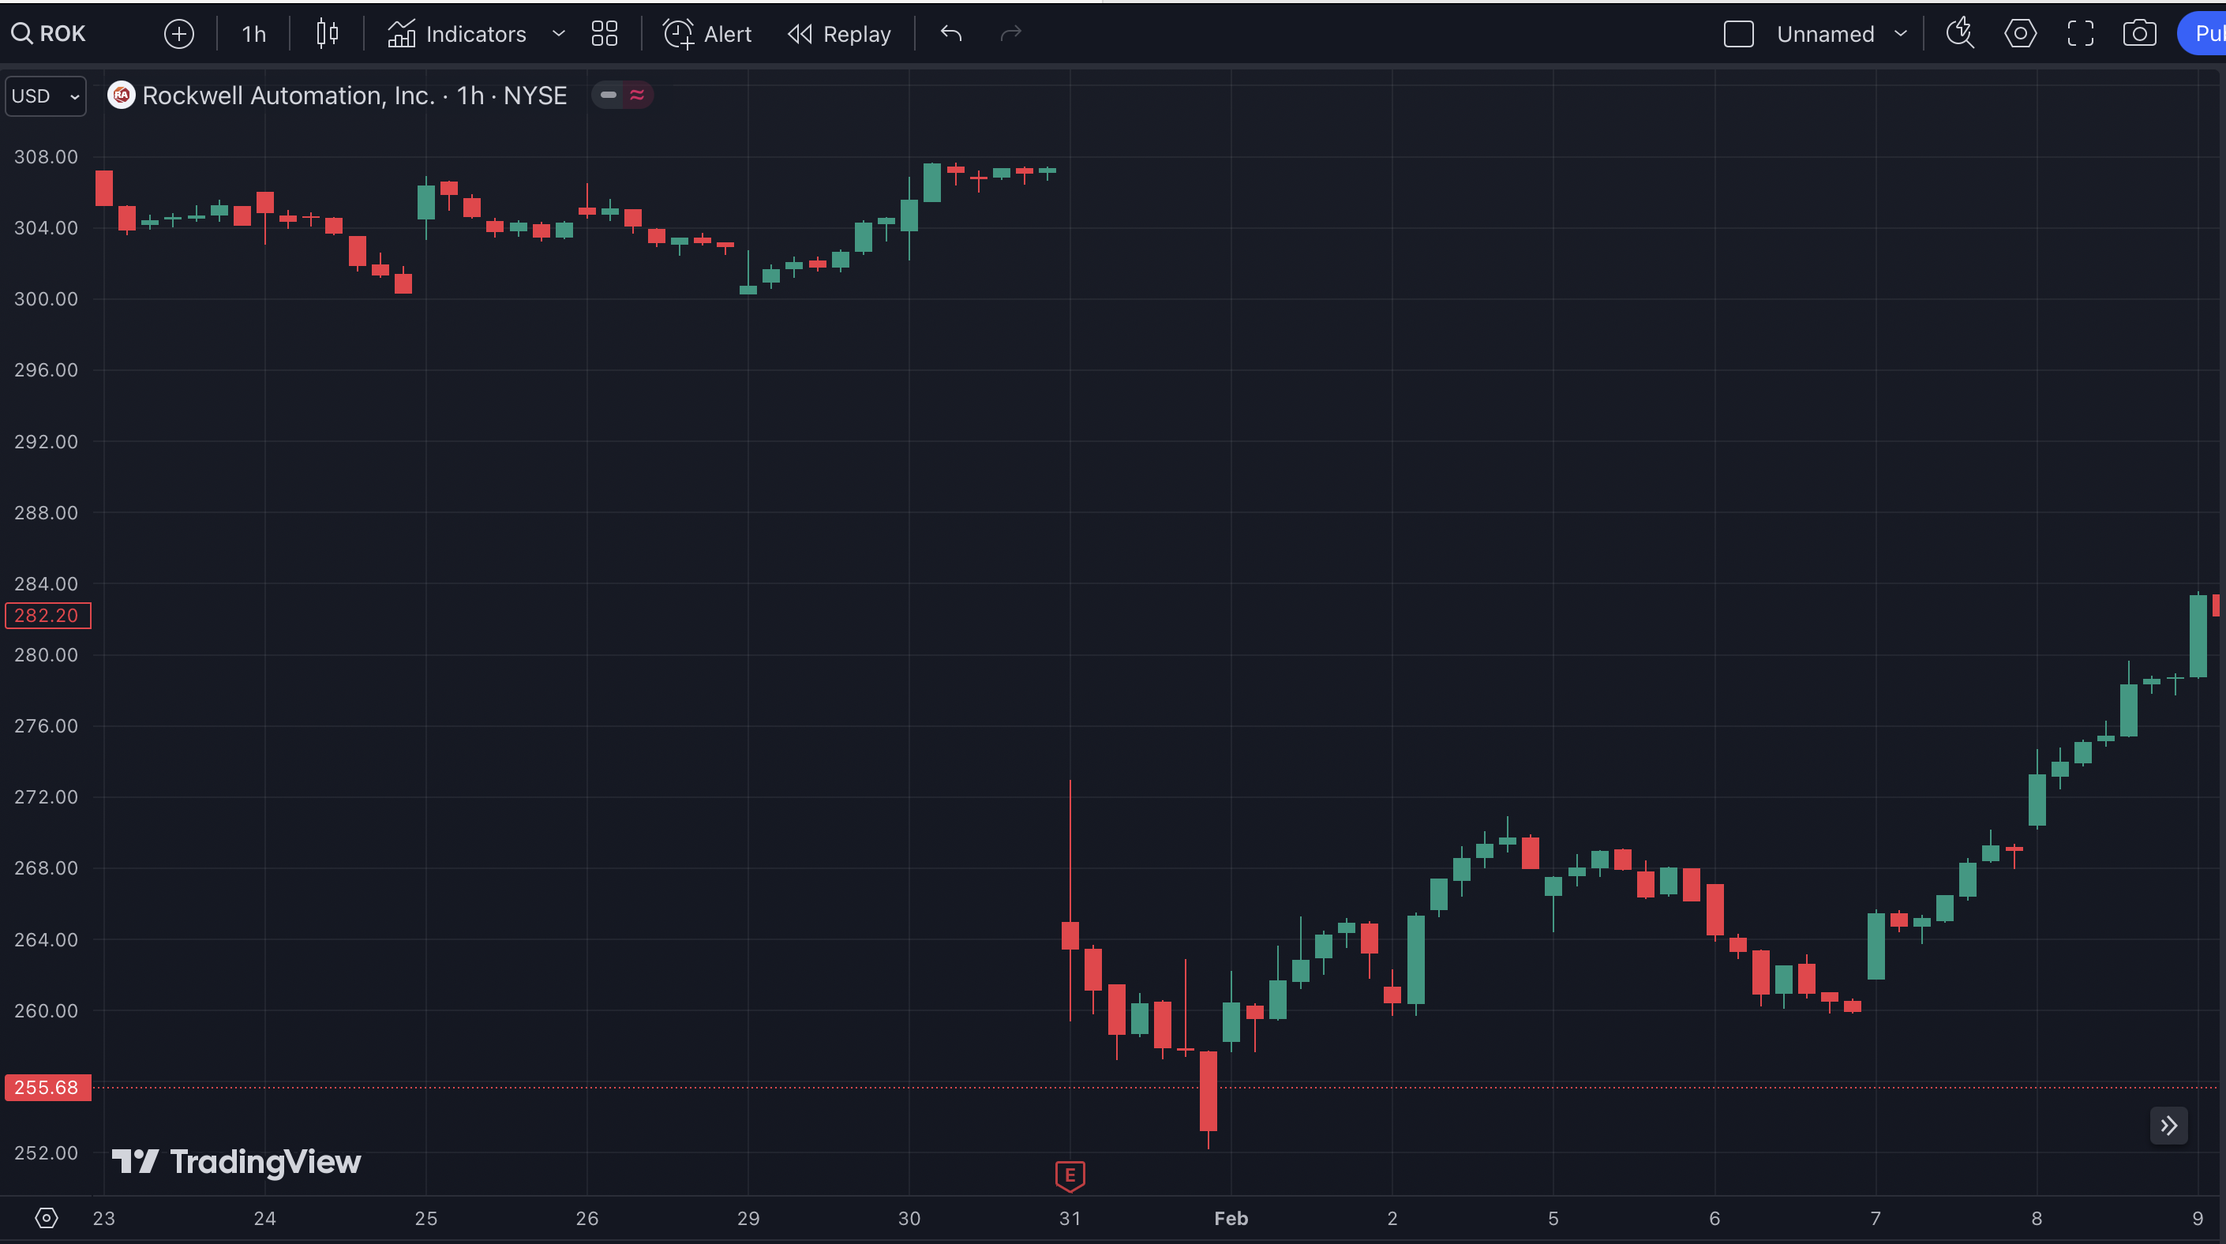
452%
in 8 Days

Slide 71
You’ve Only See Half of the Story!
We’ve Shown You Down Gaps…
But This Works with
Up Gaps Too.

Slide 72
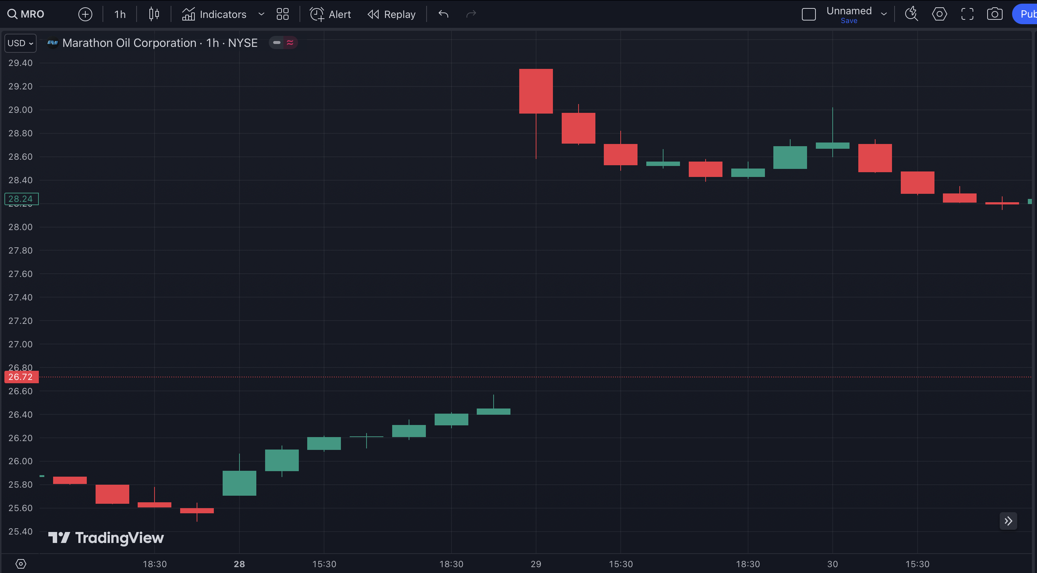
Gap Up

Slide 73
Gap Fill

Slide 74
32%
in One Day

Slide 75
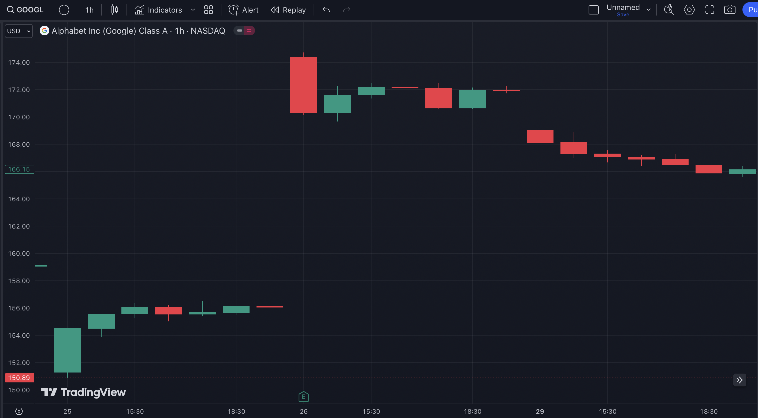
Gap Up

Slide 76
Gap Fill

Slide 77
60%
in 3 Days

Slide 78
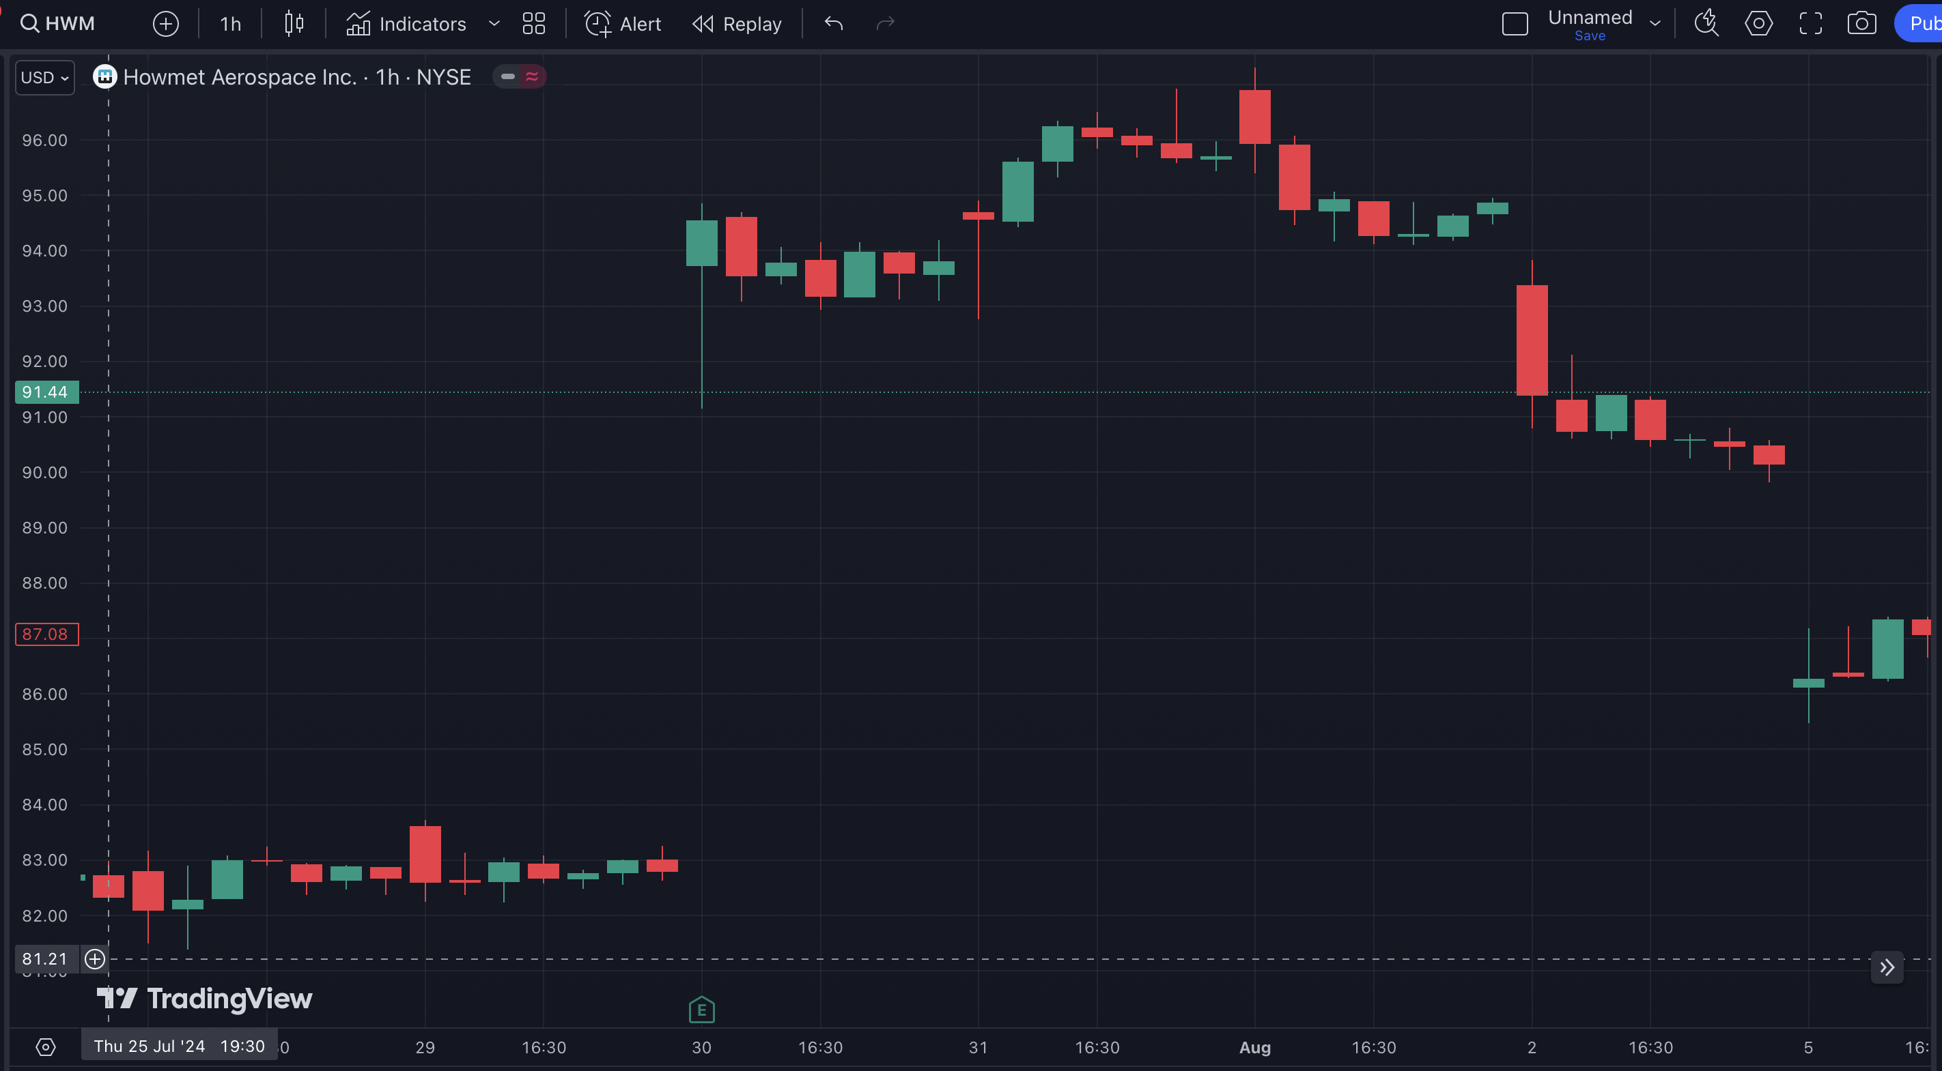
Gap Up

Slide 79
Gap Fill

Slide 80
233%
in 6 Days

Slide 81
This Is The PERFECT Strategy for a Chaotic Market!
Look at these Gift Gaps our system spotted during the most volatile period in the market…

Slide 82
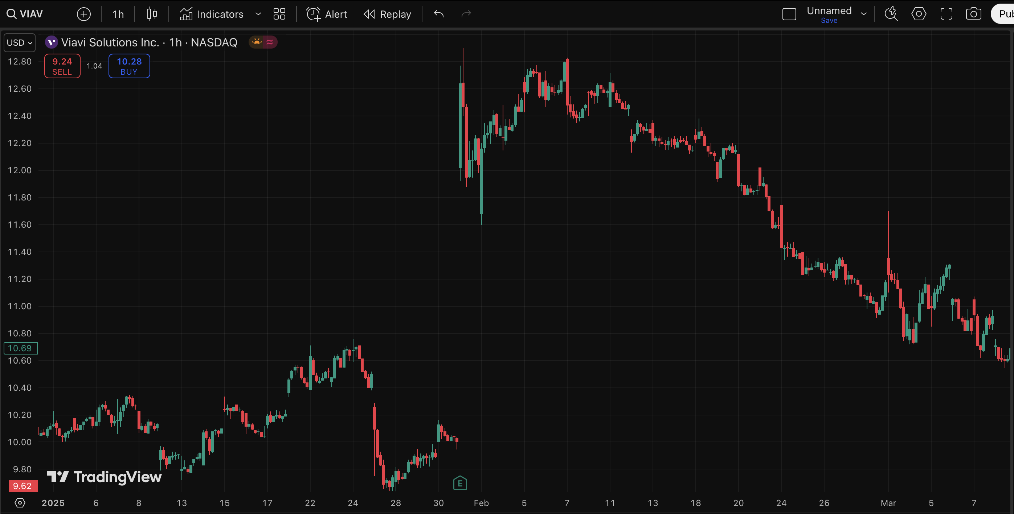
The Gap Happened in February…

Slide 83
200%
in 41 Days
And the Gap Fill!

Slide 84
Gift Gap in Viavi Solutions…

Slide 85
200%
in 36 Days
And the Gap Fill!

Slide 86
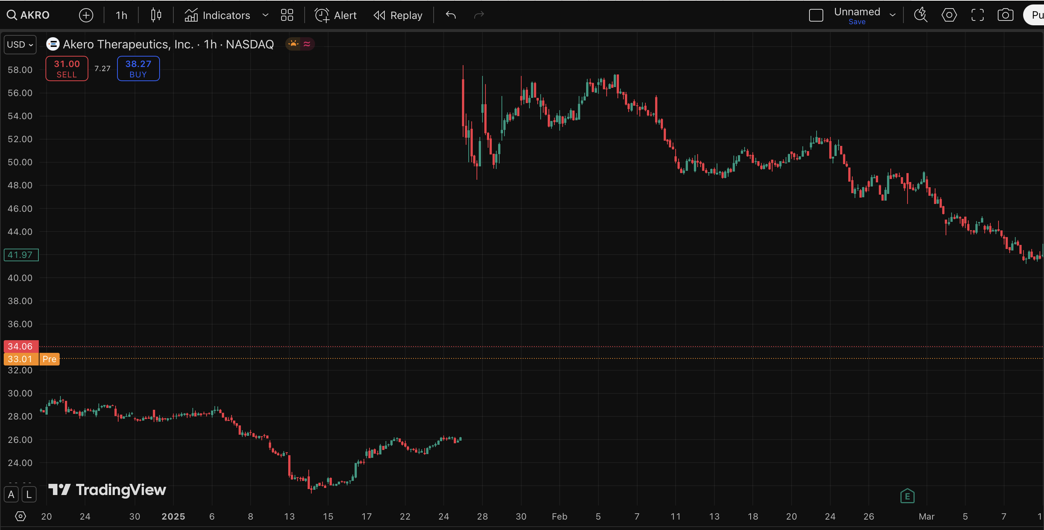
Gift Gap in Akero Therapeutics…

Slide 87
55%
in 41 Days
And the Gap Fill!

Slide 88
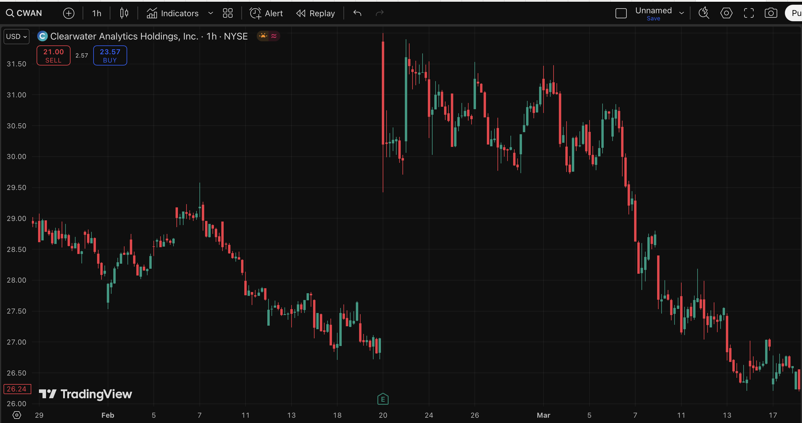
Gift Gap in Clearwater Analytics…

Slide 89
204%
in 26 Days
And the Gap Fill!

Slide 90
We Launched the Gift Gap Scanner in October 2024…
And Our Members Love it!

Slide 91
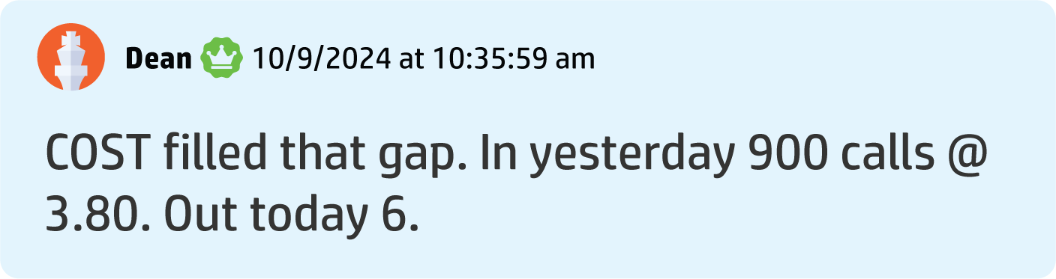
Dean S. made 57% in 1 day

Slide 92
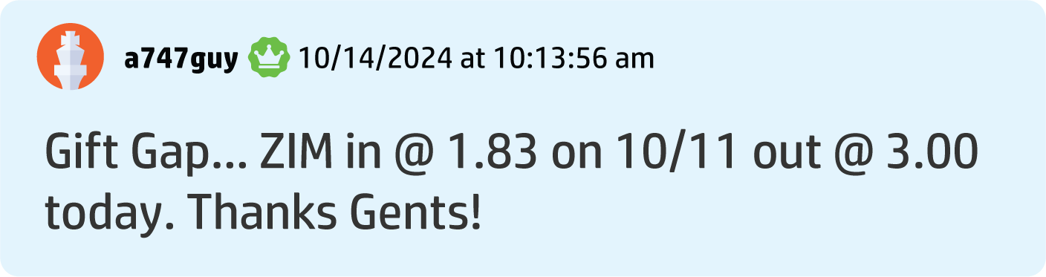
Aaron G. made 63% in 4 days

Slide 93
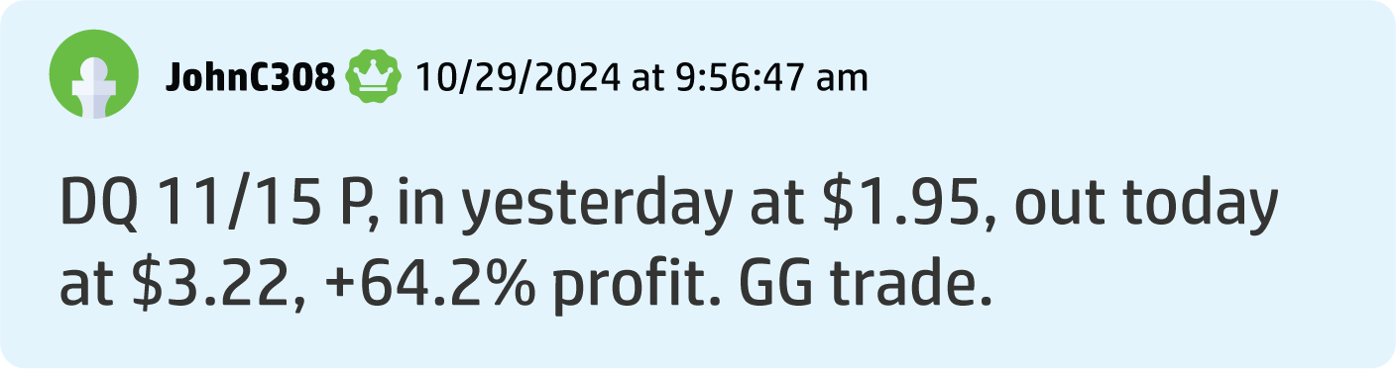
John C. Made a 62% Gain in 1 Day

Slide 94
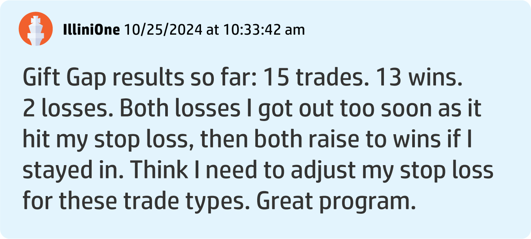
Illini O. made 15 gap trades for 13 wins and just 2 losses.

Slide 95
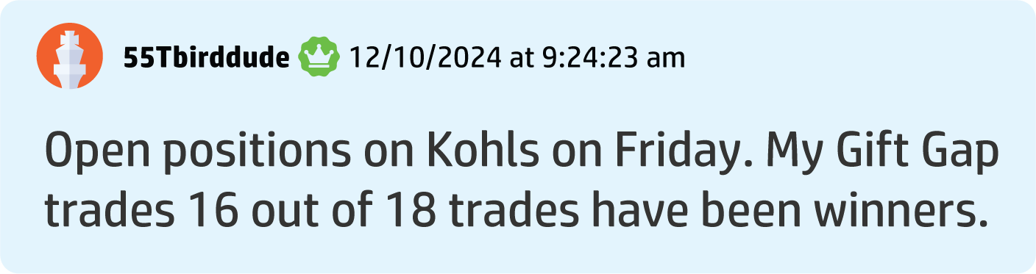
Another Member Says 89% of His Gift Gap Trades Are Winner!

Slide 96
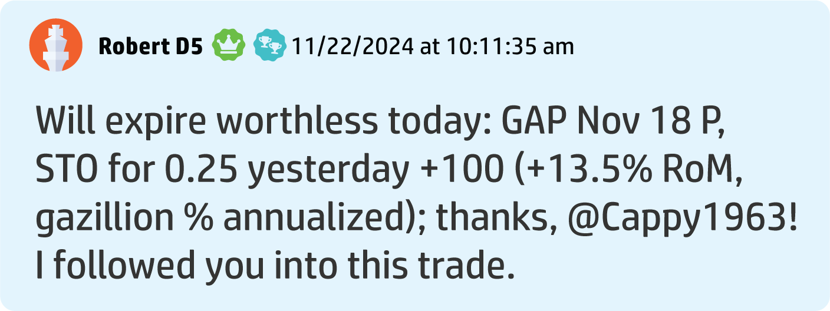
Robert D. banked over a 100% win in 24 hours

Slide 97
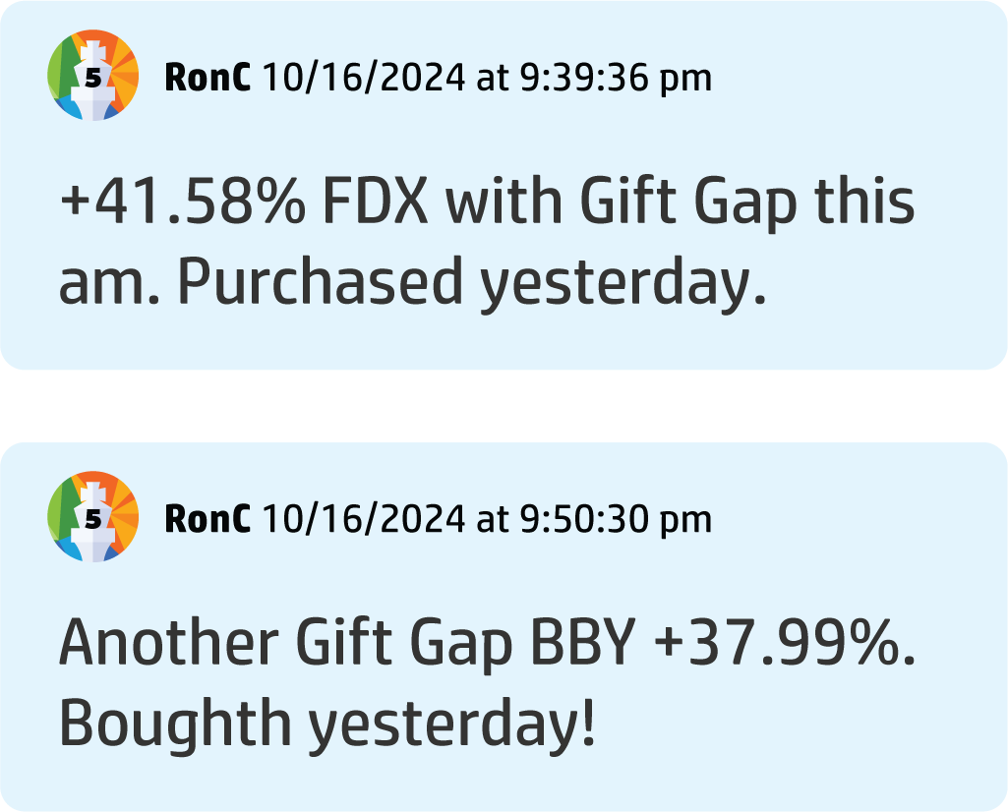
Ron C. made two back-to-back plays: 41% in a day and 37% within two days!

Slide 98
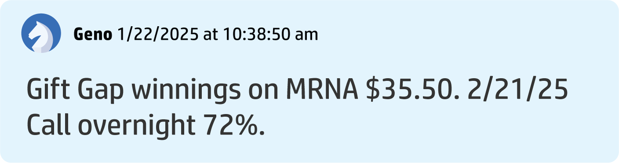
Geno Made a 72% Gain Overnight!

Slide 99
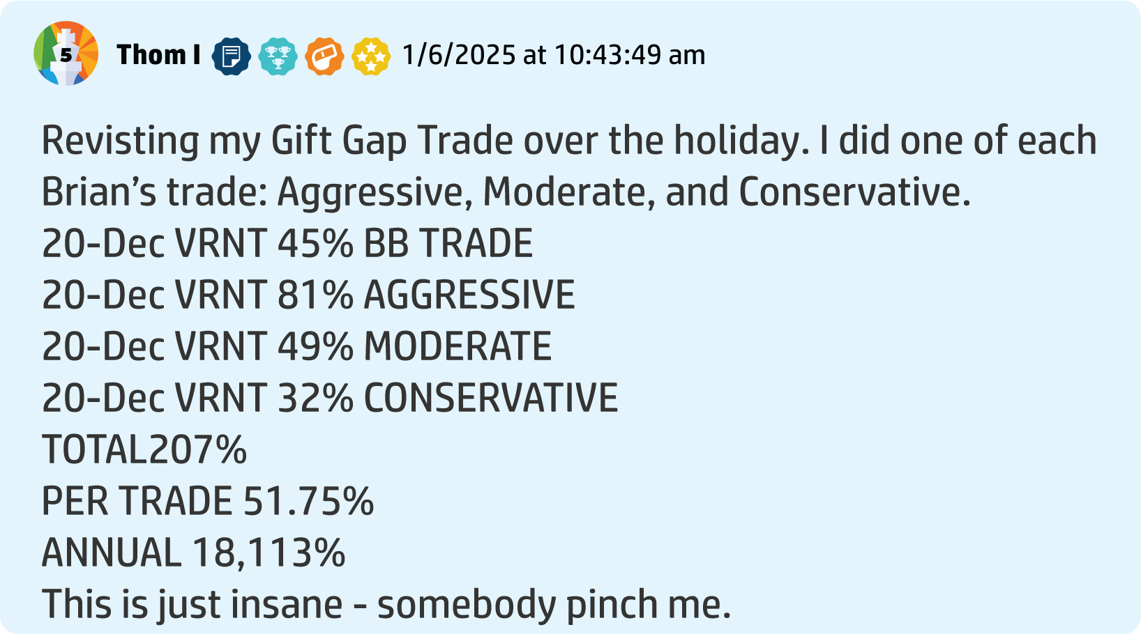
Thom I. Says He Made a 51.75% Average Per Trade in Two Months

Slide 100
Ryan Always Puts New Systems to The Test – Using His Own Money on Gift Gap Trades!
DLTR: 100% in 3 trading days
ALLY: 66.67% in 3 days
BROS: 50% in 14 trading days

Slide 101
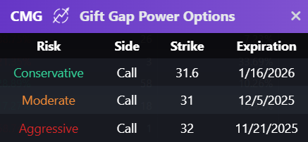
New Bonus Feature Each Gift Gap Now Comes With Power Options!

Slide 102
In Our Launch Demo,
We Gave Away Two Picks Using Power Options

Slide 103
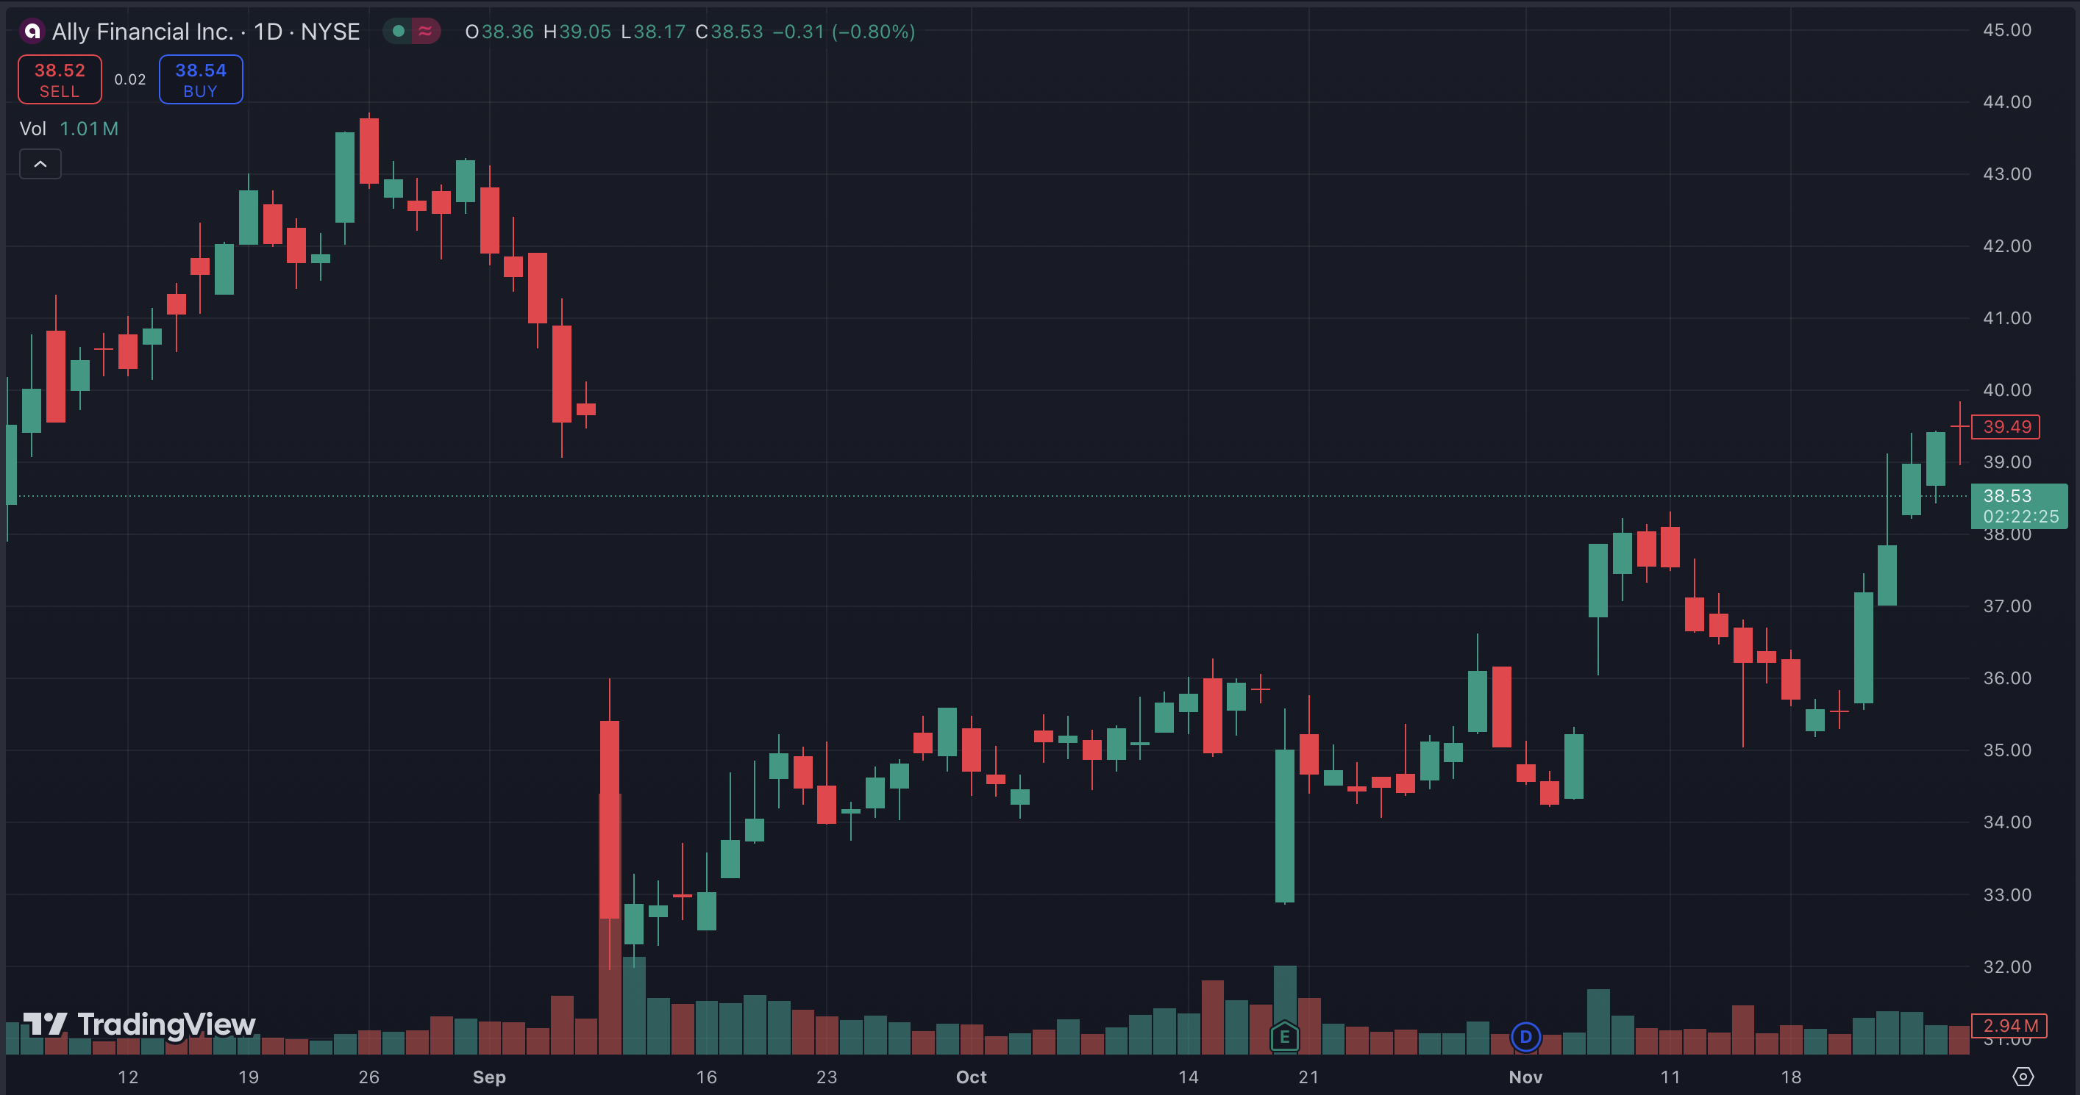
119%
in two months

Slide 104
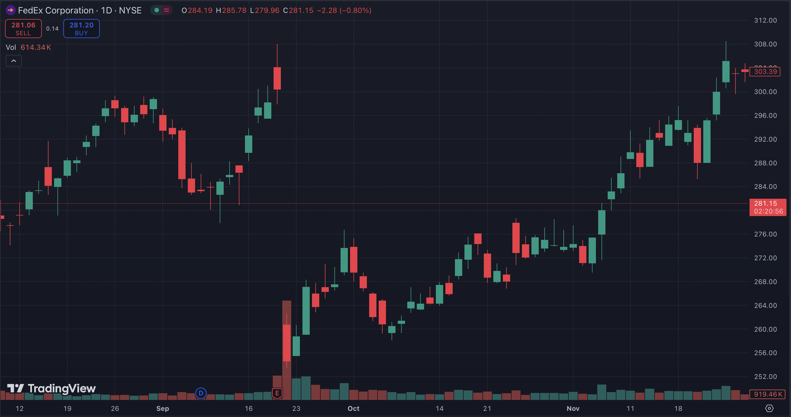
200%
in two months

Slide 105
This is Why We’ve Created The Gift Gap Indicator…
It’s Found Nowhere Else!

Slide 106

Introducing The Gift Gap Scanner
Proprietary Scanner That Automatically Finds Gift Gaps in the Market
Only Recommends a Gap That’s
Being Filled
Tells You How Much of a Gap is Filled

Slide 107
Let’s See It in Action!
“This might be the most profitable feature of ProfitSight we’ve ever created.”– Bryan Bottarelli

Slide 108
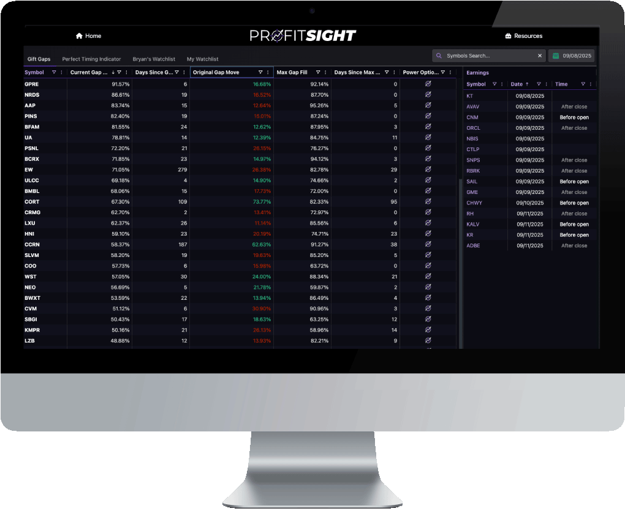
Website DEMO!

Slide 109
Now, You Can Access These Powerful Gift Gap Alerts!

Slide 110
You get alerted to Gift Gap trades – every single day, the instant it’s time to enter.

Slide 111
The New ProfitSight Package
The Perfect Indicator
Earnings tracking
And now… full access to
our brand-new, proprietary
Gift Gap indicator

Slide 112
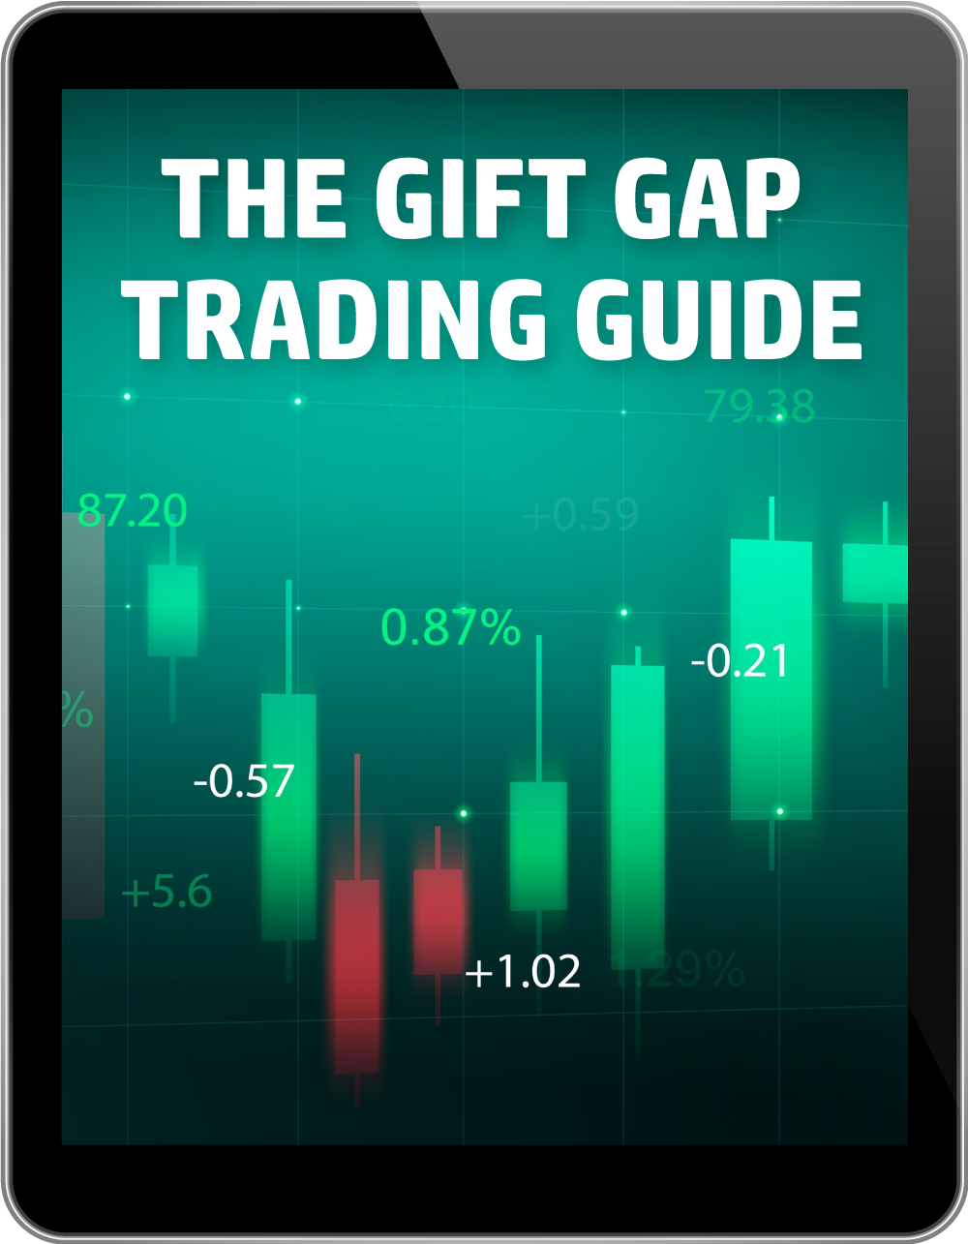
ProfitSight Package
Report – The Gift Gap Trading Guide
Complete breakdown on how to use The Gift Gap software

Slide 113

ProfitSight Package
Video – ProfitSight Quick Start
A complete breakdown on how
to use the ProfitSight website, step by step

Slide 114

Today:
Choose the ProfitSight Level That Works for You
If You Join Today, You WILL NOT Pay the Retail Price

Slide 115

LEVEL 1 | BRONZE
RETAIL PRICE: $3,000/YEAR
Full access to the NEW Gift Gap setups
NEW: Earnings announcement tracker
The Perfect Timing Indicator
Custom alert list

Slide 116
LEVEL 2 | SILVER
RETAIL PRICE: $4,000/YEAR
Everything in Bronze
PLUS Bryan’s Handpicked Watchlist

Slide 117

LEVEL 3 | GOLD
RETAIL PRICE: $5,000/YEAR
Everything in the Bronze and Silver levels
PLUS Power Options with conservative, moderate, and aggressive settings
Conservative
Moderate
Aggressive

Slide 118

Cost of Data:
Included for FREE
on ALL Levels!

Slide 119

Backed By Our
Gift Gap Guarantee
If after your first 60 days, you aren’t 100% satisfied… Call our VIP Concierge Team and we’ll refund your money, minus a 10% processing fee.

Slide 120

Bonus Special
Plus…
Give you a FULL YEAR of
Catalyst Cash Outs Live
(Value: $997)
You’ll get LIVE weekly trades,
every Tuesday at 2 p.m.

Slide 121
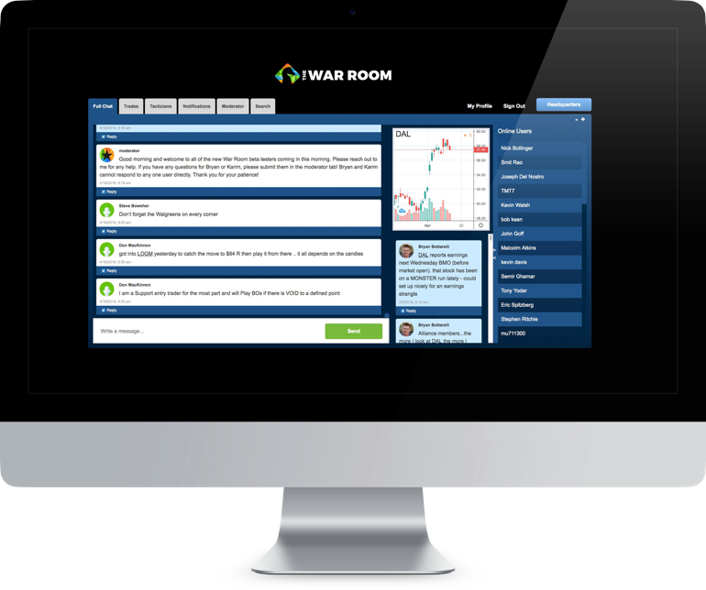
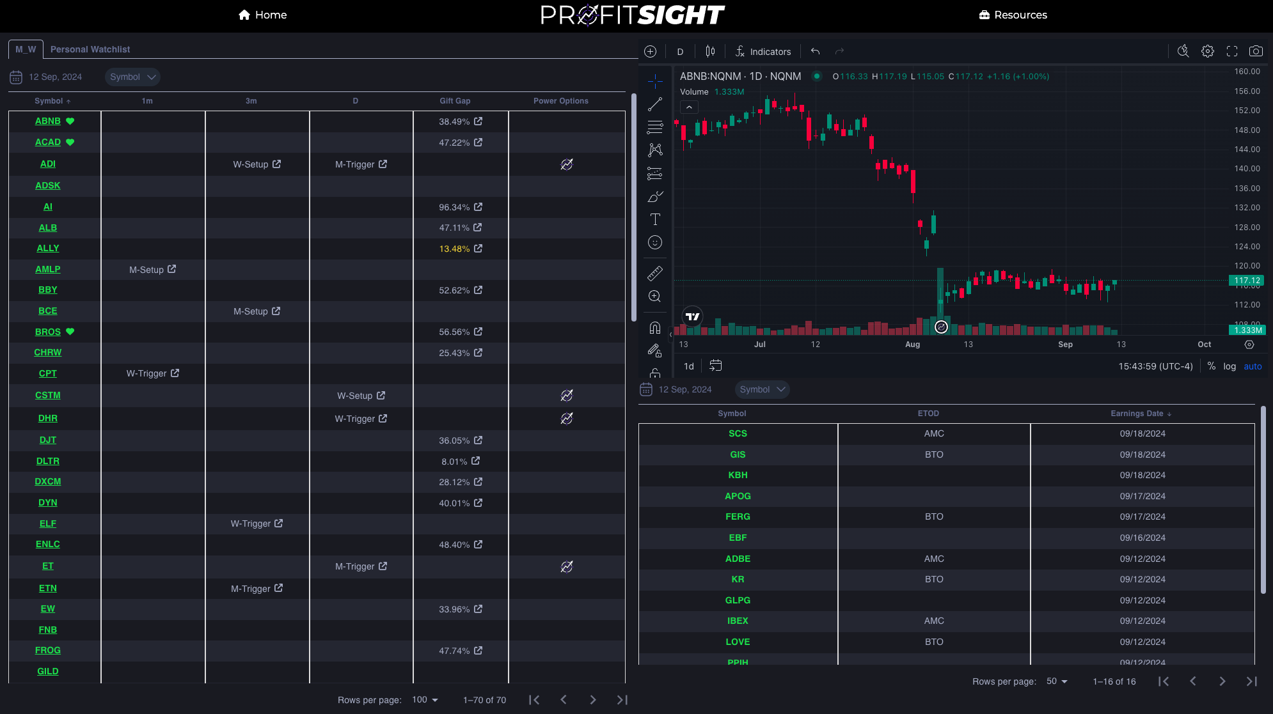
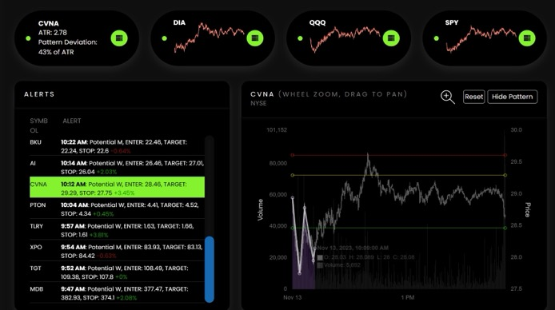
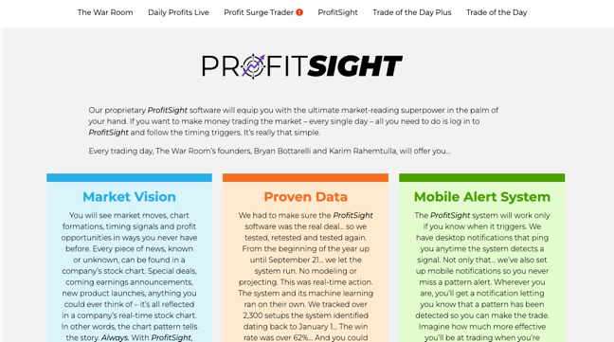

Special ProfitSight Price to Celebrate the NEW Gift Gap Tracker
BRONZE
$3,000 PER YEAR $1,697
SILVER
$4,000 PER YEAR $2,297
GOLD
$5,000 ONE-TIME! $2,797
PLUS…
For Unlimited Access + $199 Annual Maintenance Fee

Slide 122
One Day Gift Gap
Flash Sale!
Discount Code “500GIFT” Takes Additional $500 Off
TODAY ONLY!

Slide 123
ProfitSight Price – TODAY ONLY!
SPECIAL BONUS: Save An Additional $500 OFF Until Midnight: USE CODE: 500GIFT
BRONZE
$3,000 PER YEAR $1,697 $1,197
SILVER
$4,000 PER YEAR $2,297 $1,797
GOLD
$5,000 ONE-TIME! $2,797 $2,297
PLUS…
For Unlimited Access + $199 Annual Maintenance Fee

Slide 124
ProfitSight Price – TODAY ONLY!
SPECIAL BONUS: Save An Additional $500 OFF Until Midnight: USE CODE: 500GIFT
BRONZE
$3,000 PER YEAR $1,697 $1,197
SILVER
$4,000 PER YEAR $2,297 $1,797
GOLD
$5,000 ONE-TIME! $2,797 $2,297
PLUS…
Q&A
For Unlimited Access + $199 Annual Maintenance Fee
Click the button in the chat or call 888.215.5311 to order by phone or ask questions!

