Slide 2
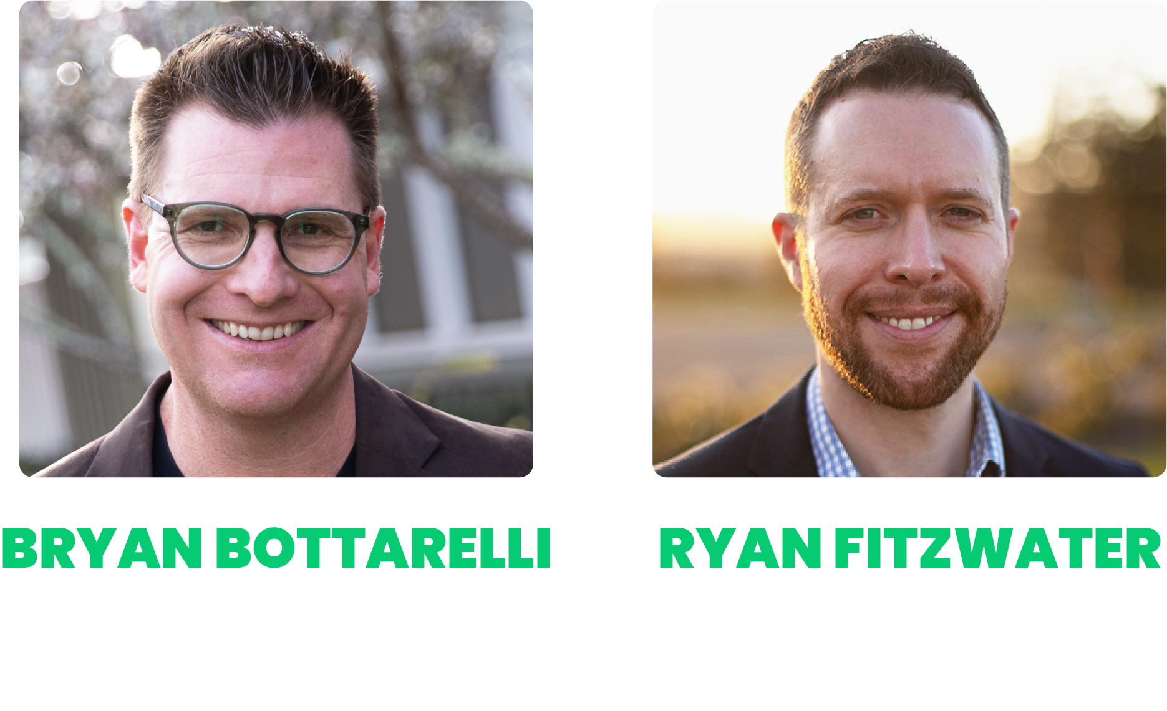

Welcome to
The Cash Code X Live Trading Event
AI Developed Trading Technology
How to Target 11X Gains in a Year with 70% Accuracy!
Stay tuned for our live Q&A at the end of the event

Slide 3
Housekeeping!
This is a skillset, and you need to pay attention during the following course material.
Shut the door
Turn off Slack, YouTube, or whatever else could distract you
Close Facebook
Phones on silent mode
Kick out the kids, grandkids, etc.
You took the time to be here… this is important, now focus on being here!

Slide 4
Disclaimer
Risk is a part of all investing. You should never invest more than you can afford to lose.
The software points out when a green arrow appears according to our metrics, but that should not be considered an automatic buy or sell recommendation. You should do your own due diligence before entering any trade.
We’ll show you the top examples we’ve found looking back, but individual results will vary. We will also show the results of our backtest on the Nasdaq 100 tracking the indicator’s performance since 2019.

Slide 5
Agenda
How Recent AI Breakthroughs Created Cash Code X
Why Bryan and Ryan call it “Cash GPT”
Stock gains up to 1,047% in a year… and 49X since 2019!
Option gains up to 1,463% in less than 3 months
Data from Nasdaq 100 going back to 2019 showing indicator precedes wins with 70% accuracy
$1.3 MILLION from ONE ticker since 2024 (“Weird” Way to make 25X)
Live Demo of Cash Code X… including live setups
Live Q&A

Slide 6
What is Cash Code X?

Slide 7
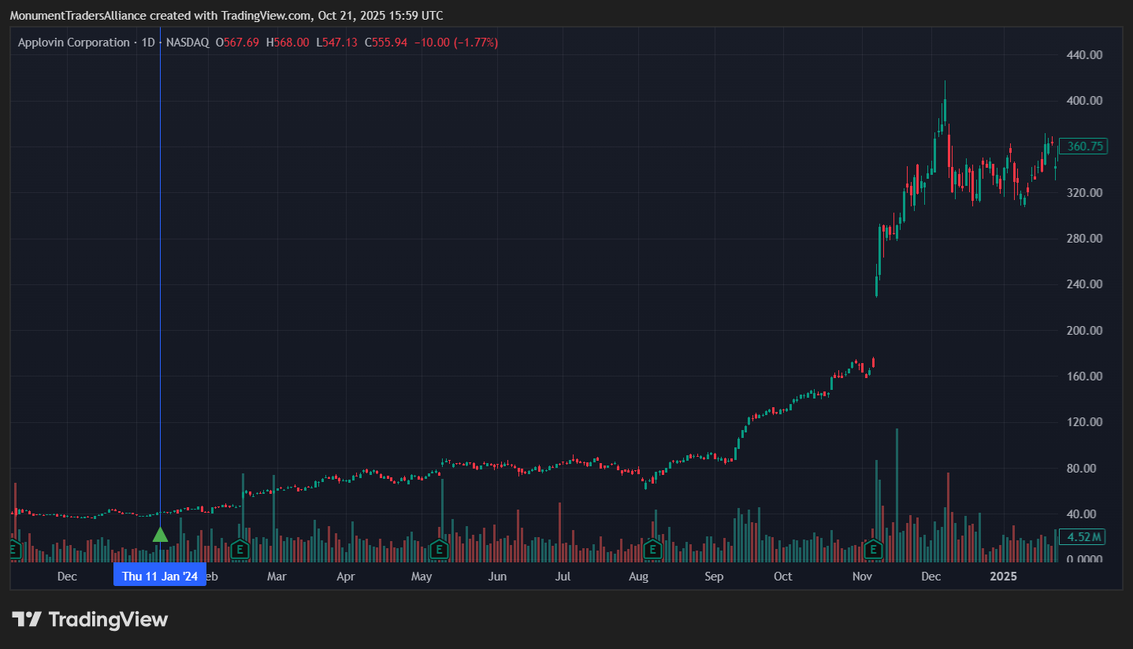
Apploving (APP)
Take a look at this chart…
Would have been to have been in BEFORE that surge, right?

Slide 8
With Cash Code X
Green Arrow January 11 when stock was around 40

Slide 9
676% Gains!
No options… One year gains!

Slide 10
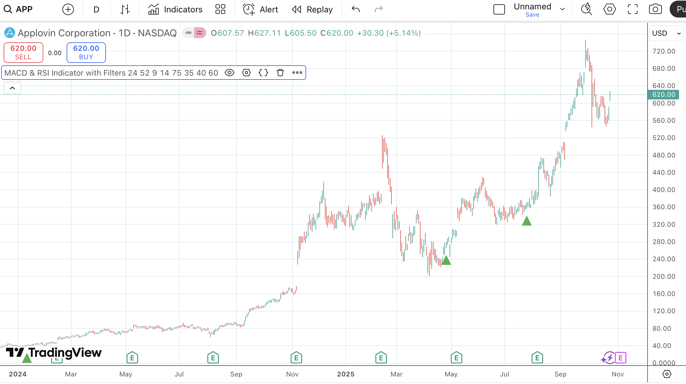
Continues to Soar… 17X Gains!
Stock kept going!
That’s 1,650% gains…
On a STOCK… without options!

Slide 11
How is this Possible?

Slide 12
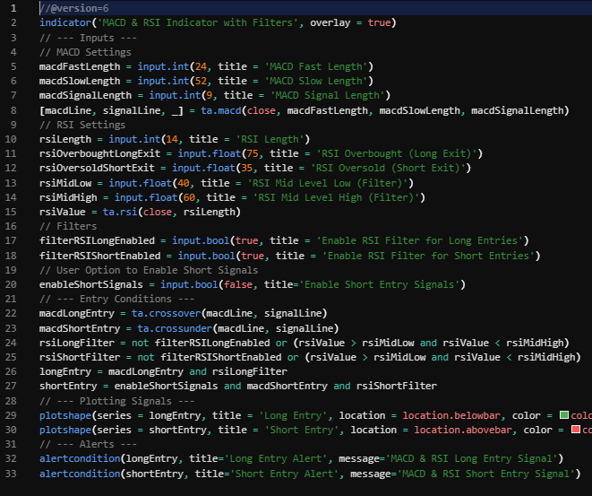
Developed with AI

Slide 13
AI Has Reached a Whole New Level
Changed from model of AI that just learned to perform complicated tasks
Now AI is what experts call a “thinking model”
Gave the AI ability to evolve
Solves problems more like humans do
Create their own problem solving process

Slide 14
Train AI to Play “Go”
Go is an ancient Chinese game similar to checkers but much more complex
More possible board positions than the number of atoms in the universe
Even with all the computers in the world run for a million years – couldn’t calculate all positions
Google’s Deepmind team trained an AI called AlphaGo to play the game

Slide 15
“Strange” AI Learning
At first… just gave it a bunch of data from humans playing matches
Allowed AI to find patterns
But then… they made a copy of AI
And let AI play itself
It could do millions and millions of matches
It learned by doing… not just data

Slide 16
AI Did The Unthinkable
Tested against a human player with 18 world championships
Even though chess had fallen to AI and Jeopardy had fallen to AI… people thought Go was too hard (or even too “human”)
Good players say they rely on “intuition” to win – even Google thought AI would lose
During the match, AI made a move so surprising -- the spectators and the opponent thought it was a mistake
Later in the match… the human player resigned

Slide 17
The AI’s “Mistake” Move
Researchers evaluated the match… and the win went back to the “weird” move
It made a move that NO human had ever done on record in ANY game
Was an original thought from AI – and the human team couldn’t even explain how the computer came up with such an original strategy
Huge evolution of AI
And that’s the kind of power we have at our disposal now

Slide 18
AI Is Even MORE Powerful Now
To win the match… AlphaGo used 280 GPUs
GPU’s are specialized chips capable of performing simple calculations in staggering quantities
With their Microsoft partnership -- OpenAI now has access to supercomputers with thousands and thousands of GPUs
They cranked it up to 10,000 GPUs… and fed it all the data in the entire internet

Slide 19
We Used AI to Create Cash Code X
The first few versions of our indicator did NOT work
We couldn’t find the right combination of indicators that would predictably find the stocks that were set to surge
But with the power of AI… we were able to find the perfect combination

Slide 20
The “Code” of Cash Code X
From there…
We also used AI to create the code to use to flag the EXACT moment the stock was set to surge

Slide 21
Cash Code X Would NOT Have Been Possible 5 years ago…
Or even 2 years ago!

Slide 22
Available Now ONLY Because of the Power of AI

Slide 23
Let’s look at some past stock setups Cash Code X could have found

Slide 24
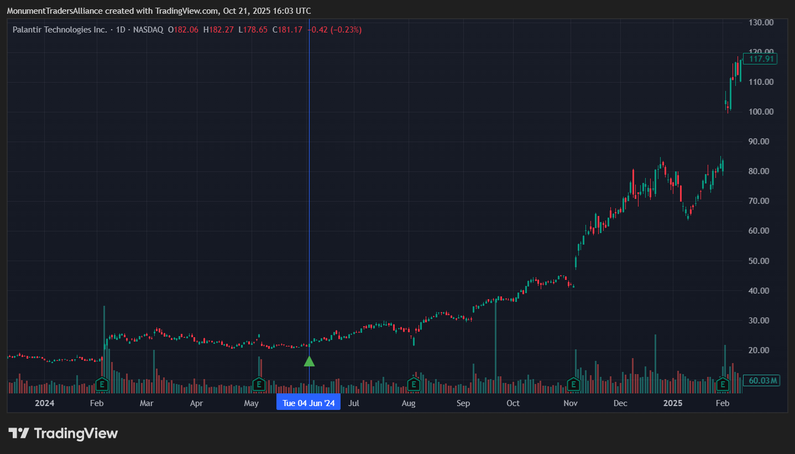
Palantir (PLTR)

Slide 25
With Cash Code X
Green Arrow June 24 – stock around 20

Slide 26
229% Gains in 6 Months!
By December… 229% Gains

Slide 27
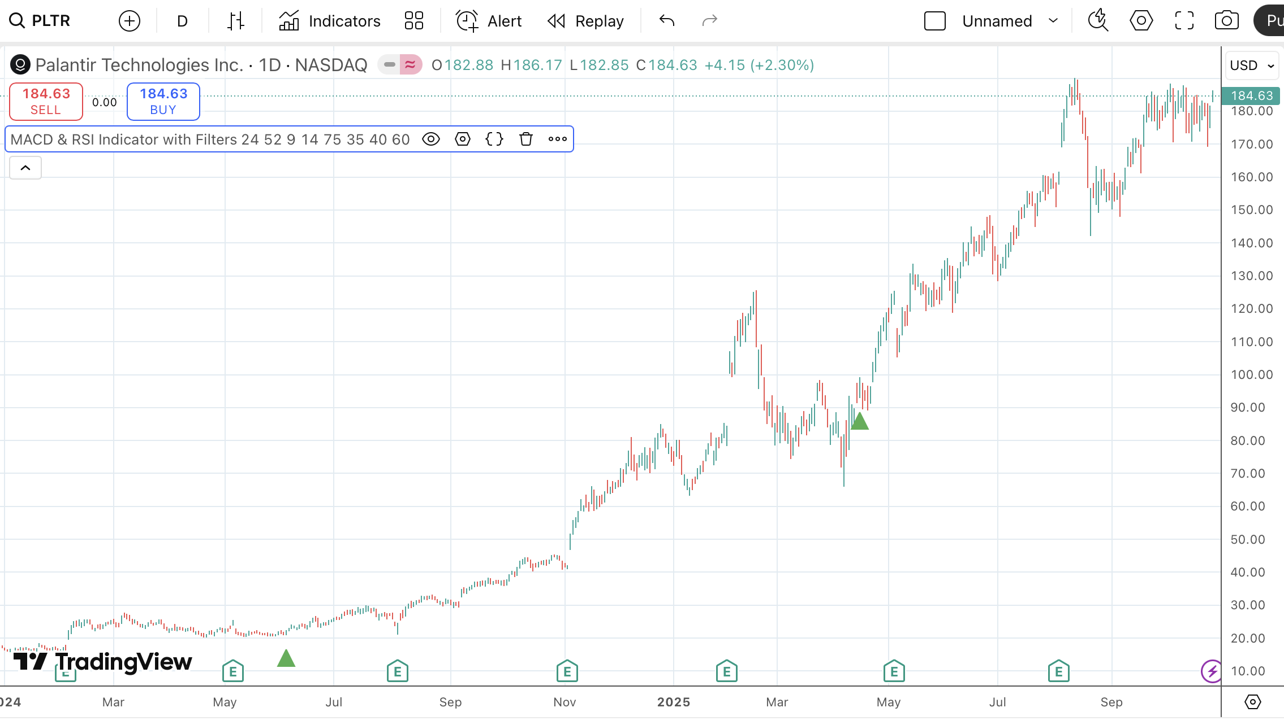
9X Gains!
From there…
Been as high as 850%!
$1,000 turns to over $9,500…
$5,000 to over $47,000!

Slide 28
$47,000?!?
That’s why we call it
CASH-GPT!

Slide 29
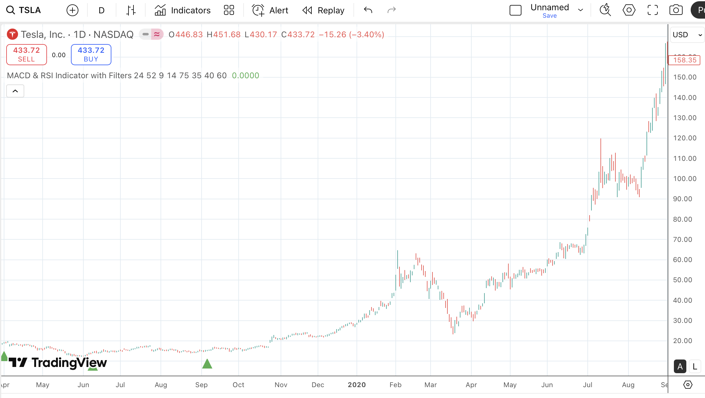
Look at Tesla…
Green Arrow showed up in 2019
Stock soared over 1,000% in just one year!
Turned every $1,000 into $10,000!

Slide 30
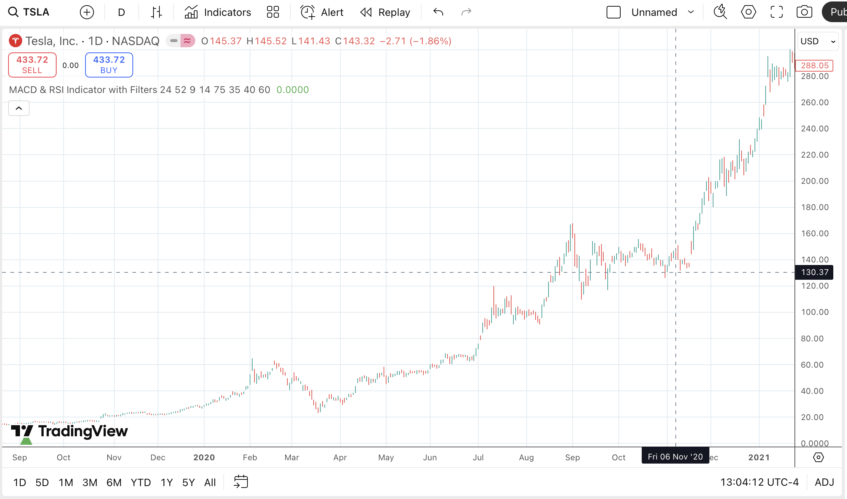
Over 20X Gains
But it didn’t stop there…
Went up to over 2,000% gains by 2021

Slide 31
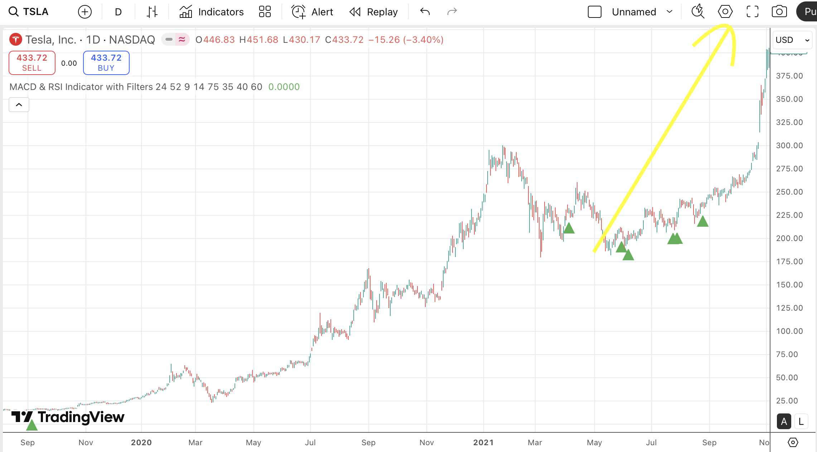
Buying the Dip = Bonus 100%!
Look at the green arrows from April to August
It was SCREAMING to buy MORE Tesla during the dip
$1,000 during the dip…
Would have nearly DOUBLED by November!

Slide 32
$5,000 When the Green Arrow Flashed Would Have Grown to Over $100,000 in Just Two Years!

Slide 33
What is making the Green Arrows?

Slide 34
Cash Code = Momentum
It’s all about a MOMENTUM SHIFT
AI helped us find the BEST way to track momentum
Key: MACD (Moving Average Convergence Divergence)

Slide 35
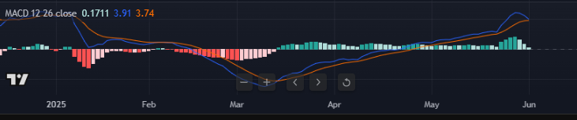
X Marks The Spot
Look for two Moving Averages (fast and slow) to cross over
That lets you know the trend has changed
That’s our X!

Slide 36
But the AI Secret Sauce…
Added RSI to boost probability
Filters out oversold and undersold conditions
That was the key that made this Cash Code X work…
And gives us the ability to spot stock surges BEFORE they happen

Slide 37
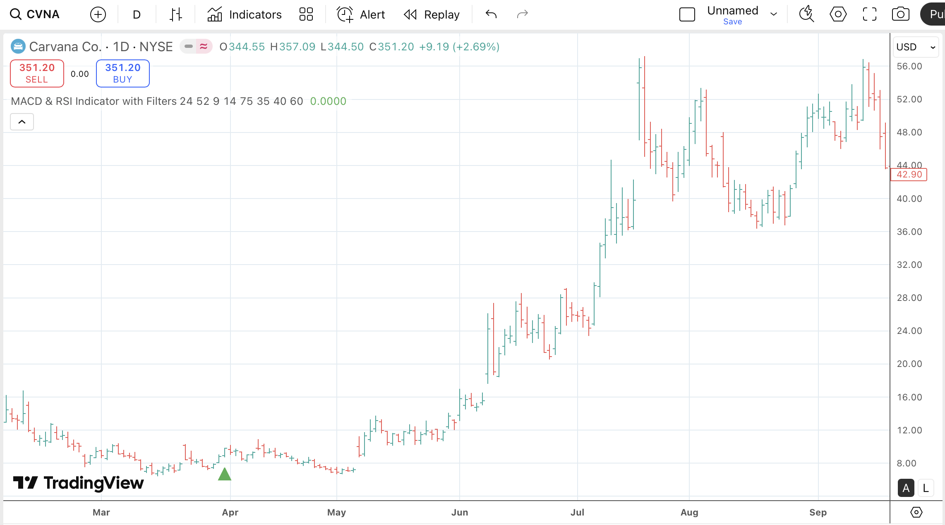
Carvana Went Parabolic after Green Arrow
Green arrow flashed
Stock went from $33 to $259 in a year

Slide 38
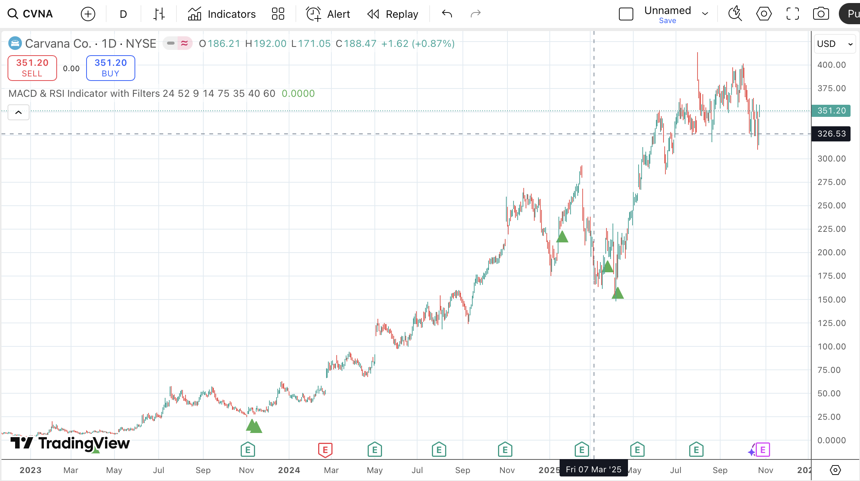
12X Gains!!
Went all the way to $400
That’s 1,100% gains under 2 years!
Gave multiple places to buy more!
This is dip buying on steroids!

Slide 39
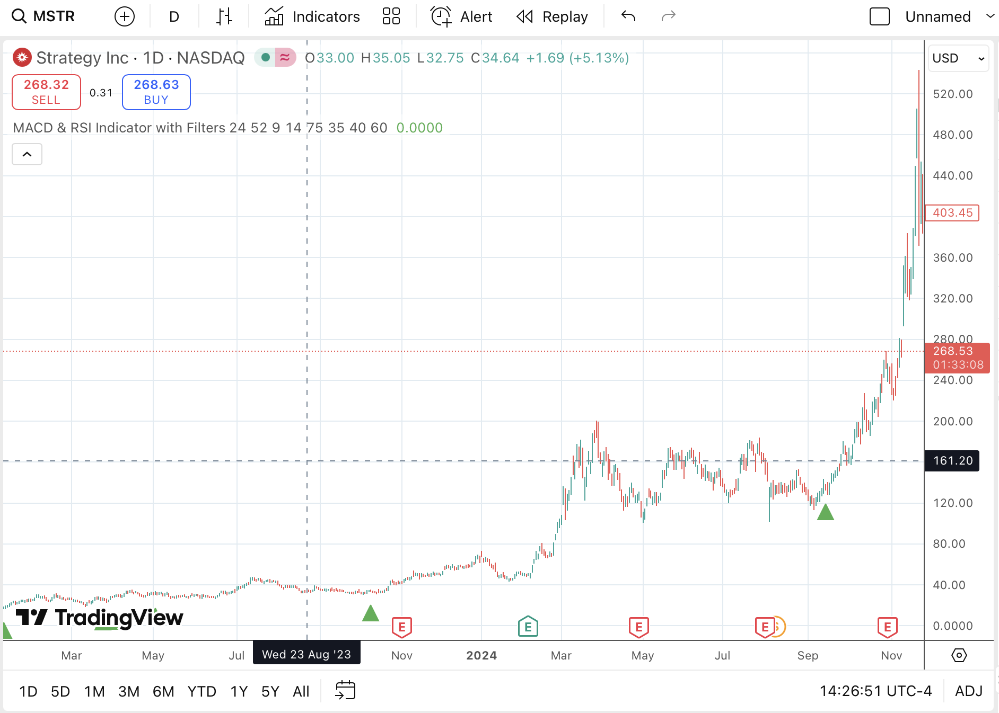
Strategy Inc – 1,800%!
Green Arrow showed up in 2023
Stock went from $28 to $164 in a year
Went on to make as much as 1,812% gains
in about a year and half!

Slide 40
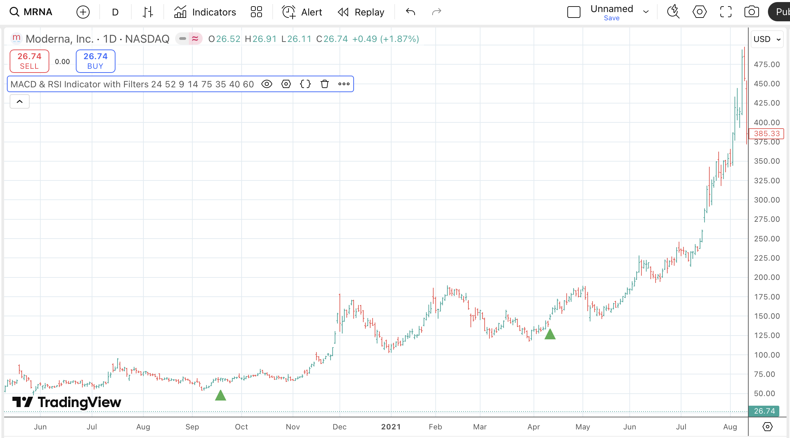
Moderna Over 500%!
Green Arrow showed up in 2020
BEFORE stock shot up over 506% in just one year!

Slide 41
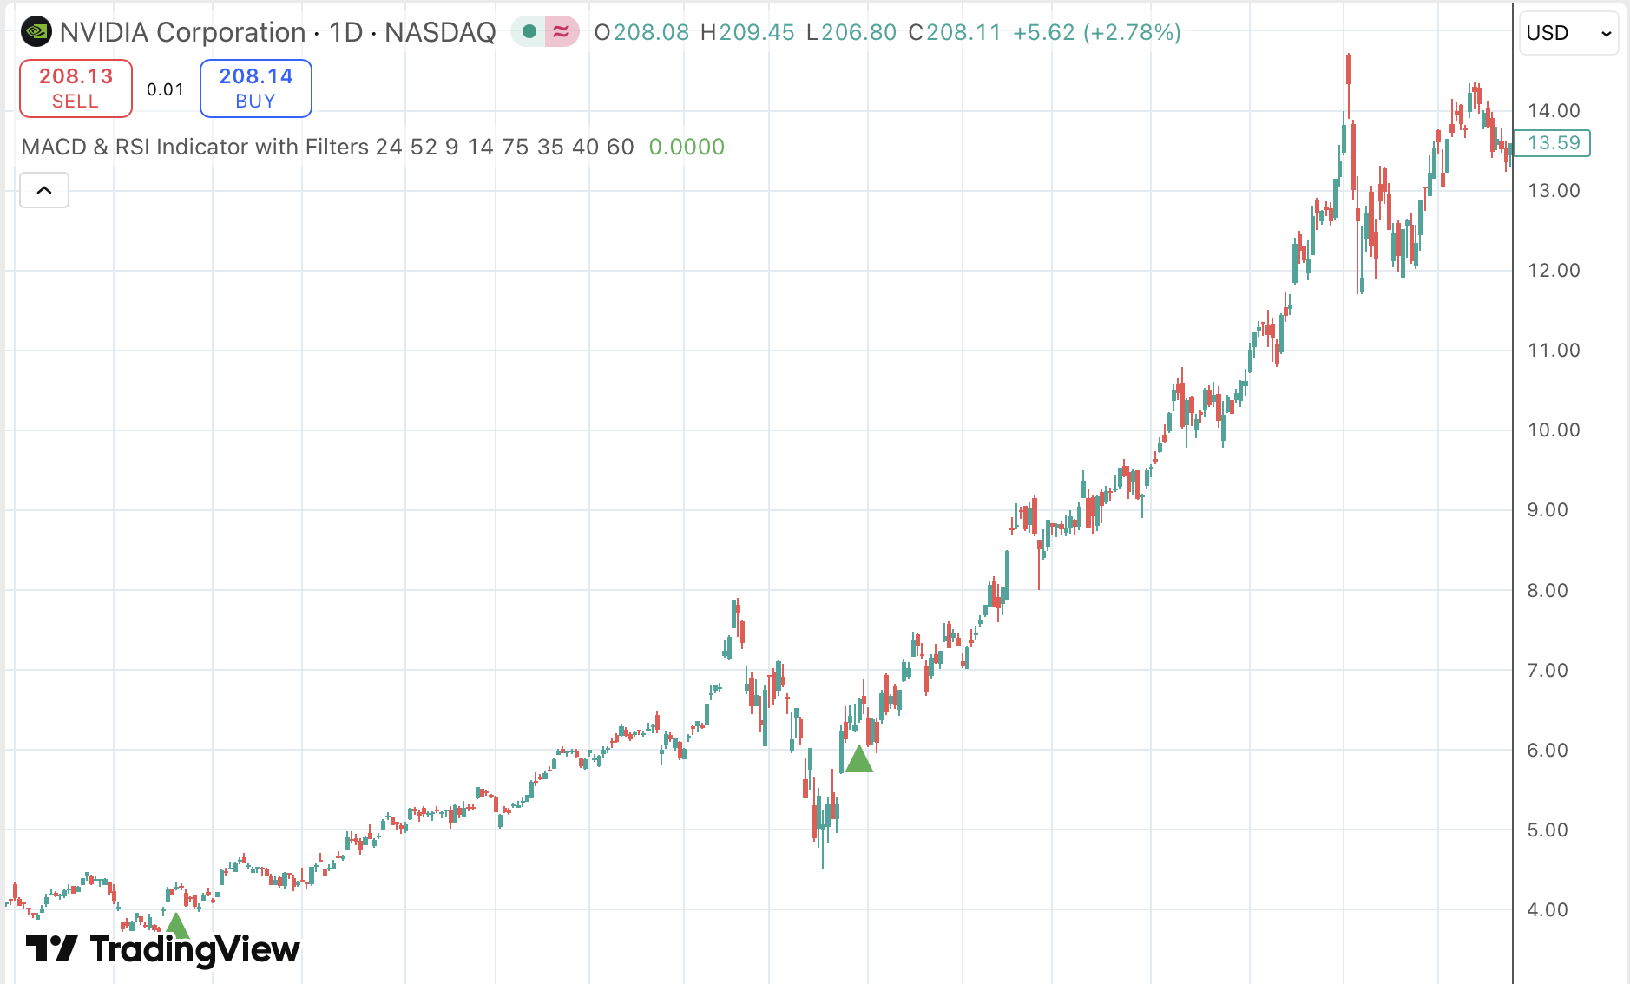
Nvidia… at $4!
Cash Code X even spotted Nvidia back in 2019
Green Arrow showed when the stock was just $4.28
BEFORE stock shot up over 180% in just one year…

Slide 42
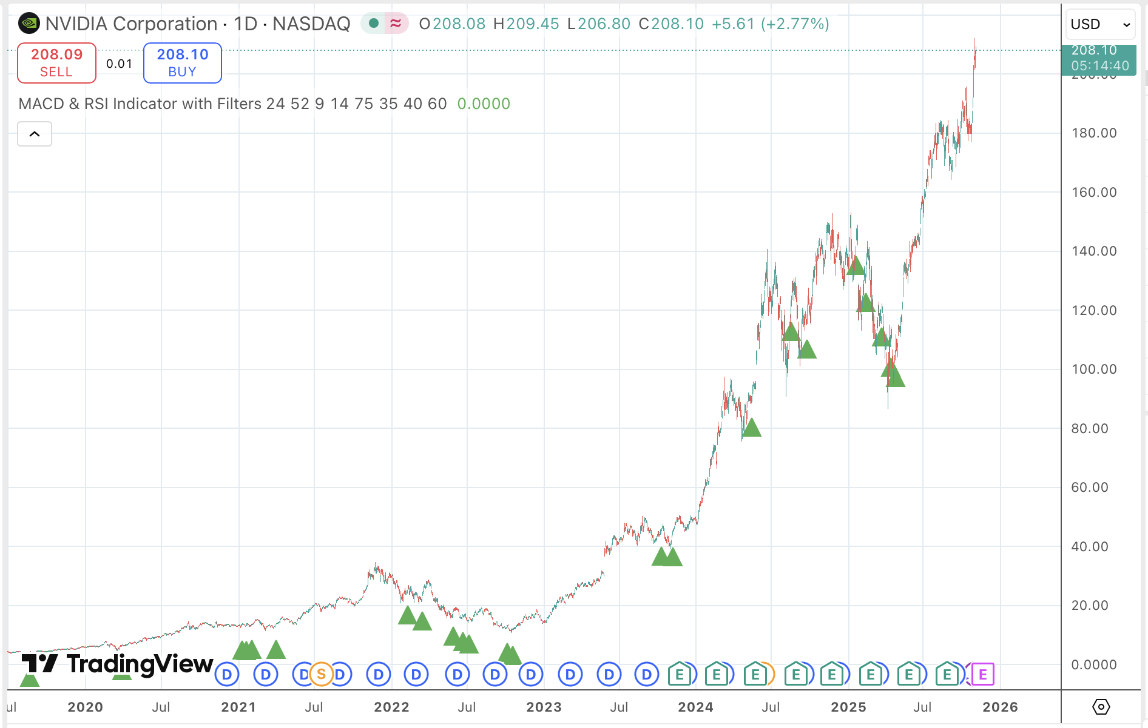
Stock Up 49X Since Then!

Slide 43
What about Options?

Slide 44
Options Multiply Big Moves into Even BIGGER Gains
This is PERFECT for using options
Once you see a green arrow… you could choose to buy an option
You could look at options with three month, six month, or even one year expirations
Helps you go for BIGGER gains… even FASTER!
Let’s look at some examples using three month options…

Slide 45
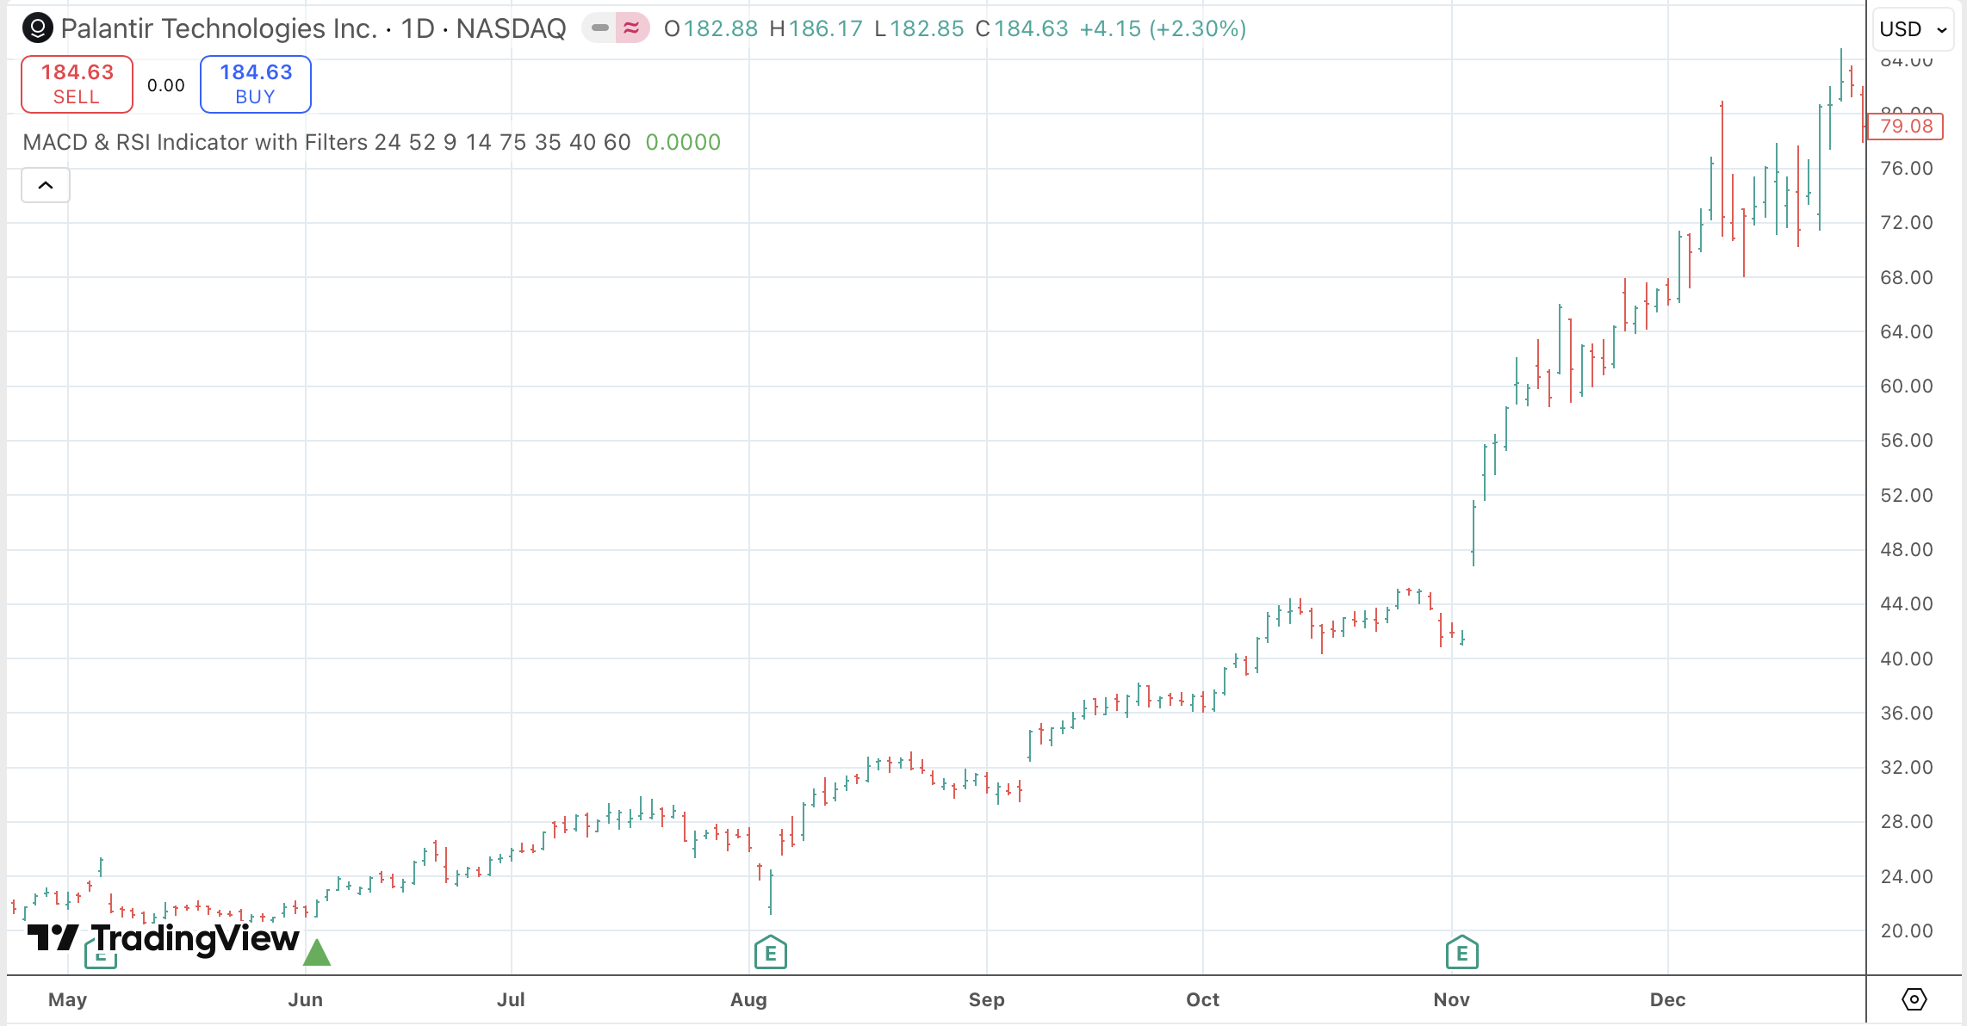
Boost Gains 8X!
Green arrow appeared on Palantir
Stock moved 65%...
But options shot up 548% in three months
That’s more than 10X higher than the stock move!

Slide 46
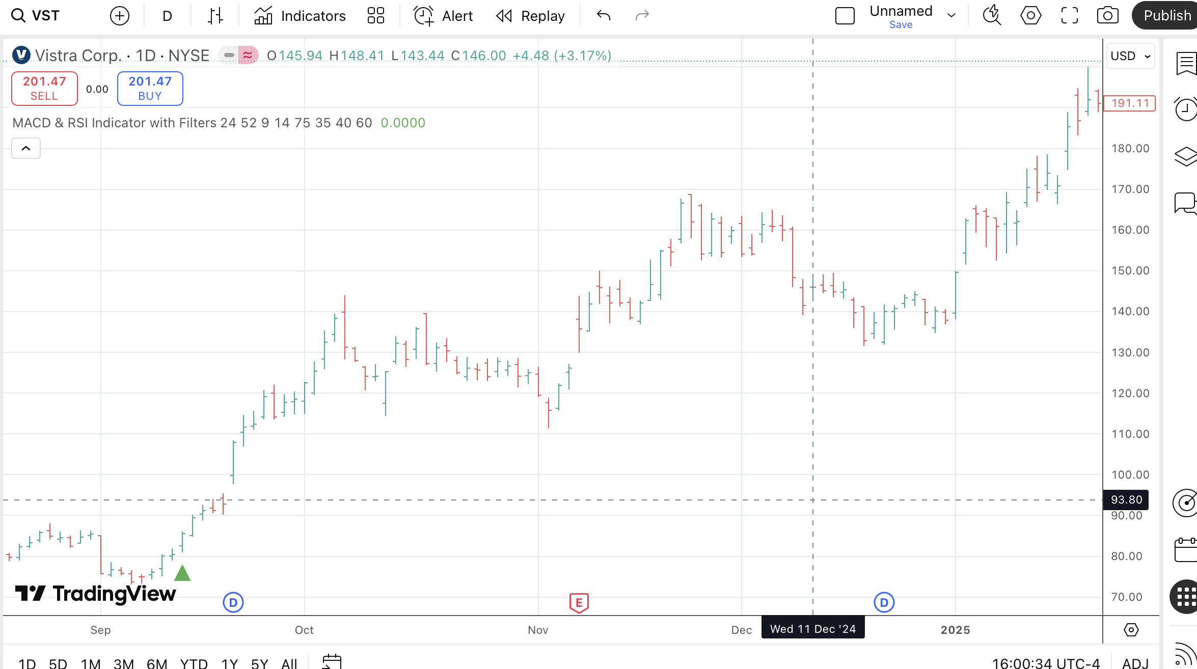
Vistra Corp – 7X Returns!
September 13th green arrow appeared
Stock moved 89% by November
Options moved as high as 605% in that time!

Slide 47
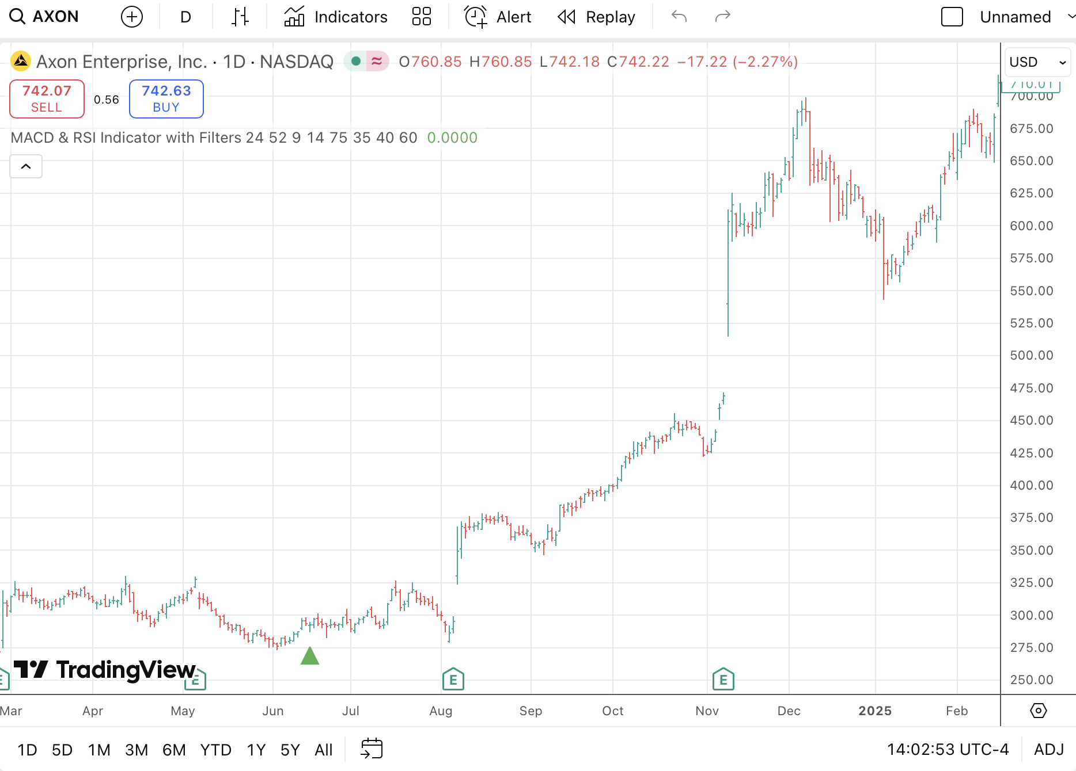
434% from Axon!
Cash Code X flashed Green on AXON
Stock moved 32%
Options moved 434%!

Slide 48
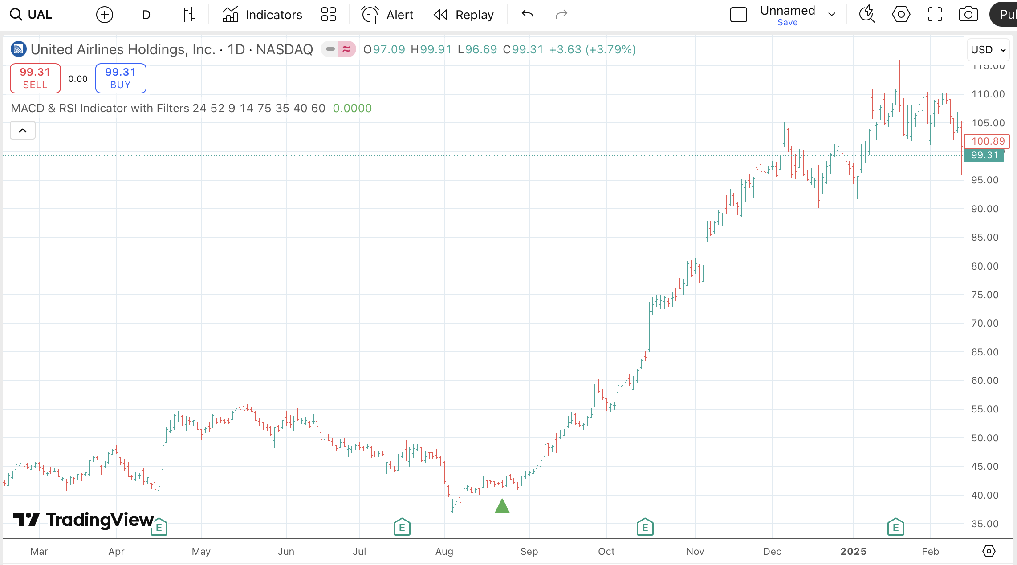
1,463% in three months!
Green arrow appeared on United Airlines
Stock moved 120%
Options moved 1,463% in just three months!
That’s enough to turn $5,000 into more than $78,000!

Slide 49
Best of BOTH Worlds (Stocks and Options)

Slide 50
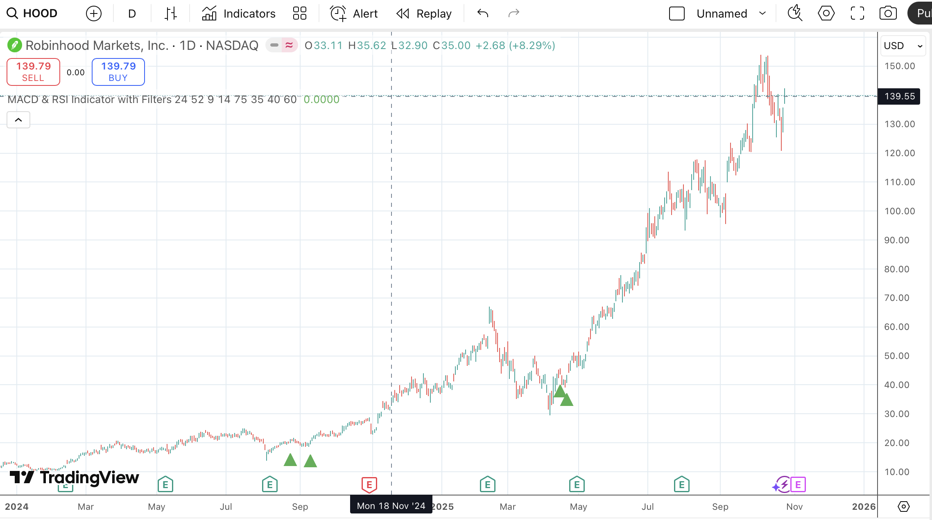
Robinhood (HOOD)… 11X Gains!
Green arrow flashed February 2024
$1,000 in the stock would have grown to as much as $11,200

Slide 51
What about adding options?
Green arrows flashed four other times
What if you put $1,000 into three month options…
And just held them until expiration?
No cherry picking… no peak gains

Slide 52
40X Gains!
Feb 14 Arrow: $4,000 in profit
April 16 Arrow: $13,000 in profit
April 22: $12,000 in profit
August 23: $4,000 in profit
September 11: $5,000 in profit
Grand total: $1,000 turns into $39,000!

Slide 53
Stocks AND Options: $1.3 MILLION!
What if you used $25,000?
Stock grows to over $270,000
Options jumps to over $1 MILLION
Over $1.3 MILLION… from just ONE ticker!

Slide 54
That’s the True Power of Cash Code X!

Slide 55
This isn’t luck…
It’s backed by a statistical anomaly

Slide 56
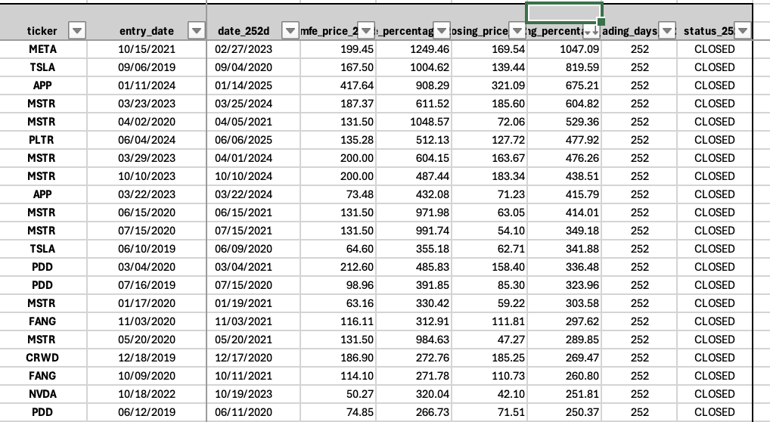
Strong 7 Year Data
Nasdaq 100 Setups since 2019
Total Trades: 2,769
70% Accuracy Rate
24.52% Average Gain (Wins and Losses)
Simply holding stock one year
S&P Averaged 8.4% annually for past 20 years
Almost 3X S&P 500

Slide 57
Odds are finally on YOUR Side!
Keep in mind…
That’s getting in EVERY arrow… on EVERY stock… for over 6 years
Even with the worst case scenario – blind monkey throwing darts at the wall…
YOU have a huge statistical advantage!
We do NOT recommend getting in EVERY green arrow
Using common sense could make your results even BETTER!

Slide 58
Huge Stock Returns on Nasdaq 100
Three Month Stock Gains as high as 204%
Six Month Gains as high as 356%
One Year Stock Gains as high as 1,047%

Slide 59
But that’s not all…

Slide 60
This Could Enhance ALL Your Other Subscriptions!

Slide 61
How You Could Use Cash Code X With Other Subscriptions
Step 1: Get Stock Recommendation From Any Other Publication and Put it On Your Personal Watchlist
Step 2: Watch for Green Arrows to Help Decide When to Buy… or When to Buy MORE
Step 3: Use Green Arrows With Options to Boost Returns (Small Bets to Go For BIG Gains!)

Slide 62
War Room Trades vs
Cash Code X

Slide 63
Vertiv Holdings (VRT)
VRT 35% vs 135% 3/12 TO 3/21
THESE WILL ALL BE BAR CHARTS SHOWING WAR ROOM TRADES vs WHERE SOFTWARE FLASHED THE INDICATOR

Slide 64
Nike (NKE)
NKE 21% vs 122% 5/28 TO 6/6

Slide 65
Etsy (ETSY)
ETSY 17% vs 91% 2/1 TO 2/9

Slide 66
Intel (INTC)
11% vs 254%
2/29 TO 3/4

Slide 67
AeroVironment (AVAV)
AVAV 1.7% vs 94% 1/14 TO 1/28
Bryan has a stellar win rate
Managed to save this trade and make it a winner
But… Cash Code X… could have made it a HUGE winner!

Slide 68
Karim Trade!
BITO 195% vs 293%
9/18/23 TO 3/4/24

Slide 69
Old Way…
Use Code Manually

Slide 70
New Way…

Slide 71
Our Brand-New Technology Scans Thousands of Stocks Every Second…
Automatically!

Slide 72
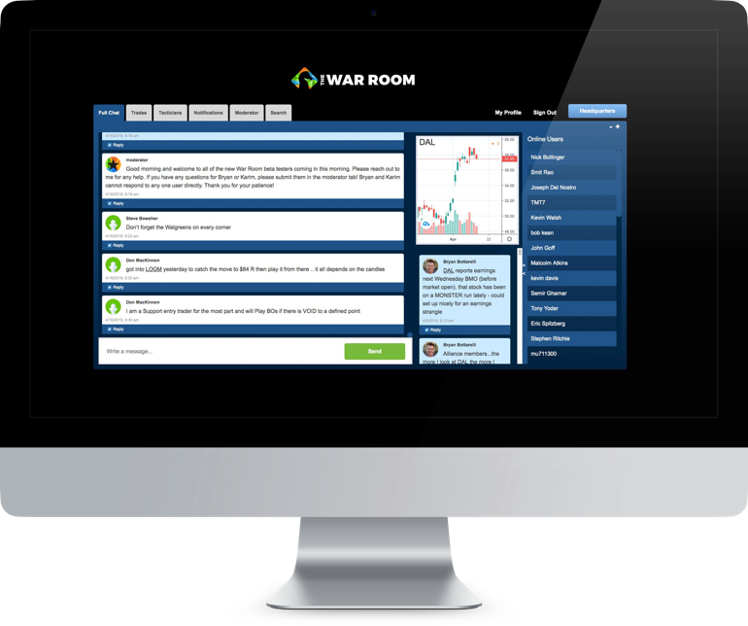
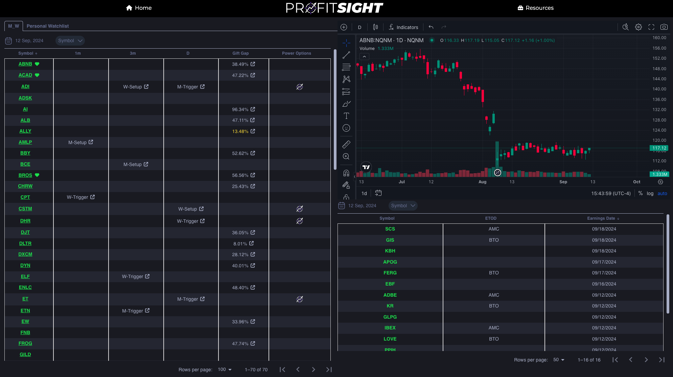
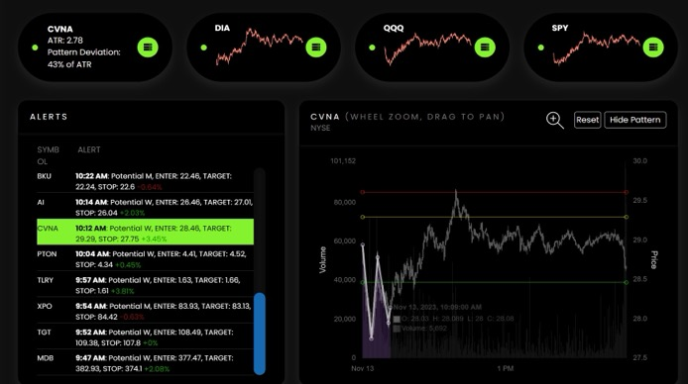
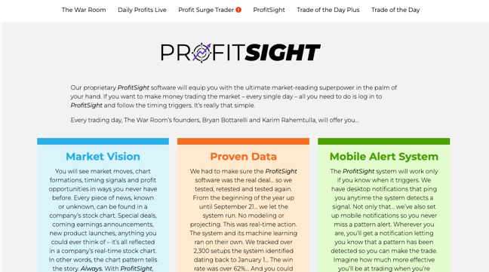
Website DEMO!

Slide 73
Bryan is already starting to use this brand-new tool…

Slide 74
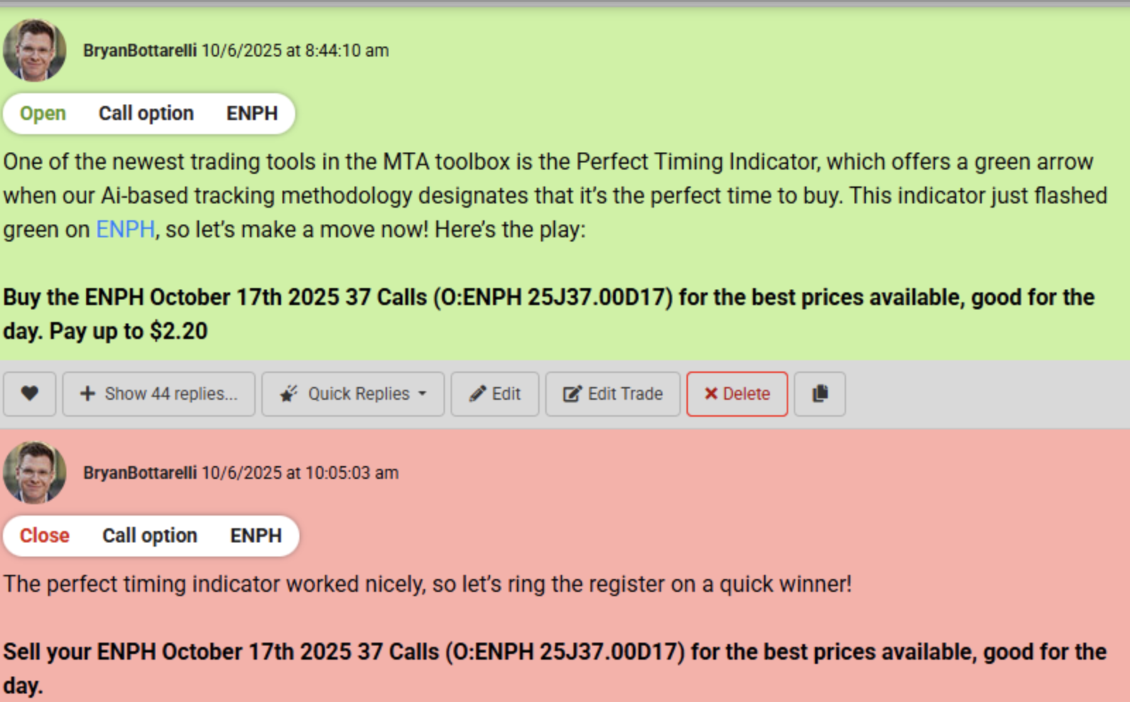
Quick 15% Gain in an HOUR!

Slide 75
Until Today… Only a Small Group of Beta Testers Have Had Access to Cash Code X…

Slide 76
Now… YOU Can Access
These Powerful Cash Code X Setups!

Slide 77
Cash Code X gives you a list of setups – every single day – the instant the green arrows appear!

Slide 78
The New ProfitSight Package
Full access to
our brand-new, proprietary
Cash Code X indicator…
Earnings Tracking
Plus… our proprietary Gift Gap system!

Slide 79
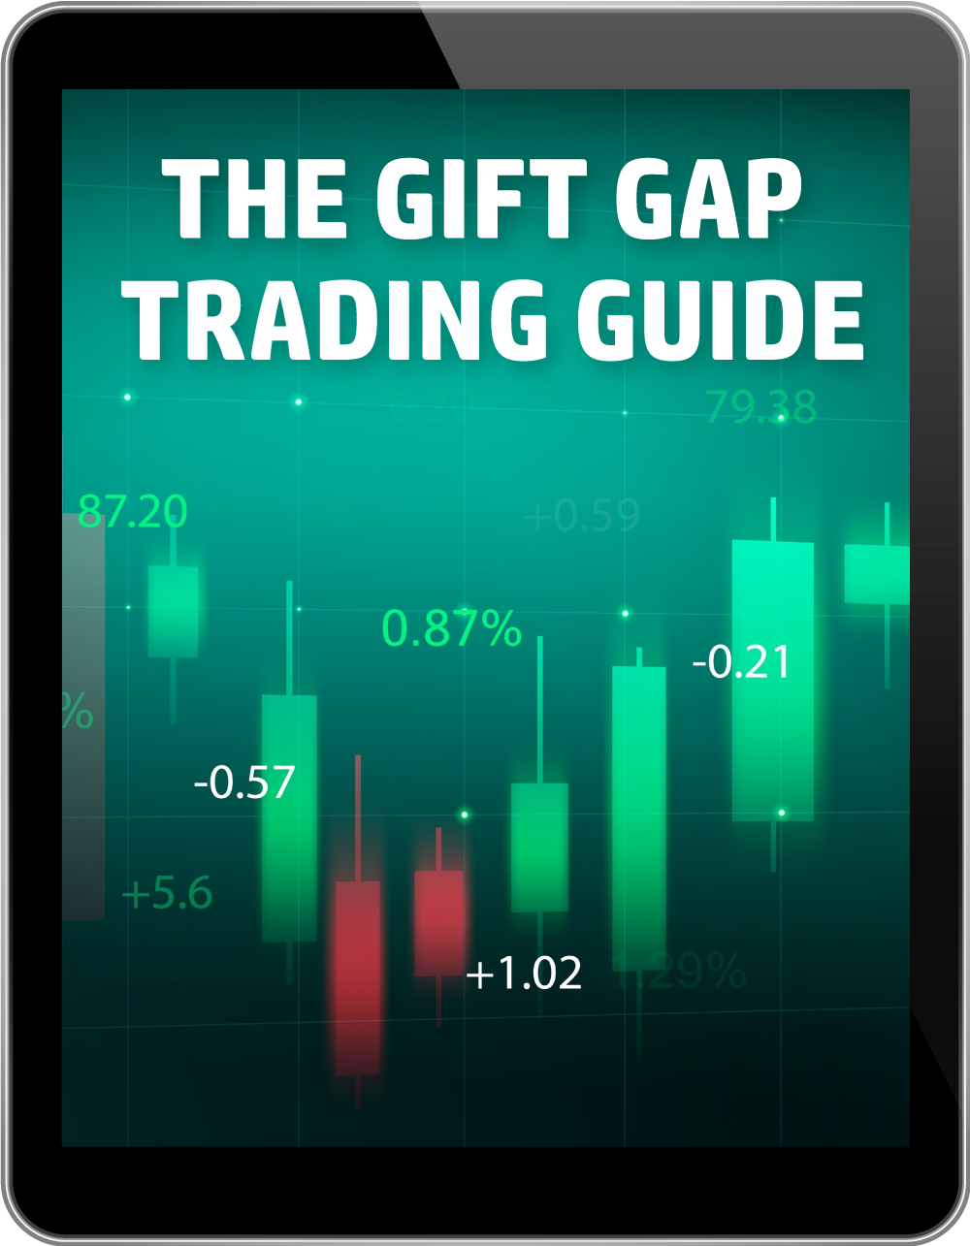
ProfitSight Package
Report – Cash Code X Trading Guide
Complete breakdown on how to use The Cash Code X Software to know when is the best time to buy

Slide 80
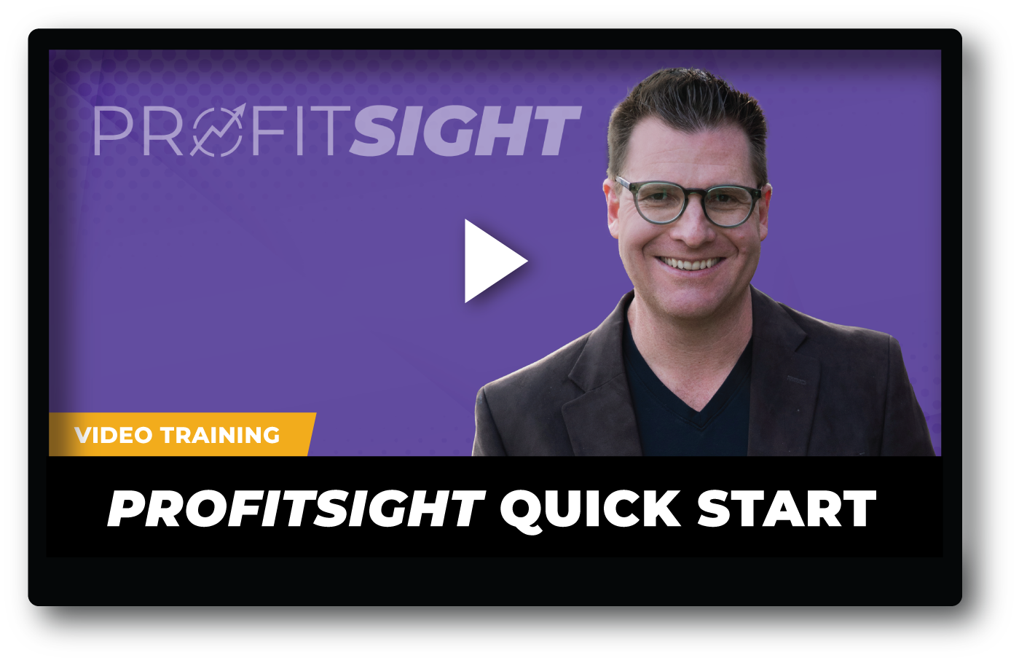
ProfitSight Package
Video – ProfitSight Quick Start
A complete breakdown on how
to use the ProfitSight website, step by step

Slide 81

Today:
Choose the ProfitSight Level That Works for You
If You Join Today, You WILL NOT Pay the Retail Price

Slide 82
LEVEL 1 | BRONZE
RETAIL PRICE: $3,000/YEAR
Full access to the New Cash Code X setups
PLUS: Earnings Announcement Tracker
And Our Gift Gap scanner!
Bryan’s Current Watchlist

Slide 83
LEVEL 2 | SILVER
RETAIL PRICE: $4,000/YEAR
Everything in Bronze
PLUS custom Profit Targets and Sell Stops based on our proprietary algorithm.

Slide 84

LEVEL 3 | GOLD
RETAIL PRICE: $5,000/YEAR
Everything in the Bronze and Silver levels
PLUS Power Options with conservative, moderate, and aggressive settings
These Power Options are available on Cash Code X and Gift Gaps.
Conservative
Moderate
Aggressive

Slide 85


Special ProfitSight Price to Celebrate the NEW Cash Code X Tracker
BRONZE
$3,000 PER YEAR $1,397
SILVER
$4,000 PER YEAR $1,997
PLUS…
GOLD
$5,000 ONE-TIME! $2,497
For Unlimited Access + $199 Annual Maintenance Fee

Slide 86

Cost of Data:
Included for FREE on
ALL Levels!

Slide 87

Backed By Our
Cash Code X Guarantee
Give the software a try for 60 days, if you aren’t 100% satisfied after… Call our VIP Concierge Team and we’ll refund your money, minus a 10% processing fee.

Slide 88

FAST ACTION BONUS (Expires at MIDNIGHT!)
Plus…
Give you THREE MONTHS of The War Room (Value: $1,750)
You’ll get LIVE market analysis and trade recommendations every single day
It’s FREE… Must act by MIDNIGHT TONIGHT!

Slide 89
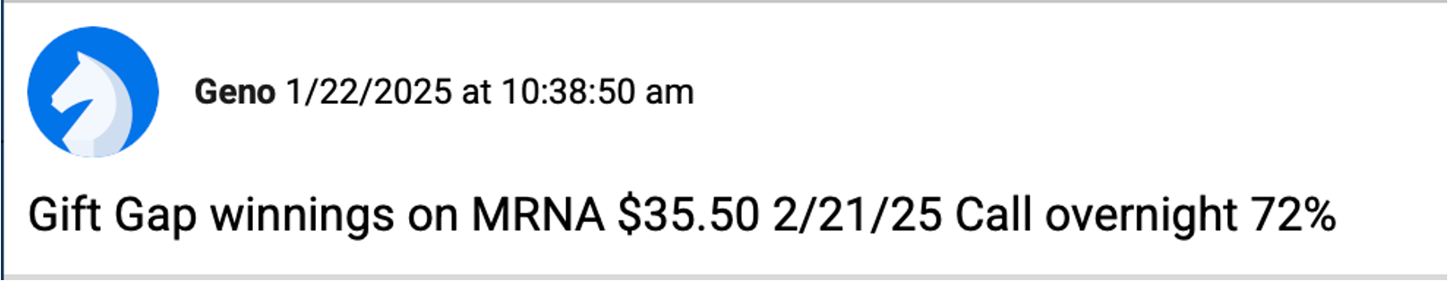
ProfitSight Users Getting Results
One user made almost $7,000… on a cruise ship in the Bahamas! In one week he made 142%!
Geno made a quick 72% overnight!

Slide 90
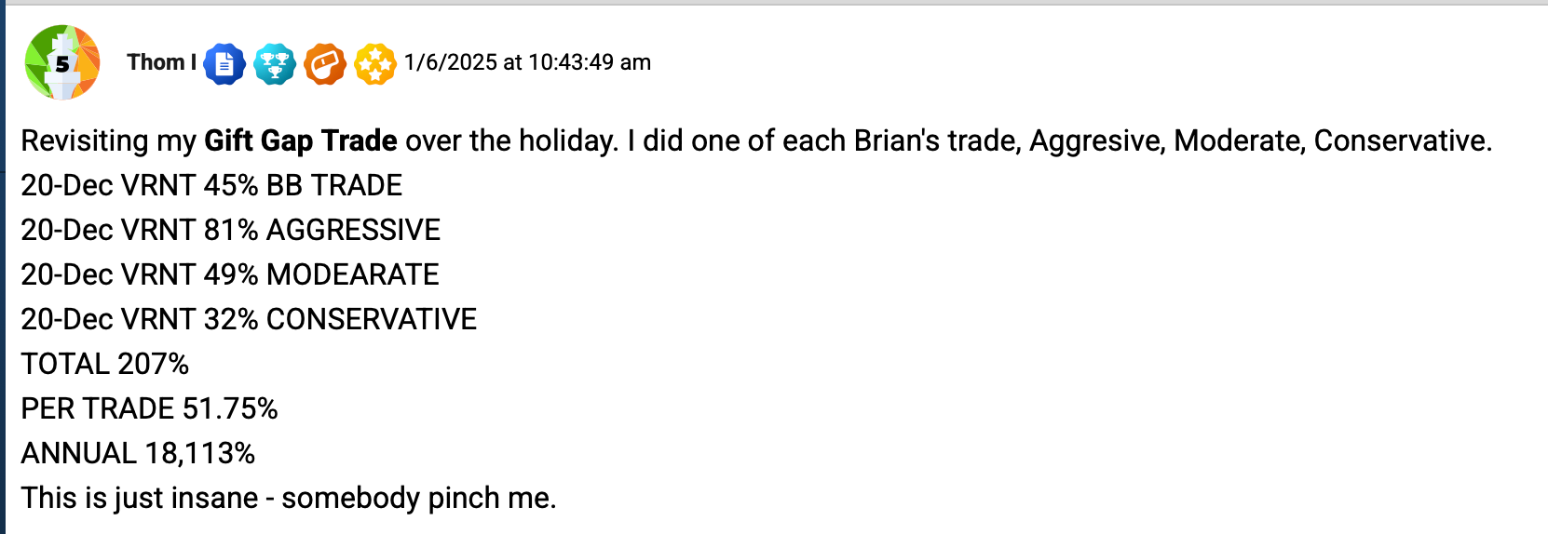
207%... Somebody Pinch Me!
Thom made a bunch of wins over a couple weeks totaling 207%.
He said “somebody pinch me”!

Slide 91


275% Gains With Cash Code!
We opened the Cash Code X to users in XXXXX (TIME)
Since Then… Ron has gotten 50% in just one day...
And even 275% Gains!

Slide 92

Can we make the header of the closing slides look like this one (just the header… rest of the format looks good):

Slide 93
ProfitSight Price – TODAY ONLY!
Q&A Time Before Midnight: Get THREE Months in The War Room FREE ($1,750 Value)
BRONZE
$3,000 PER YEAR $1,397
SILVER
$4,000 PER YEAR $1,997
PLUS…
GOLD
$5,000 ONE-TIME! $2,497
For Unlimited Access + $199 Annual Maintenance Fee

Slide 94
ProfitSight Price – TODAY ONLY!
BRONZE
$3,000 PER YEAR $1,697 $1,397
SILVER
$4,000 PER YEAR $2,297 $1,997
PLUS…
GOLD
$5,000 ONE-TIME! $2,797 $2,497
Q&A
For Unlimited Access + $199 Annual Maintenance Fee
Click the button in the chat or call 888.215.5311 to order by phone or ask questions!

