Slide 1


Slide 2



Welcome to
The Chaos Cash Trading Summit
Revealed: Bryan’s Favorite
Way to Trade Volatile Markets
Stay Tuned for our live Q&A
at the end of the event.

Slide 3


The Big Question:
How Do I Trade This Chaotic Market?
Tariffs and Trade Wars Cause Wild Market Swings... Up AND Down.
The VIX Just Hit Its Highest Level Since 2020.
This Month, The U.S. Market Lost $6 Trillion in Value Within Two Days... Then Made the Third Biggest One-Day Jump Since WWII!
Volatility Is NOT Going Away Anytime Soon.
Notes:
VIX: https://www.home.saxo/content/articles/equities/why-markets-just-got-so-volatile---and-what-it-means-for-investors-07042025
April: https://www.indmoney.com/blog/us-stocks/nasdaq-in-bear-market
Image: https://www.shutterstock.com/image-vector/financial-crisis-stock-market-crash-loss-2072075432

Slide 4

The #1 Strategy for A Volatile Market
Tells You Exactly When to
Buy a Stock After a Big Drop
Also Tells You Exactly When a Stock is Overbought After a Big Move Up
It’s a method Bryan calls
“The Gift Gap.”

Slide 5
Trading Gift Gaps Can Show You Gains As High As…
89% in 5 days
114% in 19 days
235% in 11 days
452% in 8 days

Slide 6
Gift Gaps Are PERFECT For Tariff-Triggered Market Volatility
Gift Gaps are a way to play the market chaos using one simple, elegant, and powerful signal.
Every day, new announcements create “flash sales” on a stock… Where you can exploit market overreactions in a simple way.
We’ll show you live trade setups during this demo session.

Slide 7
What You’ll Learn Today
We’ll walk through the entire Gift Gap strategy.
You’ll see how our best test achieved a 97% win rate, and we’ll show you many of our top examples today.
And we’ll reveal exactly how to trade Gift Gaps for maximum potential profits during the market chaos.

Slide 8

Disclaimer
Risk is a part of all investing.
You should never invest more
than you can afford to lose.

Slide 9
Let’s Dive Into Gift Gaps!
What Do You Notice About
These Charts?

Slide 10
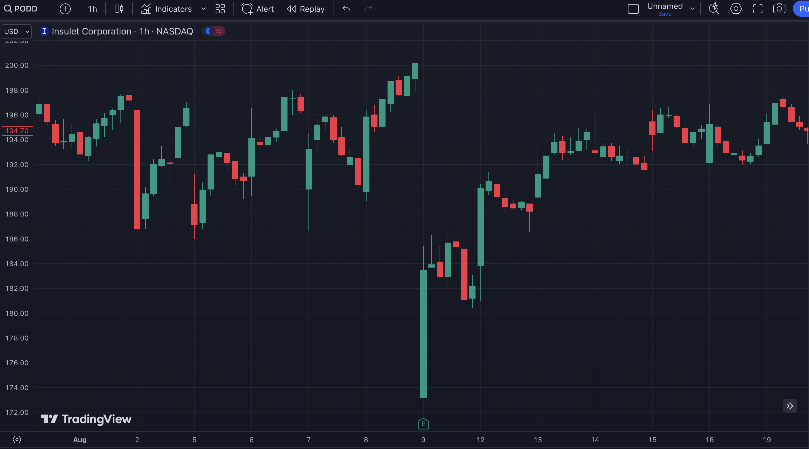

Slide 11
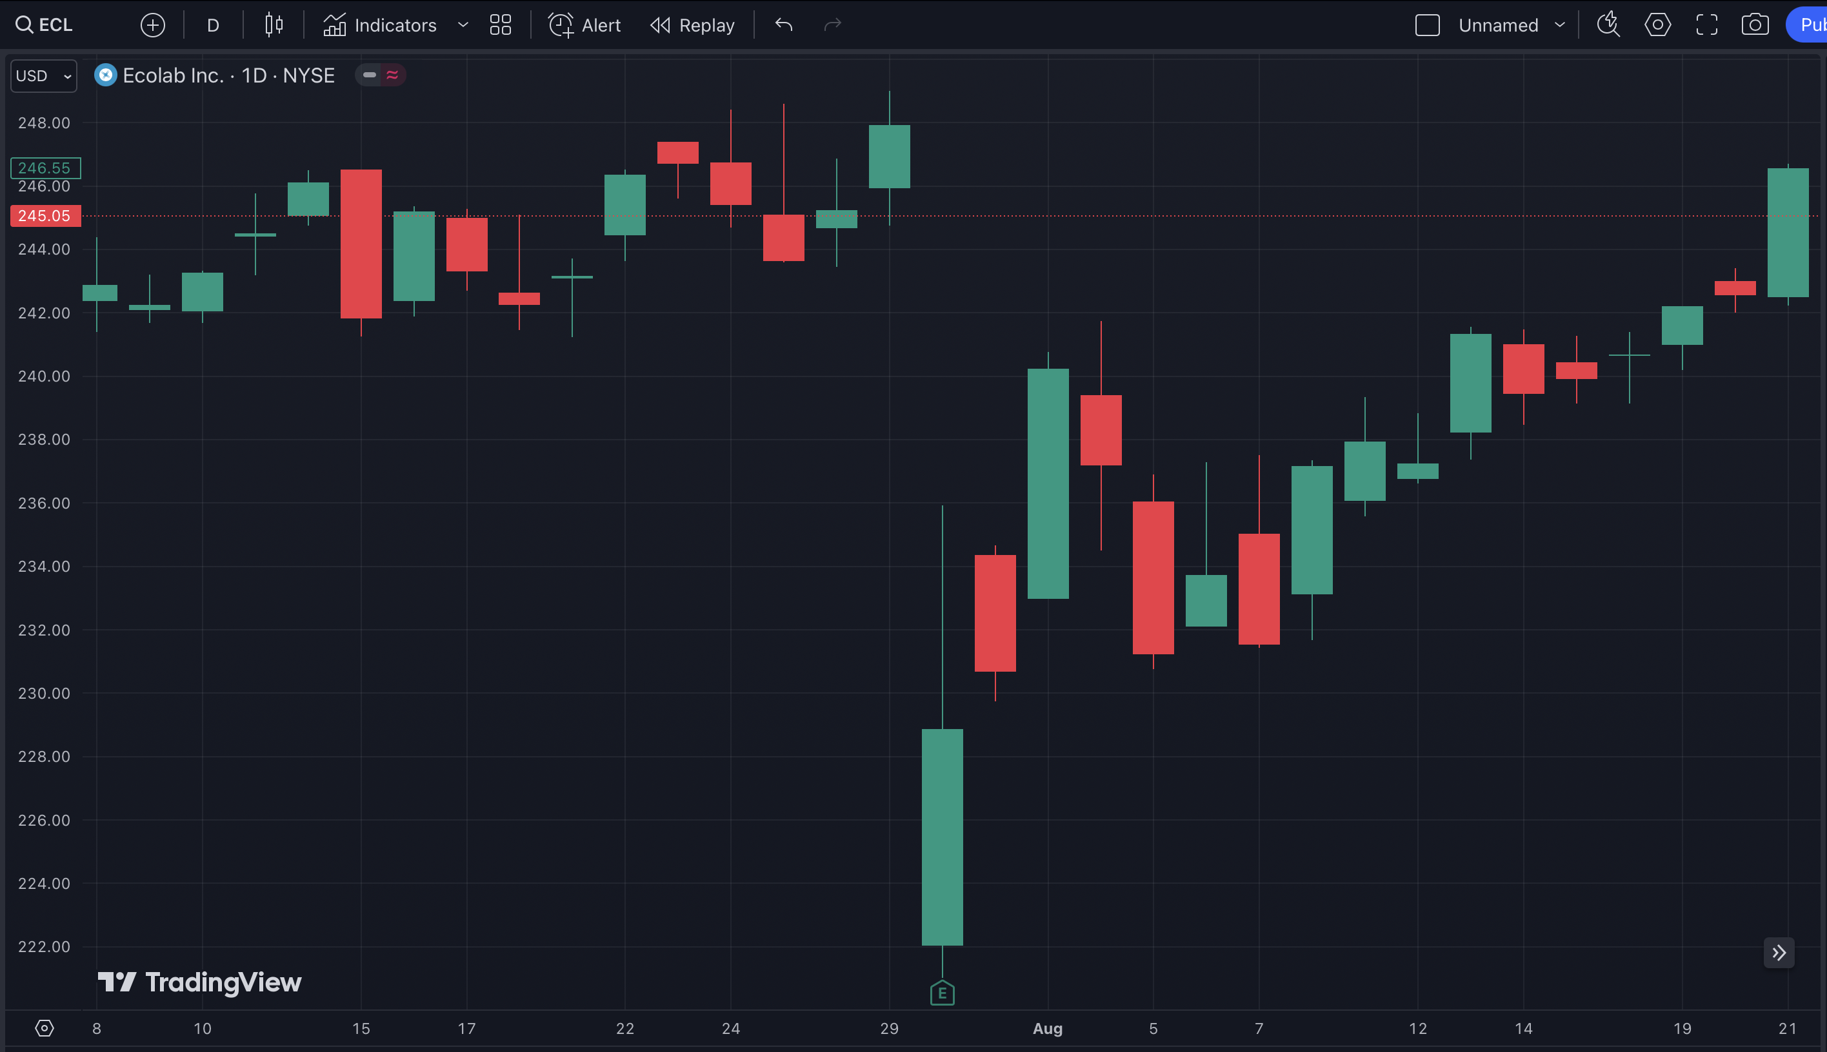

Slide 12
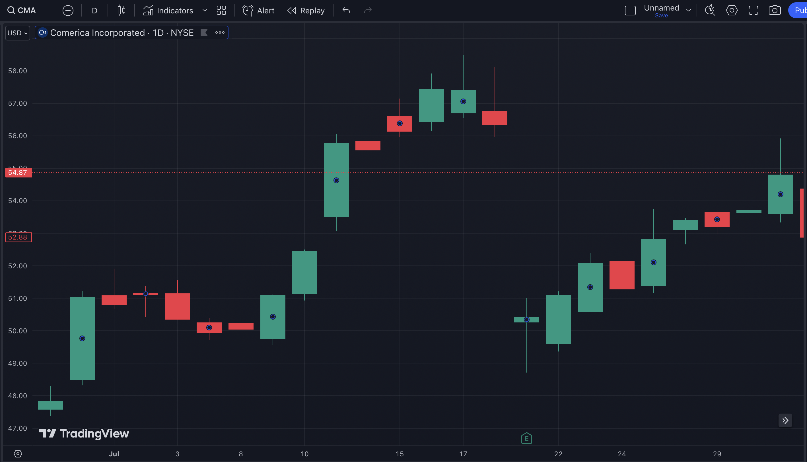

Slide 13
So What Are You Seeing Here?
Gaps happen when a stock moves 10% or more, up or down, often within hours.
This creates a temporary gap in the stock chart.
This is important: the gap is then filled.

Slide 14
Gap

Slide 15
Gap Fill

Slide 16
Gap

Slide 17
Gap Fill

Slide 18
Gap

Slide 19
Gap Fill

Slide 20
This is Why I Call
These Gifts…
These Are Opportunities for
Huge Gains!

Slide 21
It’s Like Getting a
“Flash Sale” on a Stock
The Gains Could Be Huge…
If You Know How to Properly
Trade Them!

Slide 22
114%
in 19 Days

Slide 23
250%
in 35 Days

Slide 24
454%
in 31 Days

Slide 25
Do you see why I consider them gifts?
If you know how to trade them, it’s serious money.

Slide 26
Here’s the Secret…
Most Gaps Get Filled!
Coming up… secret gap fill trigger revealed!

Slide 27
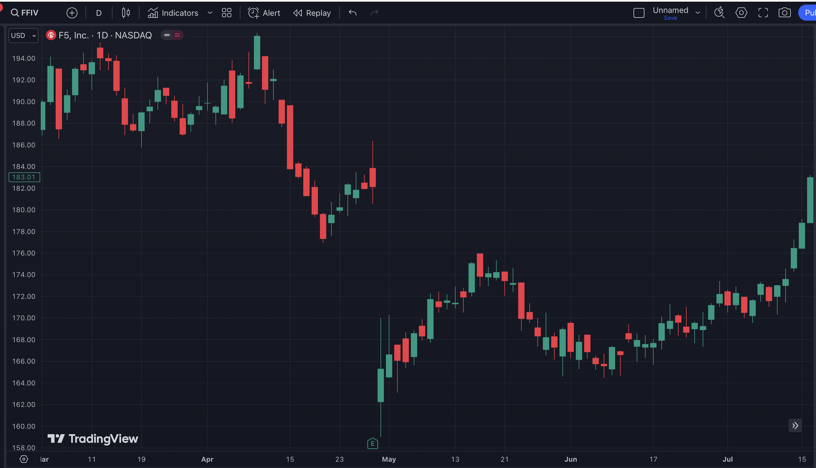
Gap

Slide 28
127%
in 77 Days

Slide 29
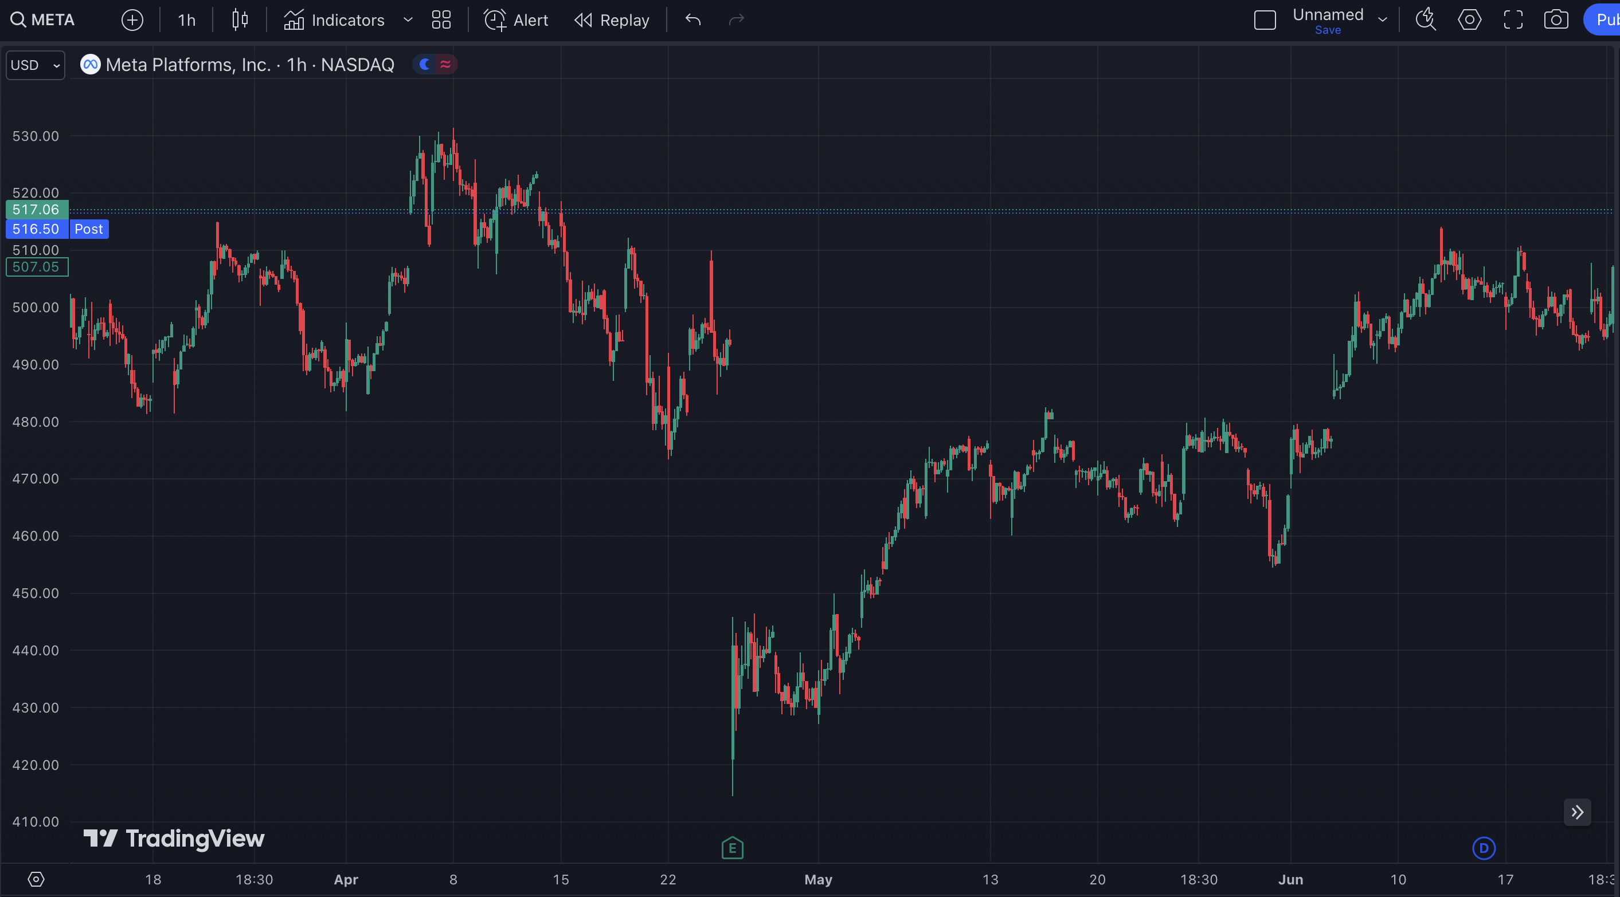
Gap

Slide 30
151%
in 42 Days

Slide 31
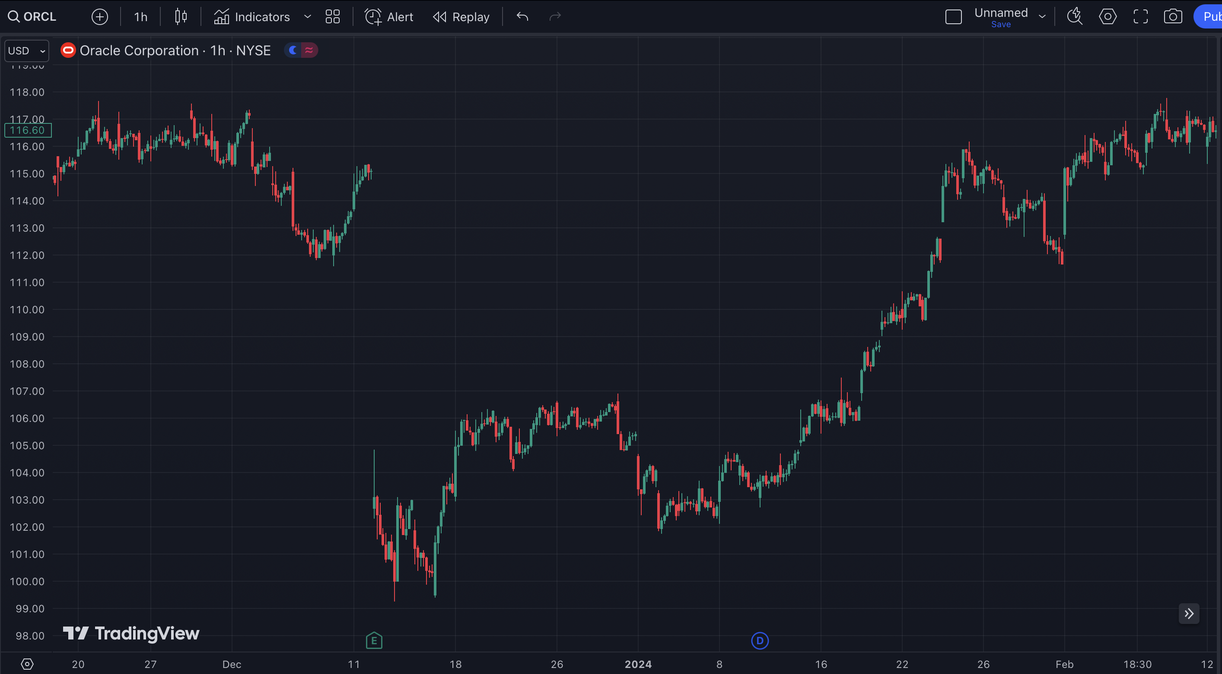
Gap

Slide 32
397%
in 52 Days

Slide 33
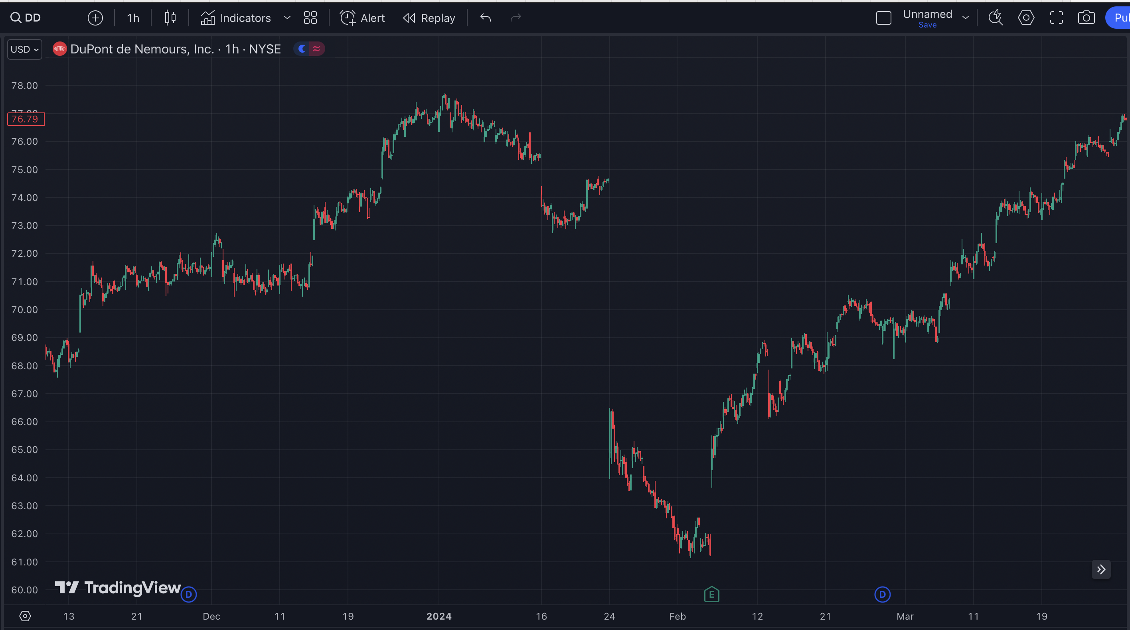
Gap

Slide 34
437%
in 58 Days

Slide 35
But…
There’s a problem.

Slide 36
The Problem
You can’t blindly buy stocks that gap down.
Never catch a falling knife.

Slide 37
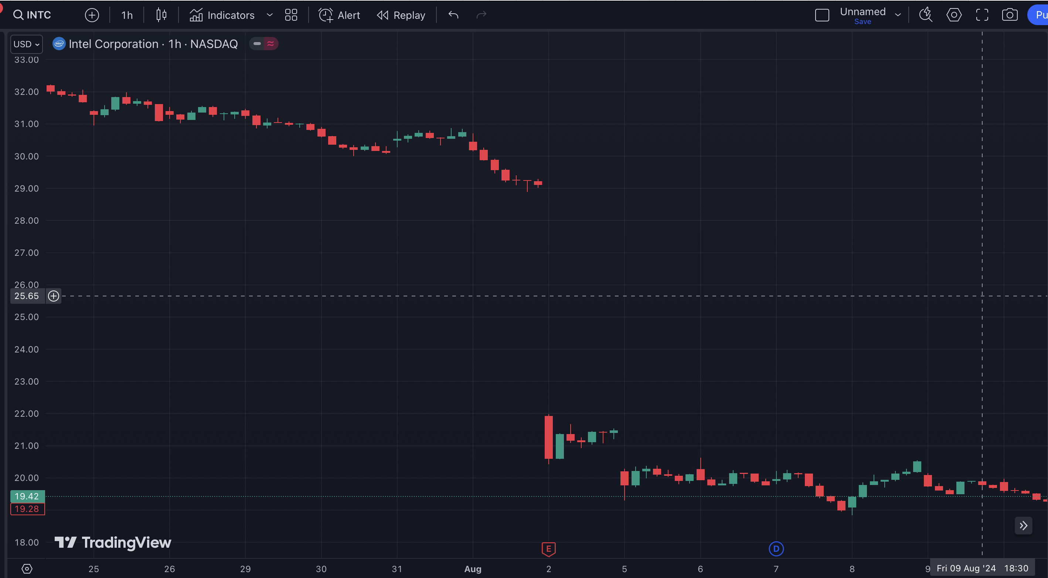
Gap

Slide 38
No Gap Fill

Slide 39
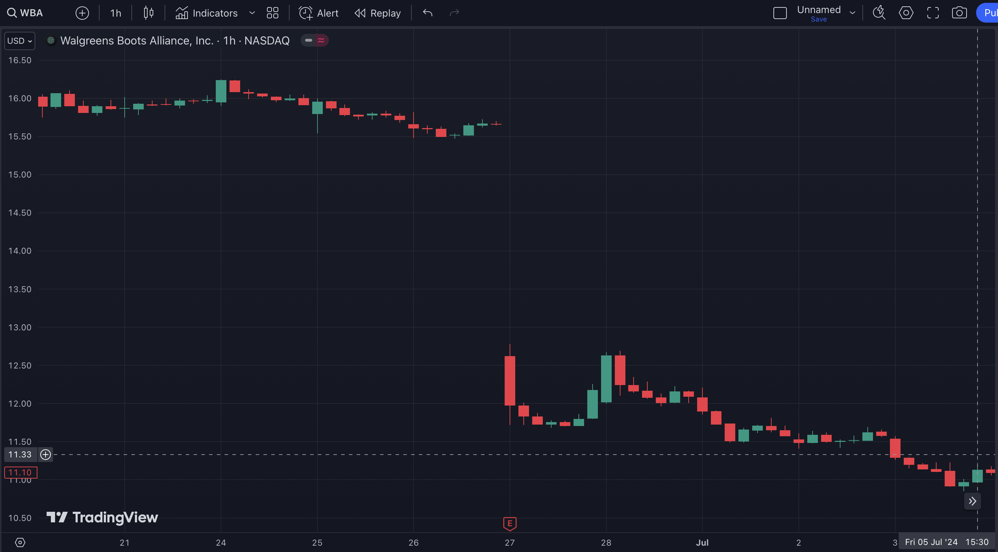
Gap

Slide 40
No Gap Fill

Slide 41
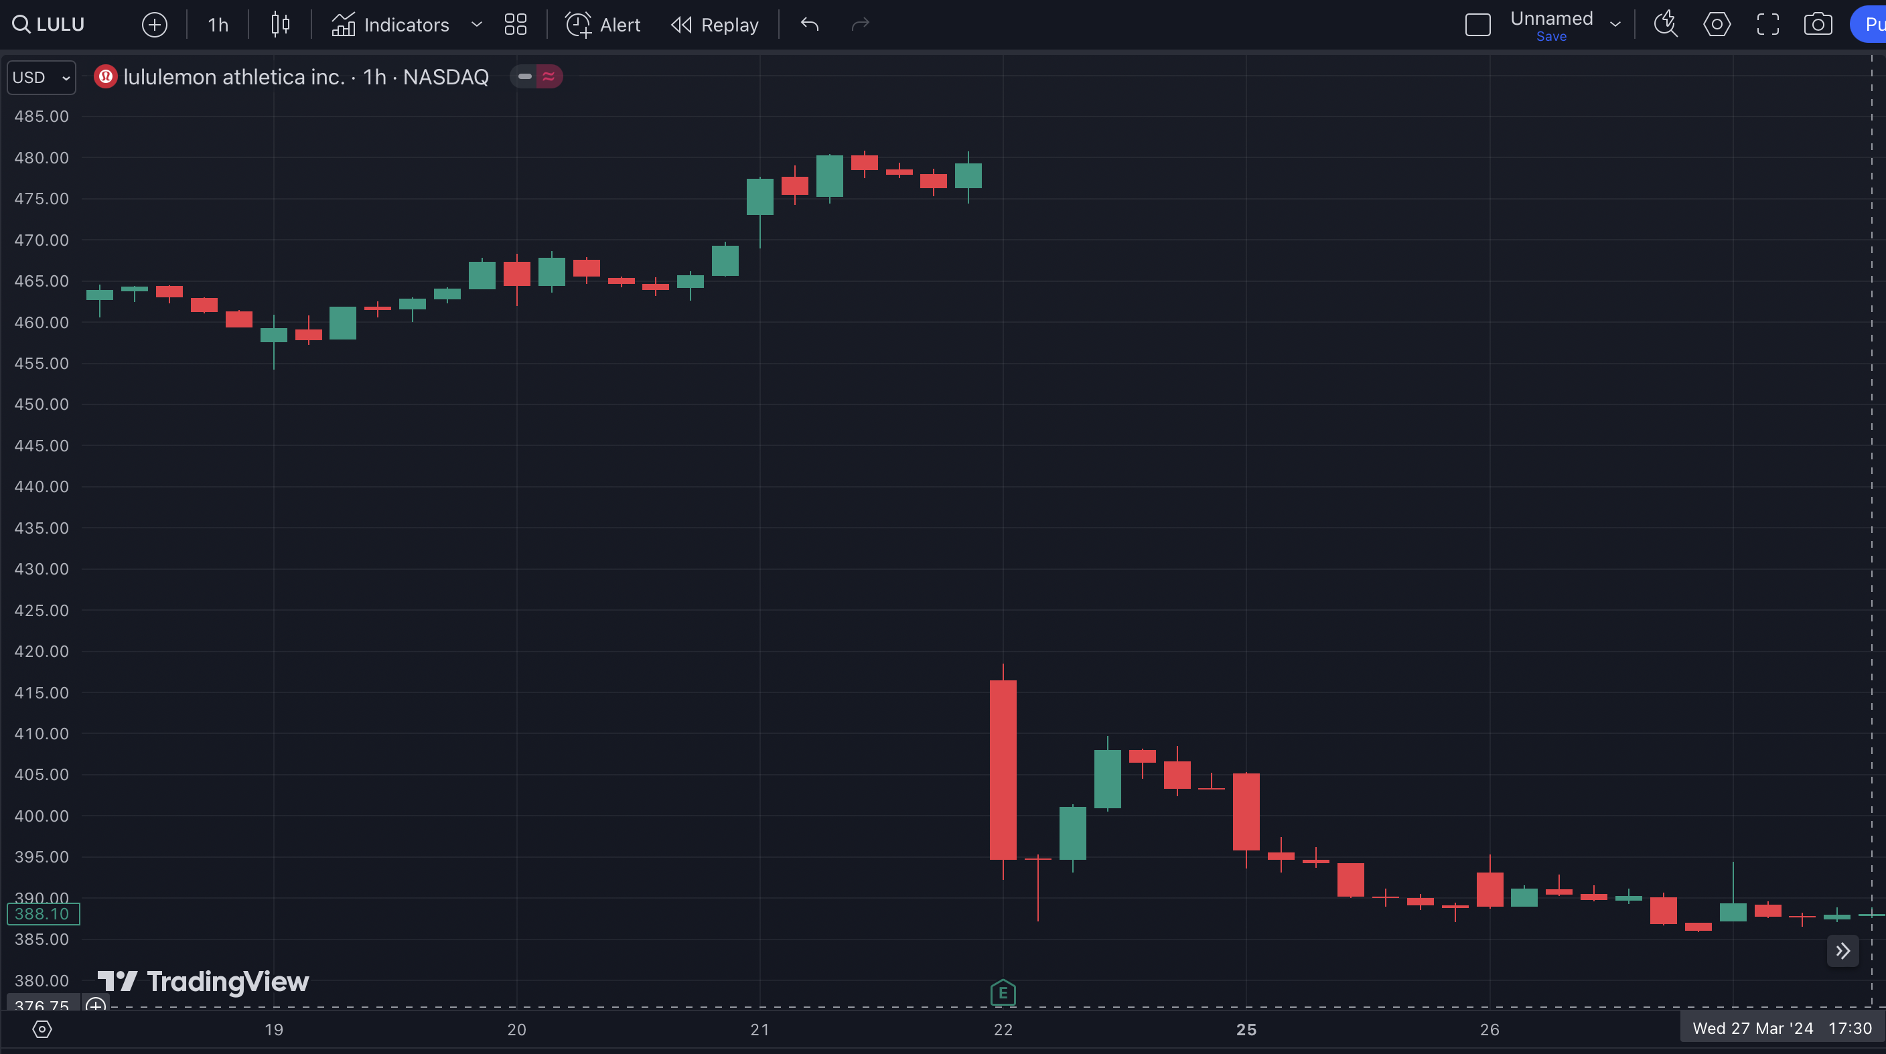
Gap

Slide 42
No Gap Fill

Slide 43
The Solution…
We have created a system to solve this.
Let me show you…

Slide 44
How Do You Know When The Gap Will Get Filled?
Most traders don’t use this because they do not understand how to trade proper signals.
You need to make sure the stock is poised and ready to fill a gap.
How do you know that? We’ve found the secret trigger that nobody knows…

Slide 45
The ideal time to get into a Gift Gap Trade is when it backfills…
10% of the gap move
The Gift Gap 10% Trigger

Slide 46
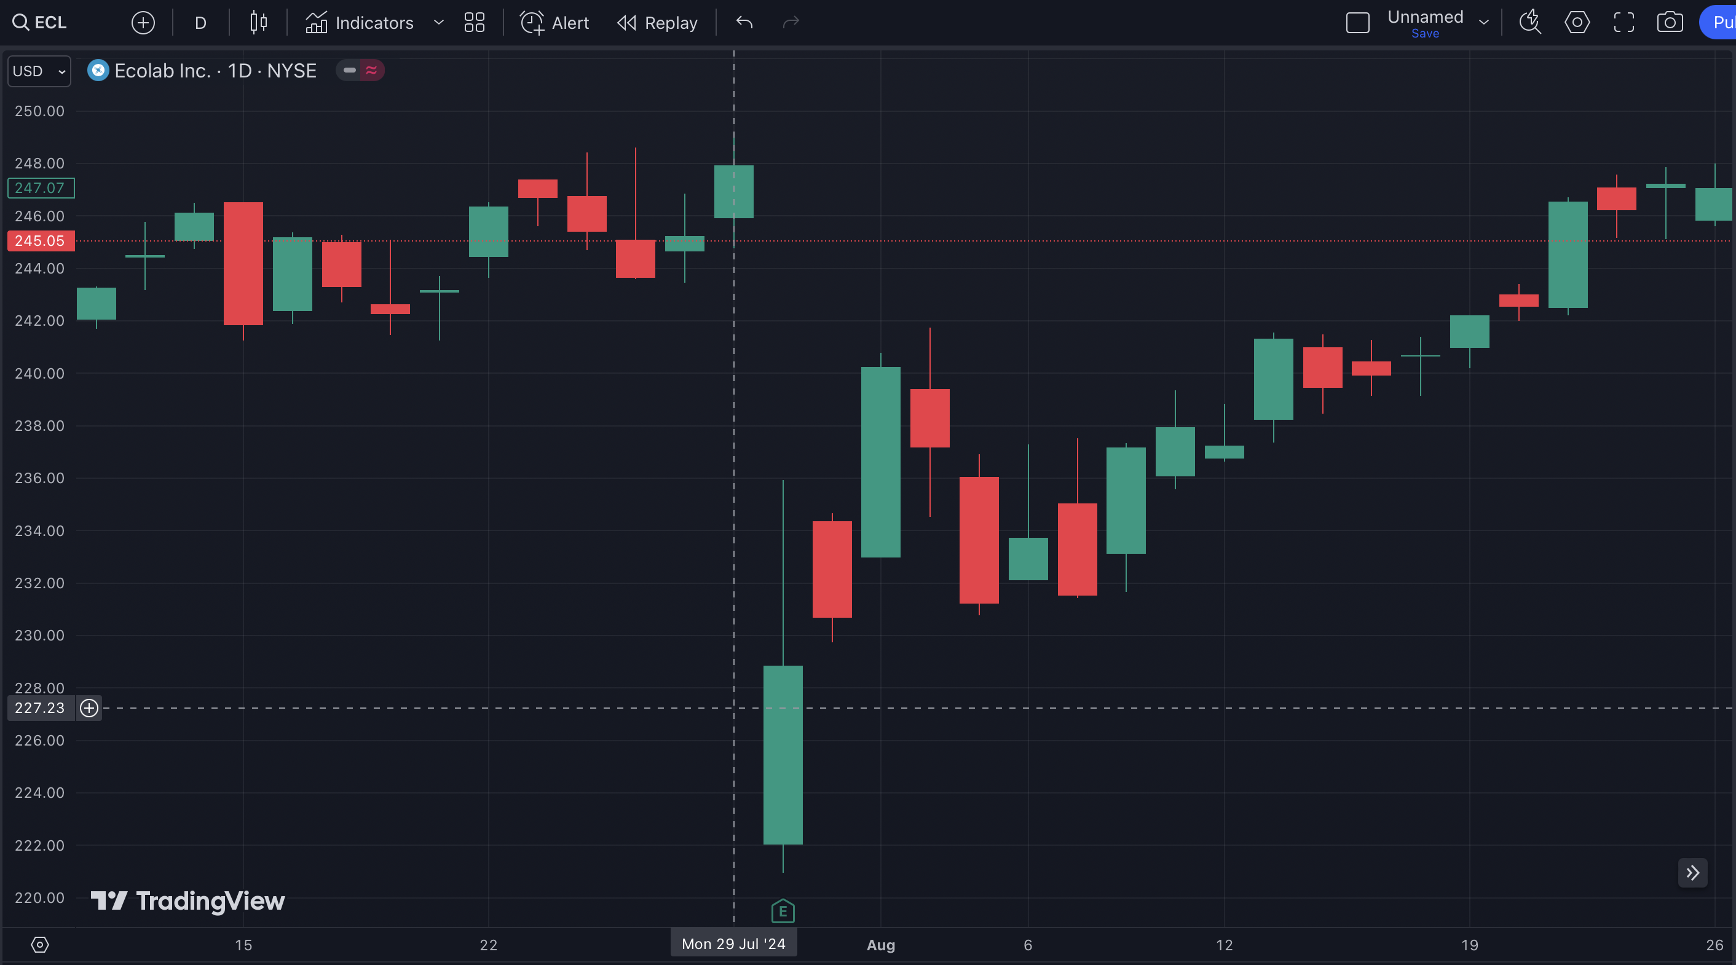
Here is the Gap on July 29, 2024

Slide 47
You Must…
Wait For The 10% Gap
Fill Trigger!

Slide 48
THIS is the trigger. This is when 10% of the Gap is filled.

Slide 49
454%
in 31 Days

Slide 50
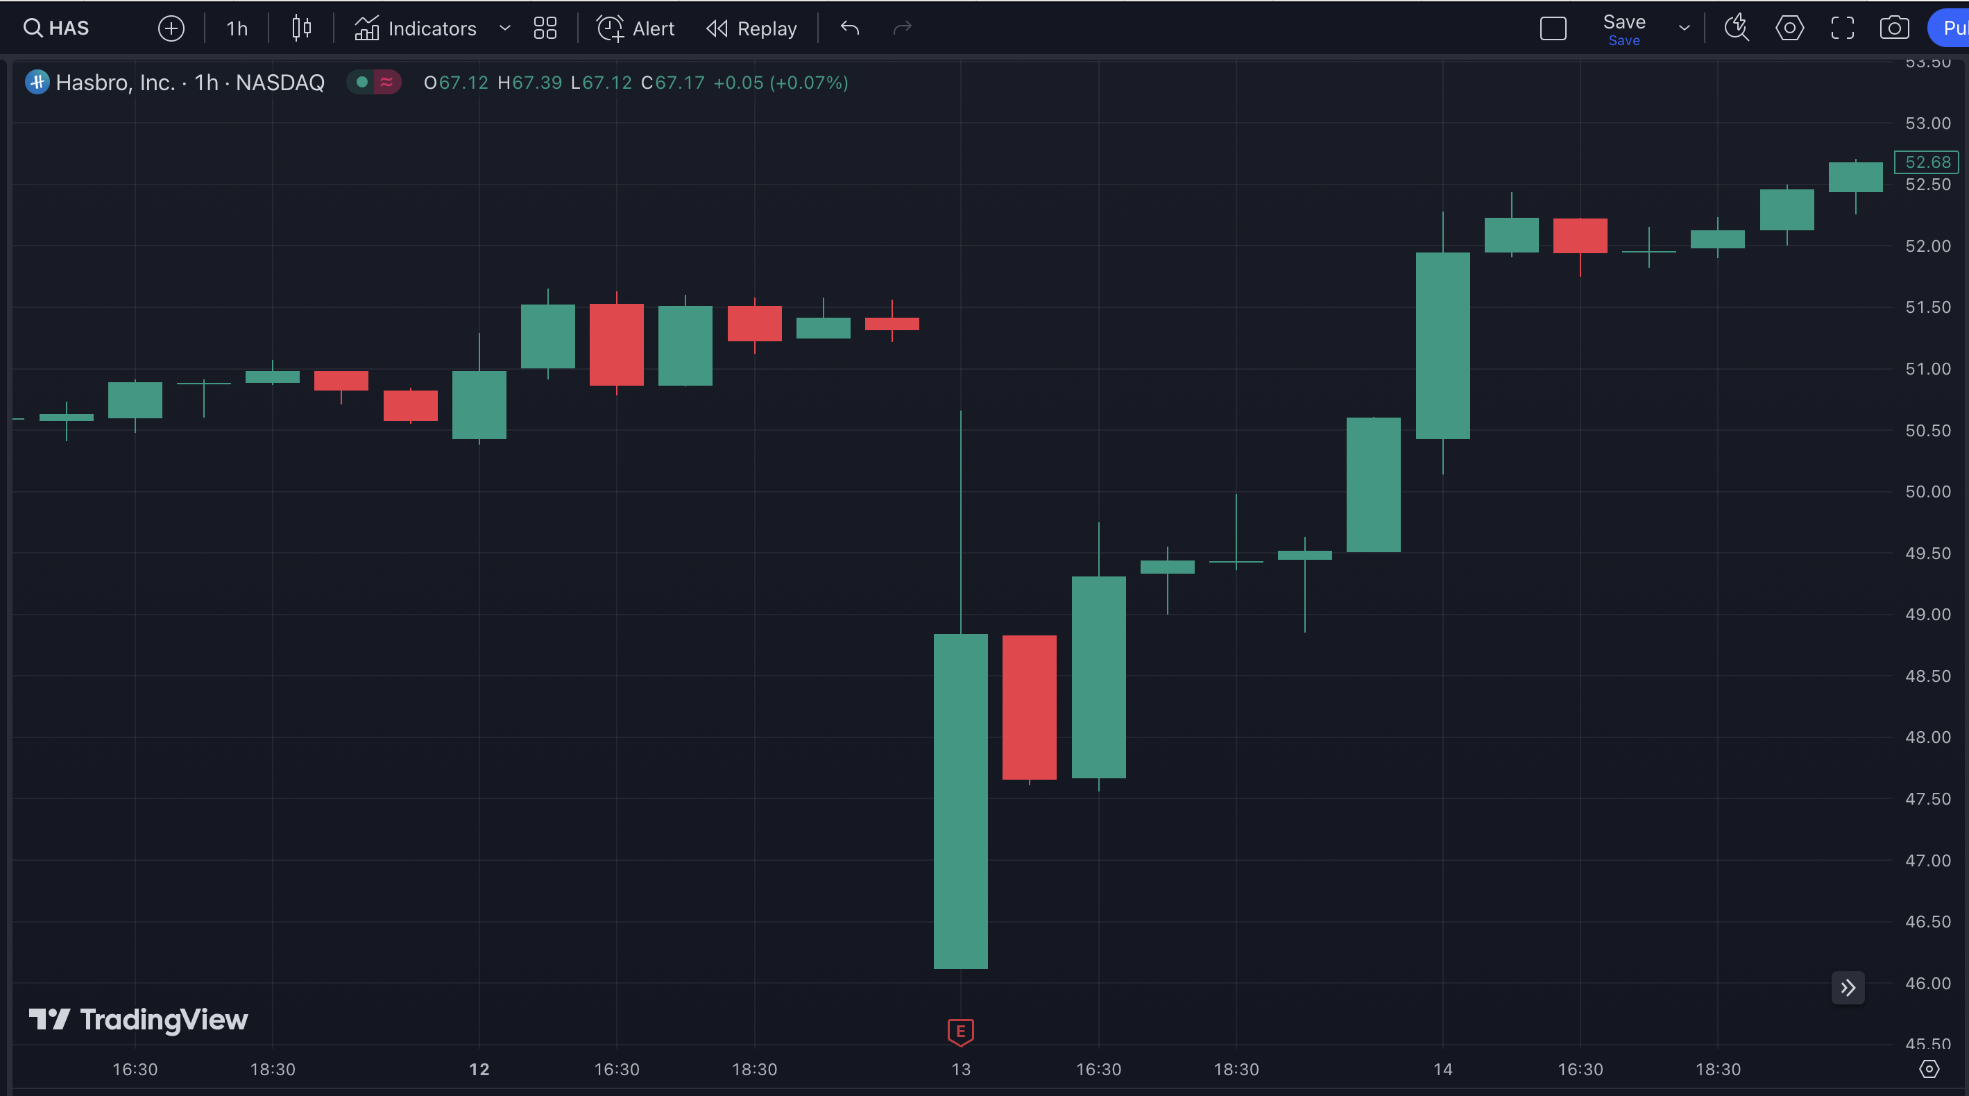
Here is the Gap

Slide 51
THIS is the trigger. 10% of the Gap has been filled.

Slide 52
103%
in One Day

Slide 53
Why Does This Work?
What you’re seeing is called a “oversold reversal”.
The stock has oversold and buyers are jumping in and pushing it back higher.
THIS is when we want to get in.

Slide 54
Key Take Away…
If You Buy After 10% of the Gap is Filled, The Win Rate Goes Through the Roof…

Slide 55
Backtested Gap Fill Win Rates After Trigger
¼ Gap Fill: Win Rate 97.11% in 23 Days
½ Gap Fill: Win Rate 92.79% in 44 Days
¾ Gap Fill: Win Rate 88.65% in 61 Days
Full Gap Fill: Win Rate 84.82% in 76 Days
Based on 5 year backtest and 365-day max holding period

Slide 56
Let’s Break It Down…

Slide 57
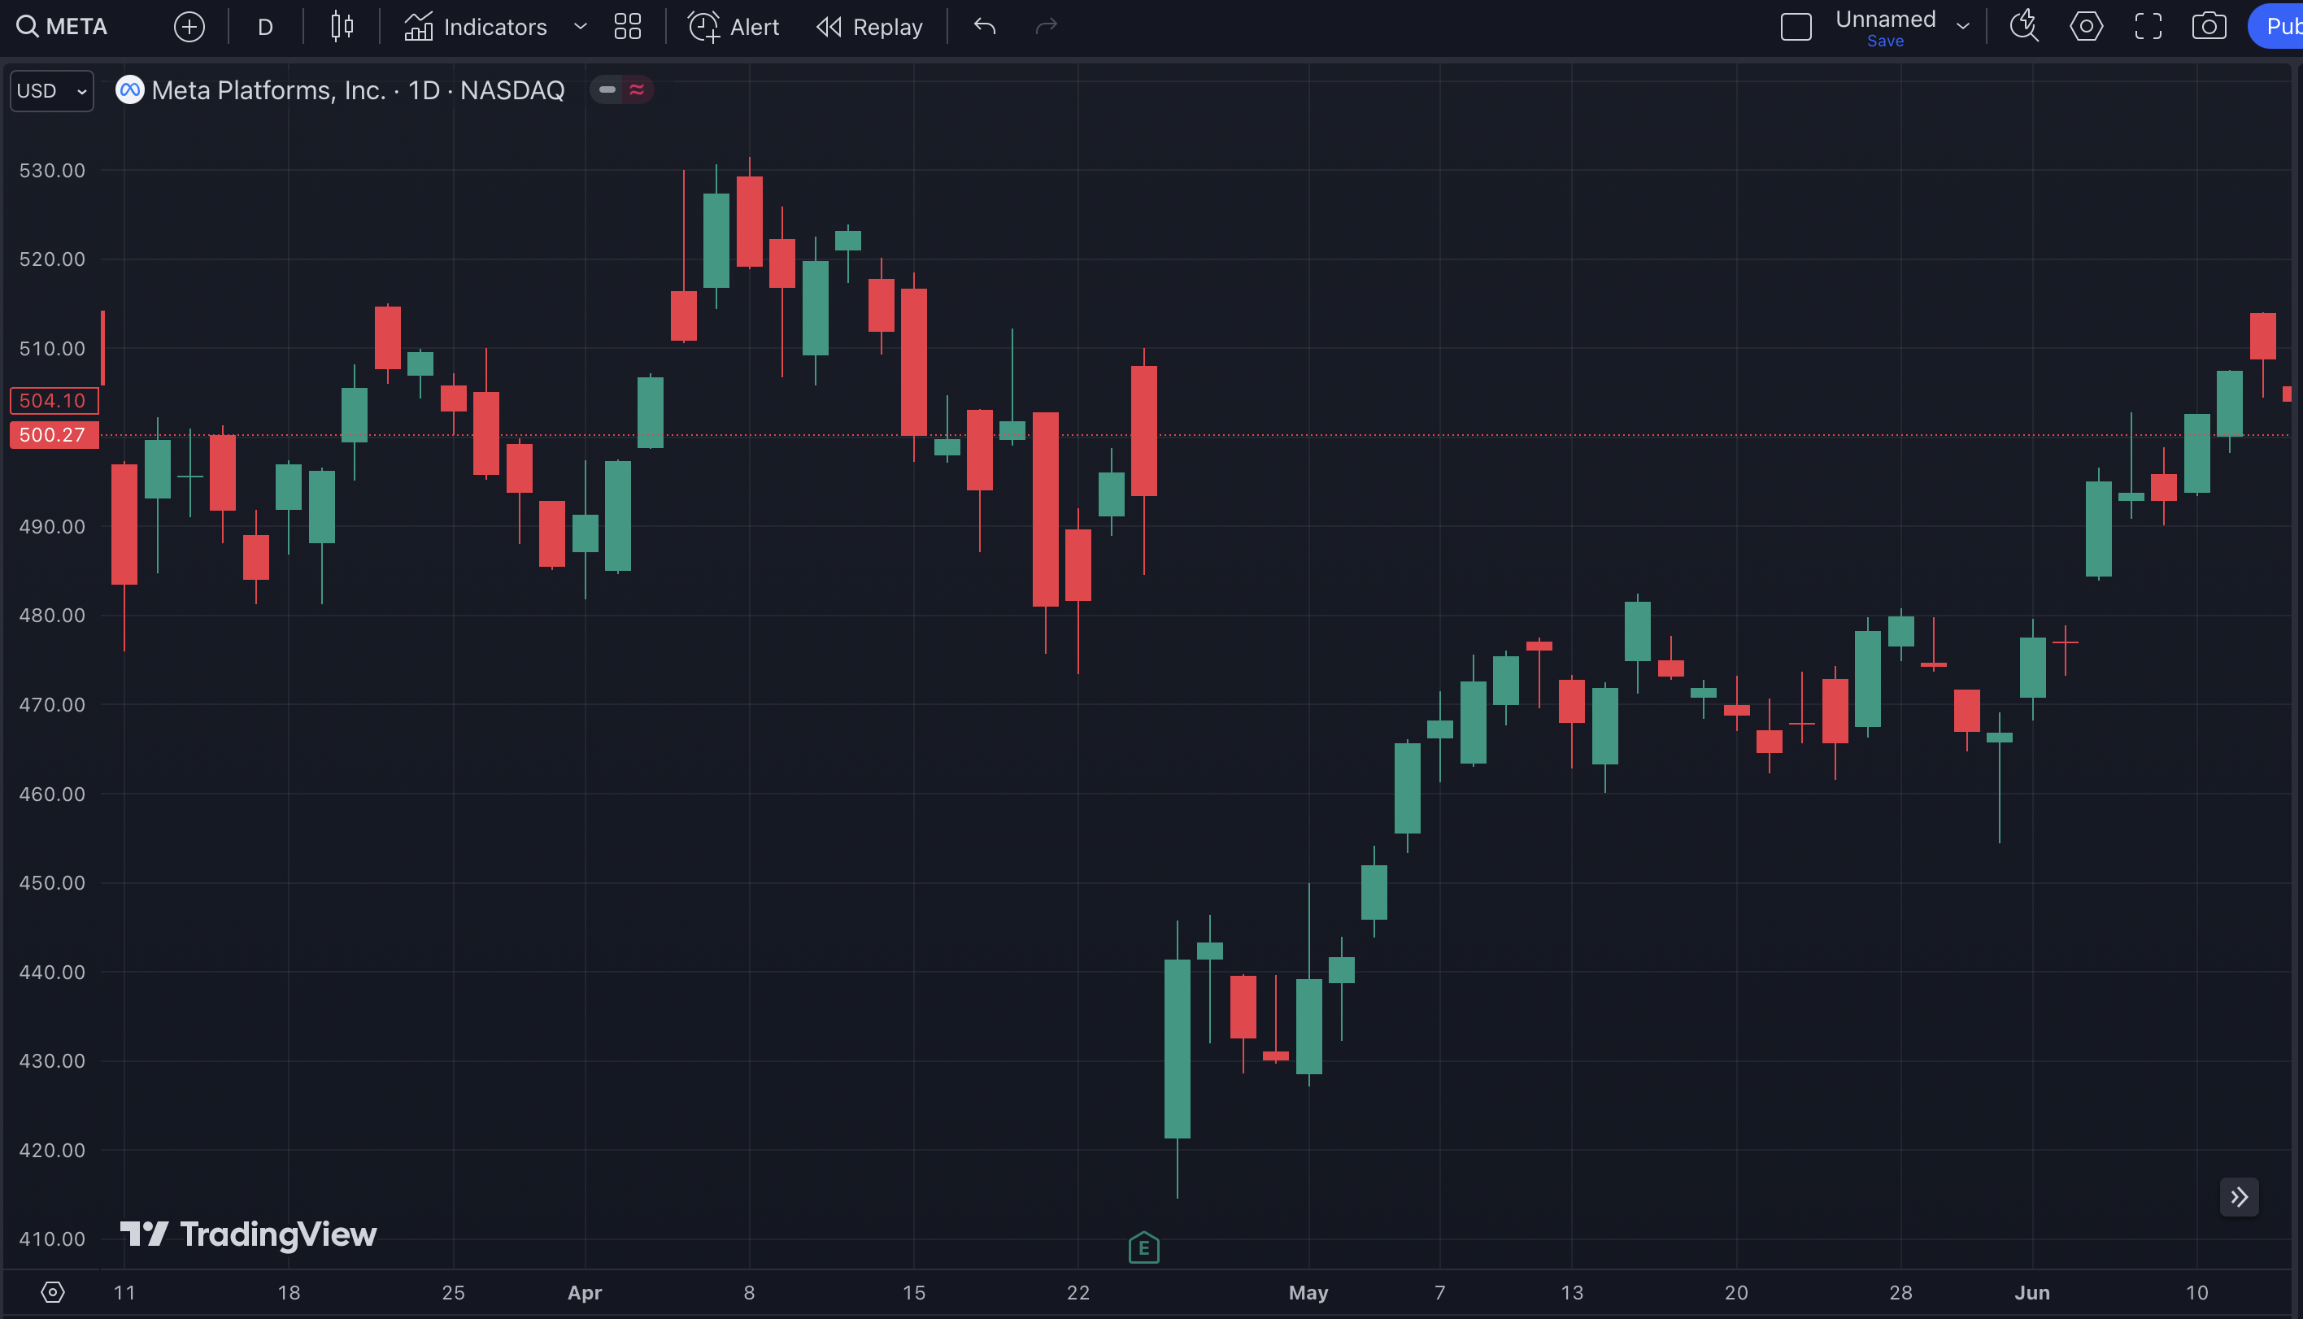
Gift Gap Here

Slide 58
Gift Gap Trigger

Slide 59
22.66%
GAIN
¼ Fill

Slide 60
58.76%
GAIN
½ Fill

Slide 61
135.17%
GAIN
¾ Fill

Slide 62
225.59%
GAIN
Full Gap Fill

Slide 63

We Found the Sweet Spot!

Slide 64
Backtested Gap Fill Win Rates After Trigger
¼ Gap Fill: Win Rate 97.11% in 23 Days
½ Gap Fill: Win Rate 92.79% in 44 Days
¾ Gap Fill: Win Rate 88.65% in 61 Days
Full Gap Fill: Win Rate 84.82% in 76 Days
Based on 5 year backtest and 365-day max holding period

Slide 65
You Want to Target the First Leg of the Fill
Over a 10-year period, we analyzed 3,735 gap down events.
When targeting a ¼ gap fill, our win rate was a staggering 97.11%.
That means out of those 3,735 trades, 3,627 were winners.
The average winning trade lasted just 4 days.
Even more remarkably, 80% of these winning
trades hit our target within the first two days.

Slide 66
The First Quarter Move of a Gap Fill is PERFECT for Short Term Trades

Slide 67
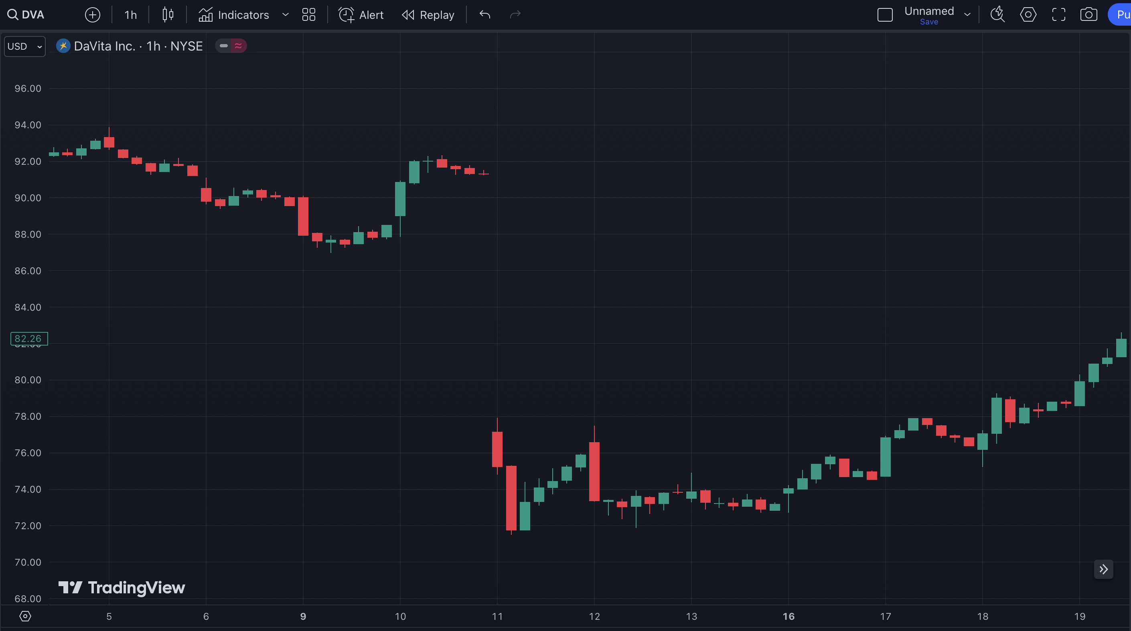
92%
in 8 Days

Slide 68
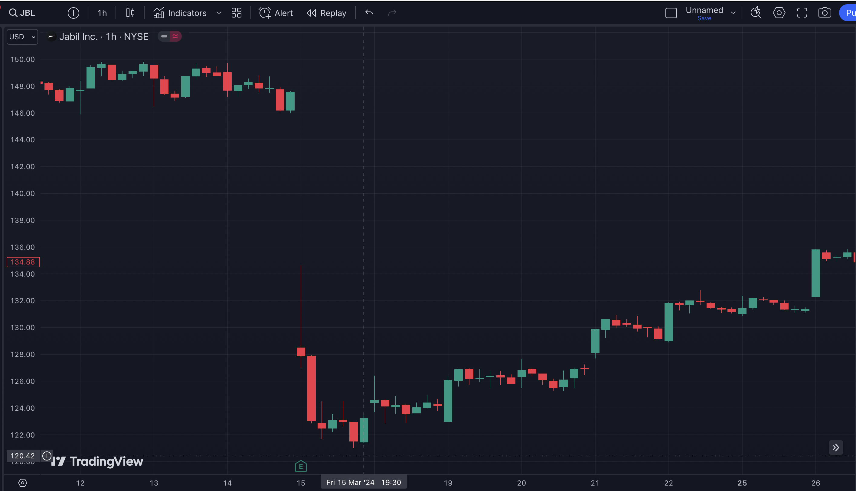
235%
in 11 Days

Slide 69
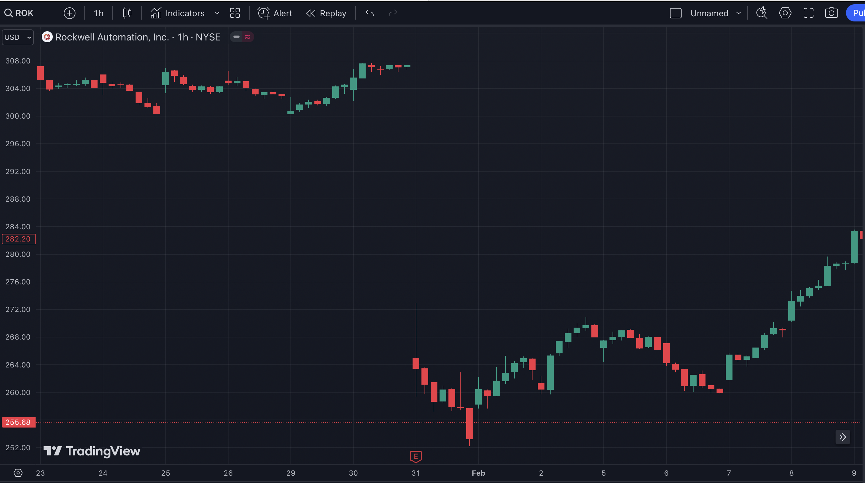
452%
in 8 Days

Slide 70
But It Gets Even Better…
We’ve Shown You
Down Gaps…
But This Works with Up
Gaps Too.

Slide 71
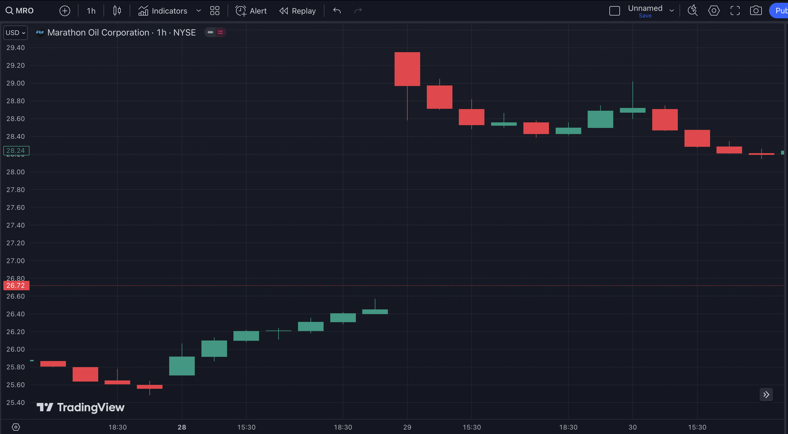
Gap Up

Slide 72
Gap Fill

Slide 73
32%
in 1 Day

Slide 74
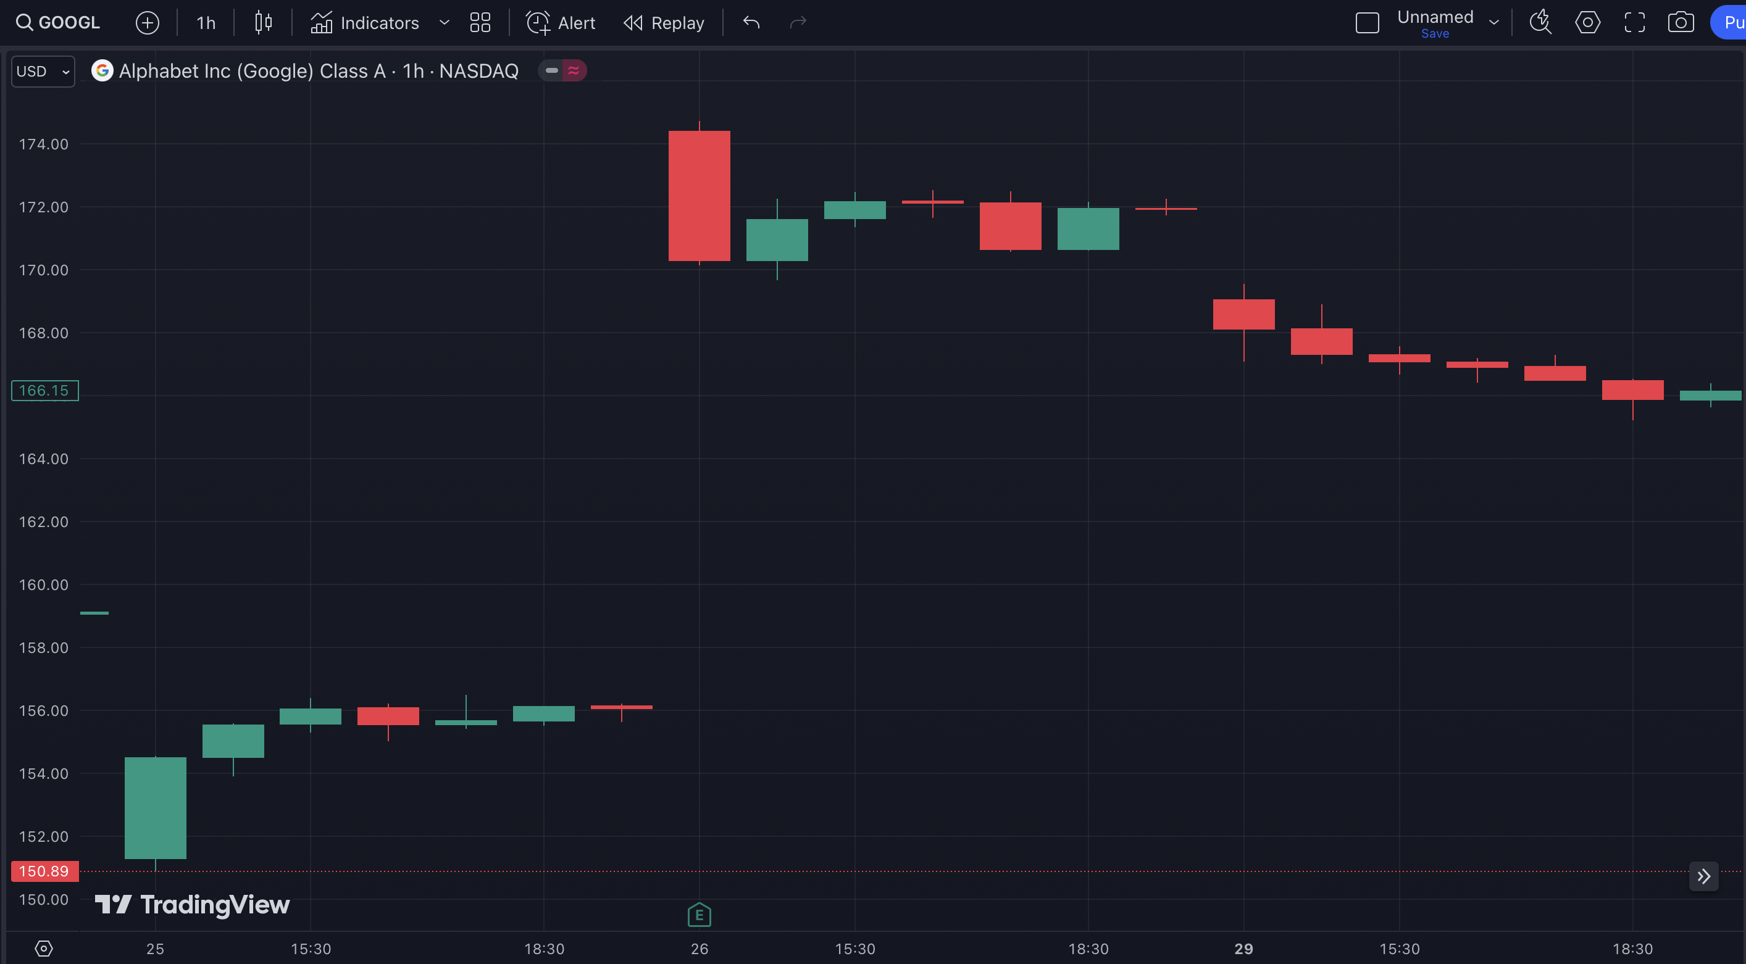
Gap Up

Slide 75
Gap Fill

Slide 76
60%
in 3 Days

Slide 77
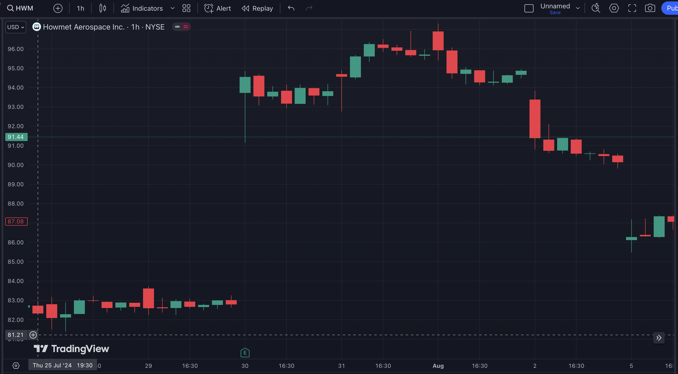
Gap Up

Slide 78
Gap Fill

Slide 79
233%
in 6 Days

Slide 80
This Is The PERFECT Strategy for This Chaotic Market!
Look at these Gift Gaps our system spotted during the last three months…

Slide 81
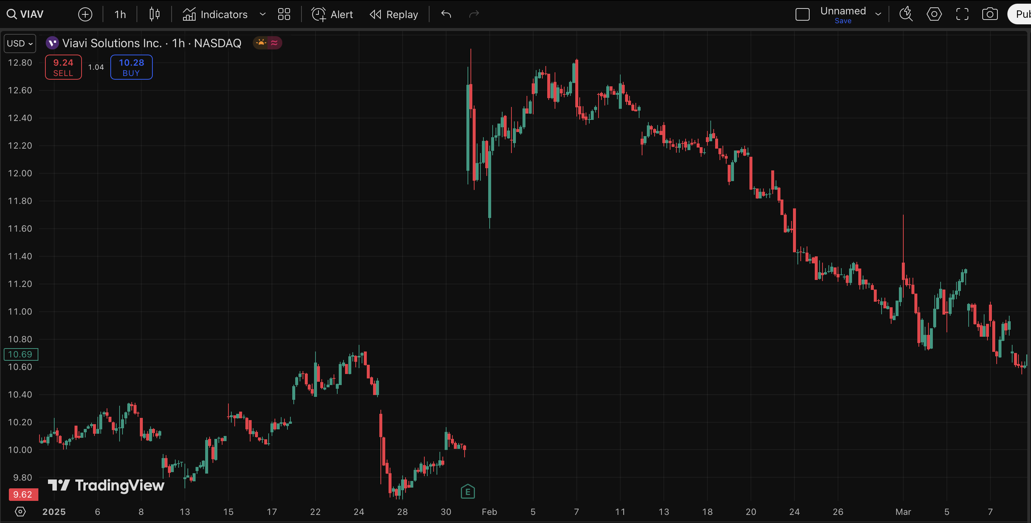
Gift Gap in Viavi Solutions…

Slide 82
And the Gap Fill!
200%
in 36 Days

Slide 83
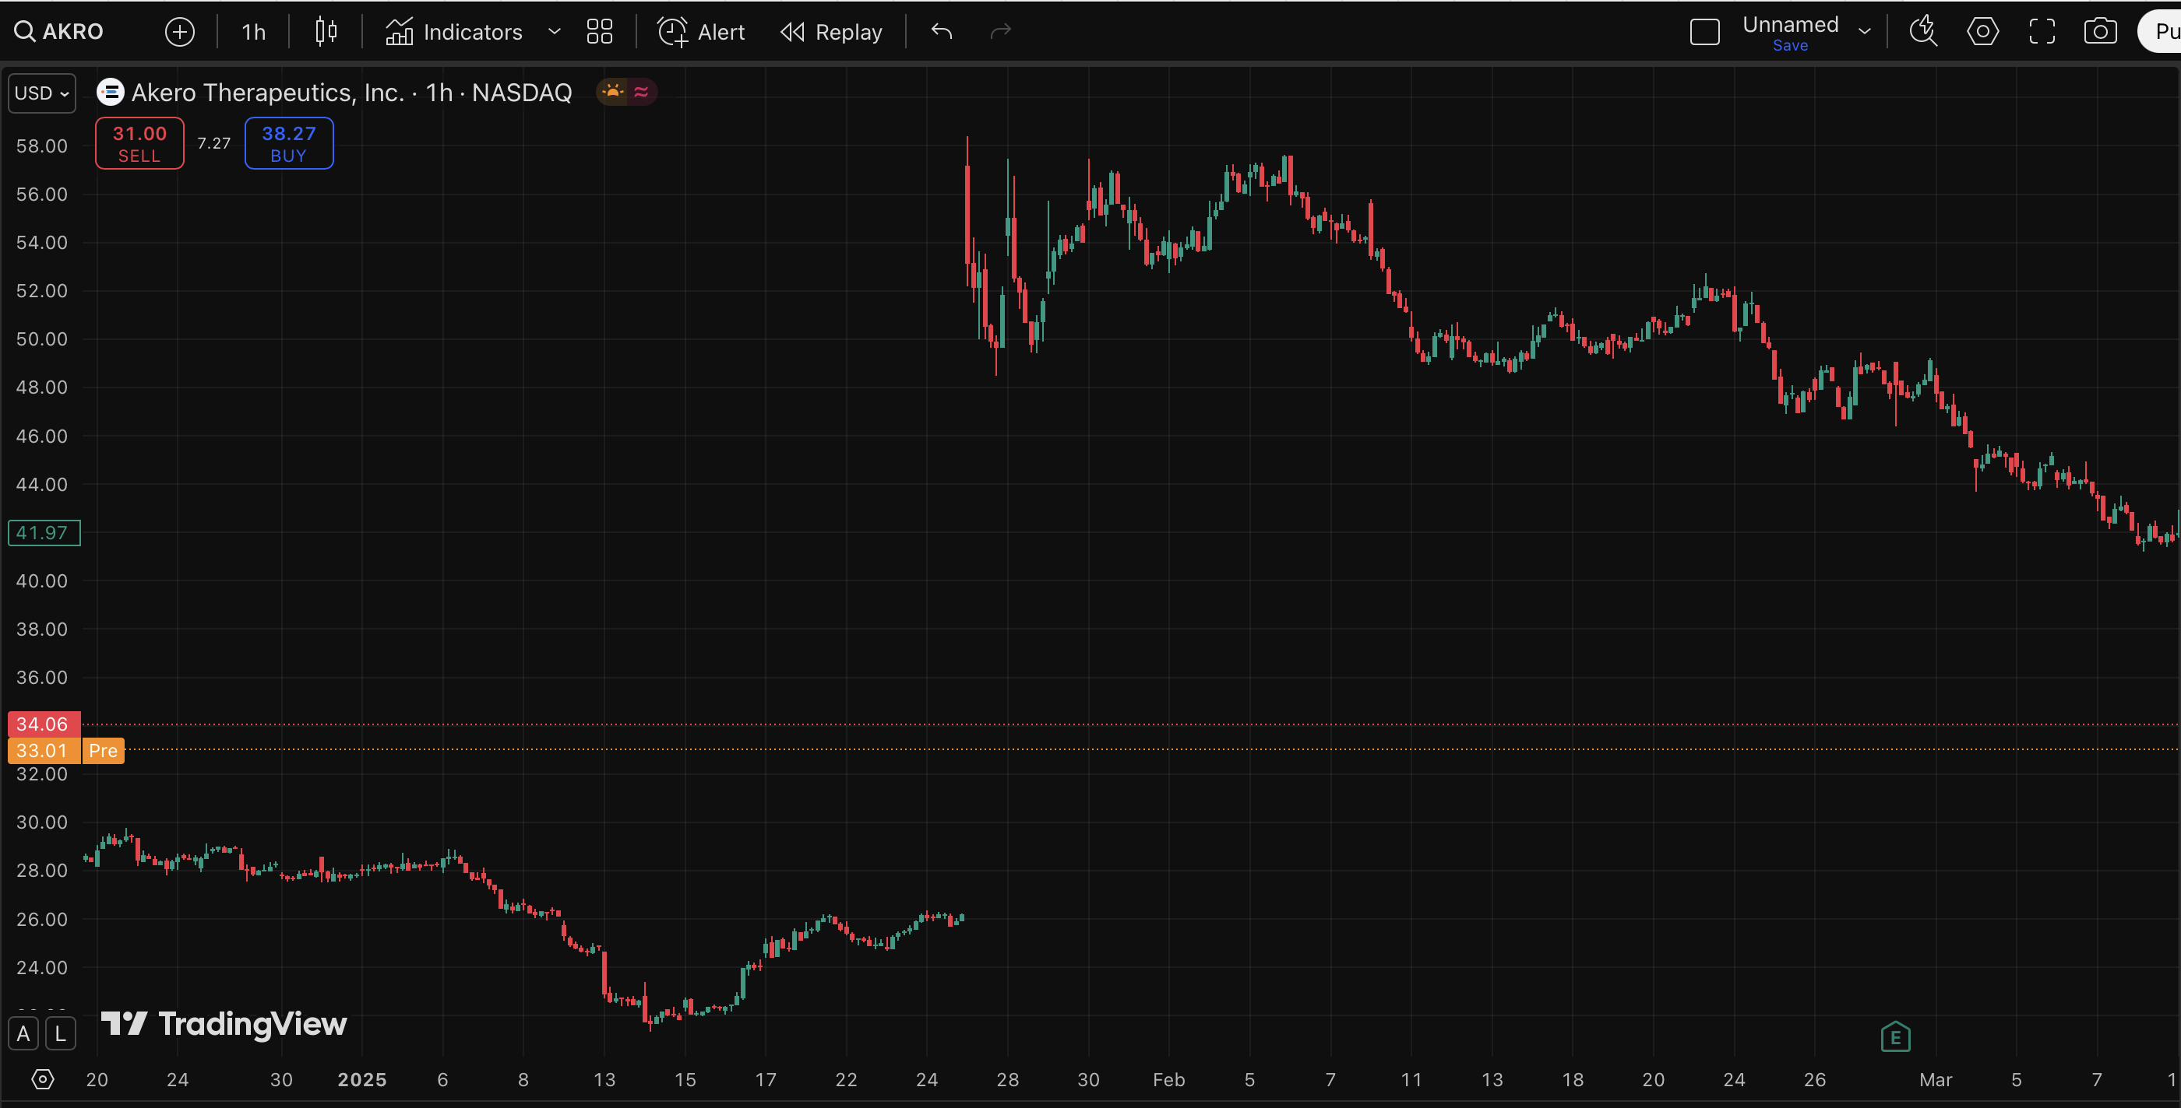
Gift Gap in Akero Therapeutics…

Slide 84
And the Gap Fill!
55%
in 41 Days

Slide 85
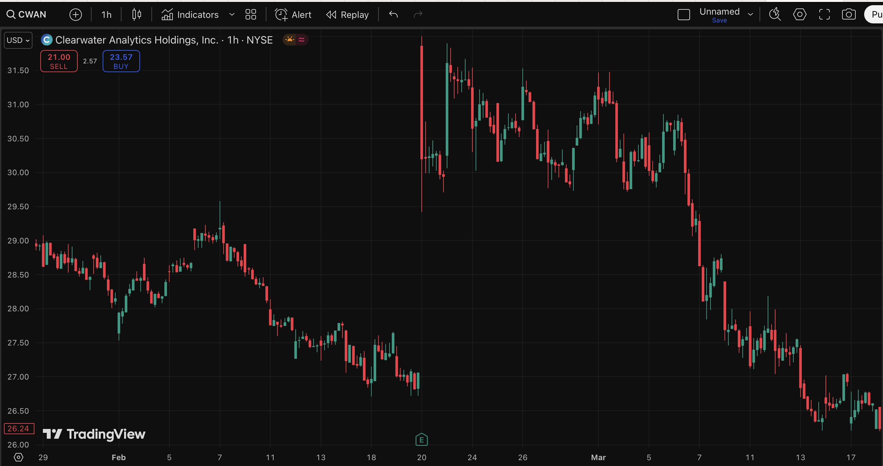
Gift Gap in Clearwater Analytics…

Slide 86
And the Gap Fill!
204%
in 26 Days

Slide 87
We Recently Launched the Gift Gap Scanner …
And Our Members Love it!

Slide 88
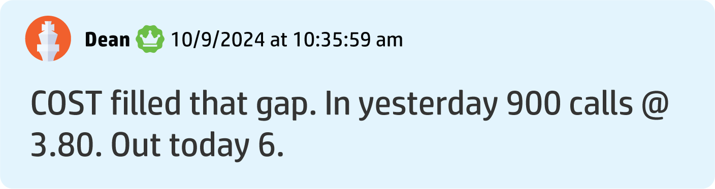
Dean S. Made 57% in 1 Day

Slide 89
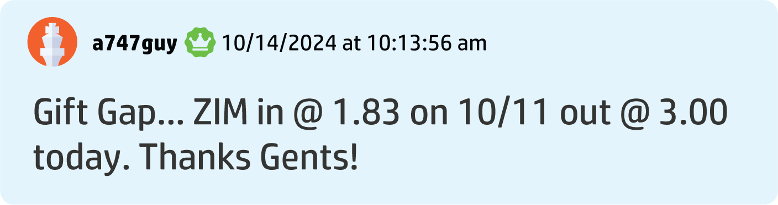
Aaron G. Made 63% in 4 Days

Slide 90
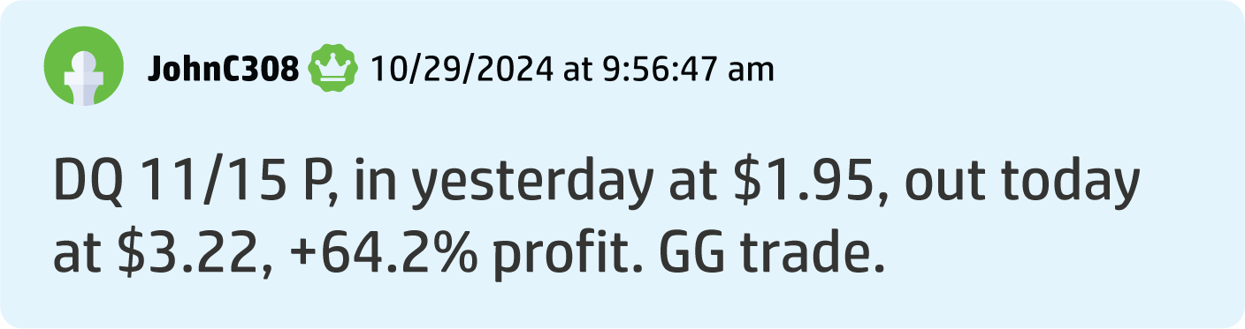
John C. Made a 62% Gain in 1 Day

Slide 91
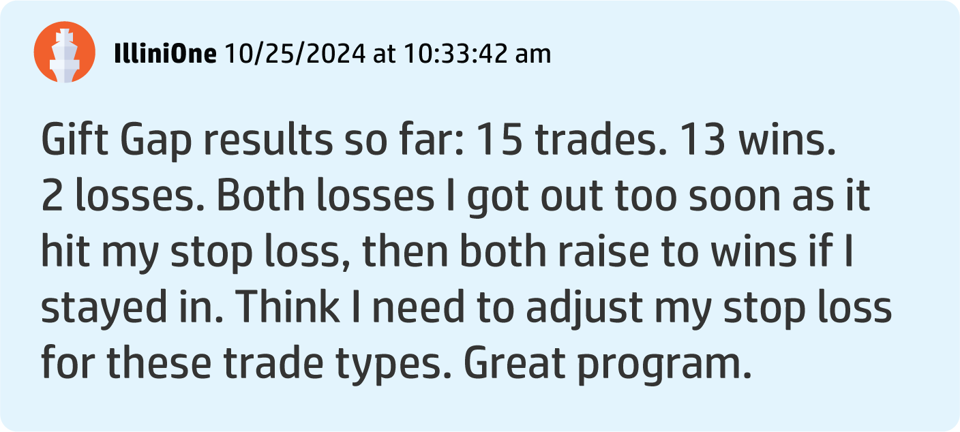
Illini O. Made 15 Gap Trades for 13 Wins and Just 2 Losses

Slide 92
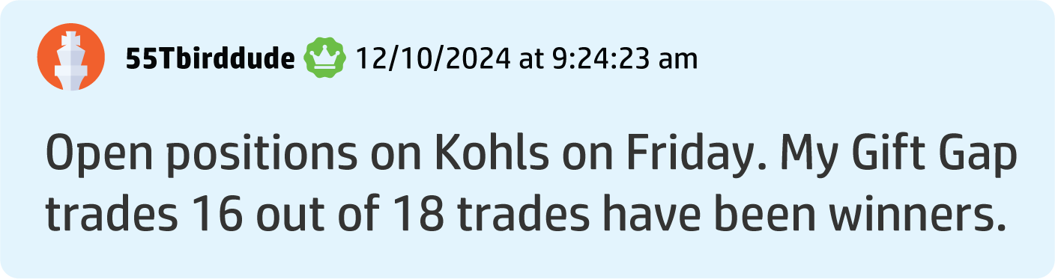
Tbird Says 89% of His Gift Gap Trades Are Winners!

Slide 93
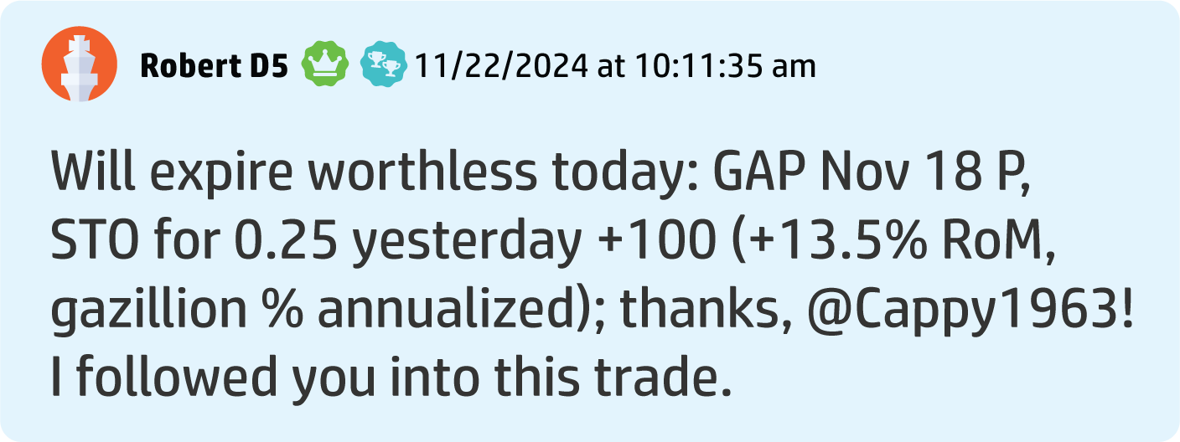
Robert D. Banked Over a 100% Win in 24 Hours

Slide 94
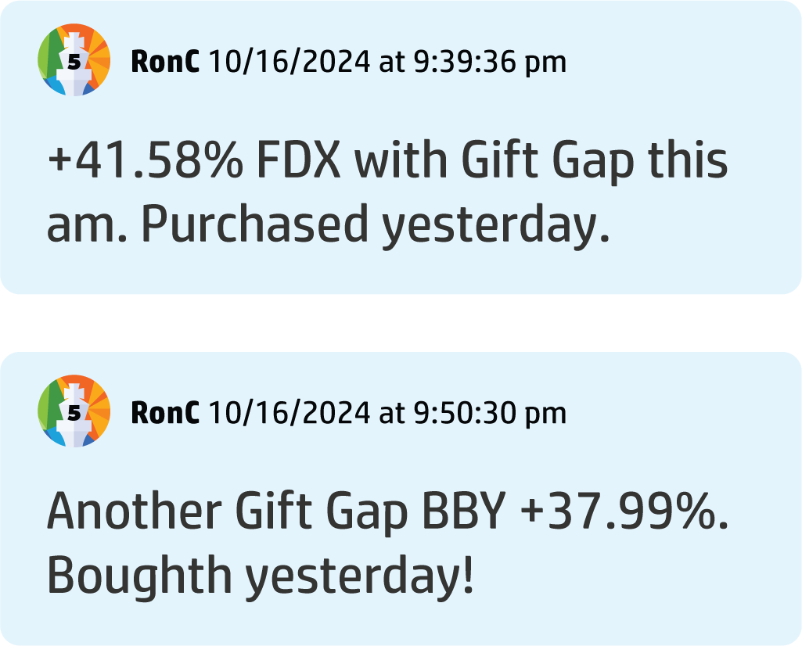
Ron C. Made Two Back-to-Back Plays: 41% in a Day and 37% Within Two Days!

Slide 95
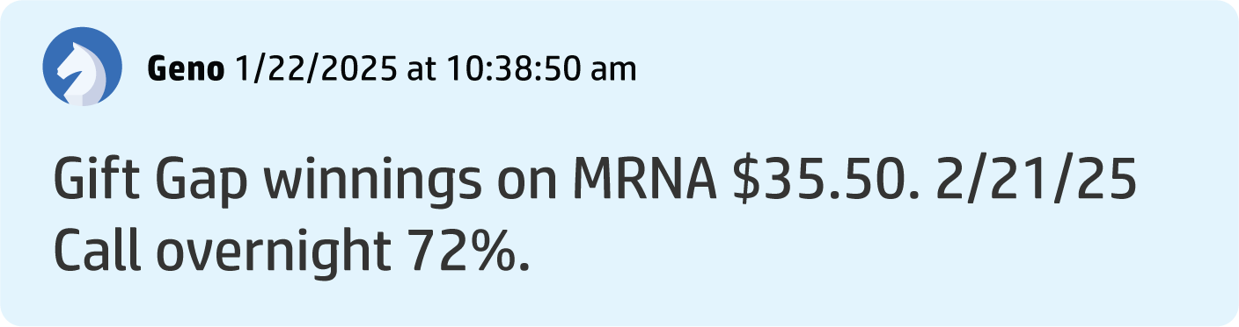
Geno Made a 72% Gain Overnight!

Slide 96
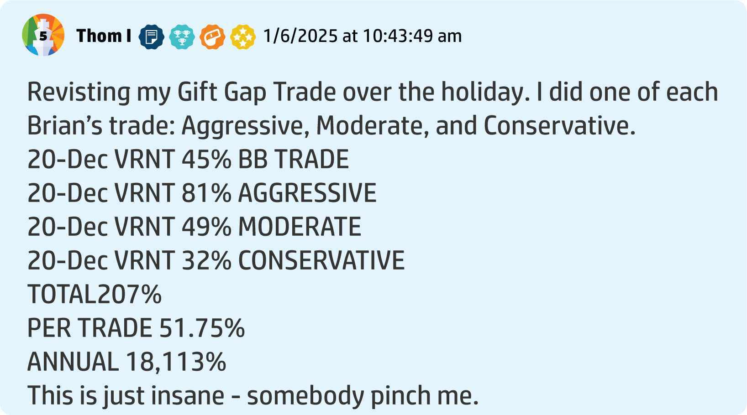
Thom I. Says He Made a 51.75% Average Per Trade in Two Months

Slide 97
Ryan Always Puts New Systems to The Test – Using His Own Money on Gift Gap Trades!
DLTR: 100% in 3 trading days
ALLY: 66.67% in 3 days
BROS: 50% in 14 trading days

Slide 98
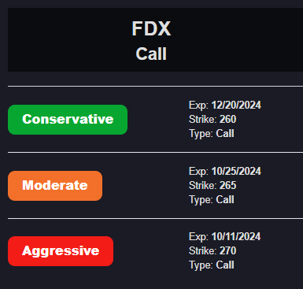
New Bonus Feature Each Gift Gap Now Comes With Power Options!

Slide 99
In Our Launch Demo,
We Gave Away Two Picks Using Power Options

Slide 100
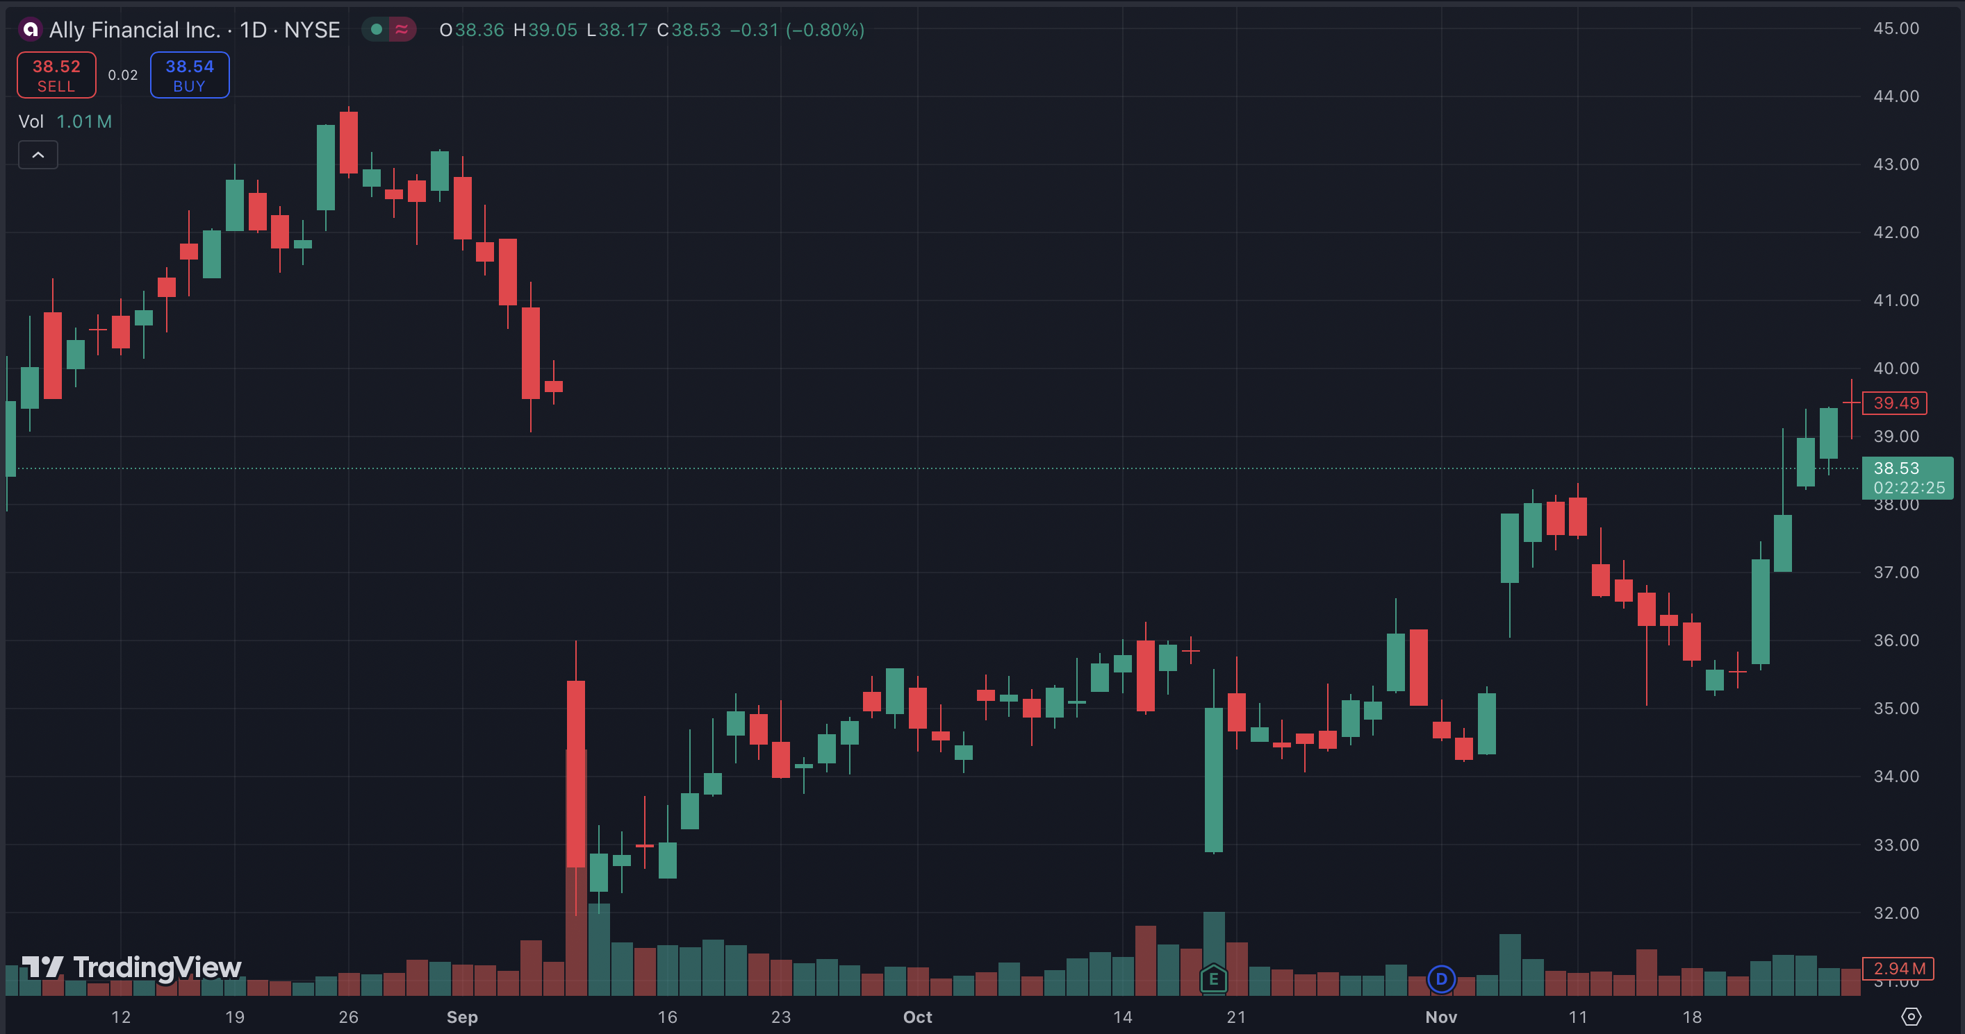
ALLY: Conservative Option Returned As Much As 119% in Two Months

Slide 101
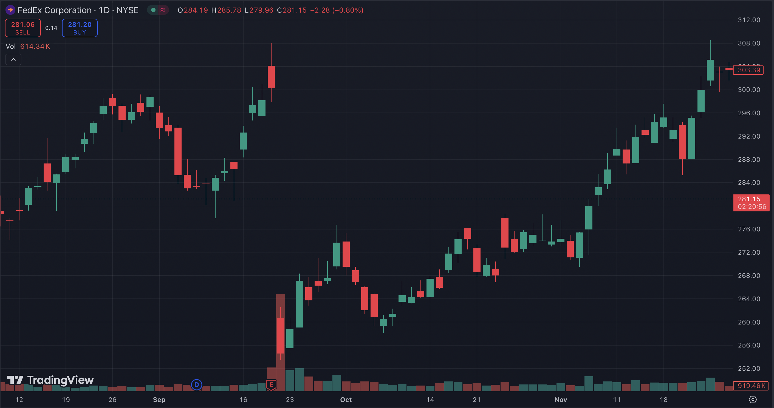
FDX: Conservative Option Returned Up to 200% in Two Months

Slide 102
This is Why We’ve Created The Gift Gap Indicator…
It’s Found Nowhere else!

Slide 103

Introducing The Gift Gap Scanner
Proprietary Scanner That Automatically Finds Gift Gaps in the Market
Only Recommends a Gap That’s
Being Filled
Tells You How Much of a Gap is Filled

Slide 104
Let’s See It in Action!
“This might be the most profitable feature of ProfitSight we’ve ever created.” – Bryan Bottarelli

Slide 105

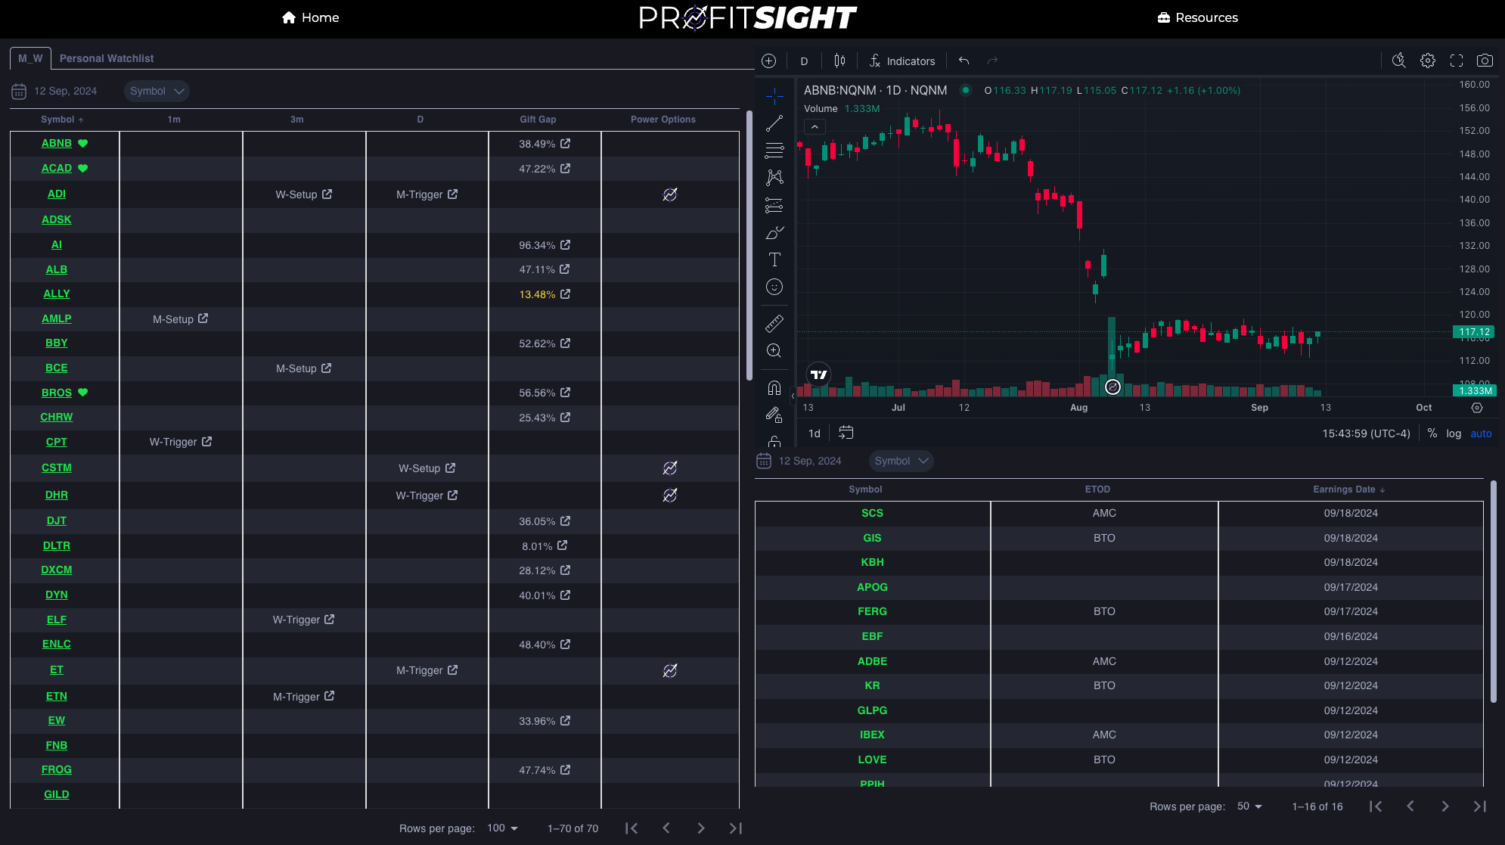
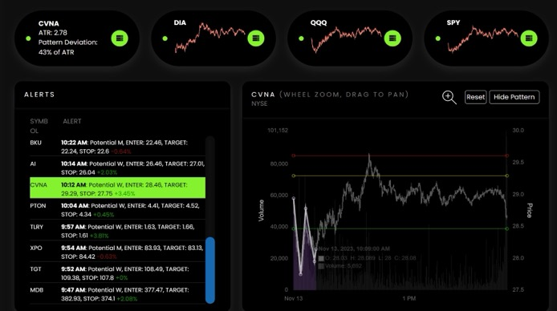
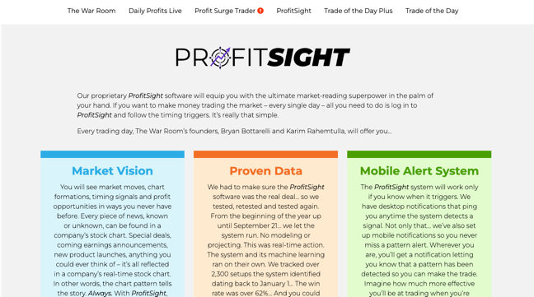
Website DEMO!

Slide 106

Why You Need Gift Gaps Now!
Q2 Earnings Season Just Started
Over 100 of S&P 500 Stocks Reporting This Week
Guidance Will Be Very Unclear Due to Tariffs
Huge Opportunities for Gift Gap Scanner

Slide 107
Gift Gap Earnings Watchlist for the Next 2 Days
Wednesday AMC: ORLY, ALK, NOW, IBM, CMG, NEM, TXN, LVS, URI, DFS, VKTX, IMAX
Thursday BMO: AAL, FCX, LUV, MRK, DOW, PEP, UNP, TSCO, HAS, MBLY, POOL, STRA
Thursday AMC: GOOG, INTC, TMUS, AEM, BYD, SKX, GILD, SAM
Friday BMO: ABBV, CL, PSX

Slide 108
Now, You Can Access
These Powerful Gift
Gap Alerts!

Slide 109
You get alerted to Gift
Gap trades – every single day, the instant it’s time to enter.

Slide 110
The New ProfitSight Package
Long and short W formations
Long and short M formations
Earnings tracking
And now… full access to
our brand-new, proprietary
Gift Gap indicator

Slide 111
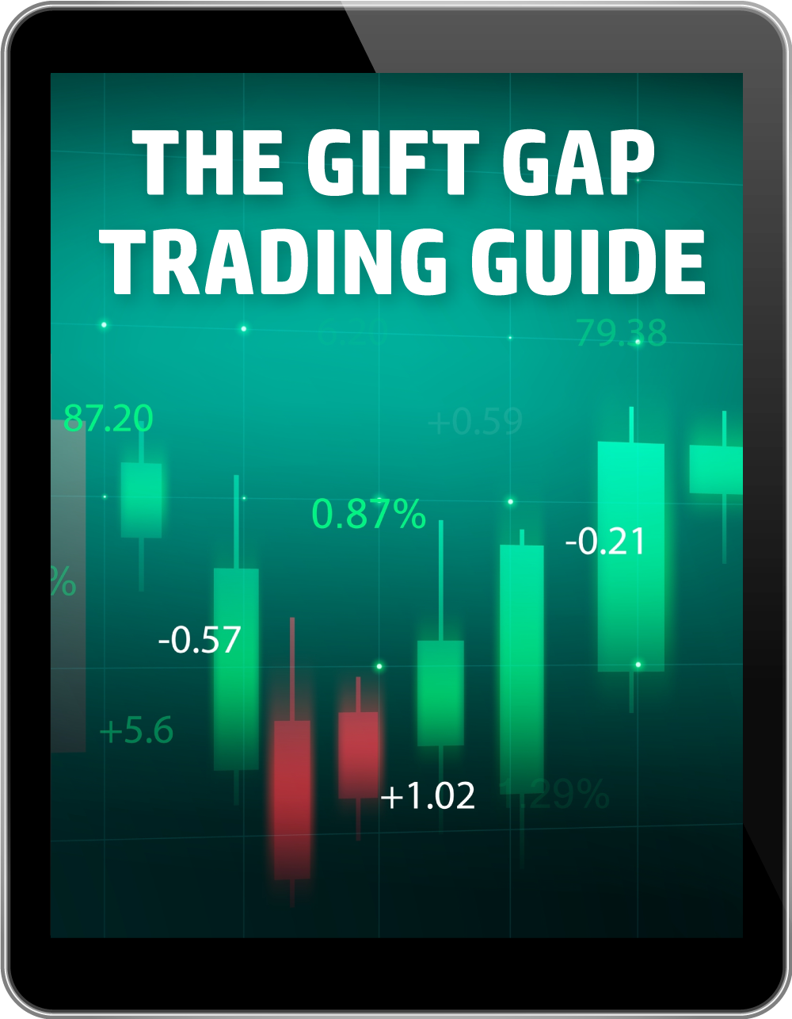
ProfitSight Package
Report – The Gift Gap Trading Guide
Complete breakdown on how to use The Gift Gap Software

Slide 112

ProfitSight Package
Video – ProfitSight Quick Start
A complete breakdown on how
to use the ProfitSight website, step by step

Slide 113

Today:
Choose the ProfitSight Level That Works for You
If You Join Today, You WILL NOT Pay the Retail Price

Slide 114
LEVEL 1 | BRONZE
RETAIL PRICE: $3,000/YEAR
Full access to the New Gift Gap setups
NEW: Earnings announcement tracker
Access to Scanner that tracks W and M patterns on 1 minute, 3 minute and daily tricks for every stock with options
Custom alert list

Slide 115
LEVEL 2 | SILVER
RETAIL PRICE: $4,000/YEAR
Everything in Bronze
PLUS custom Profit Targets and Sell stops based on our proprietary algorithm.

Slide 116

LEVEL 3 | GOLD
RETAIL PRICE: $5,000/YEAR
Everything in the Bronze and Silver levels
PLUS Power Options with conservative, moderate, and aggressive settings
These Power Options are available on Gift Gaps and daily W and M patterns.
Conservative
Moderate
Aggressive

Slide 117


Backed By Our
Gift Gap Guarantee
If after your first 60 days, you aren’t 100% satisfied… Call our VIP Concierge Team and we’ll refund your money, minus a 10% processing fee.

Slide 118

Bonus Special
Plus…
Give you a FULL YEAR of Catalyst Cash Outs Live (Value: $249)
You’ll get LIVE weekly trades, every Tuesday at 2 p.m.

Slide 119


Special ProfitSight Price to Celebrate the NEW Gift Gap Tracker
BRONZE
$3,000 PER YEAR $1,697
SILVER
$4,000 PER YEAR $2,297
PLUS…
GOLD
$5,000 ONE-TIME! $2,797
For Unlimited Access + $199 Annual Maintenance Fee

Slide 120
One Day Gift Gap Flash Sale!
Discount Code “300GIFT” Takes Additional $300 Off TODAY ONLY!

Slide 121
ProfitSight Price – TODAY ONLY!
SPECIAL BONUS: Save An Additional $300 OFF Until Midnight: USE CODE: 300GIFT
BRONZE
$3,000 PER YEAR $1,697 $1,397
SILVER
$4,000 PER YEAR $2,297 $1,997
PLUS…
GOLD
$5,000 ONE-TIME! $2,797 $2,497
For Unlimited Access + $199 Annual Maintenance Fee

Slide 122
ProfitSight Price – TODAY ONLY!
SPECIAL BONUS: Save An Additional $300 OFF Until Midnight: USE CODE: 300GIFT
BRONZE
$3,000 PER YEAR $1,697 $1,397
SILVER
$4,000 PER YEAR $2,297 $1,997
PLUS…
GOLD
$5,000 ONE-TIME! $2,797 $2,497
Q&A
For Unlimited Access + $199 Annual Maintenance Fee
Click the button in the chat or call 888.215.5311 to order by phone or ask questions!

