Slide 1

WHERE ORDINARY DAYS TURN INTO EXTRAORDINARY PROFITS
Discover the Breakthrough Trading Room That’s Delivered a Win-Per-Trading-Day Since 2019!
Notes:
DESIGN – CAN WE MAKE THE LOGO WHITE TEXT?

Slide 2
The War Room Portfolio Stats - At A Glance
  CREATE INFOGRAPHIC
  Founded: May 2019
  Members: 8,382
  Trade Ideas Per Day: 1-3 (on average)
  Winning Trades Since Inception: 2,384
  Win-Rate 75.6%
  Wins Per Trading Day: 1.46+ (Yes, we average over a win-per-day!)
  Average Holding Time: 17 Days
  Double-Digit Winners: 1,644
  Triple-Digit Winners: 55
  Biggest Single-Day Gains: 293%, 292%, 215%, 207%, 205%, 195%, 192%, 190%, 188%, 179%
Notes:
DESIGN NOTE: Create Infographic

Slide 3
Imagine the Look on Their Faces When You Tell Them…
“My portfolio has gone up 50% in the last two months!"
“I almost doubled my entire portfolio in less than a year!”
“I’ve grown my account from $1.1 million to nearly $8 million in just three years using what I’ve learned in the war room!”
“In 3 months, I turned $165k into a peak of $2.35 million!”
“My original stake of $20,000 ended up at $185,000 in 9 months. I’m making more money from my part-time hobby than I do from my day job!”
Notes:
DESIGN NOTE: Add stock images for each testimonial.

Slide 4
They’ll Ask…
“How’d You Do It?!”

Slide 5
The Answer…
THE WAR ROOM
Notes:
DESIGN – Can we add an image here?

Slide 6
FACT
51% of War Room members polled reported that they had a net worth of $1M or more!

Slide 7
Today’s Agenda:
  Meet the Dream Team Behind The War Room
  An Introduction to The War Room
  An Overview of Our Top 3 Trading Strategies
    Overnight Trades - How to Place One Trade Before the Closing Bell… and Target Huge Double- or Triple-Digit Gains the Very Next Morning
    Sniper Trades - How to Target Fast Market Moves for Potential Gains of 50%, 100%, or More… in Just Minutes
    Gift Gap Trades - How to Turn Wall Street’s Biggest Overreactions Into a Quick Payday
  A “Behind-the-Scenes” Tour of The War Room - Including FREE Bonus Trades!
  How You Can Access The War Room - And Our Top Trade Recommendations - For Yourself

Slide 8
DISCLAIMER:
Today, you’re going to see some of our top trades. Keep in mind: Past performance is never a guarantee of future results. Individual results may vary.
We are options traders, and, like all investing, trading options involves risk. It’s important to learn how to manage risk.
We are not investment advisors. Our goal is to show you how to execute our most successful strategies. But it’s important to remember that you should never invest more than you can afford to lose.

Slide 9
FIRST WHO AM I?
CHRIS JOHNSON - Senior Trading Analyst
  Seasoned equity and options analyst with nearly 30 years of experience
  Founder of Johnson Research Group and ETF Advisory Research Partners
  Holds degrees in finance, statistics, and accounting
  Highly ranked analyst (top 99.3% of financial bloggers per TipRanks)
  Appearing regularly on CNBC, Bloomberg, Fox Business News, and in publications like Barron's and The Wall Street Journal
  Now the lead host of Monument Traders LIVE and a contributor to many of of our newsletters
Notes:
Add Pic of Chris

Slide 10
THE WAR ROOM DREAM TEAM
PHOTO OF KARIM AND BRYAN

Slide 11
BRYAN BOTTARELLI
Co-Founder and Head Trade Tactician, Monument Traders Alliance
    Got his start trading in the options pit at the Chicago Board Options Exchange (CBOE) – where $82 billion changes hands daily
    Ran a private trading room from February 2006 to December 2018, where he delivered 3,765 trades and secured an average 13% gain per trade
    Launched Monument Traders Alliance and The War Room in 2019, where he and his team have personally shared thousands of double- and triple-digit gain opportunities with his members.
Notes:
ADD PIC OF BRYAN

Slide 12
KARIM RAHEMTULLA
Co-Founder and Head Fundamental Tactician, Monument Traders Alliance
  40+ years of trading experience, specializing in options, emerging markets, and alternative income strategies.
  Best-selling author of Where in the World Should I Invest? - which teaches practical strategies for investing in more than 20 countries and capital markets around the world.
  Partnered with Bryan to launch Monument Traders Alliance and The War Room, where he shares under-the-radar, contrarian opportunities and strategies with members each week.
Notes:
ADD PIC OF KARIM

Slide 13
THE BASICS…

Slide 14
If you’re a member of Monument Trend Advisory... You already know the W.A.R. Trend System
W - Winning Technicals
  Stocks showing strong, sustained momentum on the charts.
A - Accelerated Fundamentals
  Companies with exploding earnings, revenue surges, or game-changing developments.
R - Recent & Upcoming Catalysts
  Events like major contracts, regulatory approvals, product launches, or sector shifts that can ignite explosive moves.

Slide 15
THE WAR ROOM IS WHERE
BRYAN AND KARIM TAKE IT TO THE NEXT LEVEL
HIGHER POTENTIAL + FASTER TRADES!

Slide 16
Over the past 7 years, it’s become BIGGER than your typical research service...
  The War Room is a unique, game-changing, collaborative platform where an elite group of like-minded traders and market enthusiasts gather each trading day to offer insight, ideas and community - all with the same goal: to make winning trades.

Slide 17
How Does The War Room Work?
  Every trading day, The War Room founders, Bryan Bottarelli and Karim Rahemtulla, join members in the room.
  They share live, real-time plays, strategies, and tactics designed to deliver members daily winners. (Please note: They cannot give personalized investment advice.)
  You’ll also connect with a community of hundreds of like-minded traders who enjoy sharing their best ideas for daily wealth creation.

Slide 18
THE TOP 3 TRADING STRATEGIES BEHIND OUR 2,341 WINNERS
(AND COUNTING!)

Slide 19
STRATEGY #1
OVERNIGHT TRADES
Place one trade before the closing bell… and you could wake up to huge gains the next morning!

Slide 20
Real Trade Example: Block (XYZ)
  Open: May 1, 2025
  Close: May 2, 2025
  Gain: 192.34%

Slide 21
Real War Room Member Success Stories
“Bought XYZ @ $4.57 and sold @ $13.30 (191% gain).” - Iham
“In @ $4.58 and out @ $13.40 (193% gain).” - LarryD
“In @ $4.44 and out @ $13.38 for a 201% winner! Thanks for the great trade BB!” - SpacemanSnoopy
“I opened 1 contract @ $4.52 and closed @ $12.70 for a profit of 181%. Thanks, BB!” - PamelaH
“Way to go, Bryan! You nailed it. Thank you for a 190% Overnight Win!” - Mike_Mc
“Bryan - made 280% on XYZ. Nice profit.” - Cycleman007

Slide 22
Real Trade Example: TripAdvisor (TRIP)
  Open: May 7, 2024
  Close: May 8, 2024
  Gain: 206.75%

Slide 23
Real War Room Member Success Stories
“I closed the 5 contracts I opened @ $2.60 for $7.50 (188%). Thanks, Bryan!” - DavidB10
“In @ $2.60 and out @ $7.27 (180%). Super WIN!!!” - GaryLih
“I closed the 10 contracts I opened @ $1.24 for $7.80 (529%). That was AWESOME!” - KAS60
“Made the TRIP trade while playing golf. In @ $2.30 and out @ $7.60 for a 230% win.” - Grahamtwo
“Jackpot Winner! Way to go, Bryan!! I made 460% - could have held on longer for a rocket ride, but I have no complaints. Thanks a mill!!” - SnickiPop
“480% Gain on TRIP – WOW!” - ScubaRichard

Slide 24
Real War Room Member Success Stories
“Thanks BB! We knocked that one out of the park.” - Ijspy
“Thank you, BB! In @ $1.33 and out @ $8.24 for a 520% win!” - coach
“Was looking for a single or a double. Hit a GRAND SLAM on 3 contracts for a gain of 352%!” - Baron
“TRIP – In @ $2.30 and out @ $8. It’s my last day of vacation in the Caymans and this made me very happy! Thanks, Bryan.”
“Holy Shitoly! I just got up and thought I was tripping!!??” - LOADY

Slide 25
Real Trade Example: Advance Auto Parts (AAP)
  Open: May 30, 2023
  Close: May 31, 2023
  Gain: 293.27%

Slide 26
Real War Room Member Success Stories
“Now that’s what I’m talking about! I opened 1 contract @ $7.99 and closed @ $30.82 (286% gain).” - BartMan
“Best Trade EVER! In @ $4.30 and out @ $33 (667% gain). This has been the most profitable trade of the year for me. Thanks, BB!” - Fred A
“In AAP @ $4 and out at $33.20 (730%). Wonderful!” - Level Up
“In @ $8.05 and out @ $33.12 for a gain of 311% and $2,507 in real profit. Thanks, Bryan. WOW!” - Avatar
“Holy cow! Just signed in and sold my AAP put for a profit of $2,606! Thank you, Bryan! That’s the kind of thing I was hoping to see! Whoopee! (In @ $8.30 and out @ $34.35.)” - Adezutter
“Wow! Made 8X what I invested. I will buy the drinks for all!” - Seaspray

Slide 27
So, How Do We Find These Trades?

Slide 28
One Earnings Signal. One Strangle Trade. Unlimited Overnight Potential.
  Trade Earnings Announcements - Target companies about to report quarterly earnings. These events almost always trigger sharp price moves up or down.
  Look for Volume Spikes - A surge in trading volume before earnings signals that a big move is coming.
  Place a “Win Both Ways” Trade – Buy both a call and a put. This way, you profit from a big earnings move regardless of whether the stock goes up or down. You just need it to move.

Slide 29
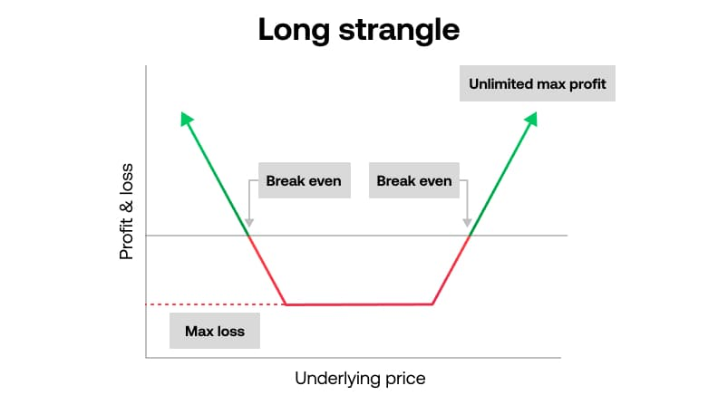
Here’s What It Looks Like…
Notes:
DESIGN – RECREATE WITH CHART HEADLINE: THE “WIN BOTH WAYS” TRADE MODEL

Slide 30
Additional Overnight Winners
  💥153.27% Overnight on ADM
  💥 154.35% Overnight on DBX
  💥 160.15% Overnight on FSLR
  💥 178.90% Overnight on YUM
  💥 188.49% Overnight on FDX
  💥 189.70% Overnight on DG

Slide 31
Too Good To Be True?
  Keep in mind: These are NOT hypothetical gains.
  These are REAL trades our tacticians recommended…
  And REAL success stories from some of our happiest VERIFIED War Room members.

Slide 32
And That’s Just Scratching The Surface…

Slide 33
STRATEGY #2
SNIPER TRADES
Target fast market moves for potential gains of 50%, 100%, or more… in just minutes!

Slide 34
Real Trade Example: Teladoc Health (TDOC)
  Open: 9:54 a.m.
  Close: 10:07 a.m.
  Total Hold Time: 13 Minutes
  Gain: 98.11%

Slide 35
Real War Room Member Success Stories
“Excellent trade, Bryan! In @ $5.80 and out @ $7.44 for a gain of 28% in 15 minutes… quicker than a call to the Dr!” - AnamCara
“In @ 5.80 and out @ $11.50 (98% gain) for a quick profit of $2,850 in 18 minutes! Thanks!” - Mark P2
“Made a total profit of $4,019 on TDOC (340% gain). My best day ever!” - Jim S.
“Thanks for your morning thoughts, Bryan! I’m up 48% on TDOC, 18% on JWN, and 17% on CLX. Easy, quick sniping – time for my morning walk.” - James R2

Slide 36
Real Trade Example: Rite Aid (RAD)
  Open: 10:14 a.m.
  Close: 3:06 p.m.
  Total Hold Time: 4 Hours and 52 Minutes
  Gain: 118.26%

Slide 37
Real War Room Member Success Stories
“Got into RAD @ $1.14 and out @ $3. Thanks, BB.” - Lancer
“Just sold RAD @ $2.70. Bought it @ $.85. Gain of 218%. Thank you, Bryan!!” - JanellM
“Took a 113% profit on RAD. Thanks War Room!” - Husker1
“Thank you for the RAD trade. I made 184.8% in less than an hour!” – HWagner248
“Entered the RAD call 1 minute before the spike @ $1.14 and sold @ $2.65 for a gain of 132% in just 13 minutes (LUCKY!)” - Todd777
“Thanks for the RAD trade, BB. Bought @ $.95 and sold @ $2.37 for a 150% gain.” - Rick VM

Slide 38
Real Trade Example: Walmart (WMT)
  Open: 10:20 a.m.
  Close: 11:39 a.m.
  Total Hold Time: 1 Hour and 19 Minutes
  Gain: 121.12%

Slide 39
Real War Room Member Success Stories
“As a new (first day today) member, THANKS! I must say, I am SOLD. I have been trading for a few years now. This ROOM ROCKS. Thanks!” - Mark P5
“WMT - That was flippin’ crazy! My best purely by the numbers War Room trade. In @ $1.62 and out @ $3.05 (88% gain).” - Dennis I.
“Wow! Super trade, Bryan! Thanks for watching this one carefully! In @ $1.62 and out @ $2.90 for a gain of 79% in just over an hour! Bryan Rocks! He deserves something on the rocks for this one.” - AnamCara
“My first War Room trade - WMT - bought @ $1.61 and sold @ $3.75 for a 133% gain. Yeeehaaa! Thanks, Bryan!” - Eka A

Slide 40
Real War Room Member Success Stories
“In @ $1.64 and out @ $4.50 for a 164% gain!” - Jethro B
“OMG Bryan! Went for a bike ride and came back to a 295% increase on WMT. You, my friend, are the Wizard of Options today. Thanks for this one, sir. You just made my week!” - RickR
“Wow! Just cashed out WMT for a 150% winner in an hour! Gotta love it!” - Jeff F1
“WMT - In @ $1.70 and out @ $8.20 for a 482% gain!” - AI B2

Slide 41
So, How Do We Uncover These Trades?

Slide 42
Quick Strikes. Quick Profits. No Guesswork.
  Zero In On Micro-Moves - Use a 3-minute chart to spot real-time signals that reveal when a stock is about to breakout.
  Strike with Precision - Enter specified trades at the exact moment momentum builds, then ride the surge for minutes… not days or weeks.
  Exit with Discipline - Follow crystal-clear alerts that tell you precisely when to close out for maximum impact.

Slide 43
Additional Sniper Trade Winners
  💥53.62% in 4 Minutes on ROKU
  💥54.90% in 38 Minutes on QCOM
  💥69.85% in 6 Minutes on DWAC
  💥71.08% in 23 Minutes on NFLX
  💥73% in 9 Minutes on RGR
  💥95.33% in 3 Hours and 45 Minutes on QQQ

Slide 44
To review, so far you’ve seen…
  Our top strategy for potentially doubling your money - or more - overnight
  Our top strategy for raking in massive double- and triple-digit gains… in minutes
  Top success stories from real members who have followed our recommendations.

Slide 45
And in just a few minutes…
  You’re going to get a behind-the-scenes tour of The War Room – including FREE live trades!

Slide 46
But first…
  I want to show you one more strategy we use to target huge, market-beating gains in just a few days or less…

Slide 47
STRATEGY #3
GIFT GAP TRADES
Turn Wall Street’s biggest overreactions into a quick payday

Slide 48
Real Trade Example: Monster Beverage Corp (MNST)
  Open: August 13, 2024
  Close: August 15, 2024
  Gain: 21.97%

Slide 49
Real War Room Member Success Stories
“Locked in 44% on MNST.”
“MNST - 24% profit.”
“Great morning! WMT and MNST paid off!”

Slide 50
Real Trade Example: DexCom (DXCM)
  Open: August 21, 2024
  Close: August 22, 2024
  Gain: 23.54%

Slide 51
Real War Room Member Success Stories
“In @ $3.75 and out @ $4.75 for a 26.7% gain. Thanks, BB!” - Brad T
“In @ $3.75 and out @ $4.83 for a 29% win. Thank you, Bryan!” - SpacemanSnoopy
“In @ $3.71 and out @ $4.80 for a nice 29% win. Thank you, BB.” - a747guy
“DXCM - in @ $3.79 and out @ $4.70 (24% gain). I’ve been keeping a running total of all the trades here from various programs I’ve bought. This is the only one consistently making money from selling options! Thank you!!!” - GuitarLady
“Bryan - thanks for the DXCM trade. In @ $3.80 and out @ $4.80 for a 26.32% gain.” - Mike2024

Slide 52
Real Trade Example: Dick’s Sporting Goods (DKS)
  Open: September 24, 2024
  Close: September 26, 2024
  Gain: 78.49%

Slide 53
Real War Room Member Success Stories
“Locked in 128% profit on DKS!” - coachrogers92
“Almost a double on DKS this morning! In @ $5.69 and out @ $11 (93% gain). Thanks again!” - Eddy B
“Wow!!! Huge shout out to Bryan on one of the best days ever for me. Up 73% on DKS… plus a double on MU and a big gain on IWM. You are killin’ it, buddy. Thanks so much.” - RickR
“What a morning! DKS – In @ $5.60 and out @ $10.15 for a profit of $4,536. IWM – In @ $1.50 and out @ $3.30 for a profit of $3,573. MU – In @ $8.30 and out @ $18 for a profit of $9,679. Total this morning is $17,788. Thanks, Bryan!” - WLLY
“Took a 103% gain on DKS. Thanks, Bryan!” - Ron-WashMo

Slide 54
So, What’s Our Playbook for Gift Gap Trades Look Like?

Slide 55
Here’s How We Turn Market Mistakes Into Fast Profits…
  Target Big One-Day Moves - Looks for a stock in a clear uptrend or downtrend that suddenly jumps or drops 10%+ in a single session.
  Trade the Empty Space - These sharp overreactions leave behind “gaps” on the chart with no built-in resistance or support, creating room for a quick reversal.
  Capture Rapid Gap Fills – Buy a short-dated call or put option when the momentum kicks back in and ride the stock to fast gains as it retraces the gap.

Slide 56
Here’s What It Looks Like…

Slide 57
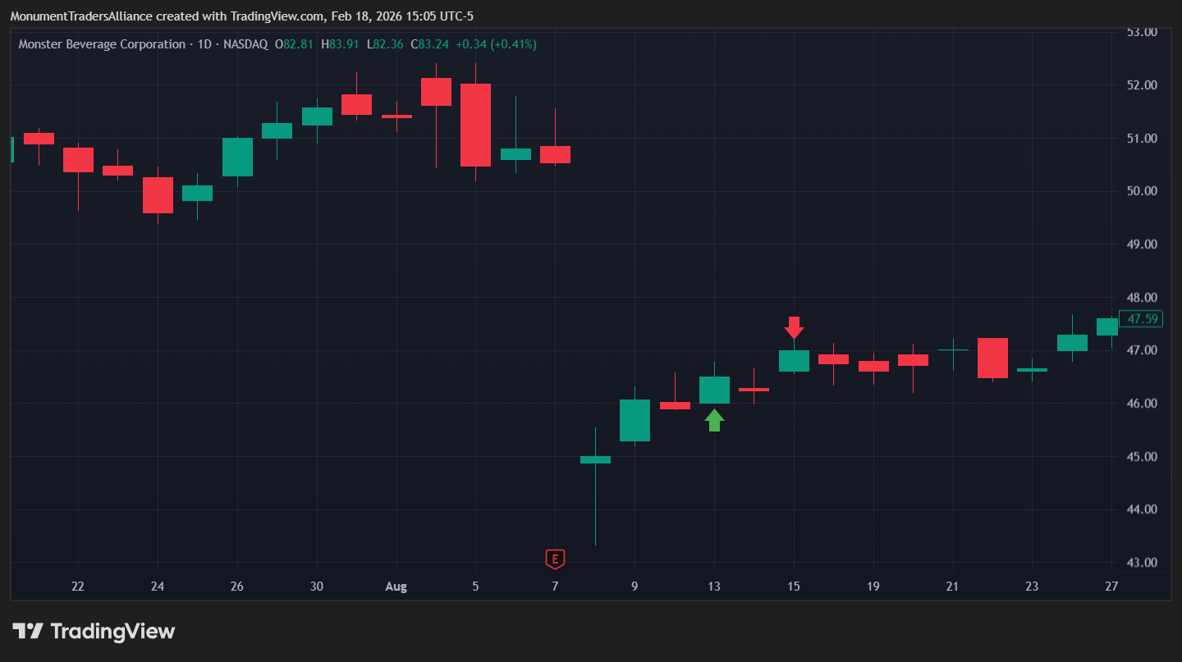
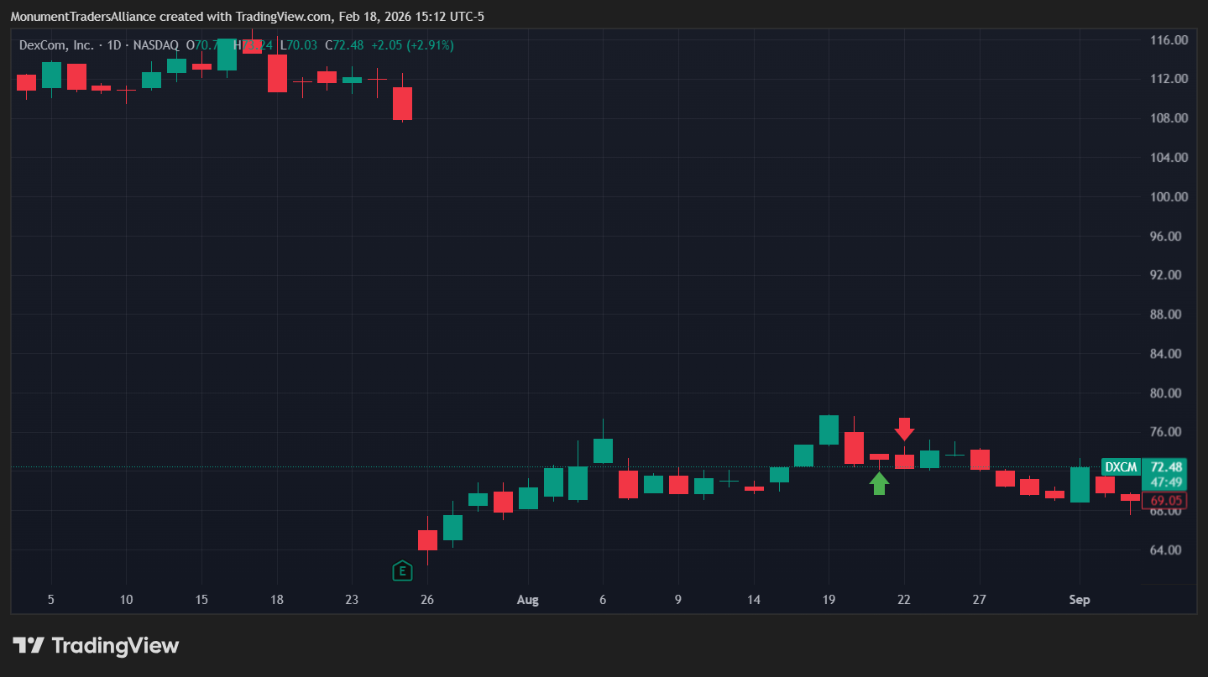
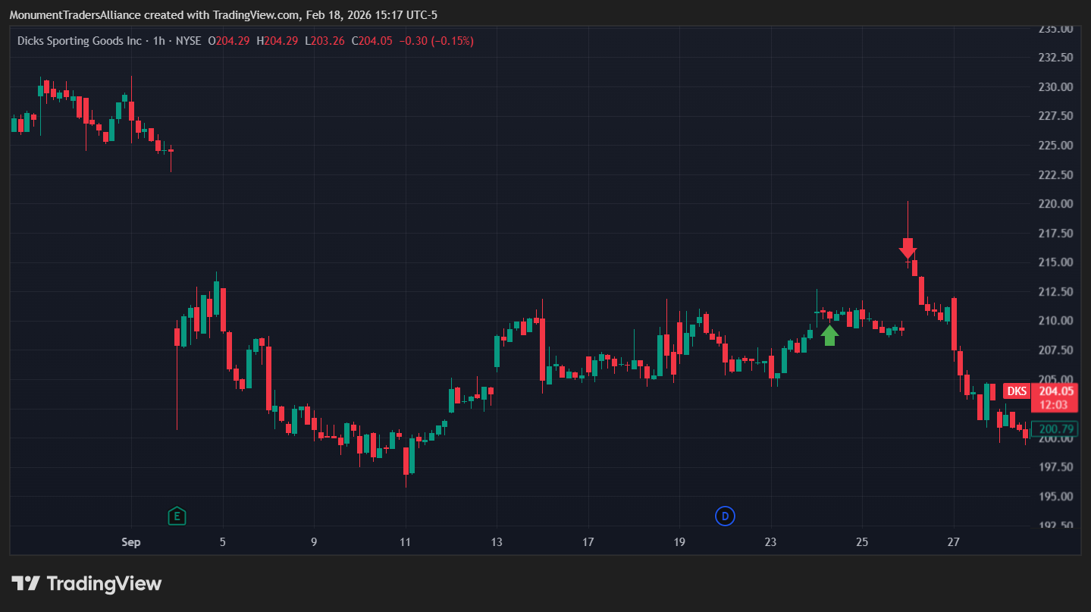
Notes:
Design – recreate these charts for MNST, DXCM, and DKS with a circle to show “The Gift Gap” on each and the gain on eaech.

Slide 58
By Following Bryan’s Expert Strategies in The War Room You Have the Chance to…
  Wake Up Richer - Place one Overnight Trade before the closing bell and wake up to potential double- or triple-digit gains the next morning.
  Cash In Fast - Use Sniper Trades to zero in on explosive market moves and target gains of 50%, 100%, or more… in minutes.
  Turn Mistakes Into Money - Leverage Gift Gap Trades to profit from Wall Street’s biggest overreactions and score quick paydays.

Slide 59
BUT THERE’S MORE…

Slide 60
BONUS! BONUS! BONUS!
  In addition to getting access to all of Bryan’s winning short-term technical trades… War Room members also get access to Karim’s longer-term fundamental trades.

Slide 61
Let’s Quickly Review These… And We’ll Dive Deeper During the Demo…

Slide 62
Karim’s Put-Sells… By The Numbers
  Since Inception:
  Closed Trades: 162
  Winning Trades: 155
  Win-Rate: 96%
  Average Hold Time: 56 Days
  *Please Note: Put-selling can be considered a higher risk strategy and is often used by more advanced traders.

Slide 63
Karim’s Top Put-Sell Trades (Gains based on a 10% margin)
Top 3 Put Sell Trades (ROM) | Open Date | Close Date | Return on Margin | Premium Capture | Duration Held
ABSI 15 AUG 25 $2 PUT | 1/28/2025 | 6/23/2025 | 70% | 58.33% | 146 DAYS
MARA 16 JAN 26 $5 PUT | 11/18/2024 | 6/25/2025 | 46.67% | 63.64% | 218 DAYS
SOFI 19 JAN 24 $6 PUT | 6/23/2023 | 7/31/2023 | 34.44% | 59.62% | 35 DAYS
Top 3 Put Sell Trades (PC) | Open Date | Close Date | Return on Margin | Premium Capture | Duration Held
SOFI TECH 21 JUN 24 $5 PUT | 2/1/2024 | 6/4/2024 | 21.33% | 88.89% | 124 DAYS
BHVN 17 JAN 25 $30 PUT | 9/25/2024 | 1/13/2025 | 19.33% | 81.31% | 110 DAYS
CHWY 19 APR 24 $12.5 PUT | 9/21/2023 | 1/2/2024 | 32.53% | 77.22% | 103 DAYS

Slide 64
Karim’s Spreads and LEAPS… By The Numbers
  Since Inception:
  Closed Trades: 115
  Winning Trades: 90
  Win-Rate: 78%
  Average Hold Time: 128 Days

Slide 65
Karim’s Top Spreads and LEAPS
Top 3 Spreads | Open Date | Close Date | Return | Duration Held
PS BITCOIN STRATEGY | 11/2/2023 | 3/4/2024 | 194.5% | 123 DAYS
B. RILEY FINANCIAL | 12/5/2023 | 4/26/2024 | 128.31% | 143 DAYS
SPDR S&P BIOTECH | 3/9/2023 | 1/11/2024 | 121.75% | 308 DAYS
Top 3 LEAPS | Open Date | Close Date | Return | Duration Held
EWG JANUARY 15, 2027 $37 CALLS | 4/9/2025 | 4/14/2025 | 61.57% | 5 DAYS
ITUB $4.5 20 JAN 23 CALLS | 12/7/2020 | 6/7/2021 | 41.18% | 182 DAYS
FCX $12 JAN 21 CALLS | 6/12/2019 | 11/5/2019 | 33.08% | 146 DAYS

Slide 66
A Quick Recap…
  The War Room is our LIVE chat room.
  Our strategists are in the room every day the market is open - sharing their market analysis, research, and live trade recommendations.
  Members from around the world join to achieve one goal: Make Winning Trades Every Day
  We can teach you how to execute ALL of these strategies - and trade like a pro - even if you’re just starting out!

Slide 67
And I’ll prove it to you now…

Slide 68
GET READY FOR YOUR “BEHIND-THE-SCENES” TOUR…

Slide 69
DEMO HERE!!!

Slide 70
And Now… YOU Have the Chance to Step Inside
THE WAR ROOM

Slide 71
The Timing Couldn’t Be Better…
  2026 market forecasts are in… and they’re incredibly bullish.

Slide 72
Predictions for the S&P indicate strong double-digit growth…
      Deutsche Bank: 8,000
      Wells Fargo: 7,800
      JPMorgan: 7,500

Slide 73
What’s Driving It?
      Continued AI Investment
      Supportive Monetary Policies
      Strong Corporate Earnings

Slide 74
And That’s Just the Beginning…
  “A New Bull Market Has Begun… And Is Still In The Early Stages.” - Mike Wilson, Morgan Stanley

Slide 75
In Other Words…
  You Can Now Get Access to All of Our Best Trades… Right at the Start of What’s Shaping Up to be a Banner Year!

Slide 76
THE WAR ROOM LOGO
Real Results. Real Potential for YOU.

Slide 77
To Review…
  Since 2019, we’ve shown members more than 2,300 wins.
  Year-to-date, we’ve delivered our readers 33+ winning trades (That averages out to more than 1 winning trade per day that the stock market has been open.)
  We’ve achieved a 76% win-rate on ALL of our trades since inception… full transparency.

Slide 78
The War Room Community At A Glance…
  Total Members: 8,382
  Global Reach: Members From Over 100 Countries
  Net Worth Of $500k+: 1,283 Members
  Goal: Achieve Millionaire Status (Or More!)
Notes:
DESIGN – Please Create Infographic

Slide 79
Building the Foundation
  War Room members aren’t just serious about making winning trades… they’re serious about helping you succeed.
  Got a question? Ask it. And get answers from traders who’ve been in your shoes.
  Want fresh trade ideas beyond what our strategists recommend? Tap into a stream of moneymaking ideas being shared in real time.
  Nail a winning trade? Don’t celebrate solo. Get high-fived by a whole community that knows exactly how it feels to win.
Notes:
DESIGN – Please Create Infographic

Slide 80
In The War Room - It’s Not Just About Trading… It’s About Joining Forces With People Who Want To See You Win - And Who Will Cheer You On Every Step Of The Way.

Slide 81
Wins Worth Celebrating
“My original stake of $20,000 ended up being $185,000. I have proﬁted more than my day job paycheck... and that was only [after 9 months] part-time in The War Room.” - David D.
“My War Room portfolio has gone up over 50% in the last two months, from $65,000 to over $100,000. I love The War Room and can’t think of a better trading and learning community.” - Matthew
“With this last trade in Roku today, I managed a proﬁt of $200,000 with a starting stake of $25,000 in just four months trading in The War Room. I couldn’t manage this without the trades of Bryan, Karim, and George. My son wants me to buy a lambo, but that’s not gonna happen. Maybe a beautiful classic car!” - Mohammed
“I started The War Room back on May 25, 2020. By February 2021 I turned $90,000 into $178,000. I almost DOUBLED my entire account in less than a year!” - Tad

Slide 82
Wins Worth Celebrating...
“First 10 days of May and my account is up 53%.” - Thom
“When I started at The War Room, I was very new at this. But in three months, I turned $165,000 into peak gains of $2.35 MILLION!” - George
“I know many here are like me, joining The War Room with the hope to improve our retirement account. I had never traded options before joining The War Room. [Yet] I can comfortably say (even with market ups and downs) that I have now achieved a 100% return from my initial capital ($150,000 into more than $300,000). The eight-month gain from trading has easily outearned my salary (before tax). This has been an incredible journey, from not knowing anything about options trading to doubling my account in less than nine months. Thank you, my TEACHERS.” - Ken W.

Slide 83
Ready to Write Your
Own Success Story?

Slide 84
Let’s Start TODAY!

Slide 85
Here’s EVERYTHING That’s Included In A War Room Membership…

Slide 86
Premarket Commentary
  Every morning at 9 a.m., our strategists deliver their premarket notes to War Room members.
  They break down the big macro trends they’re seeing and the companies they’re watching.
  They ensure you have FULL access to all of their market analysis 30 minutes before the Opening Bell.
Notes:
DESIGN – Please Add Image

Slide 87
All LIVE Recommendations
  Once the Opening Bell rings at 9:30 a.m., we’re off to the races.
  The SECOND Bryan or Karim spots a recommendation, they type it into the chatroom.
  You IMMEDIATELY get all the relevant information you need.
Notes:
DESIGN – Please Add Image

Slide 88
Trade Alerts
  Do you have to be in front of your computer all day? NO!
  You can get an alert to your phone or computer any time there’s a trade.
  The War Room is designed to work around YOUR schedule.
Notes:
DESIGN – Please Add Image

Slide 89
The War Room Headquarters - Video Series
  Unlock access to our in-depth Options Master Class - including details on how to set up your options trading account, how to get approved for options trading, how to “hack” earnings season with strangles, how to read the 3-minute chart, and more!
Notes:
DESIGN – Please Add Image

Slide 90
The War Room Headquarters - Premium Reports
  Access our easy-to-follow guidelines for some of our top trading strategies
    Overnight Trades: How to Hit Massive Earnings Winners Every Day of the Week
    Magic 9 Profits: How to Play 9 Stocks for Portfolio Riches
    The 10X Profit System
    Insider Strategies for Smart Money Trades
    The Rule of 5 Profit System
    And More!
Notes:
DESIGN – Please Add Image

Slide 91
The War Room Headquarters - Monthly Intelligence Reports
  Features a summary of the most important market events for each month
  Outlines our year-to-date progress
  Lists our biggest winners of the month
  Includes a snapshot of top member success stories
Notes:
DESIGN – Please Add Image

Slide 92
BONUS: Karim’s Insider Buying Intel
  Karim shares his data on insider cluster buying (one of his FAVORITE trading strategies)
  When a group of company insiders makes a significant buy... he’ll share that intel in real-time.
  Not always trades
Notes:
DESIGN – Please Add Image

Slide 93
You’ll Have EVERYTHING You Need to Succeed…
And It’s All Backed By TWO Bold Guarantees

Slide 94
GUARANTEE #1: Our 90-Day Money Back Guarantee
  In Your First 90 Days, We Promise You’ll See An Average Of At Least 1 Winning Trade - Every Day the Markets Are Open - Per Our Track Record, Or We’ll Give You Your Money Back
  Simply chat, call, or email our VIP Concierge Team after your first 90 days, and if we haven’t delivered on our promise, you can request an immediate cash refund (minus 10% processing fee) - no questions asked!

Slide 95
GUARANTEE #2: At Least 1 Winning Trade Every Day the Markets Are Open!
  After your first year, if you haven’t seen an average of AT LEAST 1 winning trade… every day the markets are open (per our track record)… simply reach out to our VIP Concierge Team, and they’ll add another year of The War Room to your account… ABSOLUTELY FREE.

Slide 96
NORMAL RETAIL PRICE: $7,500/YEAR
Bundle image here
Notes:
DESIGN – Please Add Bundle Image

Slide 97
BUY 3 MONTHS,
GET 9 MONTHS FREE!!
FOR A LIMITED TIME ONLY: SPECIAL EVENT DEAL

Slide 98
SPECIAL EVENT DEAL
ANNUAL
$1,875
PER YEAR
Special Introductory Offer: Buy 3 Months, Get 9 Months Free!
Backed by 90-Day Money-Back Guarantee
Backed by a 365-Day Performance Guarantee
Click the button or call XXX.XXX.XXXX to order by phone or ask questions!
Notes:
Bundle Image

