Slide 1

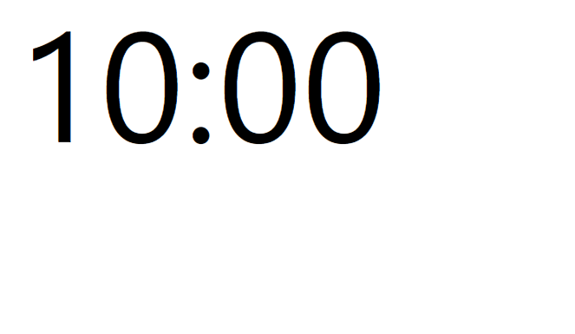

Slide 2
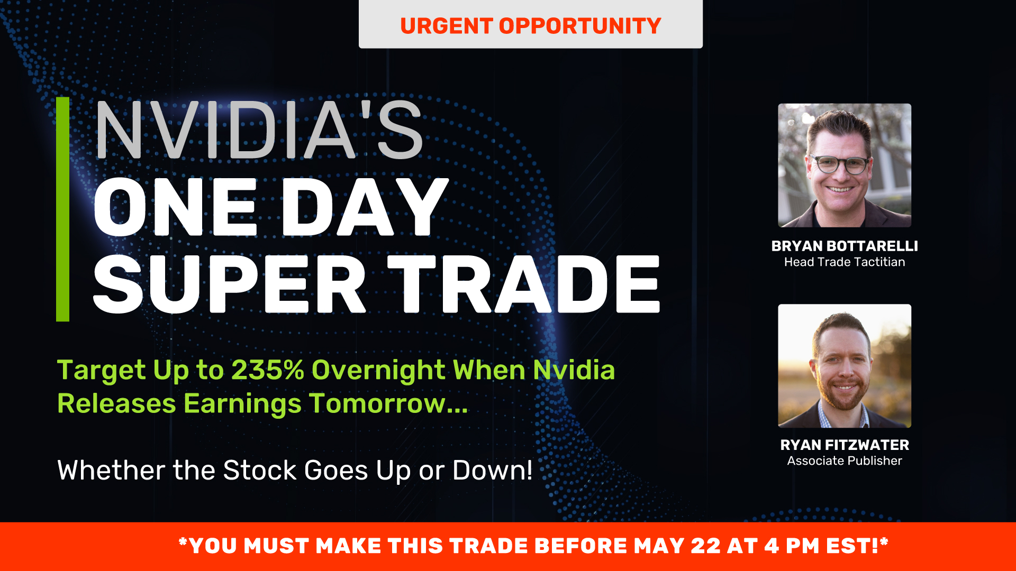

Slide 3
Your Hosts
Bryan Bottarelli
Karim Rahemtulla
Ryan Fitzwater
(headshots)

Slide 4
Agenda
State of market (Is volatility is here to stay?)
Biggest mistake most traders make in volatile markets
Pro Trader Strategies to WIN even in down markets
The immediate opportunities we have right now
Five of our favorite picks
How you can PROFIT in months ahead (even in a downturn)
Special Tariff Relief Deal for You
Live Q&A

Slide 5
Is Volatility Here to Stay?

Slide 6
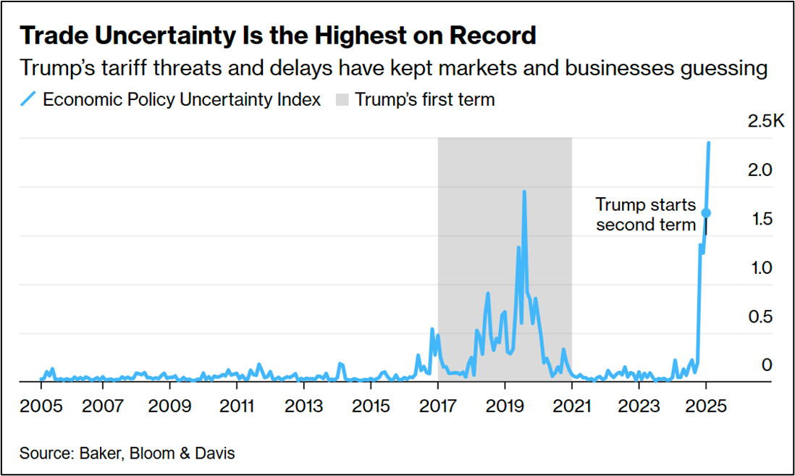
Tariff Uncertainty Surge

Slide 7
What Are The Immediate Opportunities in Highly Volatile Markets?

Slide 8
Disclaimer
Nothing is guaranteed… you should never risk more than you can afford to lose.
We will be showcasing some of the top examples from our model portfolio and some of our best subscriber success stories, but remember individual results will vary and all investing carries risk.
We are publishers providing research and making recommendations.
We do not offer personalized investment advice.
For the live the Q&A at the end – and anyone joining us in the chat right now – we cannot answer specific question about these stocks or any other specific securities.

Slide 9
Should You…
Go to Cash
Wait it Out
Sell
Ignore Your Account (Hope)
ALL MISTAKES!!!

Slide 10
Can You Really Make Money in a Volatile Markets?

Slide 11
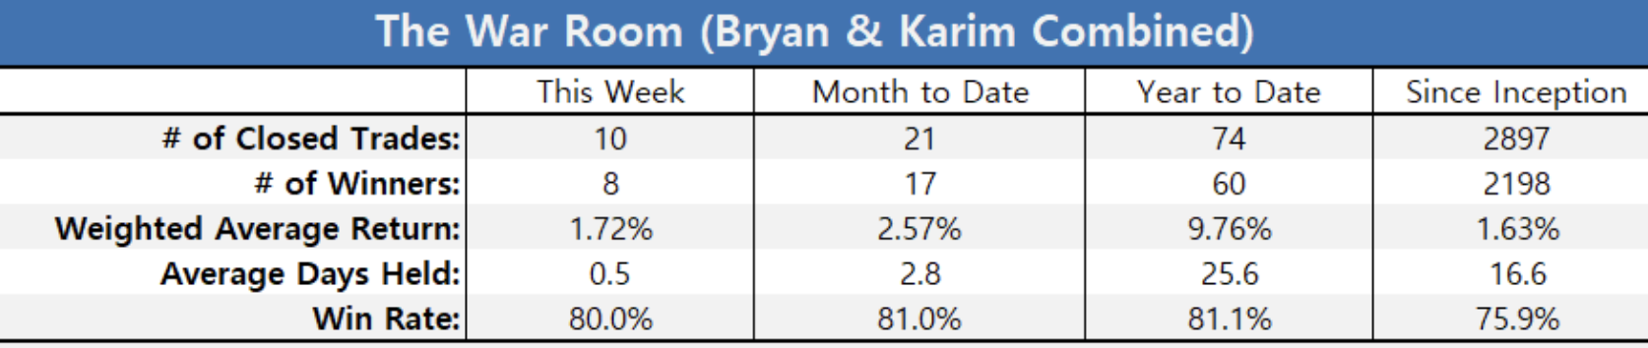
2025 Volatile Market Success
Markets are down 10% from the highs
Lost $5 Trillion in Value evaporated
Year to Date
74
60
25.6
81.1%

Slide 12
Most Volatile Market… Still Winning
COVID Crash Track Record (February 24-March 31, 2020)
73 completed trades and 71 winners (+97% win rate)
Average weighted gain: +16.45%
Average hold time: 8.4 days

Slide 13
More Proof…
At the beginning of the Russia/Ukraine conflict the market was VOLATILE…
Some days it was down 576 points, 571 points and 760 points…
We had a 89% win rate!
Russia-Ukraine Conflict Track Record (February 24, 2022 – March 8, 2022)
17 winners out of 19 completed trades (+89% win rate)
Average weighted gain: +25.76%
Average holud time: 2.3 days

Slide 14
WHAT STRATEGIES DO YOU USE TO WIN IN VOLATILE MARKETS?

Slide 15
LEAPS
Control more shares for LESS
Get increased returns with less money risked
Great for non-dividend paying stocks
ITUB 41% in about 6 months

Slide 16
Overnight Trades: Win Up or Down
These are options trades I recommend before earnings come out
All with the goal to hit a DOUBLE the very next day
Whether earnings push the stock up or down… these trades win with movement either way
With a big movement in either direction… these plays can win BIG!

Slide 17
Clorox Goes Up… We Win
We did an overnight trade before Clorox released earnings
The earnings report was positive
Our recommendation made a quick 80% gain Overnight

Slide 18
Advanced Auto Parts Goes Down...
We STILL Win
But then… Advanced Auto Parts was set to release their earnings in May 2023
The report was terrible
Shares plummeted 35%
But it was one of our biggest gains: 293% overnight!

Slide 19
Insider Buying
Why is Insider Buying important
Cluster Buying (takes insider buying to the next level)
Size of buying
HPK 30% in about 2 months

Slide 20
Biggest Insider Win… Rolls Royce
From March 2022 to March 2025
Thank you Karim!!!!! I just hit 1000% on RYCEY. And I don't think we are done yet. -- NavyNick
Up over 1000% on RYCEY today... In golf parlance KR... You Da Man!! – Raul
I am up 412% $81,000 on 10000 shares on RYCEY and still holding. Do not plan on selling for a few years. --Mitch
@Karim, regarding RYCEY , I wish I could at that time invest much more ... 200 x 1,20 ... now 10,17 !!! Just the biggest gain in my portfolio with +717% . Thank you Karim! – Member “Frenchwoman”
Size of buying

Slide 21
Tell Us Your Picks!!!!

Slide 22
Recursion Pharmaceuticals (RXRX)
Top AI Play
Strong buying by SoftBank and other major institutions
Deal with Nvidia
Straight stock buy at current levels (under $6.50)
Could be 20% 50% this year or multi-bagger if you buy the shares - speculative

Slide 23
TJX Companies (TJX)
TJX Companies: Tariff-Proof Retail winner
Ever since reporting strong earnings in late February – which triggered a bounce up to $127, shares of the discount retailer have succumbed to the market’s selling pressure – and pulled back to $$119
With strong support at $111, could we have an opportunity to snag some upside calls on a company that just reported strong earnings but fell victim to the market’s overall negative sentiment?

Slide 24
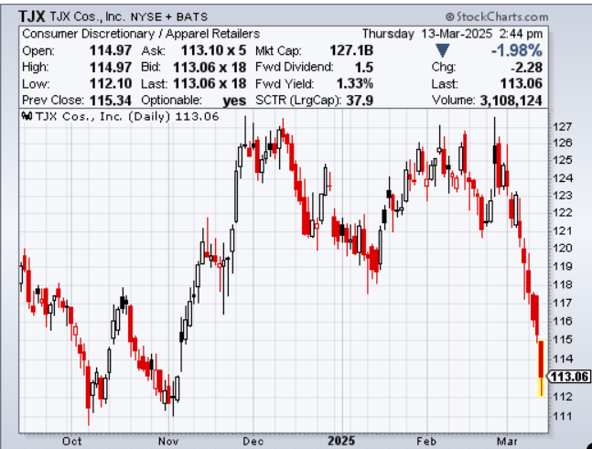
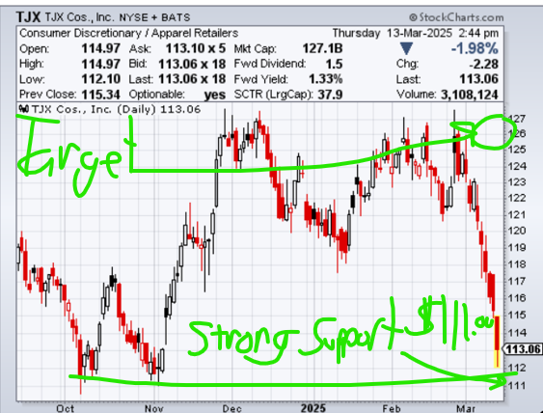
TJX
Target: $127-$130
Ultimate support at $111.00 (Best dip buy there)

Slide 25
TJX
Possible Stock gain: +14% (buy at $113 to $114, 4 to 6 months)
Possible Mid-Dated Call Gain: +200% (July 115 calls at stock of $127)

Slide 26
Cleveland-Cliffs Inc (CLF)
Trump tariff winner (CEO is pals with Trumps)
Insider buying
Steel tariffs help
Target $16 to $20 by end of next year, maybe sooner
LEAP play, Stock buy at current levels

Slide 27
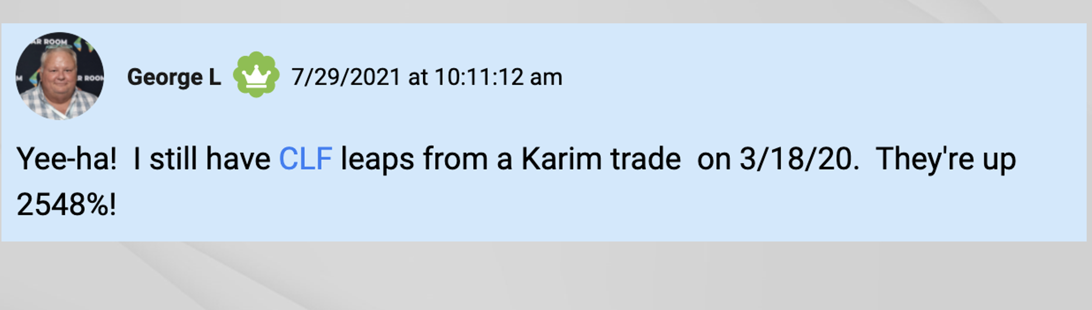
George CLF
I’ve been talking about CLF for years
George made his own LEAPS play and ended up with a huge winner

Slide 28
Polaris Inc (PII)
Polaris designs off-road vehicles (ORVs)
Includes all-terrain vehicles and side-by-side vehicles…
Also military and commercial ORVs, snowmobiles, motorcycles
Even moto-roadsters, quadricycles, and boats.
Every retirement community across American is now seeing more and more Polaris vehicles

Slide 29
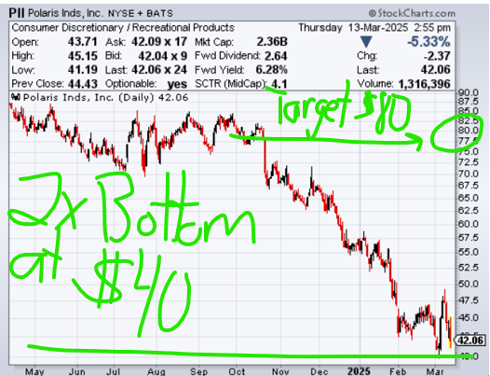
PII
The stock is at an ultimate dip buy support level at $40.00
Target: $85.00 by January 1st 2026. More than a double from current levels.

Slide 30
PII
Possible Stock gain: +90% (buy at $40, 4 to 6 months)
Possible Mid-Dated Call Gain: +450% (September 45 calls at stock of $80)

Slide 31
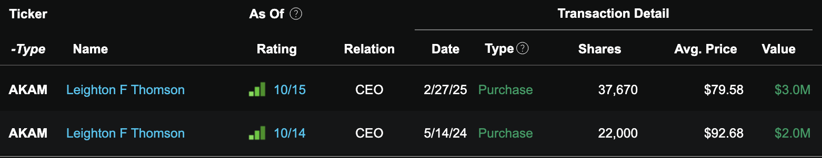
Akamai (AKAM)
Heavy Insider Buying
Second time I’ve liked AKAM (more insider buying than first time!)
Strong profits
Increased guidance even in this market
Stock is barely down
LEAPS play, Stock buy at current levels

Slide 32
Can You Tell Everyone Exactly What to Trade and When to Trade it?

Slide 33
The Tariff Ten
We’ve given you our Five Tariff Stocks
We’ve shown you trading strategies we could use for each one
We also have five MORE tariff protection stocks we are watching
That’s TEN in all we will be monitoring for the next few months for our Premium Tariff Trades
We’ll make specific recommendations for options trades… insider buys… Overnight Trades… LEAPS trades

Slide 34
Q&A is coming in a few minutes…

Slide 35
Set Your Alarm for 9:30 a.m. Tomorrow
We want you to get the exact instructions on how to make our FIRST PREMIUM tariff recommendation tomorrow
We’ll tell you the exact trading strategy we will use… including precisely what to buy
We’ll also give you the plan for exiting for maximum gains
Not only that… you’ll get ALL of The Tariff Ten stocks on our watchlist
And every other the real time trade for 2025

Slide 36
YOU’RE INVITED:
GET OUR PREMIUM TARIFF PICKS STARTING TOMORROW

Slide 37
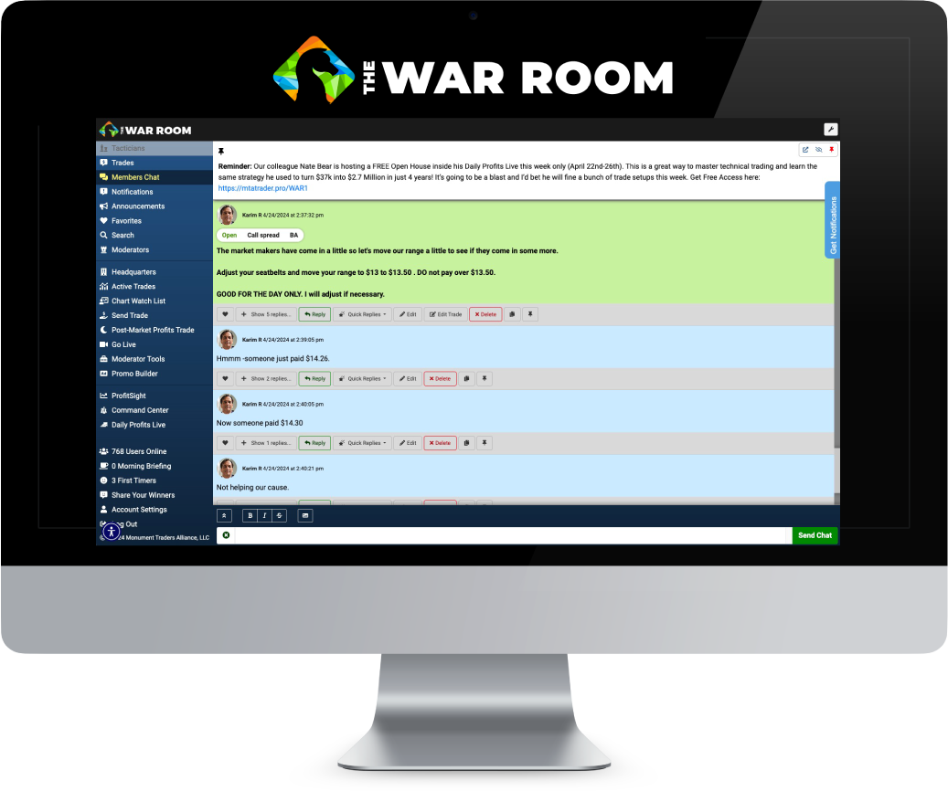
Enter The War Room
The War Room is our LIVE chat room
I can give you my market analysis, research, and live trade recommendations.
You’ll be surrounded by people from around the world who are committed to one simple goal: Make Winning Trades Every Day

Slide 38
All About Results
Since 2019… we’ve showed members more than 2,100 wins with a 76% win rate
Here’s just a sample of a few of our best wins…
Fast gains like: 53% in 4 minutes… 73% in 10 minutes… And even 121% in just over an hour.
Overnight gains like 179%... 188%... even 292%!

Slide 39
Big Overnight Gains
Take a look at just a few of Bryan’s best Overnight Trades
Dollar General 189%
Ambarella 124%
Oracle 133%
Yum Brands 179%
Cisco 125%

Slide 40
Cashing in OVERNIGHT!
FedEx 188%
Kellogg 133%
First Solar 160%
Urban Outfitters 145%
Twitter 130%

Slide 41
2024 Ledger (NEED UPDATE)
There’s only 252 trading days in a year…
But in 2024 The War Room closed 296 winners over the last 12 months with a 74% win-rate.
We aren’t perfect… but winning more than 7 out of 10 is incredible
That means on average, we hit closed 1.2 winners every day the market was open in 2024.
Hold time Average of 31 days

Slide 42
More 2024 Closed Stats (NEED UPDATE)
193 double-digit winners
13 triple-digit winners
6 hedge trade winners
44 overnight/earnings strangle winners
28 put sell winners with a 100% win-rate

Slide 43
Year to Date (Consistent Wins)
The wins keep going…
Year to Date
74
60
25.6
81.1%

Slide 44
Top Member’s Success
I share my best trades in The War Room
The recommendations are live… in real time
Members can immediately benefit
Now everyone is different and individual results vary… but we want to show you some of our happiest members’ posts
These readers took our strategies and turned them into record portfolio returns
Notes:
https://14west.atlassian.net/wiki/spaces/TL/pages/47800615259/David+D

Slide 45


Top War Room Success Stories
In David’s case, he started with a $20,000 portfolio and in 9 months, it was already worth $185,000.
He said he made more from his War Room trades than his entire income from his regular day job!
Matthew grew his portfolio 50% in two months… to over $100,000!
David D. 10:40 a.m.
My original stake of $20,000 ended up being $185,000. I have proﬁted more than my day job paycheck... and that was only part time in The War Room.
Matthew 11:23 a.m.
My War Room portfolio has gone up over 50% in the last two months, from $65,000 to over $100,000. I love The War Room and can’t think of a better trading and learning community.
Notes:
Taken from WNM… I’d like to have the name with the post on the slides with the bullets so Bryan/ryan know what to read (and don’t have to read the whole post… but we can have the post on the slide) Also we need to take off the dates

Slide 46
Top War Room Success Stories
Matthew grew his portfolio 50% in two months… to over $100,000!
David D. 10:40 a.m.
My original stake of $20,000 ended up being $185,000. I have proﬁted more than my day job paycheck... and that was only part time in The War Room.
Matthew 11:23 a.m.
My War Room portfolio has gone up over 50% in the last two months, from $65,000 to over $100,000. I love The War Room and can’t think of a better trading and learning community.
Notes:
Taken from WNM… I’d like to have the name with the post on the slides with the bullets so Bryan/ryan know what to read (and don’t have to read the whole post… but we can have the post on the slide) Also we need to take off the dates

Slide 47


Top War Room Success Stories
Mohammed 8X’d his portfolio in just 4 months!
Tom grew his account by 53% in just 10 days!
Mohammed 12:19 p.m.
With this last trade in Roku today, I managed a proﬁt of $200,000 with a starting stake of $25,000 in just four months trading in The War Room. I couldn’t manage this without the trades of Bryan, Karim, and George. My son wants me to buy a lambo, but that’s not gonna happen. Maybe a beautiful classic car!
Thom 11:57 a.m.
First 10 days of May and my account is up 53%.
Notes:
Take off date of testimonials (can leave time)

Slide 48
Top War Room Success Stories
Ken was brand new to trading options
But he still doubled his money in just 8 months
He was another member who made more trading than his salary!
Ken W. 3:48 pm
I know many here are like me, joining The War Room with the hope to improve our retirement account. I had never traded options before joining The War Room. [Yet] I can comfortably say (even with market ups and downs) that I have now achieved a 100% return from my initial capital ($150,000 into more than $300,000). The eight-month gain from trading has easily outearned my salary (before tax). This has been an incredible journey, from not knowing options trading to doubling my account in less than nine months. Thank you, my TEACHERS.
Notes:
Take off date of testimonials (can leave time)

Slide 49


Even MORE!
While these are a few of our best stories… they aren’t all
We have hundreds of posts of people bragging about their wins
From getting their first win… to small wins… to huge portfolio growth
George 11:23 am
When I started at The War Room, I was very new at this. But in three months, I turned $165,000 into peak gains of $2.35 MILLION!
Tad 10:28 am
I started The War Room back on May 25, 2020. By February 2021 I turned $90,000 into $178,000. I almost DOUBLED my entire account in less than a year!
Notes:
Matthew should be changed to George

Slide 50
A Community Built for You
Bottom line: This isn’t a Reddit group of losers living in their parent’s basement
They are the real deal… and their results prove it
We think you would be a PERFECT new member

Slide 51
Here for YOUR Success
War Room Members are serious about making winning trades… but we are all committed to helping YOU succeed
You can ask them questions
Read their trade ideas
And you can all celebrate your wins together

Slide 52
THIS YOUR CHANCE
TO JOIN THEM!

Slide 53
EVERYTHING INCLUDED
WITH YOUR WAR ROOM MEMBERSHIP

Slide 54
Premarket Commentary
Every morning at 9 a.m., I deliver all my premarket notes to War Room members
I break down the big macro trends I’m seeing and the companies I’m watching.
You get FULL access to all of my market analysis 30 minutes before the Opening Bell.

Slide 55
All Our LIVE Recommendations
Once Opening Bell rings at 9:30… we are off to the races
The SECOND there’s a recommendation…
We type it up… hit enter…
And you IMMEDIATELY get all the relevant information you need.

Slide 56
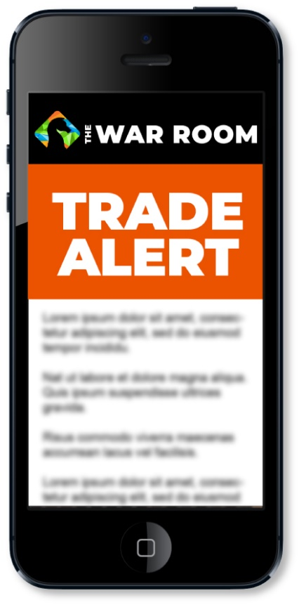
Trade Alerts
Do you have to be in front of your computer all day? NO!
You can get an alert to your phone or computer any time there’s a trade
The War Room is designed to work around YOUR schedule

Slide 57

Bryan and Karim’s Library
Here’s just a few things in our educational resources tab (called The War Room Headquarters):
The War Room’s Options Primer plus our Options Masterclass
Premium reports like:
  How To Follow The Money With Legal Insider Trading
  Developing The Winning Mindset of a Smart Trader

Slide 58
Volatile Market Strategies You Won’t Get Anywhere Else!
How To Make 200% to 300% Overnight With Earnings Strangles
Big Gains From The Black Candle of Death (And Avoiding Trading Disaster)…
Making Quick 20% to 40% in Minutes With Gift Gaps and Gap Fills…
The Power of Preset Profit Targets…
And so much more!

Slide 59
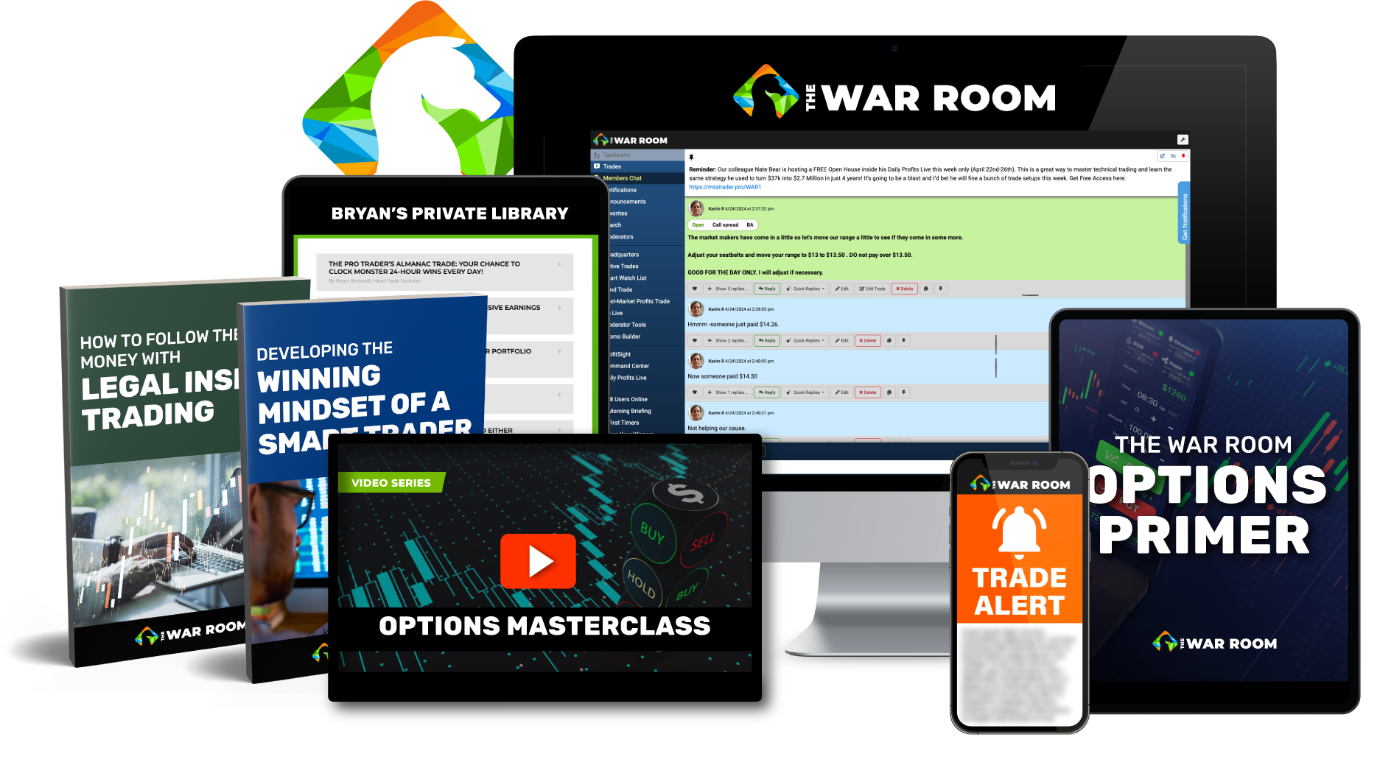
Join Us Today!
One Year Membership: $7,499
Special Discount: $1,997
STAY TUNED... SEE HOW TO GET YOUR TARIFF RELIEF DISCOUNT!

Slide 60
‘Winner Every Day Guarantee’
There’s 252 trading days in a year
If I don’t give you at least 252 winning recommendations this next year per our model portfolio…
I’ll give you a lifetime membership to The War Room for free
PLUS… WE HAVE SOMETHING BIG…

Slide 61
TARIFF RELIEF DISCOUNT (TODAY ONLY)
If you act by MIDNIGHT TONIGHT
You can use code TARIFF300 on the Order Form for an extra $300 off
Click on the link above… or in our chat
Your price for a full year: $1,697 (expires MIDNIGHT TONIGHT!)

Slide 62
60 Day Money Back Guarantee
We know times are tough right now
We want to make this as easy of a decision as possible for you
Try the War Room for a full two months
If it’s not for you… give us a call and we will refund everything you pay today (minus a small 10% processing fee)

Slide 63
JOINING TODAY
ENSURES YOU’LL GET
TOMORROW’S
URGENT NEW TARIFF TRADE

Slide 64
Q&A Time!
USE CODE “TARIFF300” FOR AN EXTRA $300 OFF
$7,499
YOUR PRICE: $1,997
$1,697
Expires Midnight Tonight!
CLICK LINK ABOVE OR IN CHAT
TARIFF RELIEF DISCOUNT PAGE!
Notes:
THIS IS FROM WNM… JUST SHOWING THE STYLE

Slide 65
Q&A Time!
USE CODE “TARIFF300” FOR AN EXTRA $300 OFF
$7,499
YOUR PRICE: $1,997
$1,697
Expires Midnight Tonight!
CLICK LINK ABOVE OR IN CHAT
OR CALL 888.215.5311 OR 410.864.3083
Notes:
THIS IS FROM WNM… JUST SHOWING THE STYLE

