Slide 1





Slide 2
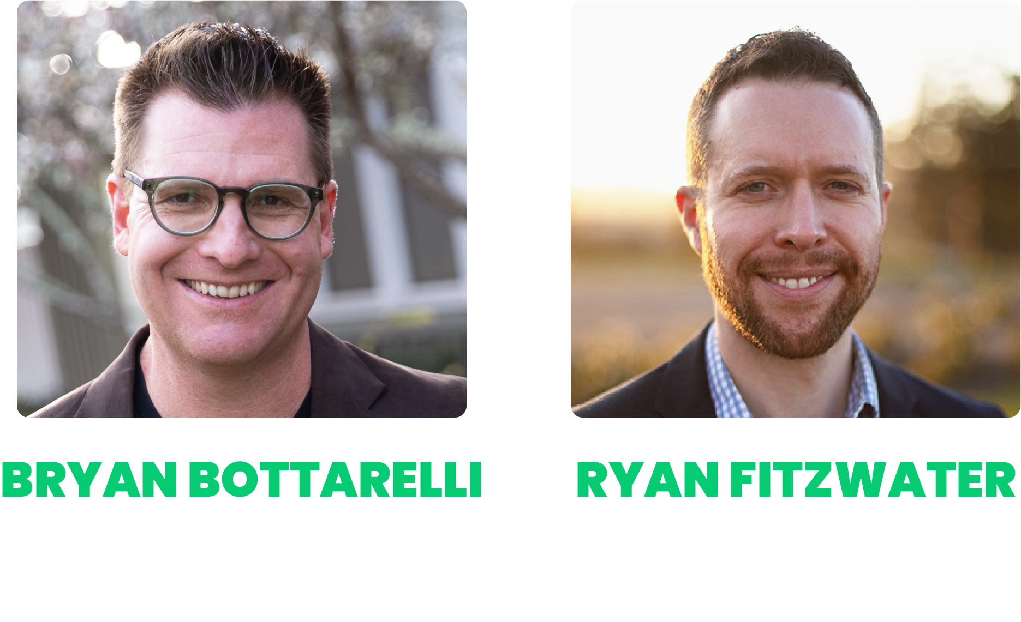
WELCOME TO
STOCK FLIP FORTUNES
Live Trading Event
BRYAN BOTTARELLI
Make $5,000 (or MORE!) by Flipping Stocks
for Overnight Doubles
Targeting Gains up to 667% Overnight!
Stay Tuned for Our Live Q&A at the
End of the Event
RYAN FITZWATER

Slide 3

Housekeeping!
This is a skillset, and you need to pay attention during the following course material.
You took the time to be here… this is important, now focus on being here!
Shut the door
Turn off Slack, YouTube, or whatever
else is distracting you
Close Facebook
Phones on silent mode
Kick out the kids, grandkids, etc.

Slide 4
Agenda
The Stock Flipping Formula you can use to target $5,000 (or more!)… OVERNIGHT
The 10+ years of historical data behind Stock Flipping that gives you an “unfair” statistical edge of 87%
How you could have turned a $25,000 account into $1.29 MILLION flipping just ONE stock for two years
Revealed Today: The EXACT list of our 30 best Stock Flip opportunities to buy one afternoon… and “flip” the next day for a chance at gains like 288%... 384%... 667%!
Why March 19 could kick off the BEST 30 days for flipping stocks!
Live Q&A

Slide 5

Disclaimer
You’ll see our extensive backtest using data goes back ten years where we looked at the peak gains and the maximum overnight profits available on each day with perfect timing.
Your returns would vary depending on when you chose to get out. Nobody should expect to hit the peaks every time.
That’s why we want to help you every step of the way… to help you maximize your daily profits and minimize your risk.
Risk is a part of all investing. You should never invest more than you can afford to lose.

Slide 6
Why Do We Call It
“Stock Flipping”?

Slide 7


You’ve Heard of House Flipping:
They Buy “Ugly” Houses They Can Fix Up
And FLIP for a Profit!

Slide 8
Could Cost $100,000 … or MORE!
Takes Months… or YEARS!
And You’d Be Lucky to Scrape a 10% Profit… or Worse, LOSE MONEY!

Slide 9


INTRODUCING:
But Cheaper Faster And BETTER!
STOCK FLIPPING
It’s Like House Flipping…

Slide 10
Flipping Stocks
Step One: Buy a GREAT stock on an UGLY day
Step Two: Log off for the day
Step Three: “Flip” it the very next day for a chance of $5,000 in profit!
NOTE: Just for attending today’s training… you’re getting our list of the BEST stocks to flip… PLUS our exact criteria emailed to you for FREE!

Slide 11
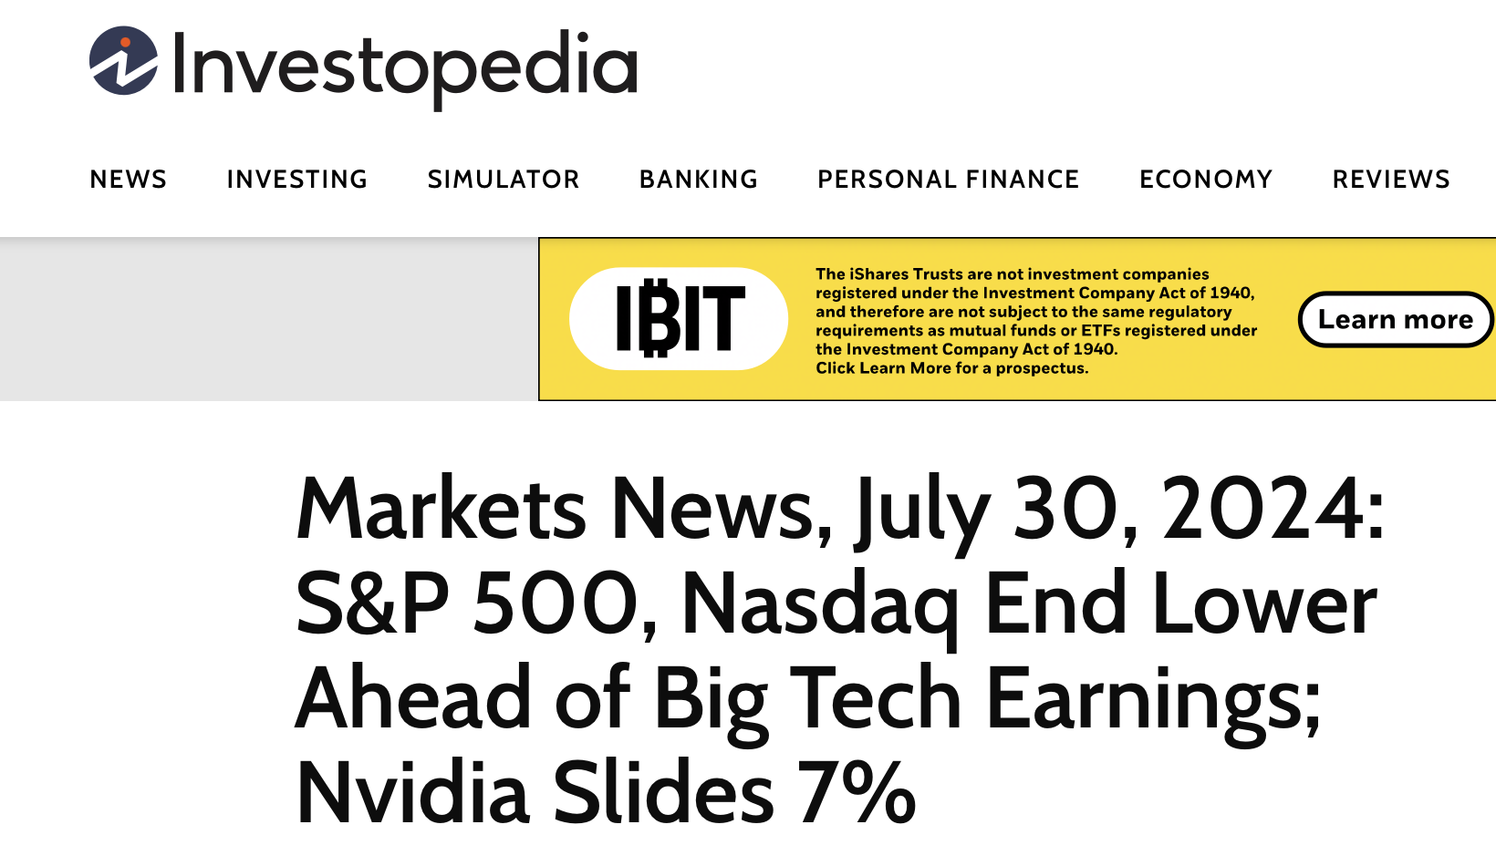
Flipping Nvidia (NVDA)
July 30, 2024
Nasdaq down big
Chip stocks fell before Mag 7 companies reported earnings
Nvidia cratered -7.04%
Huge move for one day

Slide 12
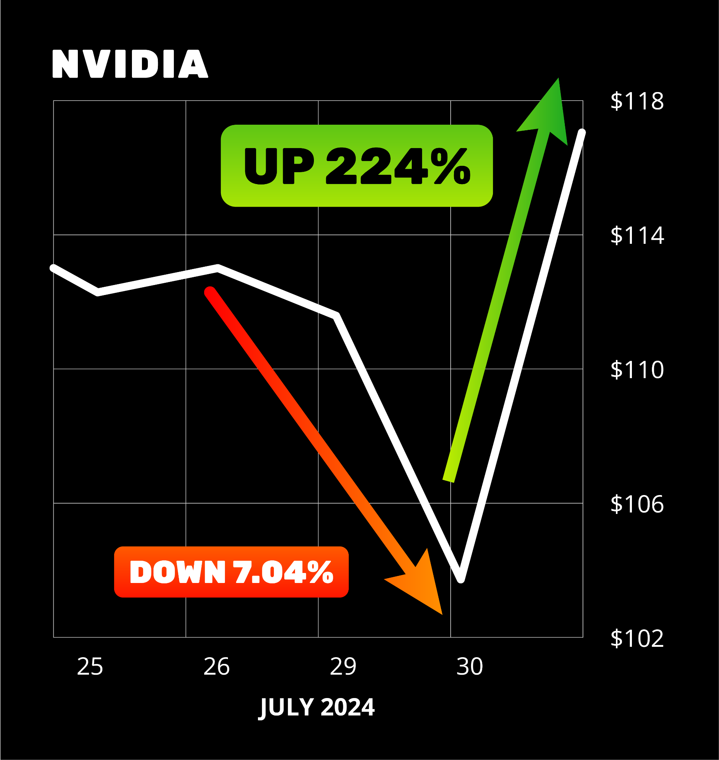
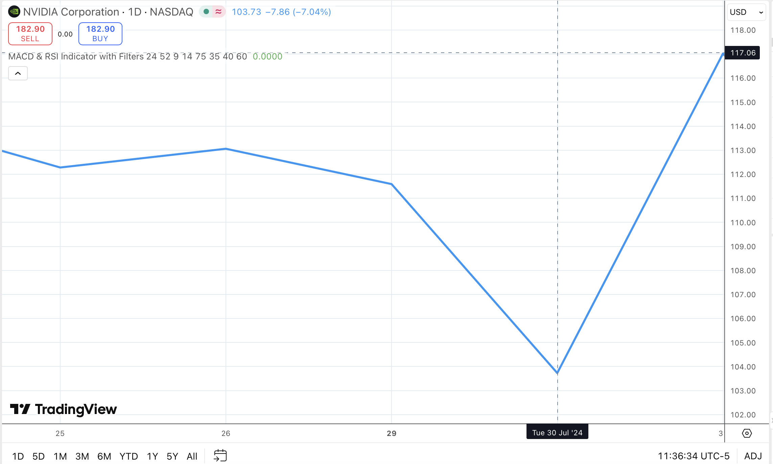
224% Stock Flip Win!
But… it was a huge OVERreaction
Perfect opportunity for
Stock Flip Trade!
Next day… a Flip Trade went as high as 224%
Notes:
OK

Slide 13
Stock Flipping Nvidia Could Have Made
$11,000 Overnight!

Slide 14
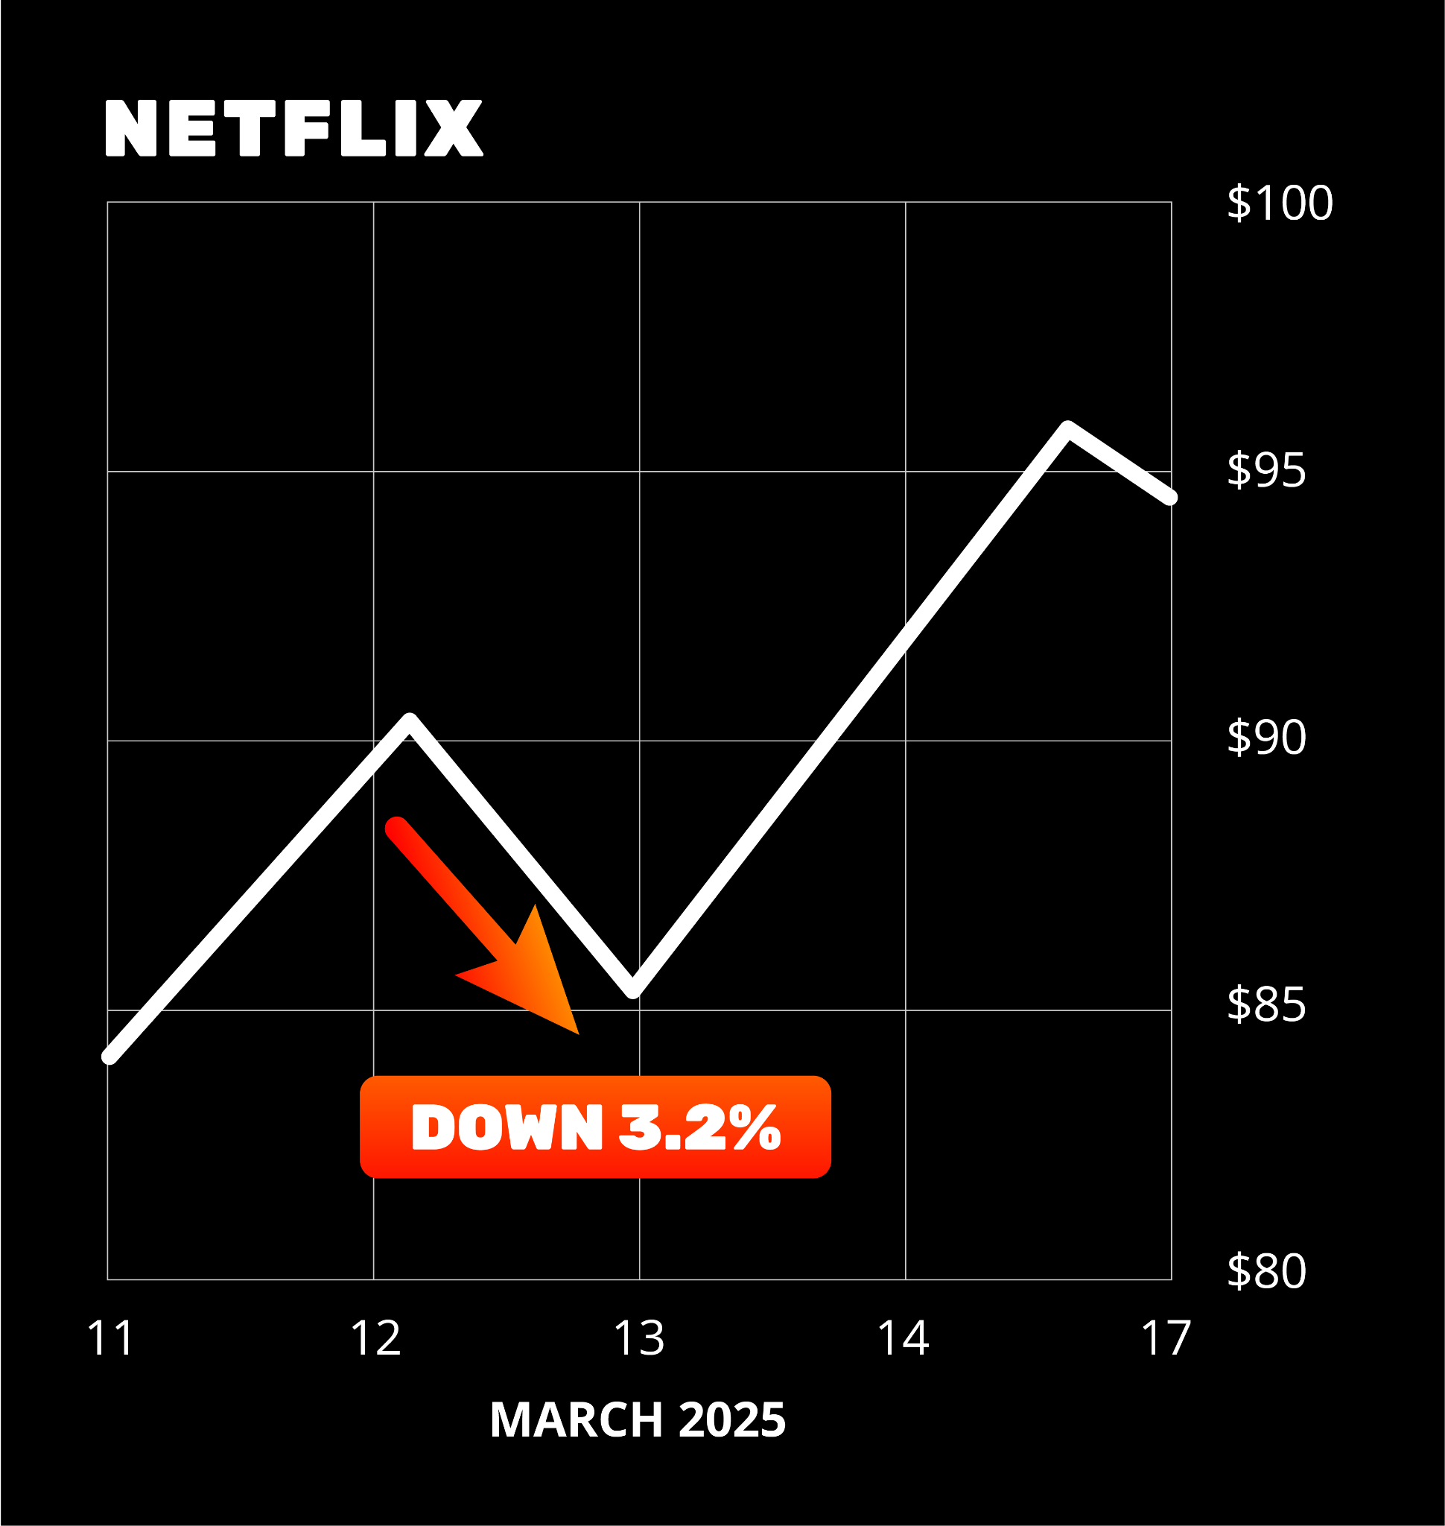
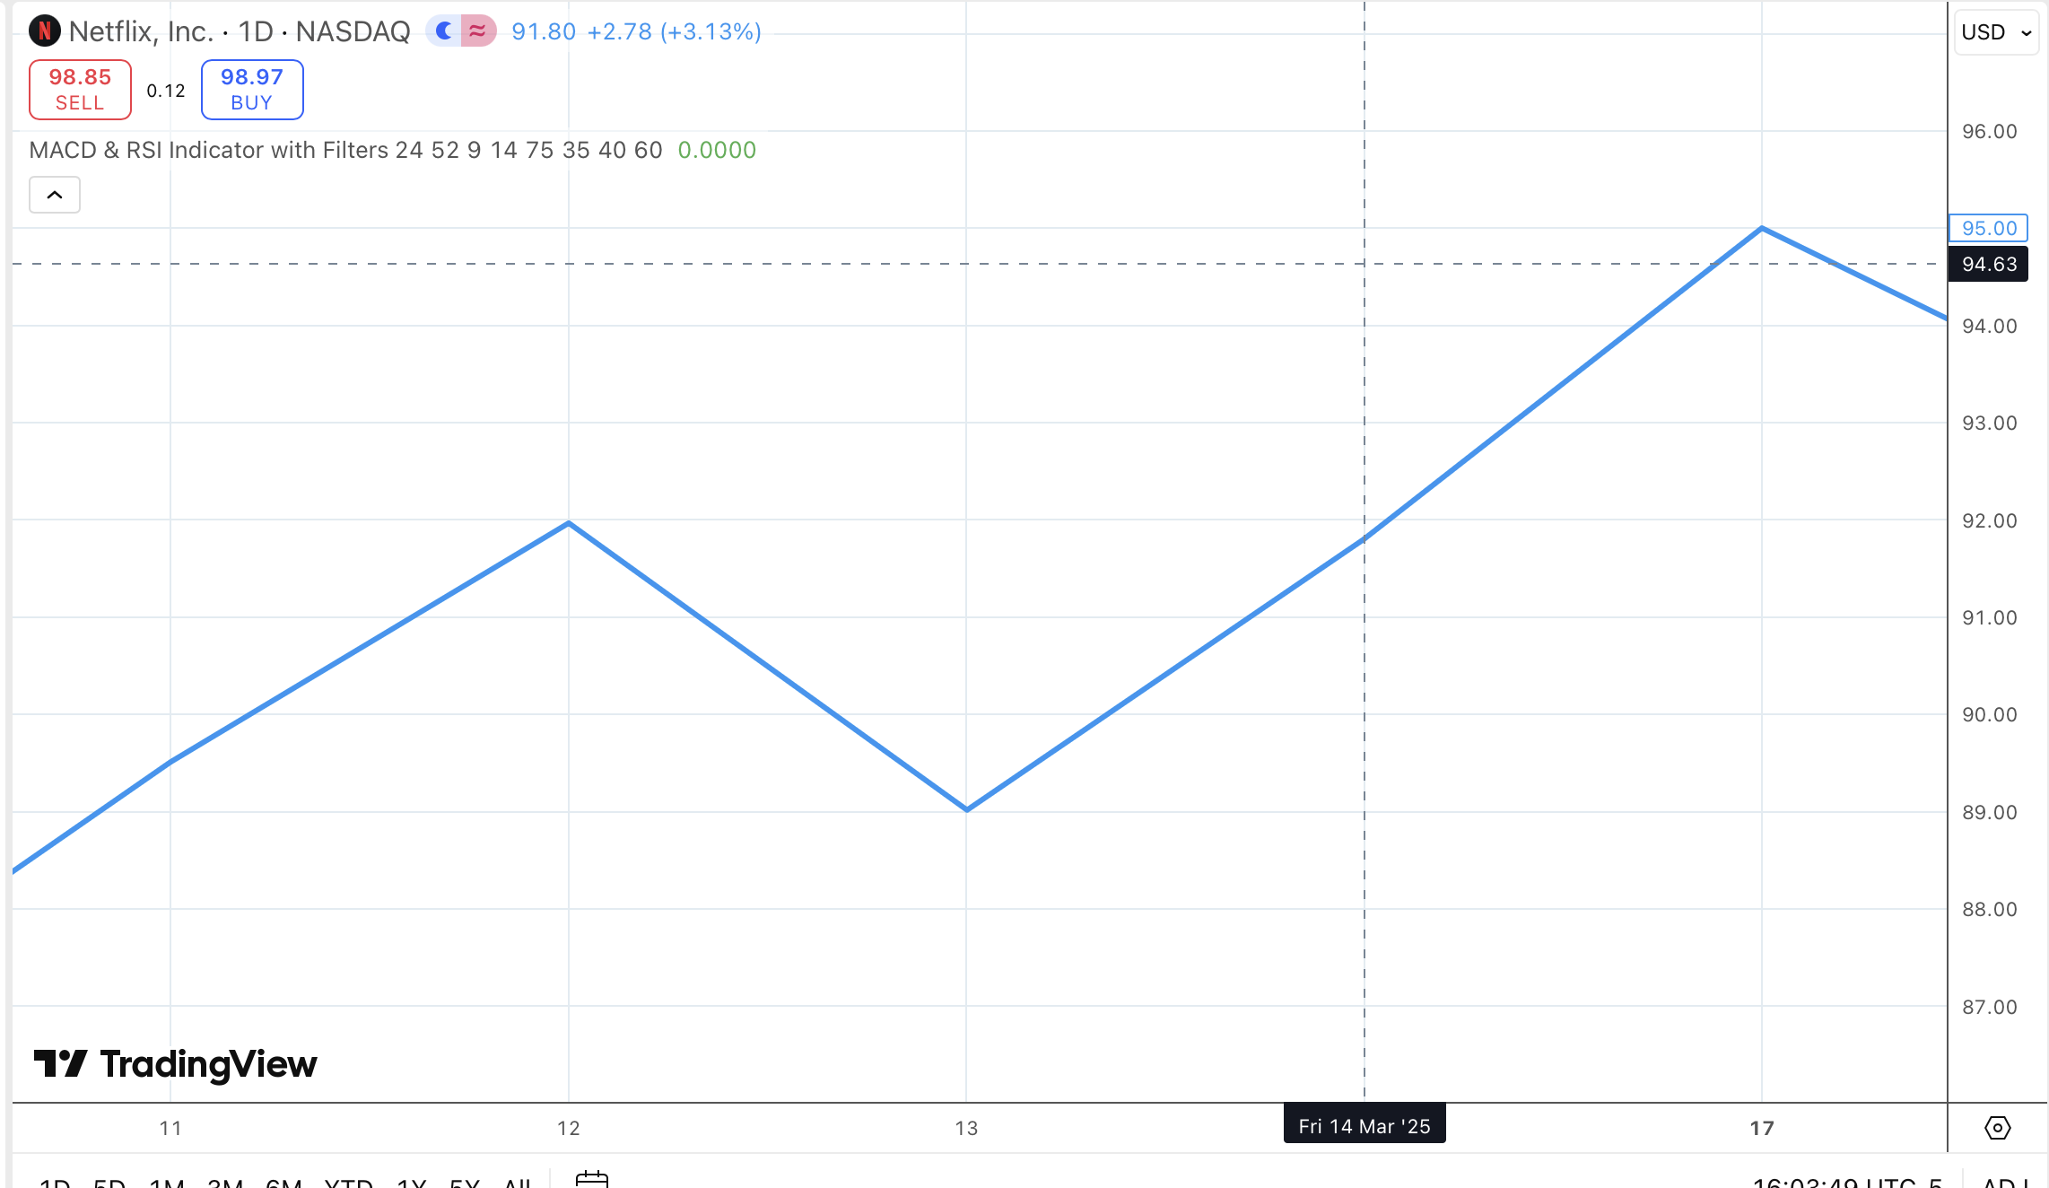

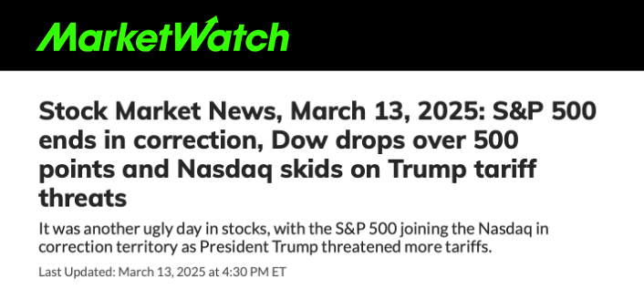
Flipping Netflix
(NFLX)
March 13, 2025
Trump threatened tariffs
S&P went to correction territory
Netflix got hit hard…
dropping -3.2%.

Slide 15
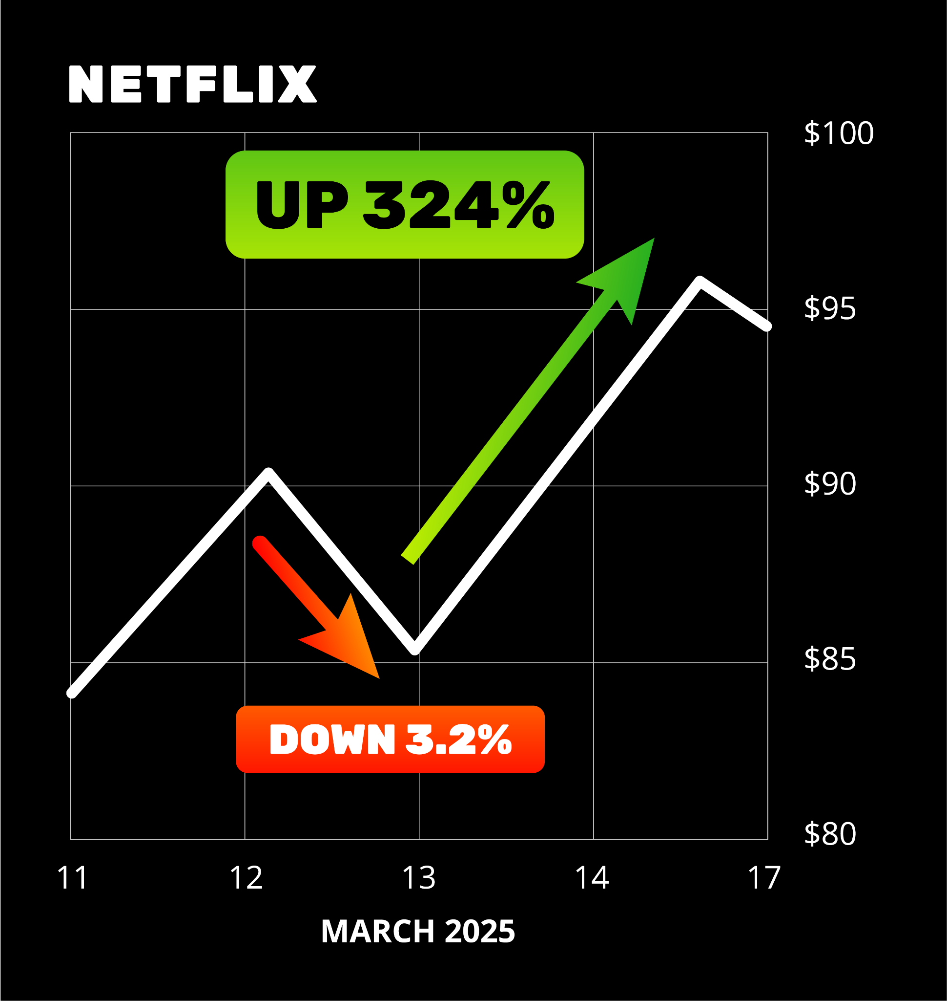
3X Stock Flip!
Classic overreaction
Perfect time for a stock flip
Stock Flip Trade could have
made as much as 324%!
Notes:
OK

Slide 16
That’s Enough to Make
That’s Enough to Maket
$16,000 the
Very Next Morning!
$16,000
the Very Next Morning!
Notes:
OK with gain% mentioned.

Slide 17
$27,000
Two Flips… Two Stocks…
That’s Enough to Maket
Way BETTER & EASIER Than House Flipping!
$16,000
REVEALED SOON!
Our Exact List of the
30 BEST Stocks to Flip
the Very Next Morning!
Notes:
OK with gain% mentioned.

Slide 18
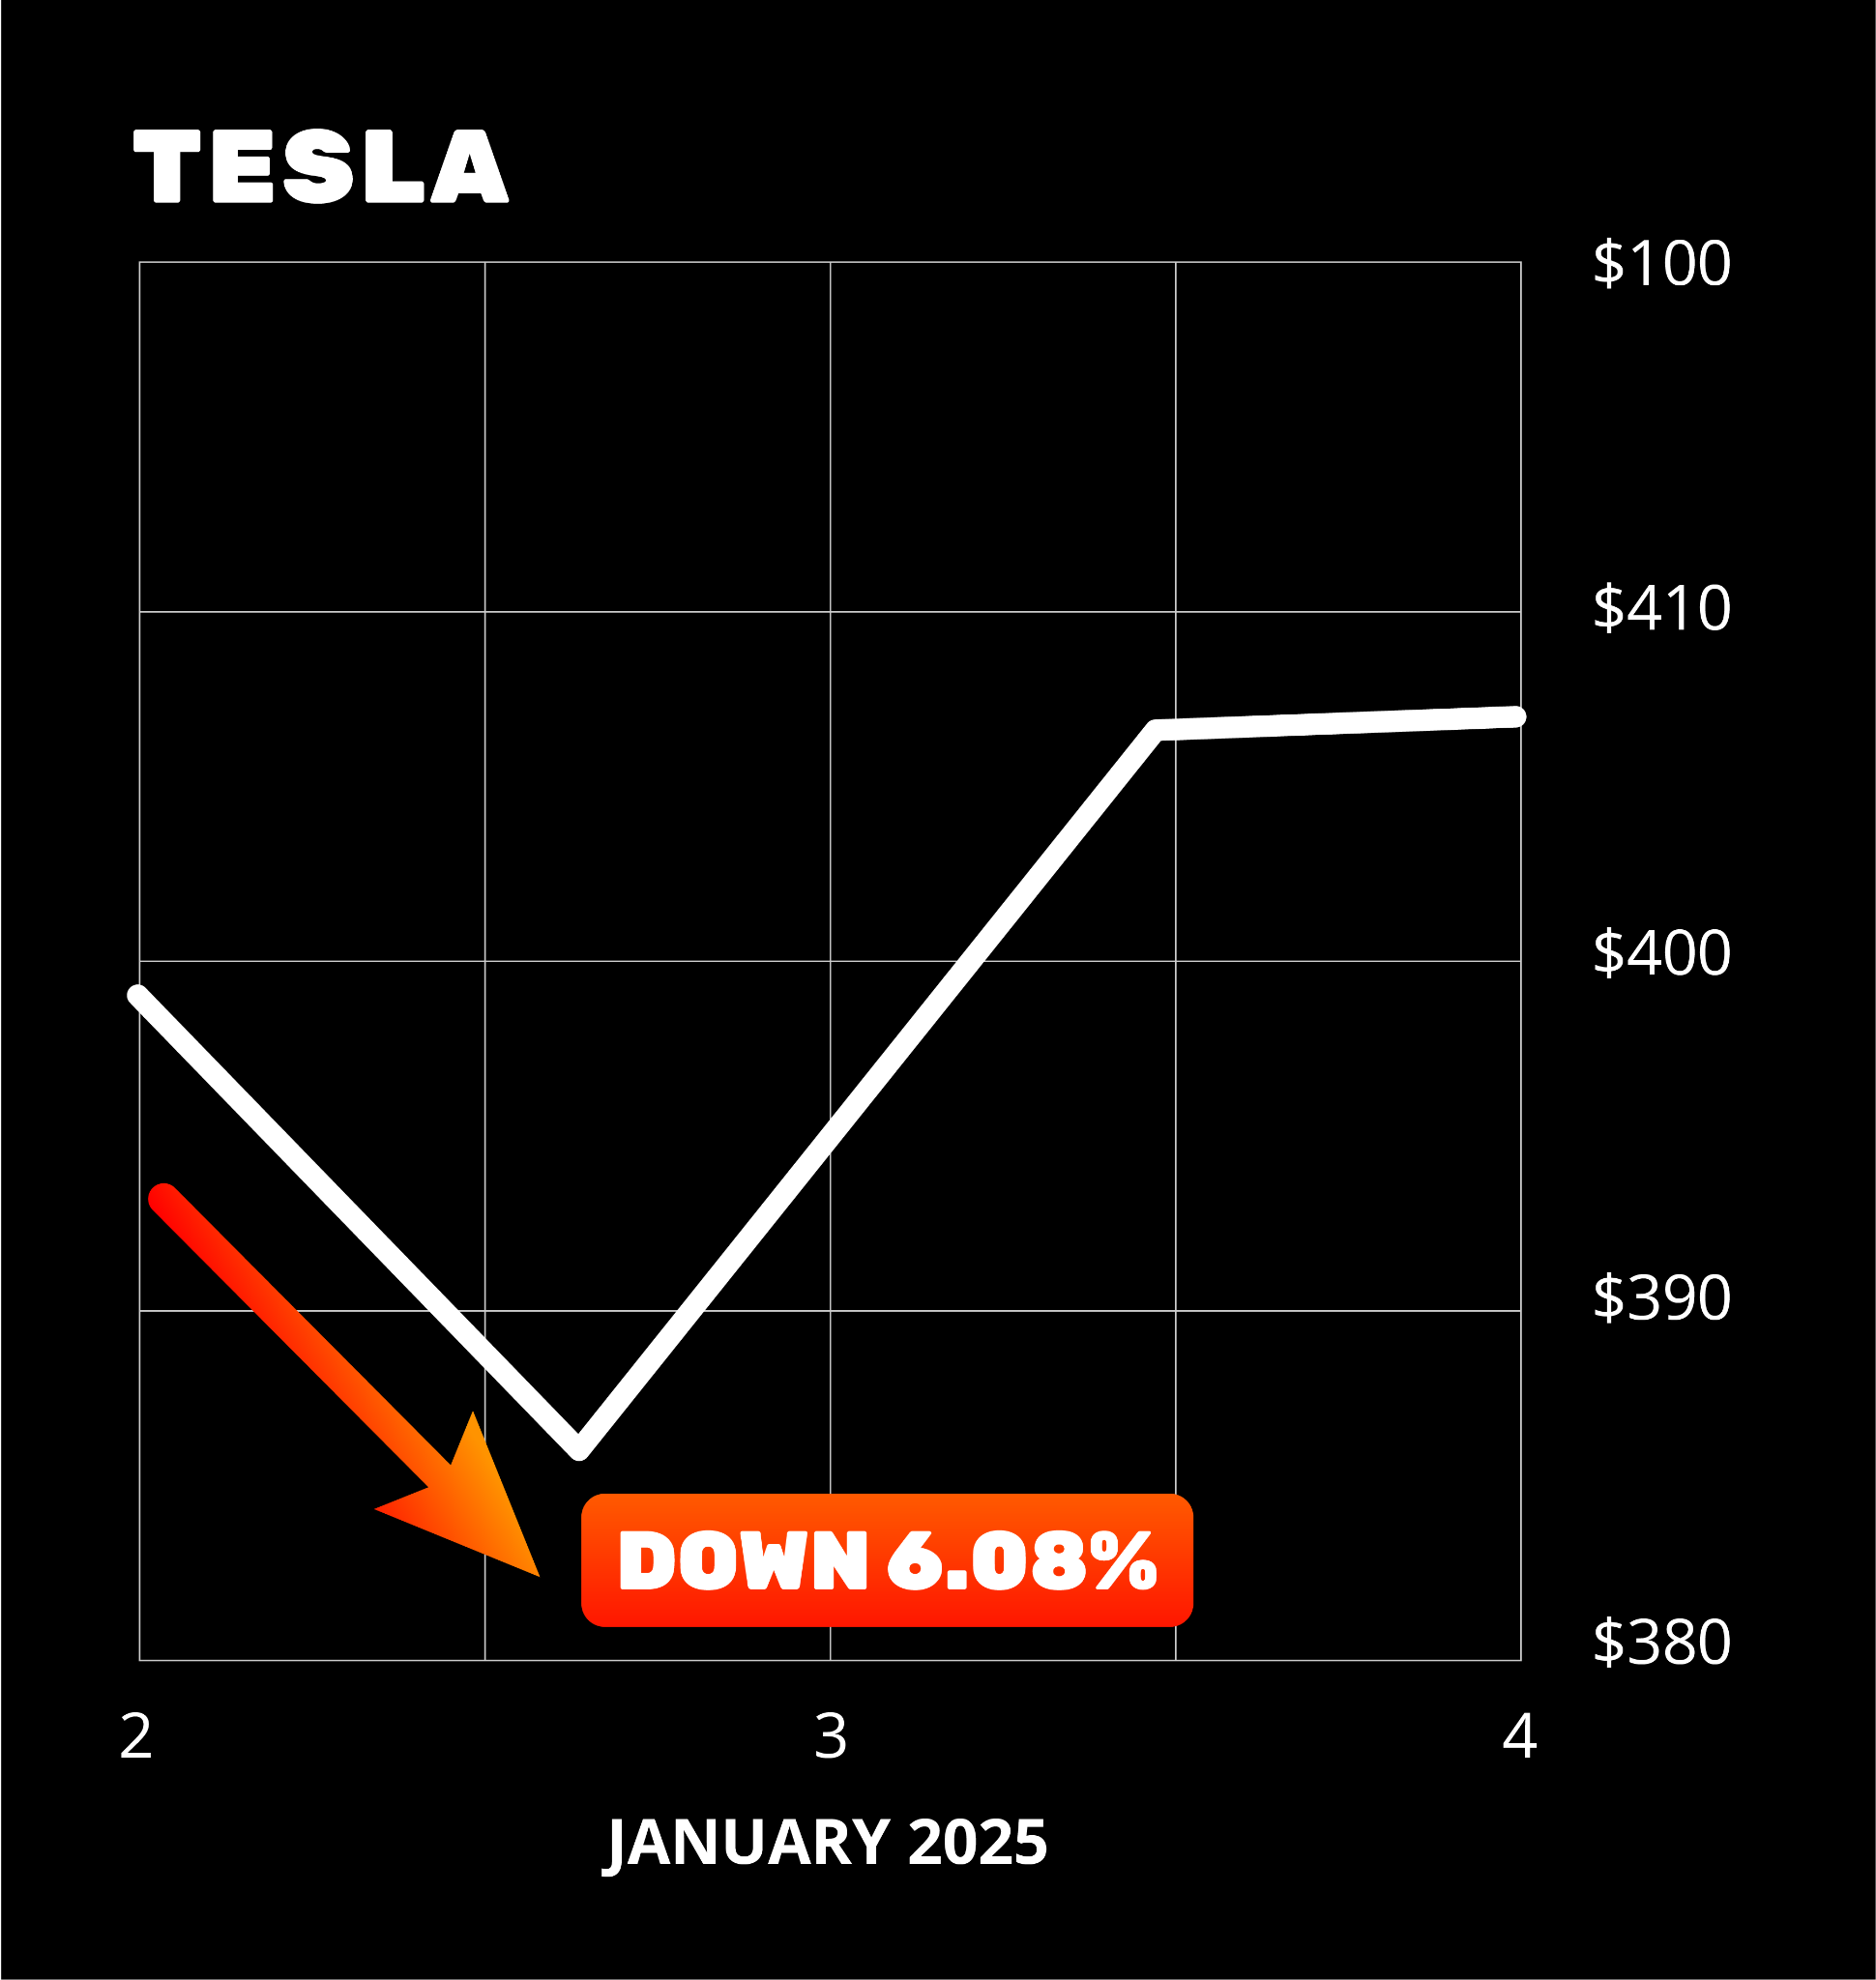
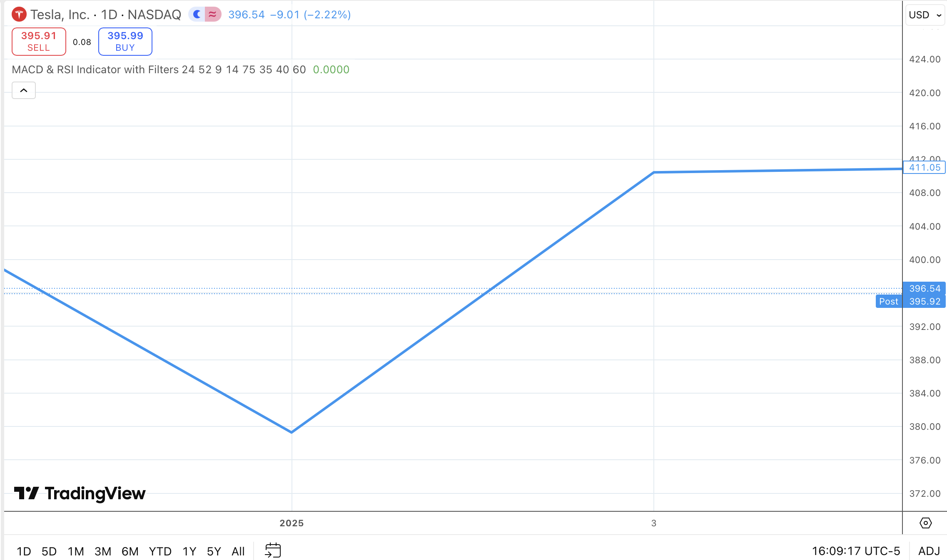
Flipping Tesla
(TSLA)
January 2, 2025
Tesla reported their first-ever annual decline in vehicle deliveries
Shares tanked -6.08% that day
It was a classic overreaction
Perfect for a Stock Flip

Slide 19
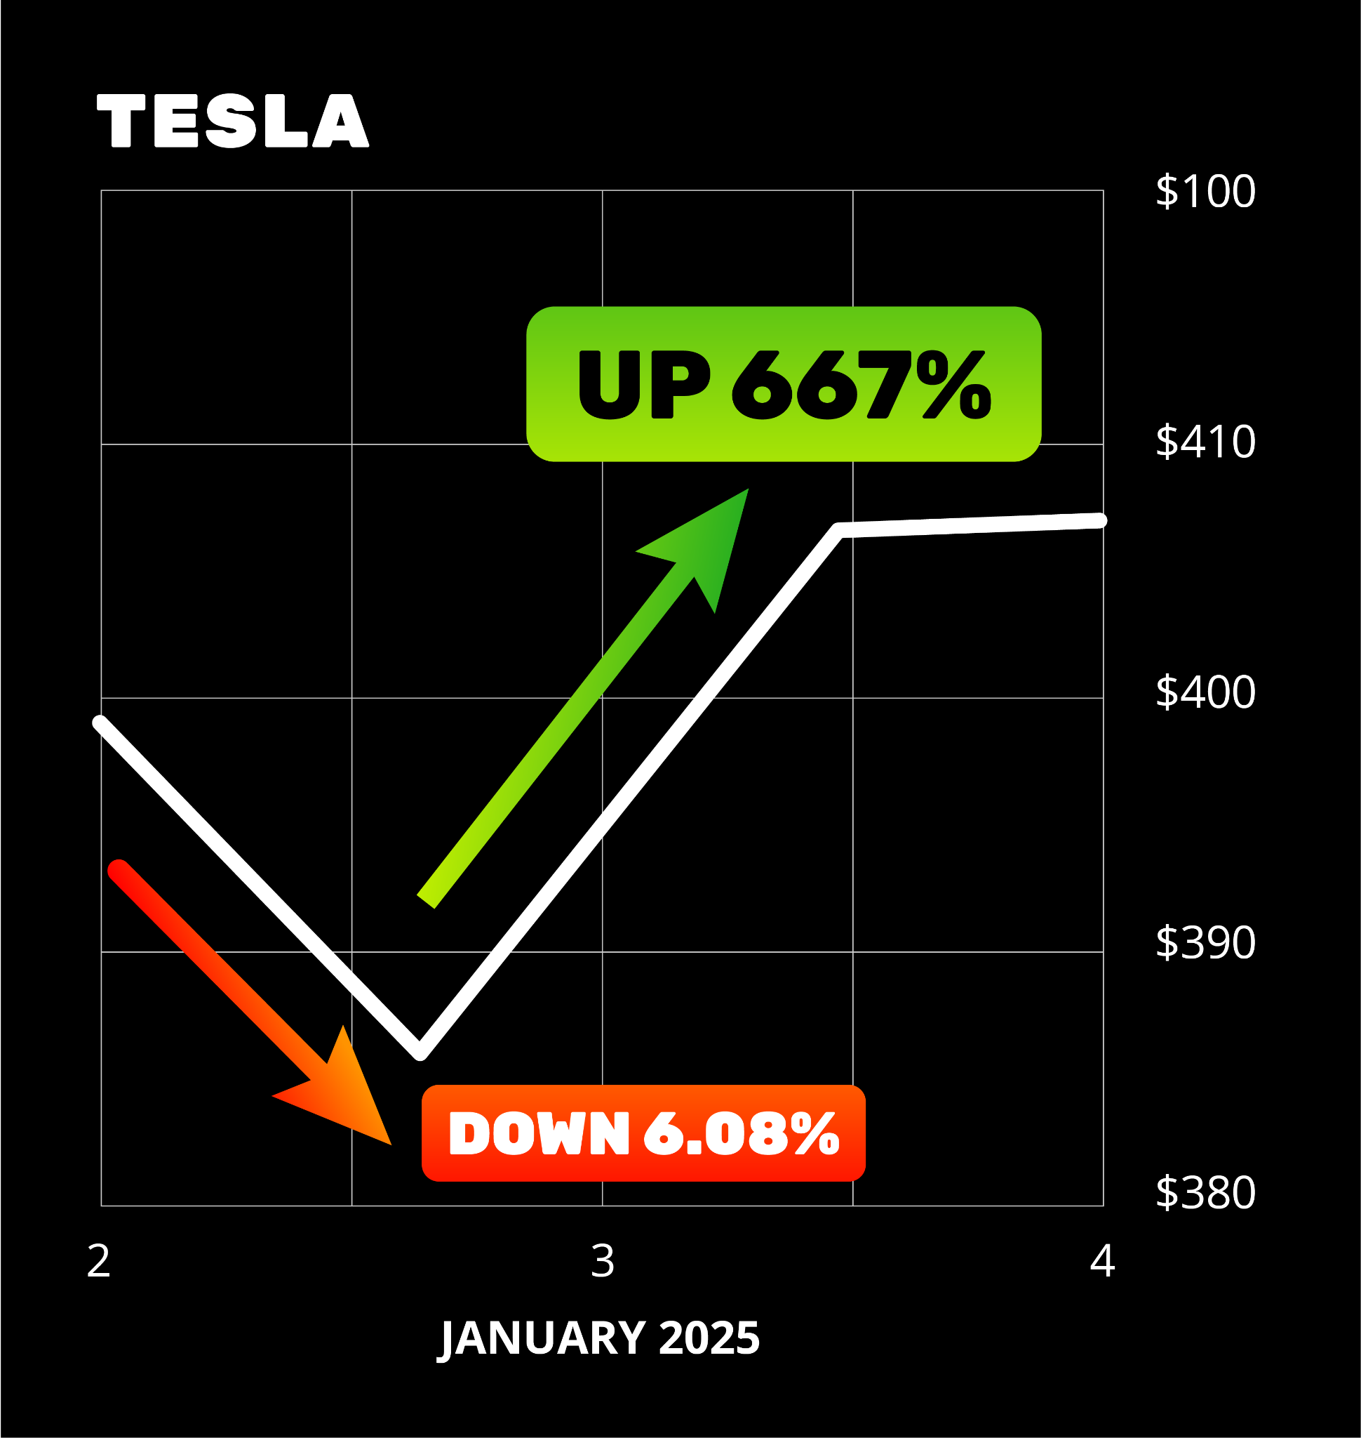
MONSTER 667%
Overnight Win!
Sure enough… the very next day…
Stock Flip Trade went up as much as a rare 667%
$5,000 would turn
into over $38,000!
Notes:
Adjust slide gain.

Slide 20
Imagine Waking Up…
That’s Enough to Maket
$16,000… $11,000… even $33,000 Richer…
$16,000
TOMORROW!
the Very Next Morning!
Notes:
OK with gain% mentioned.

Slide 21
That’s Enough to Maket
Now You Have the Chance With
$16,000
Stock Flips!
the Very Next Morning!
Notes:
OK with gain% mentioned.

Slide 22
So Much Better Than House Flipping!
You can do some trades for as little as $250
There’s no red tape, inspections, paperwork or closing costs
Instead of tying up your money for a year…
You are out the very next day!
Best of all: you can flip the same stock over and over again…
Like with Tesla

Slide 23
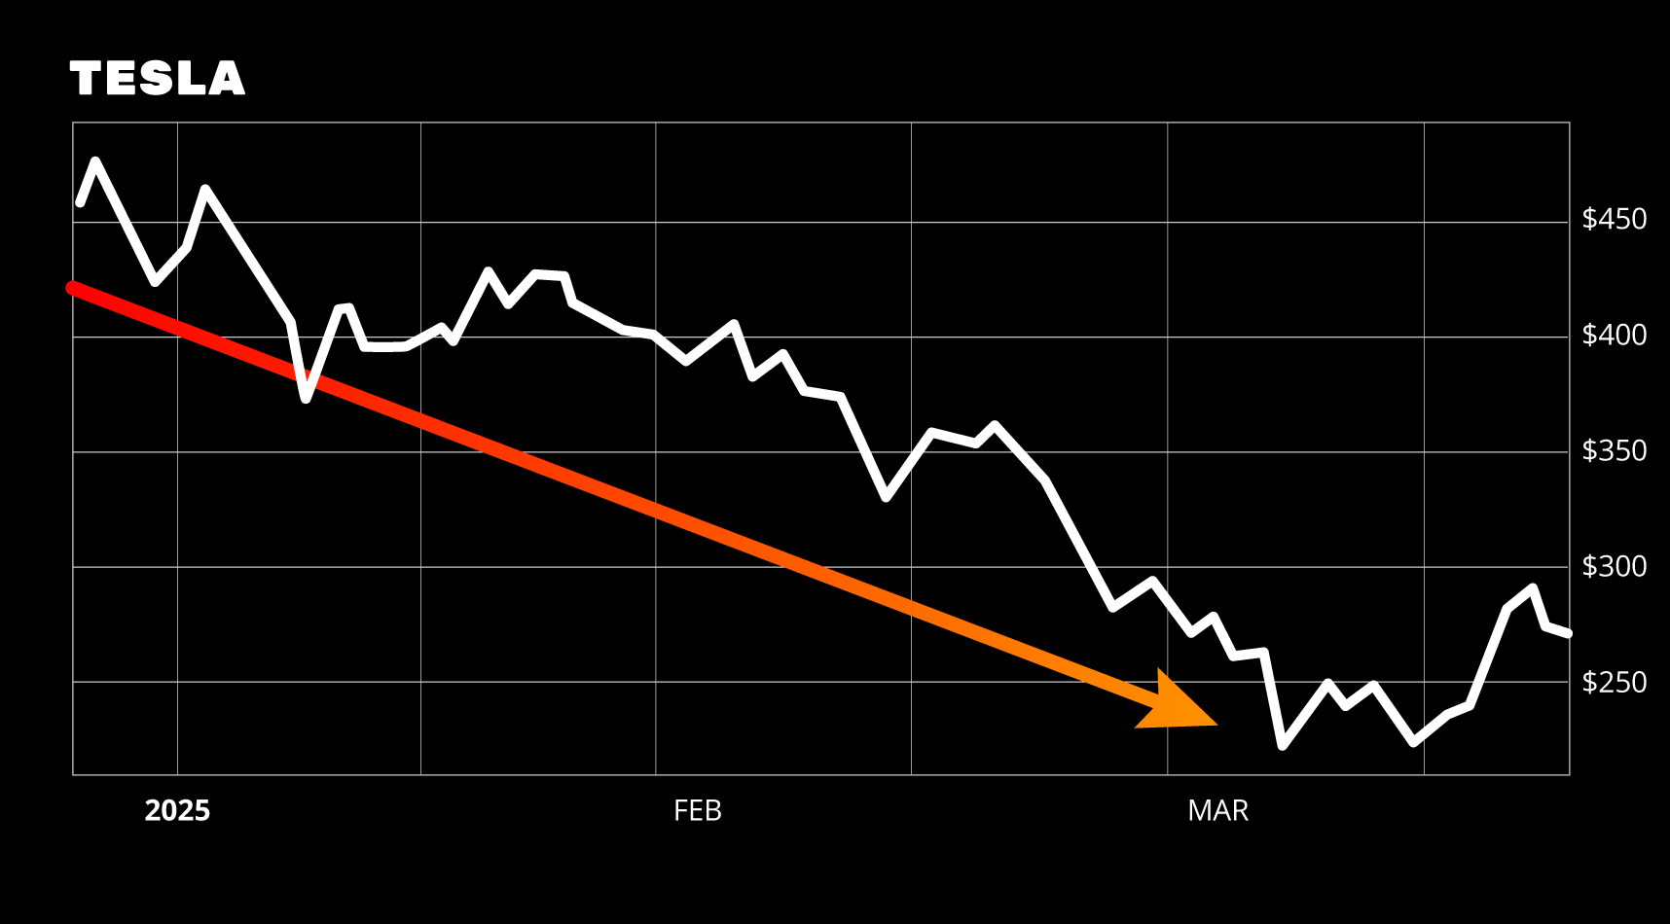
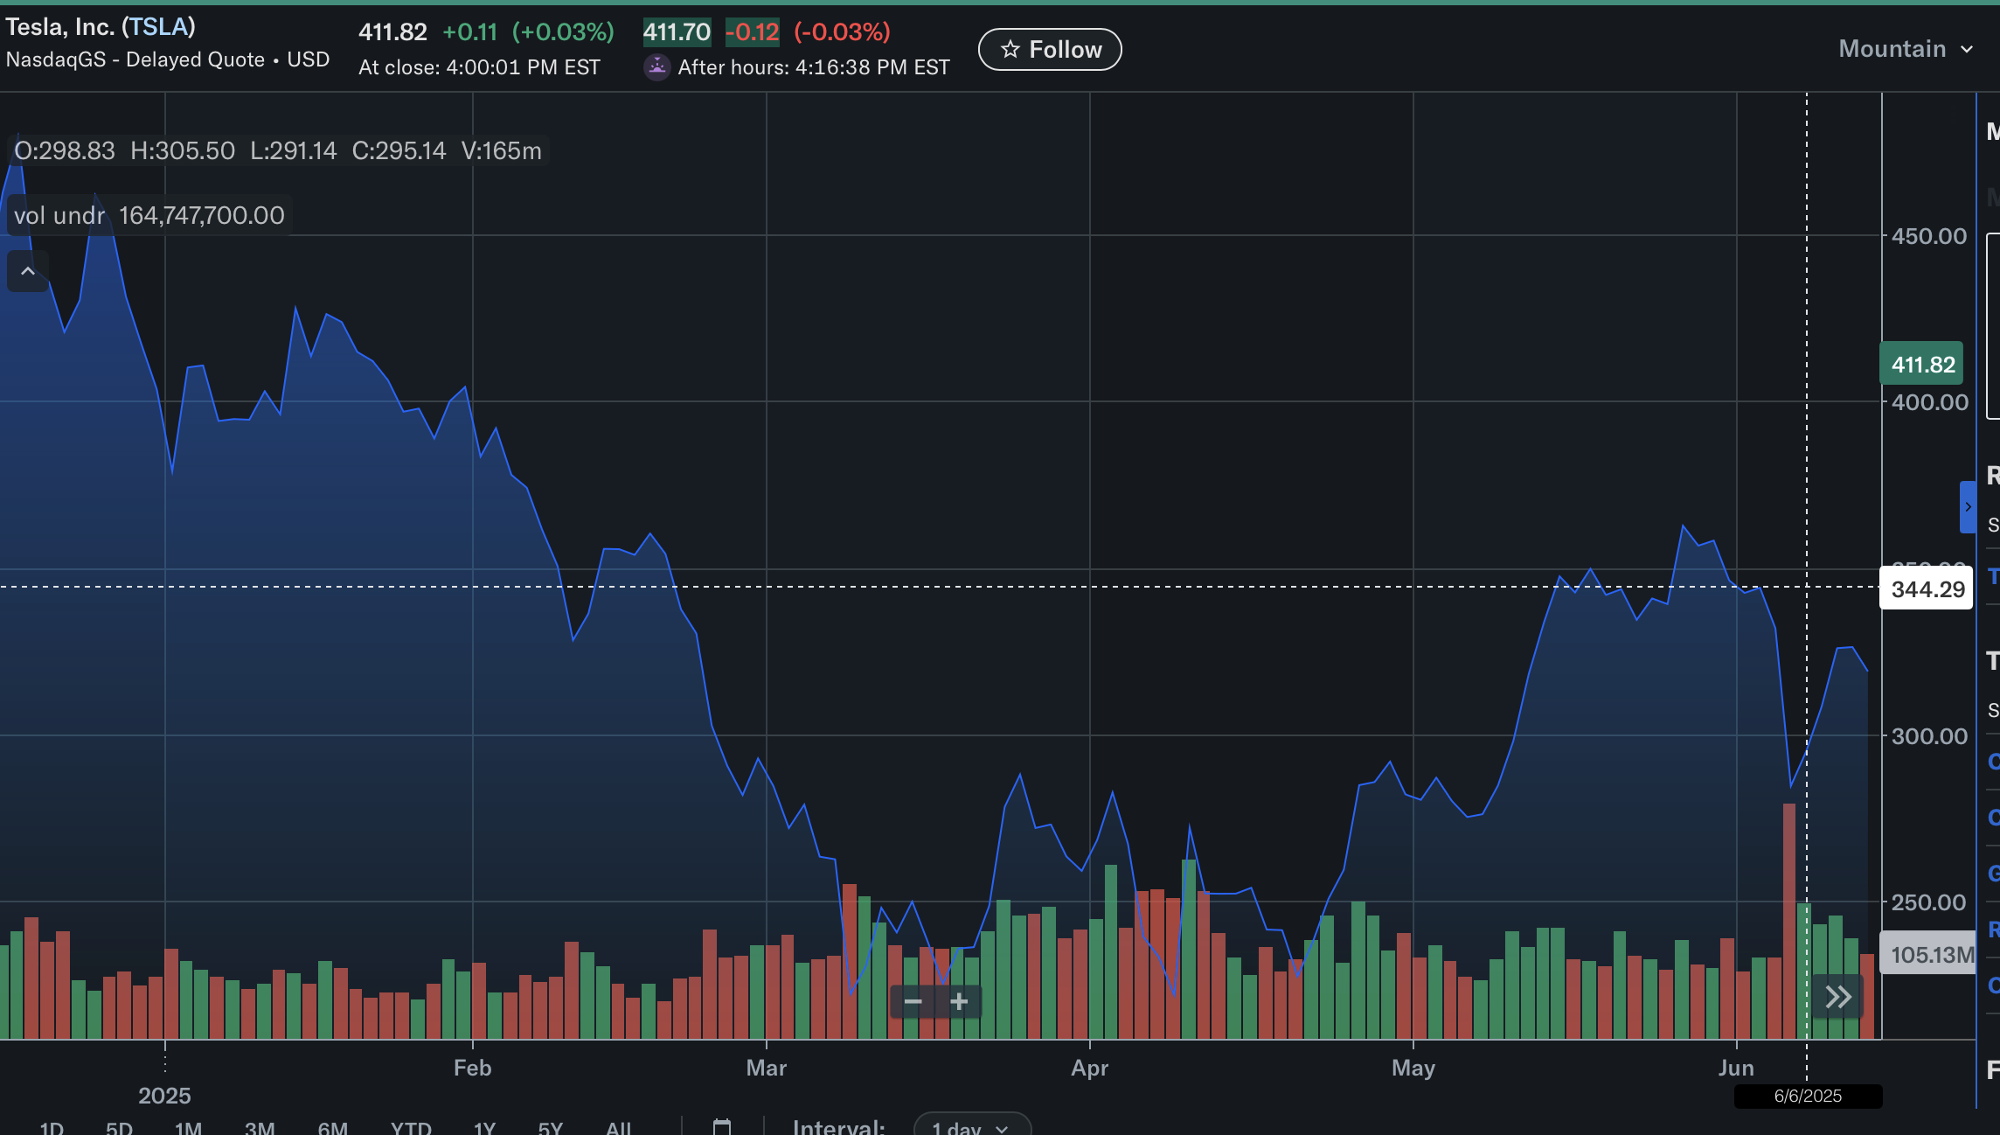
Tesla Was DOWN as Much as 50% From Highs

Slide 24
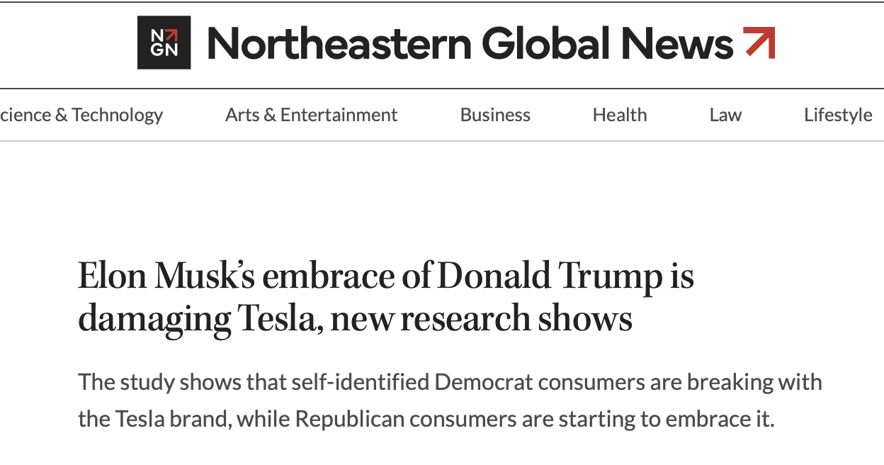
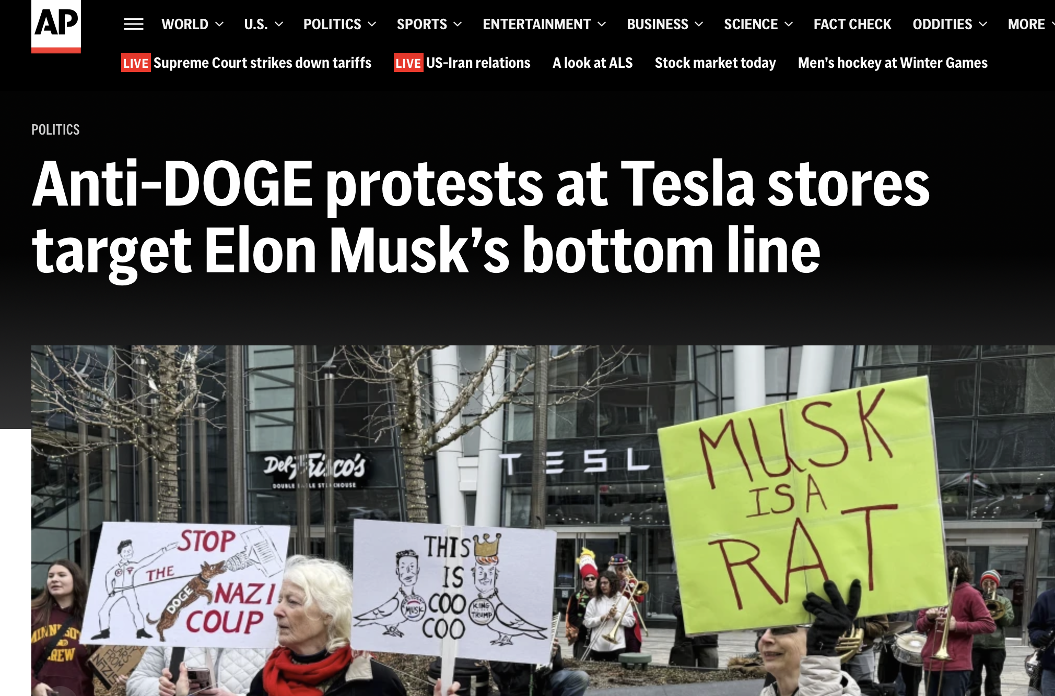
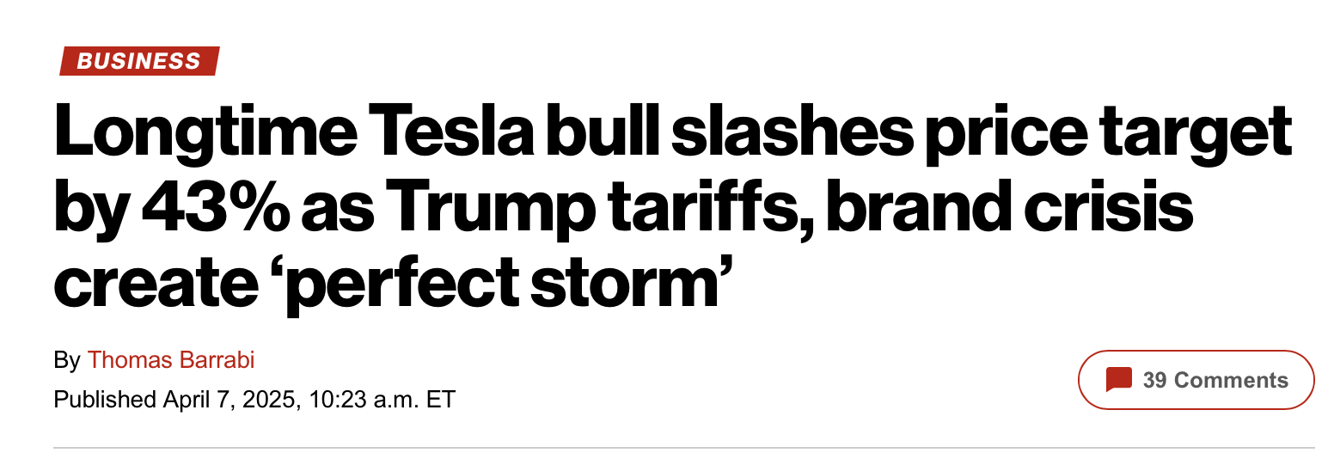
Despite the Bad Press… Tesla Was the BEST Stock to Flip in 2025!

Slide 25
Tesla Flip Trades 2025 ($5,000 in each)
January 2: +$33,300
February 11: +$6,700
February 25: +$1,615
March 10: +$3,505
April 4: +$3,172
April 10: +$1,450
June 5: +$9,088
July 7: +$3,634
July 24: +$25,418
November 11: +$4,611
Notes:
Changed 2/13 to 2/11
Changed 4/7 to 4/4
Changed 7/8 to 7/7

Slide 26
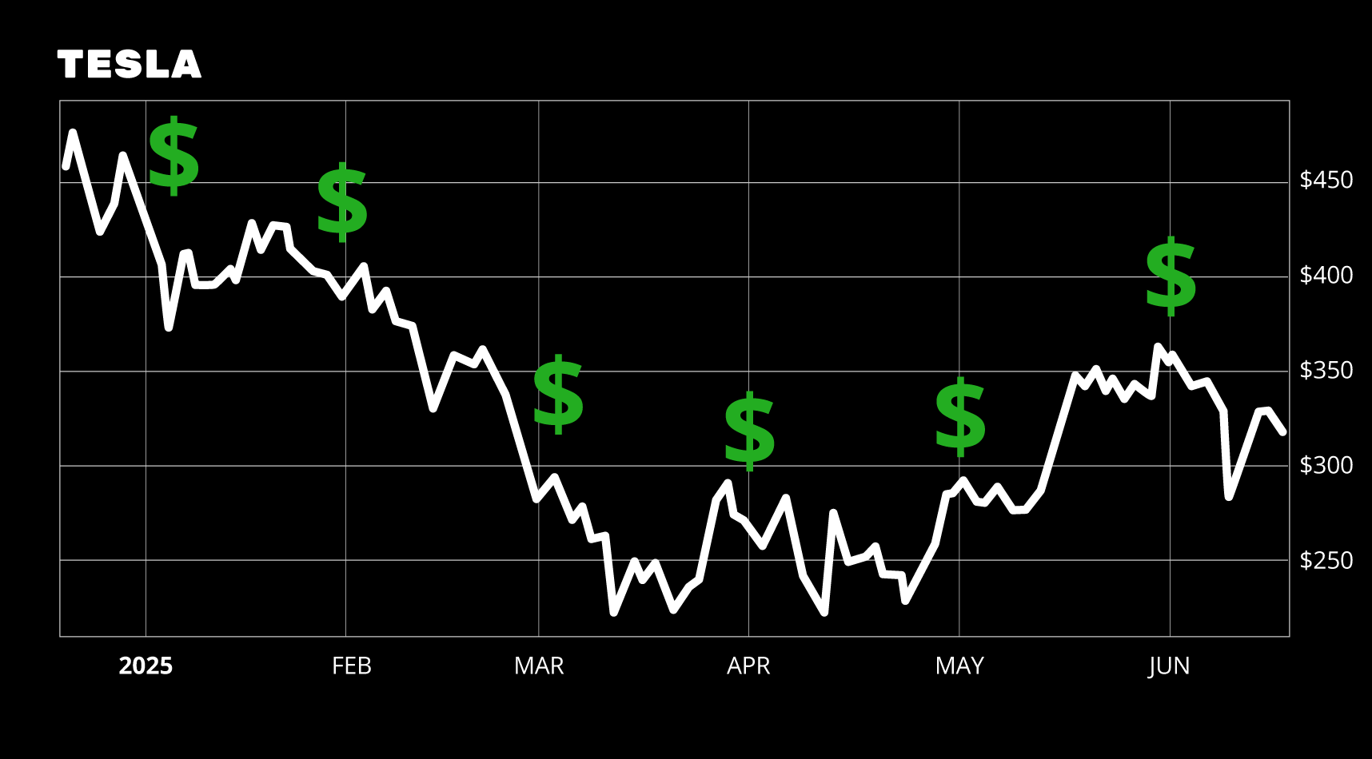
FLIPPING Just Tesla Would Have
Made Over $92,000!
Total gains flipping really add up!
$5,000 turned into as much as $92,500…
In just ONE YEAR!

Slide 27
With Stock Flipping…
You Can Start Small!
You don’t need to put $5,000 in every trade
You can get in some trades for as little as $250
And you can build your account from there
You’ll be going for $5,000 payouts (or more) in no time!
Let’s show you how a $2,500 account could have
turned into a six-figure portfolio… in just 2 years!

Slide 28
Rule of Five Profit System
You set aside a specific amount to use to flip stocks
For every trade, you divide your flip account by five
When you have a winner, you add profits to your account
When you have a loser… you subtract the loss from your account
Divide by 5 for the next trade

Slide 29
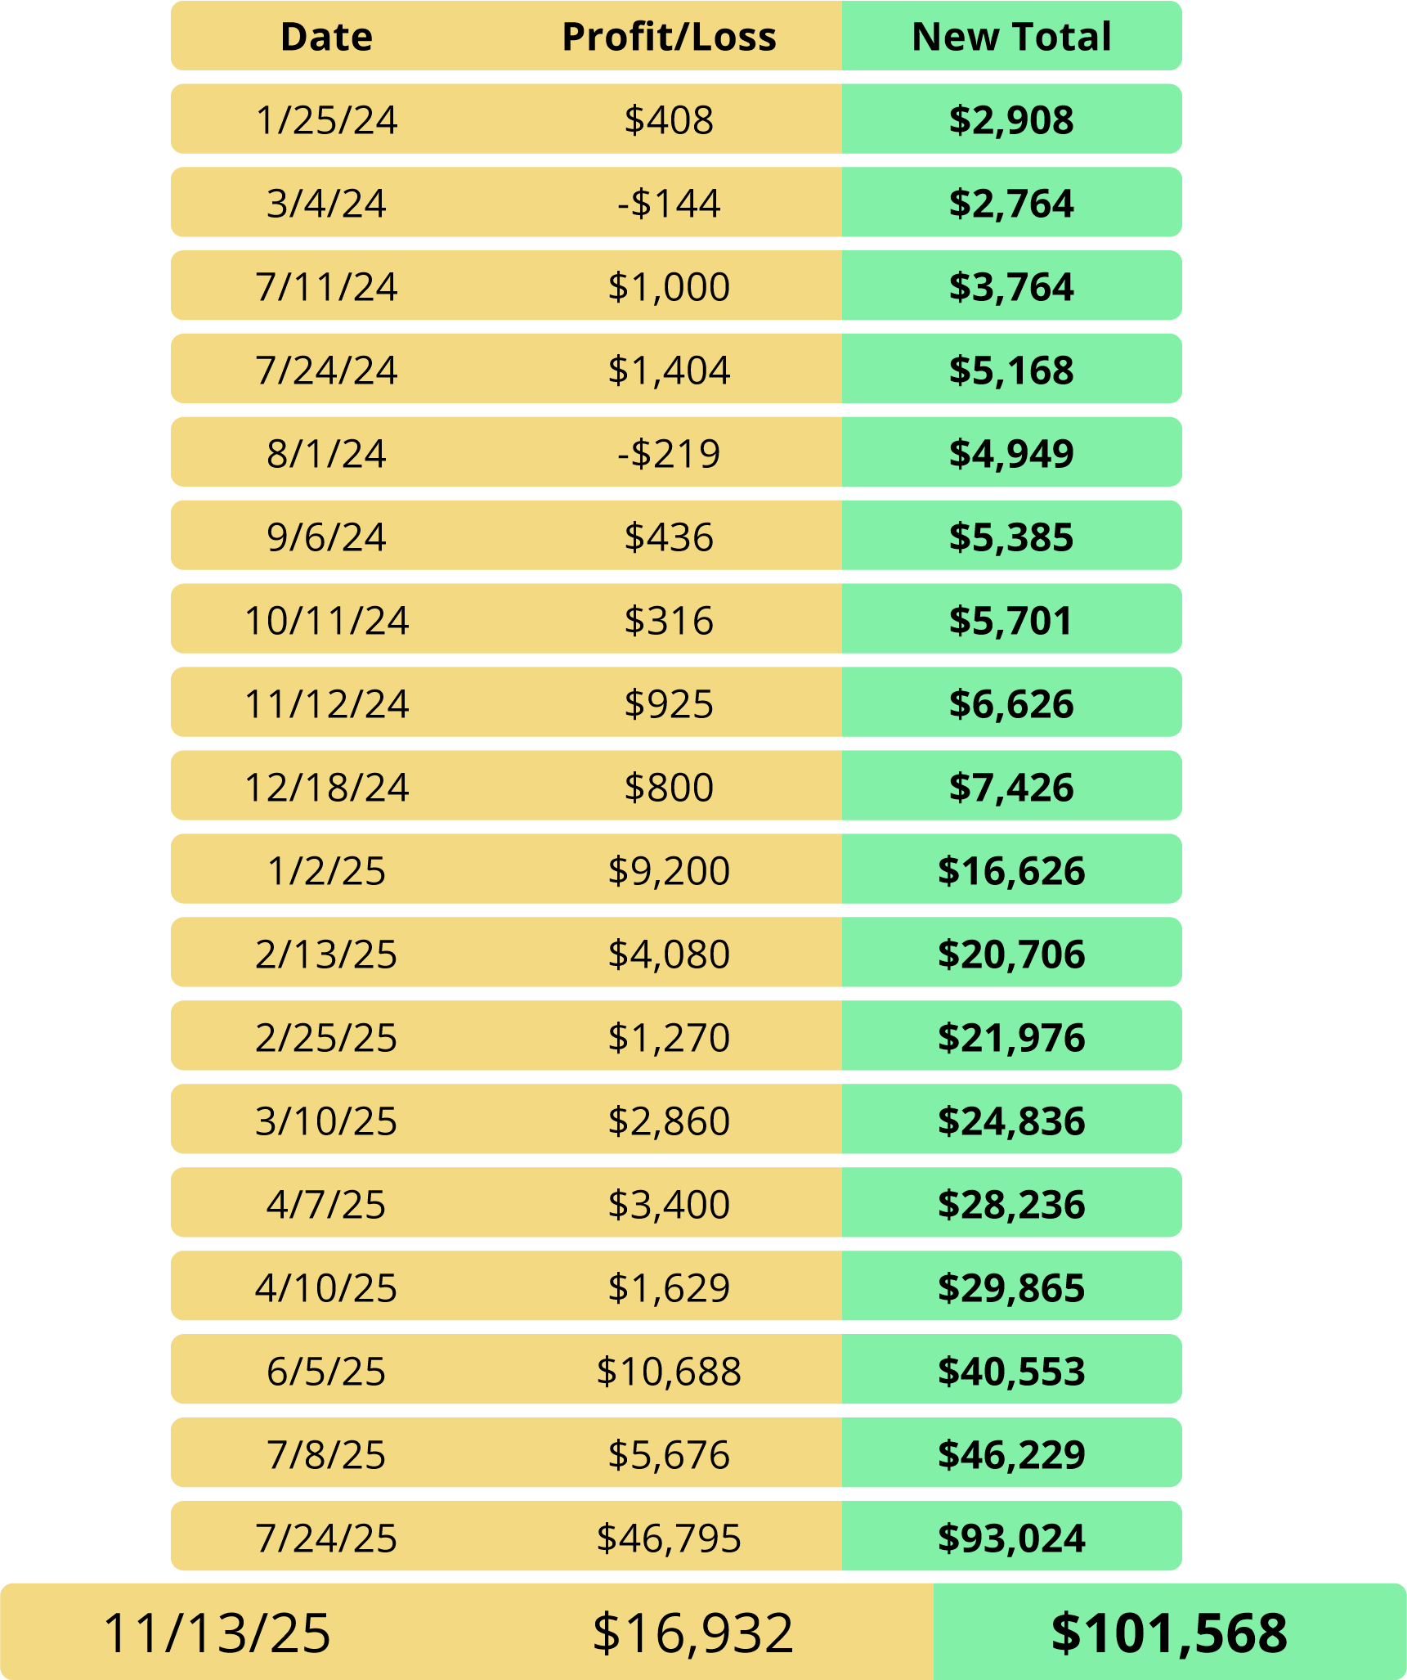
$100,000+ After Two Years Flipping Tesla!
Starting your first trade with just $507
Counting winners and losers…
Your final portfolio is at $101,568!
We can’t guarantee future results
Just wanted to show you the way
real traders grow their money
Notes:
Fix table and headline

Slide 30
You Can Start With Just $2,500…
And Grow a Six-Figure Portfolio!
That’s the Power of Stock Flipping!

Slide 31
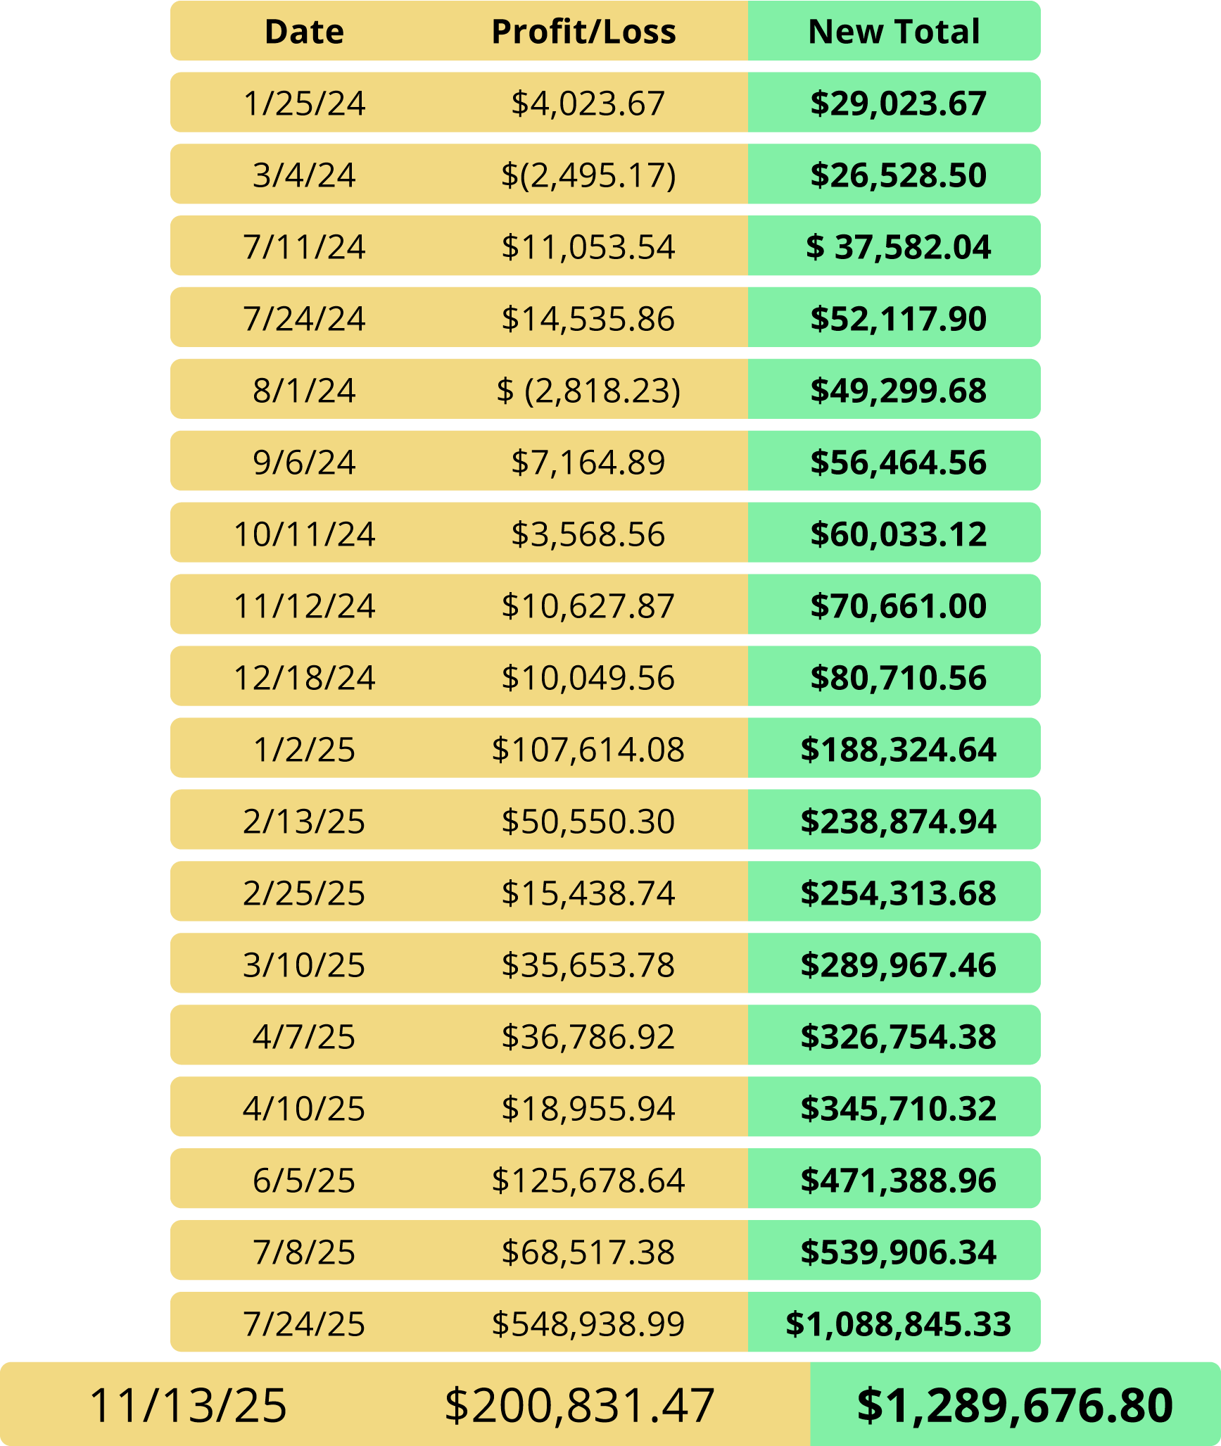
Stock Flip Millionaire!
Using the same trade examples and Rule of Five Profit System…
Starting with a $25,000
account and using $5,000
on the first trade…
Portfolio grows to an astonishing $1.29 MILLION!

Slide 32
That’s Just Flipping Tesla…
There are 30 Stocks for Potential Flips!
Full List Revealed Soon!

Slide 33
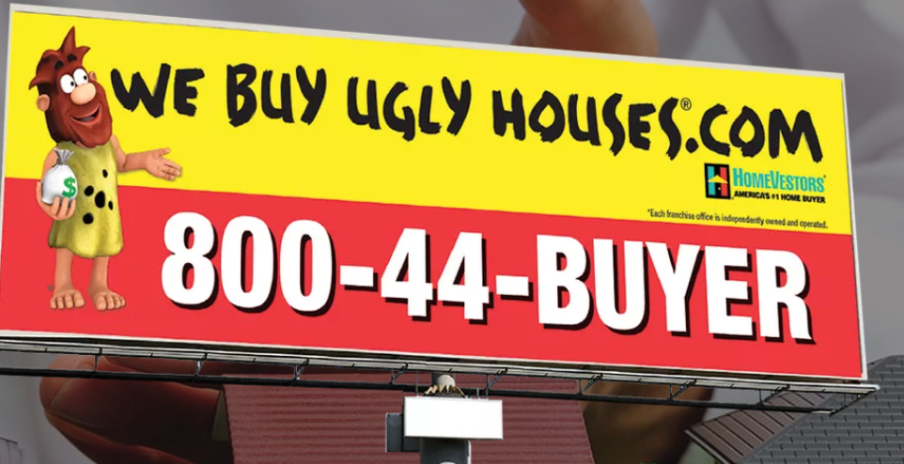
Key to Stock Flipping Fortunes:
Buy a GREAT Stock on an Ugly Day…
Flip It the Next Day for a Double…
Make $5,000 (or MORE) Overnight!

Slide 34
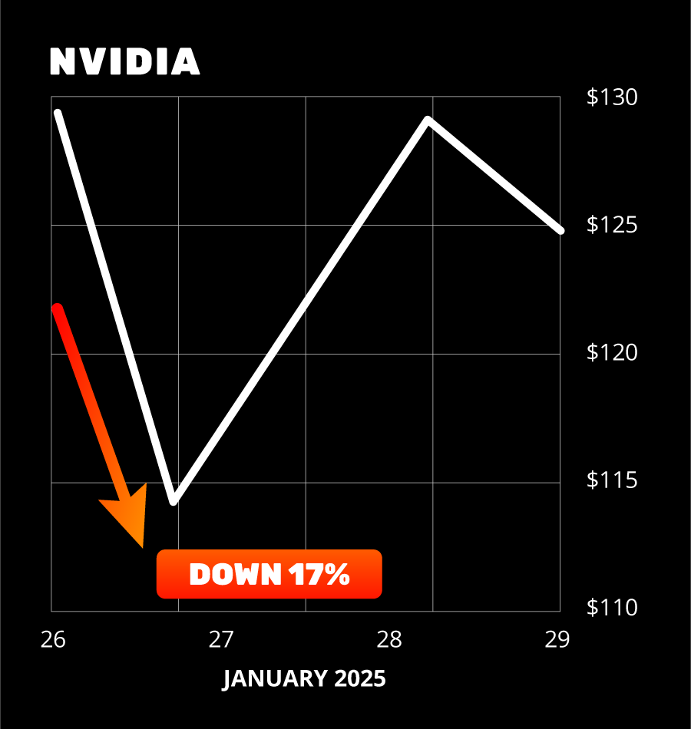
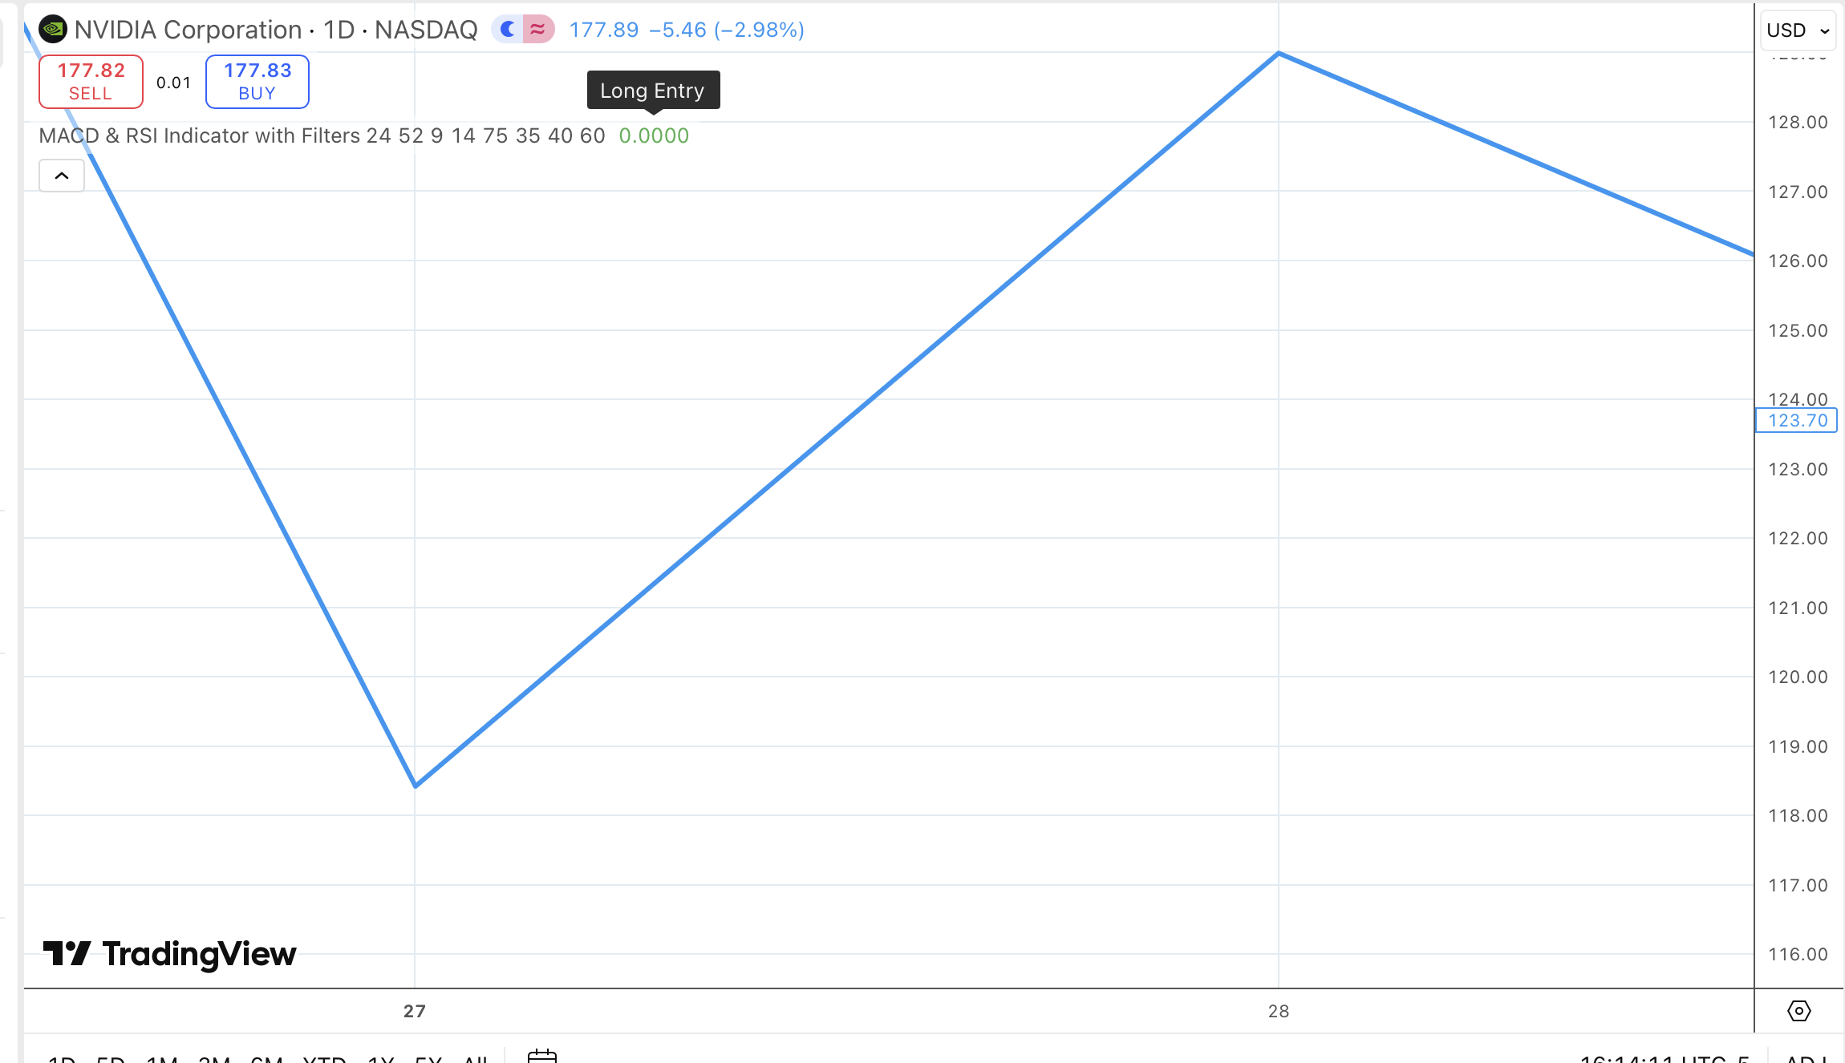
Market's Dirty Secret: Even the Best Stocks Have Ugly Days
Nvidia on January 27, 2025
Bloodbath for AI stocks
Nvidia lost 17% – $600 billion in market cap lost (largest one day dollar loss for a single stock in history)
Sky is falling?

Slide 35
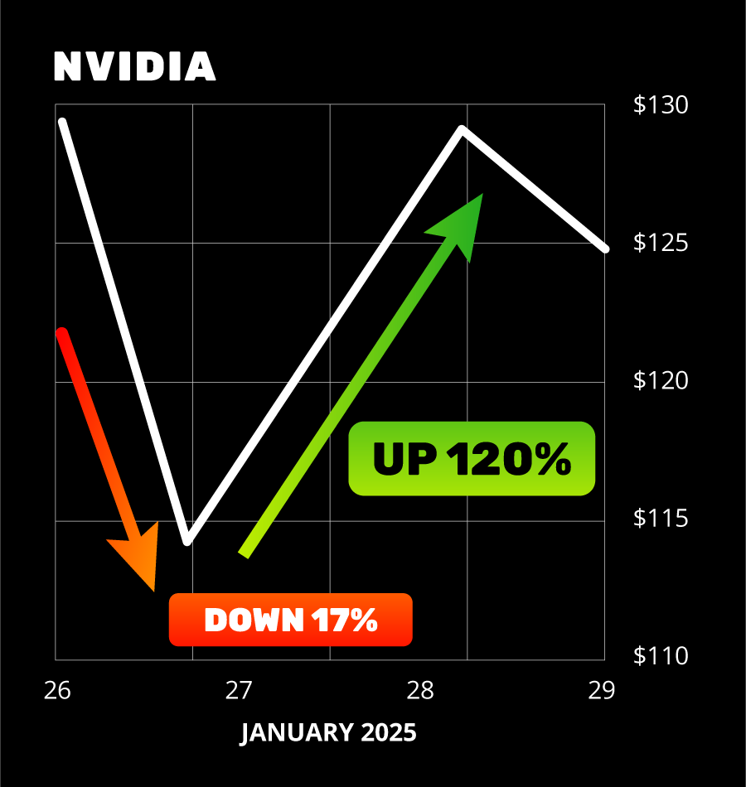
Wrong… GREAT Flipping
Opportunity!
Great stock… UGLY day
Classic setup for a Stock Flip
Stock Flip trade went up the very next day as much as 120%
Notes:
OK. Just adjust the chart to show 120%

Slide 36
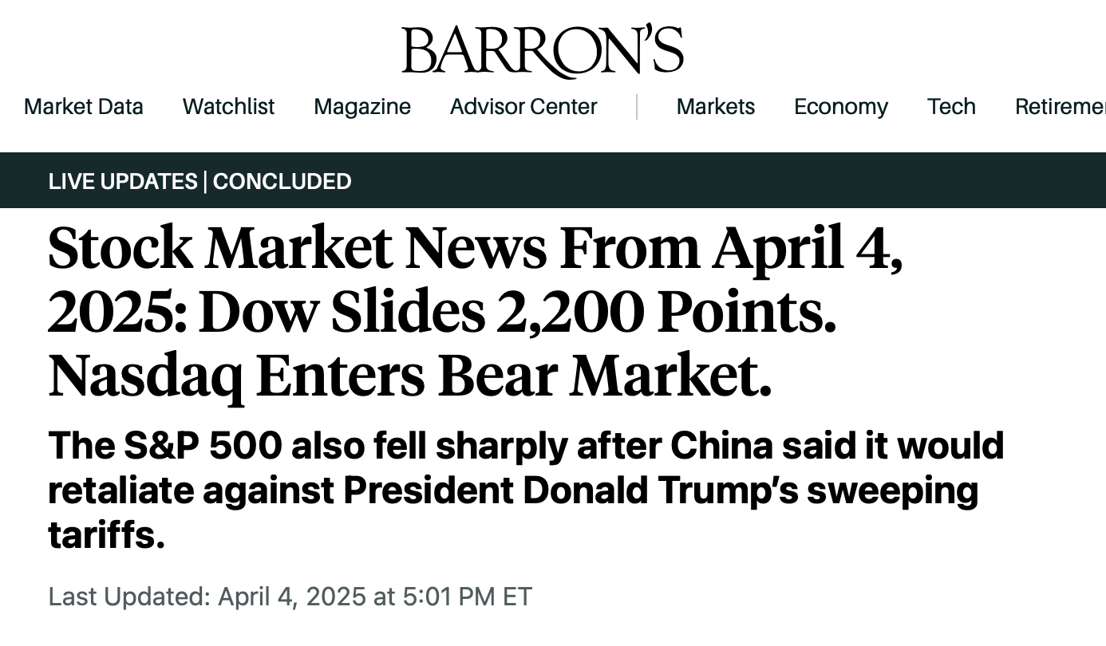
BROADCOM:
Another Great Stock on an Ugly Day
April 4, 2025 Tariff Chaos
Broadcom fell -5.01%
Sky Falling Again?

Slide 37
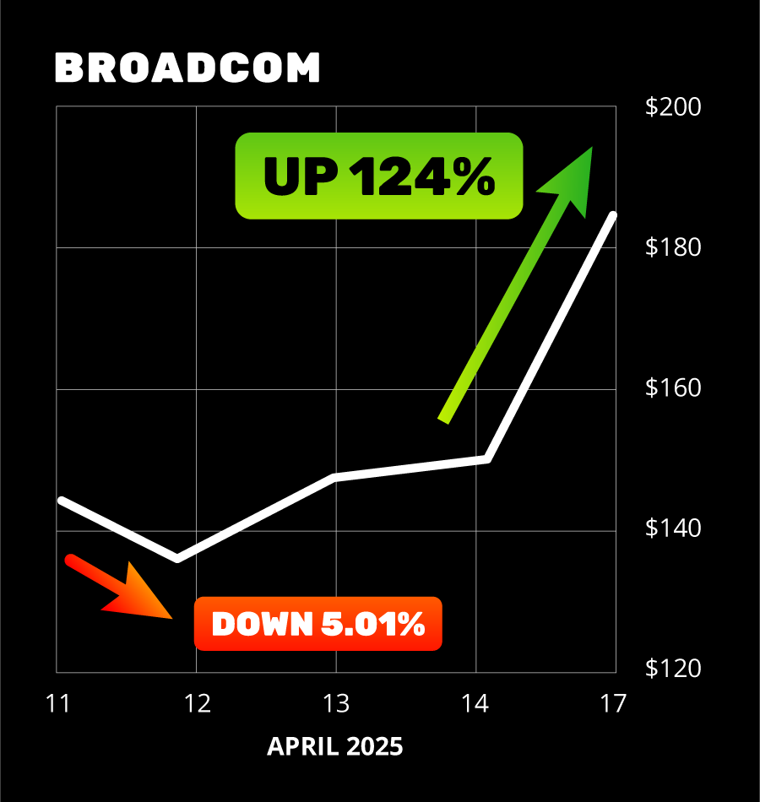
Wrong Again!
124% Overnight
Once more… a great stock
on an ”ugly” day
Perfect time for stock flip
Even in the midst of tariff chaos
Flip Trade on Broadcom would’ve surged +124% the next day!
Notes:
OK

Slide 38
What’s the Secret?
Why Does Stock
Flipping Work So Well?
Let’s Dive Into the Data!
Notes:
OK with gain% mentioned.

Slide 39
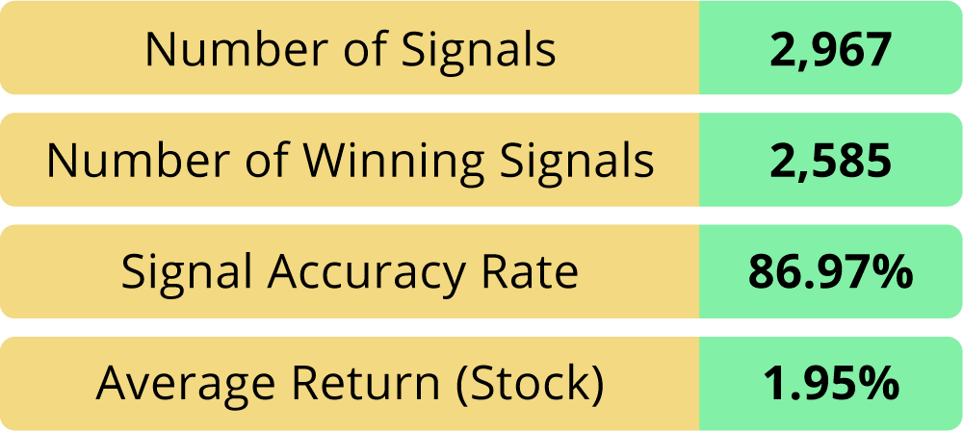
Over 10 Years of Flip Data
We looked at thousands of stocks…
dating back to 2015
Analyzed what percentage of a
one-day drop was an OVER reaction
Based on the highs the next day
30 stocks (out of thousands)
had the best percentage…
They went up the next day 87% of the time!

Slide 40
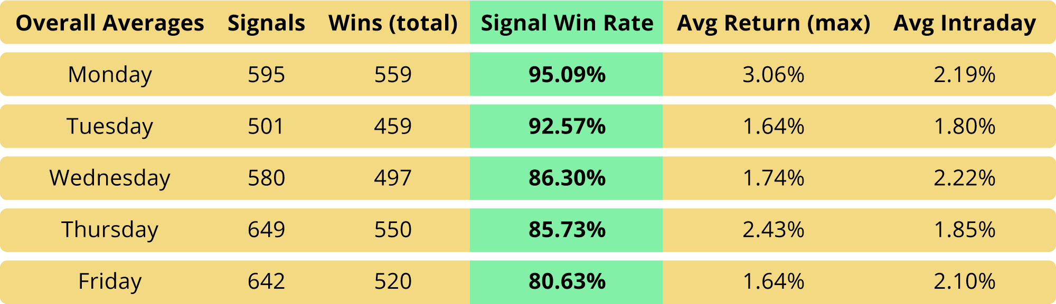
Day to Day Accuracy Rates Get Even BETTER!
We even dug into the days of the week… and figured out which days gave the best statistics!

Slide 41
What Else Did the Data Reveal?
Stock Flipping Works in
Bull and Bear Markets!

Slide 42
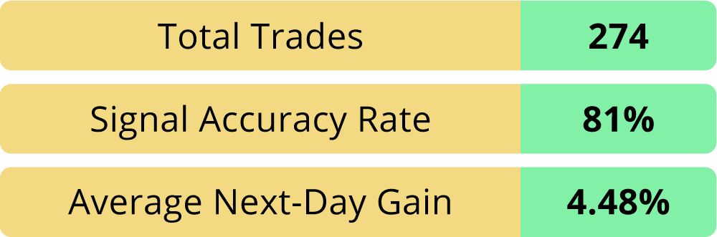
COVID Crash (2/20 to 3/31)
We looked at the worst of the
COVID crash
While EVERYTHING was in freefall
Total of 274 Flip Trade Opportunities
8 out of 10 signals were winners
Stocks averaged 4.48% the next day!

Slide 43
Bottom Line:
That’s Enough to Maket
Stock Flipping Can Give YOU a Statistical Advantage…
$16,000
In Any Market!
the Very Next Morning!
Notes:
OK with gain% mentioned.

Slide 44
How Flipping Turns Stock Moves Into
HUGE GAINS!
August 6, 2024:
Costco went up 3.90% → Flip Trade on Costco went up 142%!
July 19, 2024:
Eli Lilly went up 3.69% → Flip Trade on Eli Lilly went up 153%!
February 12, 2025:
Tesla went up 5.45% → Flip Trade on Tesla went up 135%!

Slide 45
Flipping Gives You the Chance to
DOUBLE YOUR MONEY
Every Time One Triggers!

Slide 46
Rather Than Holding Longer…
Data Found OVERNIGHT Is the
Sweet Spot for Profitable Flips
Flipping Allows You to
Cash Out the VERY NEXT DAY!

Slide 47
And Best of All…
NOW Is the Perfect Time to Get Started!

Slide 48


Write this Date Down: March 19
TOMORROW!
FedEx reports March 19 after the close
They are often considered the economic barometer for the world
We predict this will kick off 60 days of the biggest flip opportunities you’ll see this year

Slide 49
Next 60 Days:
Best Chances to Turn
Overreactions to $5,000
Overnight Stock Flip Payouts!

Slide 50
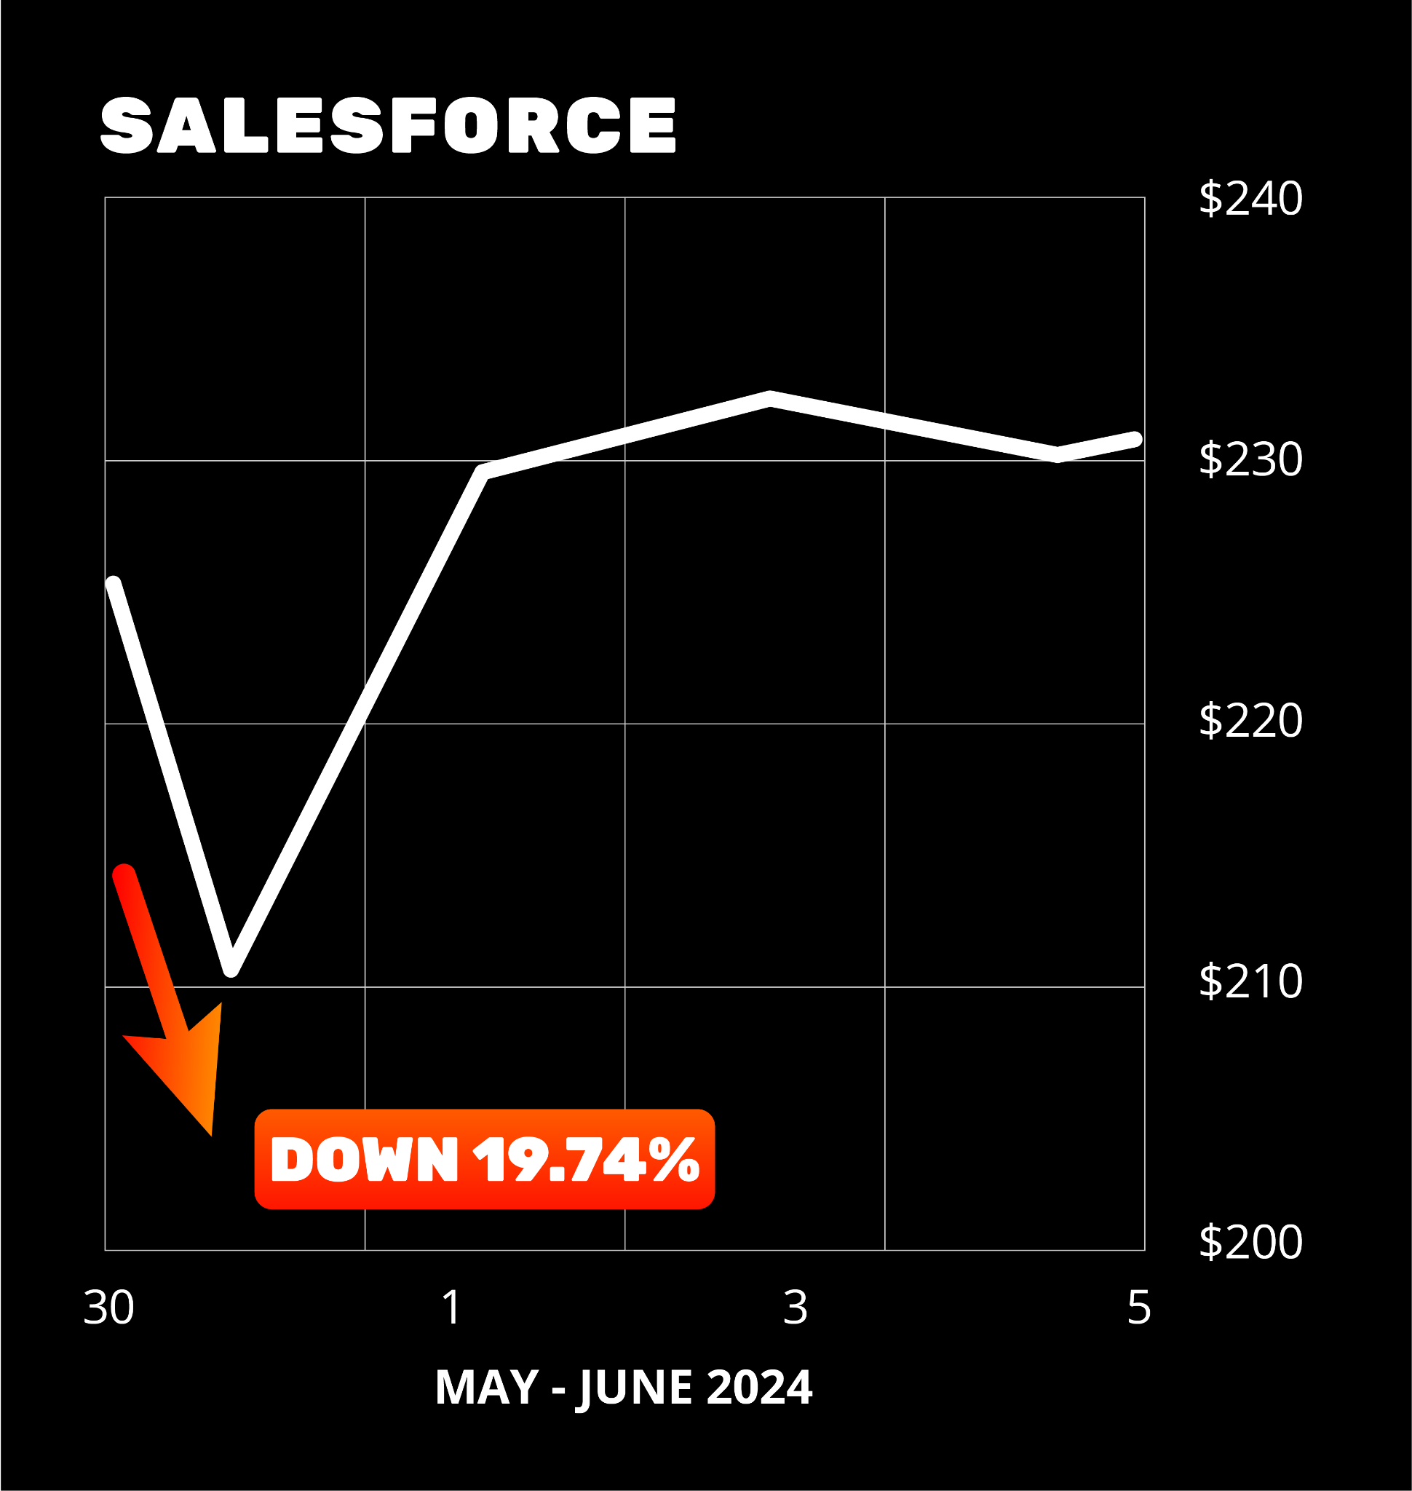
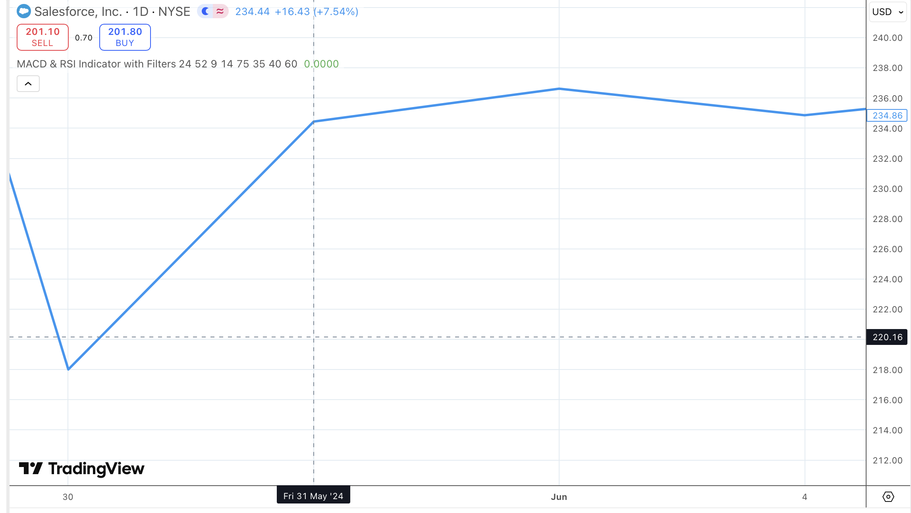
Earnings Triggered
Stock Flips
Salesforce (CRM)
May 30, 2024
Reported first quarterly
miss in 18 years
Largest one-day drop
in 20-year history
Lost -19.74%

Slide 51
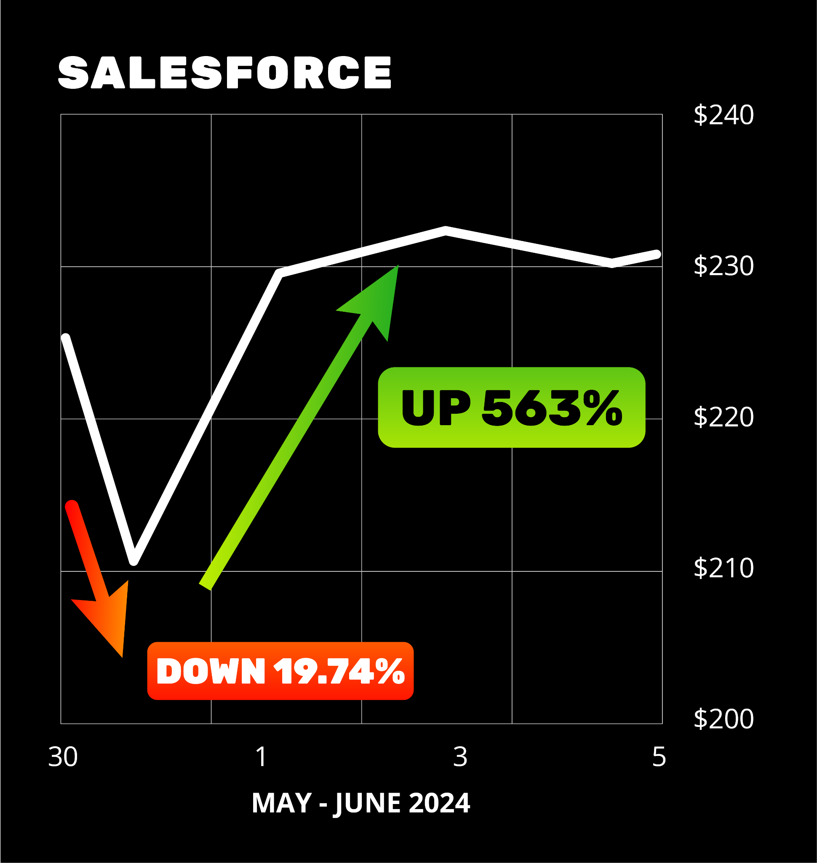
563% Earnings
Season Flip!
Classic earnings overreaction
Perfect opportunity
to flip the stock
Great stock… ugly day
Next day… Stock Flip Trade could have gone as high as 563%!

Slide 52
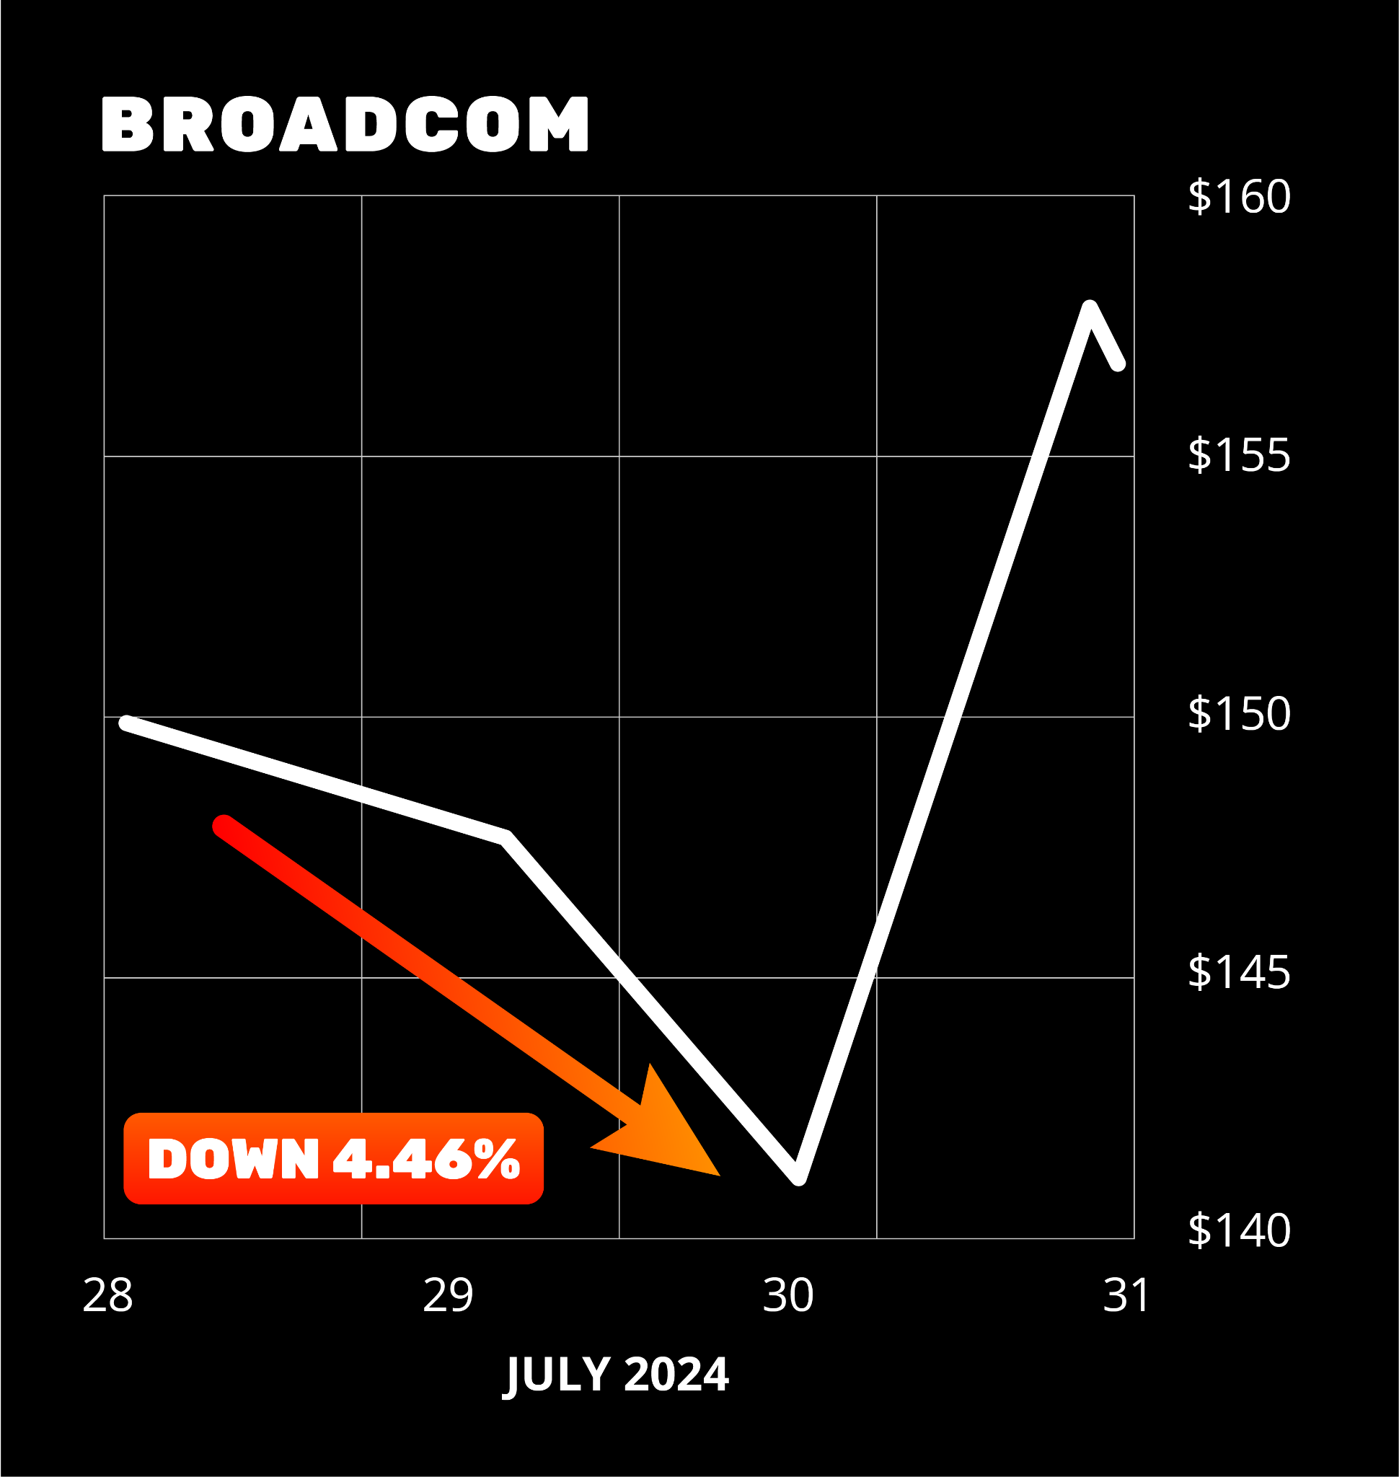
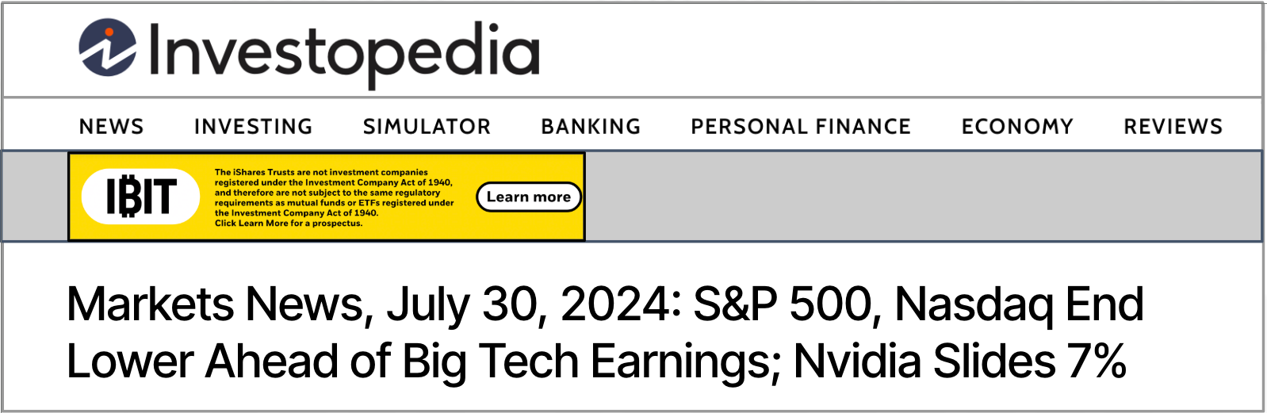
Broadcom’s
Collateral Damage
July 30, 2024, Nasdaq went down big
Chip stocks fell before Mag 7 companies reported earnings
Earnings season overreaction…
wasn’t even AVGO earnings!
Closed Down -4.46%

Slide 53
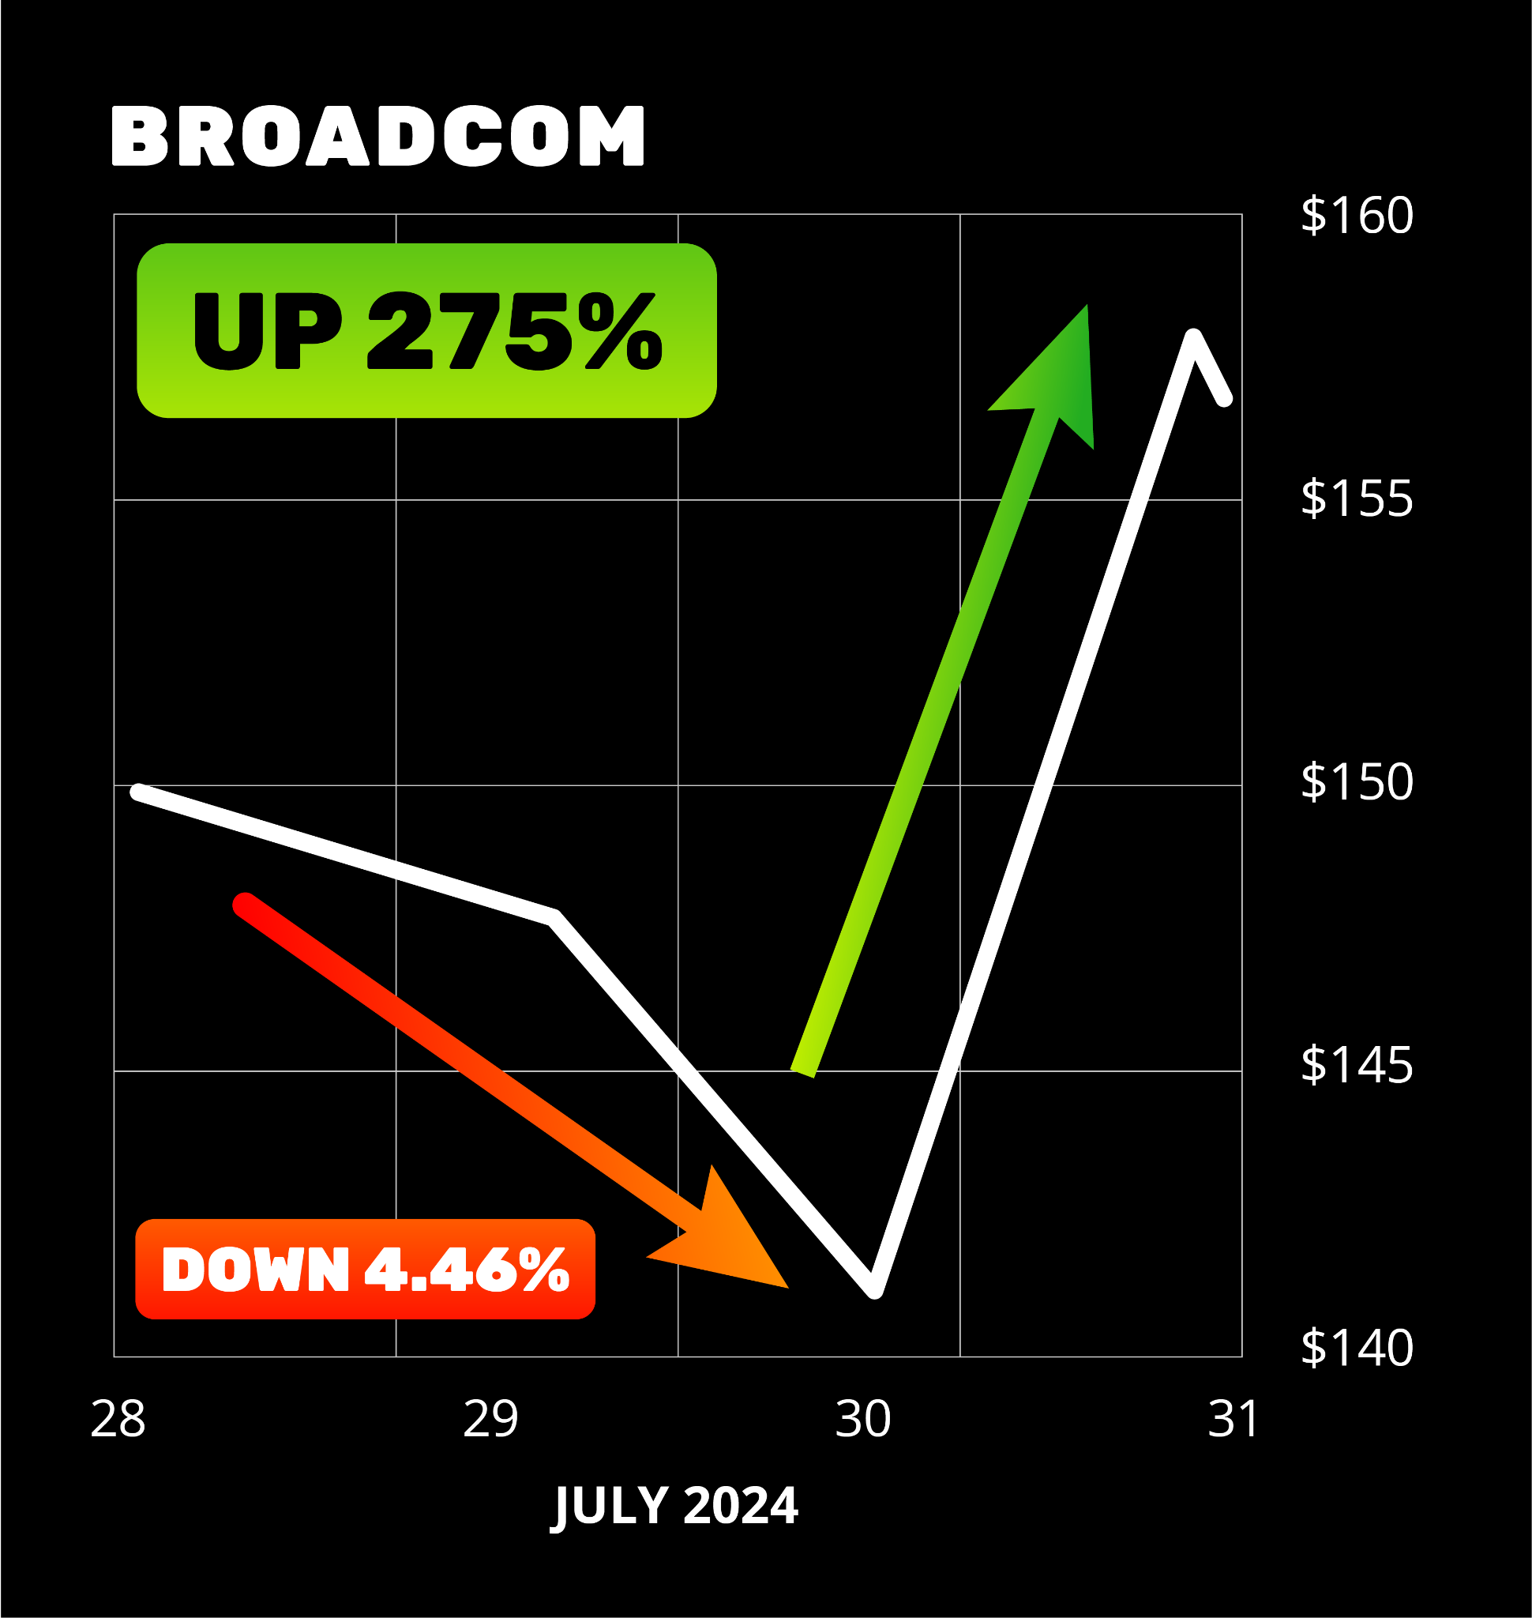
275% Overnight Win!
Good stock… ugly day
Another Stock Flip setup
Stock Flip Trade went up 275%!

Slide 54
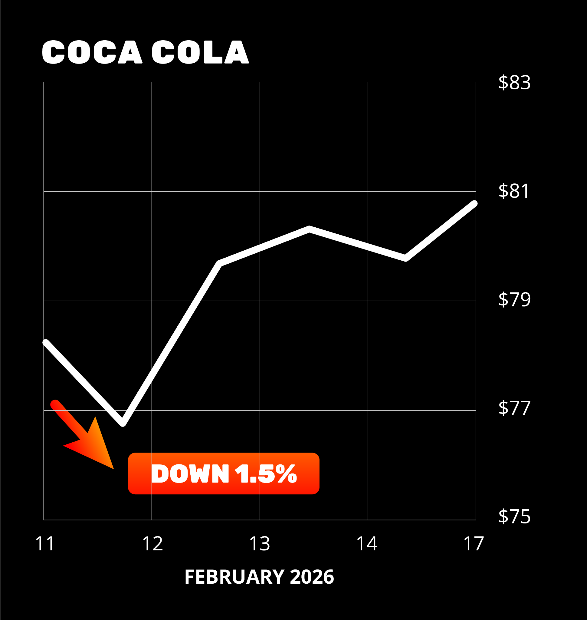
Not Just Tech
Stocks Flip: Coke (KO)
February 10, 2026, Coke reported earnings, including a rare sales miss
Stock was down -1.5% right at our 3:30 watch window

Slide 55
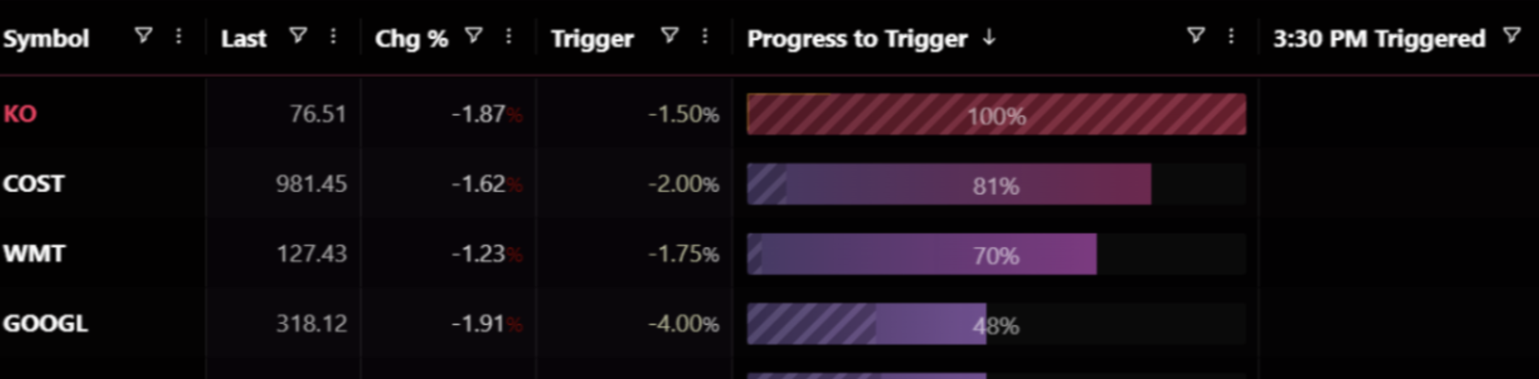
Here’s What Our Proprietary Scanner Showed Us!

Slide 56
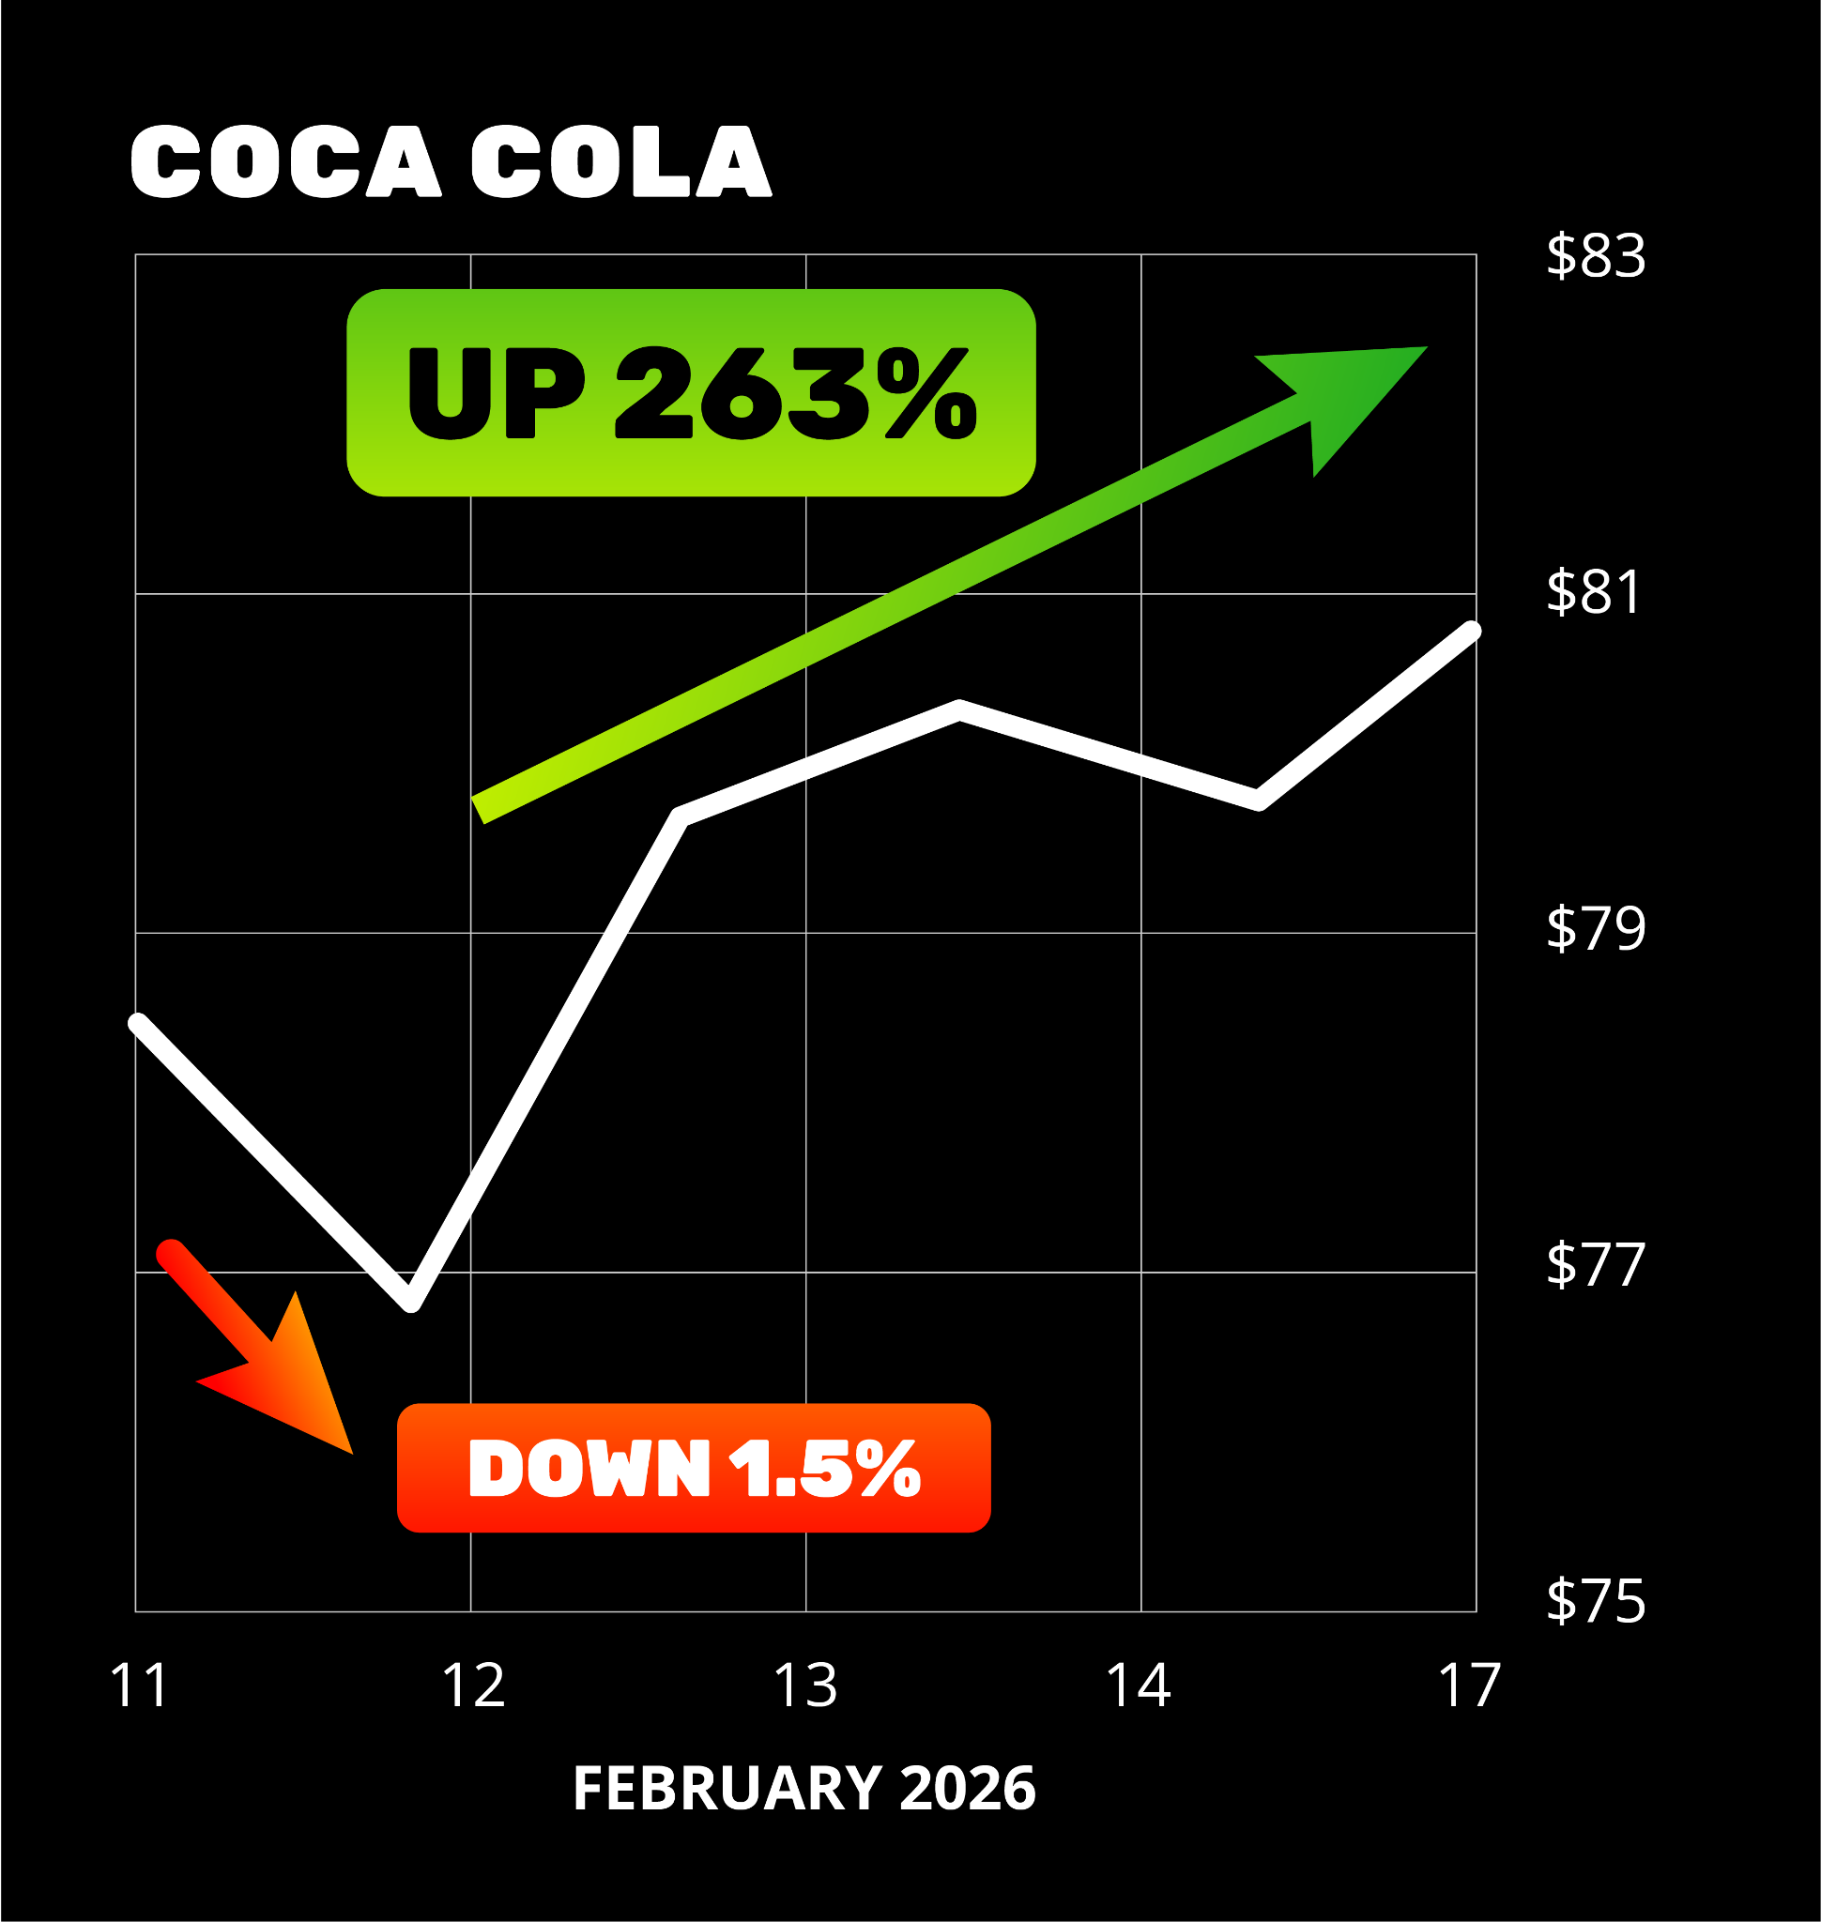
263% Overnight on ”Boring” Stock!
The very next day…
A Stock Flip Trade on Coke would have gone up 263%!

Slide 57

That’s Enough to Wake Up to
$13,000 Profits the Very Next Day!

Slide 58
Stock Flip Strategy Recap
We watch our list of 30 stocks, waiting for them
to hit our flip criteria
If they hit our trigger at 3:30… we recommend a Flip Trade
You can make some of these trades for as little as $250
Let the Flip happen… exit the next day targeting up to 667%!

Slide 59
Reminder… Stick With Us To The End!
You Get Our Full List of
30 Stocks to Flip…
Plus Our Exact Criteria
We’ll Email It to You
FREE for Attending Today!

Slide 60
After Today’s Presentation…
You Have Two Options

Slide 61
Option 1:
That’s Just Flipping Tesla…
You Can Monitor the 30 Stock List Every Single Day
Calculate if the Stock Hit’s the Flip Criteria
Pick Out the Option to Trade on Your Own
And Hope for Your Own $5,000 (or More) Win…
There’s 30 Stocks for Potential Flips!
OR…

Slide 62

Option 2
You Can Let Us
Do ALL the Heavy Lifting for You
The Choice Is Clear!

Slide 63
Here’s Your Chance to Get Stock Flip Trades Sent to YOU!
We monitor ALL the 30 potential stocks to flip…
We’ll pick what we think is the very best trade at the beginning of every week
And give you the exact Stock Flip Trade for maximum profit potential the next day!

Slide 64


Slide 65
Stock Flip Trade Alerts for YOU!
We send the real-time alerts to you the second a trade is triggered
We’ll give you all the details of the trade… including the exact option
We give you the BEST chance to make $5,000 flipping stocks the very next day by targeting gains like 135%, 263%, and 667%
PLUS a Monthly update
All you have to do is get in around 3:30 pm EST
(It only takes two to three minutes to make the trade.)

Slide 66
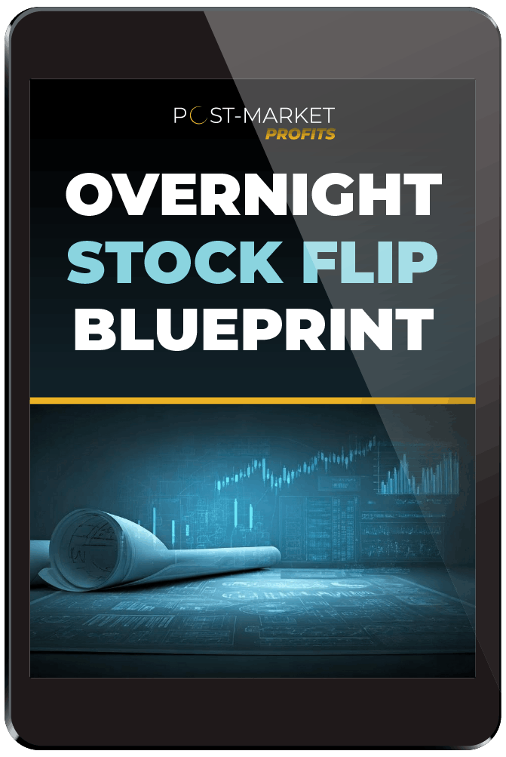
As Soon as You Join Today:
Overnight Stock Flip Blueprint
You get our quick-start guide walking you through the entire process of making
Stock Flip Trades…
Everything we’ve covered today…
but in much more detail.
You’ll see all the stocks we use for Flip Trades
And how we decide on the the options
we’ll use to make the trades

Slide 67
But That’s NOT All…
You also get our wildly popular Dark Ticker trades
It’s another proprietary trading methodology
We get in during one specific 15-minute window in the afternoon…
And exit the very next day
But the trick is… we buy them AFTER the closing bell!

Slide 68
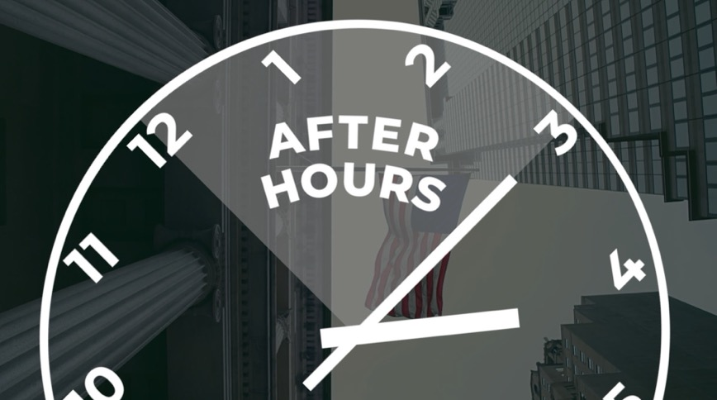
The Original Flip Trade: Dark Ticker
The biggest trading revolution you’re NOT yet using
The after-hours version of
any of the broad market ETFs…
SPY for the S&P 500
QQQ for the Nasdaq
DIA for the Dow
IWM for the Russell 2000
All available to trade after-hours –
in a small window of time – from 4:00 to 4:15 p.m. ET.

Slide 69
Trade AFTER 4 p.m.!
We call it The Dark Ticker because you trade it during an exclusive special trading window from 4 to 4:15 p.m. ET every day

Slide 70
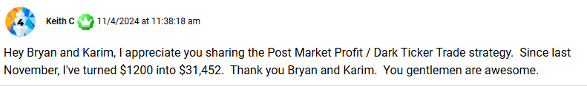
Members Are Making
Big Money!
One member turned $1,200 into over $30,000 following
our trades all year! Almost 30X his entire portfolio!

Slide 71
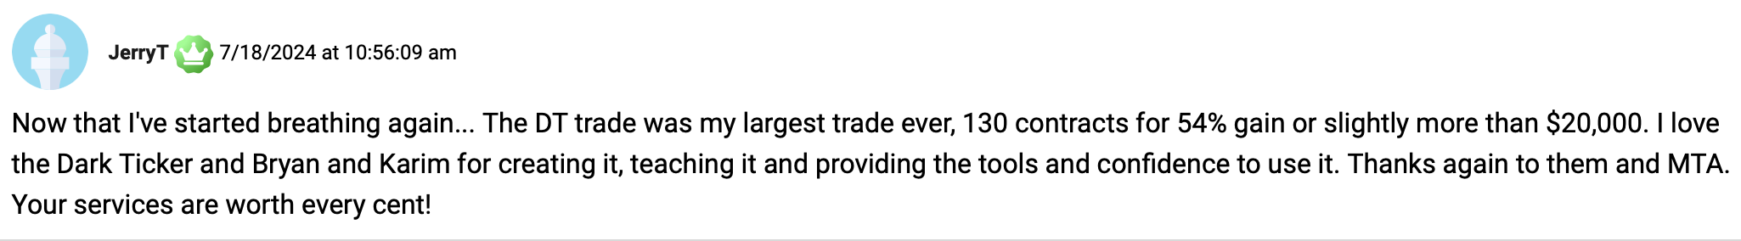
$20K Overnight!
Another member made $20,000 on
one trade that made 54% overnight!

Slide 72
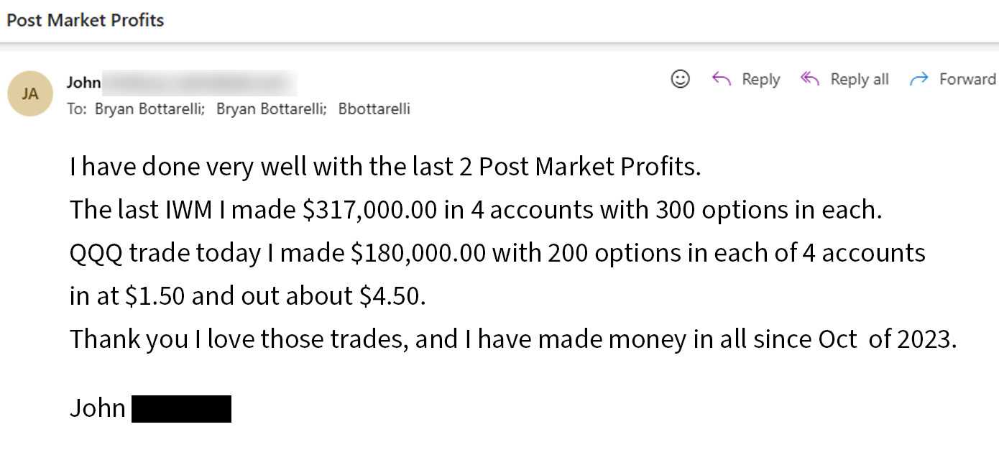
Half a Million Dollars?!?
One member even reported making almost half a million dollars… on just two trades (57% and 64% overnight)!

Slide 73

Excited for Market Drops?!
“It makes me wish the market would drop 1% every single day… I would make so much money!” – Joey
It may seem counterintuitive… but…
Once you see this trade in action,
you’ll be hoping for a big market drop.

Slide 74
Proven Results
The performance record speaks for itself.
We’ve already made 80 trades with this method.
Winning on 7 out of 10 plays…
With overnight gains up to 88%... 109%... 92%... and 157%.
Notes:
Can you tell me where I can find this data in Looker?

Slide 75
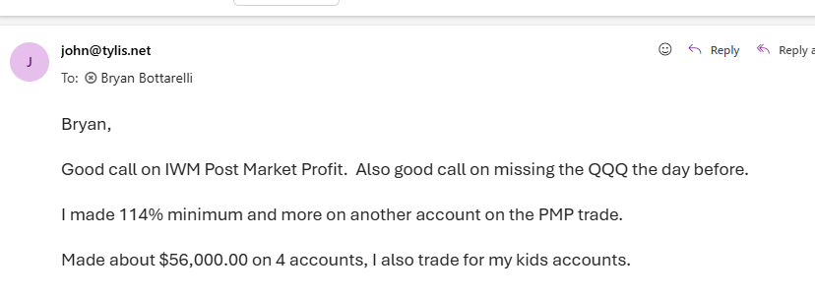
Big Wins This Year!
January 14… 87% overnight
February 5… 129% overnight!
One member made $56,000!
And even uses Dark Ticker to make his kids money!

Slide 76
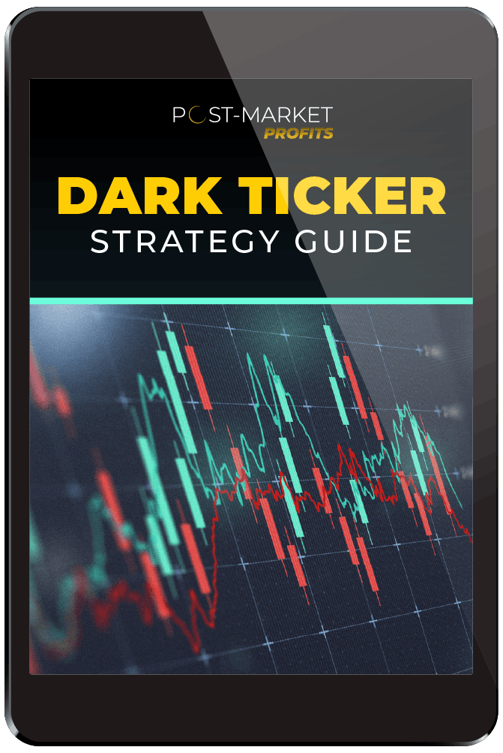
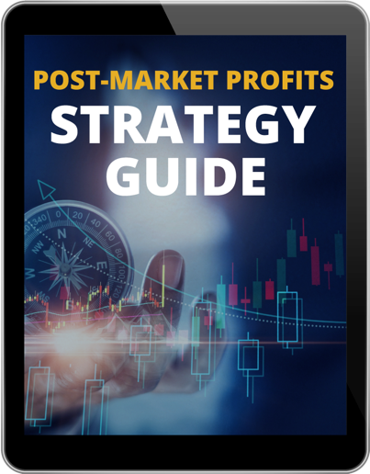
Dark Ticker Strategy Guide
It’s a short primer going through
the Dark Ticker trading strategy
It’s a short read… but you’ll know everything you need to make Dark Ticker trades
And we show you how we decide on
the indexes for the Dark Ticker trades
We’ll still give you the exact trades
if an alert triggers at 4 p.m.!

Slide 77
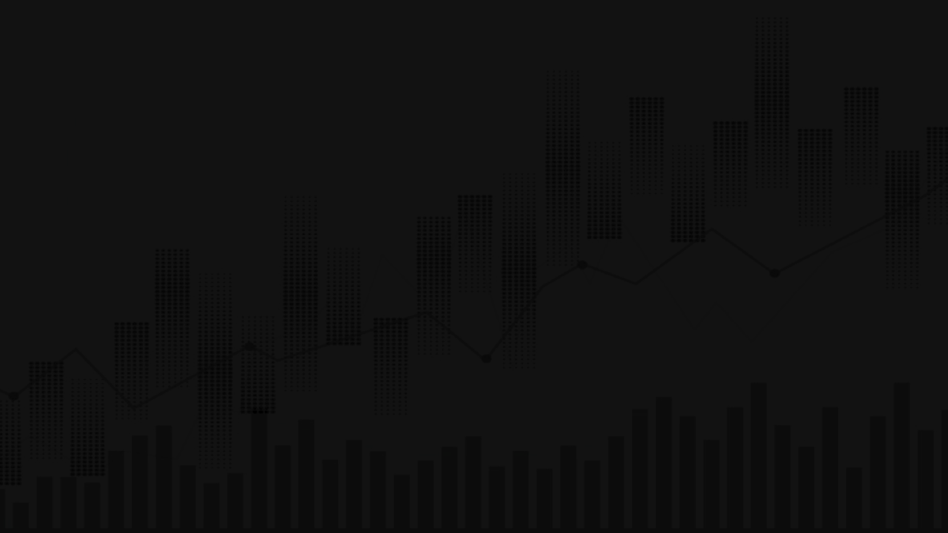



And Today… You Can Get ALL Our Stock Flip Research and Trades…
PLUS! All Our Dark Ticker Research and Trades!
MTA Inner Circle Members:
You Get This FREE!
TBD

Slide 78
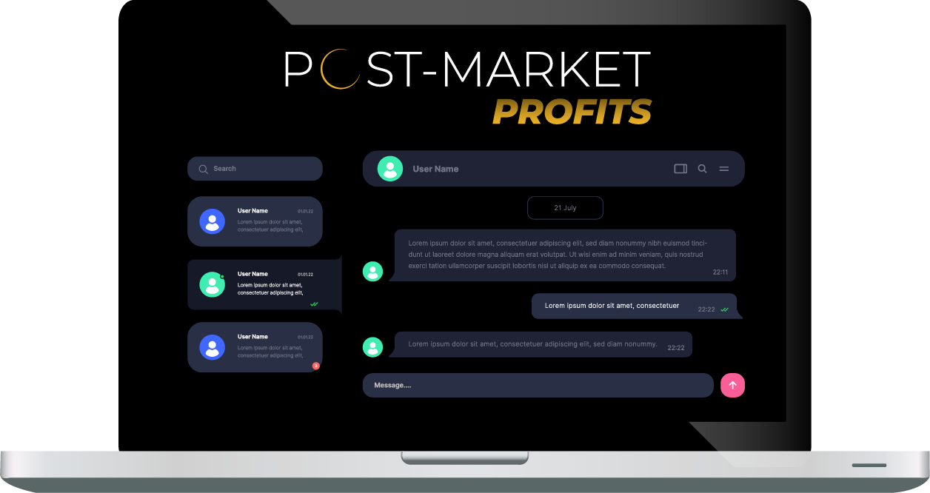
Live Chat With Moderators
You have real-time access to our moderators all trading day.
If you have any questions about
Post-Market Profits, you can message
our U.S.-based team and ask
them anything.
You know the drill…
they don’t give financial advice.

Slide 79
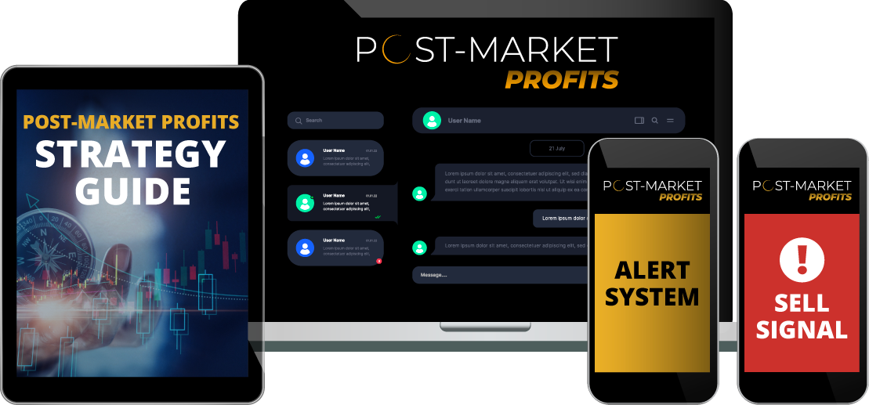
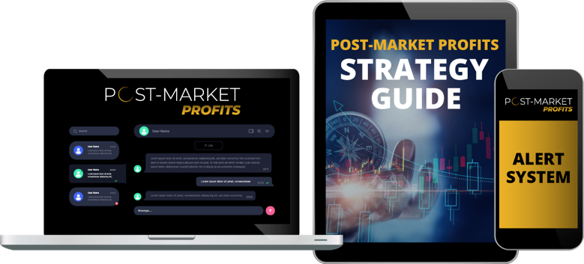
Your Entire Post-Market Profits
Benefits Package
Access to Stock Flip Trades PLUS Dark Ticker recommendations
The Post-Market Profits
Alert System
The Post-Market Profits
Strategy Guide
The Post-Market Profits
Real-Time Moderators

Slide 80
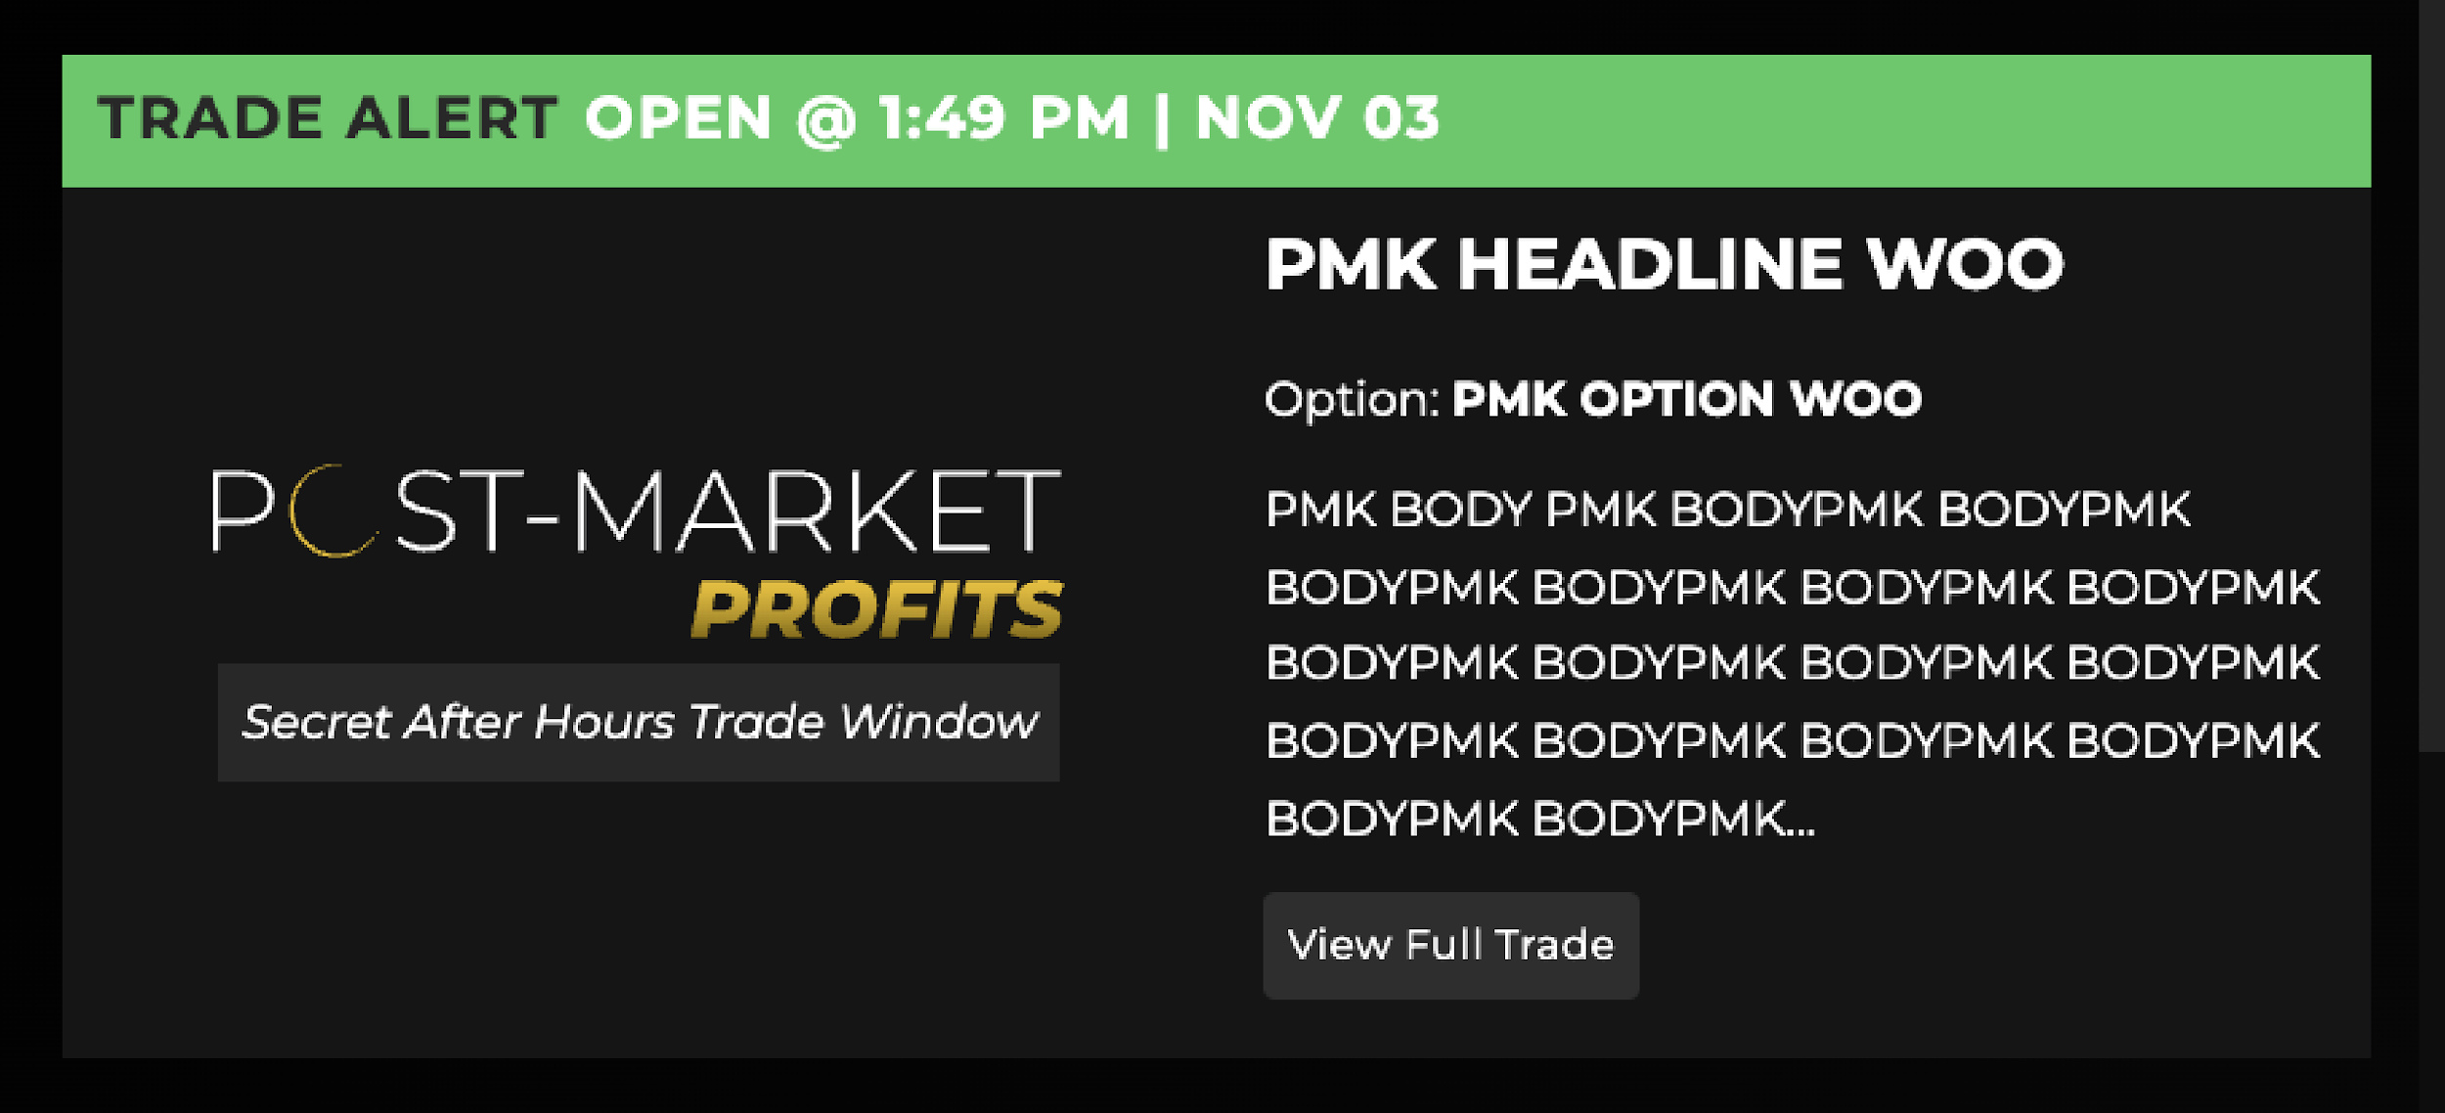

Post-Market Profits Trade Feed
TRADE ALERT OPEN @ 3:49 P.M. | NOV 03

Slide 81
Access BOTH Dark Ticker Trades & Stock Flip Trades!
For the First Time Ever:

Slide 82
Today… You Get
BOTH for LESS!
Our results have PROVEN our trades can be a game changer
Today… we are opening the doors to YOU… For LESS!
Others have paid $7,000 or MORE to access Dark Ticker trades alone…
So the retail price of $5,000 for BOTH… is a steal.

Slide 83
Get 1 Year of Post-Market Profits for $5,000 $1,997!
Today… you have the chance to join for just $1,997.
That’s a 60% discount!
That’s all you’ll pay for a full year’s worth of Stock Flip
Trades PLUS Dark Ticker Trades!
This is a special price for this event.
But… we have something even bigger for you…

Slide 84
ONE FLIP TRADE Could Cover the Entire Cost of Membership
One Overnight Double is easily worth $5,000.
Every week you’ll get that chance with Stock Flips…
Plus other chances with our Dark Ticker Trades!

Slide 85
This Could Build a Six-Figure… or Seven- Figure Portfolio!
Don’t forget! Flipping just Tesla for two years…
Could have grown $2,500 into a six-figure portfolio…
And $25,000 could have grown to an astonishing $1.29 MILLION!

Slide 86
Get UNLIMITED ACCESS! (BEST DEAL)
Since there’s so much uncertainty with the current market.
Today… we’re offering UNLIMITED access – year after year.
Full access for as long as we publish.
But that’s not all…

Slide 87
BONUS! Overnight Stock Flip Scanner
You’ll also get a proprietary tool NOT available to anyone… at any price!
Overnight Stock Flip Scanner FREE as an Unlimited member
You’ll see ALL the opportunities that are close to our trigger
Keep in mind… the tool provides information, NOT recommendations
But if you want MORE chances at overnight doubles… this tool is for YOU!

Slide 88

Overnight Stock Flip Scanner Demo
Notes:
Might need to cut if chat is dragging

Slide 89





Stock Flip Beta Tester Success!
Winners on HD… META… and AVGO!
65%… 80%… 87%… even 200% overnight!

Slide 90
Essentially UNLIMITED Opportunities
So… you get access to our service year after year…
PLUS… our proprietary scanner where you can see EVERY stock flip opportunity day in and day out
You get almost UNLIMITED Profit Opportunities
And you pay just $3,997 one time only
Then a small maintenance fee of just $199 per year to cover
technology and data costs.

Slide 91





Fast Action Bonus! (Expires at MIDNIGHT)
Gives you ONE YEAR of Monument Trend Advisory (Value: $997)
You’ll get weekly livestreams
with market analysis and monthly trade recommendations
It’s FREE… Must act by MIDNIGHT TONIGHT!

Slide 92

60-Day
Money-Back Guarantee
Try out our Flipping Stocks for a full 60 days
If it’s not right for you, give us a call
We’ll refund what you pay today
(minus a small 10% processing fee)

Slide 93
Decision Time
We’ve shown you the data… and the probability is on
your side (accuracy rate of 87%)
You’ve seen the massive profit opportunities you can make flipping stocks… up to 667% overnight
Overnight flips on Tesla alone could have turned a $25,000 account into $1.29 MILLION over just two years!
Click the Button!

Slide 94
Don’t Miss Our Next Big Flippin’ Winner!
If our Stock Flips trigger today…
Or the Dark Ticker triggers…
You’ll get the EXACT trade instructions
You don’t want to miss your very first opportunity
to make $5,000 by tomorrow morning!

Slide 95







Q&A TIME!
TODAY ONLY: One Year FREE of Monument Trend Advisory!
ANNUAL
$5,000 $1,997
PER YEAR
*UNLIMITED ONLY
BEST
DEAL!
UNLIMITED
$7,000 $3,997
ONE-TIME!
+ $199 annual maintenance fee
CLICK THE BUTTON TO GET STARTED!

Slide 96
Q&A TIME!
TODAY ONLY: Three Months FREE of Monument Trend Advisory!
ANNUAL
$5,000 $1,997
PER YEAR
*UNLIMITED ONLY
BEST
DEAL!
UNLIMITED
$7,000 $3,997
ONE-TIME!
+ $199 annual maintenance fee
CLICK THE BUTTON TO GET STARTED, OR
CALL OUR VIP SERVICE SQUAD AT 888.215.5311 OR 410.864.3083.

