Slide 1
The Ultimate Dip Buy
Make ONE Simple Trade…
On ONE Special Ticker...
Within 15 Minutes AFTER Closing Bell…
Target 157% The Very Next Morning!

Slide 2
When The Market Closes DOWN
One Ticker Went Up The Next Morning 7 out of 10 times…
Here’s How to Target 157% The Very Next Day!

Slide 3
Best… F’n Trade… EVER!!!
How We Achieved a 586% Total Return in 2024 Using Just One Simple Ticker
“Since Last November, I’ve Turned $1200 into $31,452.” – Keith C.

Slide 4
Market Selloff Alert!
Make This Trade BEFORE 4 p.m. Today!
After a Sell Off Like Today…
One Ticker Went Up The Next Morning 7 out of 10 times…
Do This Immediately to Target 157% By Tomorrow!

Slide 5
Best. Trade. Ever.
This is the single greatest trade ever
We’ve been using a special trade for past year
The results have been out of this world
We make a specific trade after hours when the market has dropped… a special window between 4 and 4:15
It’s the best way I’ve found in my 20 year trading career to target big gains with the least amount of time

Slide 6
Does This Work?
We’ve already made 39 trades with this method
With a 70% win rate
And 17% average gains OVERNIGHT (winners and losers factored in)
Total gains is 586% in a year
With wins up to 157% overnight

Slide 7
Members Are Making Big Money
Our most successful members have reported making thousands…
One turned $1,200 into over $30,000 following our trades all year!
Another made $20,000 on one trade that made 54% overnight
One even reported making almost half a million dollars… on just two trades (57% and 64% overnight)!

Slide 8
Excited for Market Drops?!
“It makes me wish the market would drop 1% every single day… I would make so much money!” -- Joey

Slide 9
27 Overnight Winners in One Year… 70% Win Rate!
88%
157%
109%
92%

Slide 10
Imagine Cashing in Tomorrow Morning
Look… the market is down… big time
Everyone is freaking out
I’ve found this is the most consistent way to turn market downturns into massive overnight profits
That’s the opportunity you have today… if you act fast
Notes:
https://medium.com/critical-investing/how-peter-lynch-made-30x-in-13-years-in-the-stock-market-67db46b98bea

Slide 11
Power of Faster Gains
Peter Lynch managed the Magellan Fund from 1977 to 1990 and grew from $18 million to $14 billion (30X in 13 years)
Magellan last year: 33.59% in one year
Us: 586% in one year!
That’s 16X more than the Magellan Fund
Following every one of our trades all year… you could have turned $5,000 into over $34,000
Notes:
https://medium.com/critical-investing/how-peter-lynch-made-30x-in-13-years-in-the-stock-market-67db46b98bea
https://money.usnews.com/funds/mutual-funds/large-growth/fidelity-magellan-fund/fmagx/performance#:~:text=The%20fund%20has%20returned%2012.72,percent%20over%20the%20past%20decade.

Slide 12
You’ll Learn the Secret Today!
That is the power of turning down days into paydays…
and why I call this the Holy Grail of Trading
I’ll show you the exact ticker symbol and strategy
You’ll see why we trade within 15 minutes AFTER the closing bell (and how we do it)
I’ll also give you the data behind it (we analyzed trades going back 10 years!)
And how we achieved a 70% win rate!

Slide 13
Disclaimer
We’re going to show you both our real results since November 2023…
But also our extensive back test using data that goes back ten years where we looked at the peak gains and the maximum overnight profits available on each day.
Your returns would vary depending on when you chose to get out. Nobody should expect to hit the peaks every time.
That’s way we want to help you every step of the way… to
help you maximize your daily profits and minimize your risk.
Risk is a part of all investing. You should never invest more
than you can afford to lose.

Slide 14
How to Exploit a Major Market Phenomenon
Have you ever noticed that almost every time the market sells off… 400… 500… sometimes 600 points
or more…
It seems to rebound the very next day?
It’s not just a feeling… This is a mathematical fact.

Slide 15
Pop Quiz
?
If the market closes down just 1% for the day…
What would you guess the odds are that the market goes into the green
the very next day?
40%... 50%... Maybe even 70%?

Slide 16
Impressive Data
We looked at every down day for the past ten years
And we found when the market closes down -1% or more on any given day…
The odds of it rising the next day are over 88%...
Nearly 9 out of 10!

Slide 17
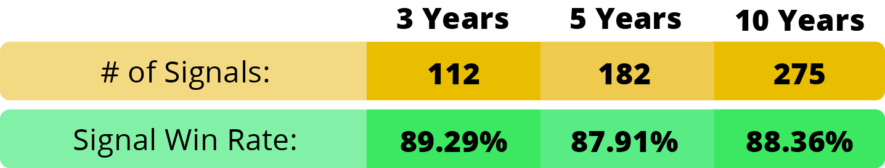
Strong Data
Whether it was over one year… three years… five years... or even 10 years (based on peak gains)…
If the market dropped 1%... The market rebounded almost 9 out of 10 times the following day…
Right at around 88%.

Slide 18
Bigger Drops… Bigger Potential
Going back 30 years… our data shows that if there was a 2% drop… The market rose the next day 92% of the time.
Over the last three decades… there have been 21 days that the market dropped 5% or more.
The market went higher the next day…
Every. Single. Time

Slide 19
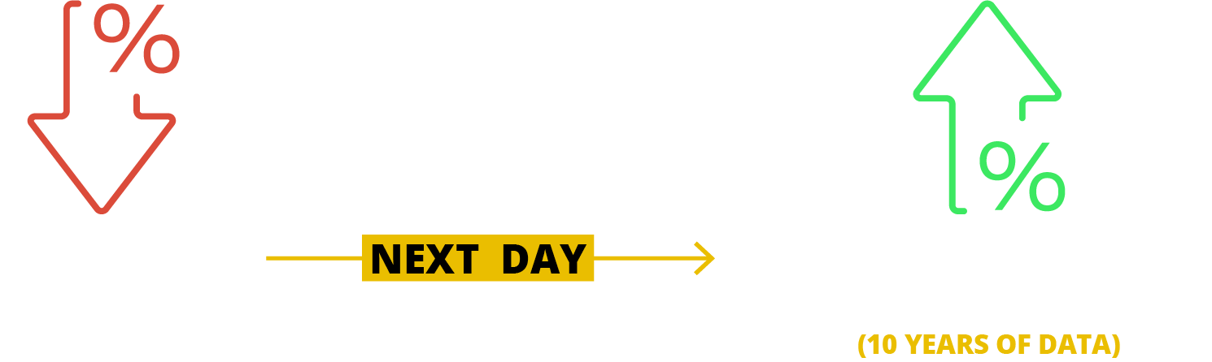
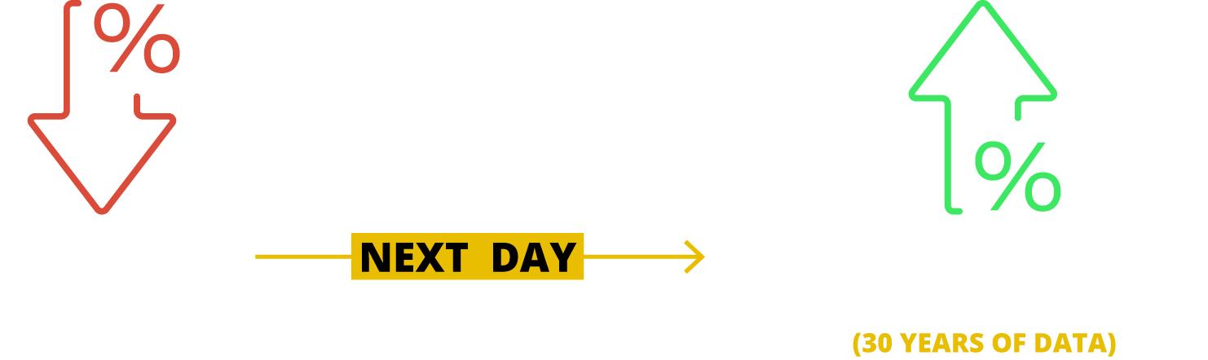
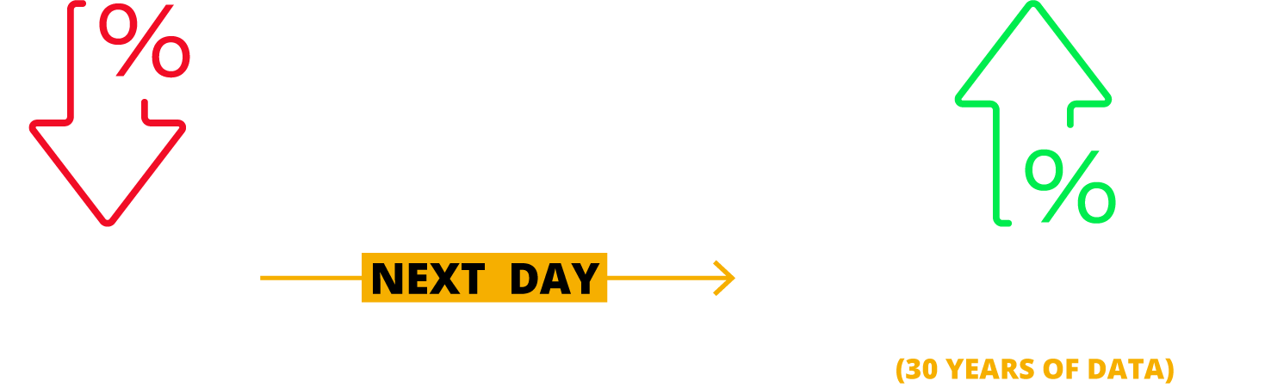

Slide 20
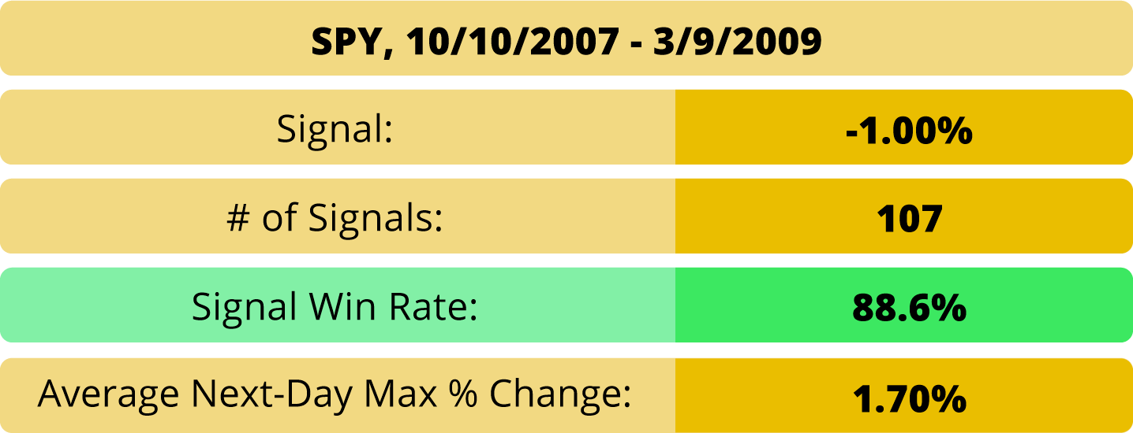
Does This Work Even in a Bear Market… Hell Yes
Financial crisis of 2008…

Slide 21
Worst of Financial Crisis: October 2007 To March 2009
The market went higher 88.6% of the time
The average max gains the next day were over 1.7%
In 18 months… there were 90 chances to make big money while the market dropped!

Slide 22
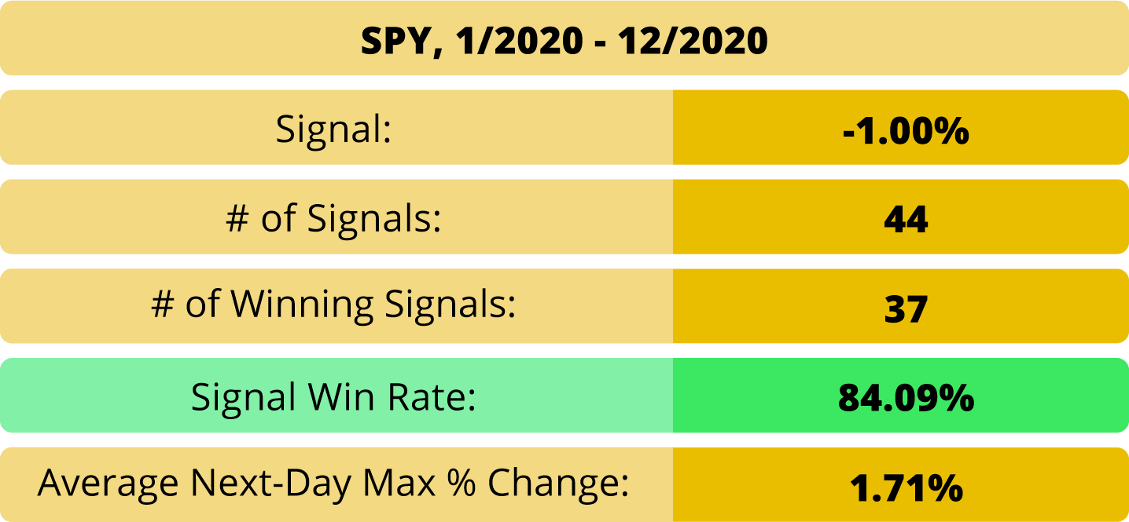
How About During Covid Crash 2020?
The same thing happened during 2020
The market still rose the following day 84% of the time.
During this period, this strategy handed out 37 opportunities to make overnight profits!

Slide 23
Dark Ticker Examples During 2020 Crash
On March 12, 2020, the market was down 9.6%.
The next day, right on cue, the market rebounded…
up 9.4%.

Slide 24
How Do You Make Money from This Phenomenon?
We used data
Could we turn this into profits in real time with real people

Slide 25
The Problem
Data showed that after the market closed down one day… the next day it went up
Problem: How do you get in after the closing bell…
But before the next day’s opening bell?
Gap up problem – get in at opening bell… too late to profit
How do you confirm the -1% at close… and get in before opening bell?
Answer: Dark Ticker

Slide 26
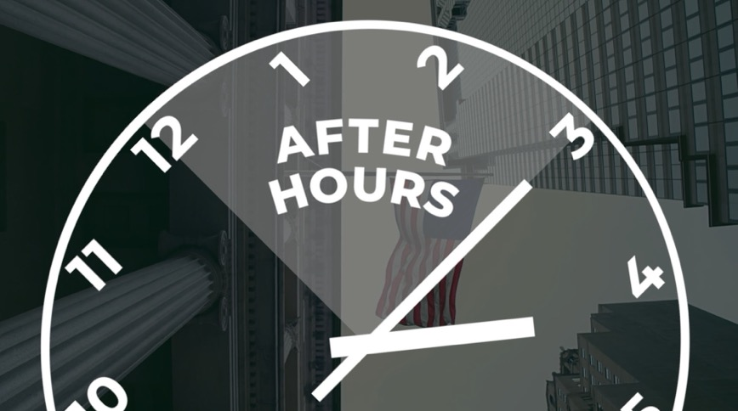
REVEALED: The Dark Ticker
The after-hours version of any of the broad market ETFs…
SPY for the S&P 500
QQQ for the Nasdaq
DIA for the Dow
IWM for the Russell 2000

Slide 27
Dark Ticker Symbols Behind Our Data
SPY
IWM
QQQ
DIA

Slide 28
Trade AFTER 4 p.m.!
Why do we call it the Dark Ticker?
Exclusive special trading window from 4 to 4:15 p.m. everyday
That’s right… you can trade it AFTER Closing Bell!

Slide 29
September 25th
At 4:00 we sent an alert telling members we were watching the Russell 2000
It closed down 1.4% (our trigger)
We knew the data said we had the probability on our side
So… we sent an alert giving our exact play on IWM

Slide 30
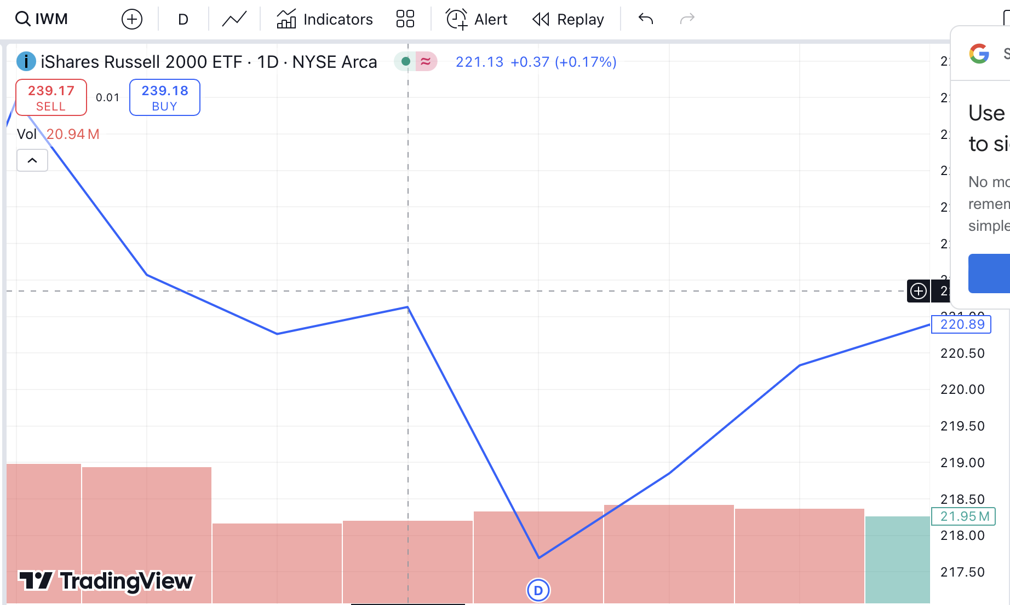
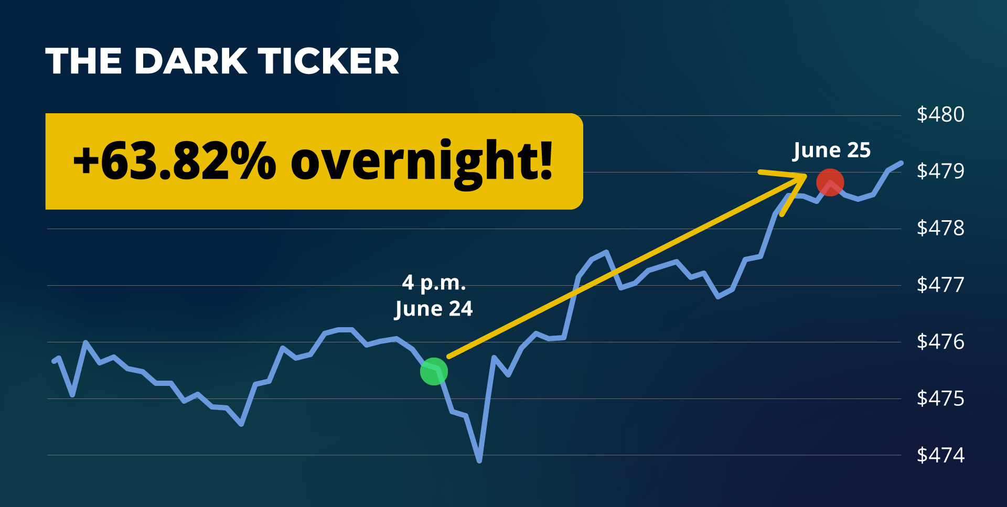
The Next Morning…
Just as expected… the Russel rose the very next day
Our play was good for 114% Overnight!
4 pm September 25th - September 26th
Notes:
I need to remake this chart with the chart in the next slide… and have it say 64% Overnight! (dates are 4 pm June 24… arrow going to June 25th

Slide 31
Members Reported Overnight Doubles!
Bill made 119%... And the trade saved his September!
Coach Rogers made over $10,000 on that ONE trade!
Thom made 112%
Willy made $3,500
Donald made 166%
And one member made 330% on that trade!

Slide 32
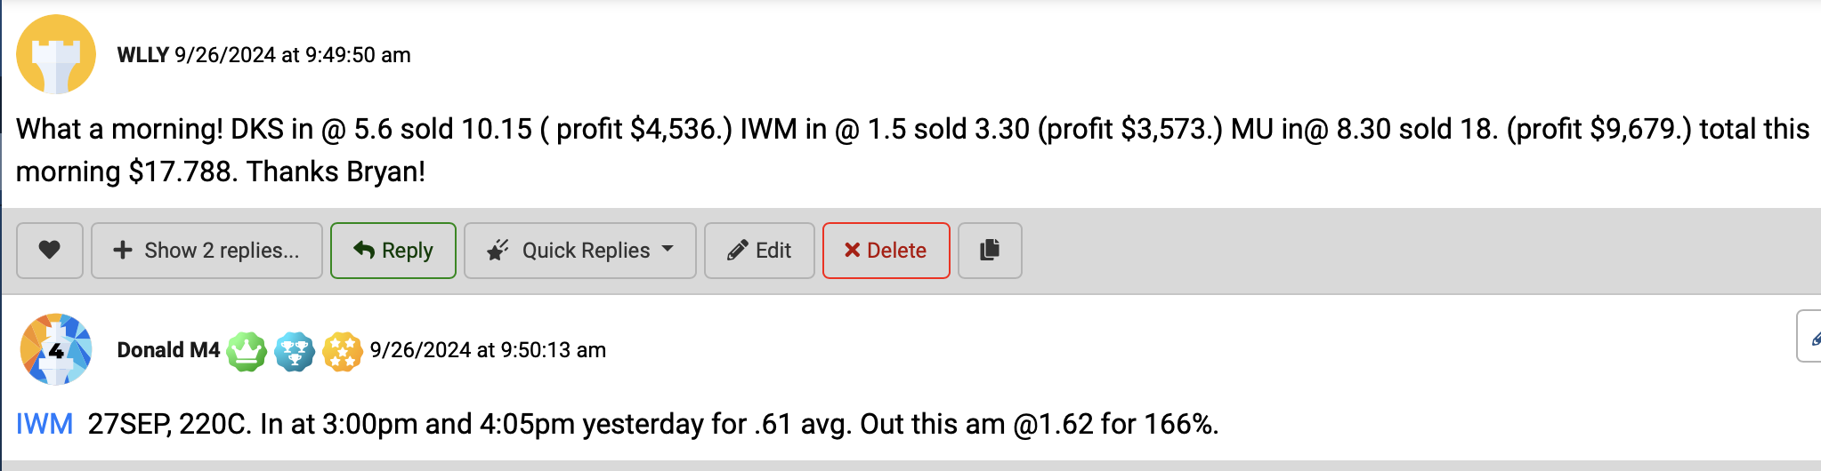
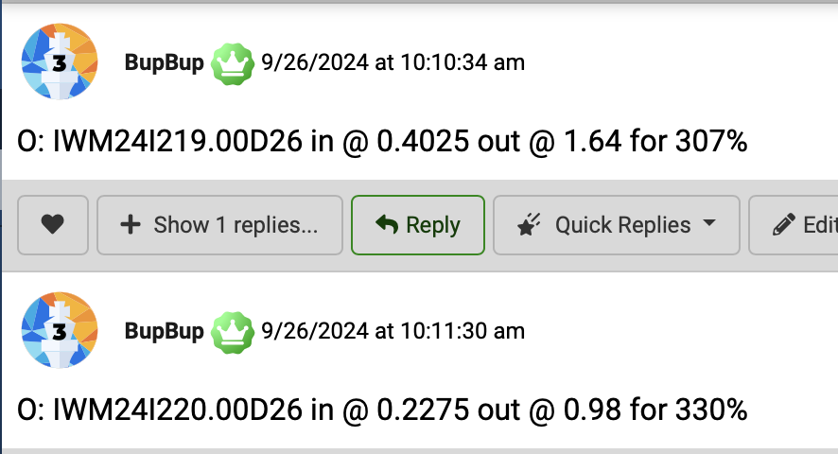
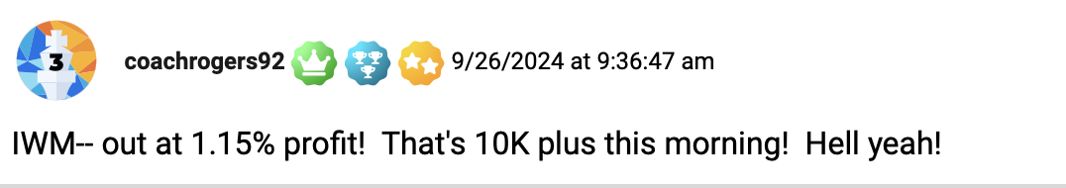
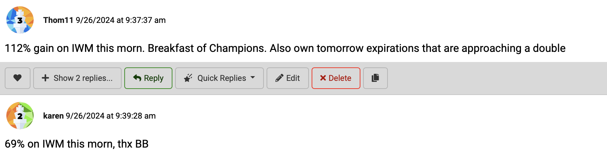
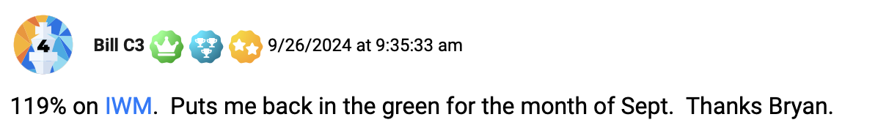

Slide 33
June 24th QQQ
The same thing happened in June with the Nasdaq
It hit our 1% trigger, and we sent our alert out at 4:00 telling our members to get ready for a Dark Ticker Trade
Sure enough… it closed down 1.1%
That was the all clear… we sent our instructions to our small group to buy their Dark Ticker by 4:15 pm

Slide 34
June 25th QQQ
Notes:
I need to remake this chart with the chart in the next slide… and have it say 64% Overnight! (dates are 4 pm June 24… arrow going to June 25th

Slide 35
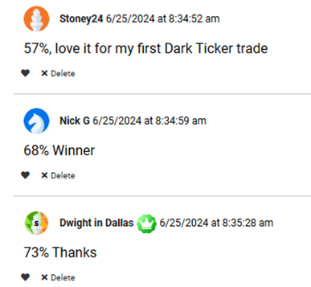
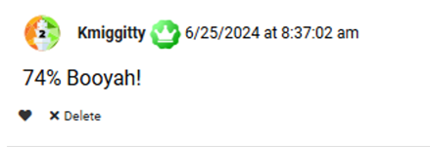
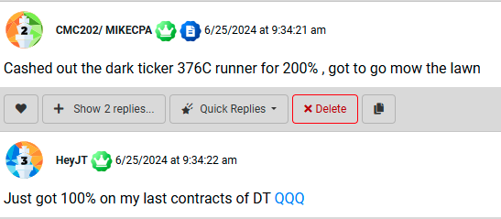
Members FLOODED Us With Praise!
Stoney made 57% on their first trade…
Nick made 68%...
Another reported 74% (and added: Booyah!)
Mike got a 200% gain… and went to mow the lawn!
JT grabbed 100%!

Slide 36
May 29th – May 30th IWM
We saw the Russell 2000 was down 1% for the day
So, we made our trade by 4:15 pm
The next day… every other index went down
But the IWM went up… that’s the power of the 1% trigger!
S&P 500: DOWN 31.47 points
Dow : DOWN 330.06 points
Nasdaq: DOWN 183.50 points
Russell 2000: UP 20.41 points!

Slide 37
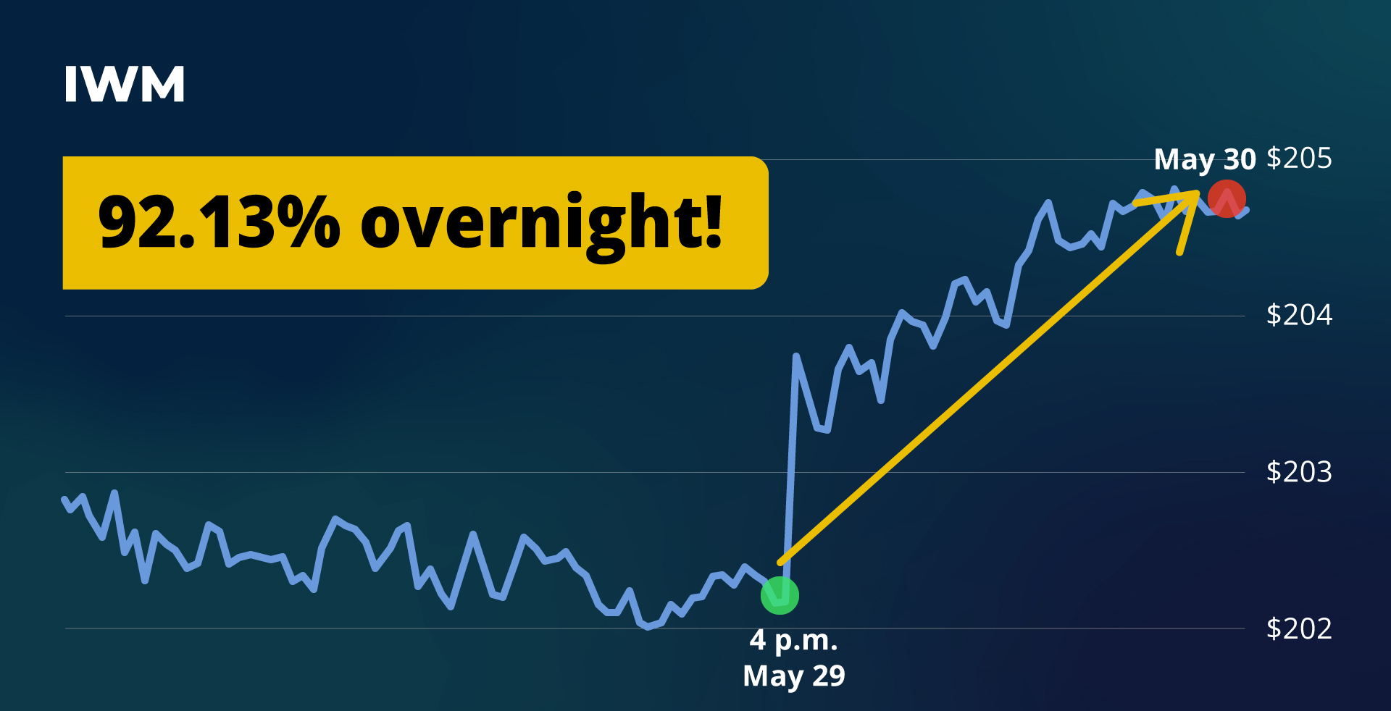
May 30th IWM
Notes:
I need to remake this chart with the chart in the next slide… and have it say 64% Overnight! (dates are 4 pm June 24… arrow going to June 25th

Slide 38
Smart Traders LOVE The Dark Ticker!
“I love the Dark Ticker. Hard to sleep at night waiting to get up for the opening bell on the Dark Ticker!” – Brian
“Dark Ticker has generated profitable trades and very few small losses. Great to have something to look forward to even after a down day. – Steven
“Seriously… I love this strategy” – Sugar Doc

Slide 39
Max Gains in Minimum Time!
“The money gained vs the time spent can’t be beat!” -- JT
“I miss opportunities during the day… but I can almost always block off from 4 to 4:15 every day” – Lew
“Love it! Another way to make CASH” – Roswell Buckeye

Slide 40
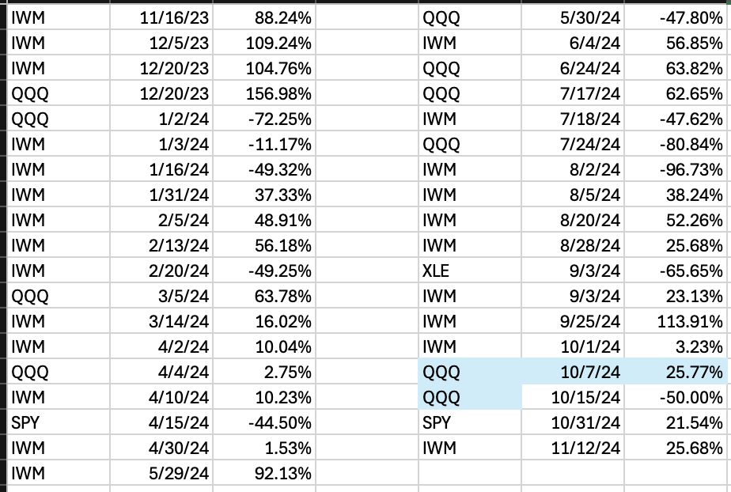
Cherry Picking is for Losers
Our FULL Dark Ticker Track Record
Up until now… I’ve been showing best trades…
But now I want you to see every single trade
39 trades… 27 winners = 70% win rate
Remember… the average gain is 17% that’s winners and losers combined
Average winner… is 50%!
So 7 times out of 10… our members were making 50%... Up to 157%!
Our members saw the chance to make a lot of money this year

Slide 41
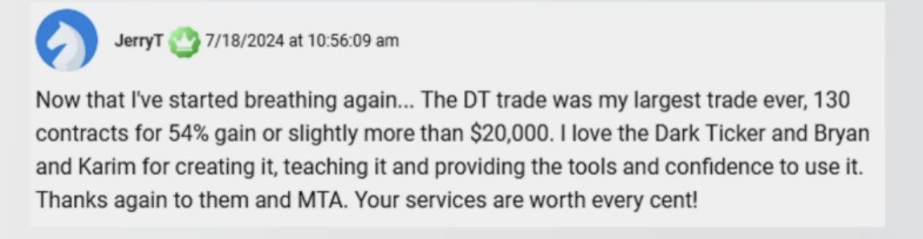
Jerry Made $20,000 on ONE Dark Ticker Trade!
One member made his biggest win EVER
A 54% gain… overnight…
Good for $20,000!
Notes:
BLUR OUT HIS LAST NAME AND EMAIL ADDRESS AND CUT ALL THE STUFF AT THE BOTTOM!

Slide 42
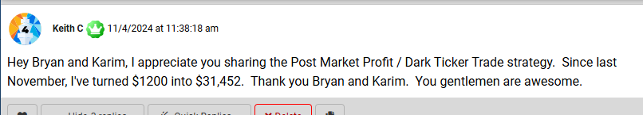
Keith Made 30X This Year With Dark Ticker!
Keith has been following these trades for the past year
He turned $1,200 into over $30,000!
Almost 30X his entire portfolio!
Notes:
BLUR OUT HIS LAST NAME AND EMAIL ADDRESS AND CUT ALL THE STUFF AT THE BOTTOM!

Slide 43
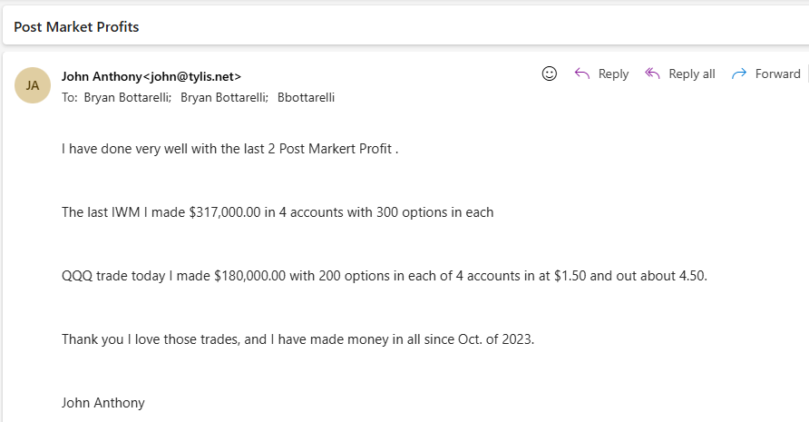
John’s Dark Ticker Gains Were In-Freaking-Sane (why best trade ever)
Our two trades in June made 57% and 64% overnight
John made $317,000 on one... Then made $180,000 on the other
That’s almost half a million dollars… On two trades!
Now we should note this was a substantial investment and you should not to invest more than you can afford to lose
Notes:
BLUR OUT HIS LAST NAME AND EMAIL ADDRESS AND CUT ALL THE STUFF AT THE BOTTOM!

Slide 44
How do we achieve such big gains in a short timeframe?

Slide 45
New Kind of Option Taking the World by Storm
The Dark Ticker trade for ETFs like SPY are called…
ZERO-DAY OPTIONS

Slide 46
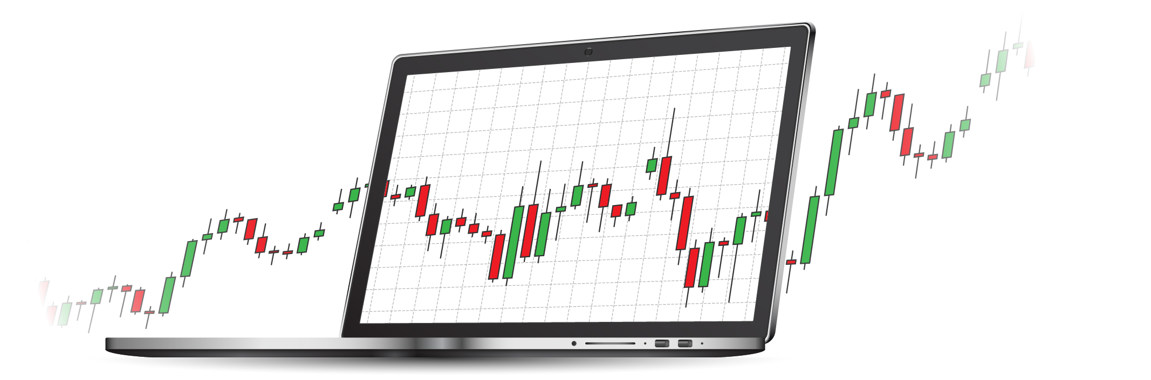
Why Trade Zero-Day Options?
Options that expire every day
(not just weekly/ monthly)
Cheaper price
Huge trading volumes
Massive overnight potential
Max profit on a short term move
Zero Day options are easy to trade

Slide 47
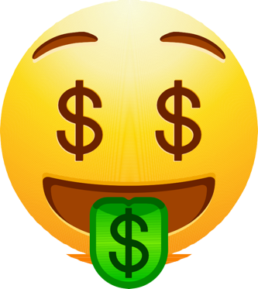
Historical Data
+
Zero-Day Options
=

Slide 48
How Much Do Zero-Day
Options Move?
Our research analyzed Dark Ticker stock movement in 2023 and compared it to 0DTE options
We found that a 1% move translated to about an 80% average gain with zero-day options.

Slide 49
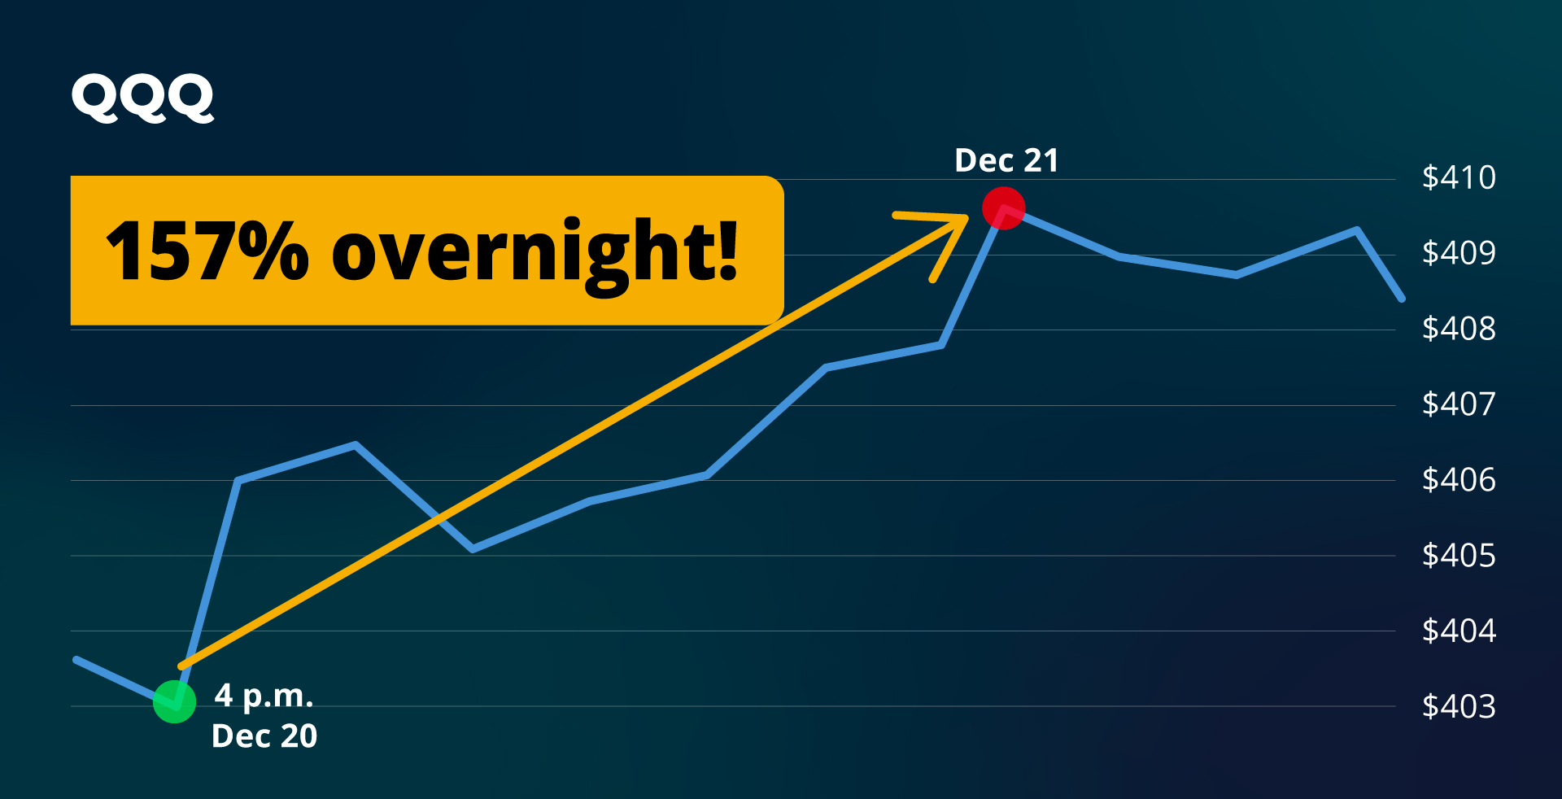
QQQ Traders vs. Dark Ticker Traders
QQQ went up 1.3%... With 0DTE… our members made 157%
If using zero day options without statistical advantage… you can lose your shirt
With statistics on your side… the gains can be out of this world
Notes:
I need to remake this chart with the chart in the next slide… and have it say 64% Overnight! (dates are 4 pm June 24… arrow going to June 25th

Slide 50
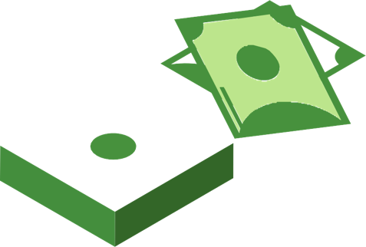
A $5,000 Trade Explodes into $12,000… Within 24 Hours!
Overnight Gain: $7,850

Slide 51
Dark Ticker Strategy Recap
We wait for days when the market falls by AT LEAST 1%... Because that’s when we know the data is on our side
We trade the Dark Ticker between 4 and 4:15 p.m.
We close out the trade the next day…
targeting a win of 100% or more.
I’ve found there is no singular strategy that makes you more money in less time than what we’ve shown you today

Slide 52
For the First Time in Your Investing Life…
Bad Market Days Now
Turn Into Massive Overnight Profit Opportunities!
“It makes me wish the market would drop 1% every single day… I would make so much money!” -- Joey

Slide 53
Imagine cheering the next time the market goes down!
Zero day options
4:15 after hours window
Dark ticker data

Slide 54
Let’s See Our Total Results
Since going live…
Let’s go through all our trades since November
And track profits starting with just $5,000…

Slide 55
First Trade On November 16th…
The market dropped 1%...
So... that’s the signal.
Sure enough… the next day, we closed out a nice
88% winner!
Good for a $4,400 payout!
Portfolio: $9,400

Slide 56
Next Trade On December 5th…
The market was down 1%...
And this time… a Dark Ticker trade made 109% the very next day…
Good for another $5,400 in the bank!
Portfolio: $14,870

Slide 57
December 20th… Two Doubles!
We had two different indexes show the signal…
Each was an overnight double…
105% and a shocking 157% winner!
Worth a total of $13,000 in extra income!
Portfolio: $27,800

Slide 58
January… Trust the Process
Up until January… we had a 100% win rate so we were able to take profits to invest the same starting $5k into our next trades
But January
However… even factoring the losers…
Portfolio: $23,110

Slide 59
February…
The Dark Ticker triggered three times
For almost $2,700 more profits added
Portfolio: $25,797

Slide 60
More and More Winners…
March… two winners
April… four winners
May… one winner
June… two winners
July… one winner
August… three winners
Notes:
I can’t bold with whatever font that is right now

Slide 61
12 Months: Over $34,000!
By the time we got to November…
Trading with $5,000 in all 39 of these Dark Ticker trades…
Would’ve grown to over $34,000!
Portfolio: $34,277

Slide 62
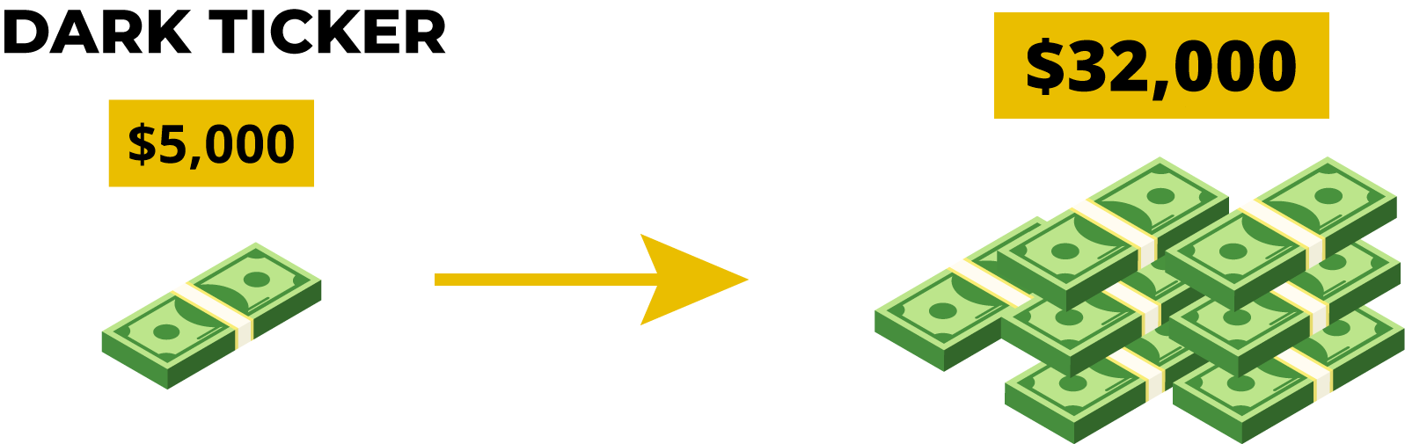
A Small Stake Goes a Very Long Way
SUMMARY
These trades only last one day.
You only need a small starting stake to make every single trade.
Notes:
UPDATE MONEY TO 32,000

Slide 63
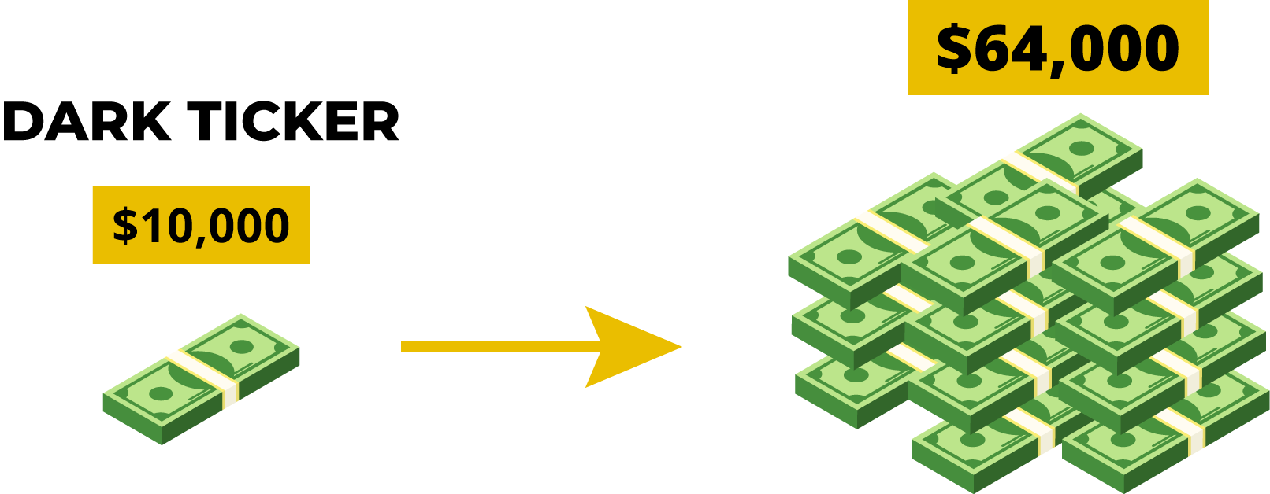
Starting with $10,000…
It could’ve made you over $68,000!
And again… that’s all
39 trades over just one year
That includes winners
and losers!
Notes:
UPDATE MONEY TO 64,000

Slide 64
Would This Work Long Term?
I’ve given you the results for the past year
But I want you to focus on the big picture and what an edge can mean over time
What would happen using this year after year?

Slide 65
What If We Started Sooner?
But let’s say we started this a few years ago… and only got HALF these results
Year one: $5,000 would have turned into $14,650
Year two: $42,924
Year three: $125,479
Year four: $367,371

Slide 66
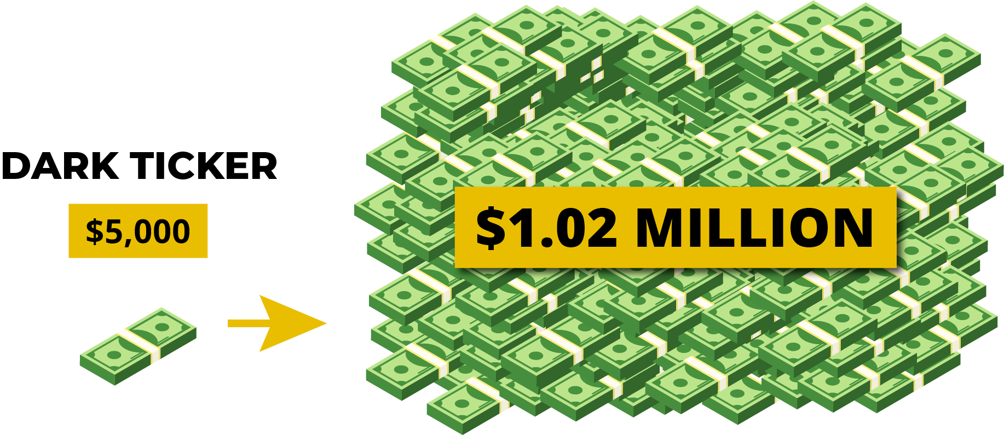
Year Five: Holy Millionaire!
The final portfolio would be $1.08 million!

Slide 67
An “Edge” Can Change Everything
No guarantee what the future will hold…
Just showing how an edge over time could be life-changing
That’s why we always trade based on where the data has shown we have a clear advantage
When the odds are in your favor… over time you can be successful.

Slide 68
Your Chance to Get Every Dark Ticker Trade
November 2023… we launched a first-of-its-kind new research service to help people trade Dark Tickers
But… it was ONLY available in our highest level of membership
Now that we have a full year of research and real trades… we are confident enough to open the doors to YOU!
We monitor ALL the Dark Tickers for you.
And if there’s a 1% drop… We’ll alert you the moment the market closes
at 4 p.m.
And we’ll give you the exact Dark Ticker trade for
maximum profit potential the next day.

Slide 69


Slide 70
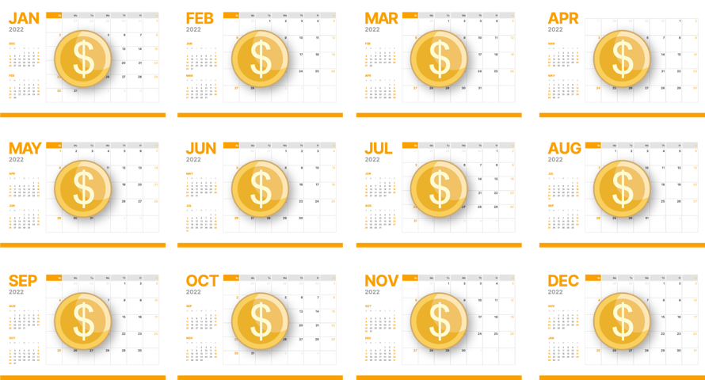
Monthly Update With Precise Trading Plan
We’ve even dug into the probability month by month.
So we know which month is the BEST for this strategy… with the maximum chance of profit
Every month we’ll send you an email with the historical data and our profit strategy

Slide 71
Dark Ticker Trade Alerts for YOU!
Real-Time alert system!
There are really only two scenarios… trade or no trade.
On days that our system triggers… we’ll give you all the details of the trade.
So you can get in by 4:15 p.m.! (It only takes two to three minutes to make the trade.)

Slide 72
Dark Ticker = Trading Made Easy
No more trying to find that one miracle stock and waiting years for it to go up…
No more trying to time the next bull market…
You can kiss all of that goodbye.
If there is a trigger… all you’ll have to do is wait until 4 p.m…
Check out the alert…
And make the trade if you choose.

Slide 73
We’ll Always Shoot For A 100% Overnight Gain
But again… nothing is guaranteed. Not every trade will be a winner.
Average winner is 50%… biggest winner is 157% Overnight!
Every day in the market is different…
And we’ll be with you every step of the way.

Slide 74

Imagine: Your New Life as a
Post-Market Profits Member
The markets are down big…
Everyone’s been freaking out.
You get an alert…
You make your Dark Ticker trade…
The next morning… You make up, check the market… and cash out for 100% gains.

Slide 75
Members LOVE Market Down Days!
“The only time this hasn’t worked was when I was out and couldn’t enter the trade. Seriously… I love this strategy! – Sugar Doc
”I look forward to closing down 1%... five QQQ’s… one SPY…
six IWM add up to well over 100% gains” – Thom
“Been a great way to boost my winnings when we have
a Dark Ticker Trade” -- Dino
“It’s one of my favorite trades! I love doing them.
I would want them every day!” -- PJ

Slide 76
Members LOVE Dark Tickers!
“It has been the most profitable for me… I bet my largest size trades on it. $ gained vs time spent can’t be beat” – JT
”Bryan, I think the Dark Ticker is the best trading tool you guys have given us. I have made a ton of money using it.”
– Budge
“It makes me wish the market would drop 1%
every single day… I would make so much
money!” -- Joey

Slide 77
You’re Among the First to Discover This NEW Trading Strategy
Remember… with just $5,000 in each trade could have grown to over $34,000 in one year!
Trading $10,000 could have been worth over $68,000!
Notes:
Update to 64,000

Slide 78
Your Chance to Become a
Post-Market Profits Member
Post-Market Profits is going to be a ton
of fun… and should give you a ton of opportunities to trade
We’re going to take a handful of people and lead them to the best Dark Ticker trade recommendations each and every month.
We have a 70% win-rate… with 17% average overnight gain!

Slide 79
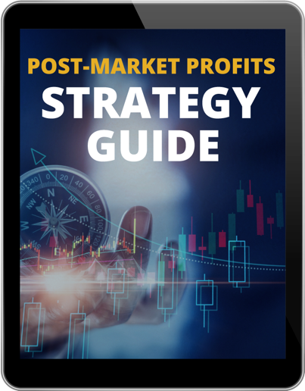
Post-Market Profits Strategy Guide
It’s a short primer going through the entire process of making a Dark Ticker trade.
Everything we’ve covered today… but in much more detail.
We’ll walk you through the strategy…
Explain how we pick which index we’ll
use… And even go into all the month-by-month data…

Slide 80
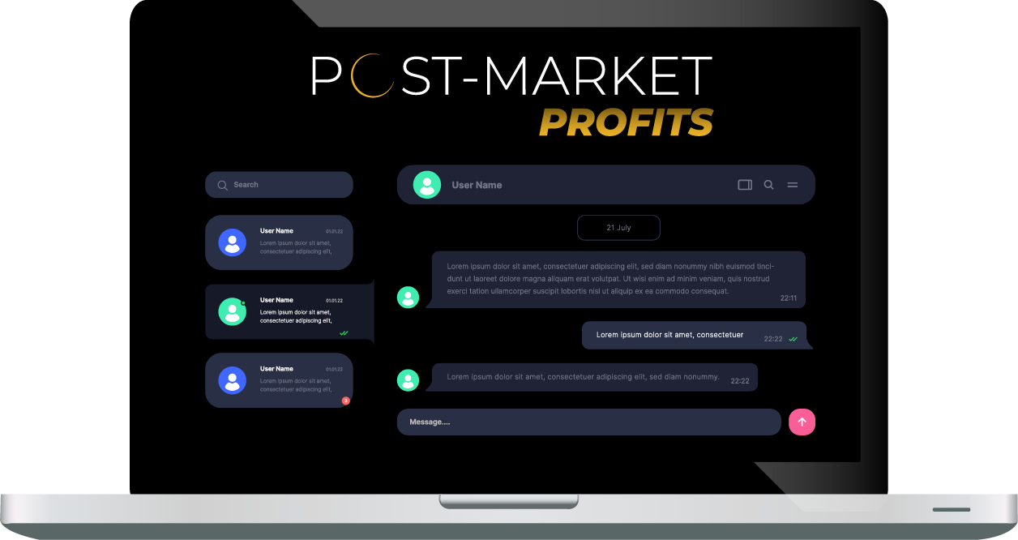
Live Chat With Moderators After-Hours
You have real-time access to our moderators from 4 to 4:30 p.m. any day we issue a new trade.
If you have any questions about Post-Market Profits you can directly message our U.S.-based team and ask them anything.
You know the drill… They don’t give financial advice.
Notes:
s

Slide 81
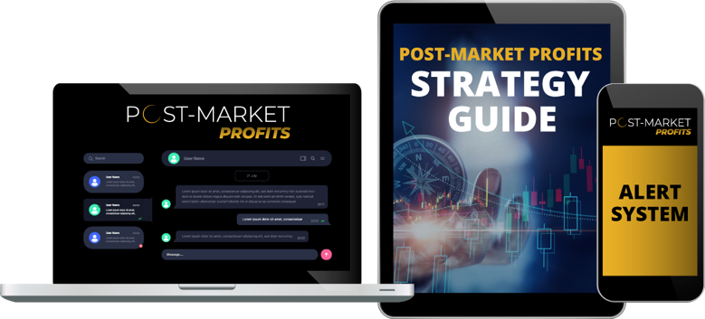
Your Entire Post-Market Profits Benefits Package
Access to All Our Post-Market Profits Research and Recommendations
The Post-Market Profits Alert System
“The Post-Market Profits Strategy Guide”
The Post-Market Profits Real-Time Moderators

Slide 82
If we decided to sell this alone…
This Elite Service Is
Easily Worth $5,000…

Slide 83
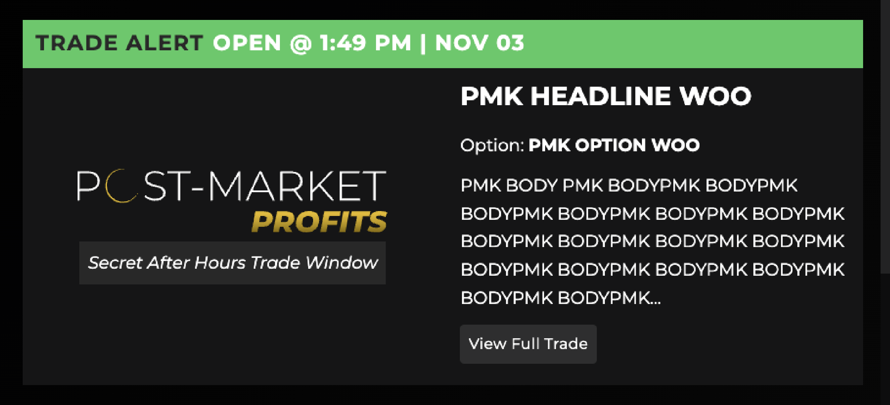
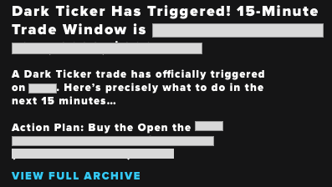
Post-Market Profits Trade Feed

Slide 84
For The First Time…
This is the FIRST time we’ve sold this service
We saw that data was strong… but wanted to PROVE it worked in Real Time
Now… making it available to you!
Prior to today, you had to be in our highest level of membership, which could have cost $7,000 or MORE
So the retail price of $5,000 is a steal
Notes:
UPDATE STICKER TO 6,199

Slide 85
One Dark Ticker Trade Could Cover the Entire Cost of Membership
One Overnight Double is easily worth $5,000
Plus… a $10,000 investment in each Dark Ticker trade could have generated over $68,000 in one year!
That’s over 10 times the retail price to join.

Slide 86
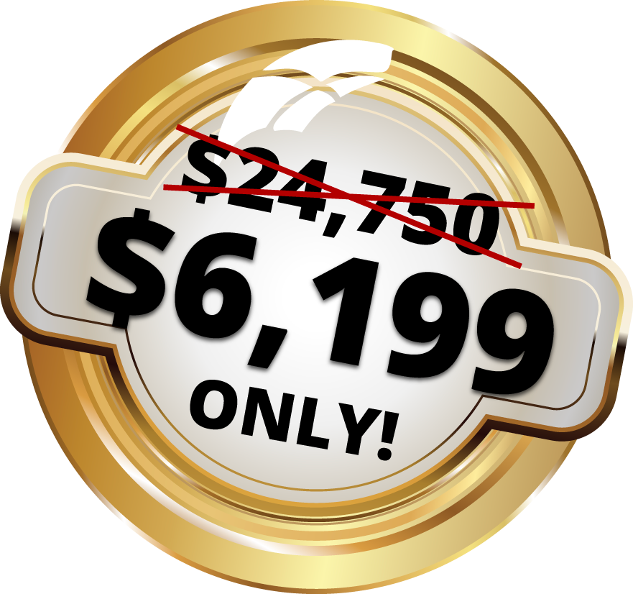
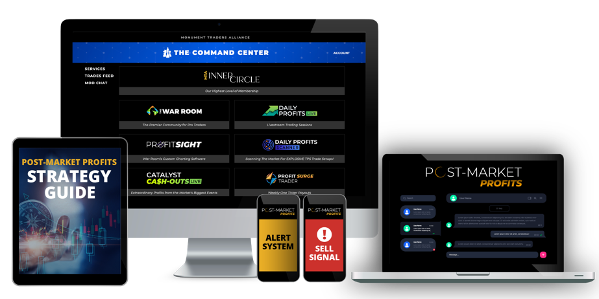
Charter Members
Today… you have the chance to join for just $1,999
That’s all you’ll pay for a full year worth of Dark Ticker Trades!
As a charter member, this is the best price
(We reserve the right to close this insane offer at any time)
FOR LIFE!
Notes:
UPDATE STICKER TO 6,199

Slide 87
Decision Time
We’ve shown you the data and the probability is on your side
I’ve given you all the trades that made up the 70% win rate
You’ve seen the real gains of 92%... 104%... 109%... Even 157% Overnight…
Click The Button!

Slide 88
Turn Big Down Market Days Into Monster Profit Opportunities
This has changed how members
views the market…
Hoping for the next big down day!
With Post-Market Profits…
You too now have the ability to turn crashing markets into overnight paydays.

Slide 89
Don’t Miss Our Next 4 p.m. Trade!
If market goes down… our next trade will go out at exactly 4 pm today
You don’t want to miss your very first opportunity to turn a DOWN day…
Into a MASSIVE Overnight Win!

Slide 90
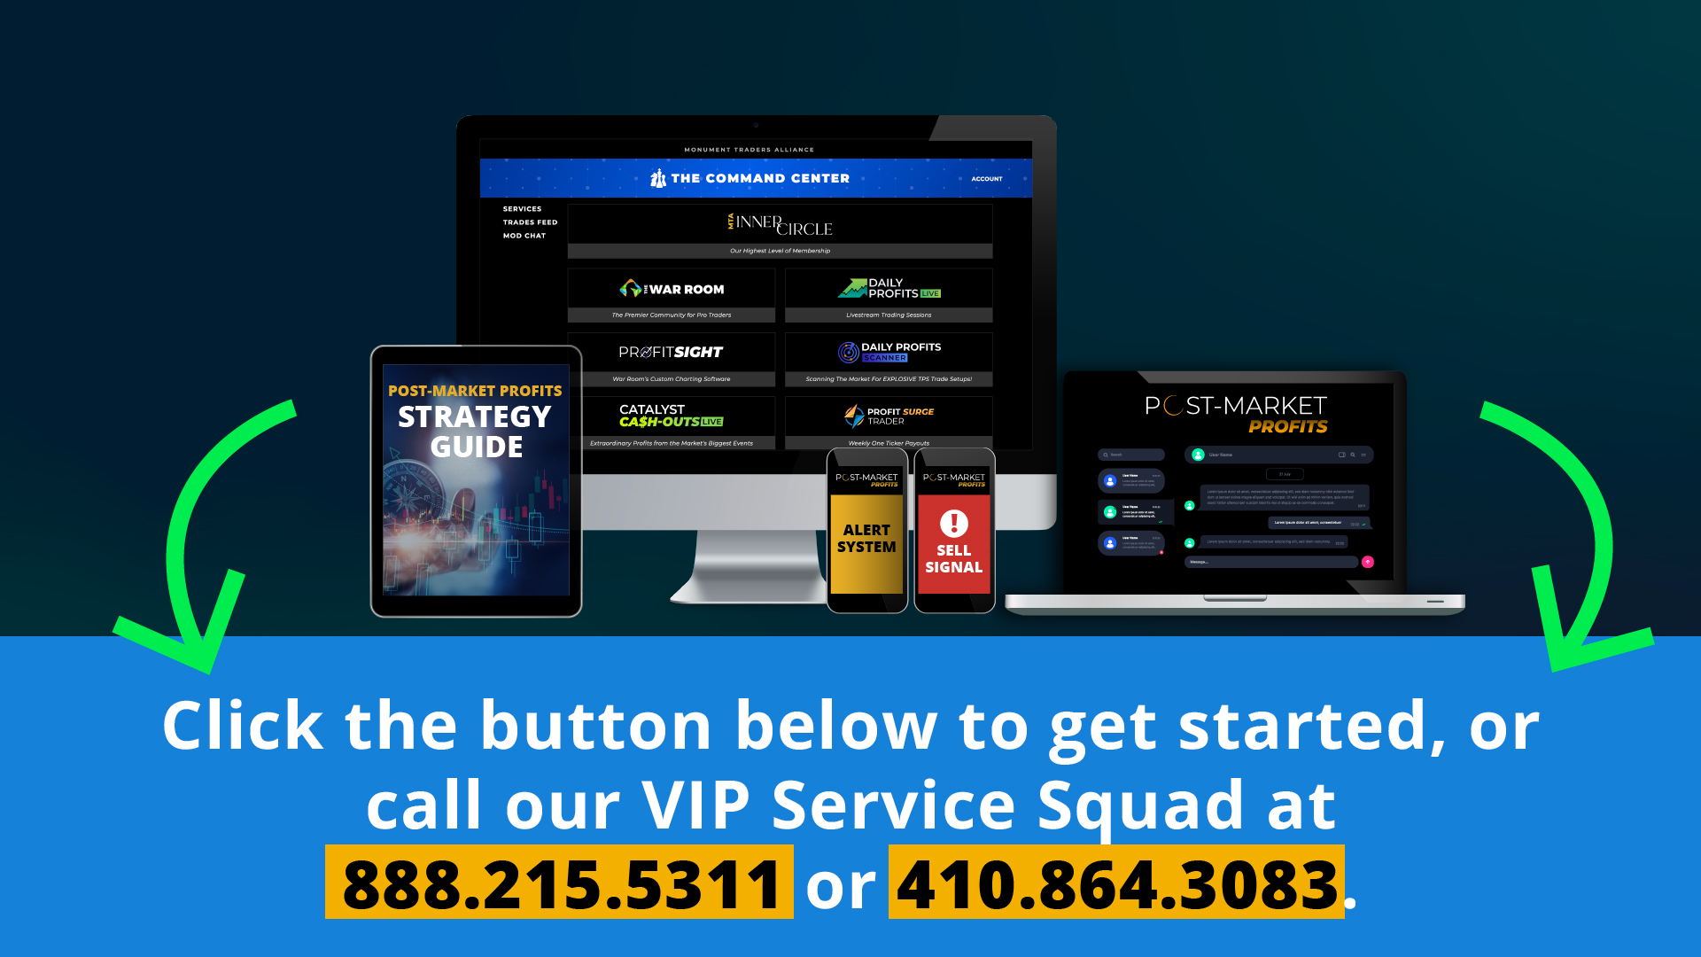
MUST ACT BEFORE 4 PM!
Notes:
UPDATE STICKER TO 6199

Slide 91
Alt version for when Market is Down
Doing the beginning…
Then the close

Slide 92
Beginning

Slide 93
Imagine… Making As Much As 157% Tomorrow Morning
The market is down big right now
After a market selloff… we’ve found one trade made money the next morning 7 out of 10 times
If you want in… you MUST make this trade TODAY between 4 and 4:15
Our real-time results have been spectacular

Slide 94
Must Act by 4 pm today
Tomorrow morning … you could use this secret to make a monster win
We’ve already made 39 trades with this method
With a 70% win rate
And 17% average gains OVERNIGHT (winners and losers factored in)
Total gains is 586% in a year
With wins up to 157% overnight
But… time is extremely critical… you can’t wait

Slide 95
Members Are Making Big Money
Some of our top Members have reported making tens of thousands…
One turned $1,200 into over $30,000 following our trades all year!
Another made $20,000 on one trade that made 54% overnight
One even reported making almost half a million dollars… on just two trades (57% and 64% overnight)!
“It makes me wish the market would drop 1%
every single day… I would make so much
money!” -- Joey

Slide 96
Imagine Cashing in Tomorrow Morning
Look… the market is down… big time
Everyone is freaking out
I’ve found this is the most consistent way to turn market downturns into massive overnight profits
That’s the opportunity you have today… if you act fast
Notes:
https://medium.com/critical-investing/how-peter-lynch-made-30x-in-13-years-in-the-stock-market-67db46b98bea

Slide 97
27 Overnight Winners in One Year… 70% Win Rate!
88%
157%
109%
92%

Slide 98
Power of Faster Gains
Peter Lynch managed the Magellan Fund from 1977 to 1990 and grew from $18 million to $14 billion (30X in 13 years)
Magellan last year: 33.59% in one year
Us: 586% in one year!
That’s 16X more than the Magellan Fund
Following every one of our trades all year… you could have turned $5,000 into over $34,000
Notes:
https://medium.com/critical-investing/how-peter-lynch-made-30x-in-13-years-in-the-stock-market-67db46b98bea
https://money.usnews.com/funds/mutual-funds/large-growth/fidelity-magellan-fund/fmagx/performance#:~:text=The%20fund%20has%20returned%2012.72,percent%20over%20the%20past%20decade.

Slide 99
You’ll Learn the Secret Today!
That is the power of turning down days into paydays…
and why I call this the Holy Grail of Trading
I’ll show you the exact ticker symbol and strategy
You’ll see why we trade within 15 minutes AFTER the closing bell (and how we do it)
I’ll also give you the data behind it (we analyzed trades going back 10 years!)
And how we achieved a 70% win rate!
Keep watching… because we must act by 4 pm today for a chance to make up to 157% tomorrow morning!

Slide 100
Close

Slide 101
Tomorrow Morning… You Could Be Cashing in on The Dark Ticker
Most people are freaking out right now
But this secret has changed how my members
view the market…
They are excited for a down day… because they want to make our Dark Ticker trade today at 4
They know they’ll have a chance to target 157% tomorrow morning
With Post-Market Profits…
You will also have the ability to turn crashing markets like today… into overnight paydays.

Slide 102
Market is DOWN Right Now
If the market stays DOWN today by 1% or more… our next trade will go out at exactly 4 pm today
You don’t want to miss your very first opportunity to turn a DOWN day…
Into a MASSIVE Overnight Win!
A small group of people could be cashing in an overnight double tomorrow morning…
Will you be one of them?

Slide 103
MUST ACT BEFORE 4 PM!
Notes:
UPDATE STICKER TO 6199

