Slide 1
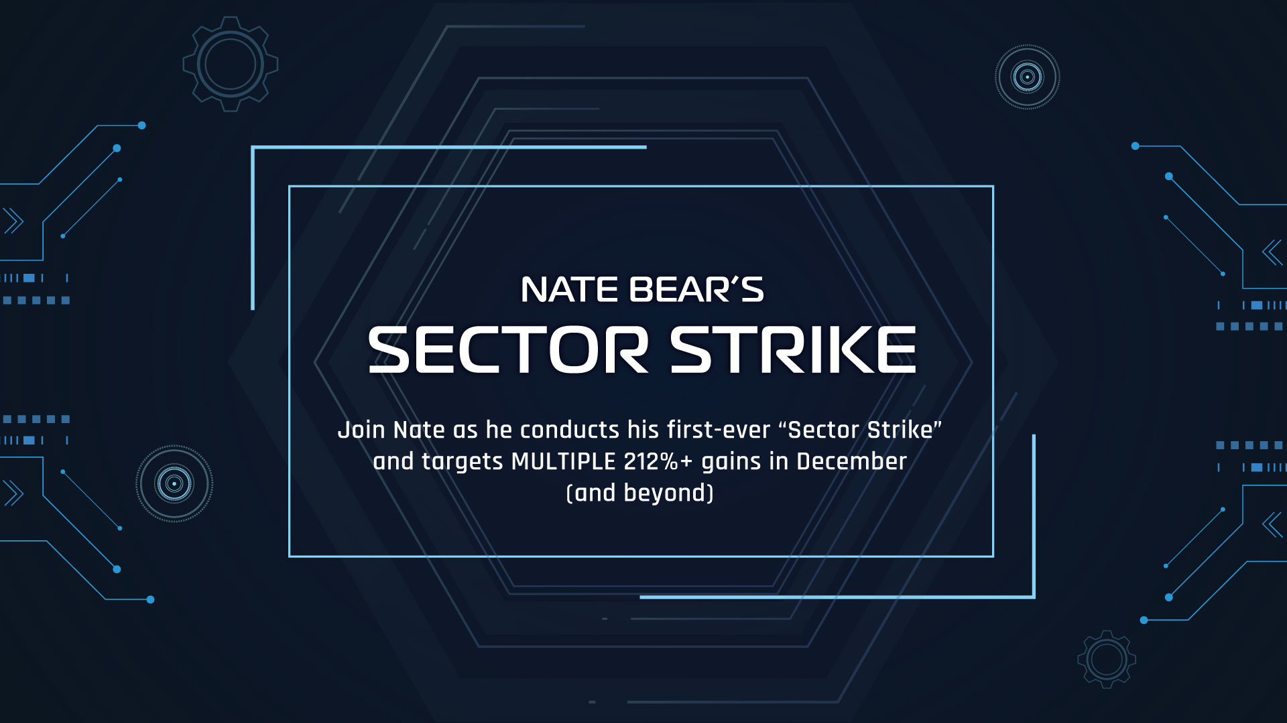

Slide 2

Today’s Special Mission Briefing
We’re going to show you a brand-new way to target massive trading opportunities... spending as little less as 30 minutes per month!
This simple strategy targets powerful sector rotations in the market
You’re going to see historical data from our research AND Nate’s recent Sector Strikes
How to follow along with Nate during next Sector Strike... NEXT week (August 1st)
At the end... We’ll give you the sector and stocks Nate is watching for August’s Sector Strike!

Slide 3
This is a BRAND-NEW low-maintenance trading strategy to ADD to your investing arsenal for the rest of 2025!

Slide 4
June 2025:
210% in 11 days

Slide 5
August 2024:
101% in 6 weeks

Slide 6
February 2025:
553% in 28 days

Slide 7
November 2023:
723% in 6 weeks

Slide 8
That’s The Power
Of The Sector Strike!

Slide 9
DISCLAIMER
We’re going to show you results from our extensive back test
using data that goes back five years where we looked at the maximum returns that could have been achieved with perfectly timed peak exits... As well as data from Nate’s recent Sector Strikes.
Your actual results depend on when you choose to get out (and we’ll show you different ways to approach that). Nobody should expect to hit the peaks every time.
Nothing is guaranteed... You should never invest more than you can afford to lose.

Slide 10
Why Are We Doing This Now?

Slide 11
“Epic Sector Rotations Set to
Dominate 2025”
-Investor Haven
Going Into 2025....

Slide 12
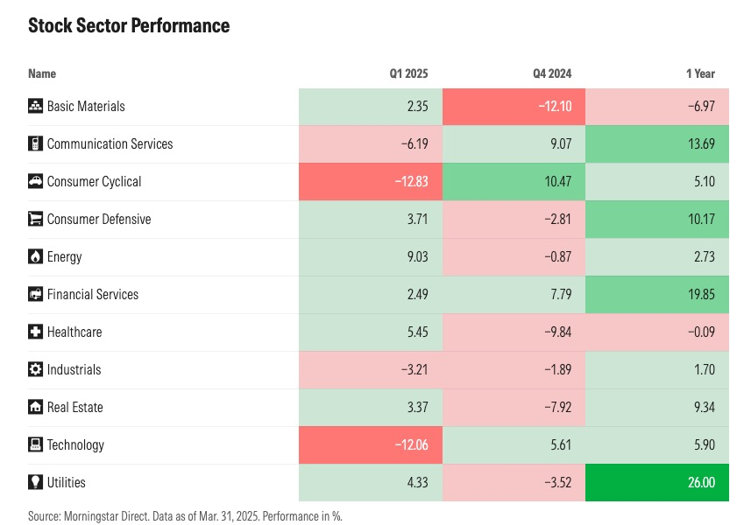
And despite all of the market unpredictability so far
... we’ve seen exactly that!

Slide 13
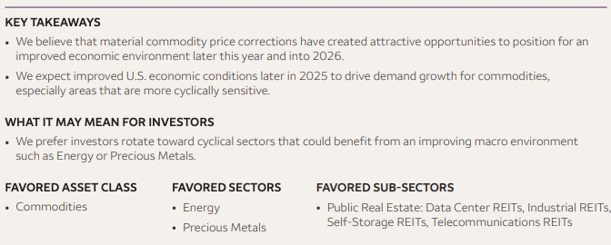
What Wells Fargo Is Telling Clients For The Rest 2025:
Source: 2025 Mid Year Outlook

Slide 14
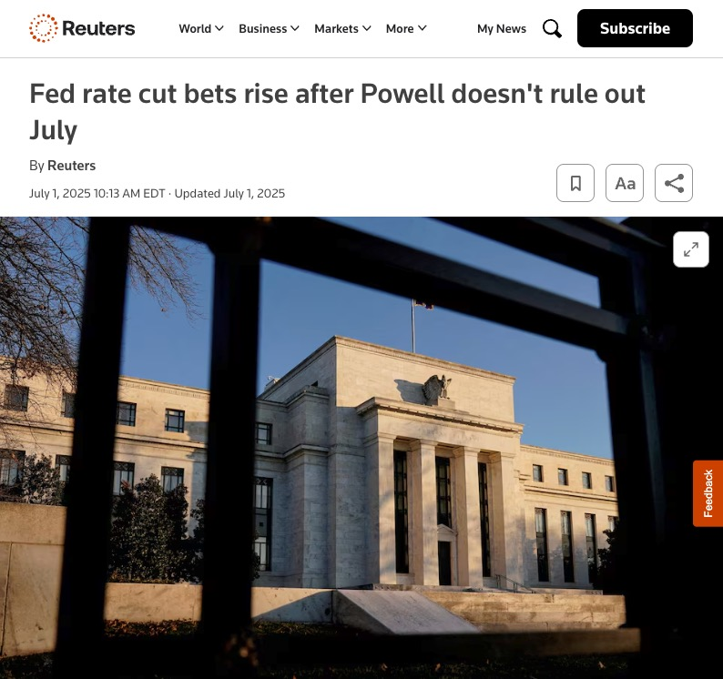
Rate Cuts?

Slide 15
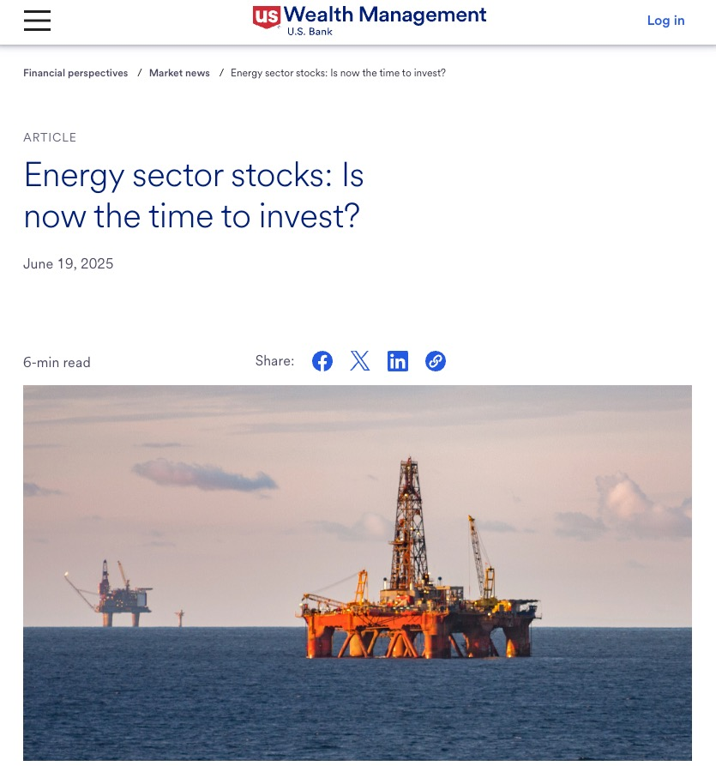
Energy Market Rebound After Iran Conflict?

Slide 16
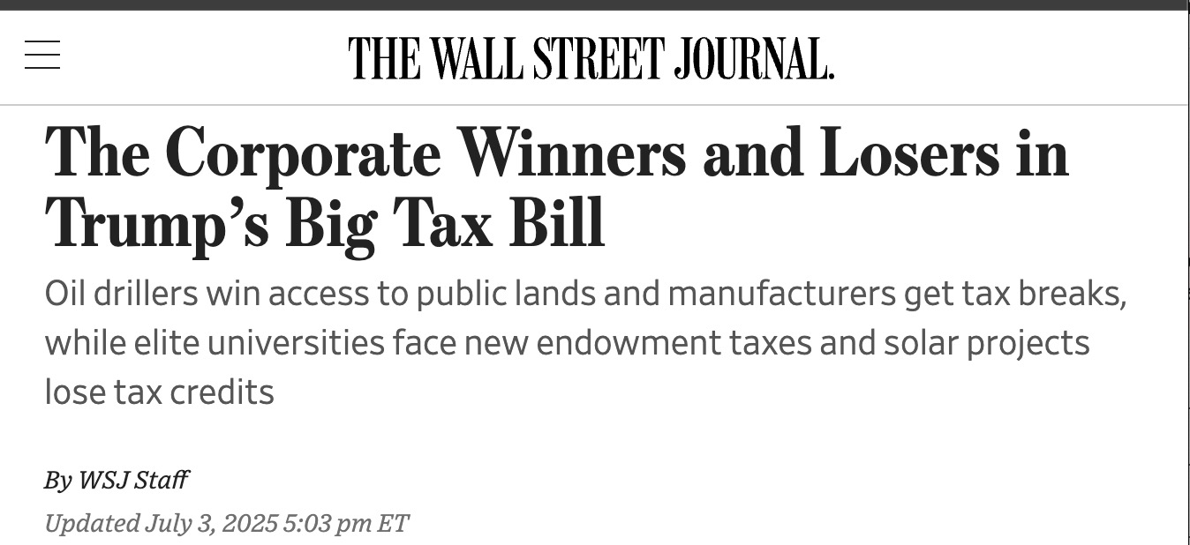
Trump’s “Big Beautiful Bill”

Slide 17
You WANT to have a sector rotation strategy “ready-to-go” for the remainder of 2025...
You DON’T WANT to be on the WRONG side of a sector rotation!

Slide 18
Introducing
The Sector Strike Strategy!
Next Sector Strike:
Friday, August 1st

Slide 19
WRITE THIS DOWN!!!
The 3-Step “Battle Plan”

Slide 20
Step 1: Identify Underperforming Sectors
We’re looking for sectors that underperformed the overall S&P 500 for
2 months in a row
We start off by using the SPDR Select Sector ETFs

Slide 21
Step 1: Identify Underperforming Sectors
11 Major S&P 500 Sector ETFs
XLY – Consumer Discretionary
XLP – Consumer Staples
XLE – Energy
XLF – Financials
XLV – Healthcare
XLI – Industrial
XLK – Technology
XLB – Materials
XLRE – Real Estate
XLC – Communications
XLU – Utilities

Slide 22
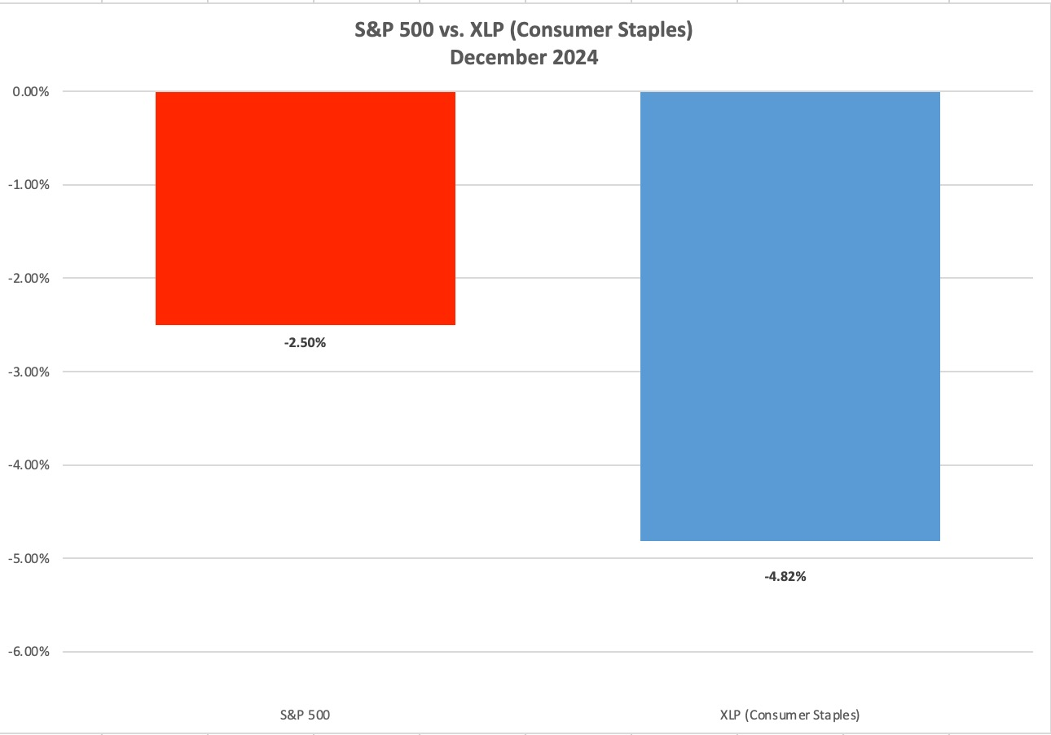
XLP Example: December 2024

Slide 23
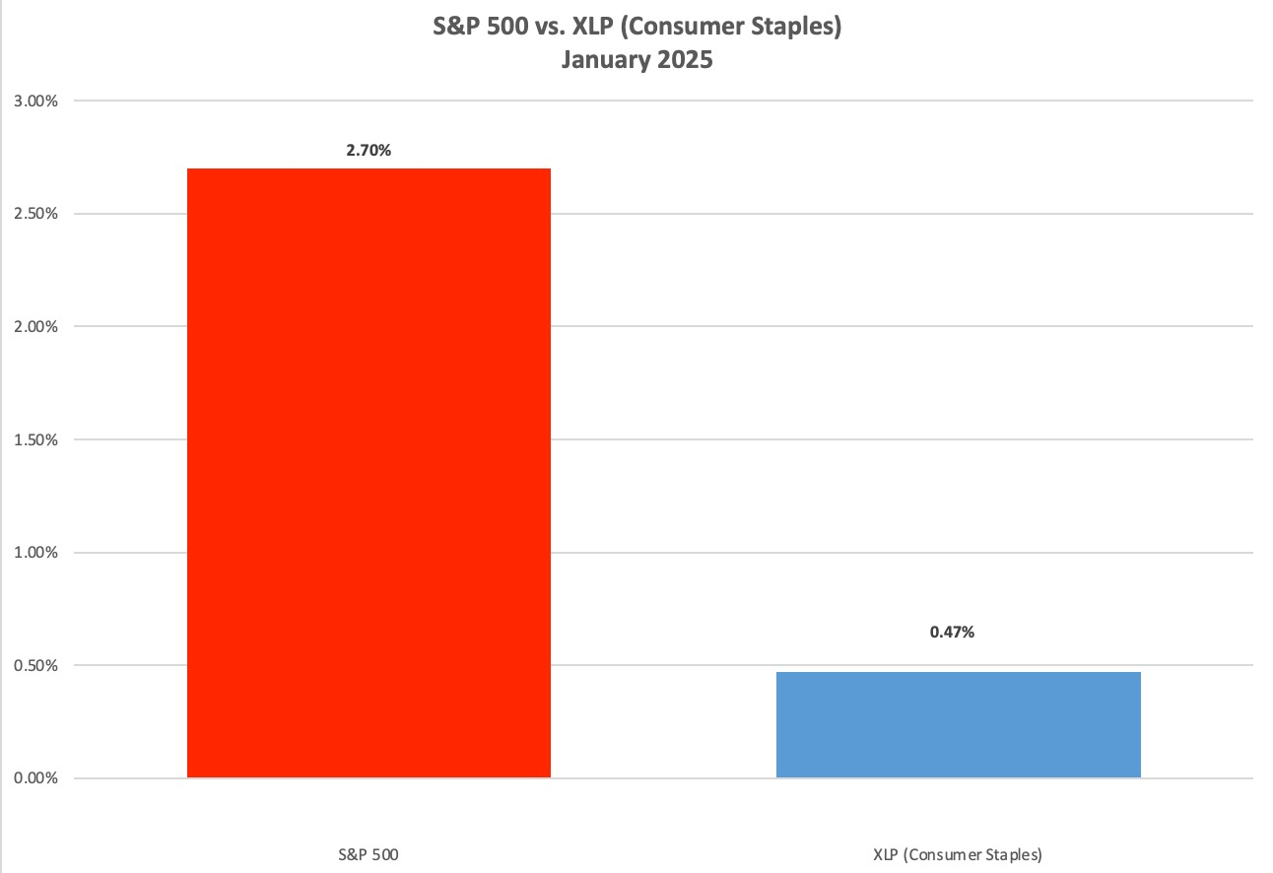
XLP Example: January 2025

Slide 24
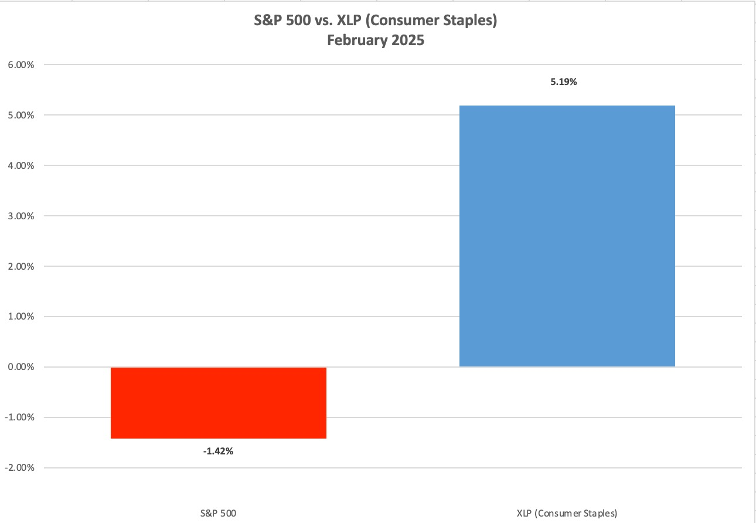
XLP Example: Feb 2025
XLP Outperformed The S&P 500!

Slide 25
Key Takeaway
When a sector underperforms the S&P 500 in TWO consecutive months...
It’s likely to outperform during the third month!

Slide 26
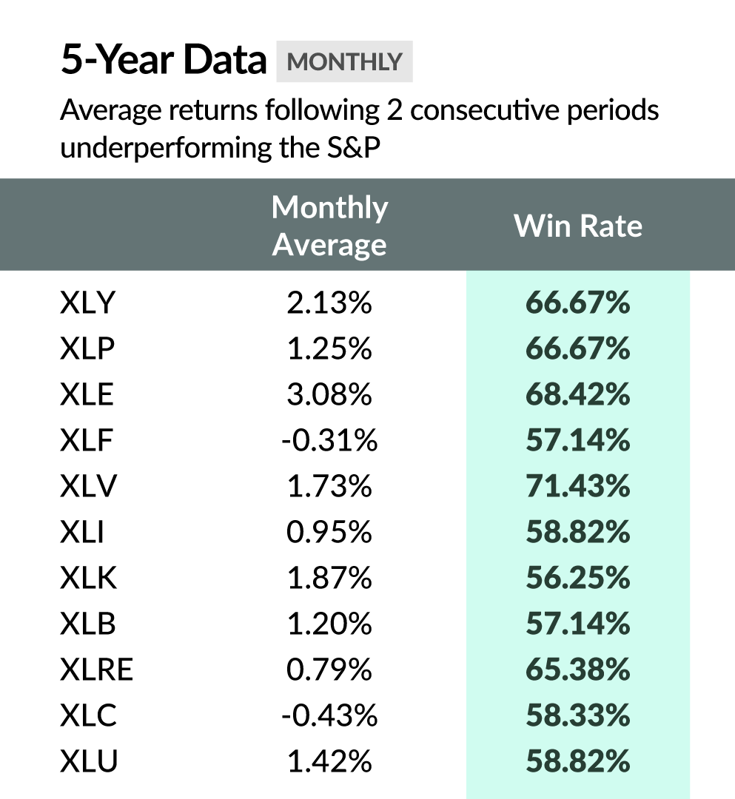
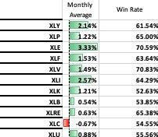
Tested Over 5 Years of Data
If you stopped at Step 1 & bought these ETFs:

Slide 27
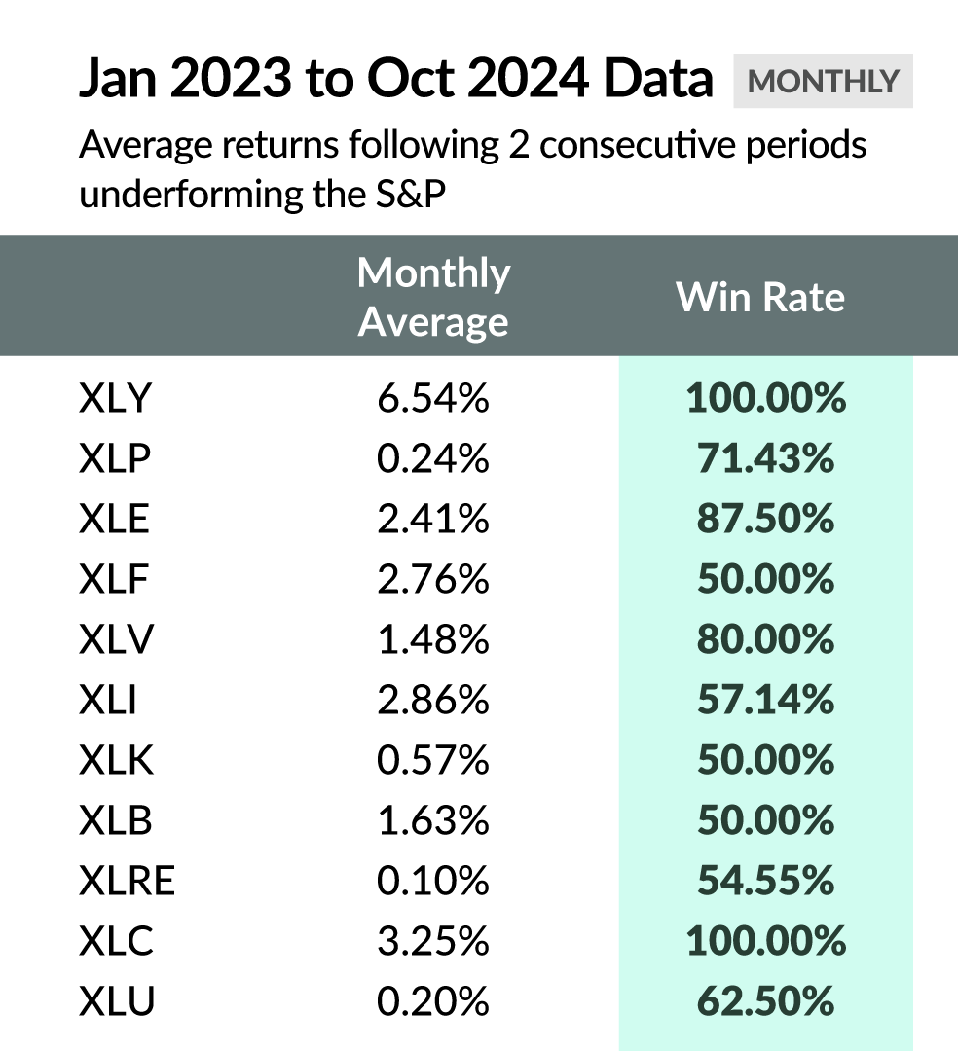
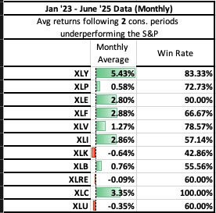
Most Recent Data (Since Jan 23):
If you stopped at Step 1 & bought these ETFs:
There is only a 25% chance that
a sector will underperform the S&P 500 3 months in a row!

Slide 28
But We’re Targeting MUCH Bigger Profits!
436% in 16 days...
128% in 16 days...
261% in 2 weeks...
277% in 1 month...
460% in less than a month...
86% in 4 days...
340% in 6 weeks...
577% in 5 weeks...
96% in 3 weeks...
723% in 6 weeks...
*Peak gains

Slide 29
HISTORICAL EXAMPLE:
XLF (Financial Sector)

Slide 30
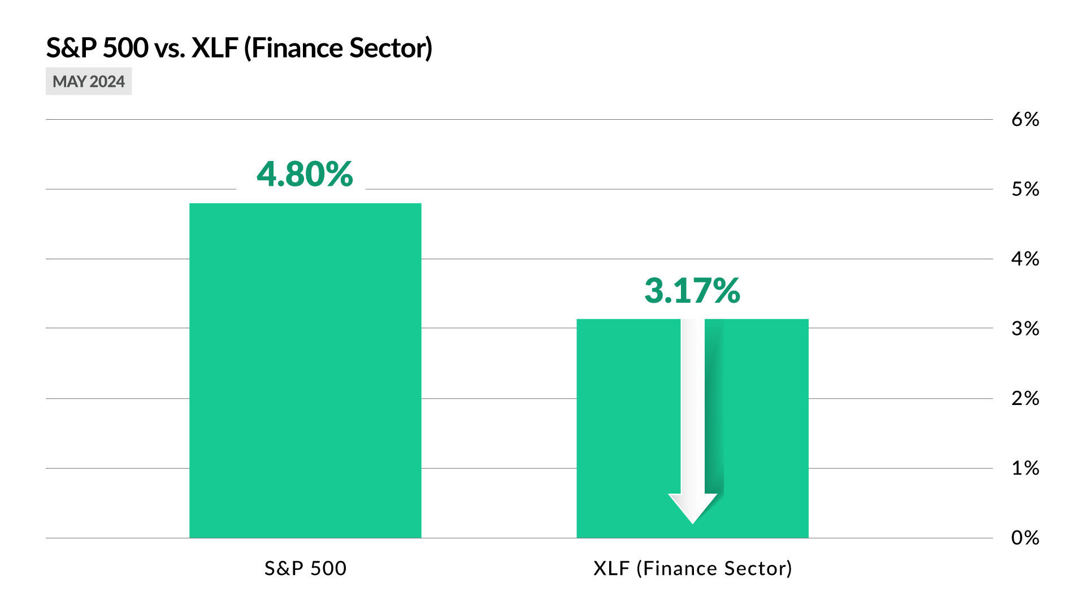
XLF Example: May 2024

Slide 31
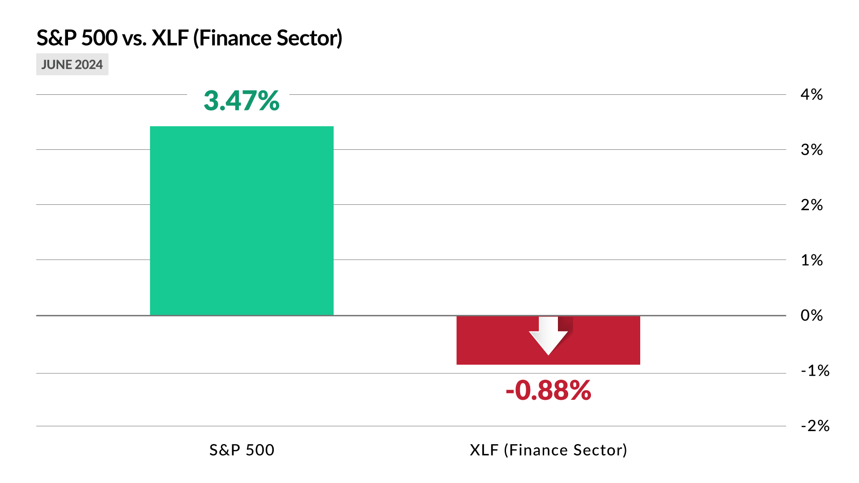
XLF Example: June 2024

Slide 32
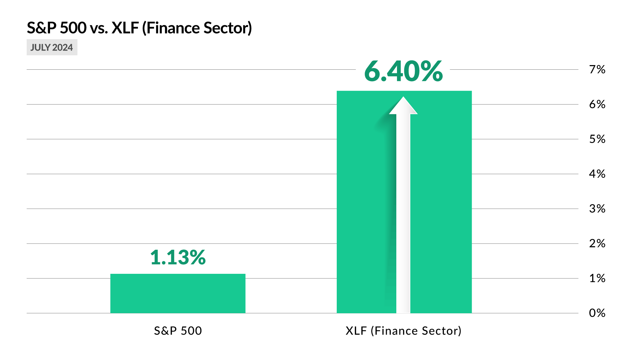
XLF Example: July 2024
XLF Outperformed The S&P 500 By 566%!

Slide 33
Step 2: Find The Top 5 Stocks In That Sector
Once we’ve found a sector that has underperformed the S&P 500 for two consecutive months... It’s then a target for a sector strike.
We ONLY focus on the top 5 within the fund as potential trade setups
See holdings from State Street’s website: https://www.ssga.com/

Slide 34
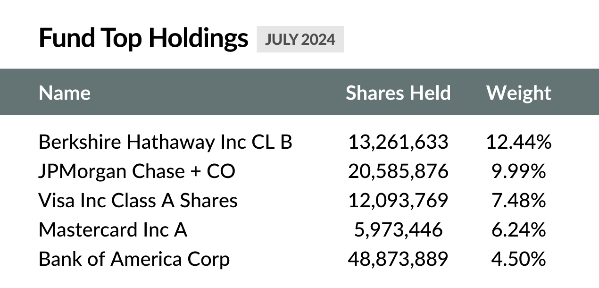
XLF Example: July 2024

Slide 35
Sector Strikes On XLF in July (2025) Could
Have Produced Gains As High As:
261% in 15 days
155% in 30 days
80% in 16 days
436% in 16 days
100% Win-rate on 4 Trade Setups!
Historical testing is a powerful tool but not a guarantee of future results. And remember these gains are based on getting out at the peak, which is a difficult feat for even one trade.

Slide 36
And that is just ONE sector...
Some months we can target multiple!

Slide 37
HISTORICAL EXAMPLE:
XLB (Materials)

Slide 38
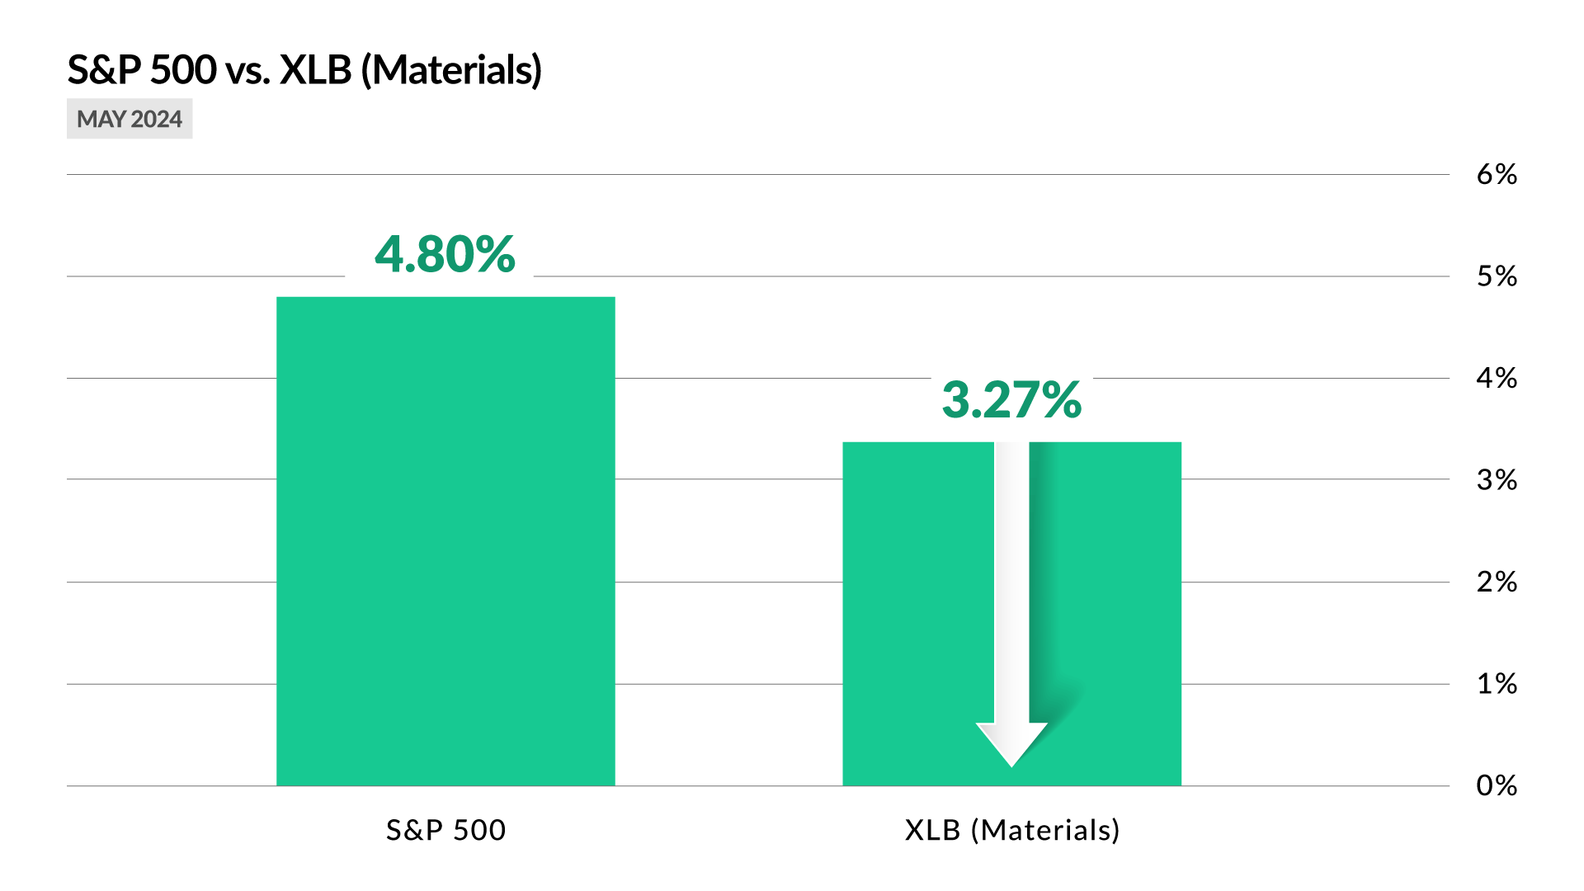
XLB Example: May 2024

Slide 39
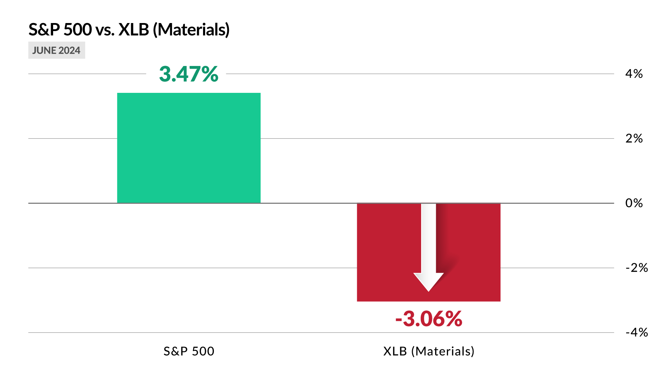
XLB Example: June 2024

Slide 40
XLB Example: July 2024
XLB Outperformed The S&P 500 By 284%!

Slide 41
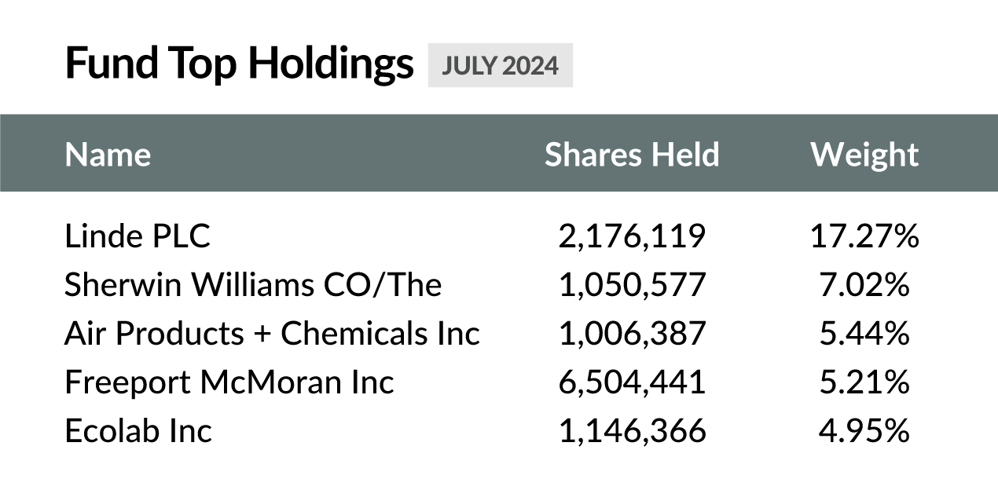
XLB Example: July 2024

Slide 42
Sector Strikes On XLB in July Could Have Produced Gains As High As:
191% on LIN in 30 days
86% on FCX in 4 Days
460% on SHW in 29 Days
100% Win-Rate On 3 Trade Setups!

Slide 43
But when you have multiple
Sector Strikes in a month...

Slide 44
July Sector Strikes On XLF, XLB, XLI, and XLP:
261% on BAC in 15 days
155% on MA in 30 days
80% on V in 16 days
436% on BRK.B in 16 days
144% on PG in 28 days
96% on GE in 22 days
277% on UNP in 30 days
191% on LIN in 30 days
86% on FCX in 4 days
460% on SHW in 29 days

Slide 45
July 2024: BIG PROFIT POTENTIAL
10 Wins (100% win-rate!)
Average Peak Gain: 219%
Average Duration: 22 days
Largest Win: 460% in 29 days
$6,000 In 10 Trades
Turns Into As Much As:
$191,176
(Perfect Timing)

Slide 46
All From a Strategy that Takes Less Than
30 MINUTES Per Month to Execute!
... So How?

Slide 47
Step 3: Trade
After we’ve found a sector that has underperformed the S&P 500 for
two consecutive months and it’s five largest holdings... We trade!
Leveraging the power of options (high risk = high reward)
This is the future of the “TPS System” that I used to help turn $37k into
$2.4 Million in 4 years
The Entry = The Squeeze

Slide 48
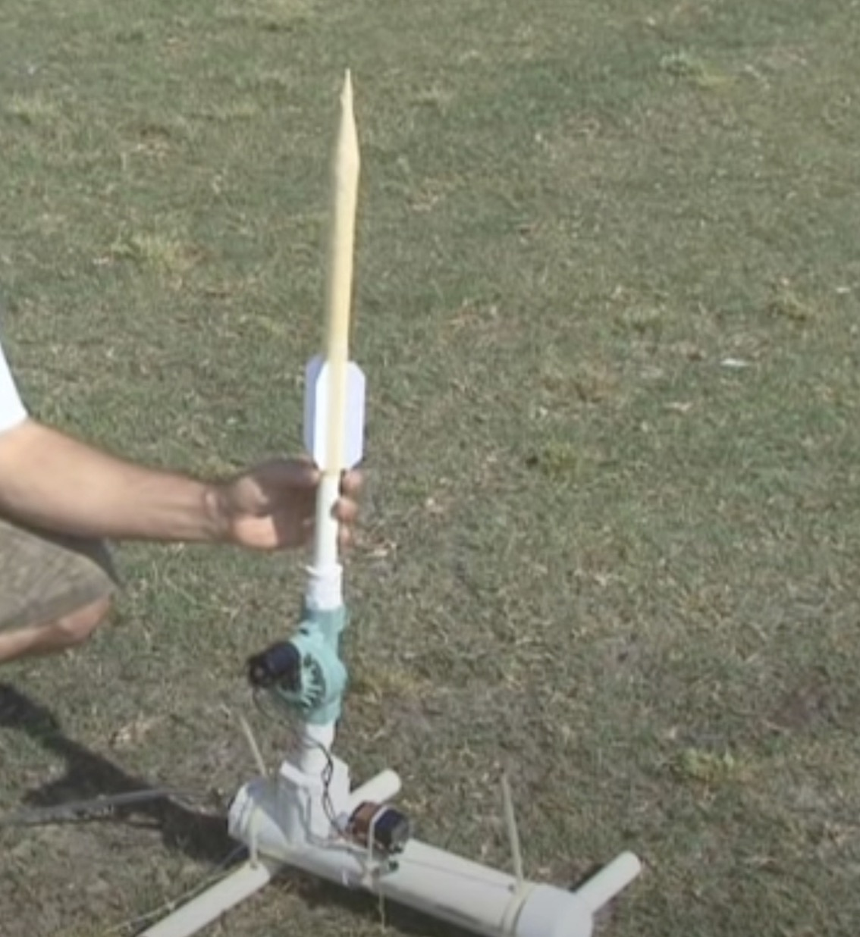
The Squeeze
Developed by Trader John Carter
20 years ago.
It’s an indicator that measures whether a stock’s price is compressed and poised to break out.
Think of a compressed air rocket… When enough pressure builds… eventually the stock’s price will
explode upwards.

Slide 49
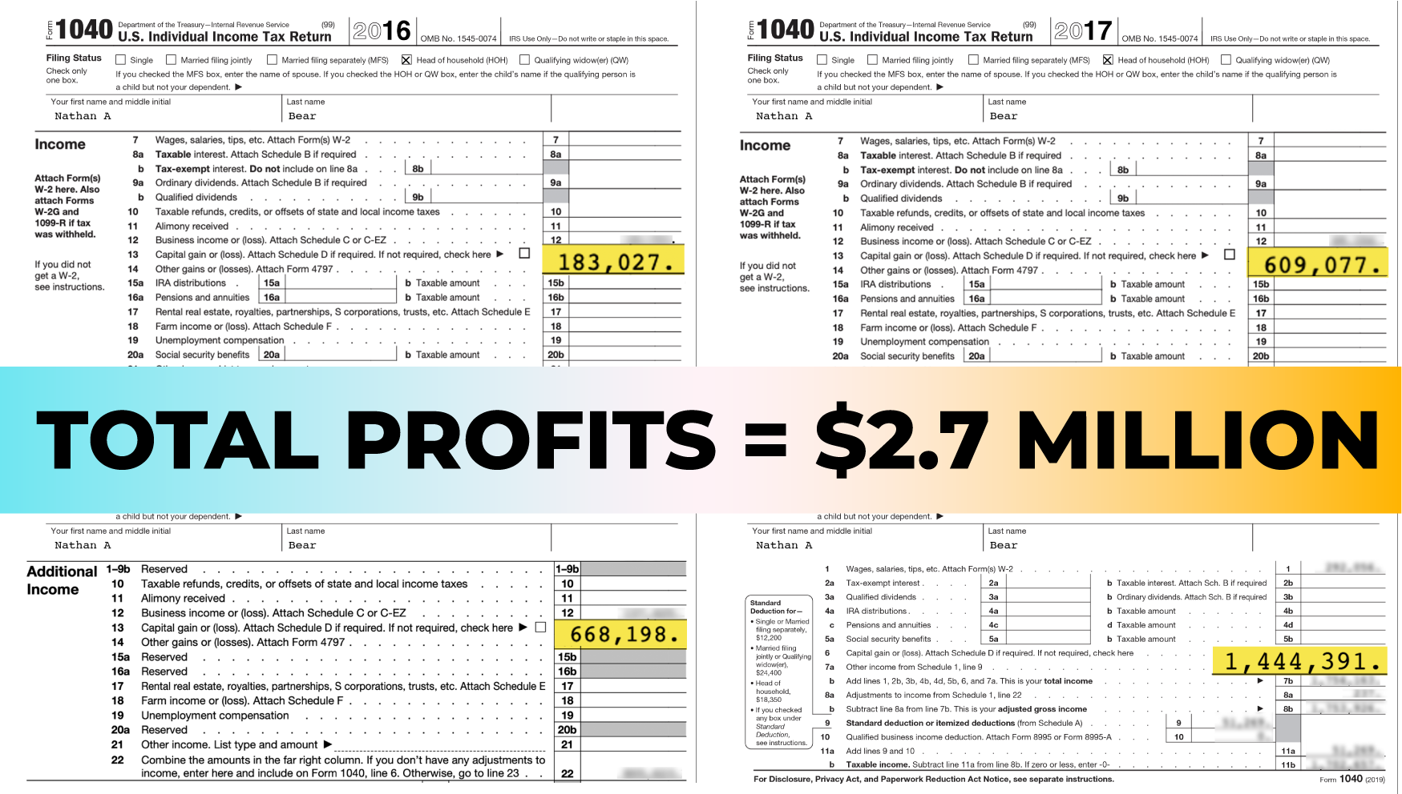
Helped Turn $37k Into $2.7M With The Squeeze!
4 years of verified
tax returns!

Slide 50
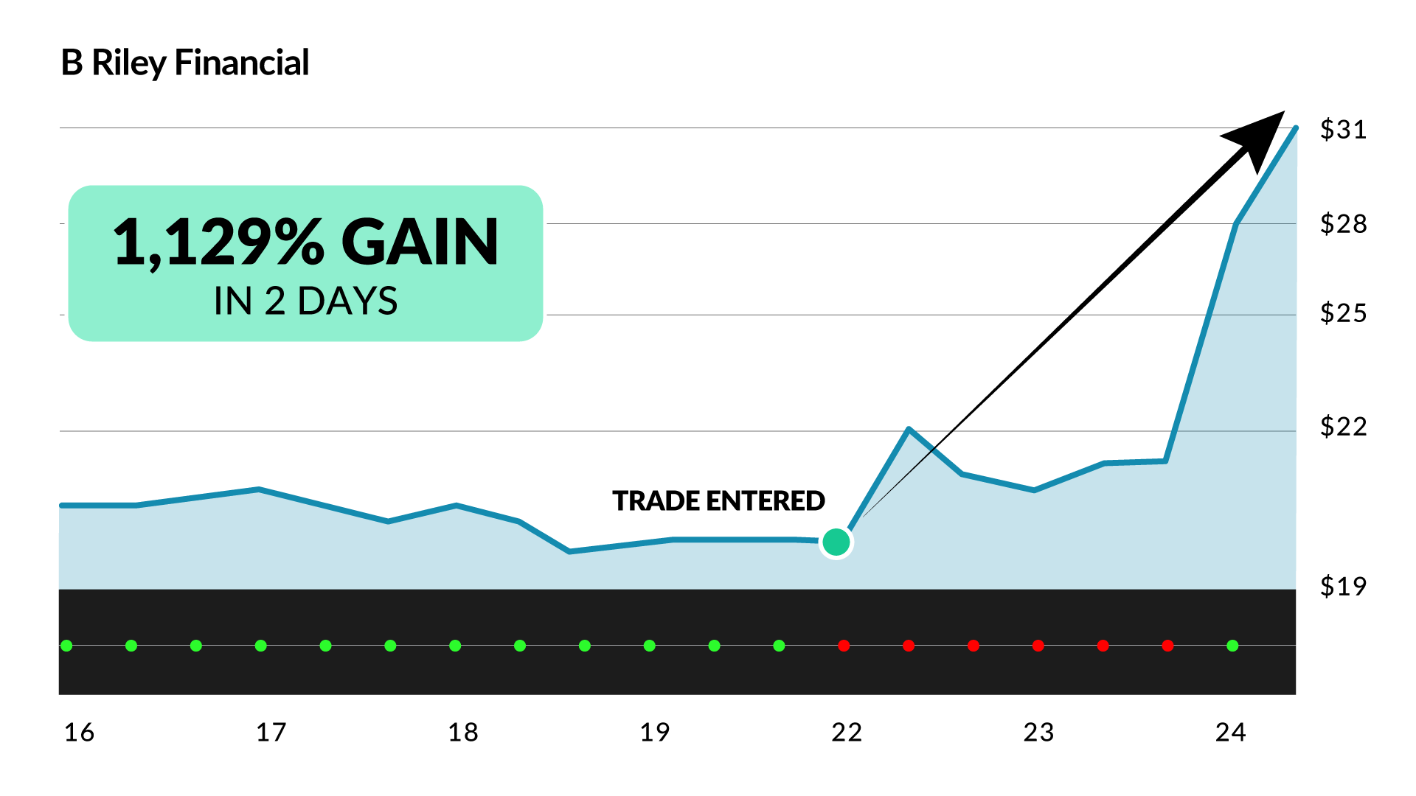
Real-Money Squeeze Example:
RILY Daily Profits Live Open House Trade

Slide 51
WRITE THIS DOWN!!!
STEP 1: Identify Underperforming Sectors
STEP 2: Find Top 5 Stocks in Sector
STEP 3: TRADE!

Slide 52
HISTORICAL EXAMPLE:
XLE (Energy)
Let’s See How This Plays Out…

Slide 53
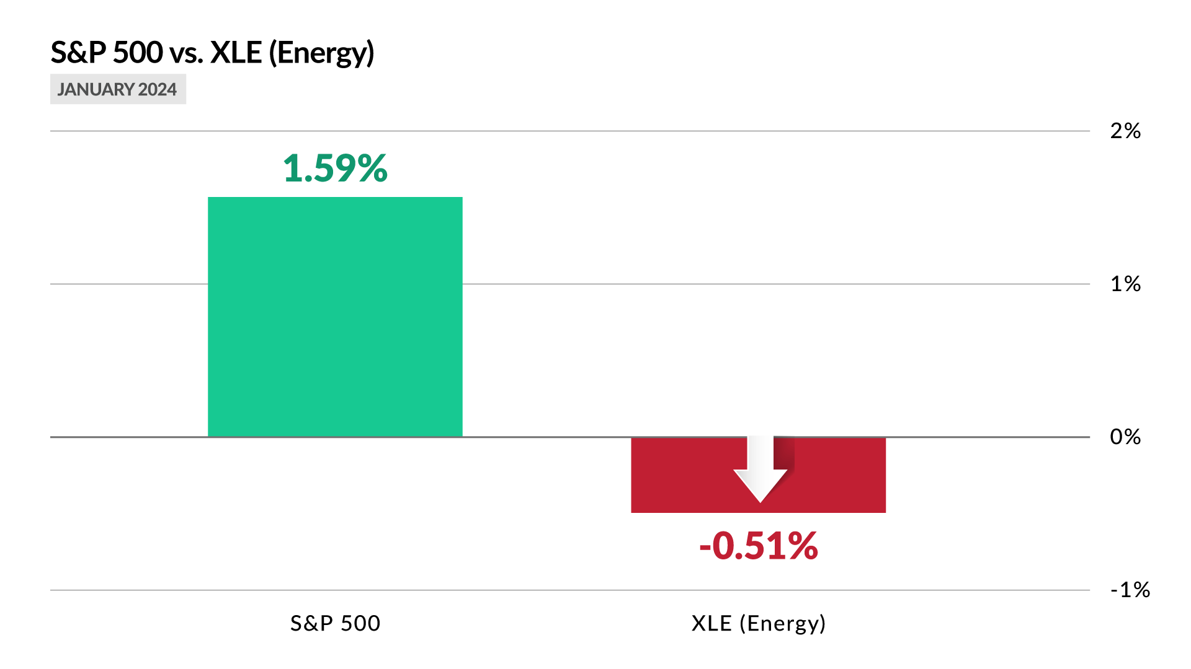
STEP 1: Identify Underperforming Sectors
XLE Example: January 2024

Slide 54
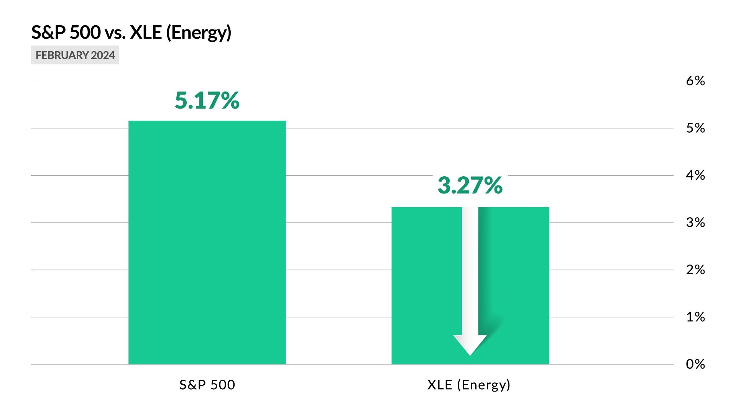
STEP 1: Identify Underperforming Sectors
XLE Example: February 2024

Slide 55
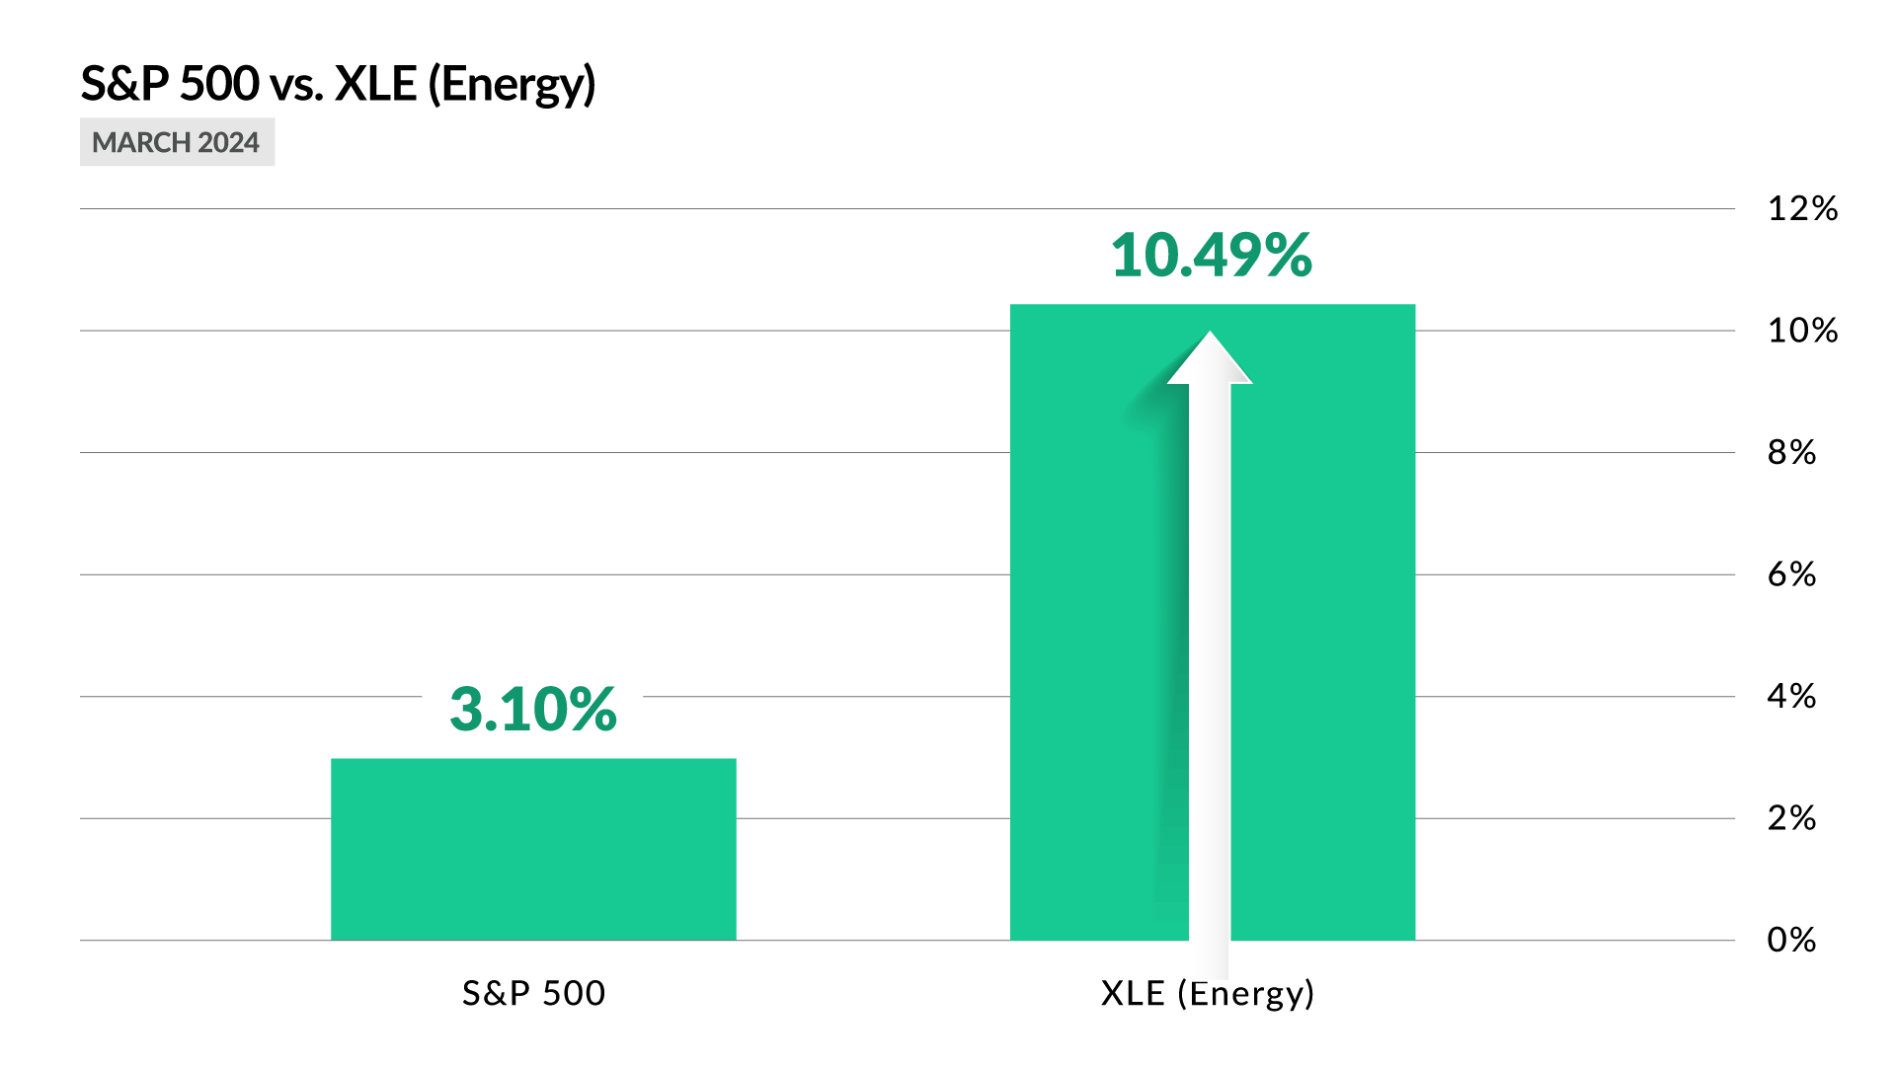
STEP 1: Identify Underperforming Sectors
XLE Example: March 2024
XLE Outperformed The S&P 500 By 284%!

Slide 56
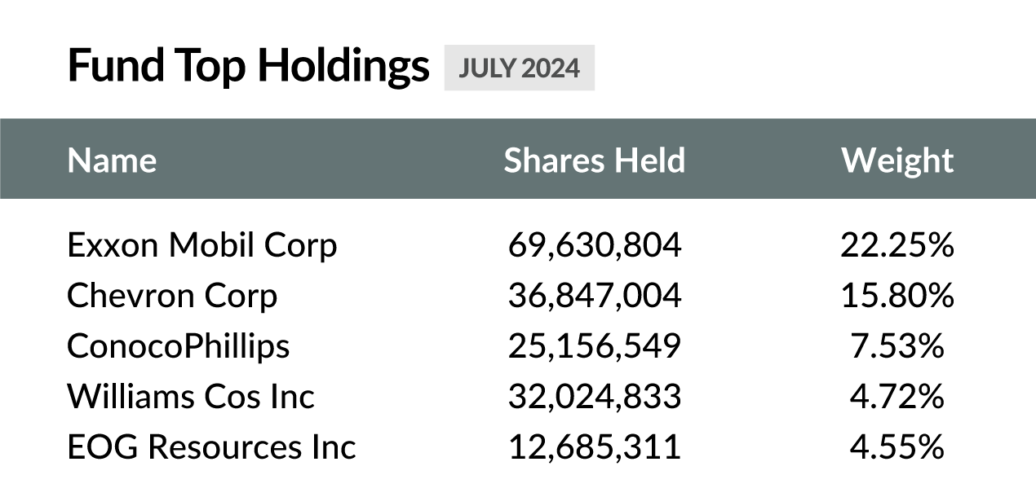
STEP 2: Find Top 5 Stocks in Sector
XLE Example: March 2024

Slide 57
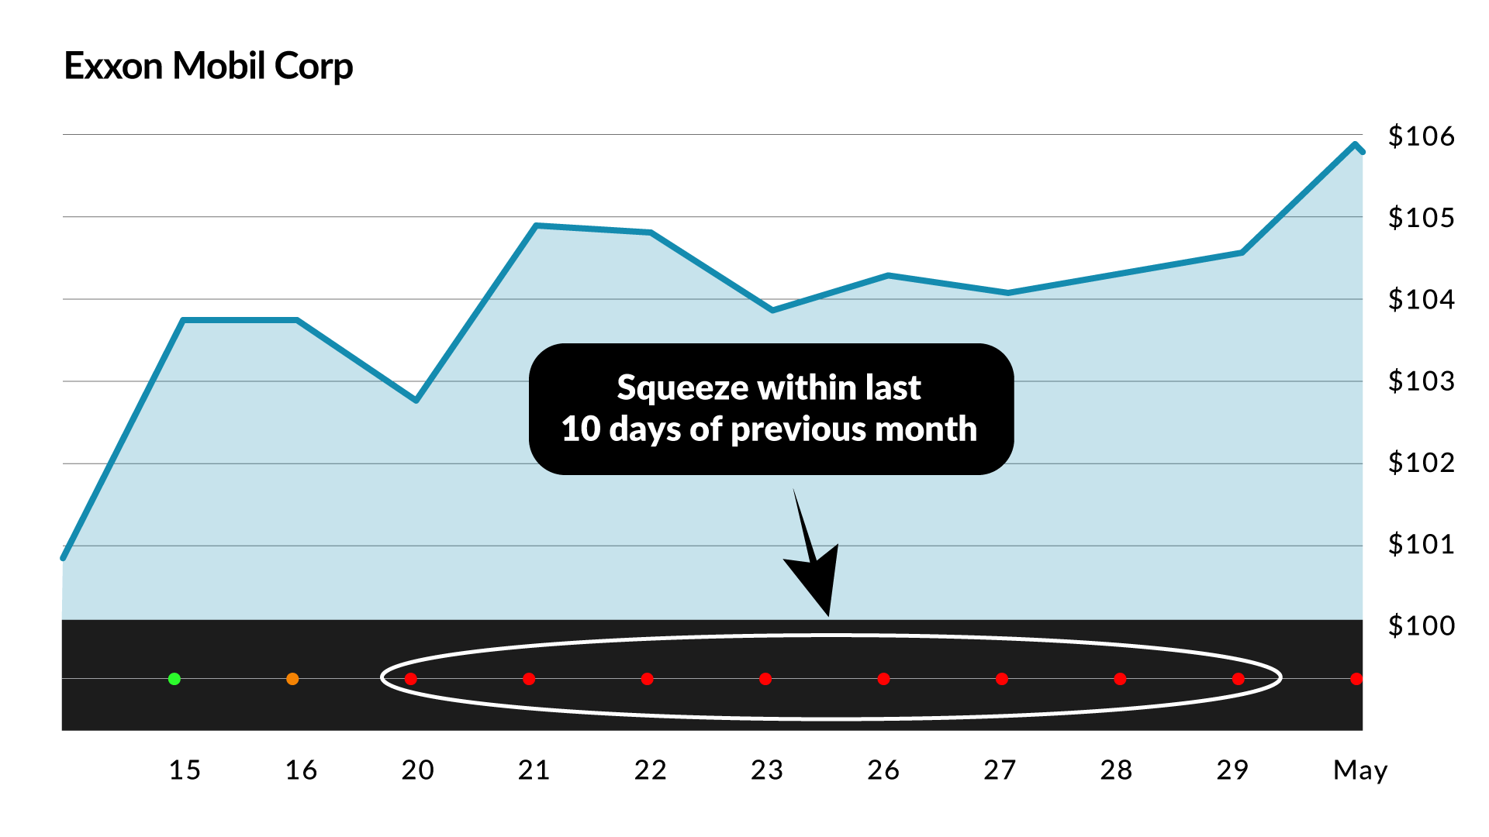
STEP 3: Trade
XLE Example: XOM Trade

Slide 58
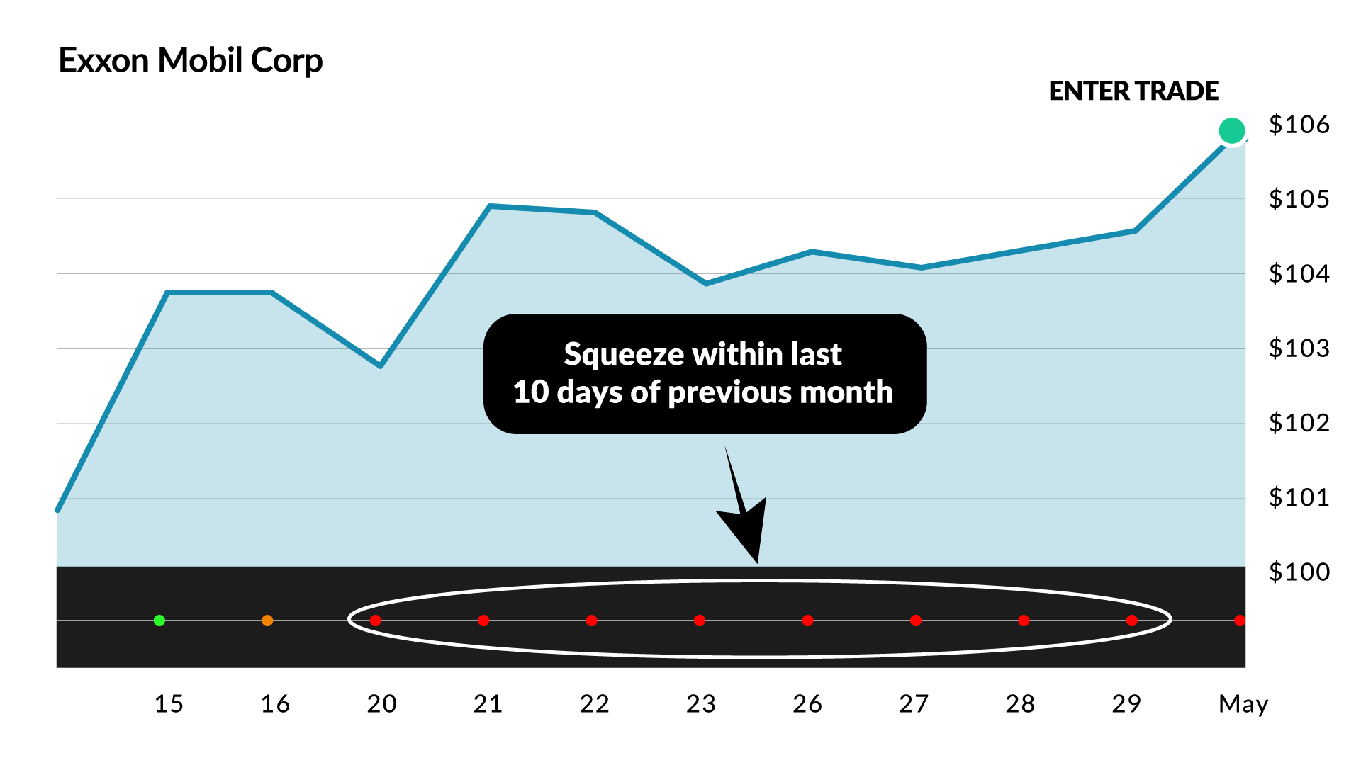
STEP 3: Trade
XLE Example: XOM Trade

Slide 59
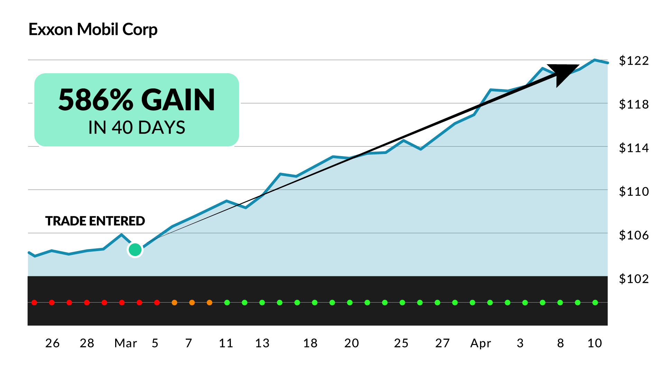
STEP 3: Trade
XLE Example: 586% Gain on XOM!

Slide 60
XLE: March 2024 Sector Strikes:
3 Wins (100% win-rate!)
Average Peak Gain: 562%
Average Duration: 38 days
Largest Win: 586% in 40 days
$6,000 In 3 Trades
Turns Into As Much As:
$119,082
(Perfect Timing)

Slide 61
What The Data Says (October 2023- June 2025)
Win-Rate: 85%
Number of Trades: 65 (3-4 Per Month)
Average Peak Gain: 165%
Average Duration: 21 Days

Slide 62
HISTORICAL EXAMPLE:
XLP (Consumer Staples)
What Happened Last Month?

Slide 63
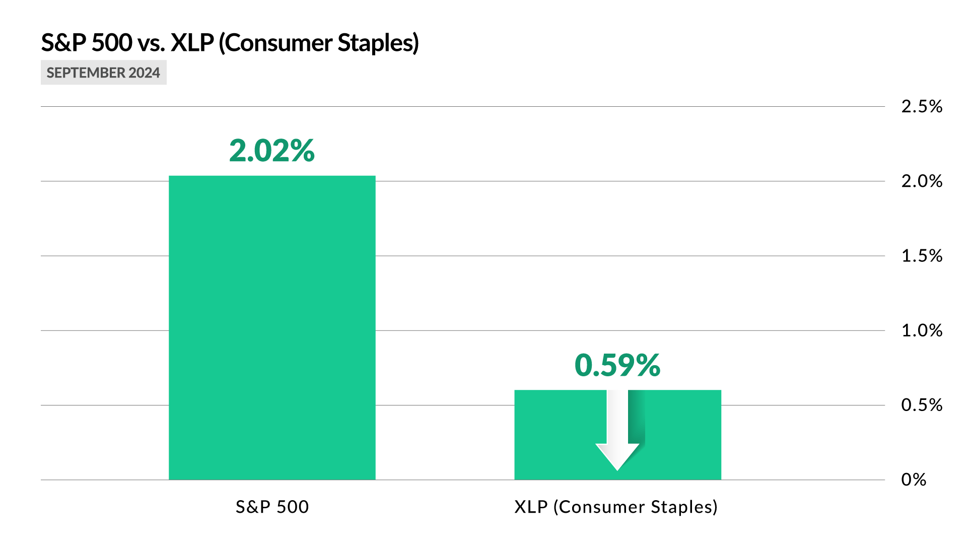
STEP 1: Identify Underperforming Sector
XLP Example: September

Slide 64
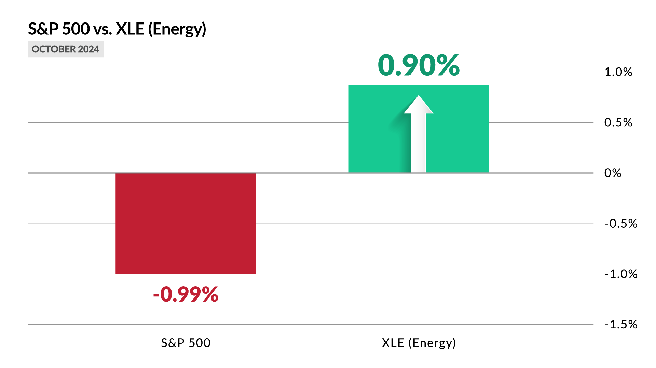
STEP 1: Identify Underperforming Sector
XLP Example: October

Slide 65
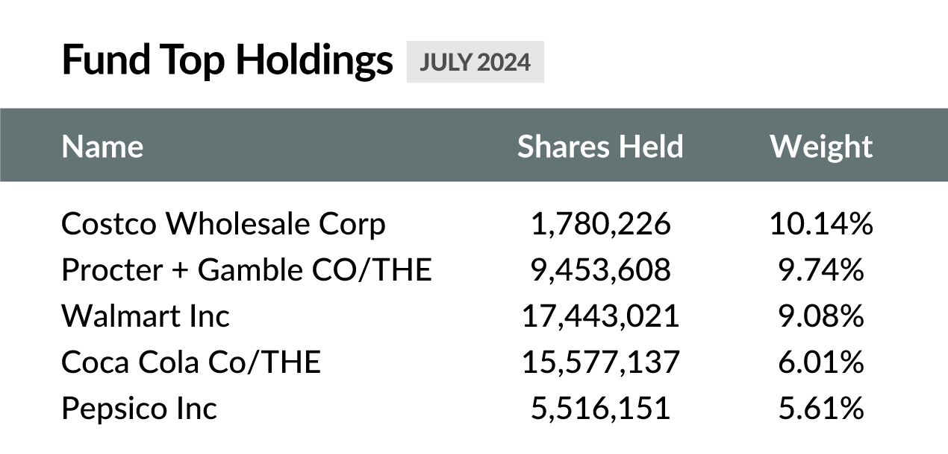
STEP 2: Find Top 5 Stocks in Sector
XLP Example: November

Slide 66
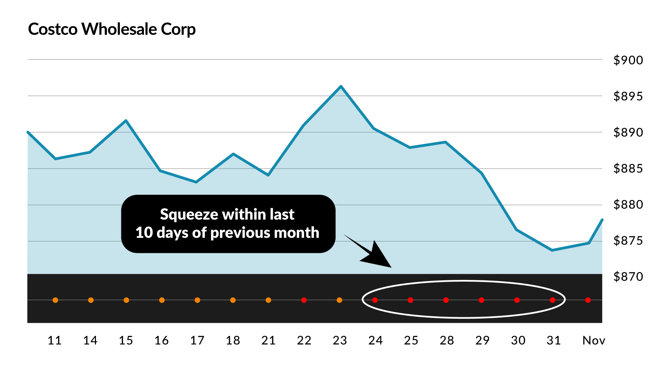
STEP 3: Trade
XLP Example: COST Trade

Slide 67
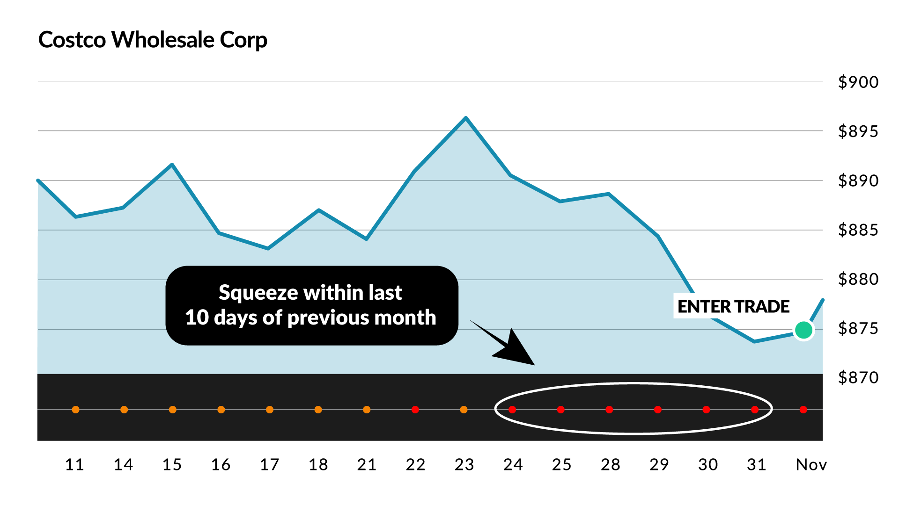
STEP 3: Trade
XLP Example: COST Trade

Slide 68
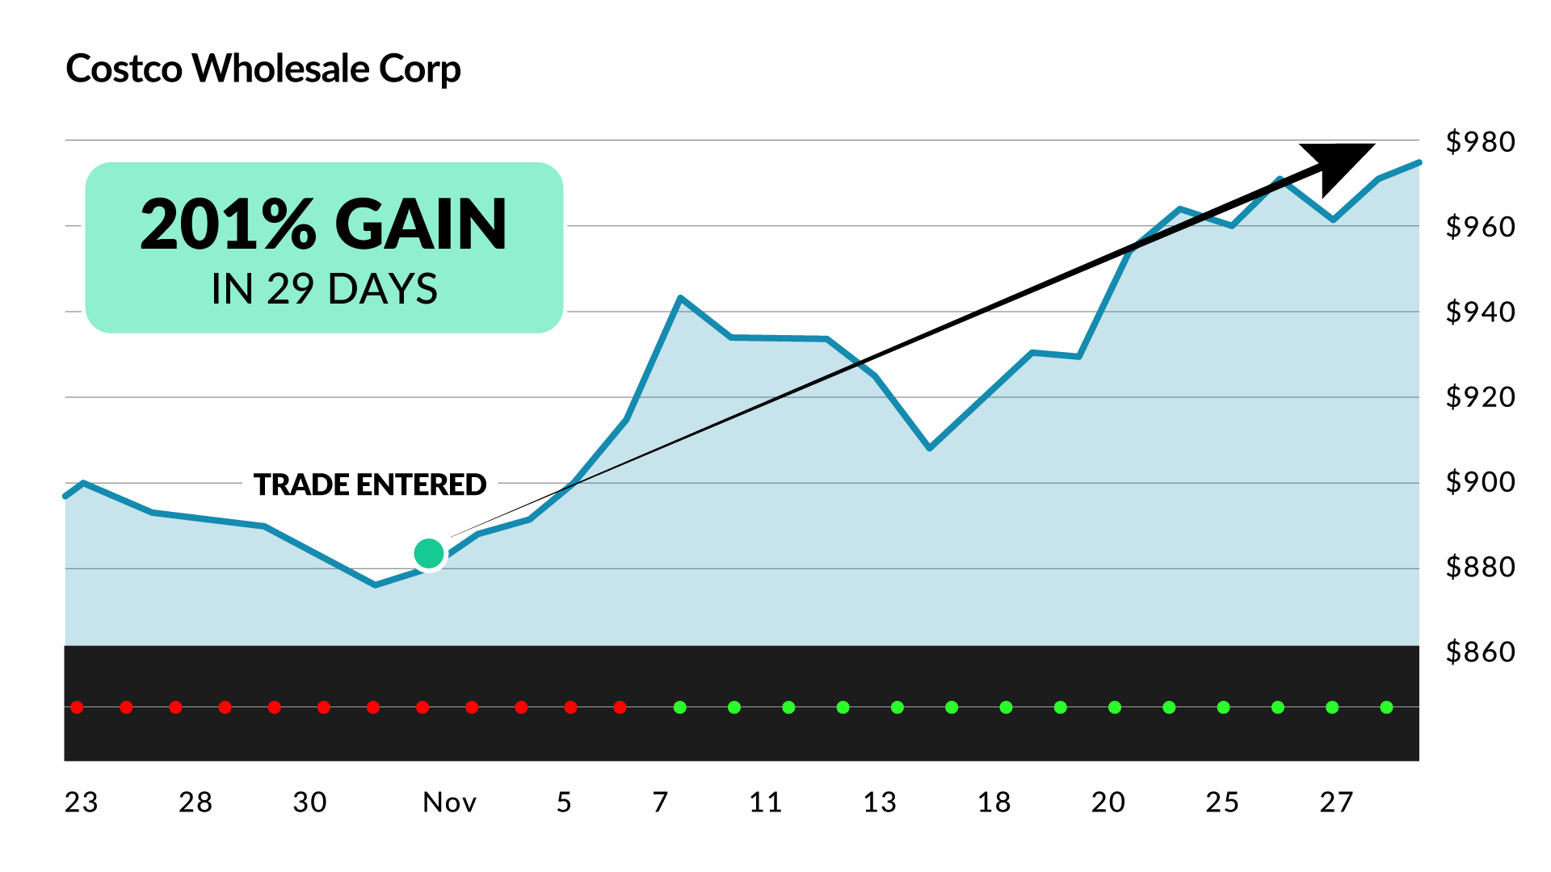
STEP 3: Trade
XLP Example: +188% Gain on COST!

Slide 69
$6,000 in each of the 65 trade setups between Oct 2023 and
June 2025 could have turned into as much as:
$990,265
(Including Losers)
*Ceiling of strategy based on perfect timing over 38 trades.

Slide 70
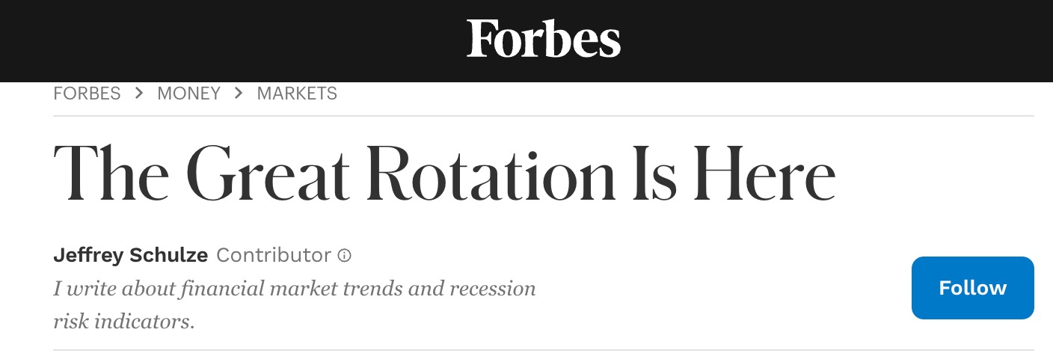
2025 is the year of sector rotations!

Slide 71
Nate is going LIVE to conduct a Sector Strike trade... Friday, August 1st @ 12 P.M. ET!

Slide 72
This 30-Min / Month Trading Strategy Is Perfect For...
Daily Profits Live Members
Profit Surge Trader Members
War Room Members
Catalyst Cashouts Live Members
Monument Traders LIVE Viewers
Any financial publication readers
Any investor who wants to take advantage
of powerful sector rotations in 2025!

Slide 73
Today Is Your Chance to Get Every
Sector Strike Trade Going Forward!
A few months ago we launched brand-new service aimed at targeting these MASSIVE Sector Rotations in the market
Opened to a small group of elite members
We’re constantly tracking all of the hottest sector rotations in the market
When we find a monthly sector rotation... We “attack” and target as many trade
setups as we can
Strategy takes about 30 minutes per month!

Slide 74

These Trades Will Be Exclusive to Our Newest Service...

Slide 75
Despite all of the market chaos this year...
Nate has won nearly 7 out of 10 of his trades, Including Gains of:
100% in 20 days on TTWO
100% in 21 days on WMT
34% in 4 days on MSFT
87% in 7 days on MCD
17% in 26 days on SHW
57% in 12 days on TJX
86% in 12 days on AAPL
75% in 5 days on MSFT
100% in 2 days on ISRG
106% in 8 days on SPG

Slide 76
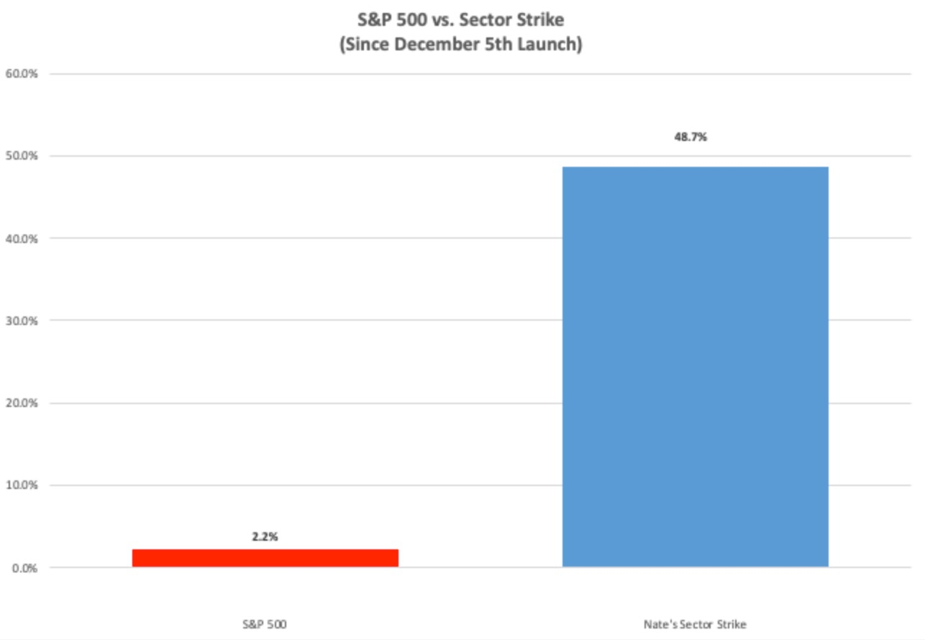
Nate’s Sector Strike strategy has outperformed the S&P 500 by more than 22X!

Slide 77
It’s Now Easier Than Ever To
Conduct Sector Strikes...

Slide 78
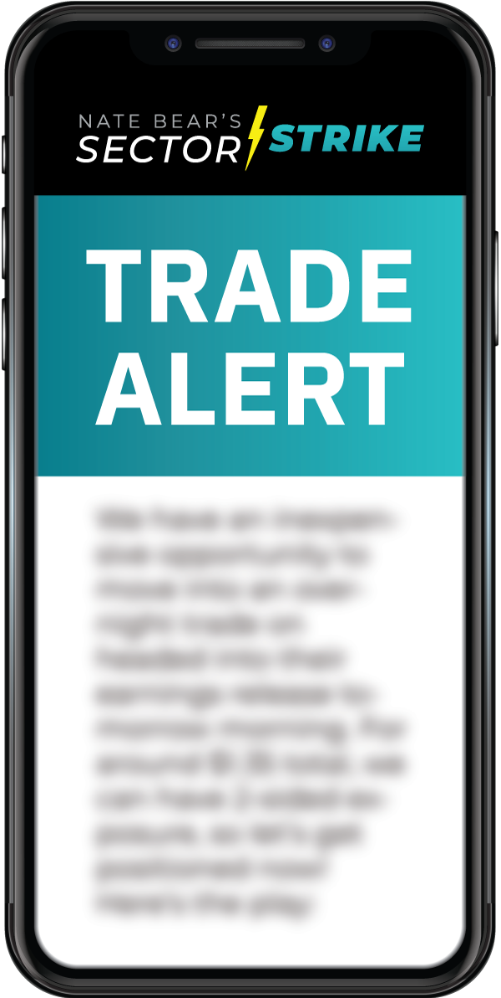
Sector Strike Trade Recommendations
Real-time trade recommendations from Nate
Typically, 3-5 trade setups per month
(give or take)
Average Duration: 3-5 weeks
The perfect strategy for busy traders who want MORE without a huge time commitment!
Delivered via email, mobile push alert, and...

Slide 79
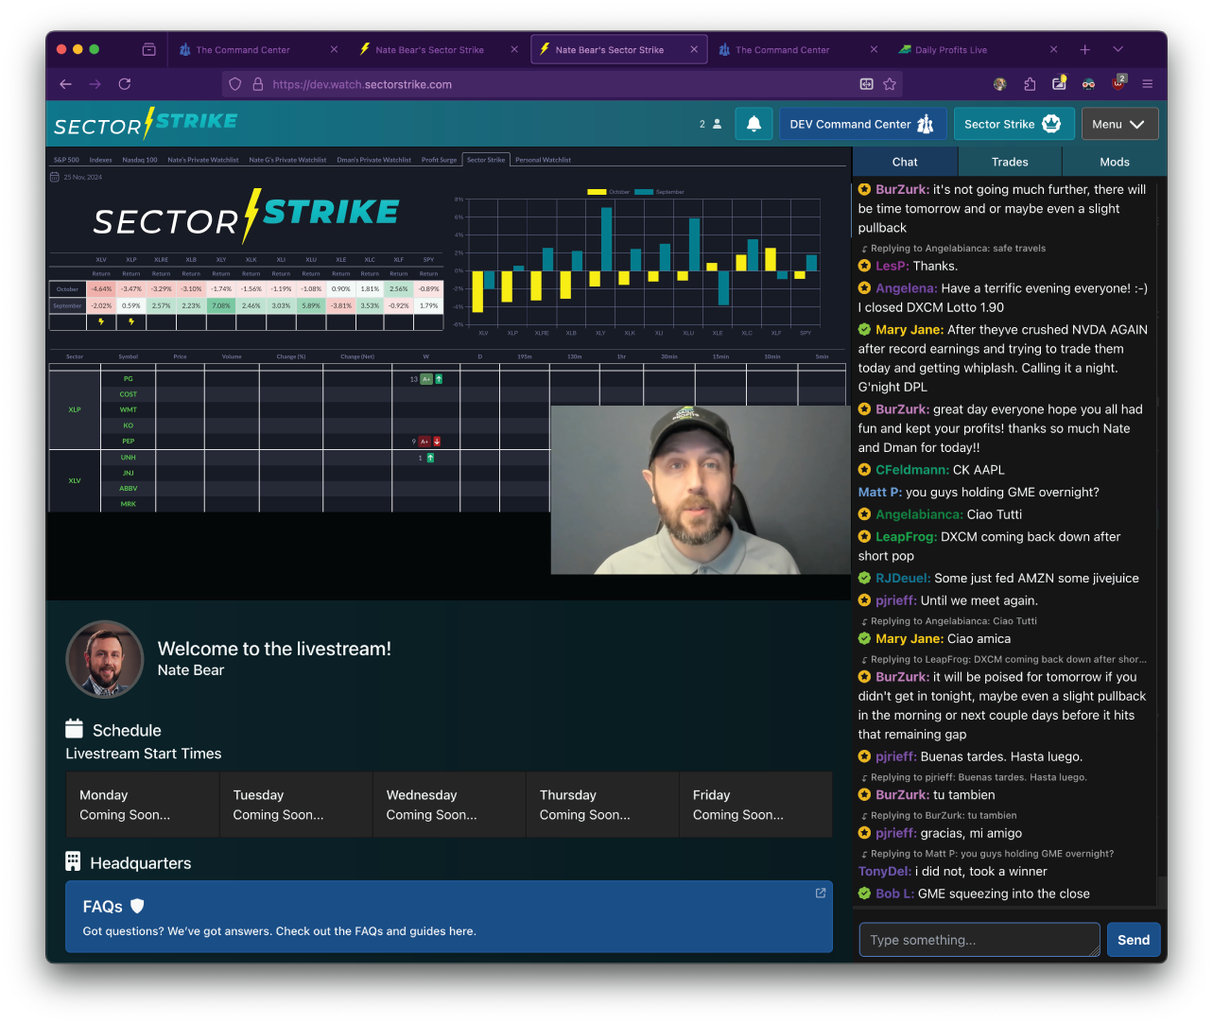
Sector Strike Trade Situation Room
Exclusive chatroom for Sector Strike trades where
you can master this powerful trading strategy.
Nate is going LIVE at 12 p.m. ET on the first Wednesday of every month to go through all of the active sector rotations and trade setups...
Look over Nate’s shoulder and get his LIVE market analysis and trade recommendations (in real-time)
Chat with other elite members and our mod squad

Slide 80
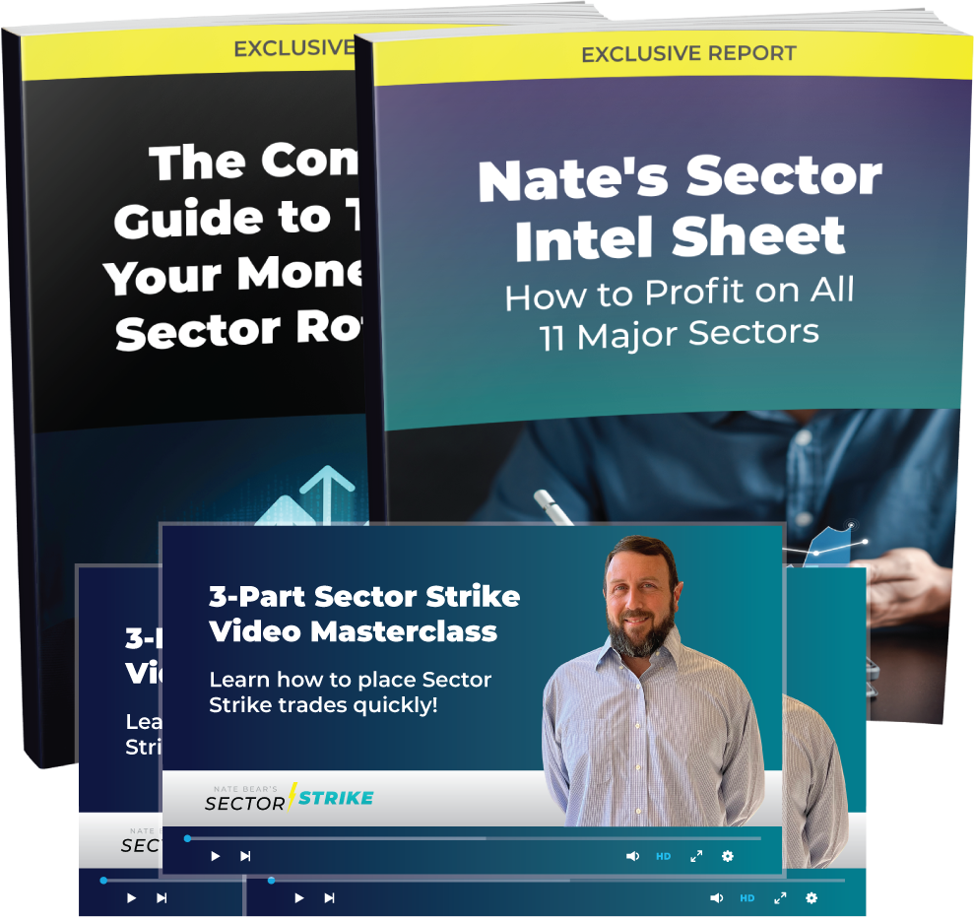
Exclusive Sector Strike Education Suite
Sector Strike Plan – The Complete Guide to
Tripling Your Money From Sector Rotations
Nate’s Sector Intel Sheet – Complete Guide to Profiting Off All 11 Major Sectors
3-Part Sector Strike Video Masterclass –
Learn how to place Sector Strike trades quickly!
Only available as a member of Nate’s Sector
Strike Research Service

Slide 81
We’ve Even Developed a Brand-New Feature in
S.A.M. (AI-Powered Scanner) to Identify Target Sectors and Trade Setups!

Slide 82
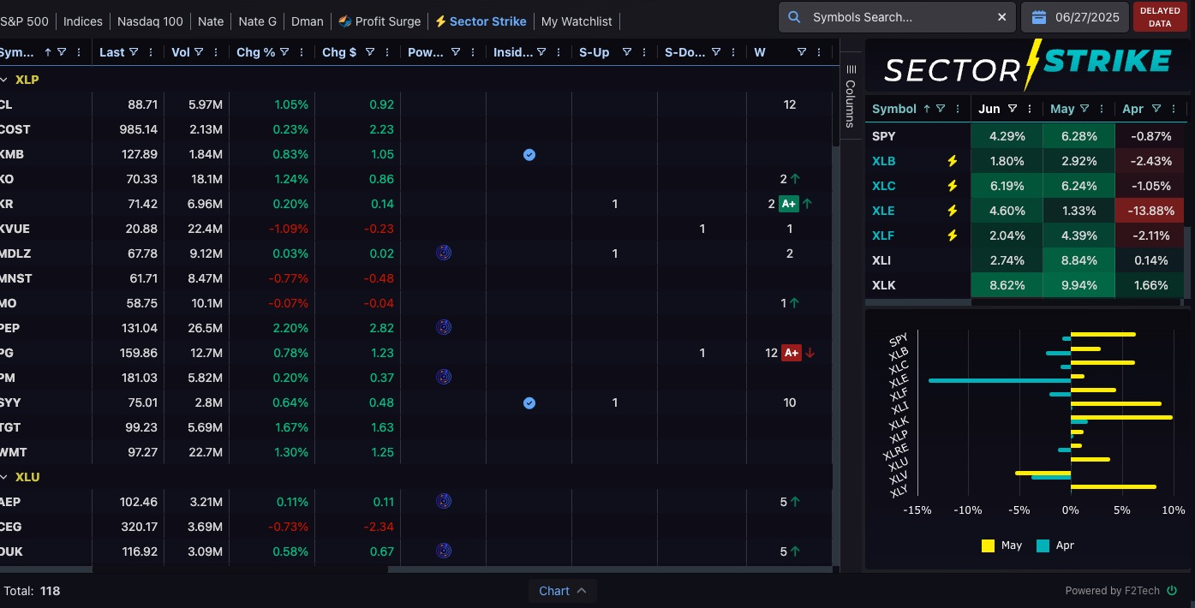
*EXCLUSIVE!
SECTOR STRIKE ADD-ON 2.0 FOR S.A.M. (AI SCANNER)

Slide 83
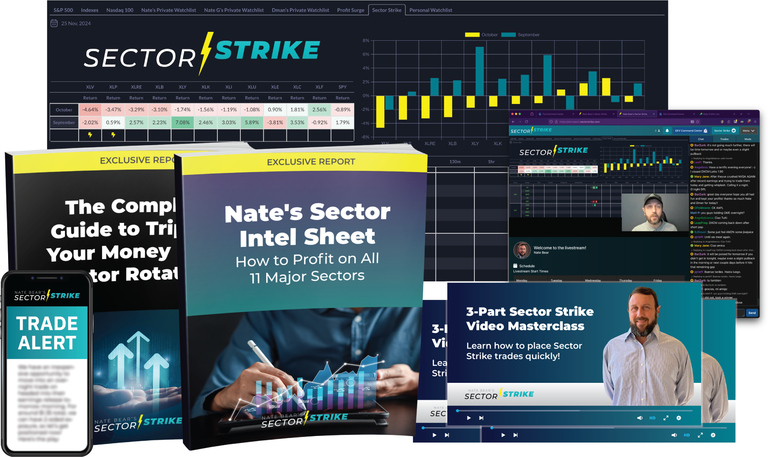
The FULL PACKAGE:
Nate Bear’s *NEW* Sector Strike Service
Real-time Sector Strike Trade Recommendations + Alerts
Nate’s Monthly Sector Strike Situation Room + Livestream
Sector Strike Plan – The Complete Guide To Tripling Your Money From Sector Rotations (REPORT)
Nate’s Sector Intel Sheet – How To Profit On All 11 Major Sectors (REPORT)
3-Part Sector Strike Video Masterclass
Exclusive Sector Strike add-on Scanner for S.A.M.
(Daily Profit Scanner)

Slide 84
This Service Will Be Sold For $6,000 When It’s Available to the Public!

Slide 85

“So How Can I Access?”
Get exclusive founding-member access to Sector Strike FREE when you become a VIP Member of Monument Traders Alliance Inner Circle

Slide 86

Here’s everything you’re going to get as a
VIP Member of the MTA Inner Circle…

Slide 87
As An Inner Circle Member, You Can Trade Alongside
Nate LIVE Every Day... FOR FREE!

Slide 88
Trade alongside Nate Bear (The Millionaire Trader) Target Explosive Squeeze Trades… Everyday!
From construction and $37,000… to generating over
$2.7 MILLION in verified trading profits over just four years!
Join Nate everyday inside of the Daily Profits Live chatroom and master profiting from ”The Squeeze”
147 x 100%+ winners since March 2023!!
Largest trade: 1,129% in 2 days!

Slide 89

The Best of Nate’s
147 x 100% Winners!
295%
334%
368%
420%
Overnight!
In Hours!
Overnight!
In Hours!
250%
500%
1,129%
In 2 Days!
In 2 Days!
In 2 Days!

Slide 90
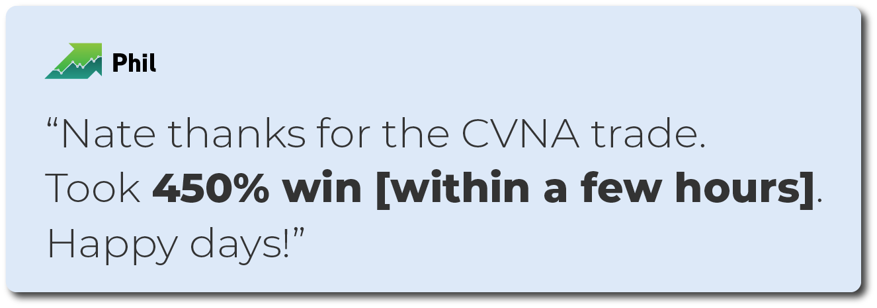
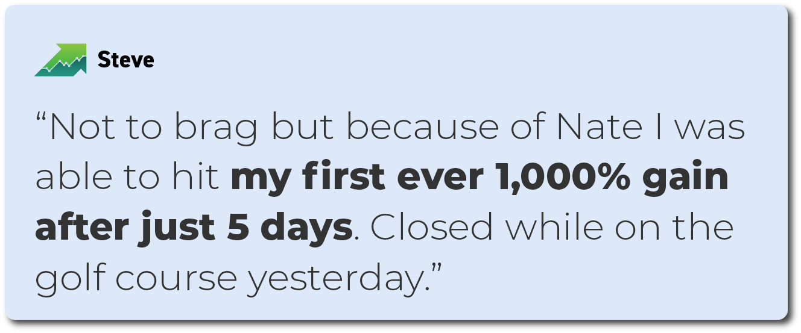
He Trains His People So Well…
His Happiest Streamers Are Even Beating His Official Stats

Slide 91

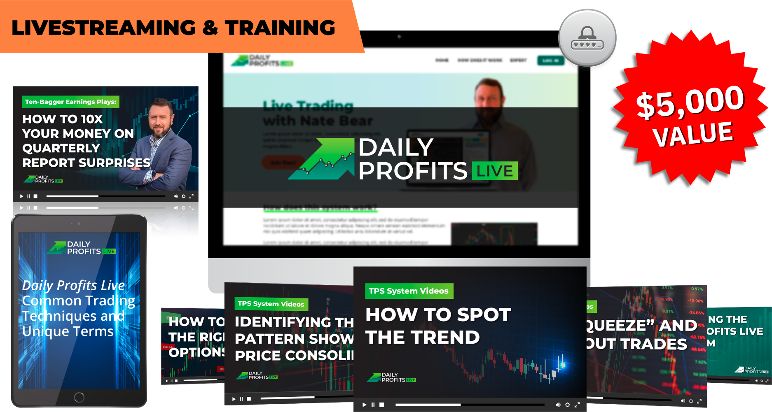
Retail Price: $5,000 / Year…
MTA Inner Circle Members:
FREE!

Slide 92
Remember...
You’re getting access to A LOT of trade recommendations...
And you don’t need to take everyone!
Not every trade recommendation will be a massive triple digit winner...
and of course some plays don't work out. But we’re always 100% committed to giving you the best education and the giving you the best market intel we have!
We’ve made it easier than ever for Inner
Circle members to review all of the trade
recommendations we send out...

Slide 93
You’ll get FREE Access To S.A.M. 2.0 (Nate’s AI-Powered Scanner)

Slide 94

Direct Access To Nate’s AI-Powered Scanner:
Proprietary technology designed to supercharge trading Nate’s favorite strategies:
The Squeeze!
Earnings Profit Surge
Starting Today: The Sector Strike!
More features added regularly!

Slide 95
We Built S.A.M. To Search For Squeeze Setups Automatically By Using The Power of AI!

Slide 96
What S.A.M. Can Do Thanks to AI:
Ultimate AI-Powered Research tool with the processing power to scan 5 million market updates per second!
Scan the S&P 500 & NASDAQ 100 to find explosive squeeze setups
Identify “A+ Setups” using a proprietary algorithm
Monitor Nate’s watchlists and create
your own!
Scans across 10 different time frames

Slide 97
What S.A.M. Can Do Thanks to AI:
Power Options - to consider for each daily play. Includes 3 contracts to fit your risk tolerance...
SAMSpeaks feature provides AI-generated commentary on what is happening with a stock’s squeeze setups
Earnings Profit Surge indicator shows when a stock has a momentum after a big earnings win.
NEW: Sector Strike Scanner
(Exclusive add-on feature)

Slide 98
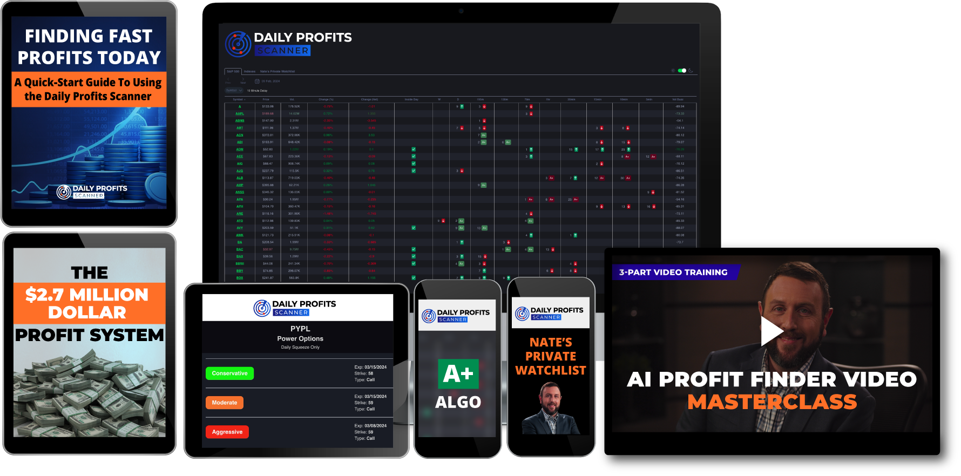
Retail Price: $6,000 / Year
MTA Inner Circle Members:
FREE!
Notes:
UPDATE TO DPS!

Slide 99

You’ll Get FREE Access To The War Room:

Slide 100



6
YEARS
76%
WIN RATE
2,279+
WINNING TRADES
Live Trade Recommendations and Research From Wall Street Legends Bryan Bottarelli and Karim Rahemtulla
Master a mixture of short-term technical trades and long-term fundamental trades inside of the famous War Room chatroom
Chatroom + renown trading education suite

Slide 101
Includes Bryan’s Top Overnight Trades!
292%
121%
205%
Overnight!
In Hours!
Overnight!
104%
150%
215%
Overnight!
Overnight!
Overnight!
Notes:
LEGAL – See comments. During the live event, we should work in an audio disclosure that states: "this is our best analysis based on the data we were able to pull at the time of the back test."

Slide 102
TOP MEMBER SUCCESS STORIES
One of Bryan and Karim’s greatest success stories is from a reader, David D., who took $20,000 and turned it into $185,000 in one year – making more from trading than from his day job.
He increased the value of his entire account by 9X!
$185,000

Slide 103
TOP MEMBER SUCCESS STORIES
Another member named Mohammed did even better…
He turned a $25,000 portfolio into over $225,000…
In just four months!
OVER $225,000

Slide 104
TOP MEMBER SUCCESS STORIES
And George knocked it our of the park during the worst three months of COVID…
He took $165,000 and hit peak gains of over
$2.3 million!
$2.3 MILLION
Top success stories, You shouldn’t expect to easily replicate

Slide 105
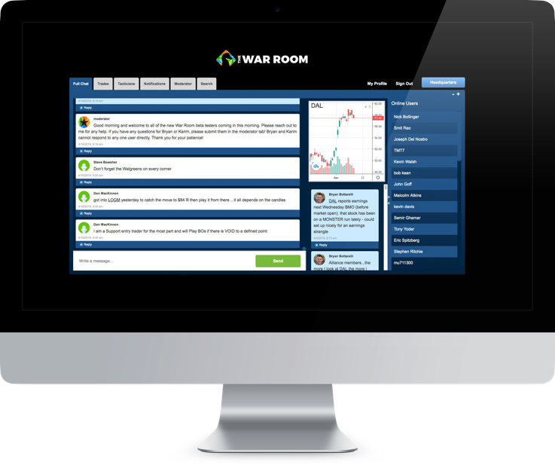
Retail Price: $7,500 / Year…
MTA Inner Circle Members:
FREE!

Slide 106

You’ll Get FREE Access To Post-Market Profits:

Slide 107
Bryan’s Dark Ticker strategy is what you NEED when the market goes DOWN!

Slide 108

What is the Dark Ticker?
It’s a unique ticker that Bryan trades that allows him to profit take advantage of down markets overnight.
When there is a down day Bryan trades the Dark Ticker between 4 and 4:15
Works with 0DTE or “Zero Days To Expiration” trades... After the market closes!

Slide 109
Post-Market Profits: Since Launch
59 Dark Ticker trade setups
over the past year
66% of the time, the Dark Ticker went up after being down during the previous close
114%
109%
92%
Overnight!
Overnight!
Overnight!
105%
88%
156%
Overnight!
Overnight!
Overnight!
Notes:
LEGAL – See comments. During the live event, we should work in an audio disclosure that states: "this is our best analysis based on the data we were able to pull at the time of the back test."

Slide 110
Inner Circle Members Can’t Stop Talking
About These Massive Gains...
“Nice 151% overnight profit on Dark Ticker. Thanks.” – Dombe
“Nice Dark Ticker trade. I jumped in a bit early but
still closed for 100% winner. ” – Trader G
“Took 110% on Dark Ticker. Thanks Bryan” – Okiedokie

Slide 111
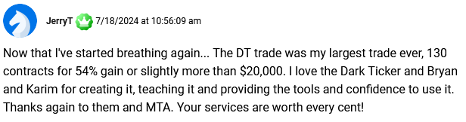
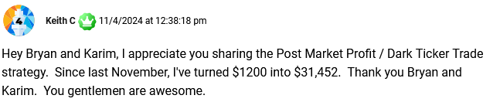
Inner Circle Members Can’t Stop Talking
About These Massive Gains...

Slide 112

How Bryan’s Post-Market Profits Works:
The markets are down big…
Everyone’s been freaking out.
You get an alert…
You make your Dark Ticker trade…
The next morning… You make up, check
the market… and cash out for as much as 100% gains.

Slide 113

Value: $5,000 / Year
Only Available To
MTA Inner Circle Members!
FREE!
Notes:
UPDATE TO DPS!

Slide 114

Retail Price: $997 / Year
There is where Bryan and Karim will give you their
#1 pick of the week, along with specific buy instructions.

Slide 115



Retail Price: $997 / Year
Nate Bear’s special livestream session
every Monday @ 12 P.M. ET
Target explosive trade setups on earnings winners
with Nate!
2 trade recommendations per week + Nate’s profit surge research!
71% Win-Rate Since August 2023

Slide 116

You’ll also receive FREE access to:

Slide 117

Version 2 of Bryan’s scanner w/ New Gift Gap Setups
Long-term and short-term W and M scans
Earnings Candidates
Power Options
Notes:
We need something to say PROFITSIGHT 2.0

Slide 118



Retail Price: $5,000 / Year
MTA Inner Circle Members:
FREE!

Slide 119


All Accessible Through Our “Command Center”

Slide 120

MTA Suite Trade Feed
Monitor all your trades in one spot!

Slide 121

One-Year Retail Value: $30,750
SUMMARY
$5,000
INNER CIRCLE ACCESS ONLY
$6,000
NEW!
$7,500
$5,000
$997
$997

Slide 122

Plus... You get every new
membership that we introduce!

Slide 123


Sector Strike ALONE is worth $40,000... Per Year!
$6,000 in each of the back-tested 38 Sector Strike peak trades between Oct 2023 and June 2025 could have turned into $990,265.
Even if someone didn’t have
perfect timing and made just
1/20th of that...
They’d be THRILLED if they only paid $40,000 per year!

Slide 124
What Inner Circle Members Are Saying:
“Go Inner Circle then methodically train yourself in each of the areas versus losing out.
You will stop worrying about not getting all opportunities and focus on training yourself
Nate makes it way to easy to win, learn and build teamwork in the Inner Circle community.”
– Quinton
“The Inner Circle is the best value for your money if you are going to purchase multiple MTA products. And once you purchase one of NATE Bear's products, you will DEFINITELY want to join all of his services.” – Sandra
“The best value for your money is to join the Inner Circle so you get the best of all services to include the updates that will be sure to come in the future. Always something new and exciting coming from MTA.” - Bettie

Slide 125
But we’re going to give you a deal of a LIFETIME today...

Slide 126



MUST ACT BEFORE MIDNIGHT
LIFETIME ACCESS
Notes:
Change price to 6,199. We will need an alternate for 6,499

Slide 127

🚨 Double Savings Until Midnight! 🚨
To celebrate the launch of Nate’s Sector Strike and to say thank you for being a Monument Traders Alliance member... we’re offering a lifetime deal to join MTA Inner Circle...Which gives you EVERYTHING we do... And all future NEW services in the works.
To credit everyone who has purchased a service from us, we’re making it simple by lowering the $30,750 per year price to a one-time fee of $7,997.
UNTIL MIDNIGHT: you can save TWICE! Take an additional $500 off today with the double savings discount code “STRIKE500”
FOR LIFE!
Notes:
UPDATE STICKER TO 6,199

Slide 128
One Sector Strike Trade Could Cover the Entire Cost of Membership
$6,000 in one Sector Strike trade could turn into as much as $15,900! (average peak)
Plus… a $6,000 investment in each of the 65 peak Sector Strike trades from the Oct 2023- June 2025 back test could have turned into as much as $990,265 in one year!
Now this is based off peaks, but that’s about 123 times the cost to join!
And that’s just from one strategy from one service... you get them all when you are in the MTA Inner Circle!

Slide 129
90-Day Guarantee
Give everything a genuine chance for the next
90 days…
Experience each service… check out each live chat
room… Review the Sector Strike Plan report…
And check out our training videos (they’re extremely helpful!).
If after, 90 days you still feel it’s not right for you…
give you a call. We’ll refund the price of membership
(minus a 10% service fee).

Slide 130

New Benefit: Learn How To Lower Your Tax
Burden From Trading!
Introducing Our Partnership With
Learn how you could potentially write off your Inner Circle Membership from your taxes!
FREE: 45-minute strategy session around trading LLCs, tax savings and business credit! ($595 Value)
FREE: Lifetime of support from a Corporate Advisor ($595 value)
FREE: List of 250+ Tax Deductions
Entity creation @ hard costs + fees (Estimate Cost: $400-$800 depending on State)
FREE: BONUS REPORT: How To Protect Your Trading Profits: ($299 Value)
Available To Inner Circle Members!

Slide 131

Legacy Benefit
This is a benefit gives you the ability to pass on to a spouse, child or grandchild…
They get FREE access because of your decision today.

Slide 132

The Ball Is In Your Court...
We’ve shown you the data. The Sector Strike could have produced an 85% success rate with an average peak gain of 165%
$6,000 in each of the 65 trades from the Oct 2023 and June 2025 backtest could have turned into as much as $990,265
By taking advantage of this double-savings deal before midnight... You’re SAVING at least $53,504 after your second year... $144,257 after year 5... And $295,510 after 10 years!!

Slide 133
DOUBLE SAVINGS UNTIL MIDNIGHT!!! USE DISCOUNT CODE: STRIKE500
LIFETIME-ACCESS
Normally $30,750 $7,997 Event Discount $7,497 TODAY ONLY! +$499 annual maintenance fee
Backed By 90-Day Credit Guarantee
Take an additional $500 off TODAY ONLY with discount code “STRIKE500”
*EXCLUSIVE* Access To New Sector Strike service
Every Current + Future Monument Traders Alliance service... For LIFE
Click the button below or call 888.215.5311 or
410.864.3083 to order by phone or ask questions!

Slide 134
AUGUST Sector Strike Plan:
SIX Sector Strike Targets!
XLP
Top 5 Tickers:
Cost
PG
WMT
KO
PEP
XLV
Top 5 Tickers:
LLY
UNH
JNJ
ABBV
MRK
XLK
Top 5 Tickers:
AAPL
NVDA
MSFT
AVGO
CRM
XLB
Top 5 Tickers:
LIN
SHW
APD
FCX
ECL
XLRE
Top 5 Tickers:
PLD
AMT
EQIX
WELL
DLR
XLU
Top 5 Tickers:
NEE
SO
DUK
CEG
SRE
Join us LIVE @ 12 P.M. tomorrow for the first trades!

Slide 135
DOUBLE SAVINGS UNTIL MIDNIGHT!!! USE DISCOUNT CODE: STRIKE500
LIFETIME-ACCESS
Normally $30,750 $7,997 Event Discount $7,497 TODAY ONLY! +$499 annual maintenance fee
Backed By 90-Day Credit Guarantee
Take an additional $500 off TODAY ONLY with discount code “STRIKE500”
*EXCLUSIVE* Access To New Sector Strike service
Every Current + Future Monument Traders Alliance service... For LIFE
Click the button below or call 888.215.5311 or
410.864.3083 to order by phone or ask questions!

