Slide 1


Slide 2
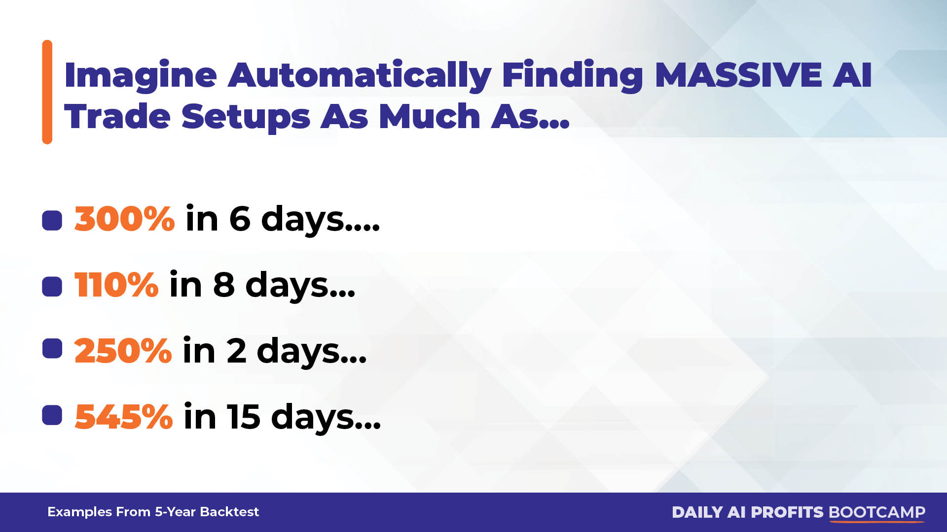

Slide 3
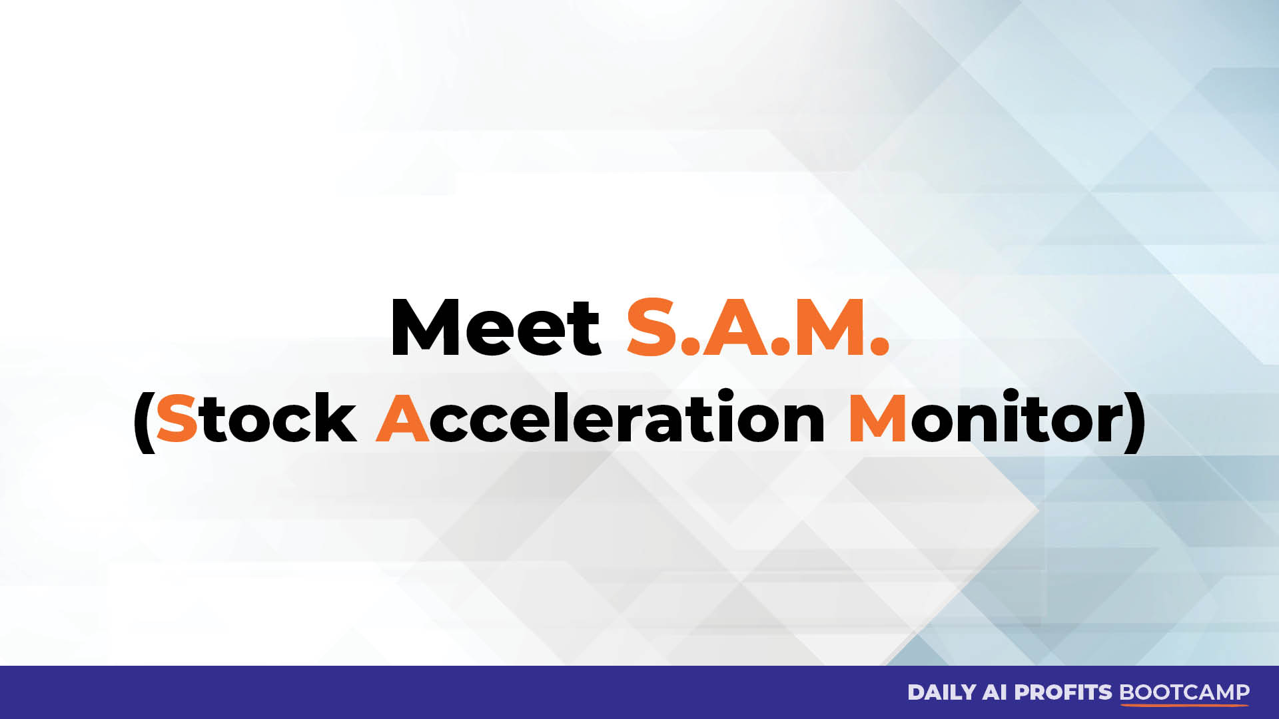

Slide 4


Slide 5
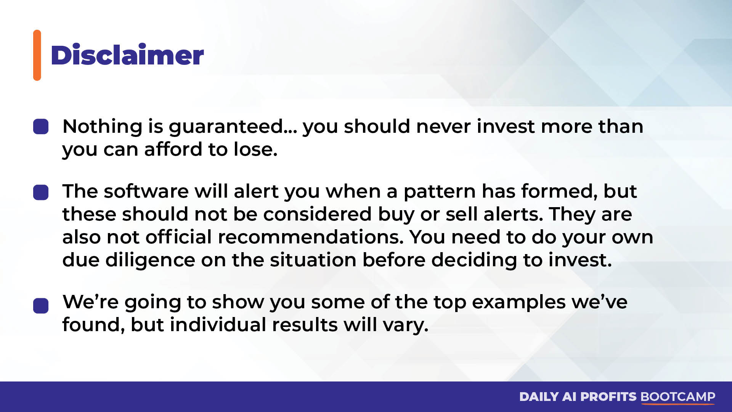

Slide 6
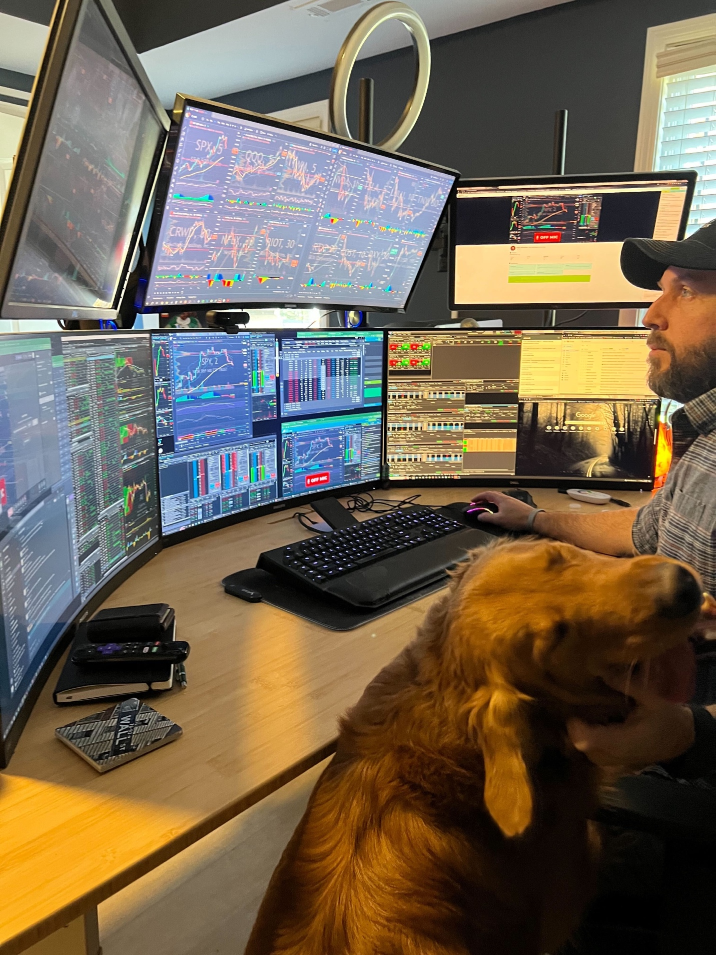
Nate’s Millionaire Journey
Former Construction Worker To Pro Trader
Turned $37k into $2.7 Million (7,127% Total Return) in 4 years!
Has trained his winning strategies to tens of thousands of traders
2024 Profit Surge Trader Track Record
  100% Win-Rate (21-for-21)
  122% Total Return (17x Better than S&P 500)

Slide 7
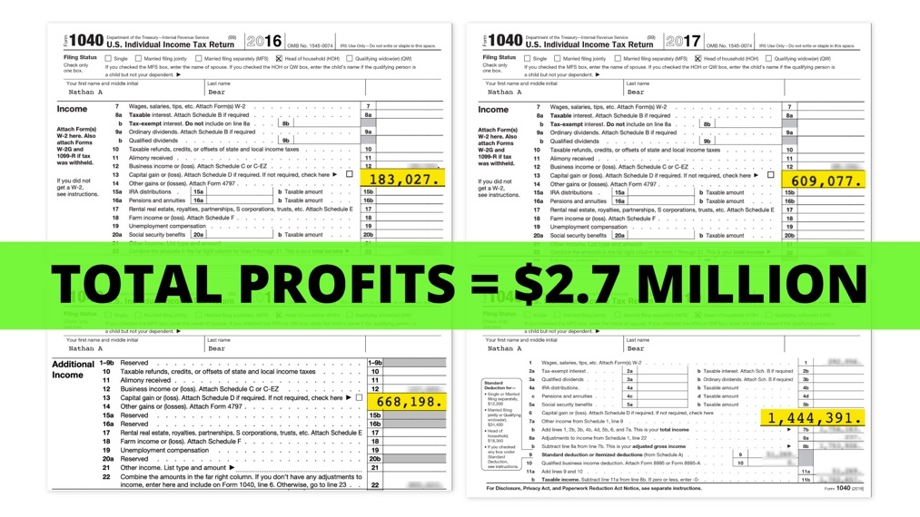
It’s All Thanks To A Powerful
Market Event Called “The Squeeze”

Slide 8
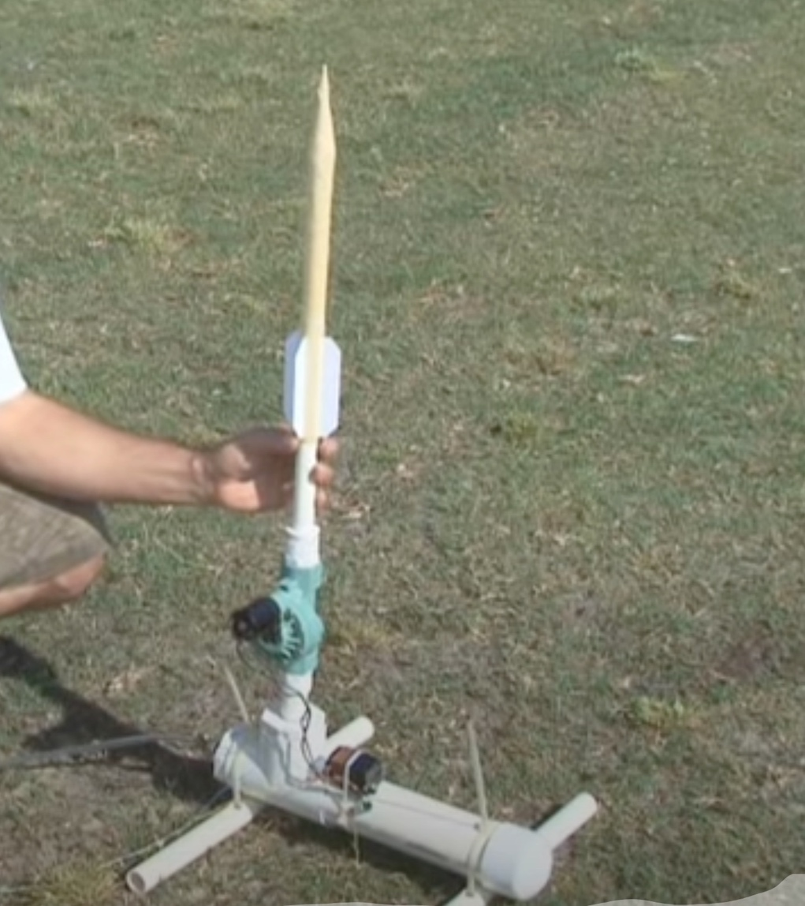
What Is The Squeeze?
Developed by John Carter 20 years ago. He famously made $18.2 Million in 2020 alone!
It’s an indicator that measures whether a stock’s price is compressed and poised to break out.
Think of a compressed air rocket... When enough pressure builds... eventually the stock’s price will explode upwards.
Traditionally these trade setups are found by manually searching for a series of colored dots underneath a chart across multiple time frames.
10 timeframes = 10 charts to look at for 1 stock! 😫

Slide 9
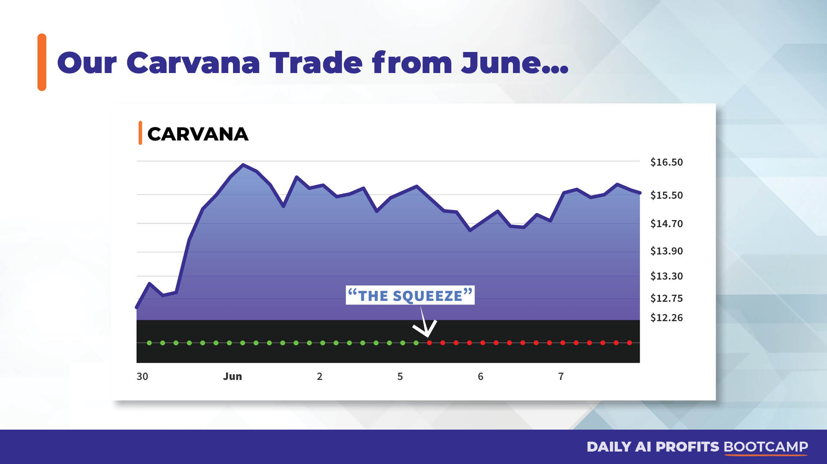

Slide 10
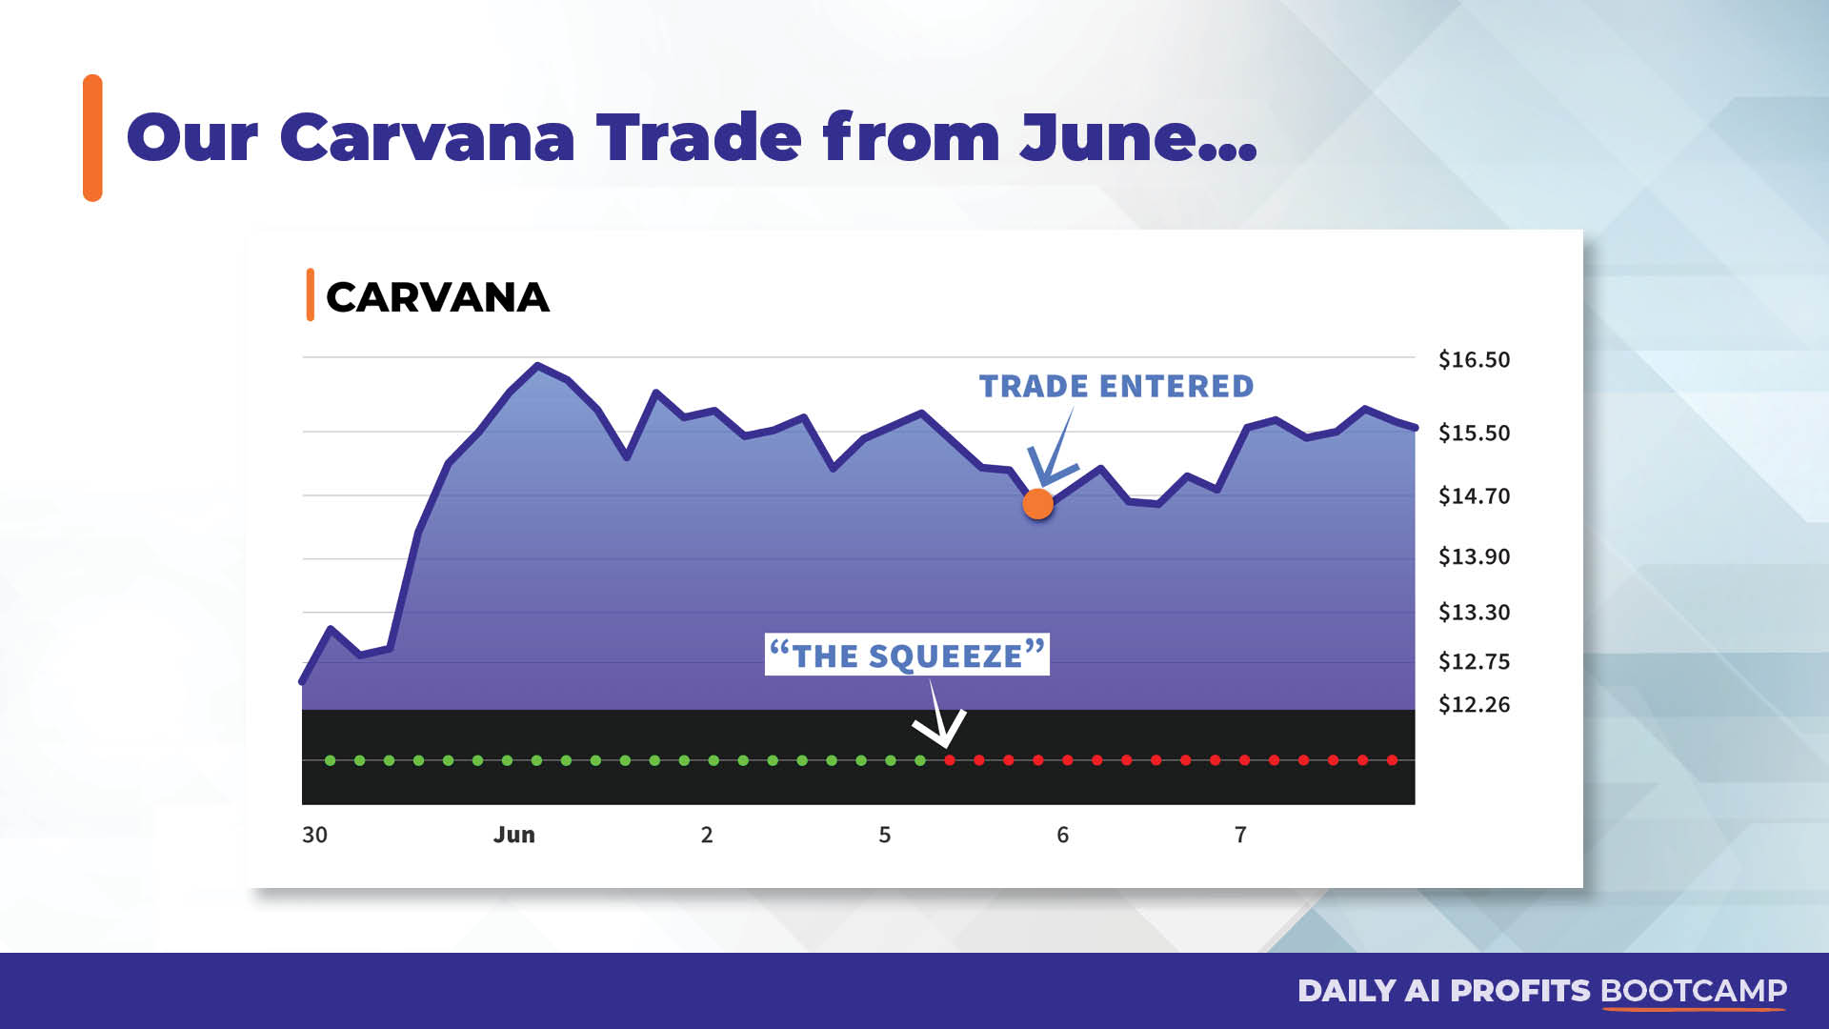

Slide 11
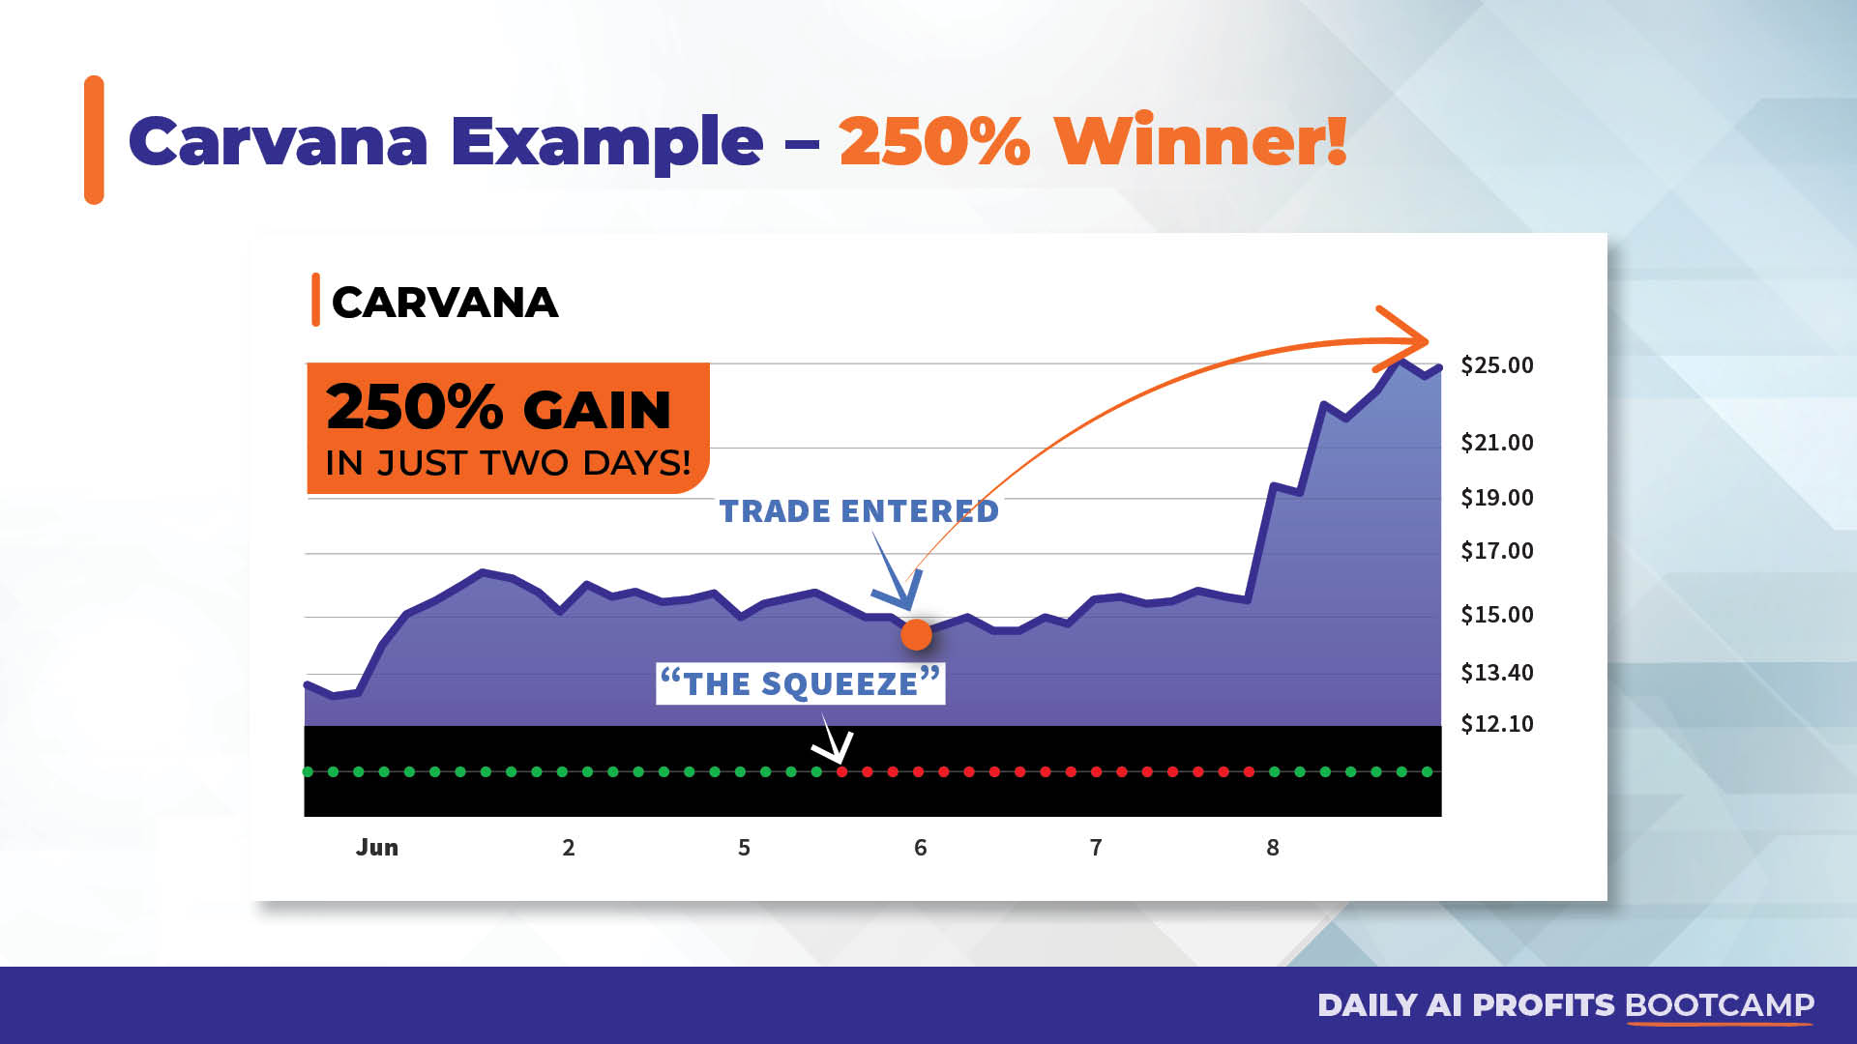

Slide 12
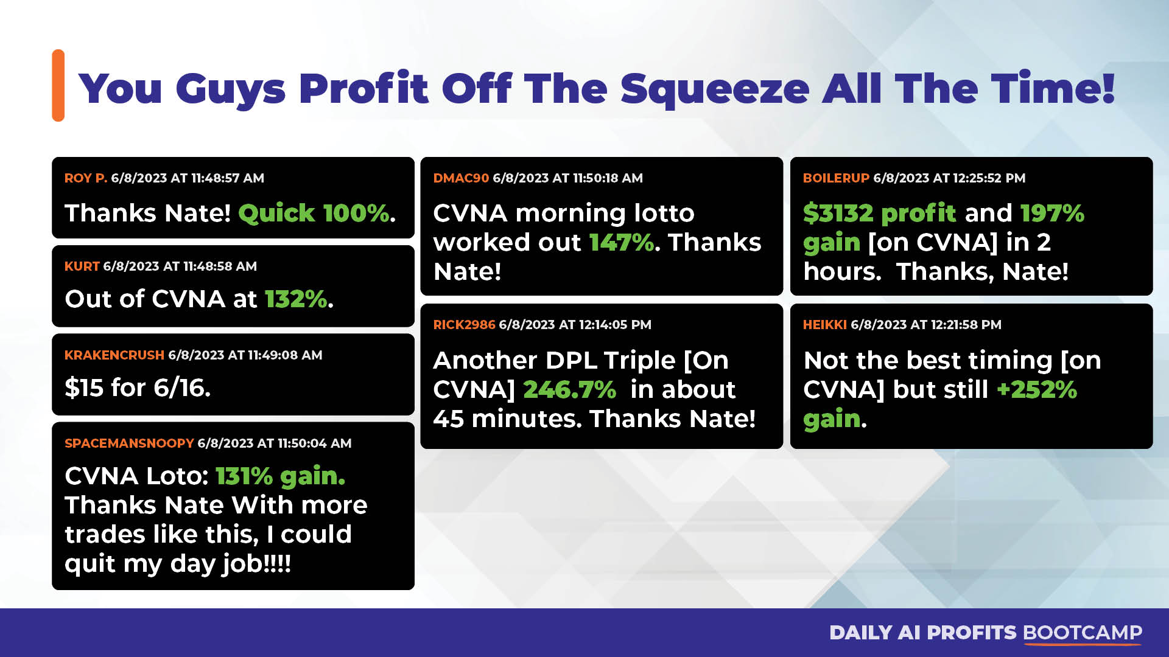

Slide 13
Coming Up Stay Tuned For REAL-TIME Squeeze Examples & LIVE Q&A Shortly!
We’ve Used The Squeeze To Find
Massive Gains Over The Past Year
295% on the QQQ overnight
169% on MSFT within hours
261% on META within hours
178% on NVDA overnight
105% on AVGO in 3 days
112% on COST in 2 days
86% on GOOGL in 6 days
500% on RILY within hours
169% on MSFT within hours
217% on NFLX in 1 day

Slide 14


Slide 15
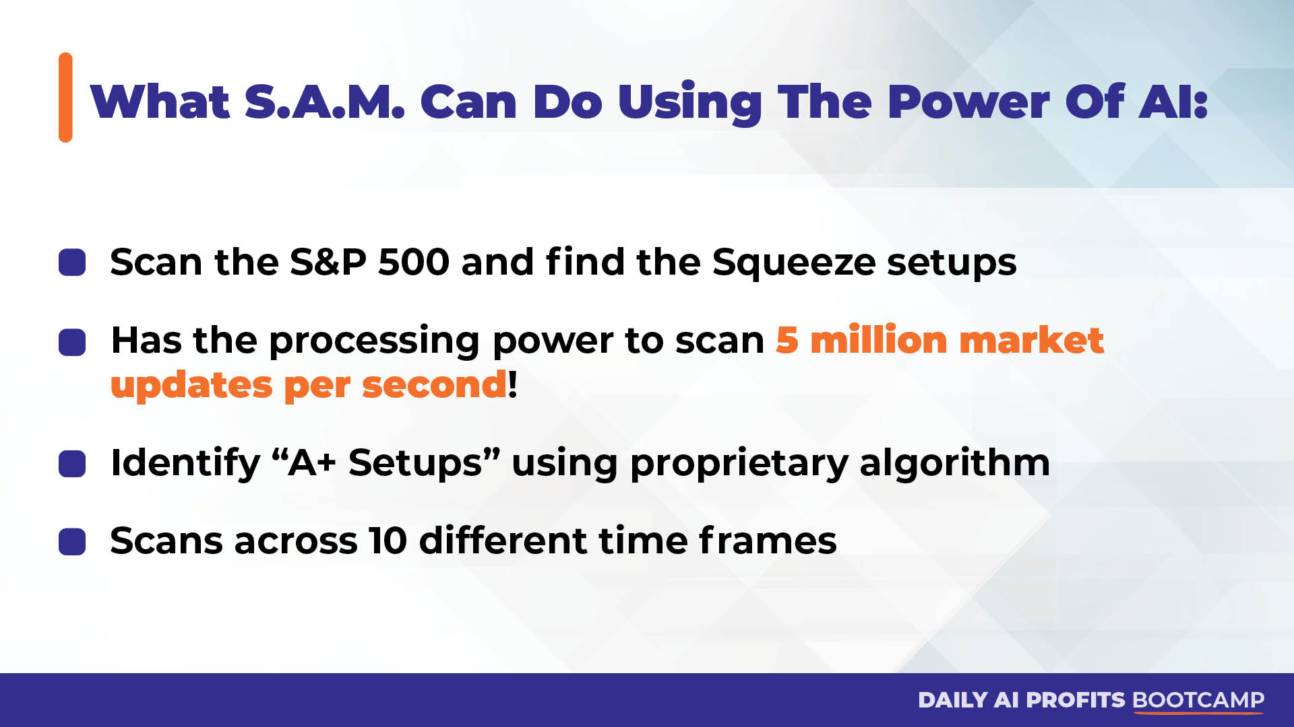

Slide 16
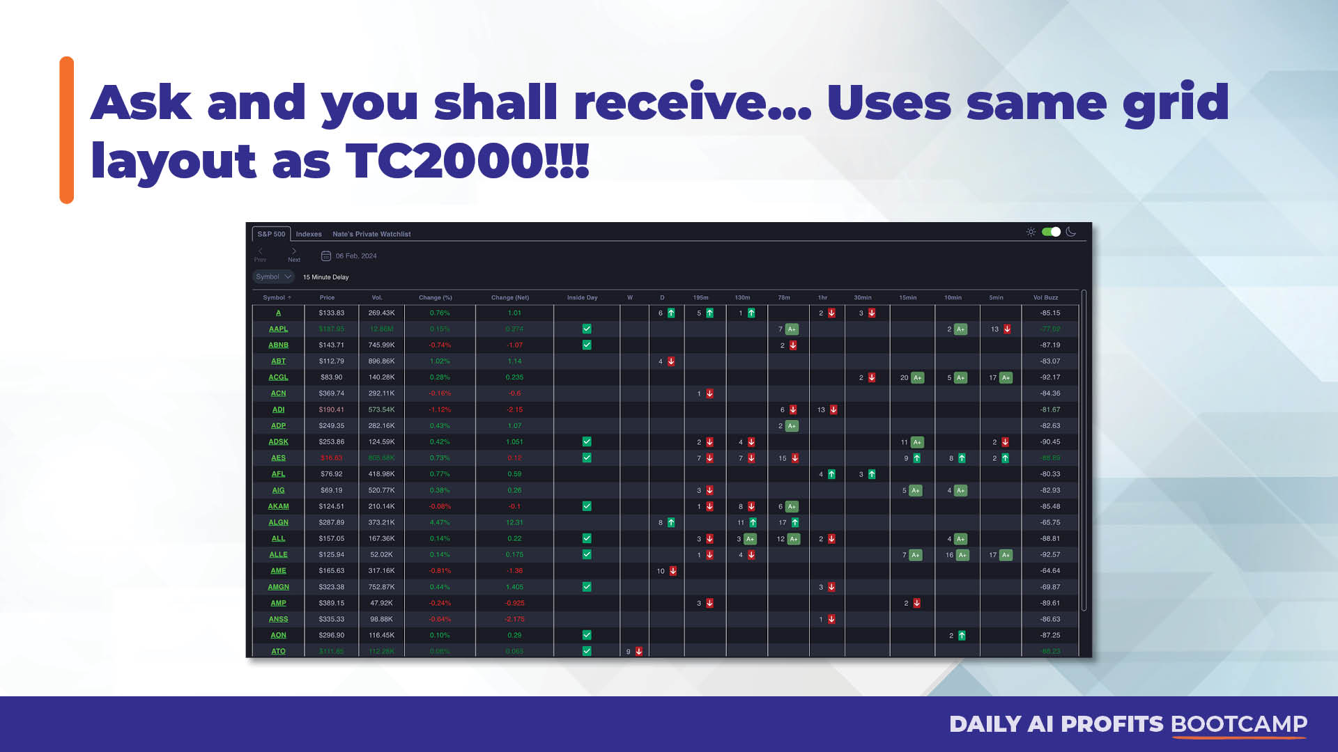

Slide 17
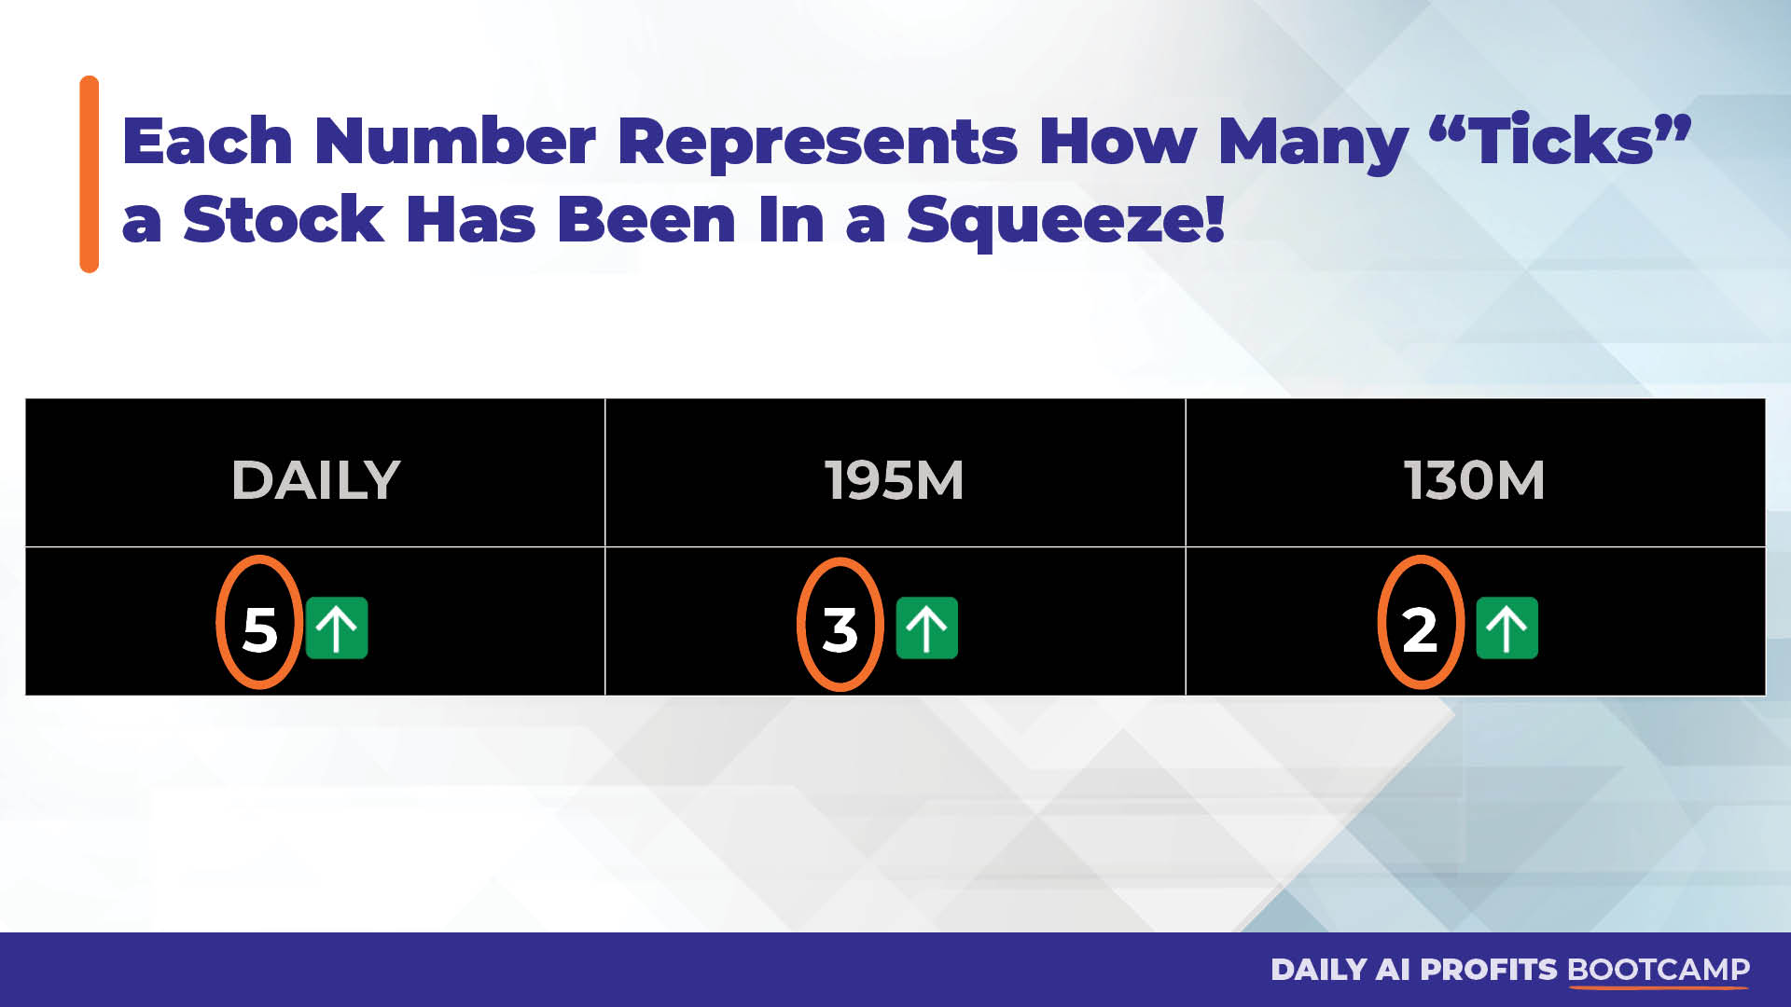

Slide 18
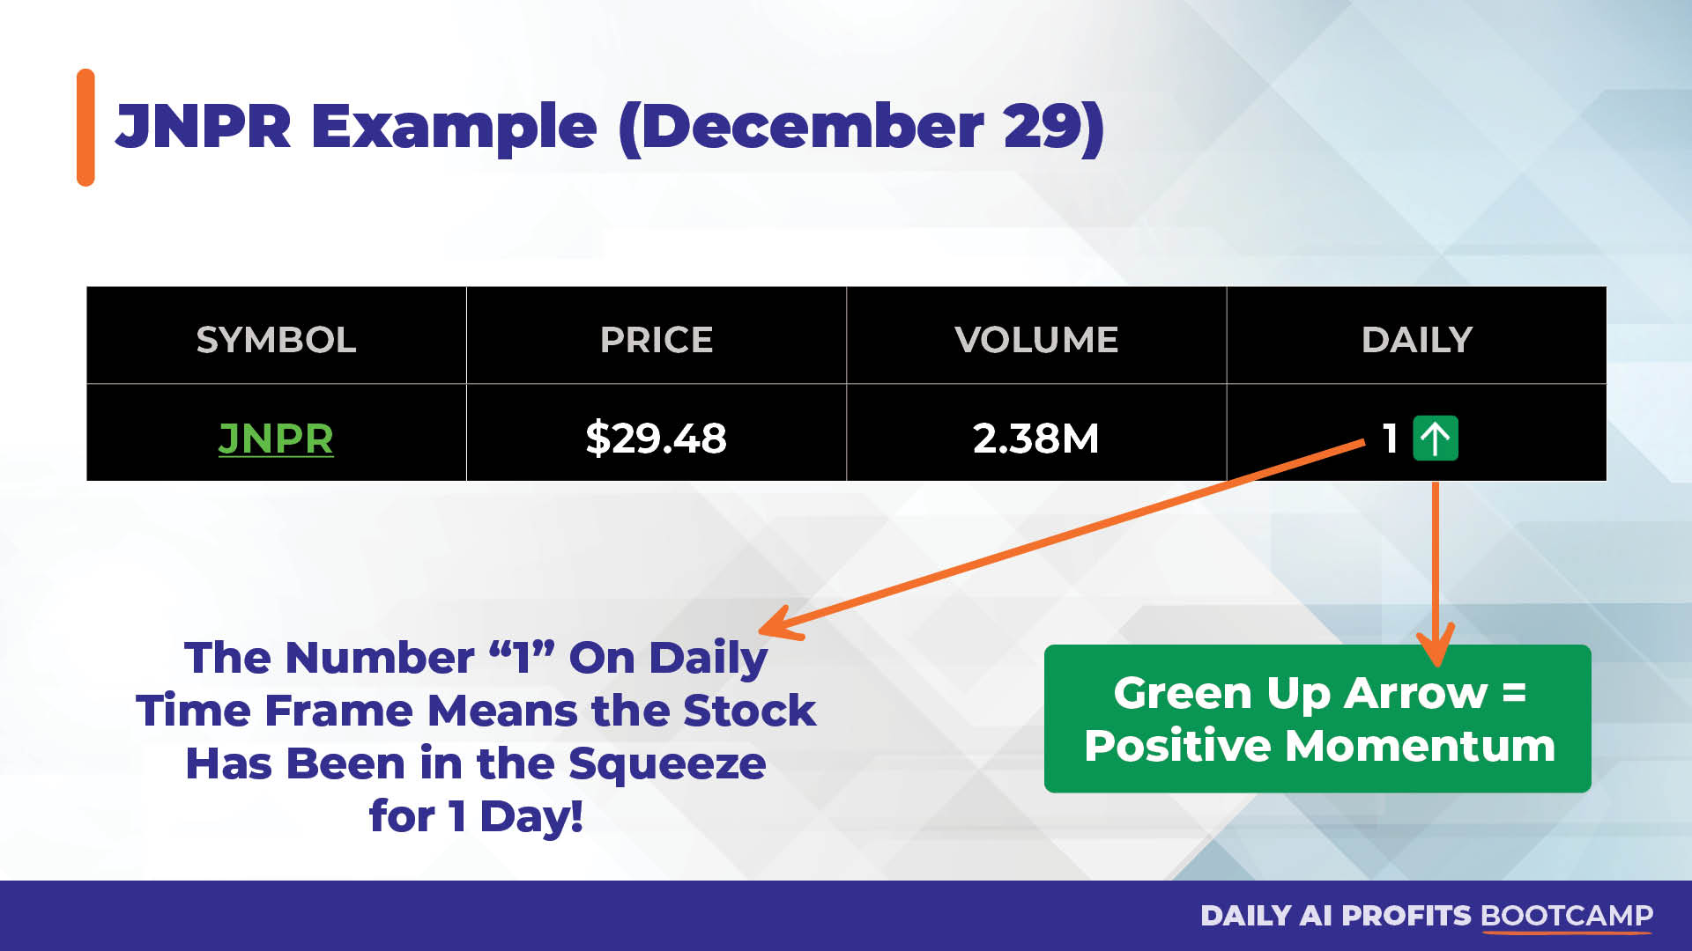

Slide 19
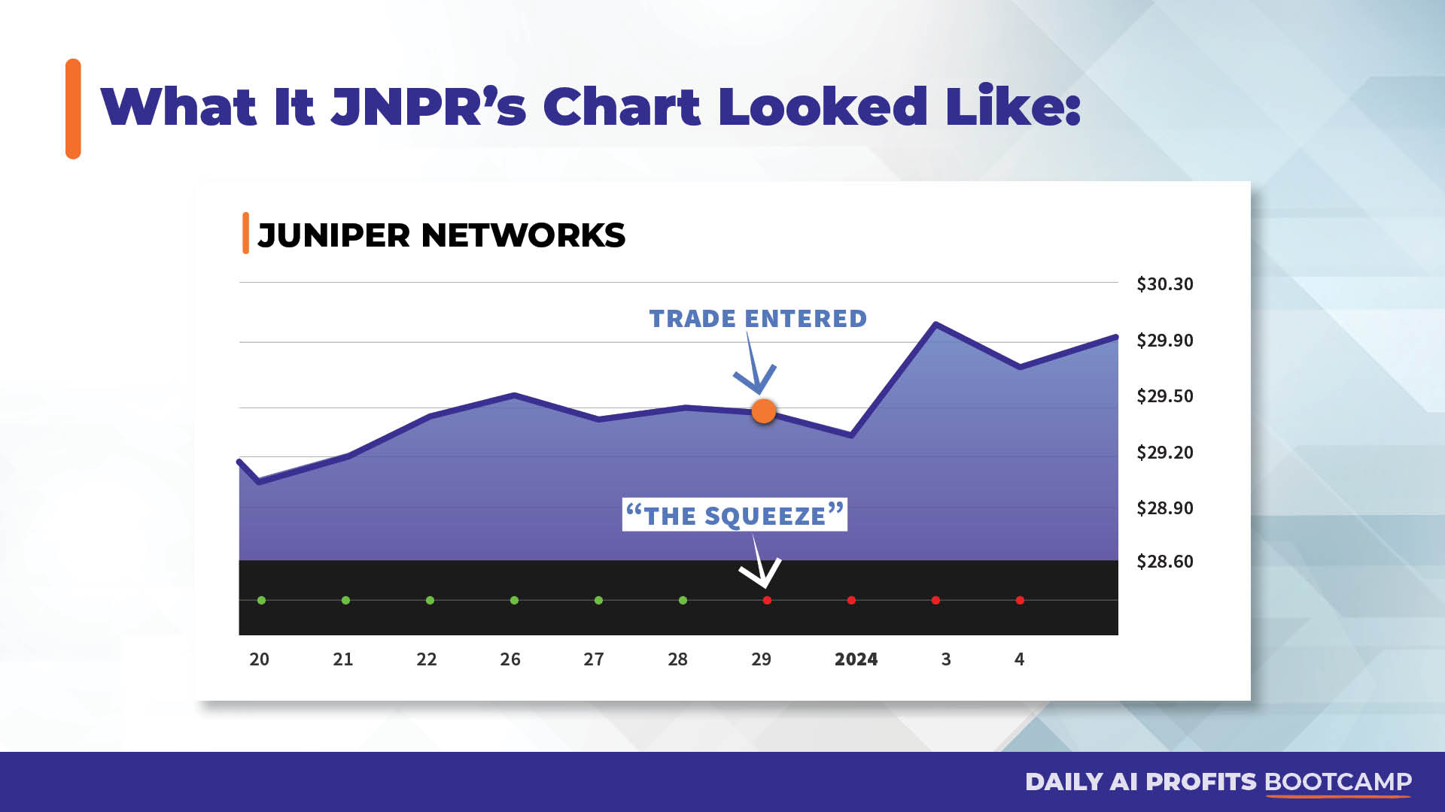

Slide 20
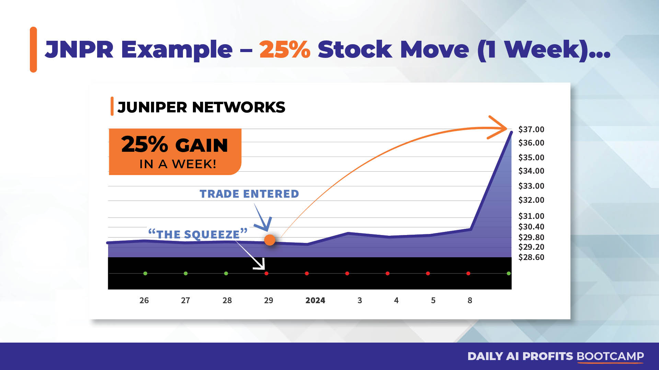

Slide 21
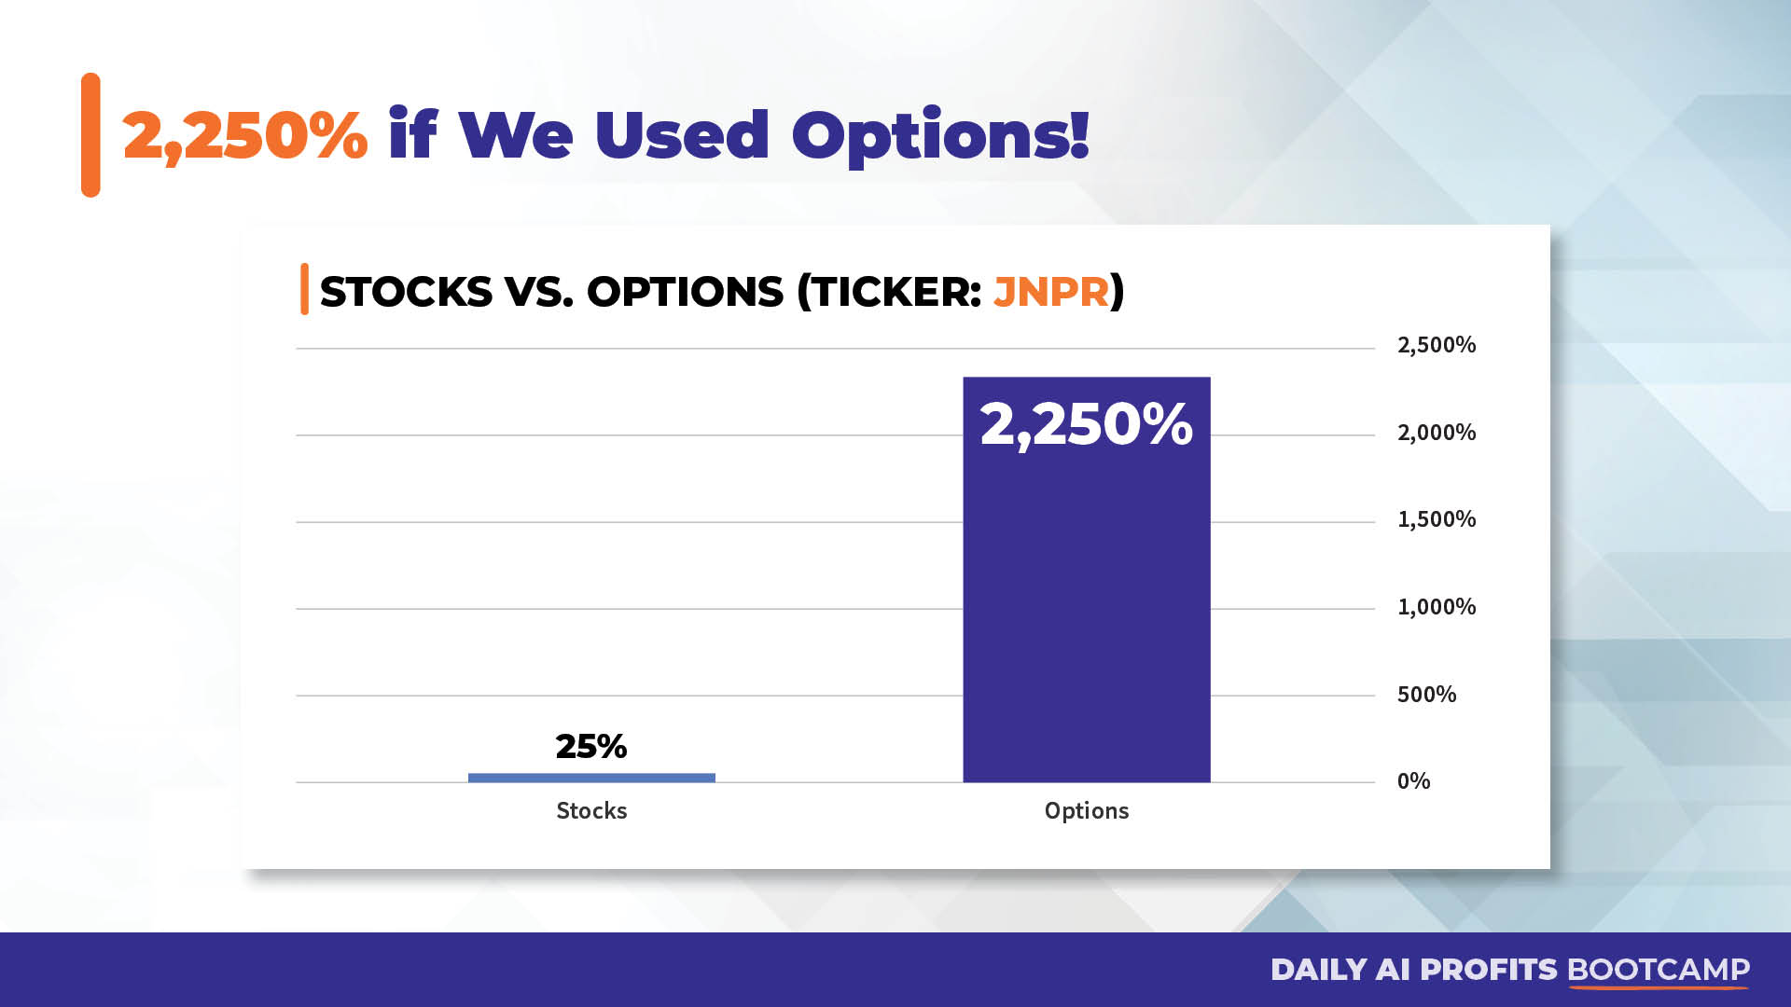

Slide 22


Slide 23
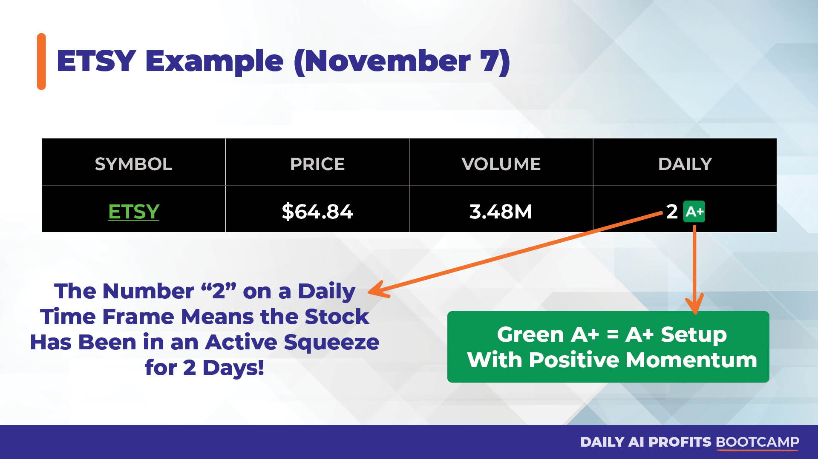

Slide 24
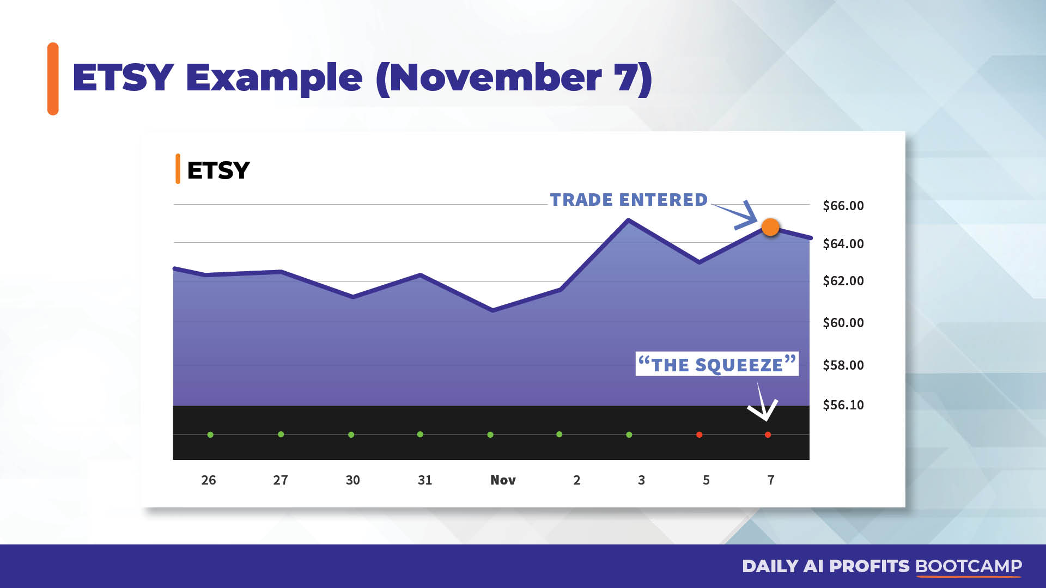

Slide 25
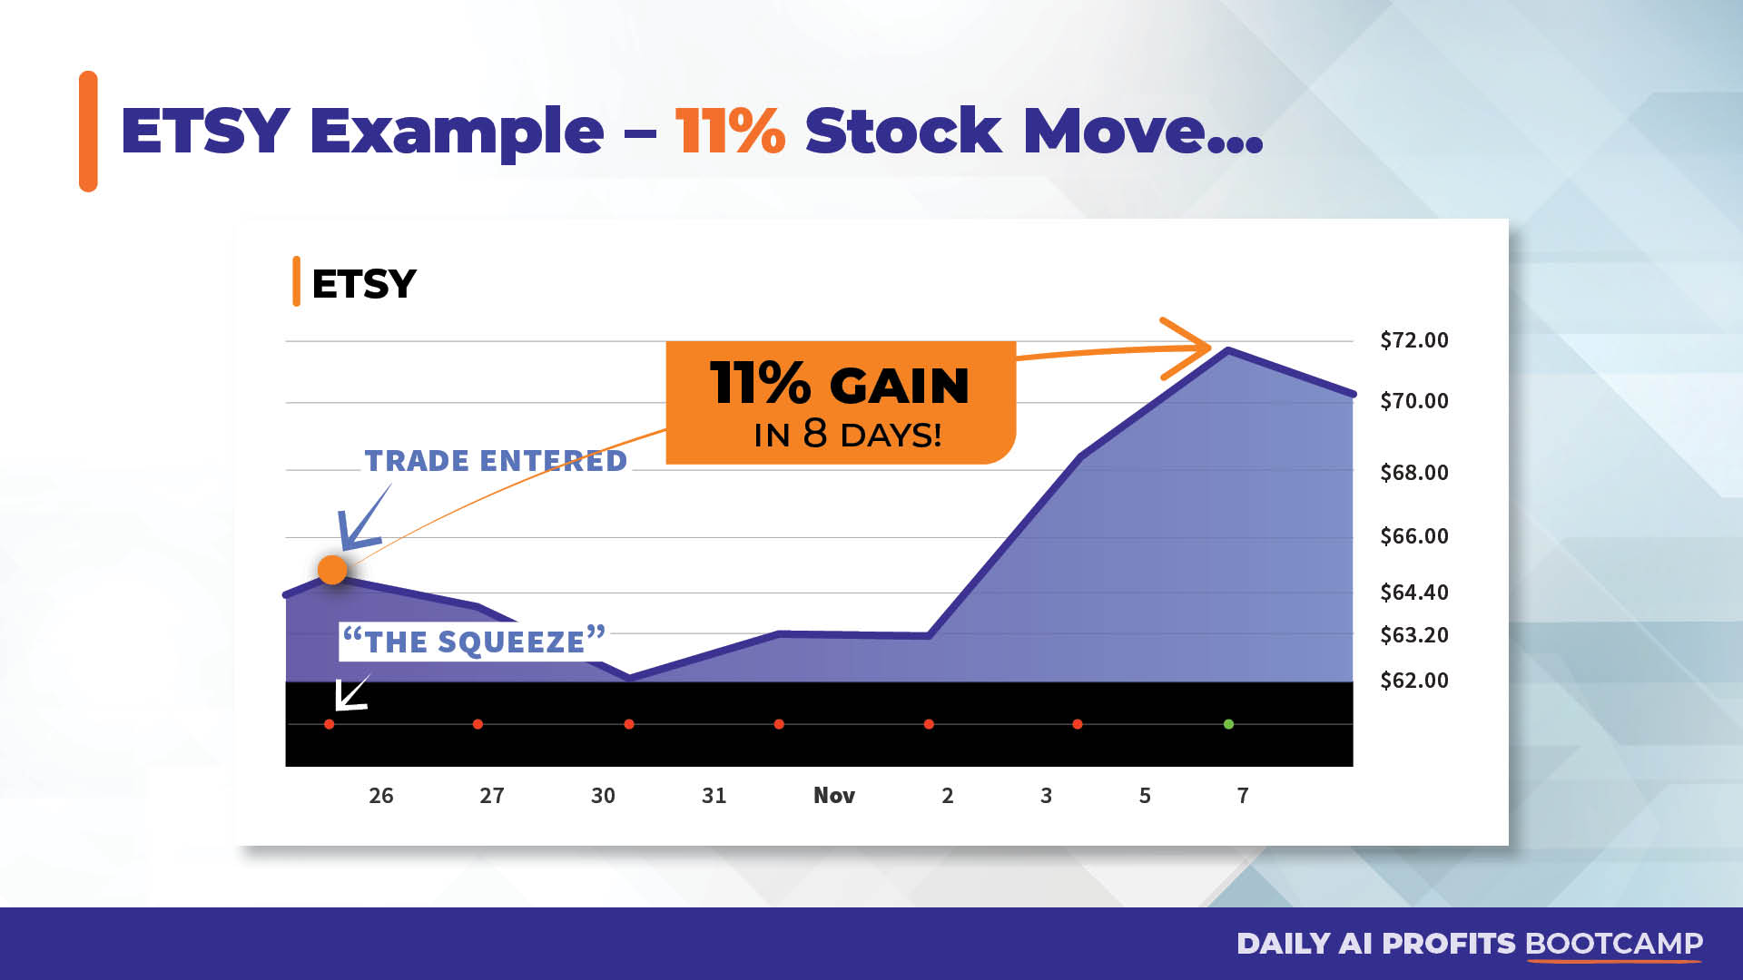

Slide 26
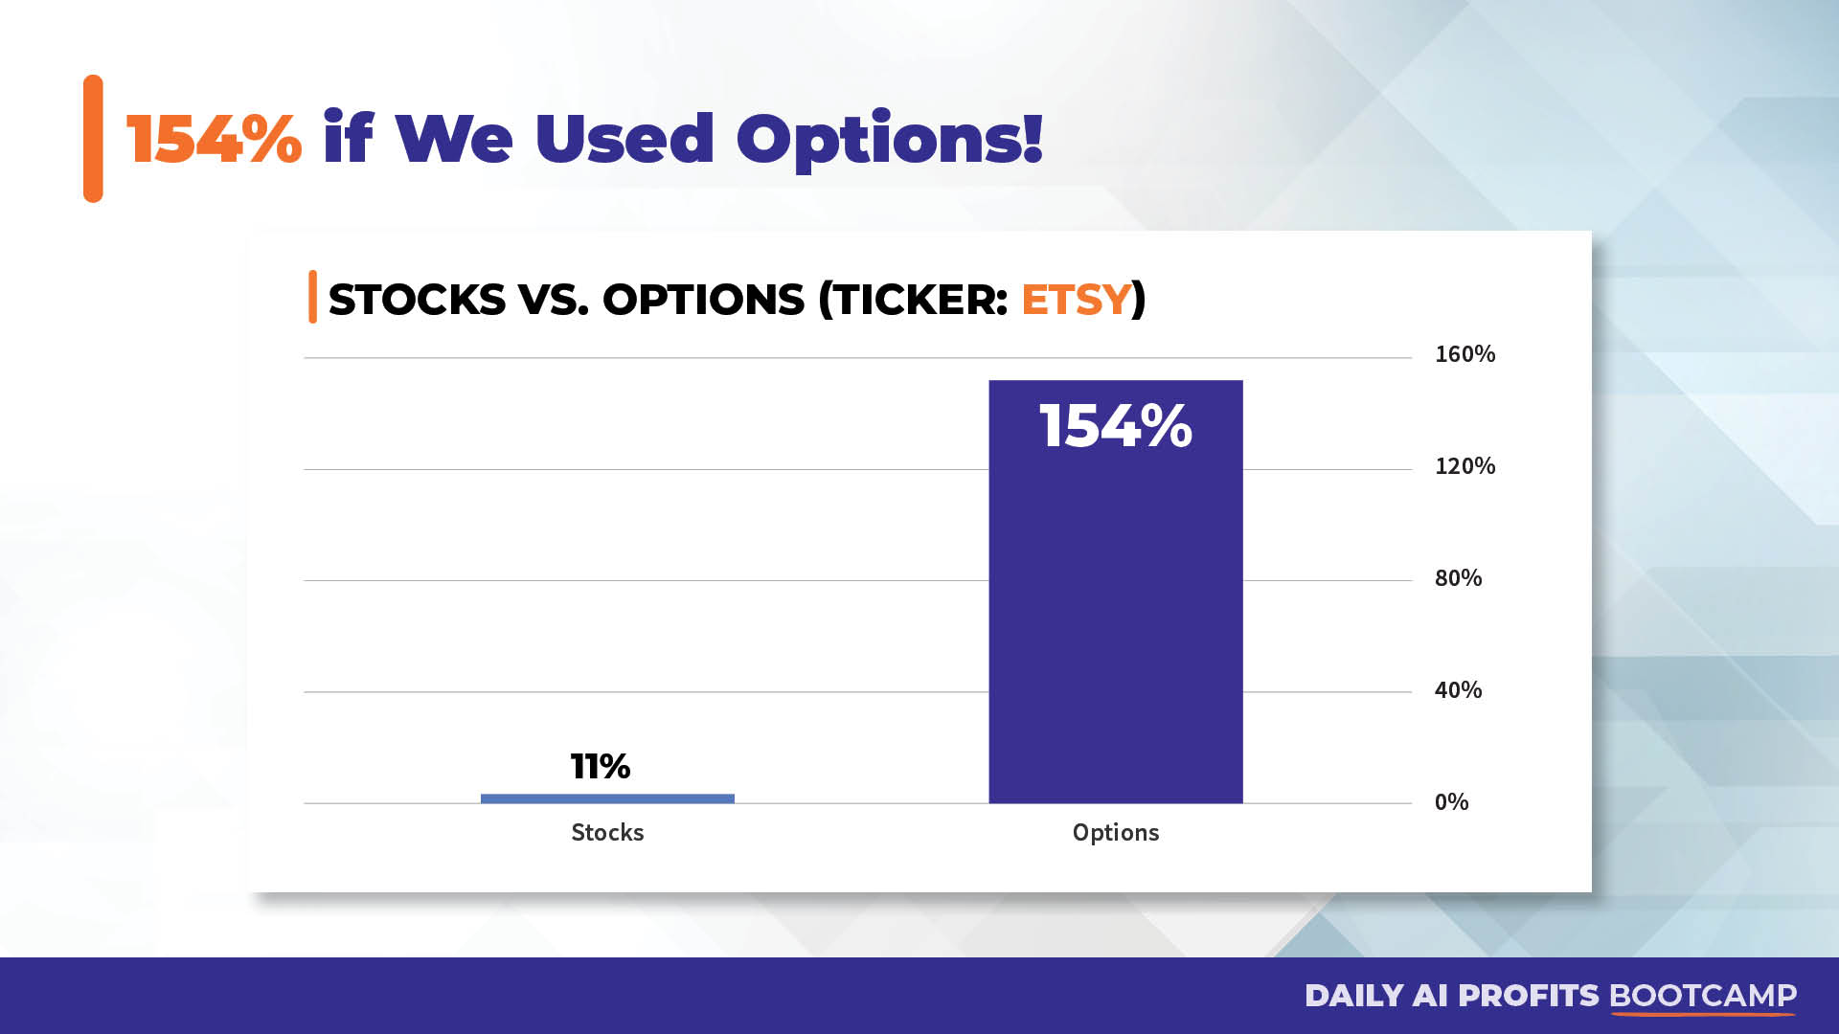

Slide 27
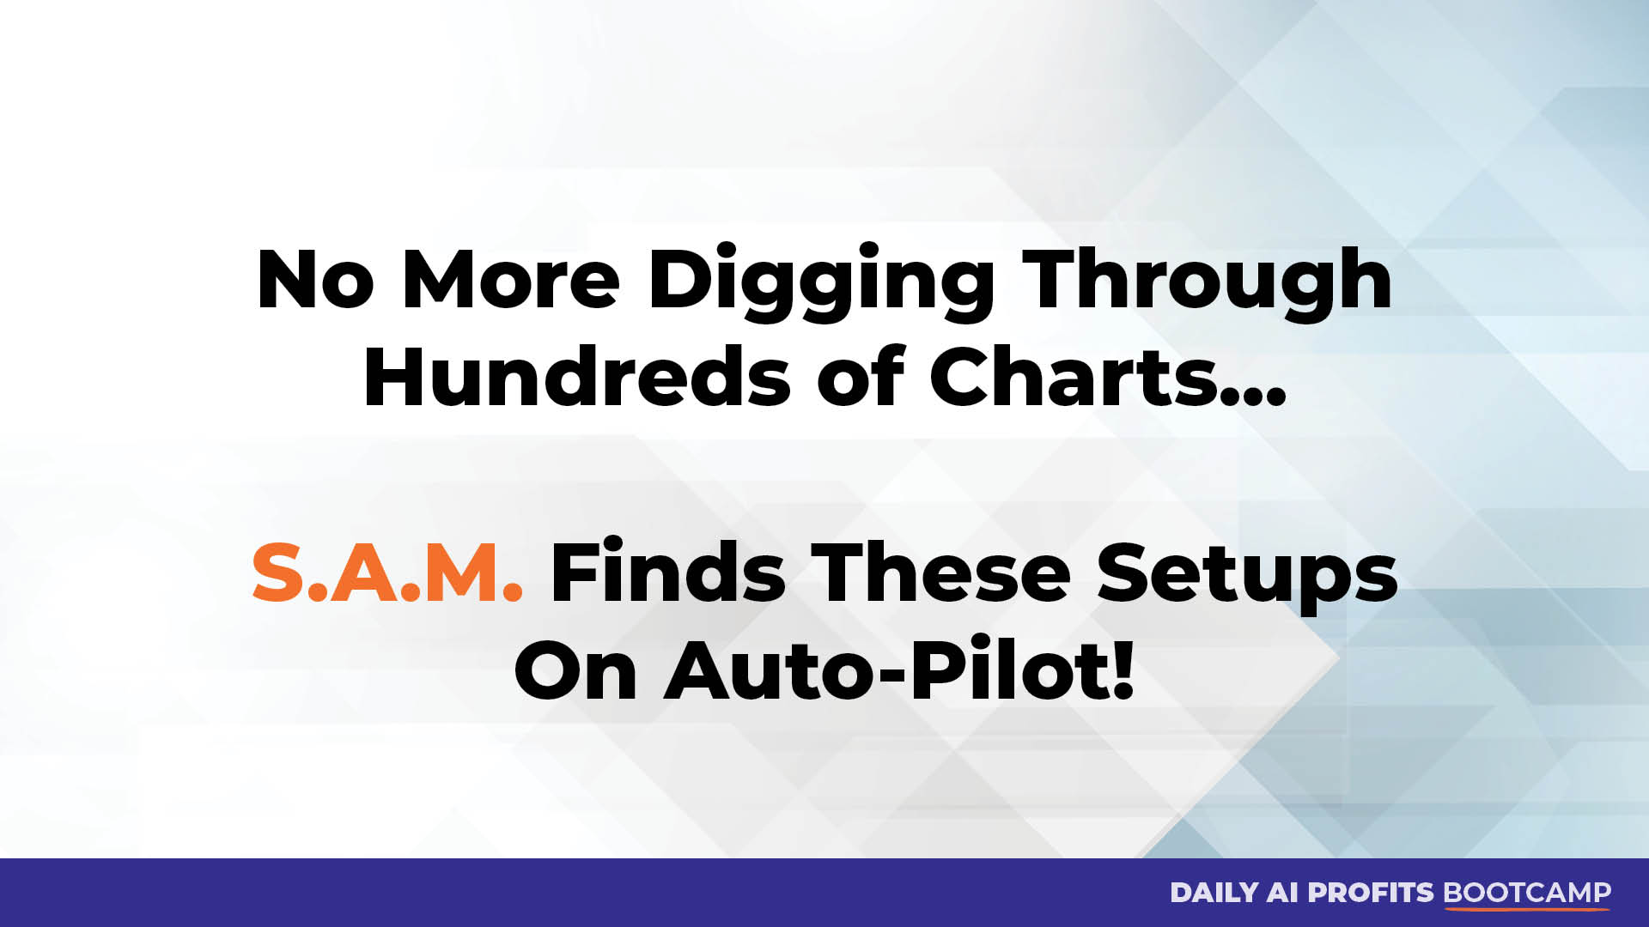

Slide 28
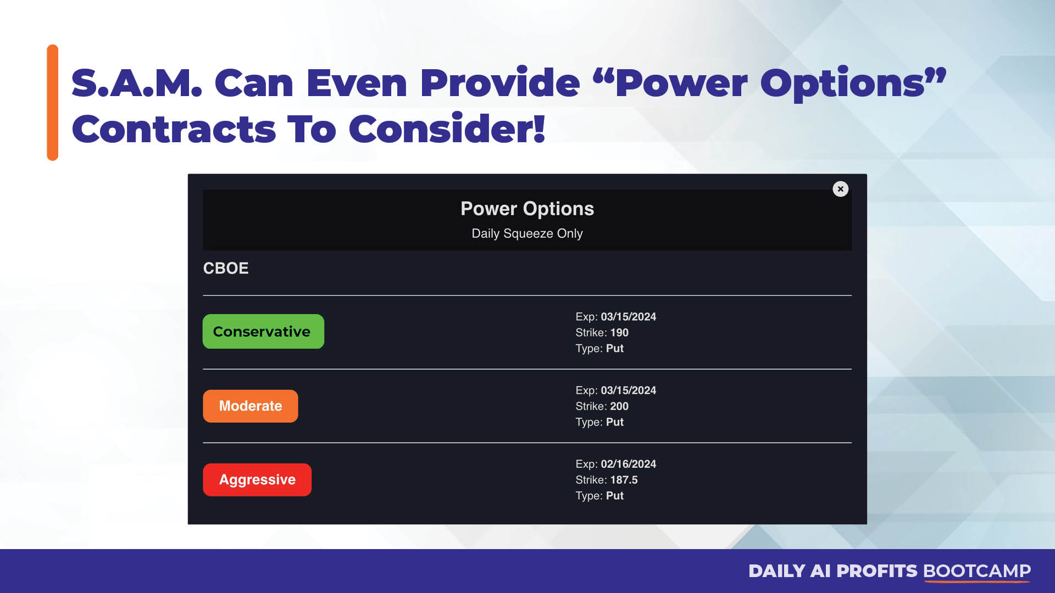

Slide 29
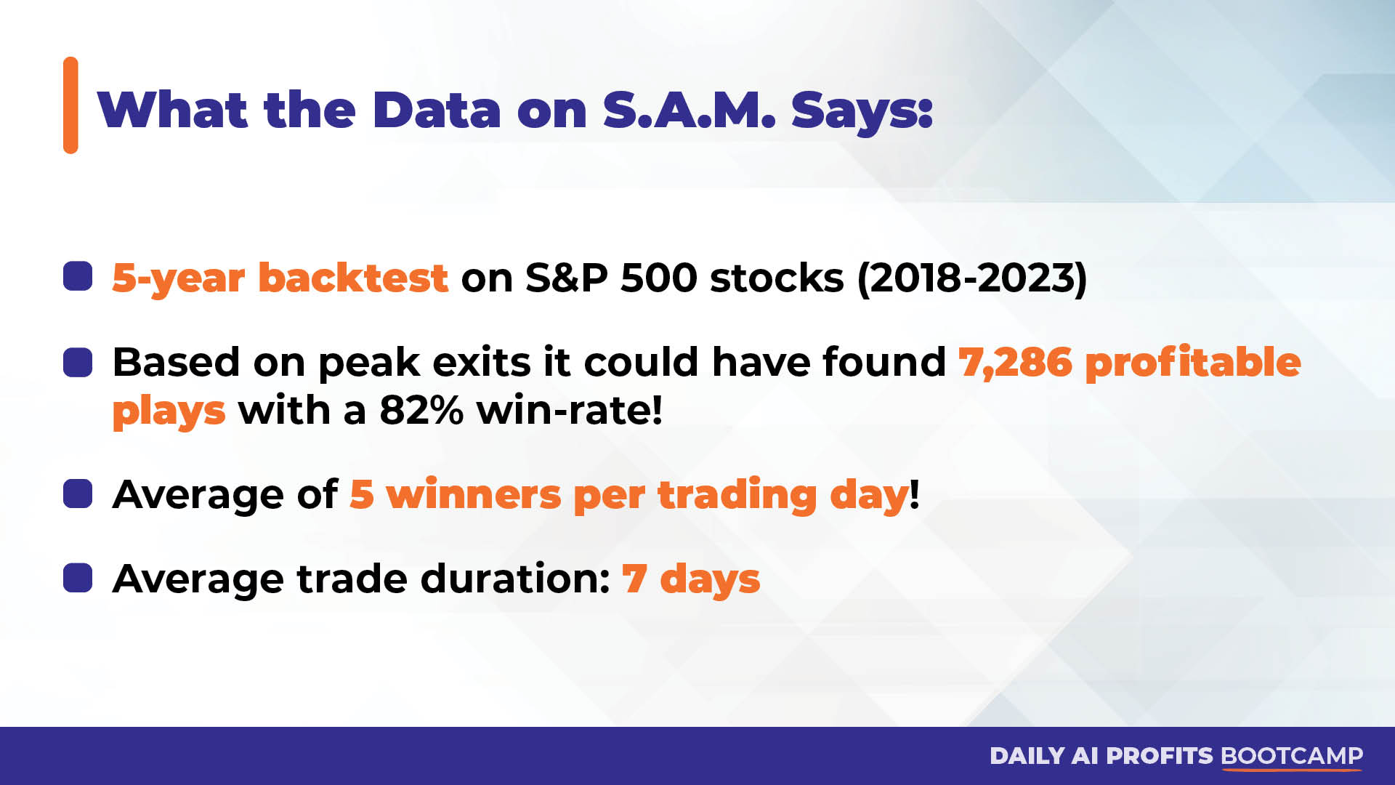

Slide 30
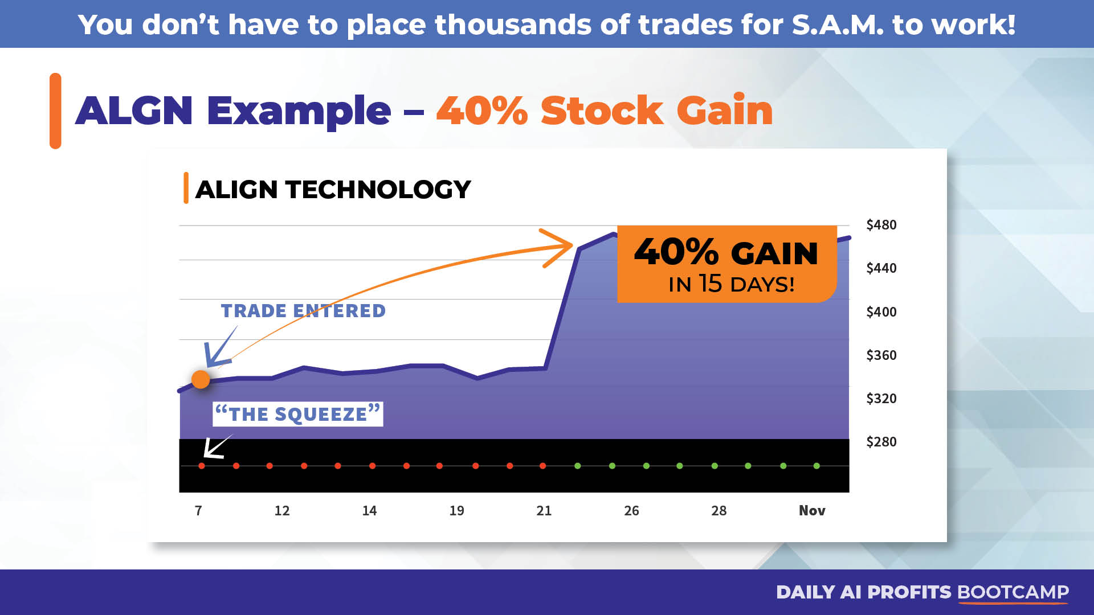

Slide 31
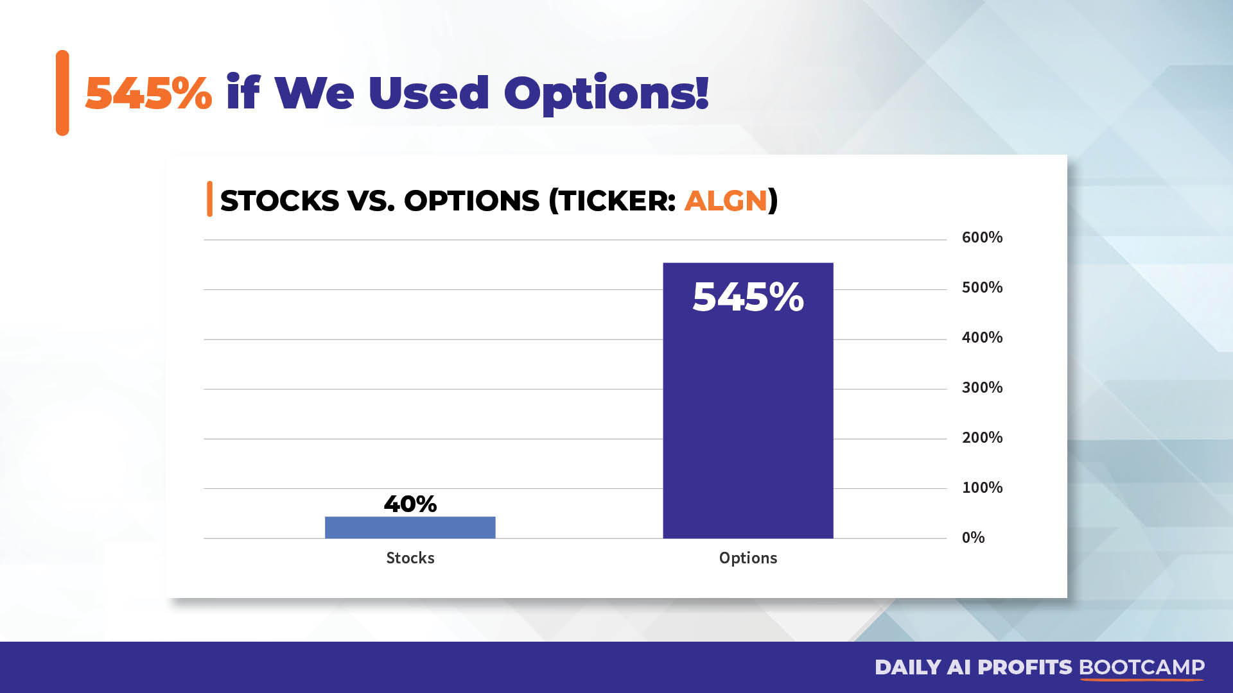

Slide 32
Results So Good...
Ryan Had To Put S.A.M. To The Test
With Own REAL Money Last Week:

Slide 33
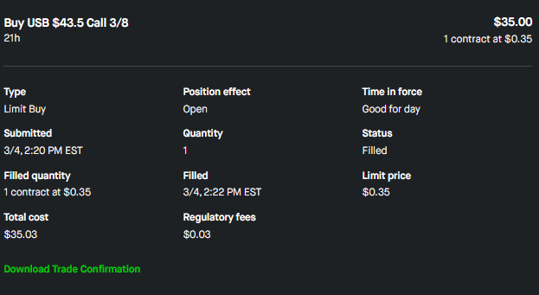
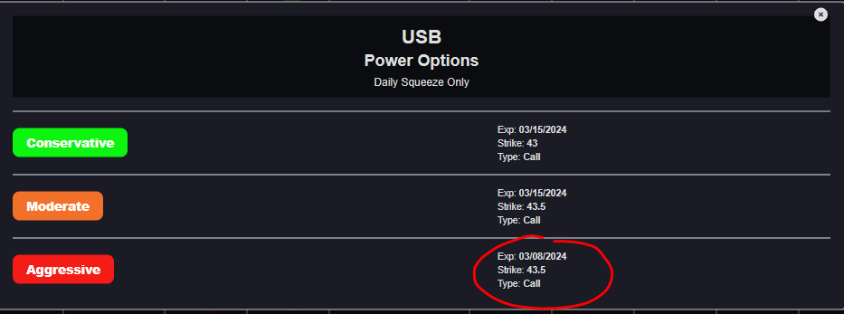
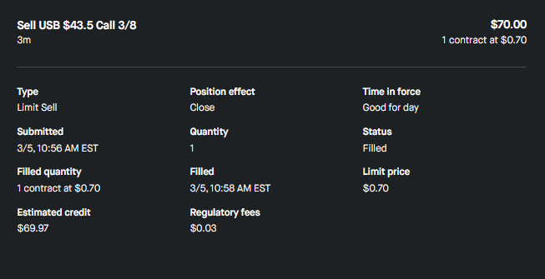
100% Overnight Winner On US Bank

Slide 34
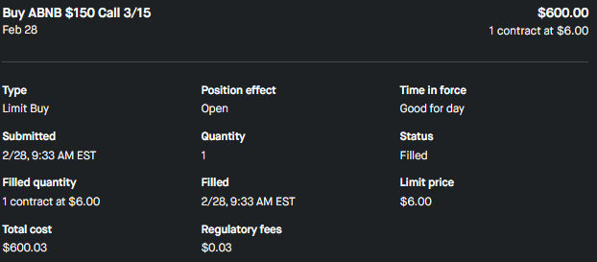
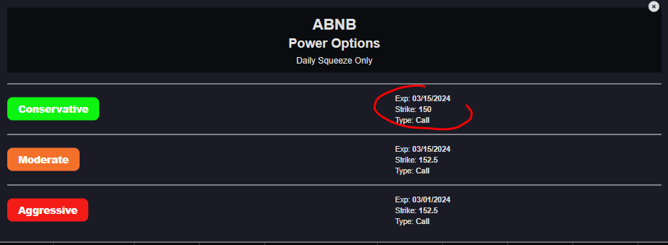
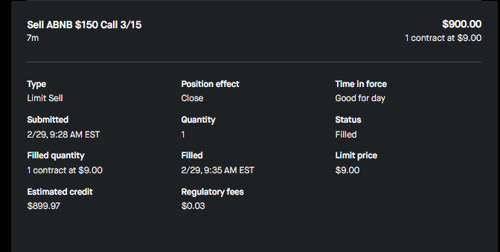
50% Overnight Winner On AirBNB

Slide 35
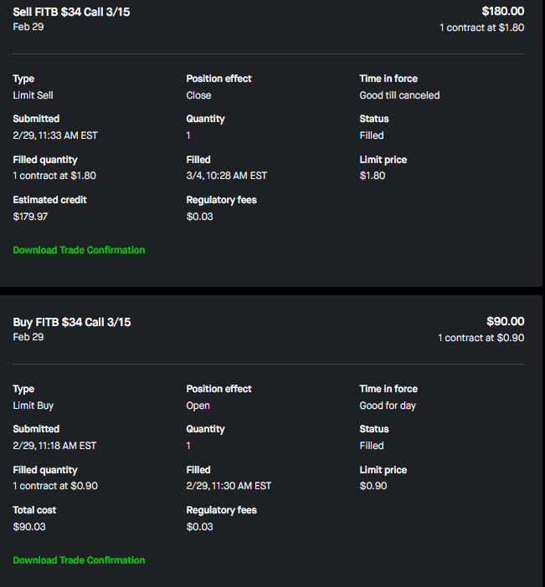
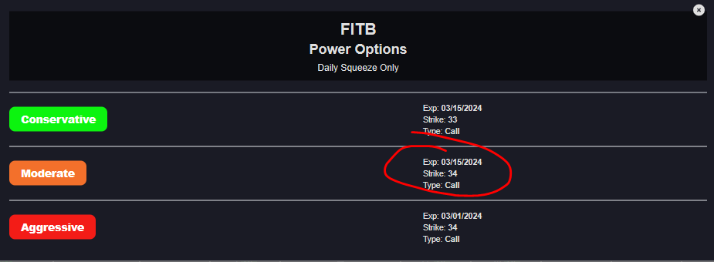
100% Winner On Fifth Third Bank... In 15 Minutes!

Slide 36


Slide 37
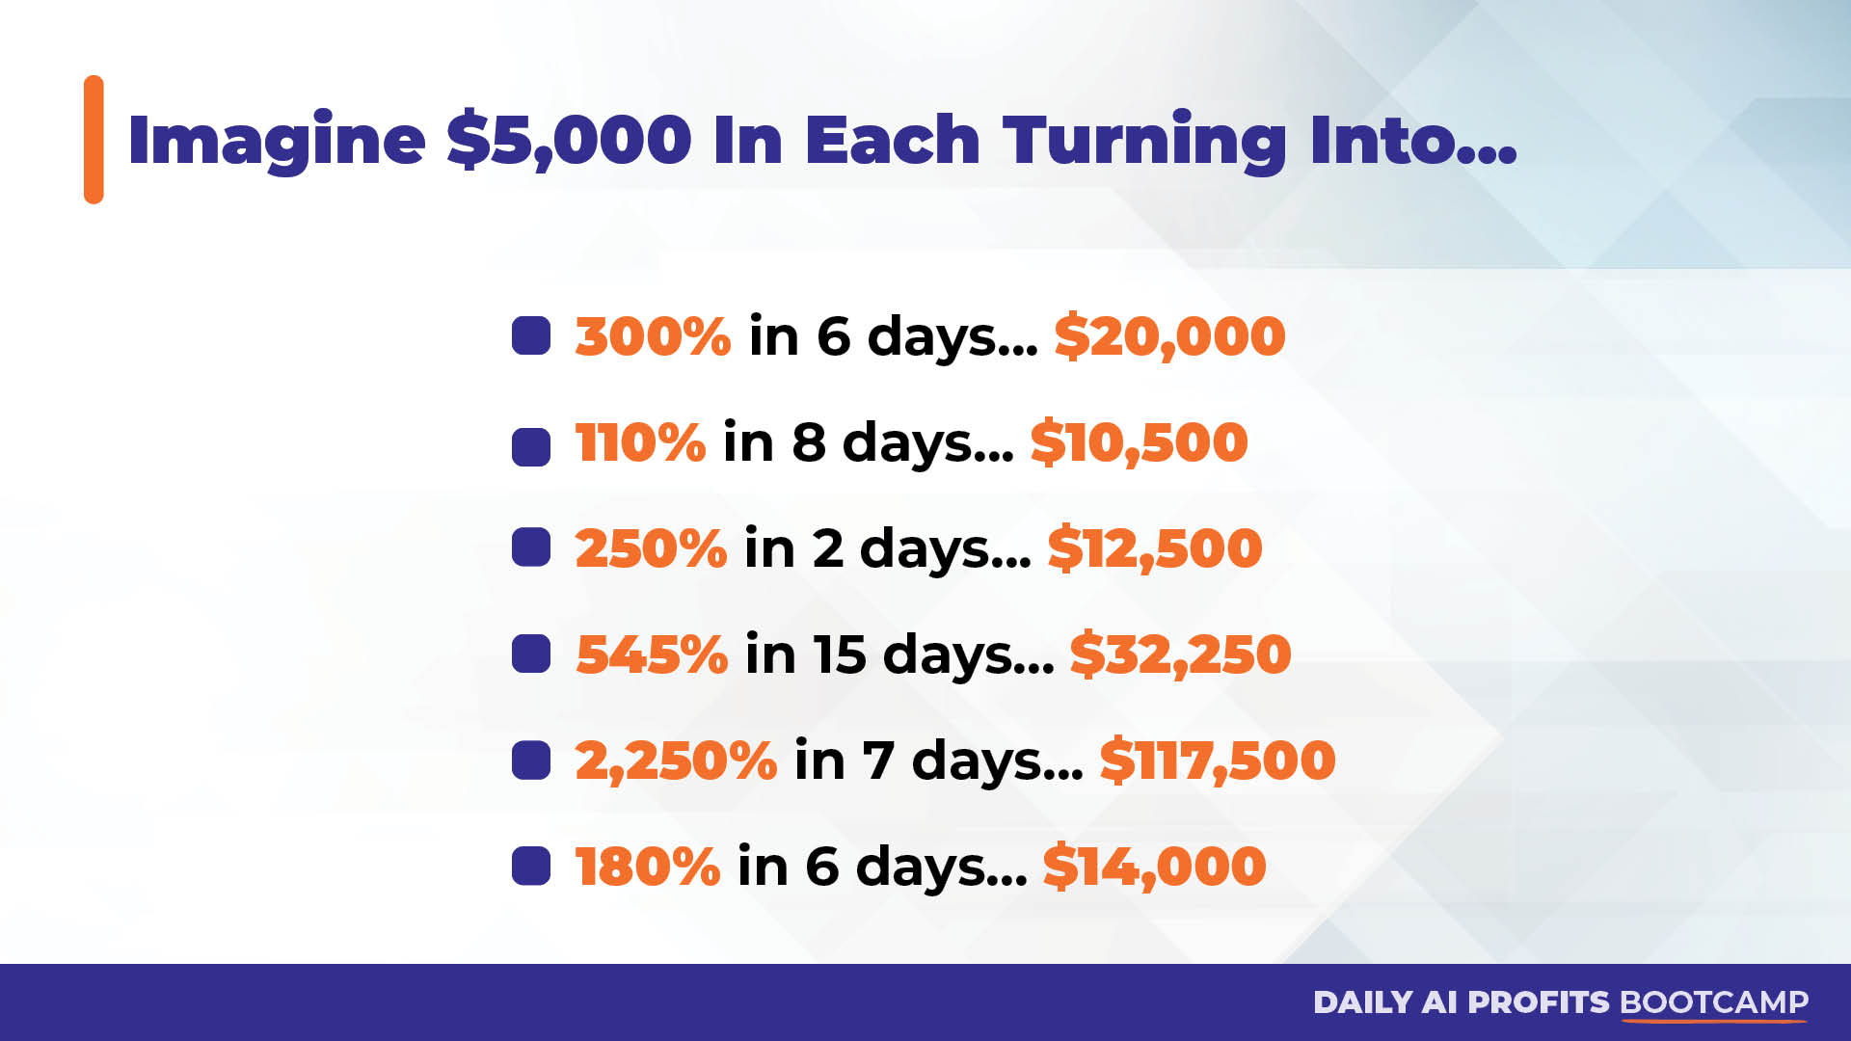

Slide 38


Slide 39


Slide 40
What Early-Access Users Are Saying:
“I’ve got to say that I joined last week and have had all winners since. And I’m doing it on my own looking
at what SAM is showing. The longest I’ve held a position is 2 days. Amazing!” – Kirk
"SAM gave me a 74% winner in three days on CE” -Ash
“NATE - SAM IS FANTASTIC - $8K to $18K account [125% Return] in a week on SAM so far - - how about that ??” - Bill
“Everyone I have played was a winner. I can’t wait to put more size into them when I get the hang of using it!” - Nina

Slide 41
What Early-Access Users Are Saying:
“Used SAM to play LULU this morning and hit a quick 38% win on the 3min chart. Go SAM” - Nick
“Last Friday I bought WY based on SAM. It dropped so and bought more at a support level. I just sold for 100% profit
[in 5 days] ” - Steve
“Just by Watching SAM today, I bought NUE. Im already up 18.77%” – PJ
“200% + on AMD [In 6 days] thanks to Sammy !!” – Ron

Slide 42
What Early-Access Users Are Saying:
I have sent a couple of concerns in prior emails, but I feel it’s only fair to report that I am amazed
at the success I am having with the help of Nate and SAM. I joined Daily Profit Scanner three weeks ago today
In that time I have closed 21 trades and profited on 18 of them. My gains have been $2,600 and my average return
is 30%. I could have made more but trying to be conservative, setting 25% targets and trying to stick to them,
which has caused me to miss out on some bigger gains (like AMD!).
I only hope to continue to do better as I learn more from Nate and learn how to
better use SAM, but I can tell you at 72 years old and retired for two years now, I am finally sleeping at night
because I have hope for true financial security and to be able to leave a good nest egg for my disabled daughter.
Buying your services was the best financial decision I have made in a long time!
-Mike

Slide 43
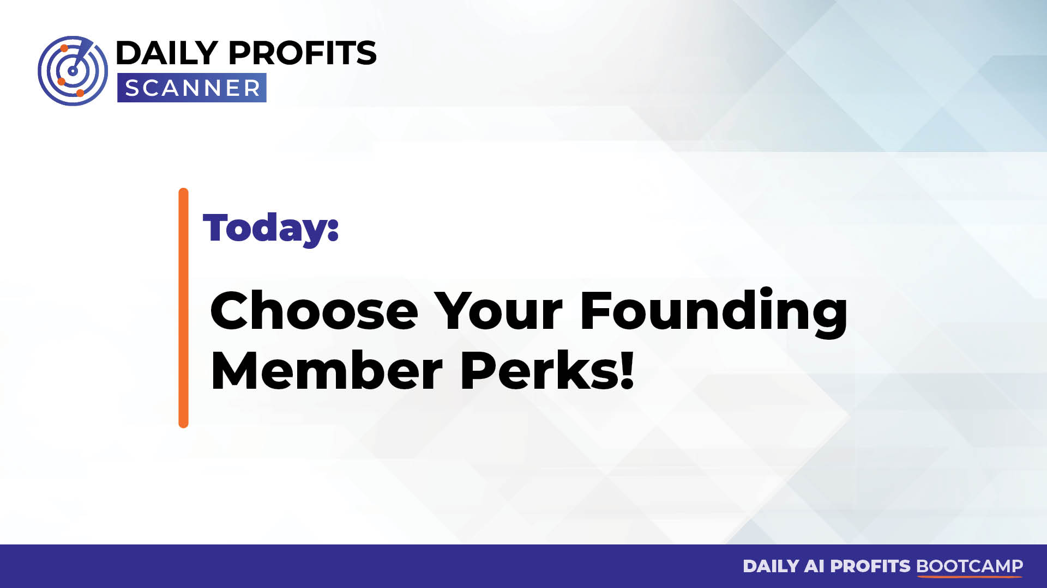

Slide 44
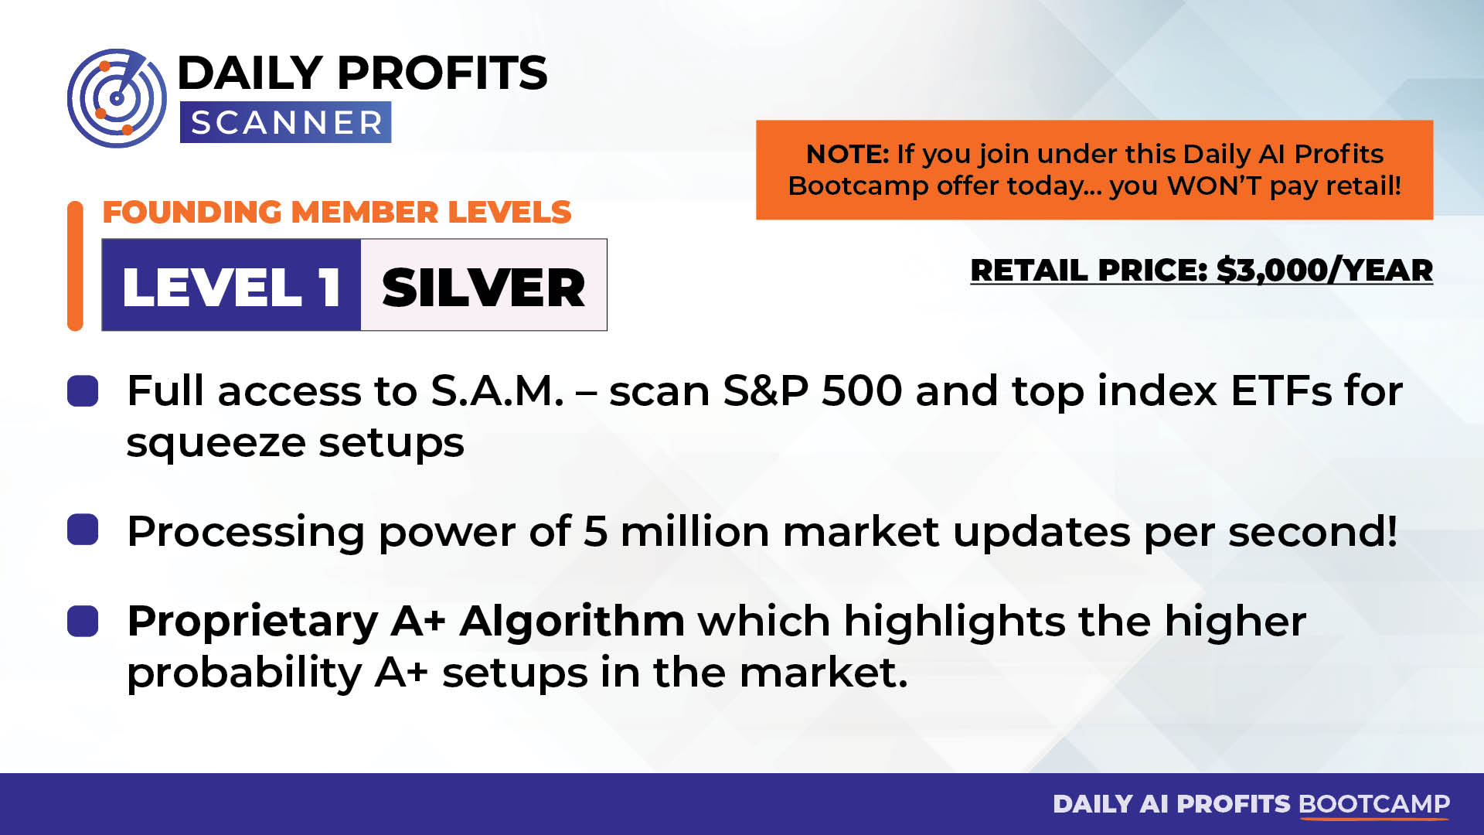

Slide 45
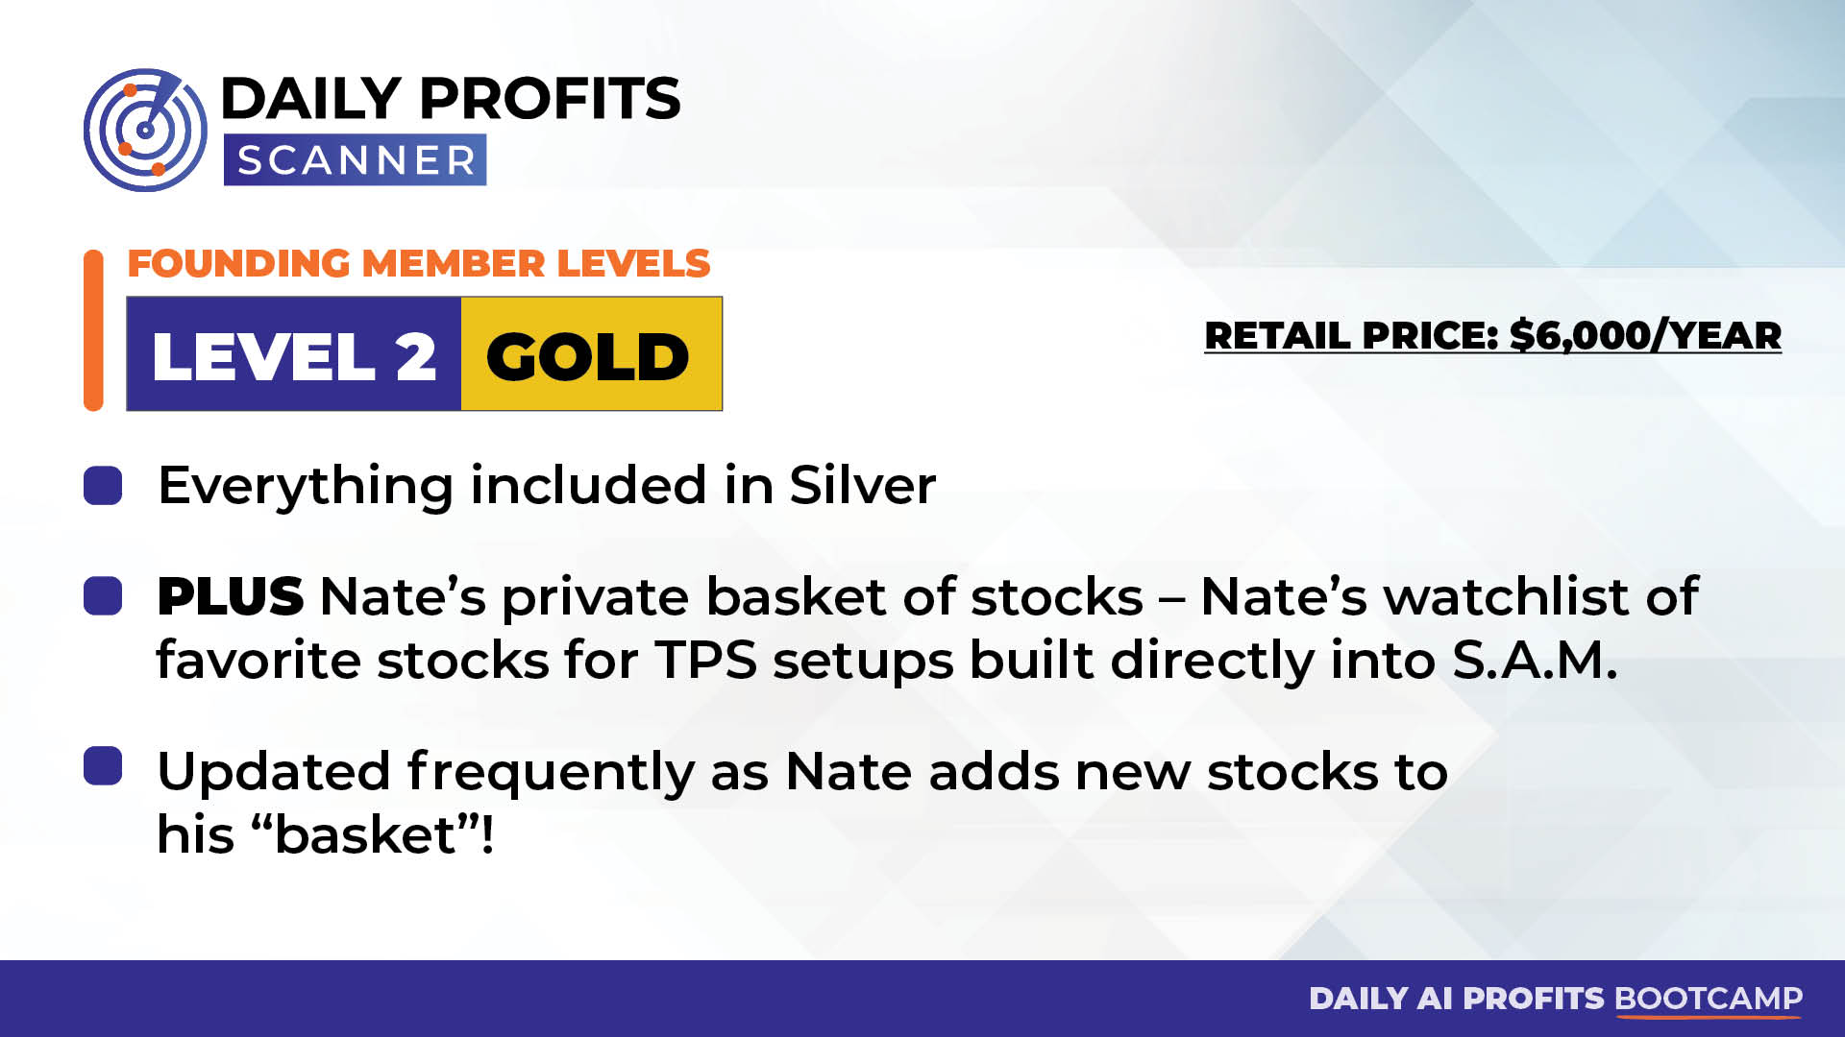

Slide 46


Slide 47
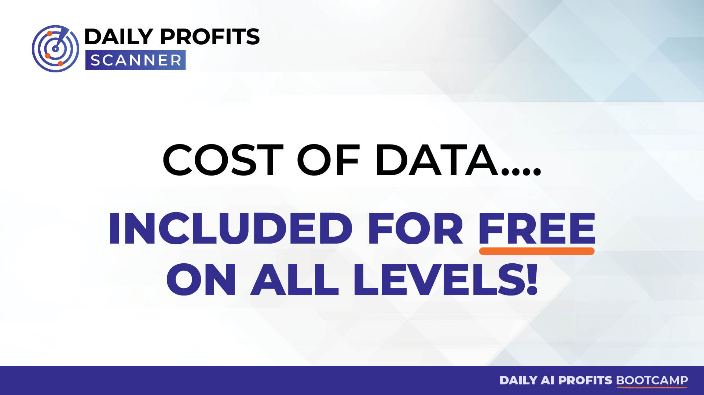

Slide 48
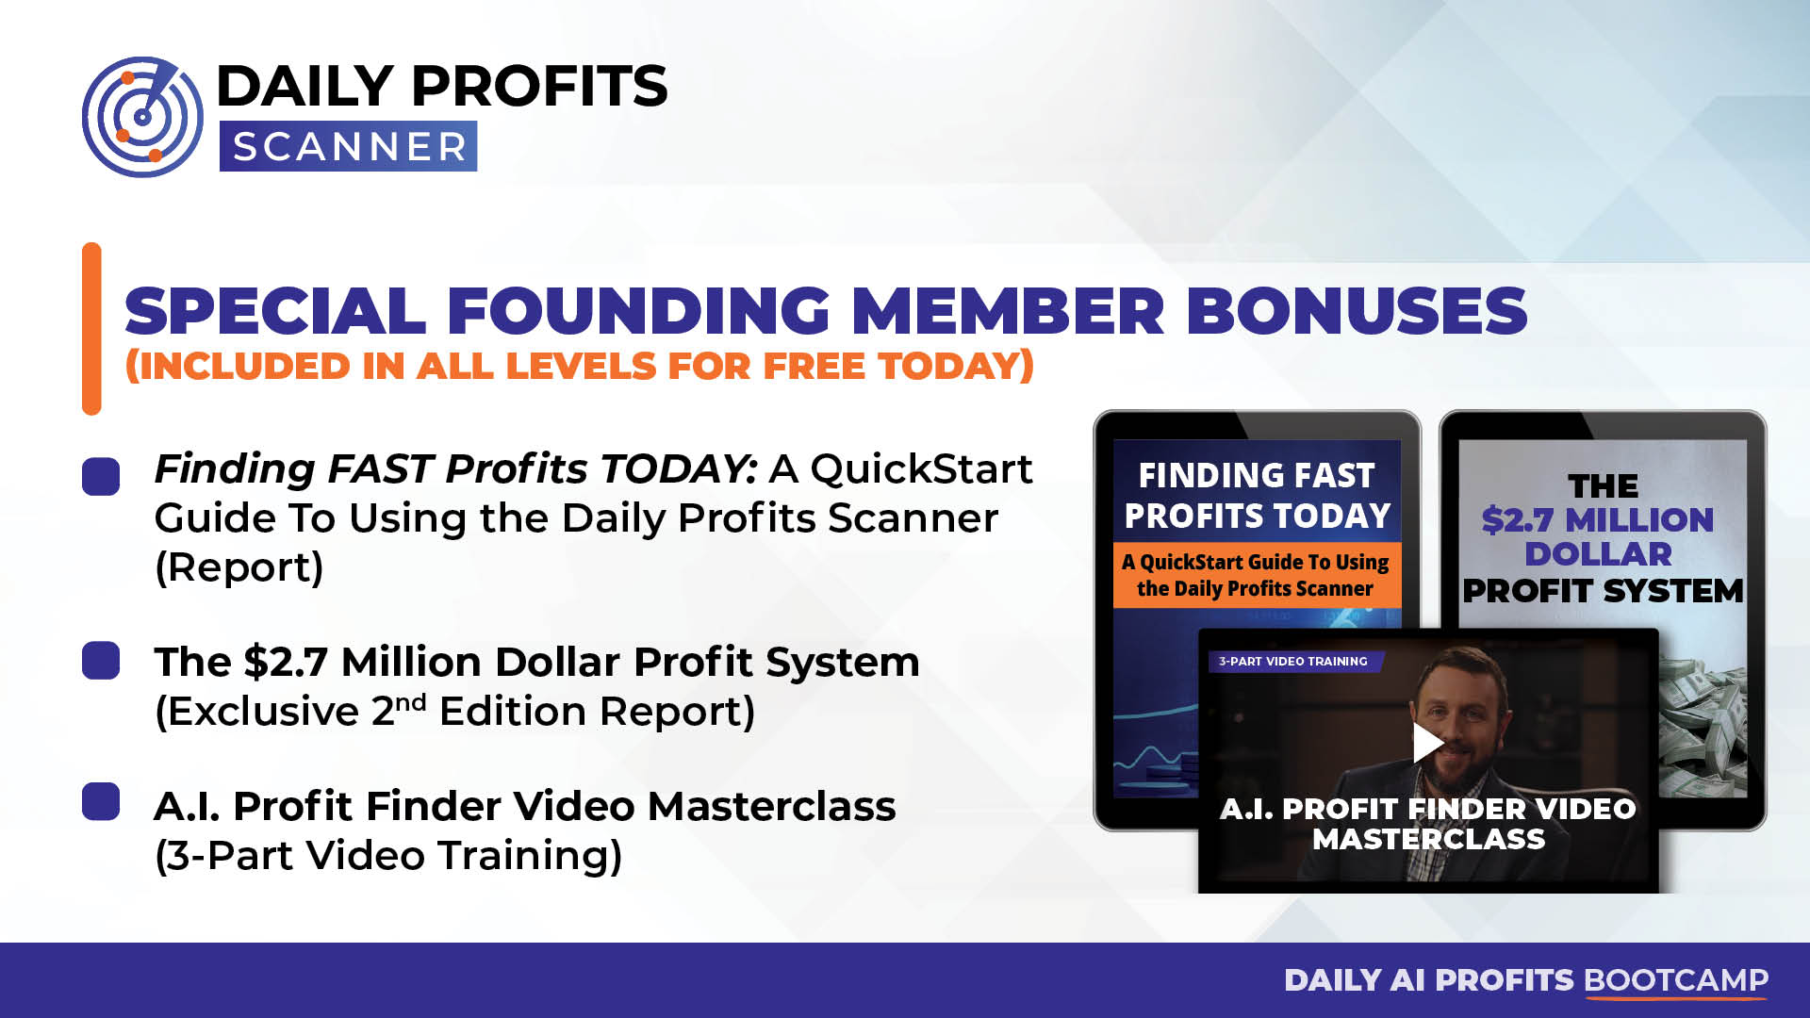

Slide 49
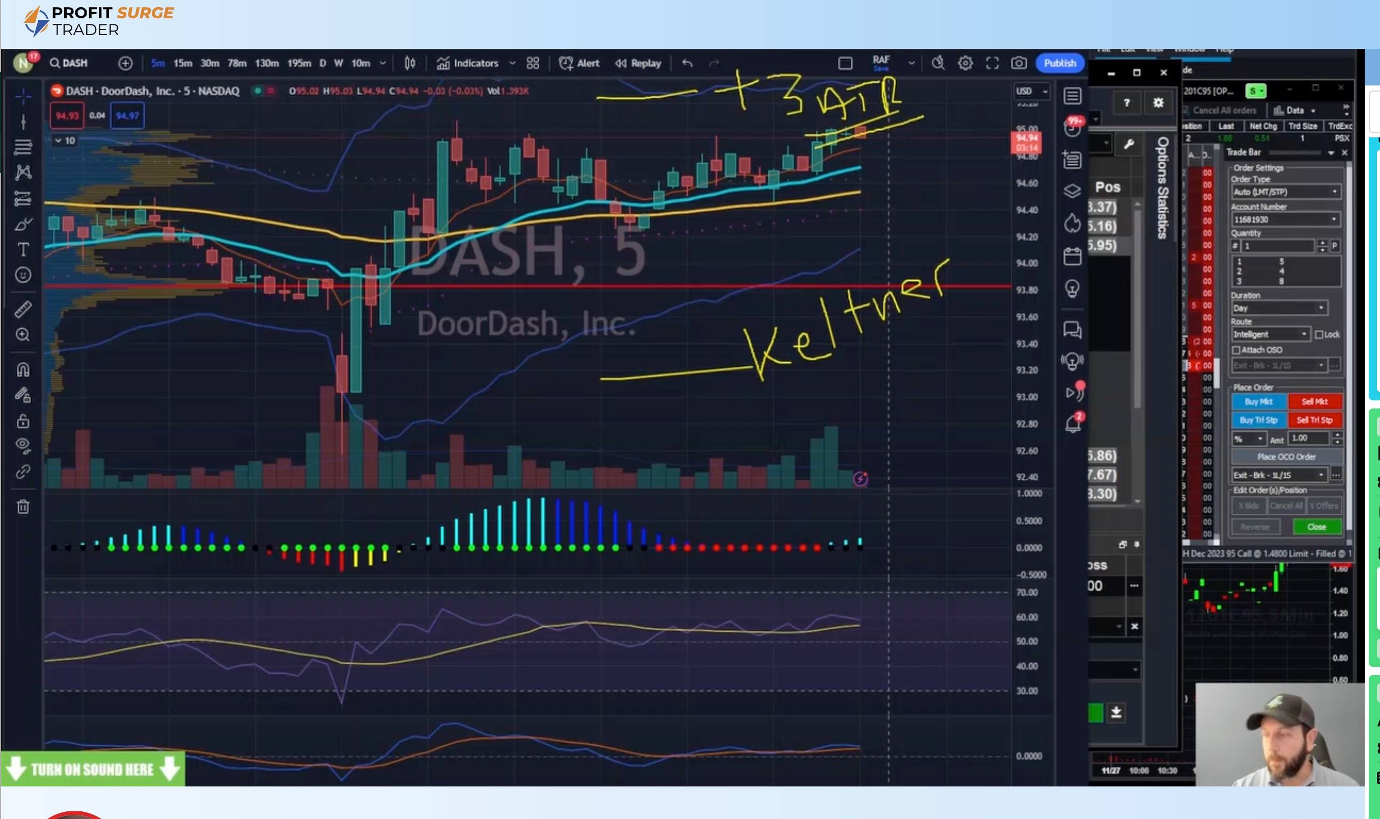

LIMITED-TIME BONUS:
1 YEAR OF PROFIT SURGE TRADER... FREE!
Trade Alongside Nate Every Monday @ 12pm EST... LIVE!
1x Weekly trade using S.A.M.
1x Weekly trade using “One Ticker Payout” Strategy
All-Time Total Return: 208%
(13x Better than S&P 500 Since Aug 7)
All-Time Win Rate: 89%
(49-for-55)
2024 Total Return: 122%
(17x Better than S&P 500)
2024 Win Rate: 100%!
(21-for-21)

Slide 50
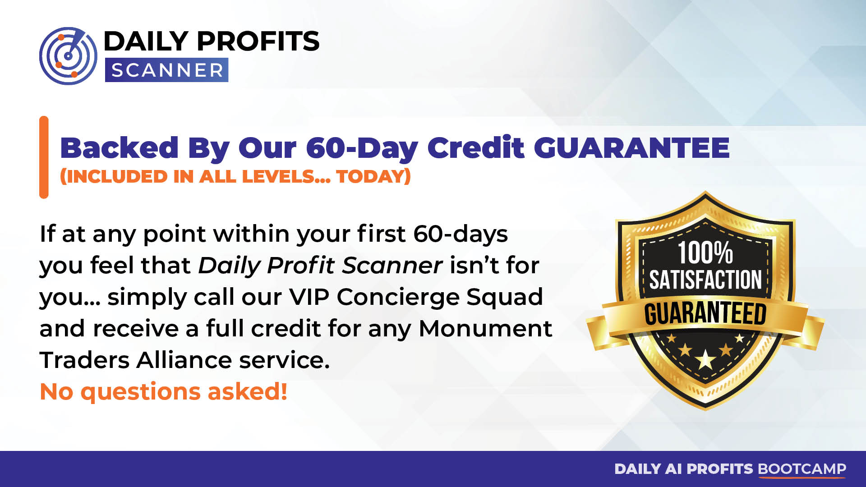

Slide 51


Slide 52
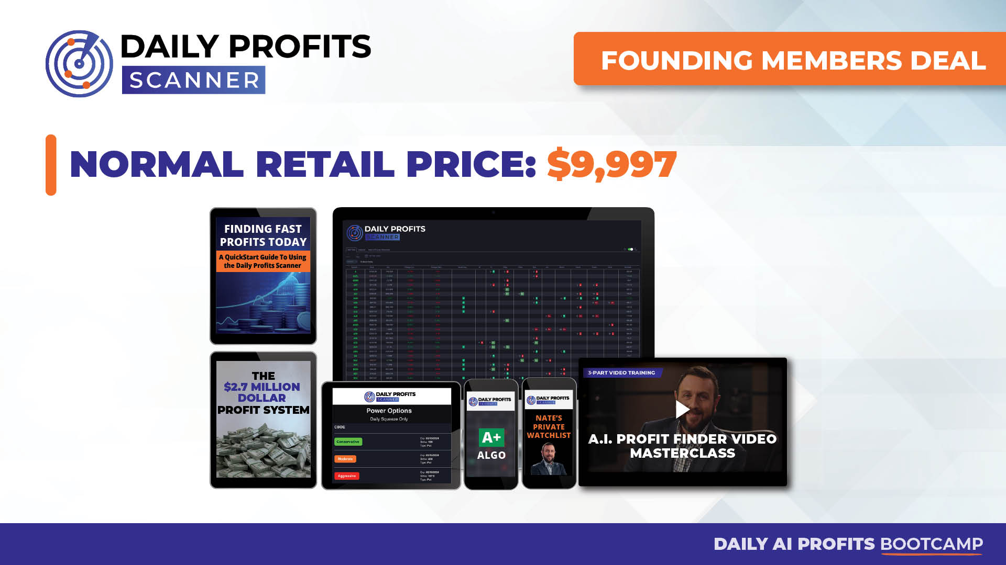

Slide 53
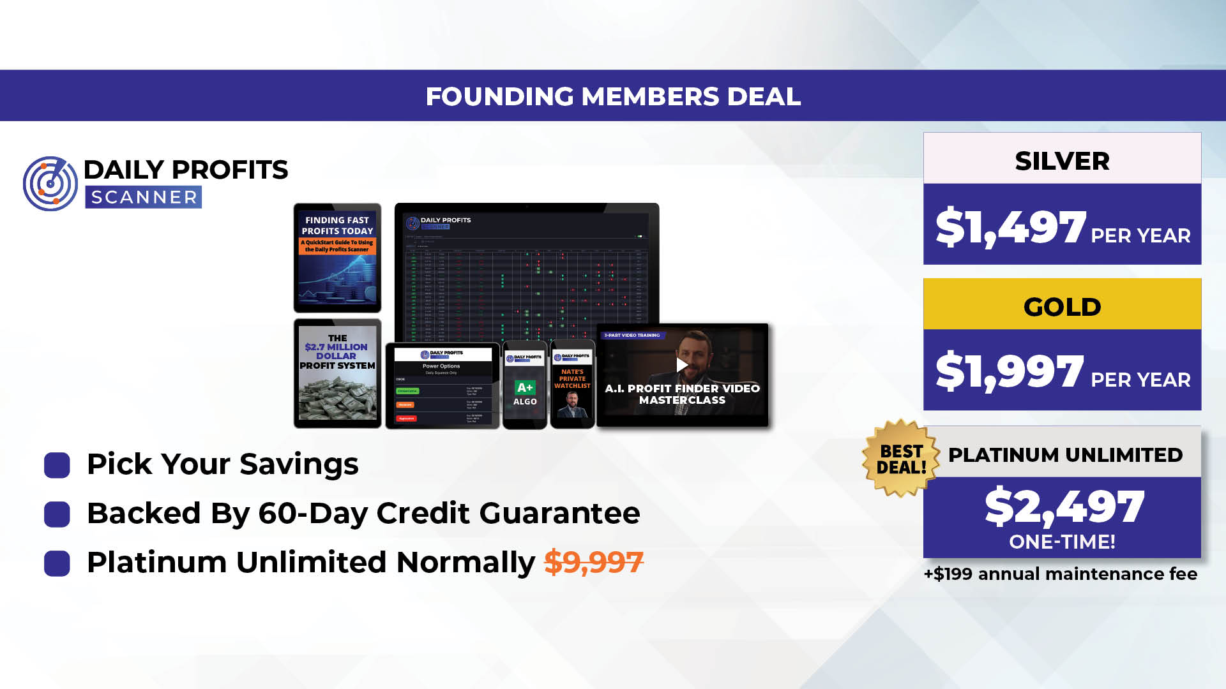

Slide 54
