Slide 1


Discover how to find MASSIVE trade setups in this chaotic market using the power of AI

Slide 2
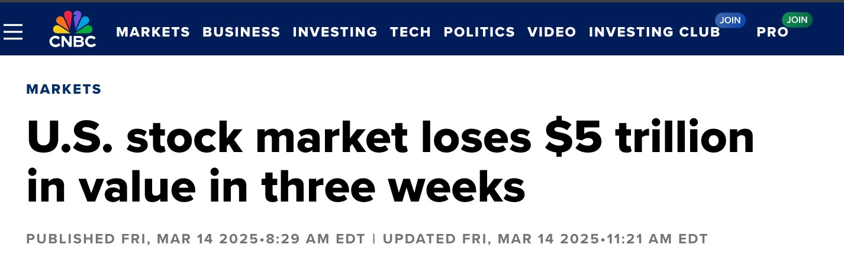
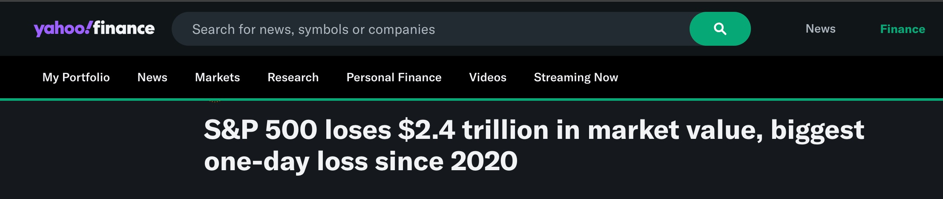
We’re Dealing With Market Conditions We Haven’t Seen in YEARS!

Slide 3

Yet In Daily Profits Live...
Members Are Still Making HUGE Gains!
Nate Bear’s TMUS Trades: 49% and 83% overnight during Trump’s Tariff Market Crash Thursday!

Slide 4
Imagine Finding Trade Setups Like These... Even In This Market:
103% in overnight…
287% in 2 days…
100% overnight…
124% overnight…
144% overnight…
224% in 5 days…
106% overnight...
1,129% in 2 days…

Slide 5
HOW?

Slide 6
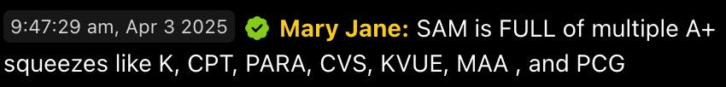

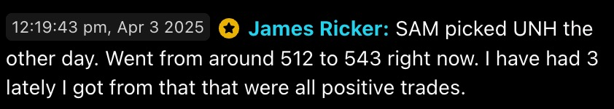
MEET S.A.M.
(Stock Acceleration Monitor)

Slide 7
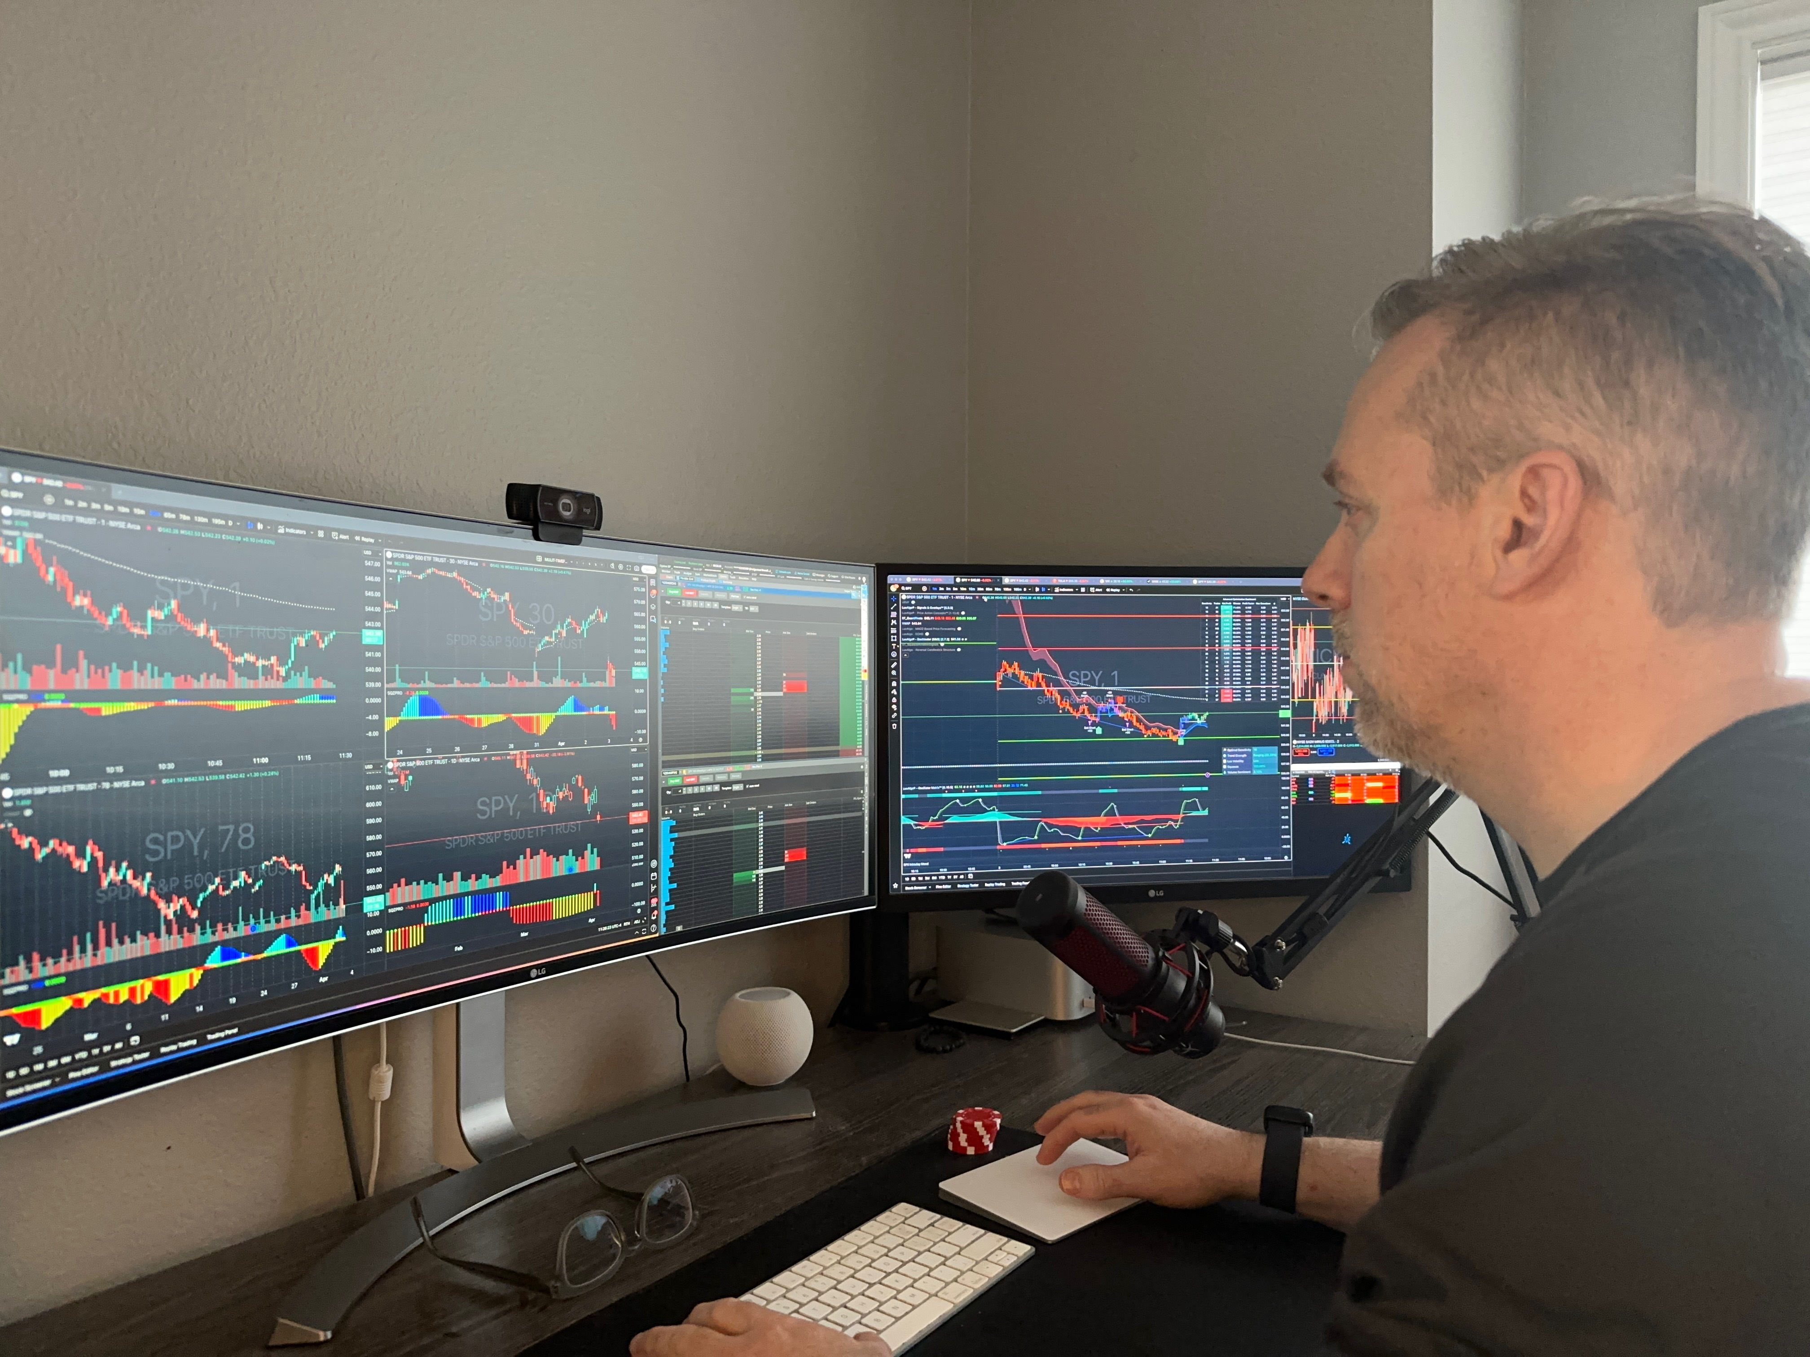
Special Guest: Nate G.
Started trading back in 2016
Learned from Nate Bear and has been trading alongside him and Dman for 6 years.
Love paying it forward and teaching everyday people
Trade in IRA to build wealth for retirement year

Slide 8
Today’s Agenda:
What is S.A.M. (our new
AI-powered scanner)
Behind-the-scenes demo
of how S.A.M. works in these markets
Performance data
Get the FIRST look at some
powerful *NEW* features
LIVE TRADING!!! See S.A.M.
in action
How can you get access after today?
Q&A!!!

Slide 9
To be clear…
Nothing is guaranteed… you should never invest more than you can afford to lose.
The software will alert you when a pattern has formed, but these should not be considered buy or sell alerts. They are
also not official recommendations. You need to do your own due diligence on the situation before deciding to invest.
We’re going to show you some of the top examples
we’ve found, but individual results will vary.

Slide 10
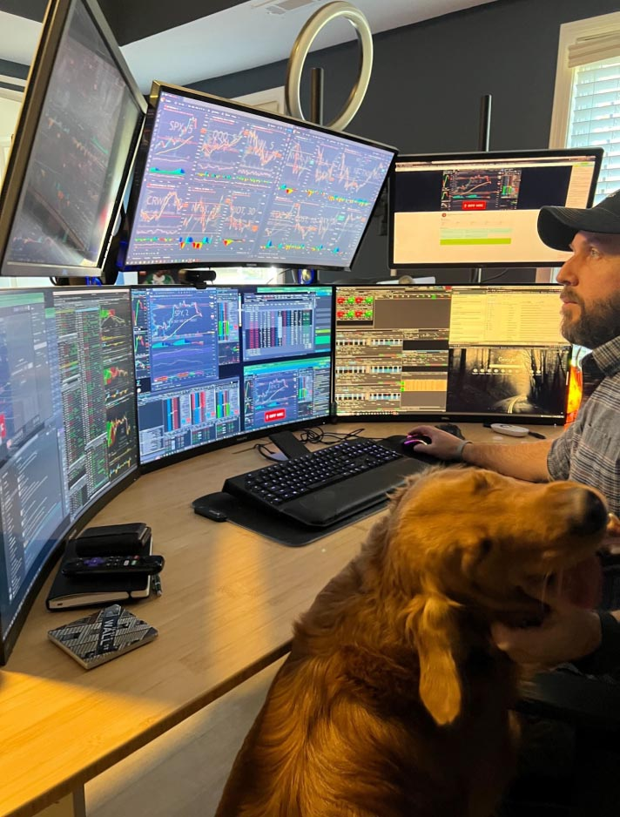
Developed by our very own Millionaire Trader Nate Bear...
Former Construction Worker
To Pro Trader
Turned $37k into $2.7 Million
(7,127% Total Return) in 4 years!
Teaches his winning strategies to thousands of Americans each day
125 x 100% winners since March 2023!

Slide 11
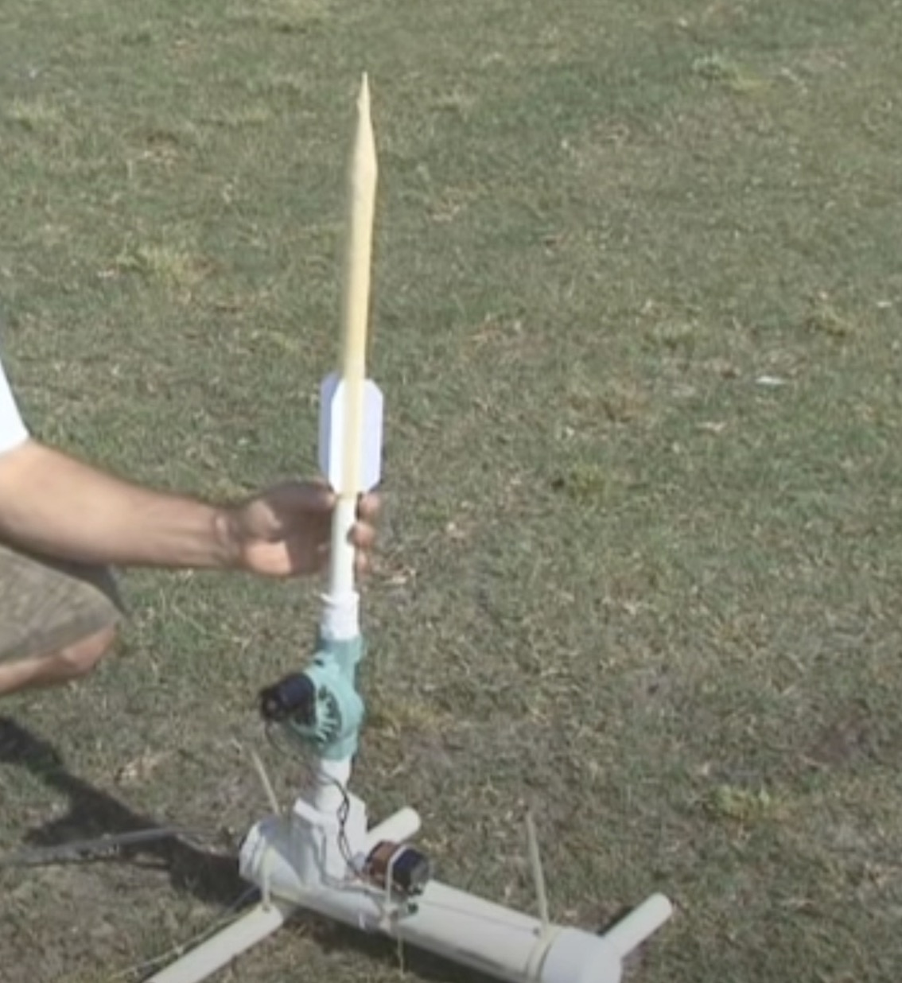
What is the “The Squeeze?”
Developed by Trader John Carter 20 years ago. Carter famously made $18.2 Million in 2020 alone! (a 1,270% gain!)
It’s an indicator that measures whether a stock’s price is compressed and poised to break out.
Think of a compressed air rocket… When enough pressure builds… eventually the stock’s price will explode upwards.
Traditionally these trade setups are found by manually searching for a series of colored dots across multiple timeframes beneath a stock chart.
10 timeframes = 10 charts to look at for 1 stock!

Slide 12
Let’s See The Squeeze
In Real Time…

Slide 13
We’ve Been Scoring Big Profits Off The Squeeze Over The Past Year…

Slide 14
Some of the top trades in our Daily Profits Live chatroom:
COMING UP! Stay Tuned For MORE Live Trading & Q&A Shortly!
295% on the QQQ overnight
150% on SMCI within hours
261% on META within hours
178% on NVDA overnight
418% on AVGO within hours
122% on TSLA overnight
387% on CVNA overnight
494% on RILY within hours
102% on LYFT within hours
217% on NFLX in 1 day

Slide 15
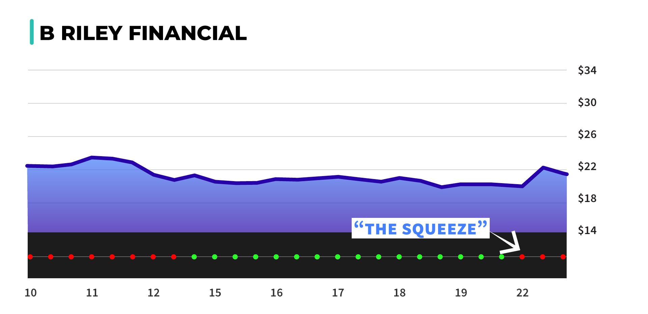
Nate Bear’s RILY Trade From April 2024…

Slide 16
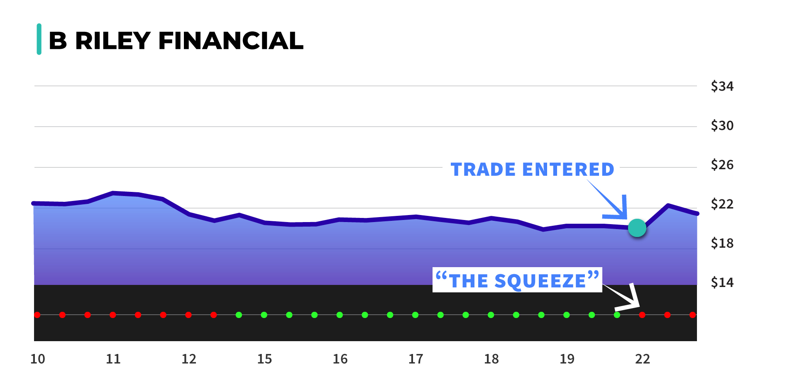
Nate Bear’s RILY Trade From April’s Open House…

Slide 17
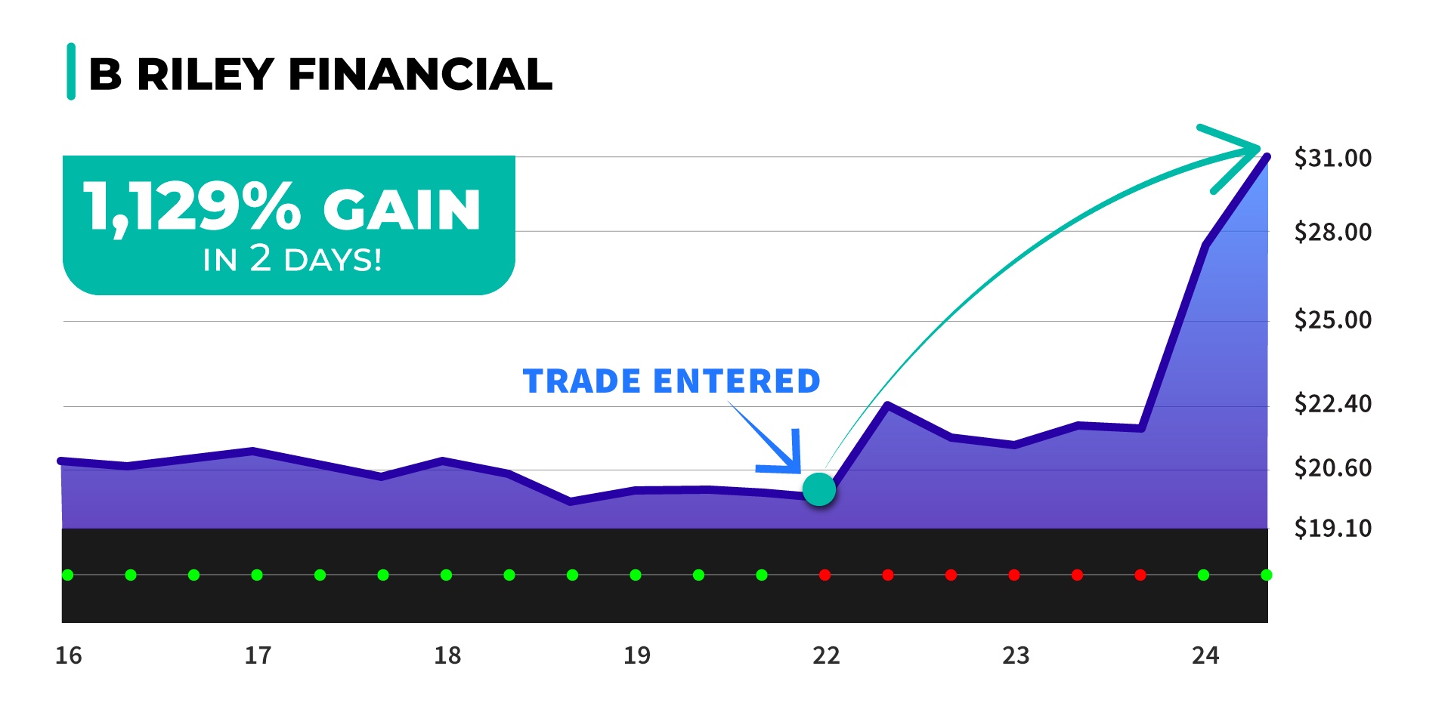
RILY: 1,129% Winner In 2 Days!
(#1 Trade from April’s Daily Profits Live Trading Blitz)

Slide 18
Members Profited Off This Squeeze on RILY!
Grumpy Grandpa 4/24/2024 AT 9:37:29 AM
RichN 4/24/2024 AT 9:32:34 AM
WEB 4/24/2024 AT 9:43:36 AM
1,180% on RILY. Great play Nate.
Over 1,000% for me
1,550% on RILY
ERICGLAD 4/24/2024 AT 9:46:02 AM
BoilerUp 4/24/2024 AT 10:06:21 AM
rodm72 4/24/2024 AT 9:46:02 AM
1,385% on RILY! Best trade of my life
Rily 20. In @ .78. Out @ $10.20. $18,840 profit. 1,206% gain
RILY out @ 800% thanks Nate
QuintonE 4/24/2024 AT 9:46:02 AM
Cypher00 4/24/2024 AT 9:37:00 AM
Nate Big thanks; RILY Lotto in: $.50 out avg $10.49, 1,987% gain
RILY! 1,506%

Slide 19
We Built S.A.M. To Search For Squeeze Setups Automatically By Using The Power of AI!

Slide 20
What S.A.M. Can Do Thanks to AI:
Has the processing power to scan 5 million market updates per second!
Scan the S&P 500 & NASDAQ 100 to find the squeeze setups (Across 10 different time frames)
Identify “A+ Setups” using our proprietary algorithm

Slide 21


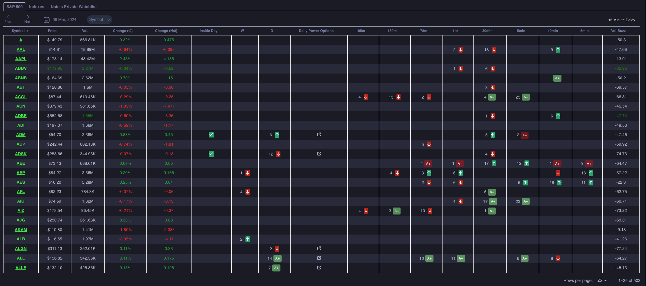
All you need to look for are the green up arrows or an A+

Slide 22
Each Number Represents How Many “Ticks” a Stock Has Been In a Squeeze!
DAILY
195M
130M
5
3
2

Slide 23
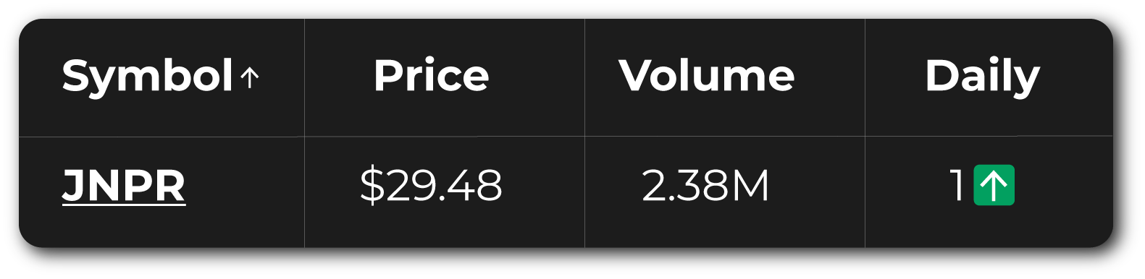
JNPR Example
The Number “1” On Daily Time Frame Means the Stock Has Been in the Squeeze for 1 Day!
Green Up Arrow =
Positive Momentum

Slide 24
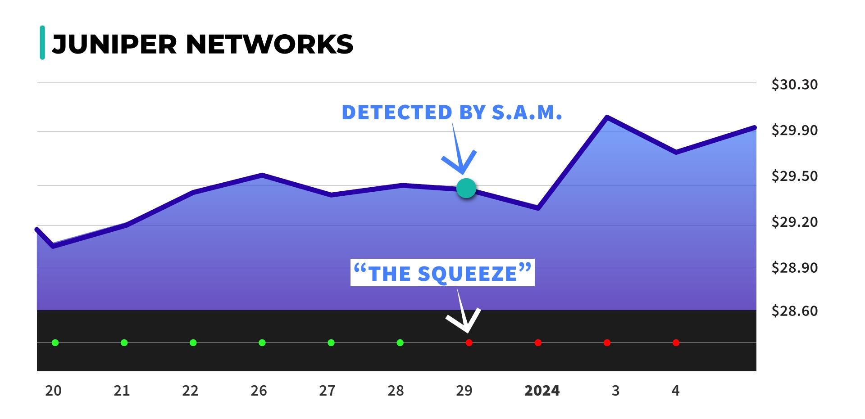
What It JNPR’s Chart Looked Like:

Slide 25
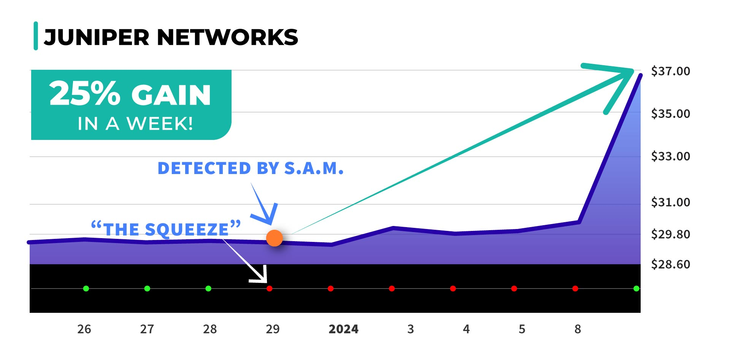
JNPR Example: 25% Stock Move (1 Week)…

Slide 26
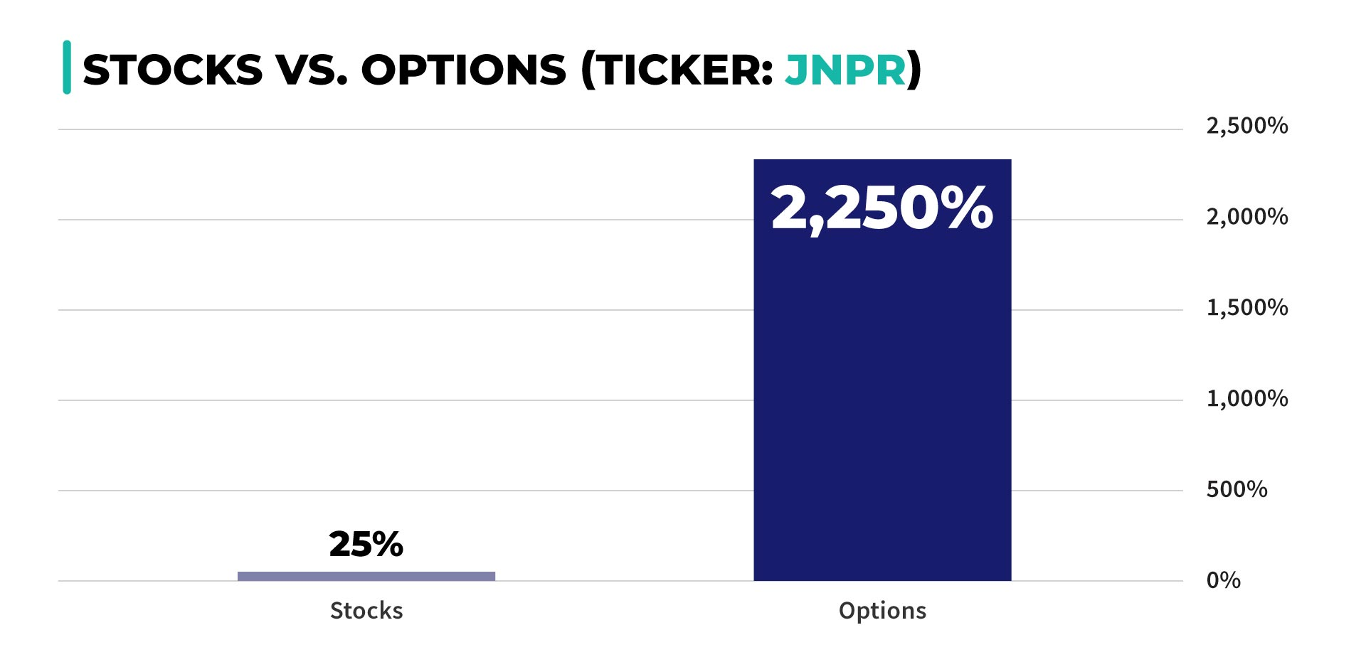
2,250% if We Used Options!

Slide 27
S.A.M. Ranks the Biggest Opportunities as A+!!!

Slide 28
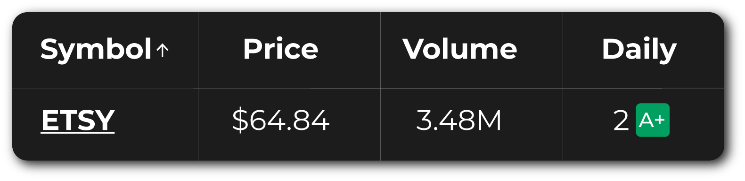
ETSY Example
The Number “2” on a Daily Time Frame Means the Stock Has Been in
an Active Squeeze
for 2 Days!
Green A+ = A+ Setup With
Positive Momentum

Slide 29
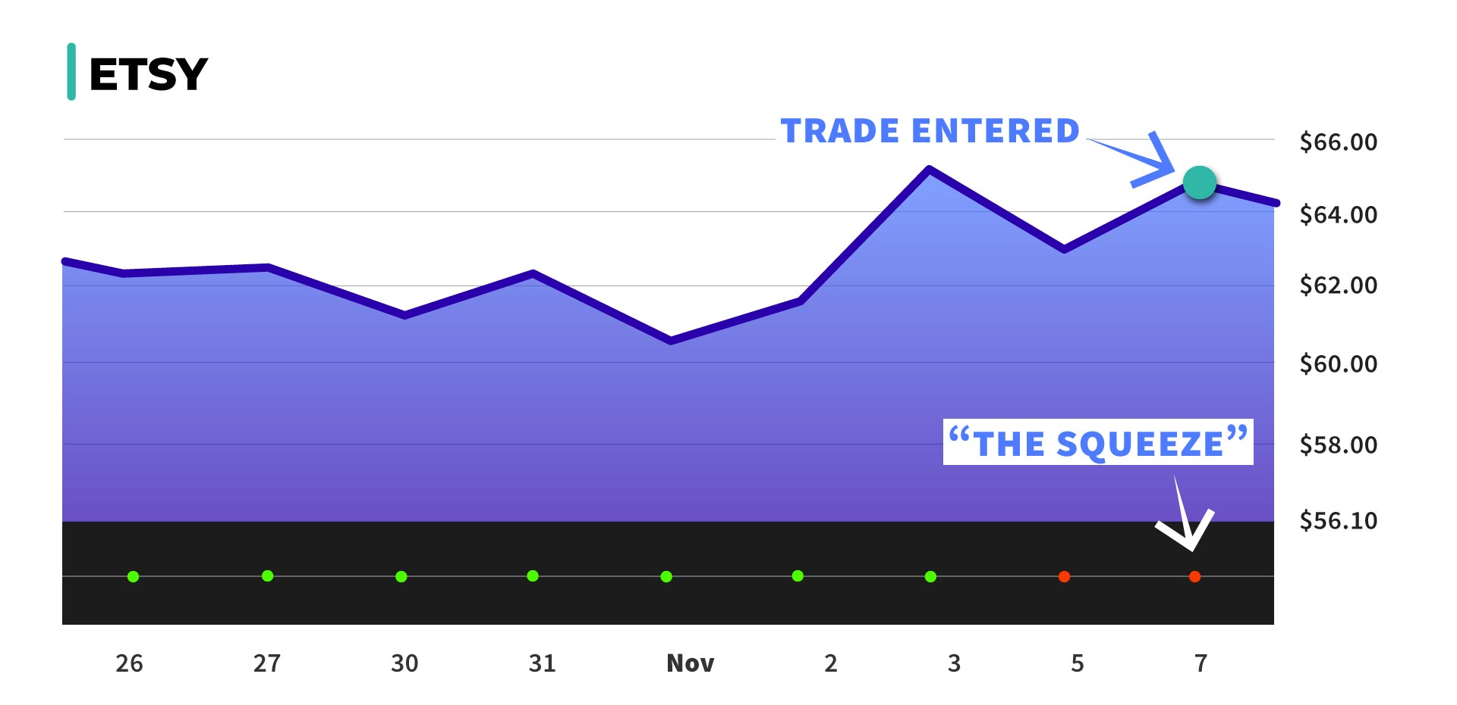
ETSY Example

Slide 30
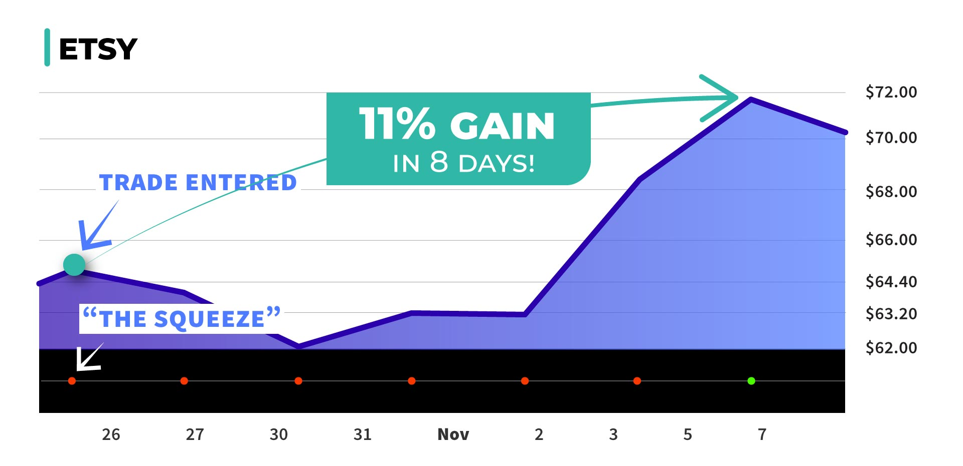
ESTY Example – 11% Stock Move

Slide 31

154% if We Used Options!

Slide 32
No More Digging Through Hundreds of Charts…
S.A.M. Finds These Setups On Auto-Pilot!

Slide 33
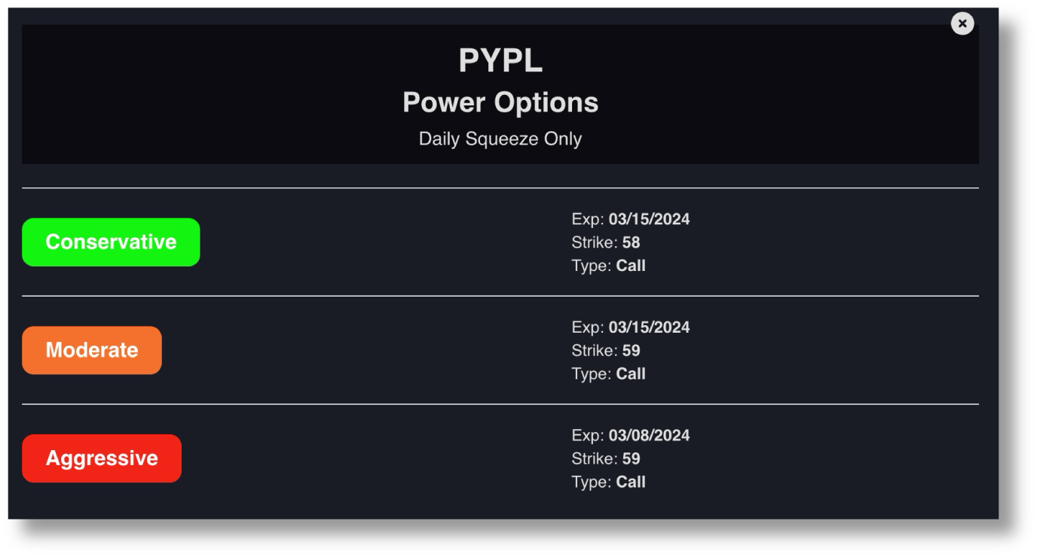
S.A.M. Can Even Provide “Power Options” Contracts To Consider!

Slide 34
What the Data on S.A.M. Says:
5-year backtest on S&P 500 stocks (2018-2023)
Based on peak exits it could have found 7,286 profitable plays with an 82% win-rate!
Average of 5 winners per trading day!
Average trade duration: 10 days

Slide 35
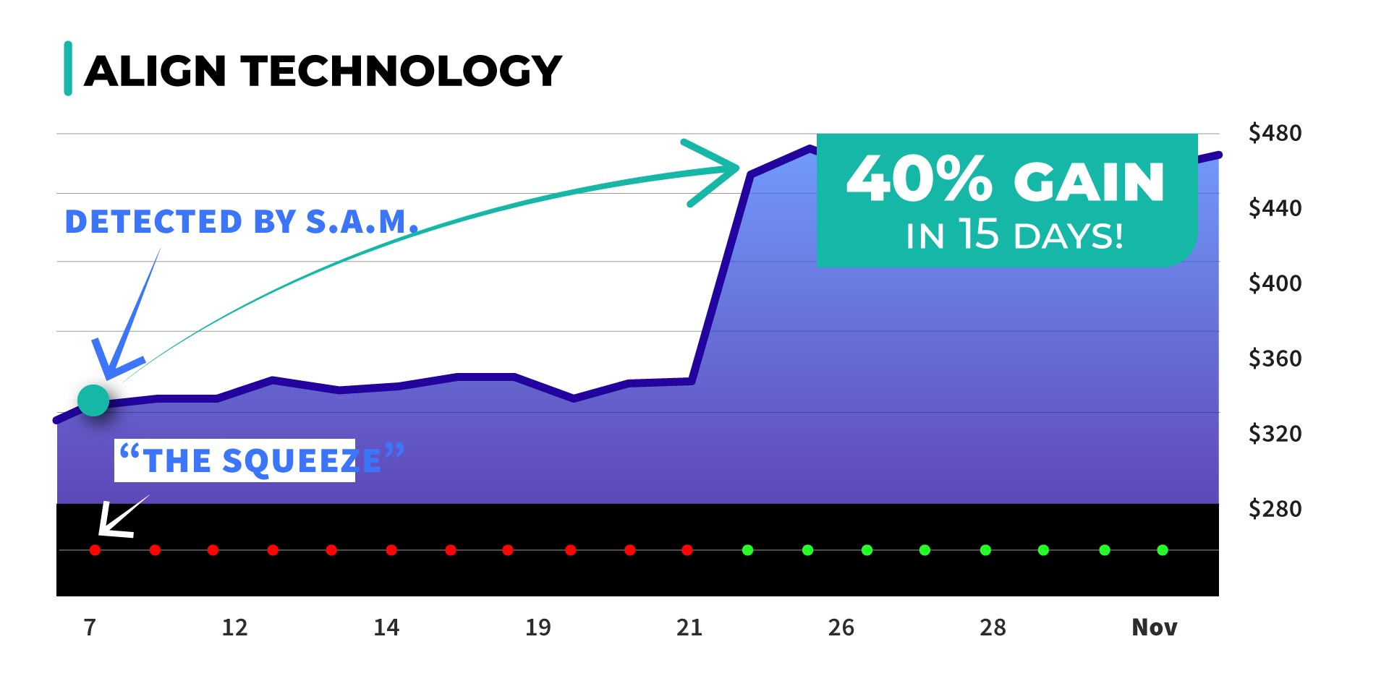
You don’t have to place thousands of trades for S.A.M. to work!
ALGN Example – 40% Stock Gain

Slide 36
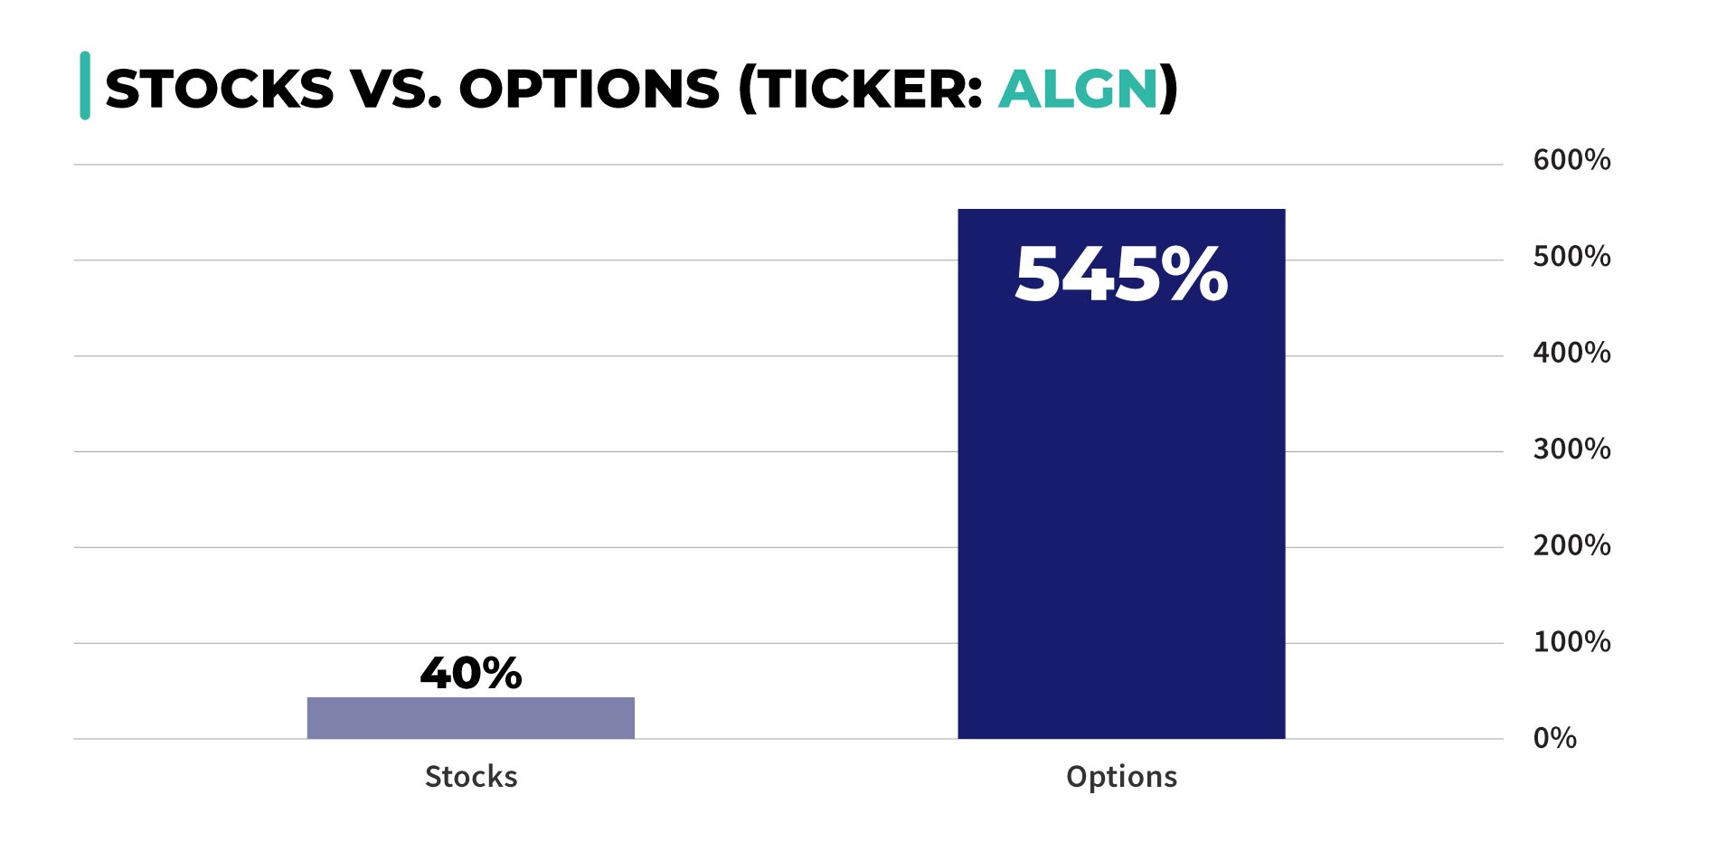
545% if We Used Options!

Slide 37
Since we launched last year... we’ve added several NEW FEATURES to make S.A.M. even more powerful

Slide 38
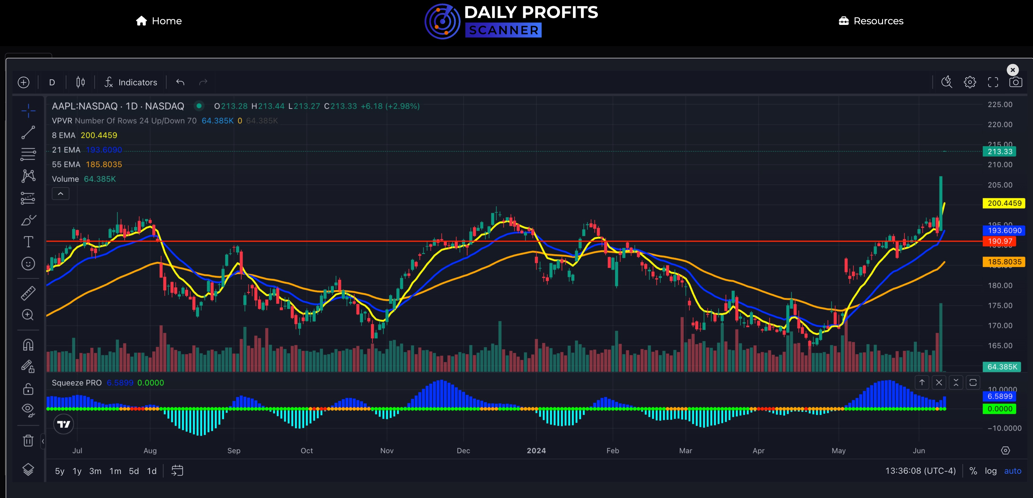
Real-Time TradingView Charts With Powerful Indicators

Slide 39
Real-Time TradingView Charts With Powerful Indicators
Including…
The Squeeze
Nate’s favorite Exponential Moving Averages
Volume profile visible range
AND you can add your own & draw on chart!

Slide 40



Nate Bear, Dman & Nate G’s
Personal Watchlists Built Into S.A.M.!

Slide 41
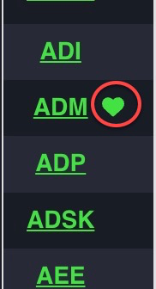
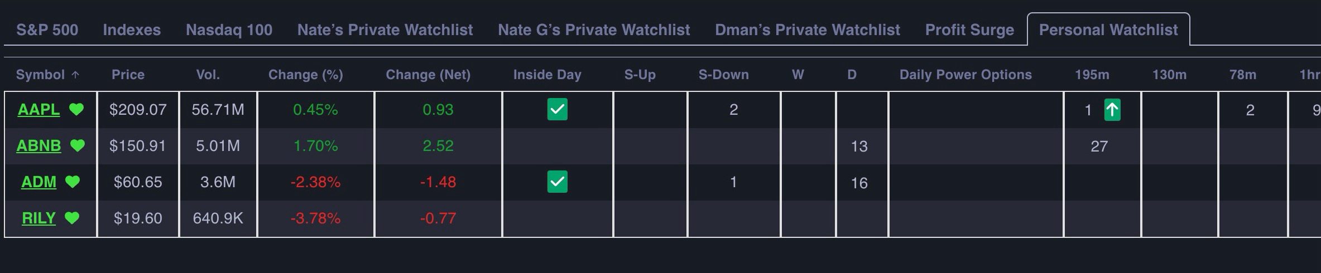
Custom Watchlists!
Add and track any S&P 500 or Nasdaq 100 stocks on your own personal watchlist!

Slide 42
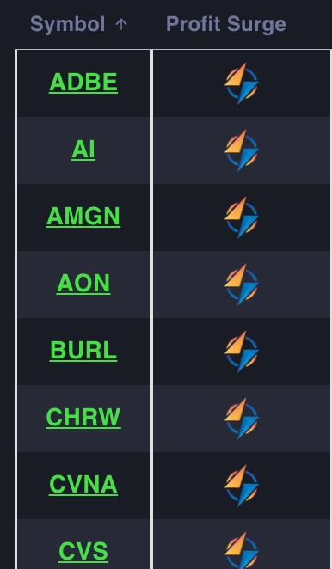
Profit Surge Scanner
Indicates whether the stock is experiencing an active “Earning Profit Surge.”
This strategy has an 80% win-rate since inception
Nate Bear went a perfect 27-fot-27 (100%
win-rate) and beat the S&P 500 by 17X
to start 2024…
S.A.M. Will Help Find More Trade Setups!

Slide 43

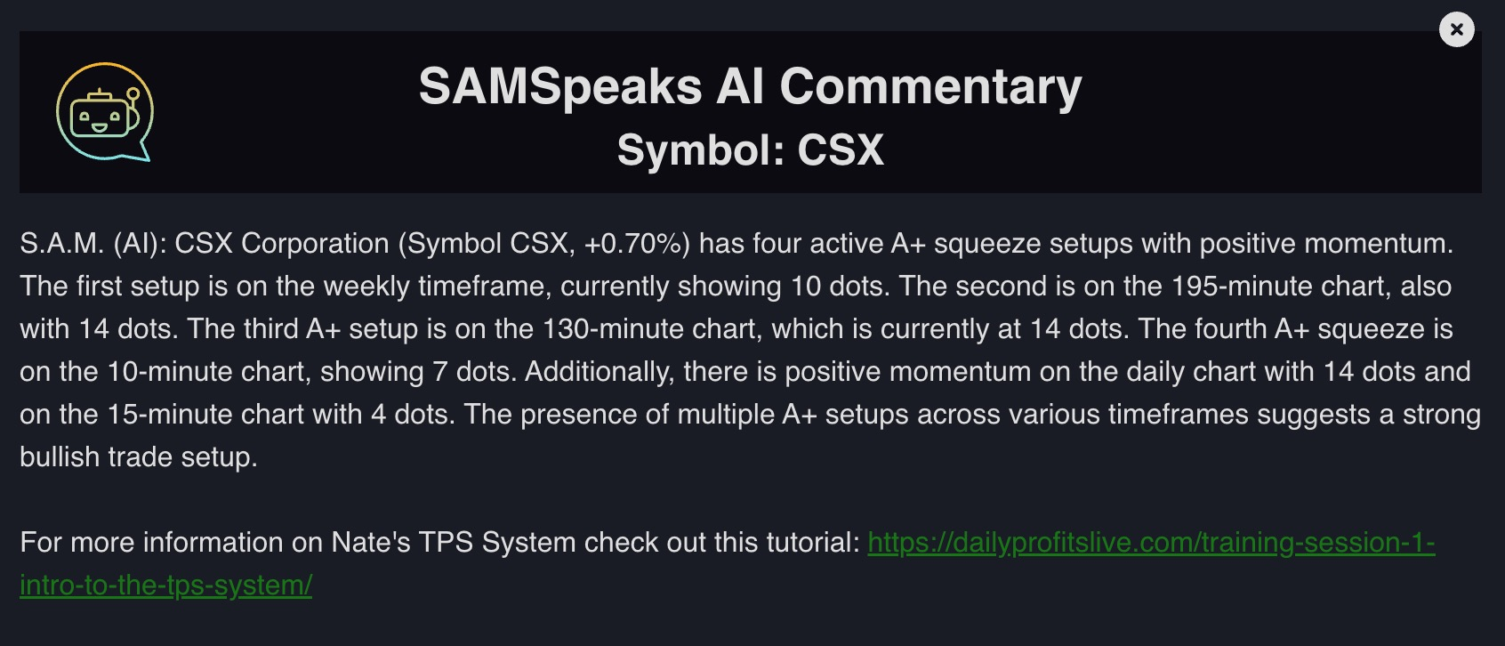
“SAMSpeaks” AI Commentary

Slide 44
BRAND-NEW!
Opening Bell Aftershocks Scanner
“1.5x Earnings”
Finds stocks with earnings win that have outperformed expected moves by 1.5x
These setups have the potential to generate 100%, 200% and even 300% gains
within minutes of the opening bell!
Nate Bear’s Recent Trade: 334% on APP within 11 minutes!

Slide 45
New Today!
Short Floats!
Sort by Short Float (% of
shares traded short).
Used to help identify stocks that have
been oversold.
Perfect example: Nate Bear’s famous
RILY trades

Slide 46
New Today!
Average True Range (ATR)!
Measures the range in which a stock has been moving.
Used to help confirm if a stock is worth trading
Low = Not worth trading.
High = Probably too late.

Slide 47
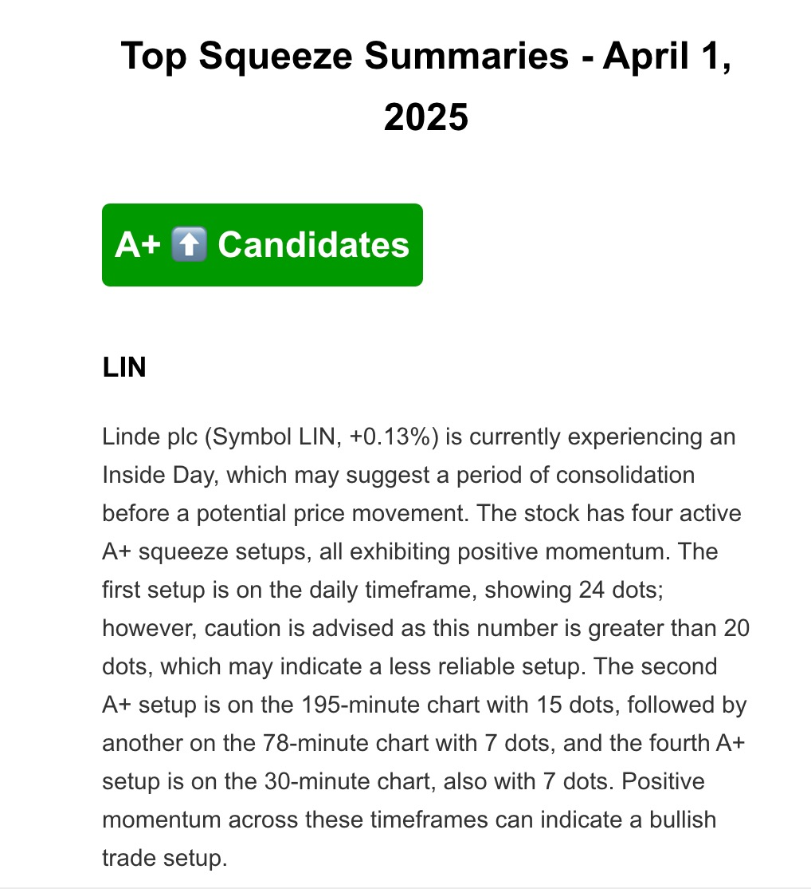
Coming Q2/Q3
Email Alerts From S.A.M.!

Slide 48
This is just the beginning!
We’re constantly listening to your feedback to improve S.A.M.

Slide 49
DEMO TIME!
Let’s See What Setup S.A.M. Is Finding NOW!

Slide 50
Imagine $5,000 In Each Turning Into…
300% in 6 days… $20,000
110% in 8 days… $10,500
250% in 2 days… $12,500
545% in 15 days… $32,250
380% in 2 days… $24,000
2,250% in 7 days… $117,500

Slide 51
Today Is YOUR chance
to start using S.A.M.
for yourself!

Slide 52

Introducing Our Latest Wealth
Building Initiative…

Slide 53
What Early- Access Users Are Saying
“I joined last week and have had all winners since. And I’m doing it on my own looking at what S.A.M. is showing. The longest I’ve held a position is 2 days. Amazing!” — Kirk
“SAM gave me a 74% winner in three days on CE.” — Ash
“SAM IS FANTASTIC - $8K to $18K account [125% Return]
in a week on SAM so far – how about that??” — Bill
“Everyone I have played was a winner. I can’t wait to put more size into them when I get the hang of using it!” — Nina

Slide 54
What Early- Access Users Are Saying
SAM's scanner is amazing Nate, especially what all three of you have on your watchlist. Pays to have the live that” — Coach Rogers
“Last Friday I bought WY based on SAM. It dropped, so I bought more
at a support level. I just sold for 100% profit [in 5 days].” — Steve
Anybody else make the play off SAM with CSCO from yesterday? +40% this morning— Michael
“200%+ on AMD [in 6 days] thanks to Sammy!” — Ron

Slide 55
What Early- Access Users Are Saying
“I am amazed at the success I am having with the help of Nate and SAM. I joined Daily Profit Scanner three weeks ago today. In that time I have closed 21 trades and profited on 18 of them.”
“My gains have been $2,600 and my average return in 30%. I could have made more but trying to be conservative, setting 25% targets and trying to stick to them, which has caused me to miss out on some bigger gains (like AMD!).”
“I only hope to continue to do better as I learn more from Nate and learn how to better use SAM, but I can tell you at 72 years old and retired from two years now,
I am finally sleeping at night because I have hope for true financial security and to be able to leave a good nest egg for my disable daughter. Buying your services was the best financial decision I have made in a long time!”
— Mike (Daily Profits Live Member)

Slide 56
Choose Your Special Event Member Perks!
Today:

Slide 57
NOTE: If you join under this AI Power Blitz offer today… you WON’T pay retail!
SPECIAL EVENT MEMBER LEVELS
RETAIL PRICE: $3,000/YEAR
LEVEL 1 | SILVER
Full access to S.A.M. – scan S&P 500 and top index ETFs for squeeze setups
Processing power of 5 million market updates per second!
Proprietary A+ Algorithm which highlights the higher probability setups
“SAMSpeaks” AI Commentary feature
Custom Watchlists – Build your own personal watchlist with one click!
COMING SOON: AI Generated Email Alerts

Slide 58
SPECIAL EVENT MEMBER LEVELS
RETAIL PRICE: $6,000/YEAR
LEVEL 2 | GOLD
Everything included in Silver
PLUS Nate’s, Dman, and Nate G’s private basket of stocks – Monitor their favorite stocks directly in S.A.M.
Earnings Profit Surge Trade Scanner
COMING SOON: New Opening Bell Aftershock (1.5x) Scanner

Slide 59

SPECIAL EVENT MEMBER LEVELS
RETAIL PRICE: $9,997/YEAR
LEVEL 3 | PLATINUM UNLIMITED
Everything included in Silver and Gold… Forever!
Exclusive “Power Options” Bonus Feature: Options contracts to consider for each daily play. Includes 3 contracts to fit your risk tolerance..
Conservative
Moderate
Aggressive

Slide 60
COST OF DATA…
INCLUDED FOR FREE
ON ALL LEVELS!

Slide 61

SPECIAL EVENT MEMBER BONUSES
(INCLUDED IN ALL LEVELS FOR FREE TODAY)
Finding FAST Profits Today: A Quick-Start
Guide To Using the Daily Profits Scanner
(Report)
The $2.7 Million Dollar Profit System
(Exclusive 2nd Edition Report)
AI Profit Finder Video Masterclass
(3-Part Video Training)

Slide 62

Backed By Our 60-Day Credit GUARANTEE
(INCLUDED IN ALL LEVELS… TODAY)
If at any point within your first 60-days you feel that Daily Profit Scanner isn’t for you… simply call our VIP Concierge Squad and receive a full credit for any Monument Traders Alliance service.
NO QUESTIONS ASKED!

Slide 63

S.A.M. IS THE ULTIMATE WAY TO “FLY ON YOUR OWN”!
QuintonE at 2:09 PM
Nate, thanks personally for all the wins since Oct when I started, what a wild time to start. The real win is the invaluable training you receive. The start has been great. What I have learned is there is no down time for you other than those small breaks. You literally treat us so well, like another family. Therefore, you need to continue to kick us out of the nest so we can fly on our own. And the mental training is your services secret weapon. Thx Q.

Slide 64
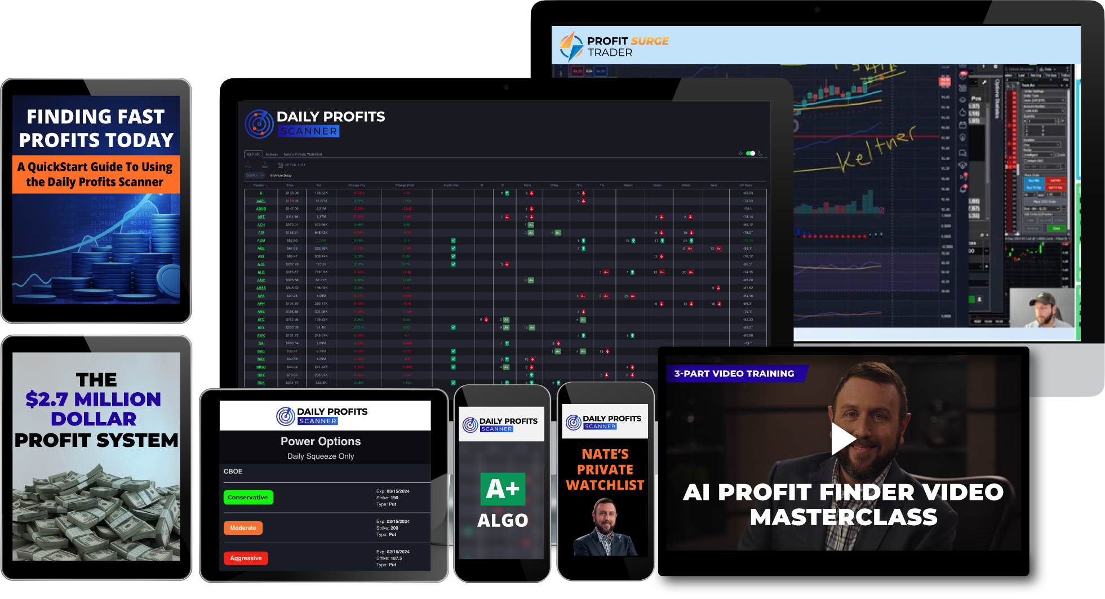
SPECIAL EVENT DEAL
NORMAL RETAIL PRICE: $9,997

Slide 65

SPECIAL EVENT DEAL
SILVER
$1,997 PER YEAR
GOLD
$2,497 PER YEAR
Take an additional $500 off TODAY ONLY
with discount code “SAM500”
Backed By 60-Day Credit Guarantee
PLATINUM UNLIMITED
$2,997 ONE-TIME! + $199 annual maintenance fee
Click the button below or call 888.215.5311 to order by phone or ask questions!

Slide 66
DOUBLE SAVINGS UNTIL MIDNIGHT!!! USE DISCOUNT CODE: SAM500
Q&A Time!
SILVER
$1,997 PER YEAR $1,497 today!
GOLD
$2,497 PER YEAR $1,997 today!
Take an additional $500 off TODAY ONLY
with discount code “SAM500”
Backed By 60-Day Credit Guarantee
PLATINUM UNLIMITED
$2,997 ONE-TIME! $2,497 today! + $199 annual maintenance fee
Click the button below or call 888.215.5311 to order by phone or ask questions!

