Slide 1


How to target 1,000% gains with trades costing less than $2 (in just days or hours)

Slide 2
Nate Has Closed 183
Real-Money Trades For
AT LEAST 100%+
Since March 2023...
*Across all research services

Slide 3
183
>100% winners
Breakdown Of Our Real-Money Winners:
32
>200% winners
9
>400% winners
1,129%
(2 Days)
Top % Return
$15,704
(148% in 6 days)
Largest $ Profit
*Across all research services

Slide 4
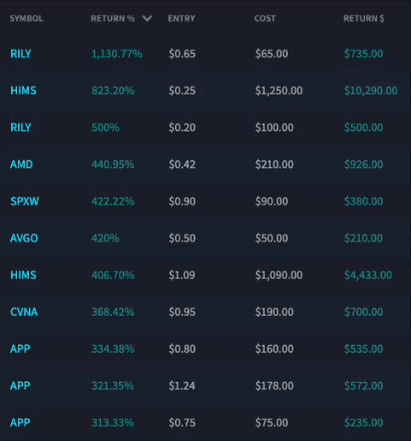
Today You’re Going to Learn How to Target
Gains Just Like These:
REAL TRADES!

Slide 5
Imagine Turning...
$65 into $800 in 2 days...
$246 into $903 within hours...
$305 into $1,205 overnight...
$1,250 into $11,540 overnight...
$3,650 into $14,677 overnight!

Slide 6
Type in “READY!” if you’re ready to target these trades!

Slide 7
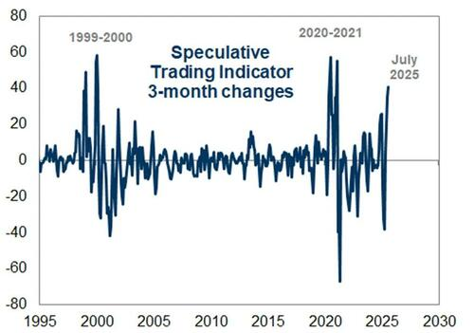
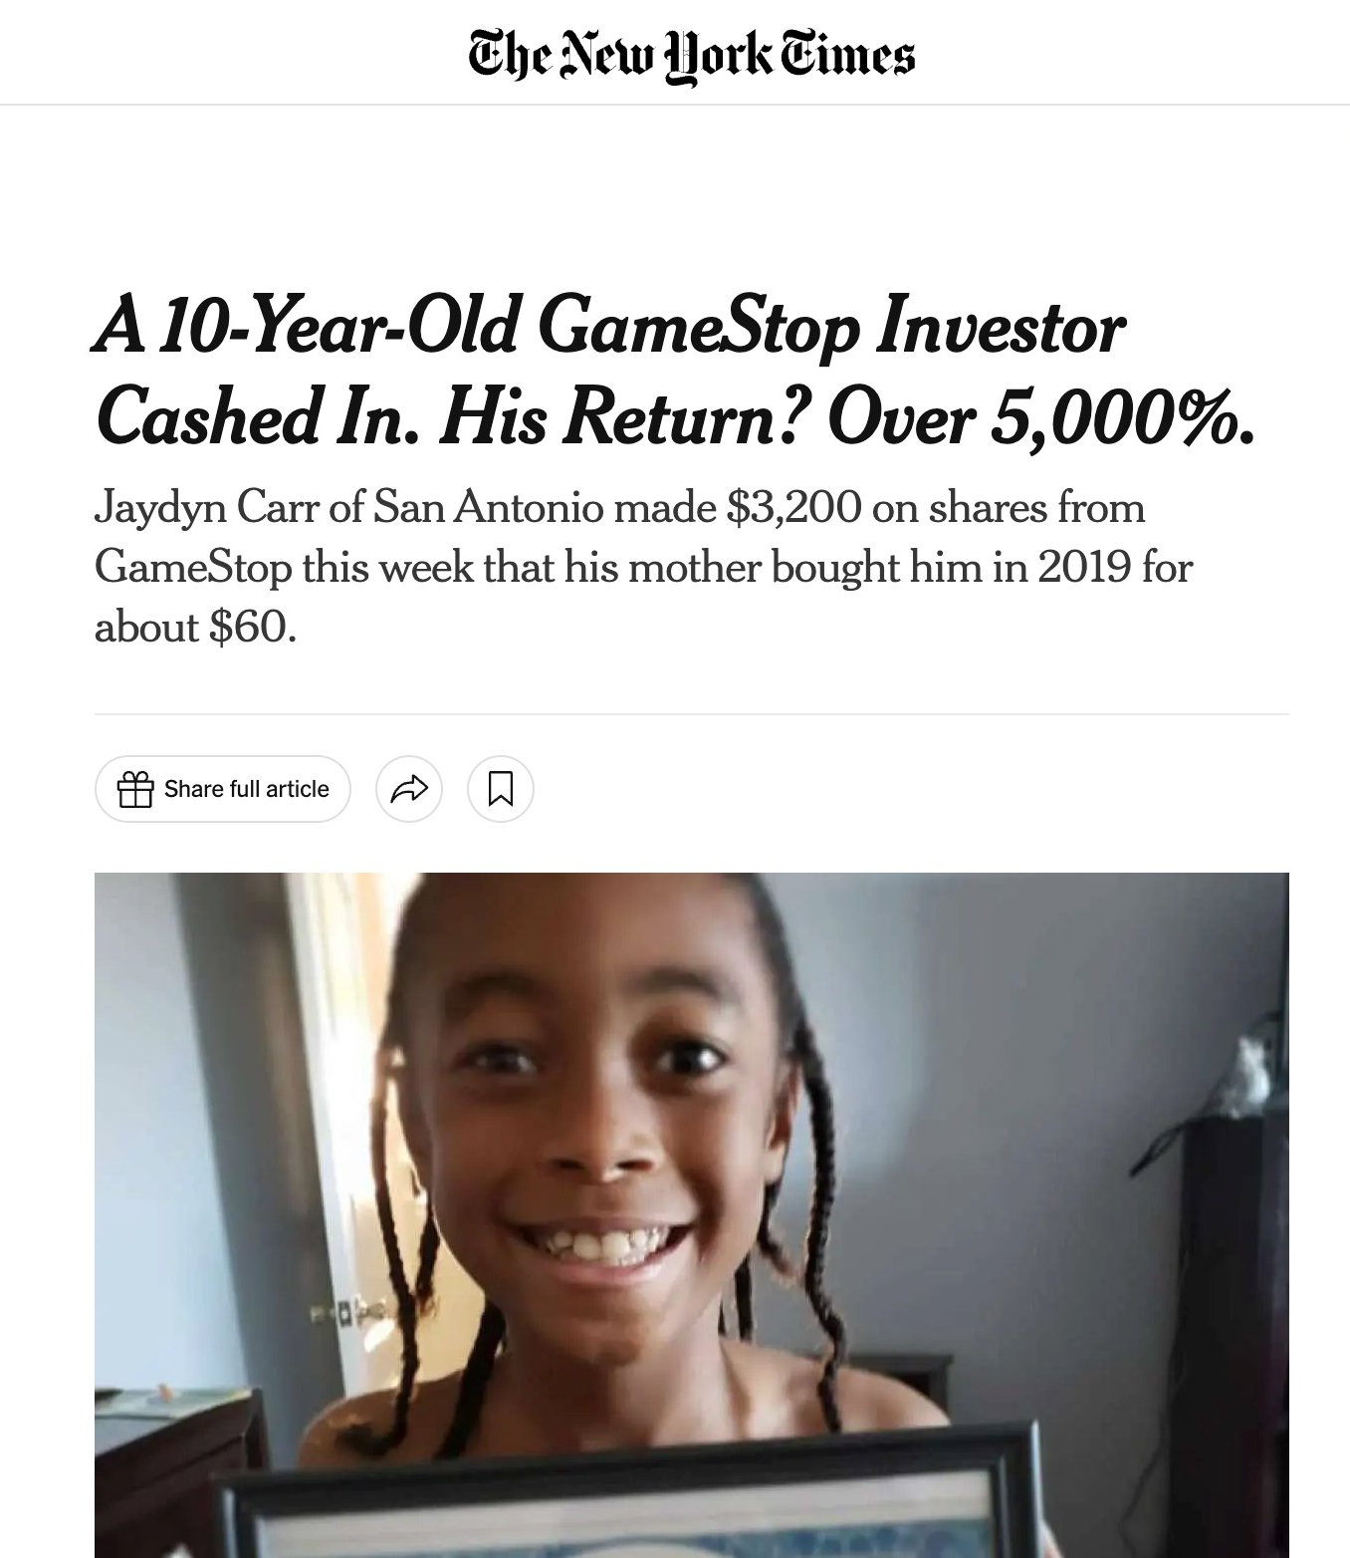
Where we are in the market according to Goldman Sachs:

Slide 8
The Goal
Take advantage of 100%, 200% and even 1,000%+ setups in this record speculative market...
WITHOUT BETTING THE FARM!!!

Slide 9
Introducing the...
”Lotto Trade”

Slide 10
Today’s Agenda
What is a lotto trade (and why Nate believe it’s the most FUN, EXCITING way to
target BIG money from trades.
The indicator Nate uses to know when to enter cheap (less than $2) lotto trades.
Nate’s exact exit strategy for targeting 100%-1,000%+ profits.
How to manage risk when playing these trades.
Why Friday mornings are ESPECIALLY great days to target MASSIVE lotto trades.
How you can get Nate’s top lotto trade intel and recommendations.

Slide 11
Disclaimer
Today, you’re going to see some of my top real-money ”Lotto trades”. Past performance is never a guarantee of future results. Individual results may vary.
Nate is an options trader, and, like all investing, trading options involves risk. It’s important to learn how to manage risk.
We are not investment advisors. Our goal is to teach you one of Nate’s favorite strategies that has been successful for us. It’s important to “trade within your means”. You should never invest more than you can afford to lose.

Slide 12
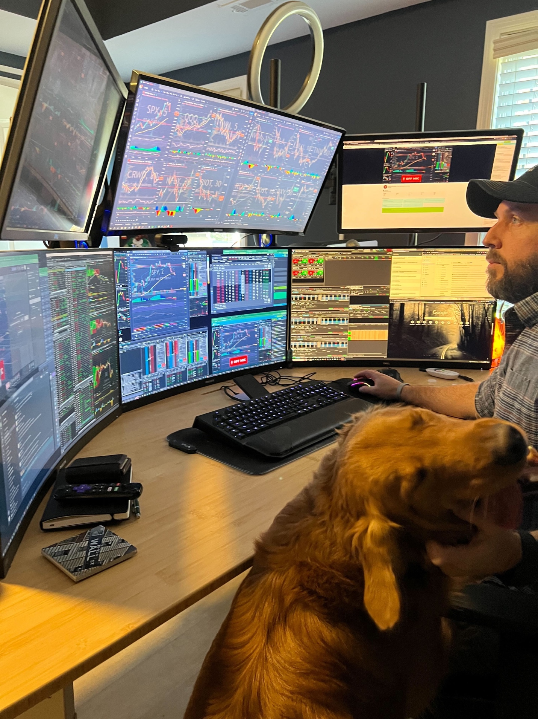
First… Who Is Nate Bear???
Former Construction Worker to Pro Trader
Turned $37k into $2.7 million
(7,127% total return) in 4 years!
Taught his winning strategies to tens of
THOUSANDS of everyday Americans
Founded the Daily Profits Live chatroom in 2023,
where he teaches and trades LIVE every day

Slide 13
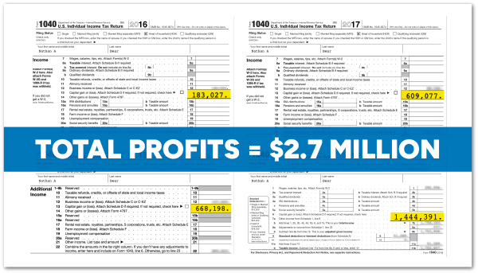
This Isn’t Imagination Money!
4 years of verified
tax returns!

Slide 14
What Is A Lotto Trade?
Cheaper than $2 option contracts (usually under $1)
Expiration less than 2 weeks out
Target FAST 100% winners (with 1,000%+ gain potential)
High risk = high reward
The #1 key is to manage risk is by controlling our position size
(Do NOT put your entire retirement account into a lotto trade!)

Slide 15
We target these lotto trades every day...
But later... You’ll see why it’s ESPECIALLY lucrative to trade these on
Fridays at 9:30 a.m.

Slide 16
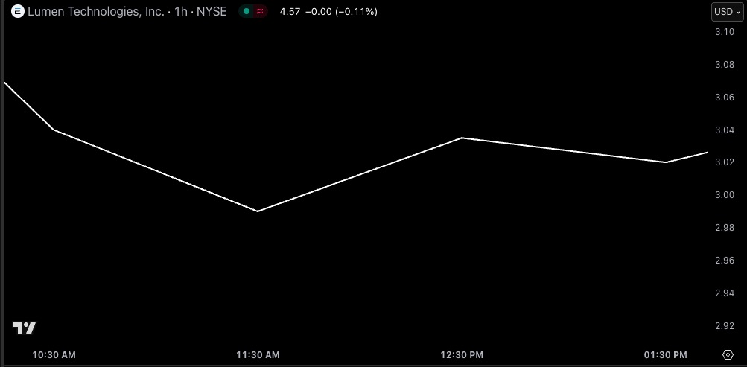
Real Trade Example: LUMN

Slide 17
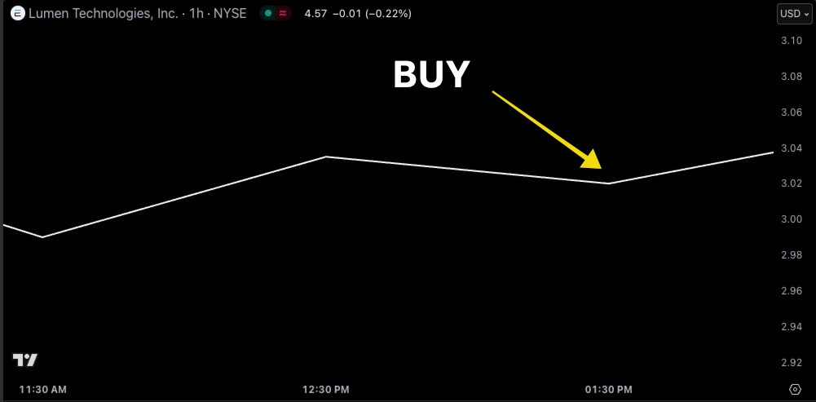
Real Trade Example: LUMN
Bought: 5 Contracts
Entry: $0.54
Total Cost: $270

Slide 18
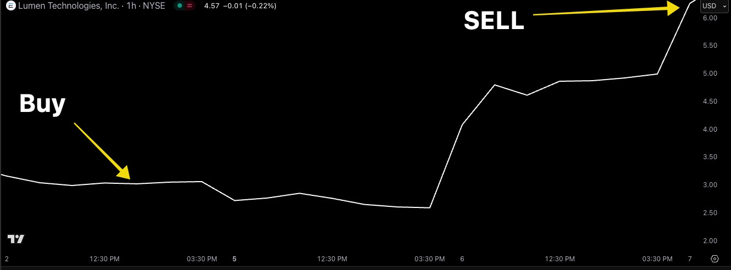
LUMN Trade: 223% in 5 Days!
3X LOTTO WINNER!
$270 → $875

Slide 19
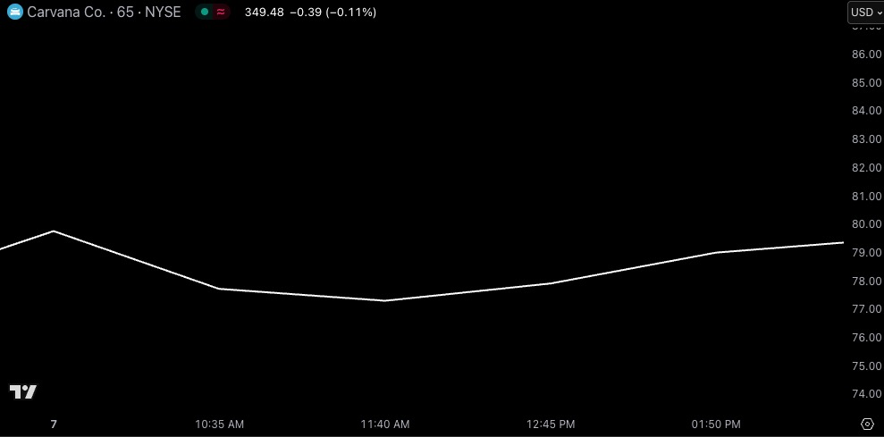
Real Trade Example: CVNA

Slide 20
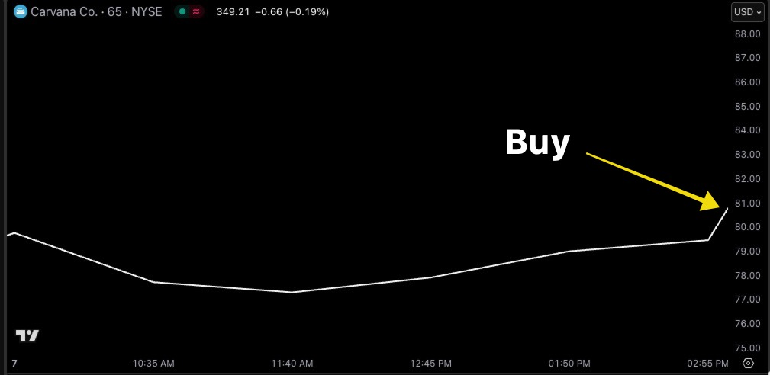
Real Trade Example: CVNA
Bought: 2 Contracts
Days To Expiration: 1 day
Entry: $0.95
Total Cost: $190

Slide 21
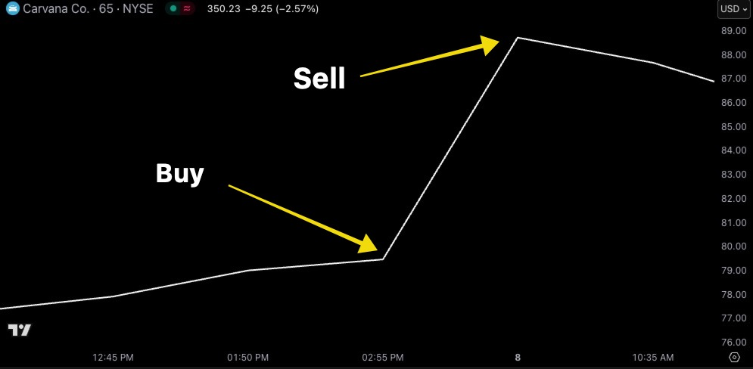
CVNA Trade: 368% Overnight!
4.7X LOTTO WINNER!
$190 → $890

Slide 22
Top Students Profited on CVNA Too!
9:52:27 am, Mar 8 2024 ARE: 650% on CNVA, thanks NateB
9:34:26 am, Mar 8 2024 Genesis: CNVA 400%
9:37:32 am, Mar 8 2024 Helen: Out CNVA with +485%
9:31:33 am, Mar 8 2024 LKK: I was lucky to make 500% on CNVA
10:28:18 am, Mar 8 2024 MarkT60: Just closed CNVA position, 567%, +$12,300!

Slide 23
Lotto Trades Even Work
When Stocks Go Down!
Stocks Up ⬆️ Buy Call Lottos
Stocks Down ⬇️ Buy Put Lottos

Slide 24
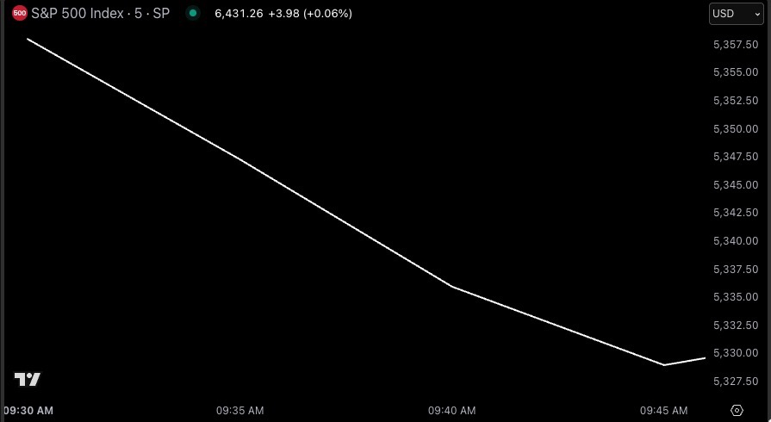
Real Trade Example: S&P 500 (SPX)

Slide 25
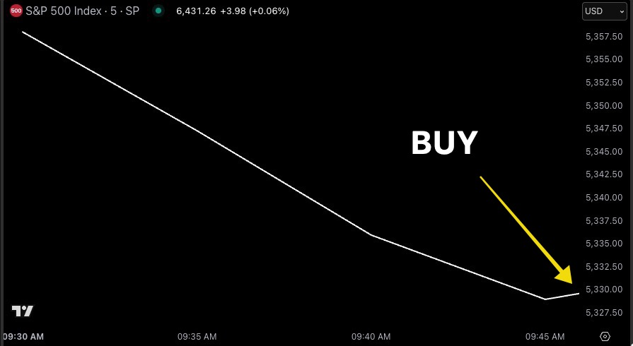
Real Trade Example: S&P 500 (SPX)
Bought: 1 Contract (PUTS)
Days To Expiration: 0
Entry: $0.90
Total Cost: $90
Friday Morning Trade!
😉🤑

Slide 26
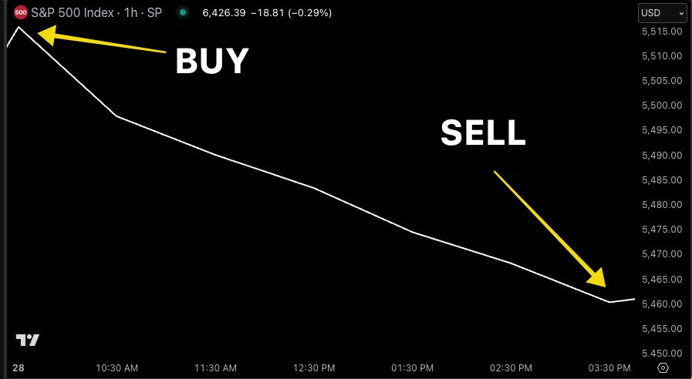
S&P 500 (SPX) Trade: 422% within hours!
5X LOTTO WINNER!
$90 → $470

Slide 27
If I had put more into that trade...
$1,000 → $5,220
$5,000 → $26,100
$10,000 → $52,200

Slide 28
So how do I find these trades?

Slide 29
T.P.S.
What Nate Looks For Before Placing a Lotto Trade:
Chart with a strong Trend
(Usually bullish... But works with bearish too)
A Pattern showing ongoing price consolidation
I look for my #1 favorite indicator... ”The Squeeze”

Slide 30
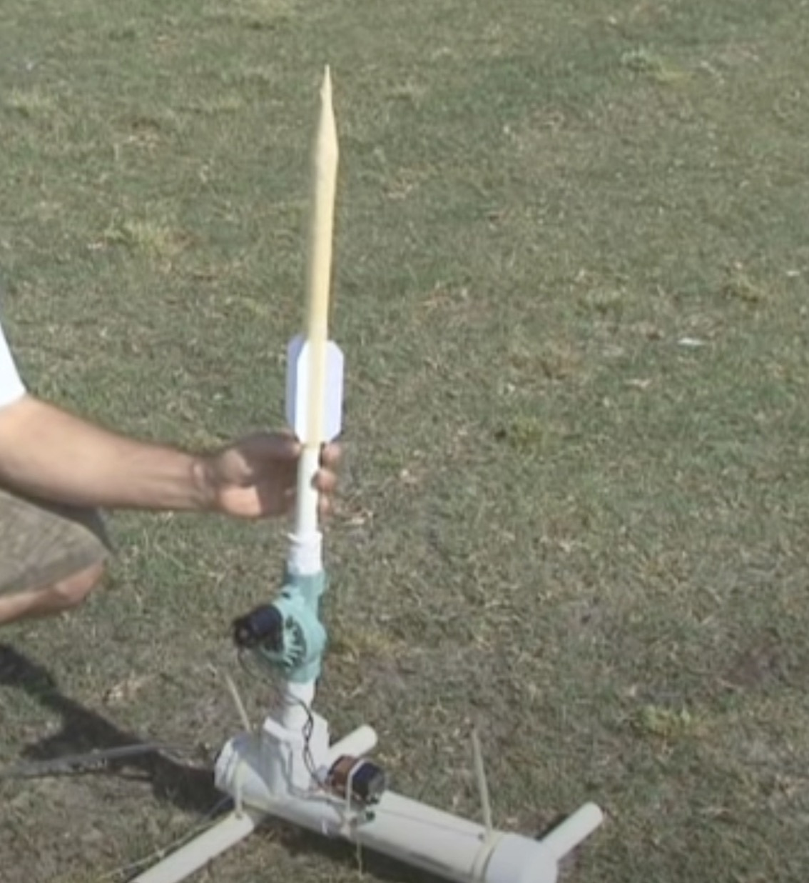
The “Squeeze” Indicator
Developed by Trader John Carter 20 years ago. Carter famously made $18.2 Million in 2020 alone! (a 1,270% gain!)
It’s an indicator that measures whether a stock’s price is compressed and poised to break out.
Think of a compressed air rocket… When enough pressure builds… eventually the stock’s price will explode upwards.

Slide 31
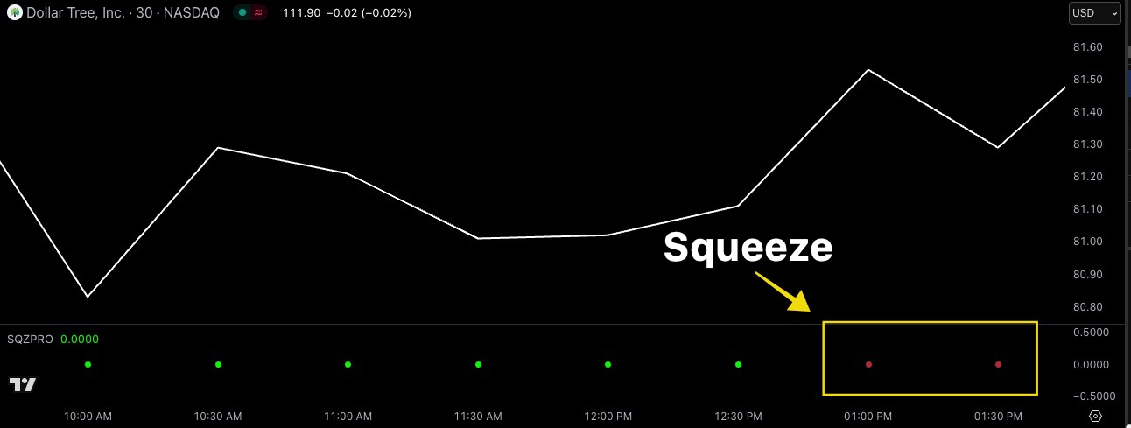
DLTR Lotto Trade
Bought: 25 Contracts
Entry: $0.70
Total Cost: $1,742
Two red dots on 30-minute frames
=
Price compression
for 60 minutes

Slide 32
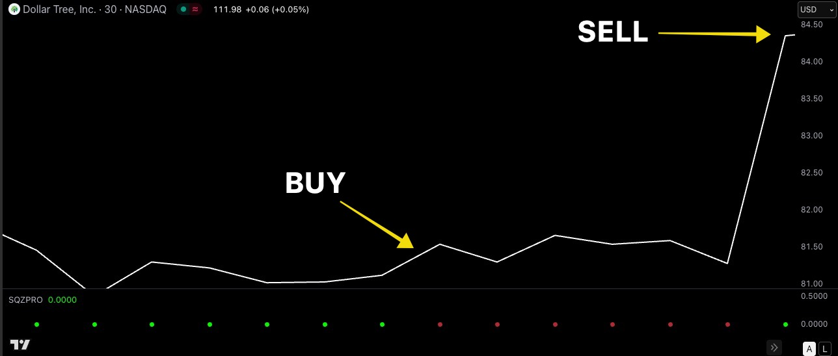
DLTR Lotto Trade 162% Overnight!
2.6X LOTTO WINNER!
$1,742 → $4,565

Slide 33
The Squeeze Works On
Multiple Chart Time Frames...
But with fast lotto trades...
We typically use shorter time frames
(i.e. 10 min, 30 min, 78 min, 195 min etc.)

Slide 34
# Of Dots Matter!
More than 1 Red Dot = Great!
4-5 Red Dots = Excellent!
20+ Red Dots = Probably Not Going To Happen

Slide 35
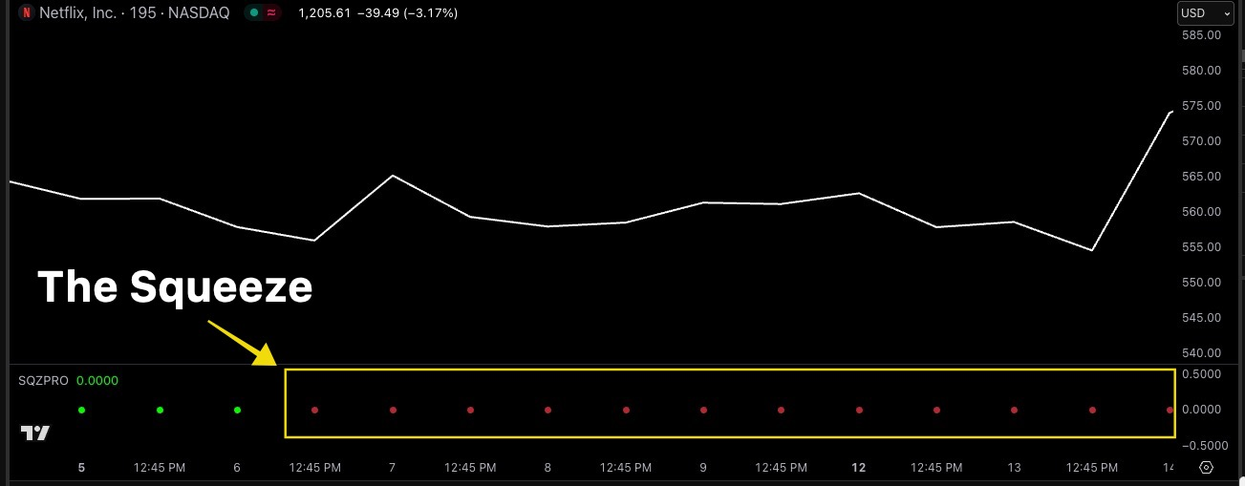
NFLX Lotto Trade
Bought: 2 Contracts
Entry: $1.46
Total Cost: $292

Slide 36
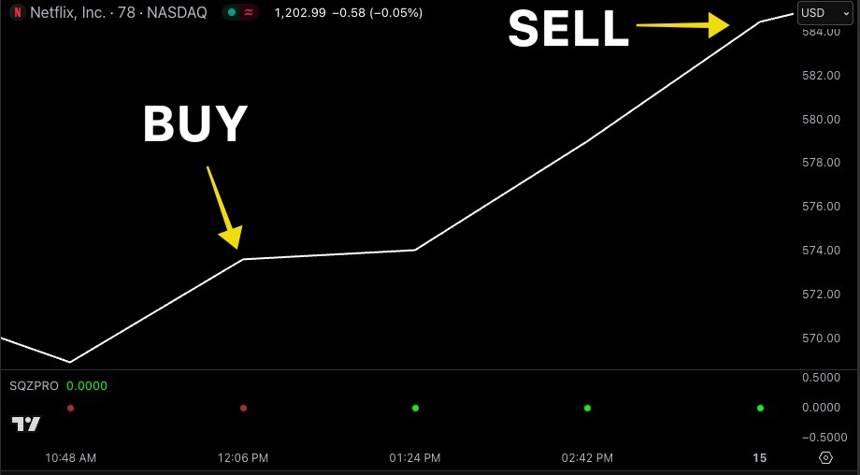
NFLX Lotto Trade 217% Overnight!
3X LOTTO WINNER!
$292 → $926

Slide 37
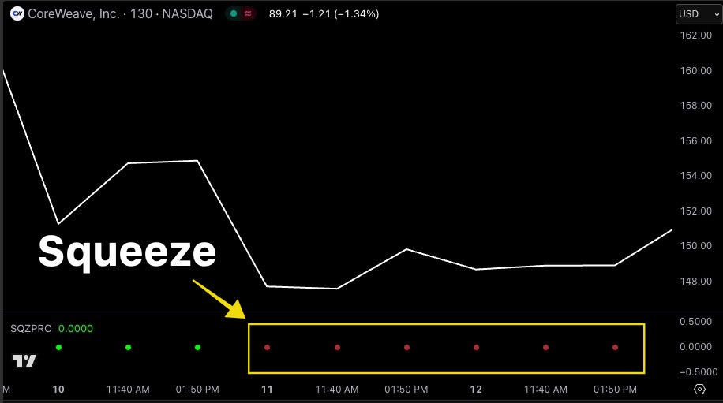
CRWV Lotto Trade
Bought: 11 Contracts
Entry: $1.31
Total Cost: $1,440

Slide 38
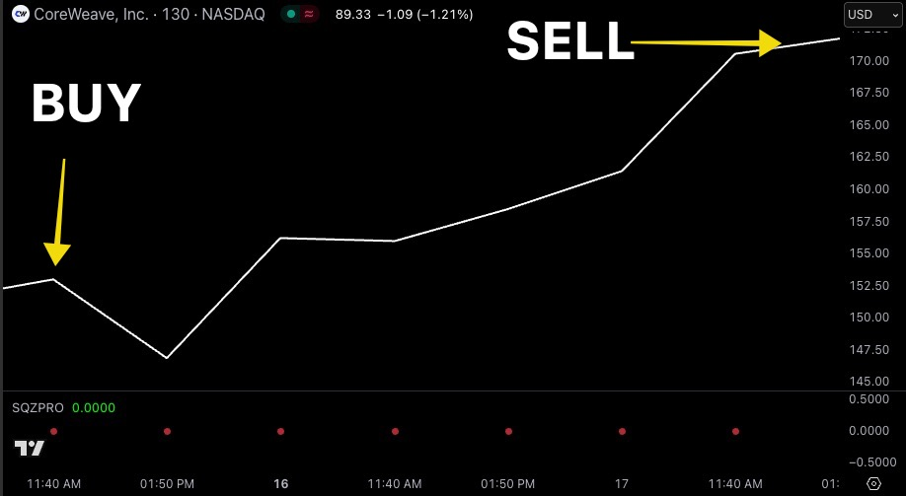
CRWV Lotto Trade 199% in 4 days!
3X LOTTO WINNER!
$1,440 → $4,300

Slide 39
With Lotto Trades, You Don’t
Need To Bet Your House to Target
MASSIVE Gains!

Slide 40
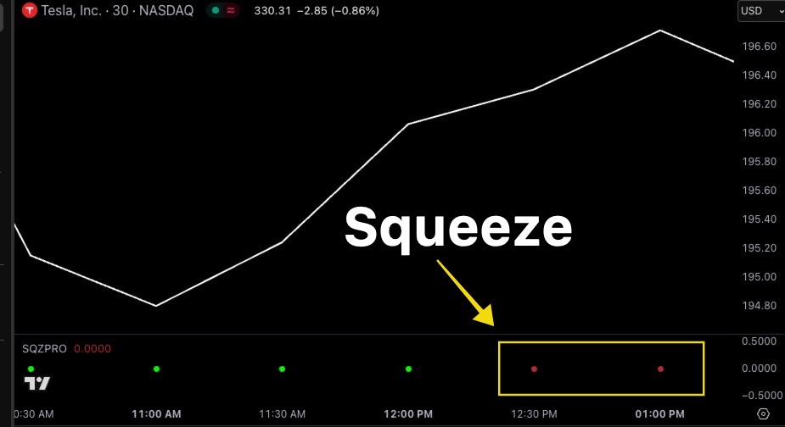
TSLA Lotto Trade
Bought: 1 Contract
Entry: $0.80
Total Cost: $80
Less than half the
price of one share!

Slide 41
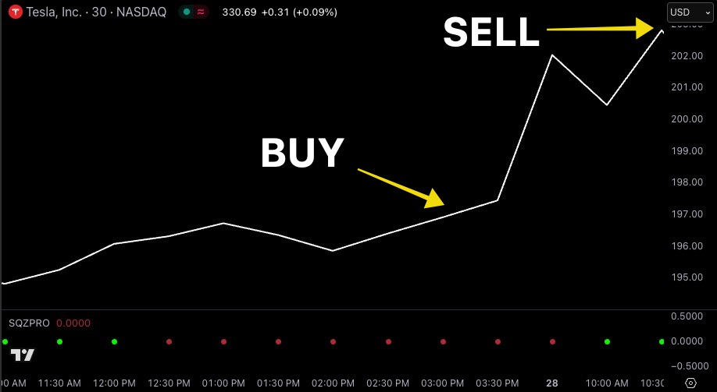
TSLA Lotto Trade 211% Overnight!
3X LOTTO WINNER!
$80 → $249

Slide 42
If I bought more of the 211% TSLA Lotto...
1 Lotto Contract: $80 → $249
2 Lotto Contracts: $160 → $498
5 Lotto Contracts: $400 → $1,245
10 Lotto Contracts: $800 → $2,490
50 Lotto Contracts: $4,000 → $12,450

Slide 43
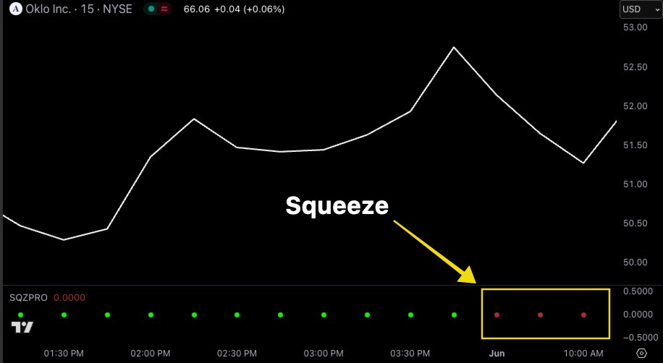
OKLO Lotto Trade
Bought: 10 Contracts
Entry: $1.55
Total Cost: $1,550

Slide 44
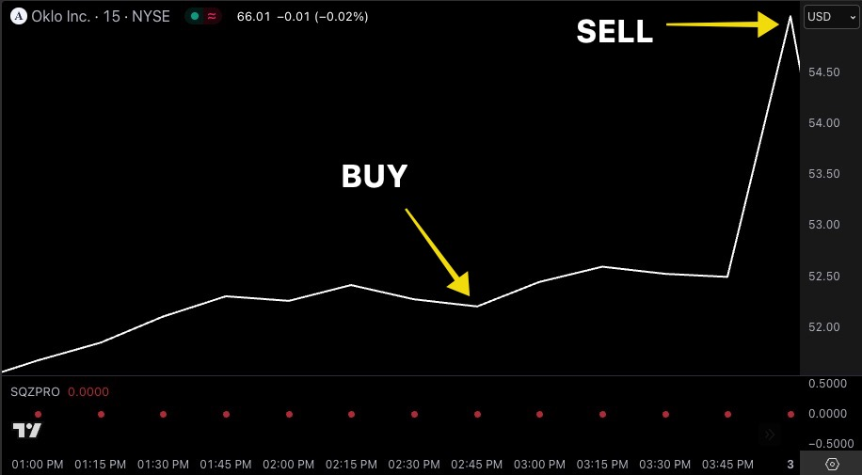
OKLO Lotto Trade 163% Overnight!
2.6X LOTTO WINNER!
$1,550 → $4,075

Slide 45
You can even make MULTIPLE lotto trades on very good setups!

Slide 46
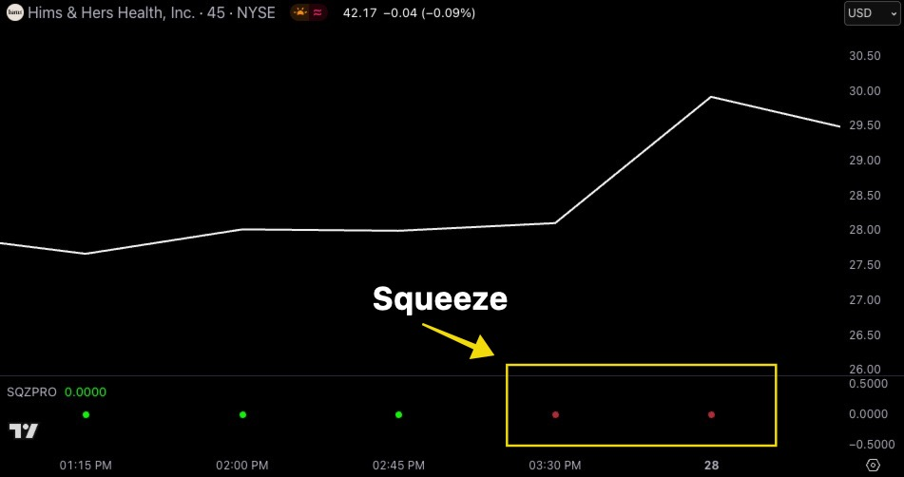
HIMS Lotto Trade Set Up

Slide 47
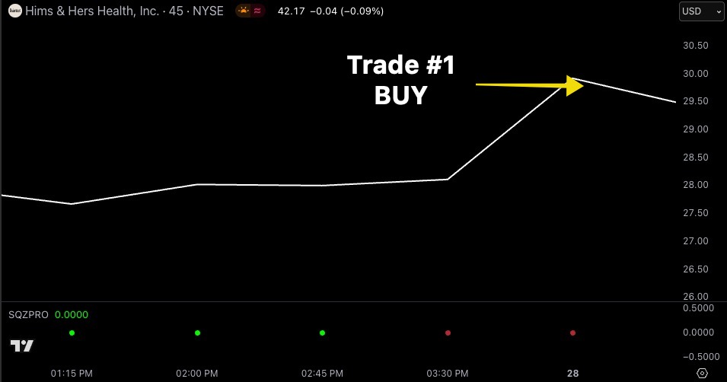
HIMS Lotto Trade #1 (More Aggressive)
Trade #1
Bought: 50 Contracts
Entry: $0.25
Total Cost: $1,250

Slide 48
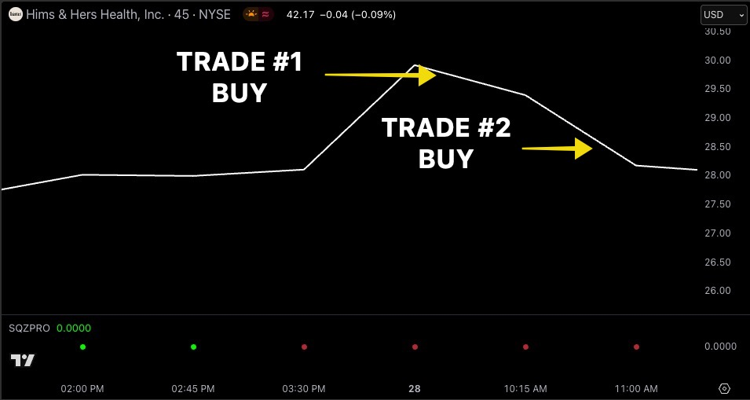
HIMS Lotto Trade #2
Trade #2
Bought: 10 Contracts
Entry: $1.09
Total Cost: $1,090

Slide 49
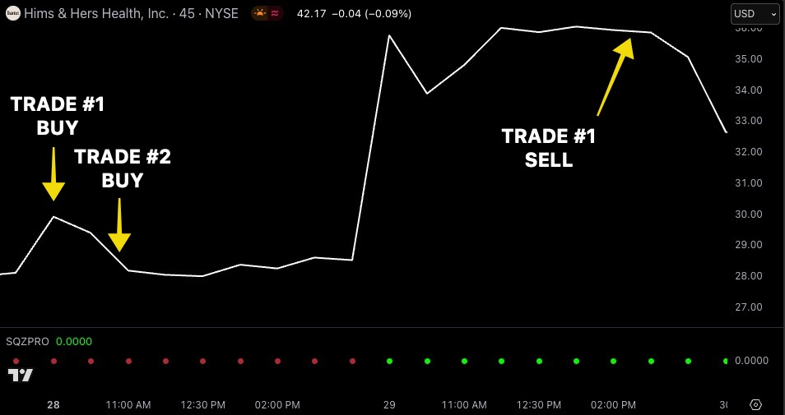
HIMS Lotto Trade #1: 823% Overnight...
Sold a portion of 50 contracts for 1,140%!

Slide 50
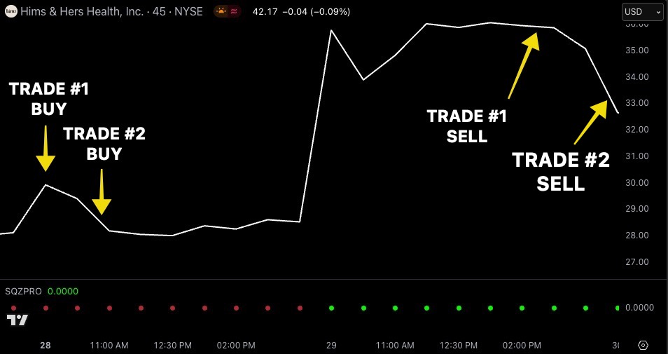
HIMS Lotto Trade #2: 407% Overnight

Slide 51
TWO Big Overnight Wins
On ONE Trade Setup!
Trade #1
Trade #2
9X LOTTO WINNER!
$1,250 → $11,540
5X LOTTO WINNER!
$1,090 → $5,523
$14,473 In Total Profit!

Slide 52
Too good to be true?
These aren’t hypothetical gains.
These are all real trades Nate made with real money LIVE in front of his students.
COMING UP: We’ll look for a Lotto Trade together... LIVE!

Slide 53
Nate’s Top Students Profited Too!
9:36 am, Apr 29 2025 JeffFS: Sharing my wins with HIMS 5/2 $31 call. Made 1,150%!!!
9:39:45 am, Apr 29 2025 CoachBill: Made 1,123% and 490% in 2 separate HIMS positions. Thank you, NateB and DPL!
PNG
9:32:38 am Apr 29 2025 Dspike20: Hims out at 900%+!!
9:42 am Apr 29 2025 Roswell Buckeye: HIMS… $31C made 410%, $35C made 1,035%. MEGA BOOM
9:41 am Apr 29 2025 Trader Craig: Hims in at .28 out at 3.16 $4,947 profit.
9:35:43 am Apr 29 2025 MattK: Out of HIMS at 1,010%. Thanks Nate!
9:38:44 am Apr 29 2025 Rob R: Over 1,300% on HIMS. Thought I was doing my math wrong!
9:36:16 am Apr 29 2025 MikeR2024: Out of HIMS at 636%. Thanks Nate!
9:36:47 am Apr 29 2025 Michael Sa: Only 1,115% on HIMS.

Slide 54
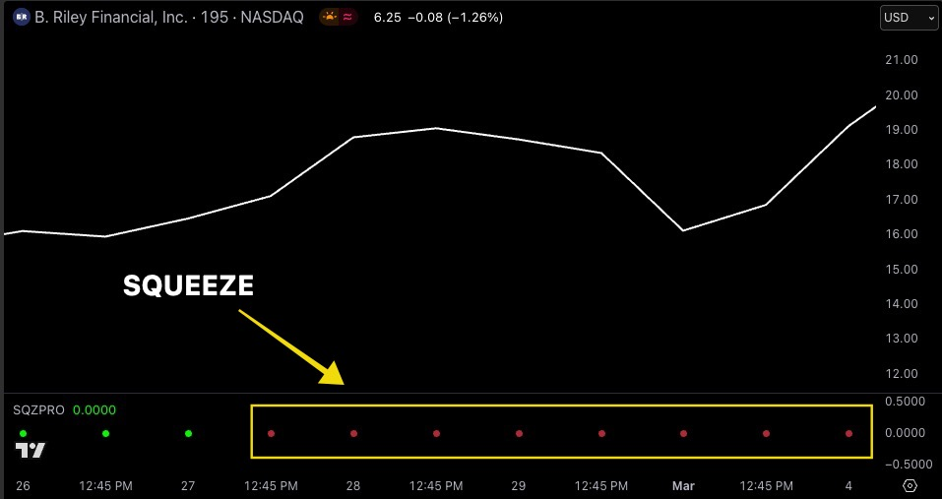
RILY Lotto Trade
Bought: 5 Contracts
Entry: $0.20
Total Cost: $100

Slide 55
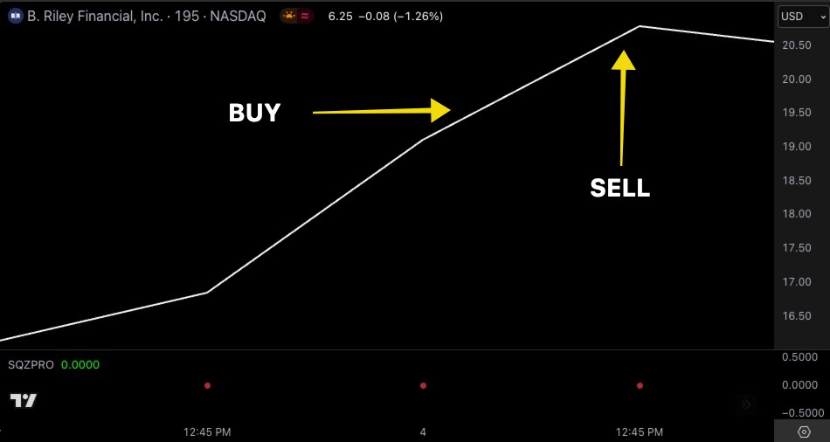
RILY Lotto Trade 500% in less than 2 hours!
6X LOTTO WINNER!
$100 → $600

Slide 56
Nate’s Top 3 Favorite Tickers for
Repeat Lotto Profits
#1: RILY
#2: APP
#3: CVNA

Slide 57
Big Lotto Profits From RILY
223% overnight
102% overnight
129% overnight
133% within hours
112% within minutes
144% overnight
101% within hours
155% overnight
114% overnight
287% within 2 days

Slide 58
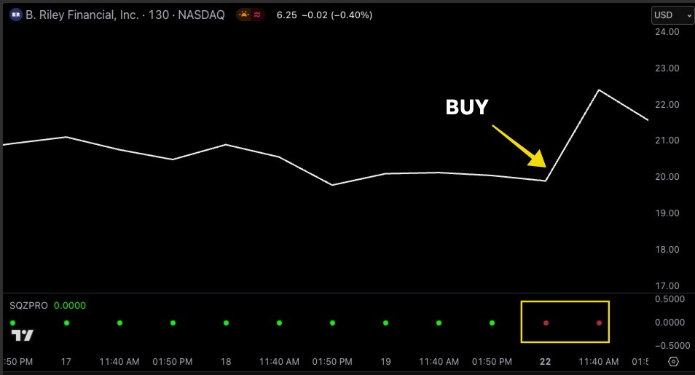
Largest RILY Lotto Trade Example
Bought: 1 Contracts
Entry: $0.65
Total Cost: $65

Slide 59
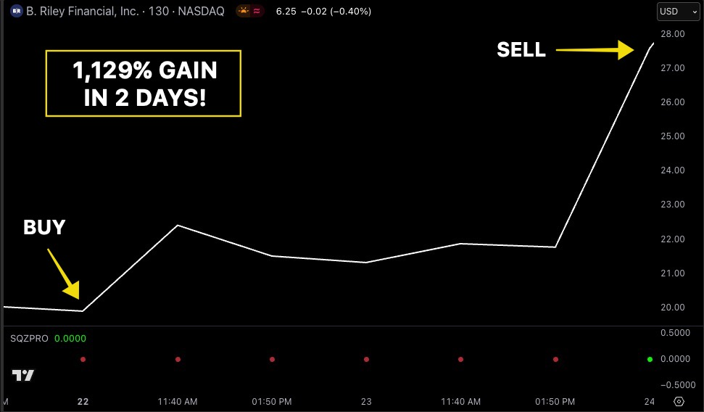
Largest RILY Lotto Trade 1,129% In 2 Days!
11X LOTTO WINNER!
$65 → $800

Slide 60
My Top Students Profited On RILY Too!
9:37:29 am, Apr 24 2025 Grump Grandpa: 1,180% on RILY. Great play Nate
9:34:43 am, Apr 24 2025 BalaV: Now up 1,500% on my second call on RILY
10:10:46 am, Apr 24 2025 QuintonE: Nate Big thx.; RILY Lotto In: $0.50 Out Abg: $10.49, 1,987% gain
9:37:00 am, Apr 24 2025 Cypher00: Riley!! 1,506%
9:06:21 am, Apr 24 2025 BoilerUp: RILY 20 IN. 78 Out 10.20 $18,840 1,206%
9:46:46 am, Apr 24 2025 EricGlad: 1,385% on Riley! Best trade of my life
9:37:50 am, Apr 24 2025 KingStink : RILY 403%
9:32:34 am, Apr 24 2025 RichN: Over 1,000% for me
9:37:09 am, Apr 24 2025 Kirk Rydberg: Solf my last RILY for 1,467% gain
9:35:58 am, Apr 24 2025 rodm72 : RILY out 800%
thanks Nate

Slide 61
Imagine putting more into that
1,129% RILY trade...
$500 → $5,220
$1,000 → $12,290
$5,000 → $61,450
$10,000 → $122,900!!!

Slide 62
Let’s Look For A Lotto Trade Together Now... LIVE!

Slide 63
You NEED to be ready
THIS Friday at 9:30 a.m.

Slide 64
Why are Fridays ESPECIALLY lucrative for Lotto trades?
Most options contracts expire on Fridays
When contracts become closer to their expiration, they become cheaper (more contracts become “lottos”)
If there is a squeeze setup at the opening bell, there is still an opportunity for HUGE price moves throughout the day.

Slide 65
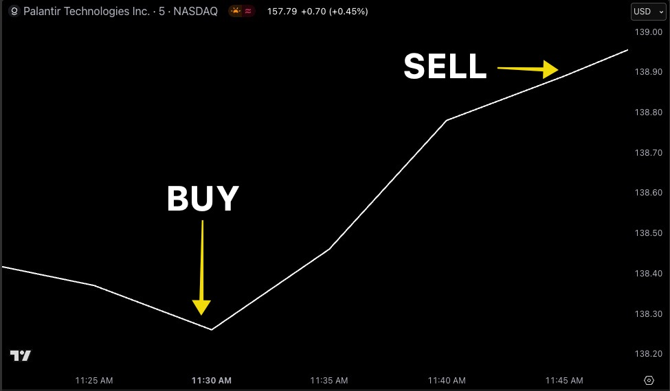
PLTR Friday Lotto – 131% in 19 minutes
2.3X LOTTO WINNER!
$350 → $810
(5 contracts)
Same day expiration!

Slide 66
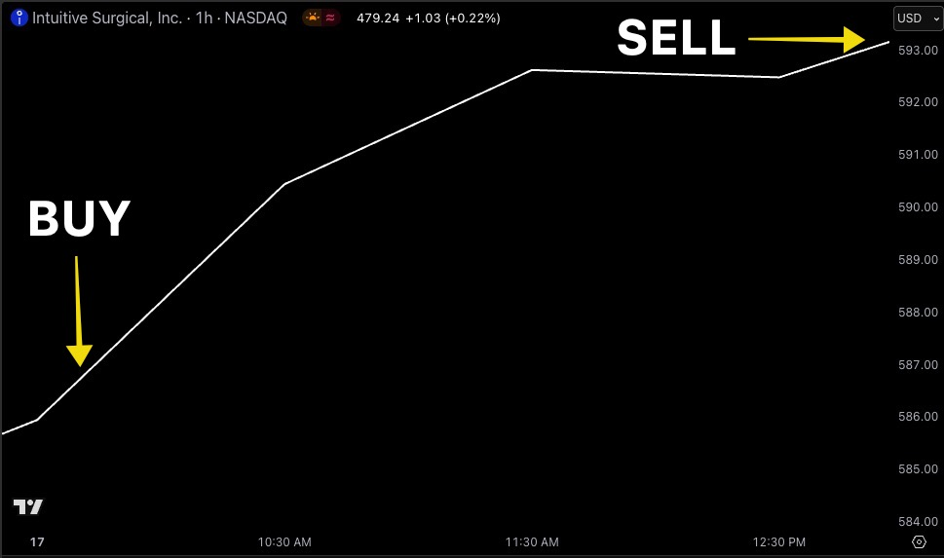
ISRG Friday Lotto – 122% within hours
2.3X LOTTO WINNER!
$755 → $1,704
(10 contracts)
Same day expiration!

Slide 67
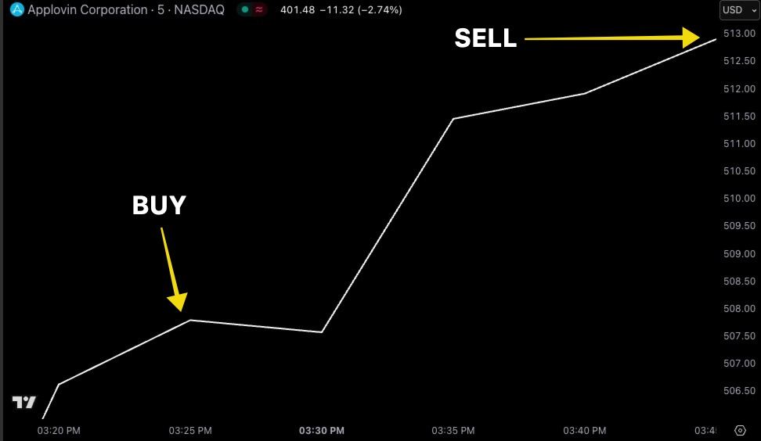
APP Friday Lotto – 311% in 20 minutes
4X LOTTO WINNER!
$140 → $575
(5 contracts)
Same day expiration!

Slide 68
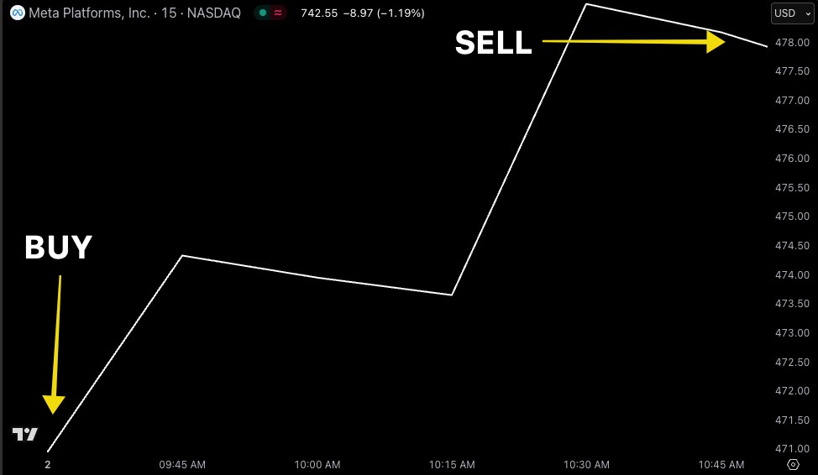
META Friday Lotto – 261% in 1 ½ hours!
3.6X LOTTO WINNER!
$266 → $960
(2 contracts)
Same day expiration!

Slide 69
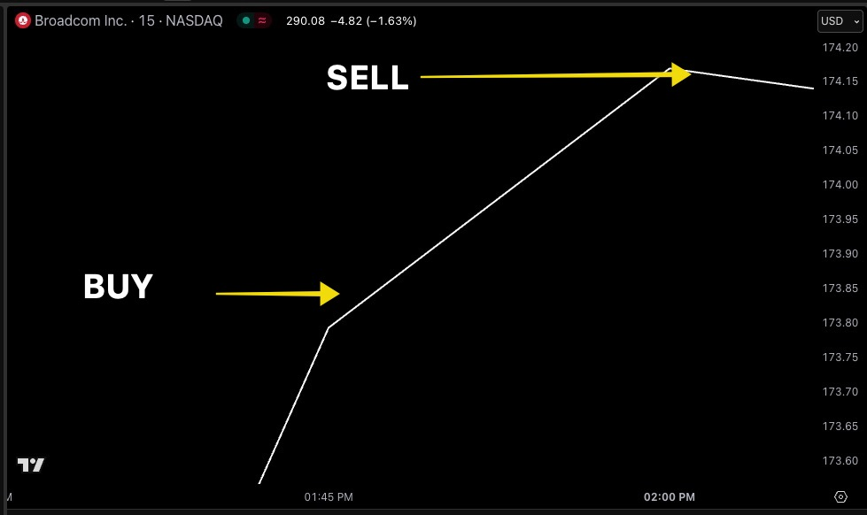
AVGO Friday Lotto – 420% in 20 minutes
5X LOTTO WINNER!
$90 → $470
(1 contract)
Same day expiration!

Slide 70

You’re invited to join us LIVE THIS Friday @ 9:30 a.m. ET for “Lottomania”
RIP

Slide 71
Our Gameplan for ”Lottomania”
Every Friday we dedicate a special LIVE session during the market open (9:30 a.m. - 11 a.m.)... EXCLUSIVELY to targeting lotto trade setups.
These will be FAST, explosive lotto trade setups (in and out within the same day).
The most THRILLING 2 hours of LIVE that you can ever experience!

Slide 72

Exclusively Inside Nate’s Flagship
Chatroom and Trading Research Service...

Slide 73
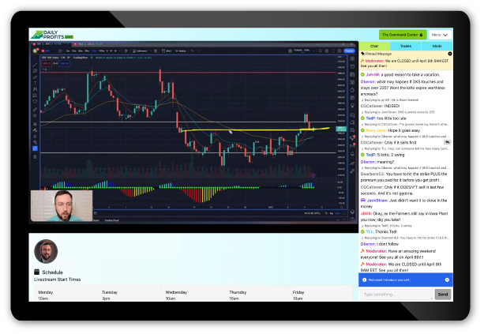
What is Daily Profits Live?
It’s the ONLY place to stream with Nate LIVE and receive trade recommendations every day.
We target MASSIVE squeeze setups every day using lottos and other options trades.
We even find setups with the help of Nate’s AI Powered Squeeze scanner ”S.A.M.” (direct access to software sold separately) .
It’s the ultimate way to learn the strategies I used to turned $37k into $2.7 Million over just 4 years.

Slide 74

Daily Profits Live Since March 2023
1,379
Winners
2,400
Total Trades
1 Day
Average Hold Time
169
100%+ Winners
(181 Across All Services)
1,129%
(2 Days)
Top % Return
$15,704
(148% in 6 Days)
Largest $ Profit
Of course... Not all trades will be winners. Never bet more than you can afford to lose.
*

Slide 75
What Top Students Have Been Saying...
1:39:28 pm, Feb 27 2025 JHolston: I love your Lotto’s Nate! I’m in and out of most of them in under an hour with 20-40% profits.
11:02:01 am, May 13 2025 BobbyS: I’m feeling ecstatic right now… I went really big on NVDA calls and sold half at 100% and the other half is sitting at 310%. The past two weeks have made up for the enormous amount of money I lost when I first started trading a little over a year ago. I’ve learned a lot being part of this community and the importance of collaborating with other traders and their styles.
9:47:46 am, Apr 3 2025 coachrogers92: GREAT trade on TMUS, kept them despite the news, this is such a great group man, we’re beating 90% of folks today, no doubt
11:23:35 am, Apr 4 2025 tradeguy1: Amazing to me - so much money in the face of such a down market – thanks Nate B, Nate G, and Dman!

Slide 76
What Top Students Have Been Saying...
10:30:05 am, May 16 2025 GolfPaul: Hey Nate, been in this group for about 2 months. There’s a lot of trading scams and false promises out there, but you and your team are the real deal. Appreciate it.
9:27:02 am, May 21 2025 dmac90: This month is my 2-yr anniversary with DPL! In the last 24 months I have had only 5 months when I was below my
$ target, however my monthly avg is 39% over my monthly $ goal. The training is unprecedented and has taught me to trade. 80% of my trades are now on stocks that I find and or trades that the team suggests but I alter to fit my circumstances. Thank you!

Slide 77
Sometimes members do even better than Nate!
... 4,900% in one morning?!
9:33:01 am, Apr 8 2025 Zweig: Nate, between the Spy Put and VRT trade, $800 turned into $40,000 this morning. Thanks for the ideas.

Slide 78
The question is...
Will you be joining us for Lottomania THIS Friday at 9:30 a.m.?

Slide 79
Today is your opportunity to try out Daily Profits Live for 60 days!

Slide 80
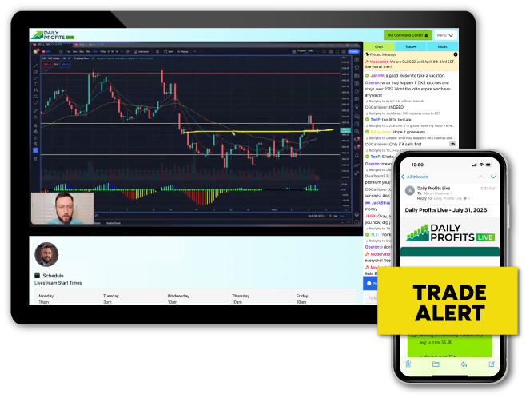
1 Full Year Of Daily Profits Live
It’s the ONLY place to trade alongside Nate LIVE every day AND receive his best trade recommendations.
Trade alerts sent via email and mobile push BEFORE he enters and exit a trade (including profit targets and stop losses).
Expect around 3-5 trade recommendations per day.

Slide 81
All-Day Chatroom + Daily Livestreams
Member Exclusive Bonus
Interact with Nate and other members ALL DAY inside the private members-only chatroom.
Typical livestream schedule (All times ET)
BONUS: Livestream sessions with top instructors Nate G. and Dman throughout the day.
Monday
10am - 11am
3pm - 4pm
Tuesday
3pm - 4pm
Wednesday
10am - 11am
1pm - 2pm
Thursday
10am - 11am
1pm - 2pm
Friday
Lottomania! 9:30am - 11am
1pm - 2pm

Slide 82
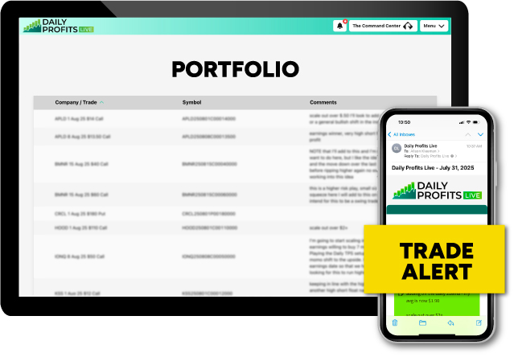
Member Exclusive Bonus
Nate’s Live Portfolio
You’ll receive updates on all of Nate’s trade recommendations whenever he manages a position.
You’ll have 24/7 access to his open portfolio and an archive of all my trade alerts, updates, and any research he shares. 100% transparency always.

Slide 83
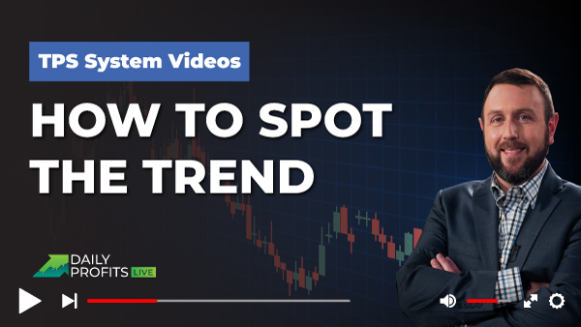
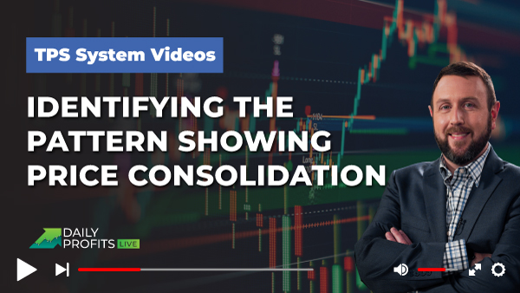
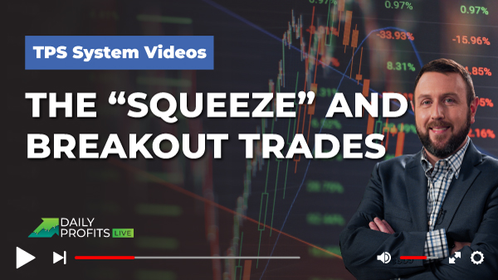
Member Exclusive Bonus
TPS System Video Series
Learn the system that made Nate a millionaire trader! This three-part video series is the only course that provides a comprehensive tutorial of the proprietary system he uses to identify and time his trades.
This series includes...
  Video #1: How to Spot the Trend
  Video #2: Identifying the Right Pattern
  Video #3: “The Squeeze” and Breakout Trades.

Slide 84
Member Exclusive Bonus
10-Part Daily Profits Live Bootcamp
Extensive bootcamp put together by Nate’s long-time instructors and trading partners, Nate G. and DMan
Over 10 hours covering topics designed to expedite and supercharge your success as a member
  How to set up chart and trade using technical analysis
  The basics of the Stock Market and Options 101
  Take advantage of chart-time frames
  How to analyze your trades using data effectively
  Risk management (even in volatile markets)
  AND much much more!

Slide 85
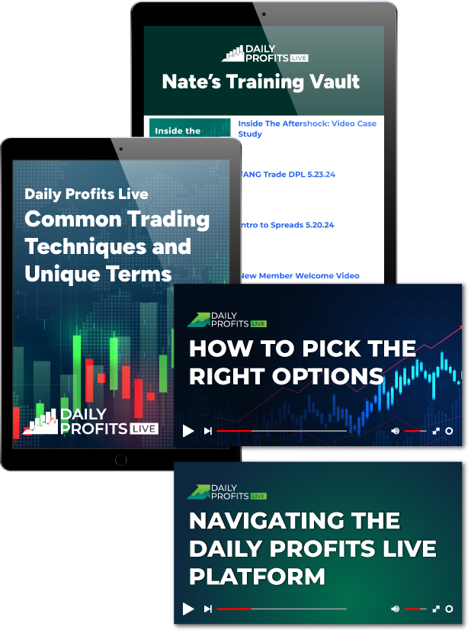
Member Exclusive Bonus
Nate’s Training Vault
You will receive full access to all of Nate’s special trainings and reports, including...
  How to Pick the Right Options
  Navigating the Daily Profits Live Platform
  “Daily Profits Live Common Trading Techniques and Unique Terms” (Report).
Every past live stream replay!
Notes:
!

Slide 86

Nate’s 60-Day Money Back Guarantee
If, within your first 60 days, you don’t feel that Daily Profits Live is for you…
Simply chat, call, or email our VIP Concierge Team and receive an immediate cash refund (minus 10% processing fee)
No questions asked!

Slide 87
TONIGHT ONLY!
Guarantee #2:
30 Money Doublers in 1 Year!
After your first year, if you haven’t seen at least THIRTY winning trade recommendations of 100% (or more) in the live portfolio...
Simply reach out to the VIP Concierge Team and you’ll get ANOTHER year for FREE. (Or another Monument Traders Alliance service of equal value.)

Slide 88

Learn how to lower your trading taxes!
It may be possible to write off your Daily Profits Live subscription and lower your tax burden.
Included with your Daily Profits Live membership:
FREE: 45-minute strategy session around trading LLCs, tax savings and business credit! ($595 Value)
FREE: Lifetime of support from a Corporate Advisor ($595 value)
FREE: List of 250+ Tax Deductions
FREE: Entity creation (Minus your State’s hard costs + filing fees)
FREE BONUS REPORT: How To Protect Your Trading Profits: ($299 Value)
Monument Traders Alliance is not a CPA firm. Check with a tax professional before
making any tax decisions!
In Partnership With

Slide 89
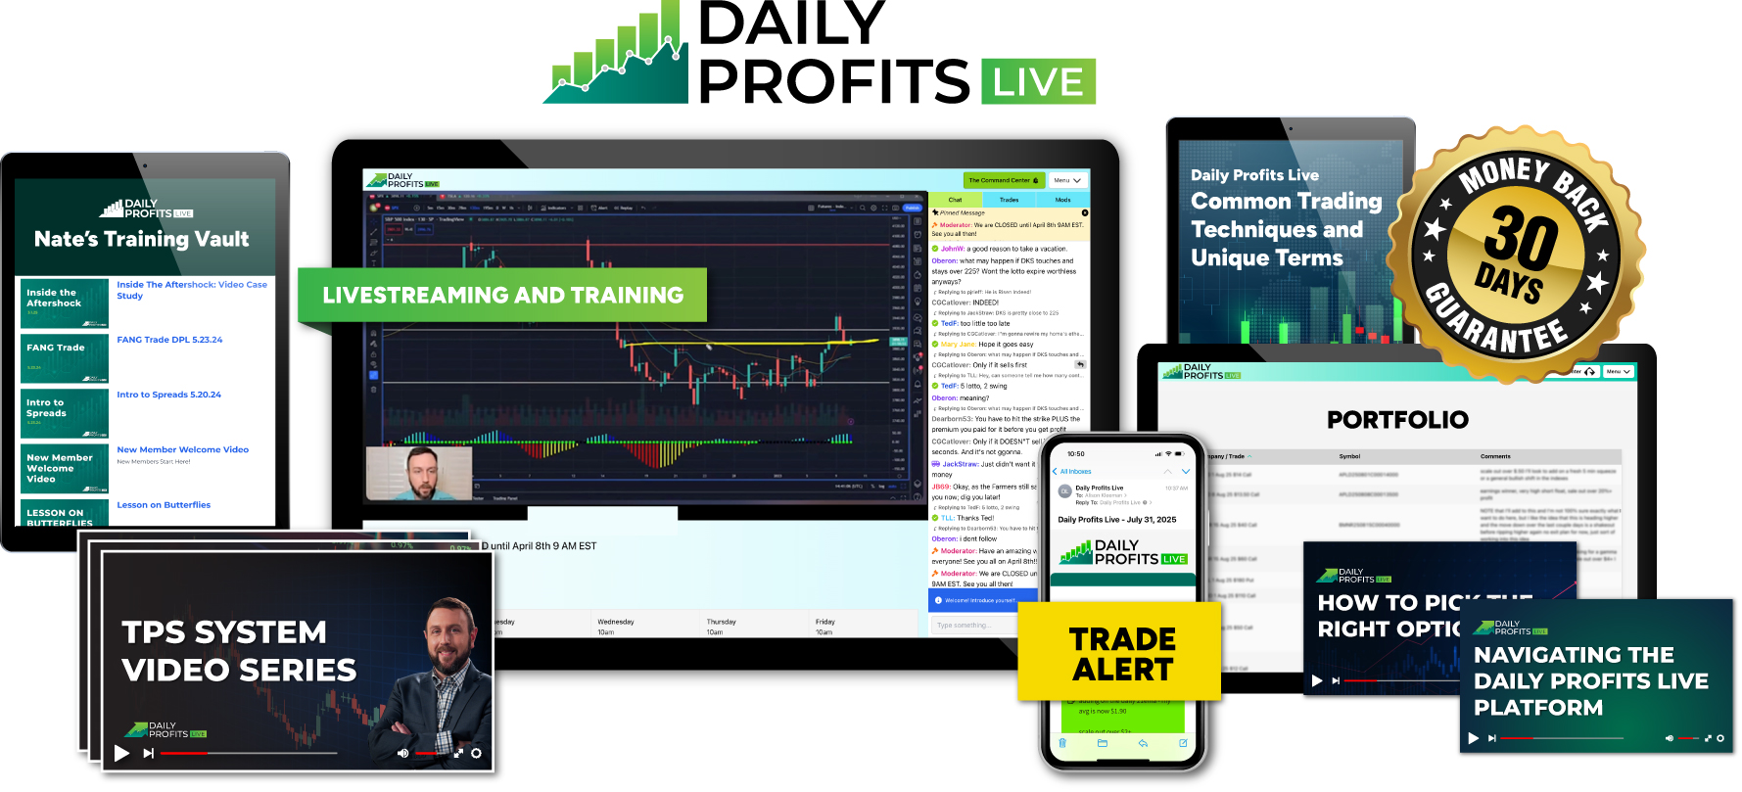
Normal Retail Price: $5,000

Slide 90

SPECIAL EVENT DEAL
$5,000 VALUE
ANNUAL
$1,997
PER YEAR
UNLIMITED
$3,997
ONE-TIME!
+ $199 annual maintenance fee
Backed By Nate’s 60-Day Money-Back Guarantee
TODAY ONLY: Nate’s 30-Money-Doublers Guarantee
Click the button or call 410.864.3083 to order by phone or ask questions!

Slide 91

******TODAY ONLY******
Double Guarantee AND Double Savings
Receive Nate’s DOUBLE guarantee AND take an extra
$500 off with the discount code…
Use code
Lotto500
for an extra $500 OFF
Click the button or call 410.864.3083 to order by phone or ask questions!
Notes:
THIS IS FROM WNM… JUST SHOWING THE STYLE

Slide 92
DOUBLE SAVINGS UNTIL MIDNIGHT! USE DISCOUNT CODE Lotto500
$5,000 VALUE
ANNUAL
$1,997 PER YEAR
$1,497
TODAY!
UNLIMITED
$3,994 ONE-TIME!
$3,497
ONE-TIME!
+ $199 annual maintenance fee
TODAY ONLY: Take an extra extra $500 off with ”Lotto500”
TODAY ONLY: Nate’s 30-Money-Doublers Guarantee
AND Nate’s 60-Day Money-Back Guarantee
Click the button or call 410.864.3083 to order by phone or ask questions!

